Slide 1
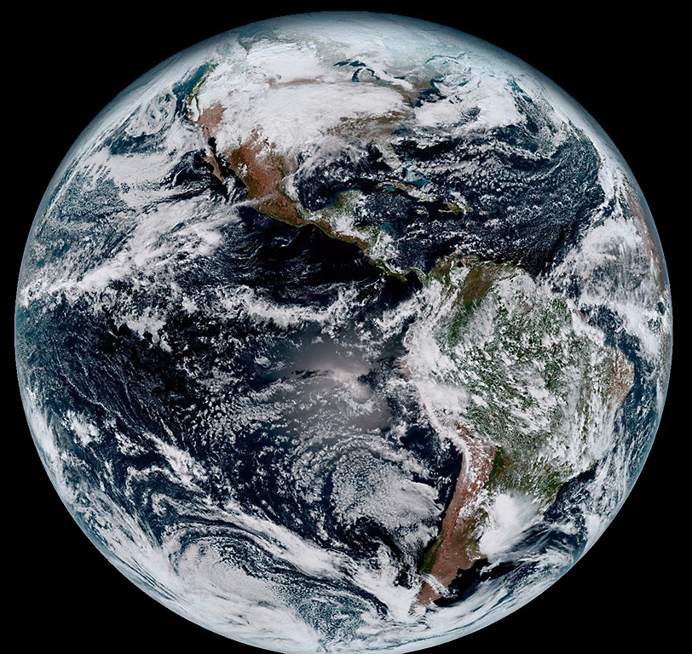



EES 598 Arctic Research Forum
25 October, 2023
Sean Birkel
Assistant Professor
Climate Change Institute &
Cooperative Extension
NOAA/NASA GOES-16

Slide 2
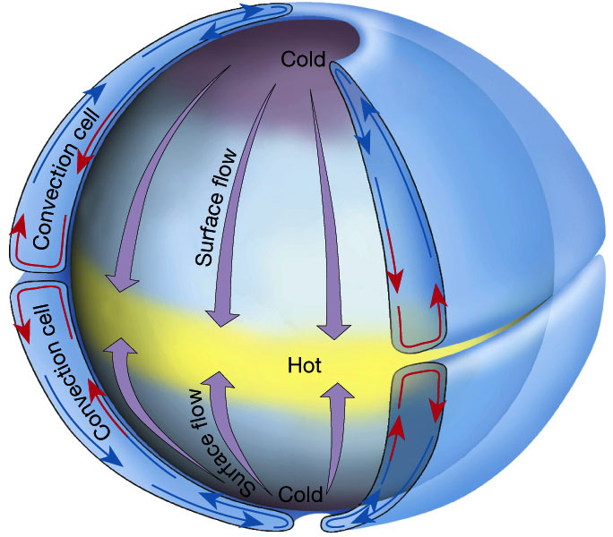
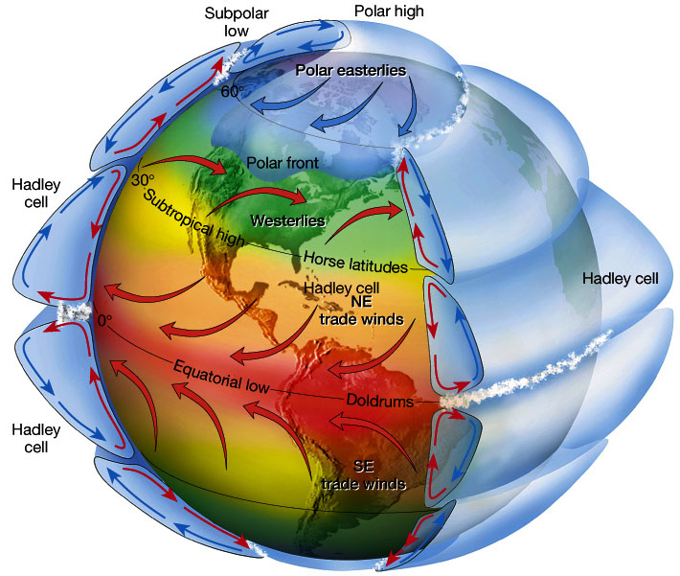
Atmospheric Circulation
Idealized single-cell atmospheric convection.
Three-cell atmospheric convection on rotating frame of reference. Wind deflections in each cell N & S of the equator due to the Coriolis force.
Figure 7.5 in The Atmosphere, 8th edition, Lutgens and Tarbuck, 8th edition, 2001
Downloaded from https://www.ux1.eiu.edu/~jpstimac/1400/circulation.html

Slide 3
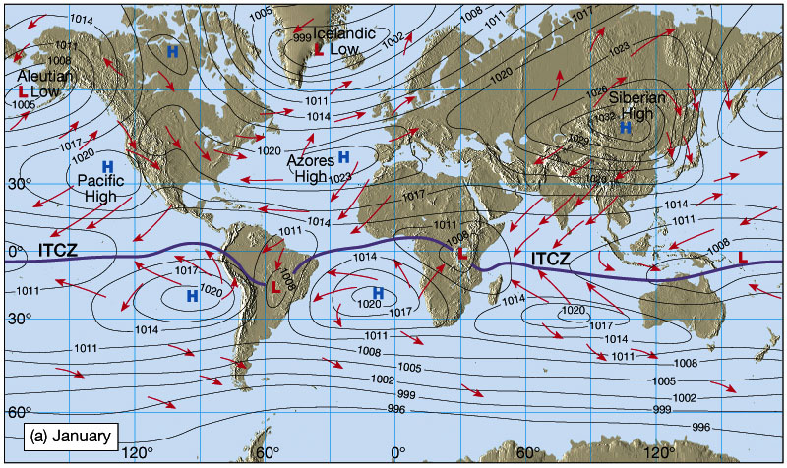
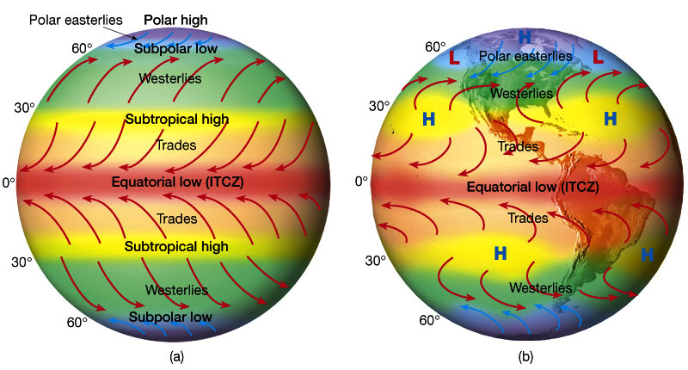
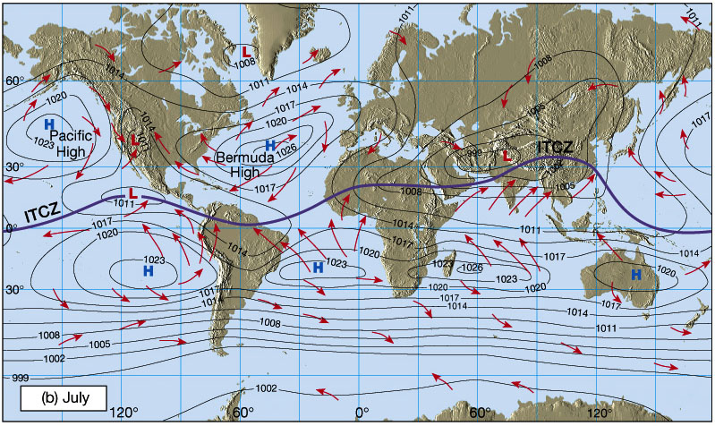
Atmospheric Circulation
Idealized winds from pressure gradient and Coriolis force.
Wind patterns due to distribution of land masses.
Figures 7.7 and 7.9 in The Atmosphere, 8th edition, Lutgens and Tarbuck, 8th edition, 2001
Downloaded from https://www.ux1.eiu.edu/~jpstimac/1400/circulation.html

Slide 4
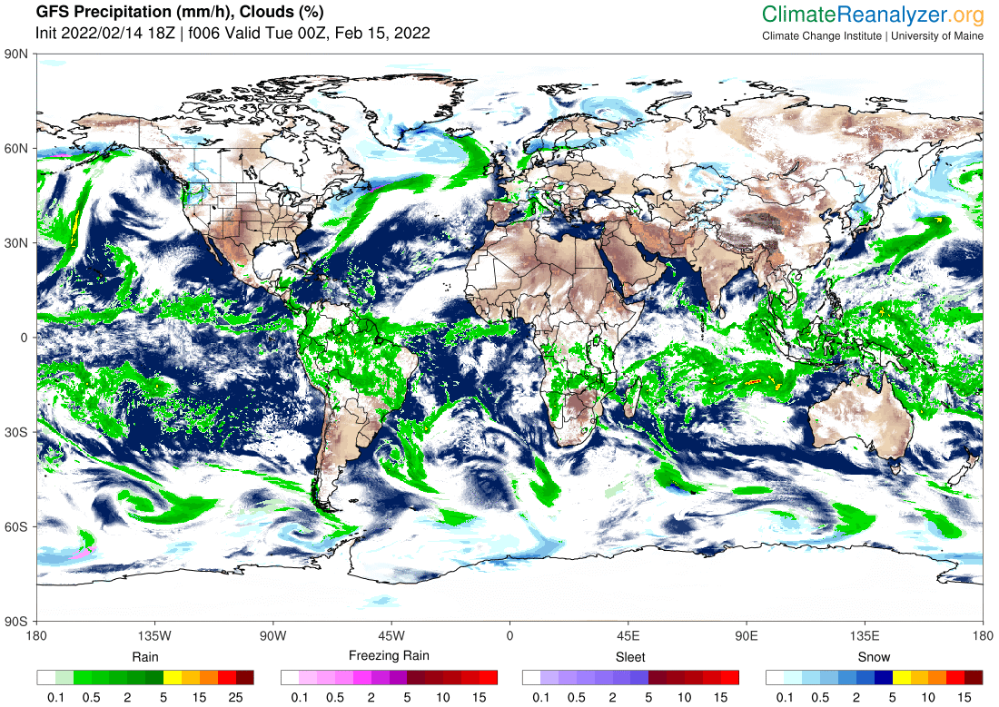
Westerlies
Subtropical High
Intertropical Convergence Zone (ITCZ)
Subtropical High
Westerlies

Slide 5
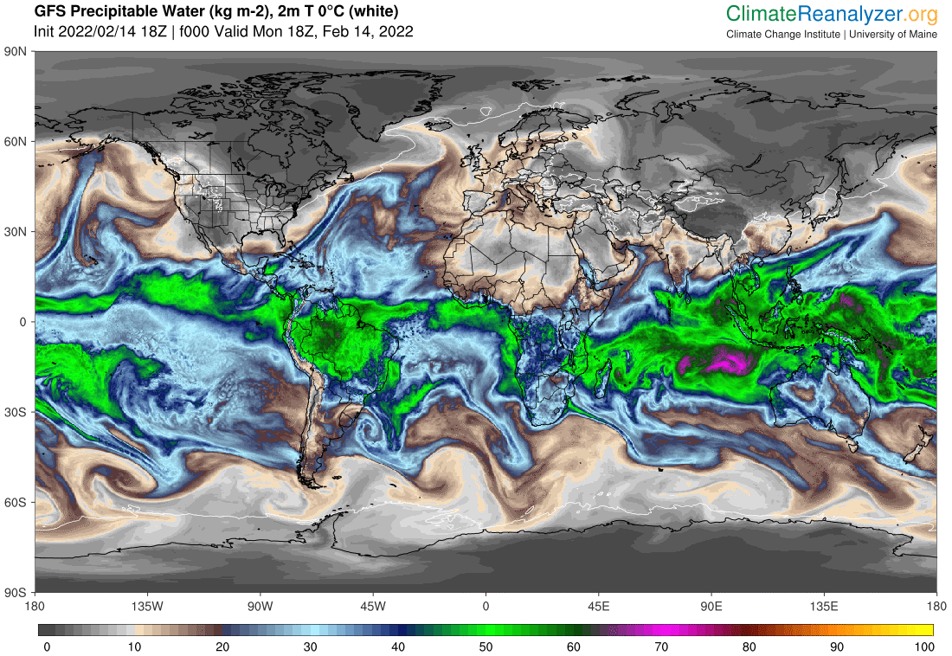
Westerlies
Subtropical High
Intertropical Convergence Zone (ITCZ)
Subtropical High
Westerlies

Slide 6
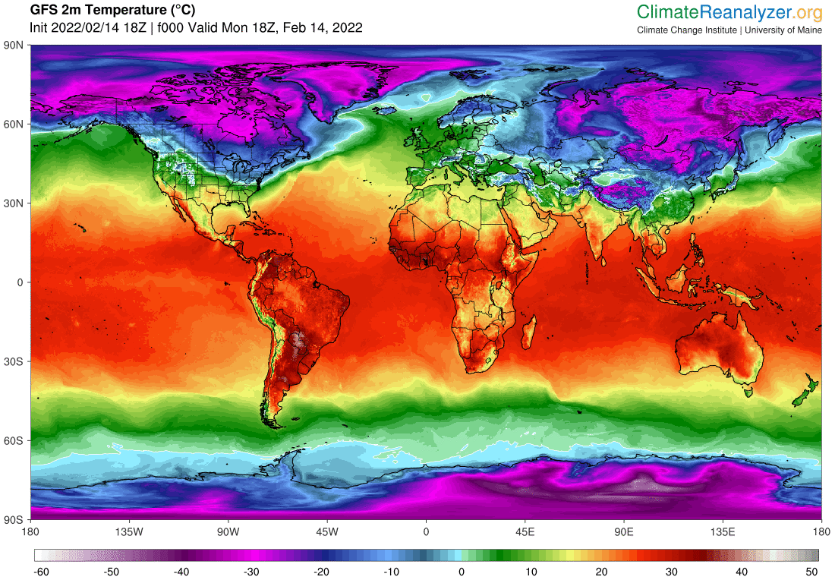
Westerlies
Subtropical High
Intertropical Convergence Zone (ITCZ)
Subtropical High
Westerlies

Slide 7
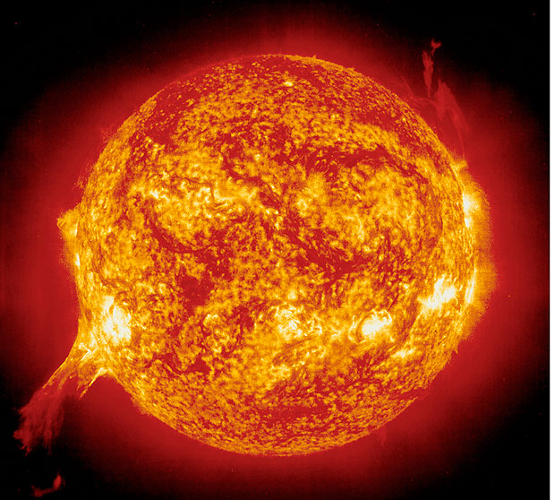
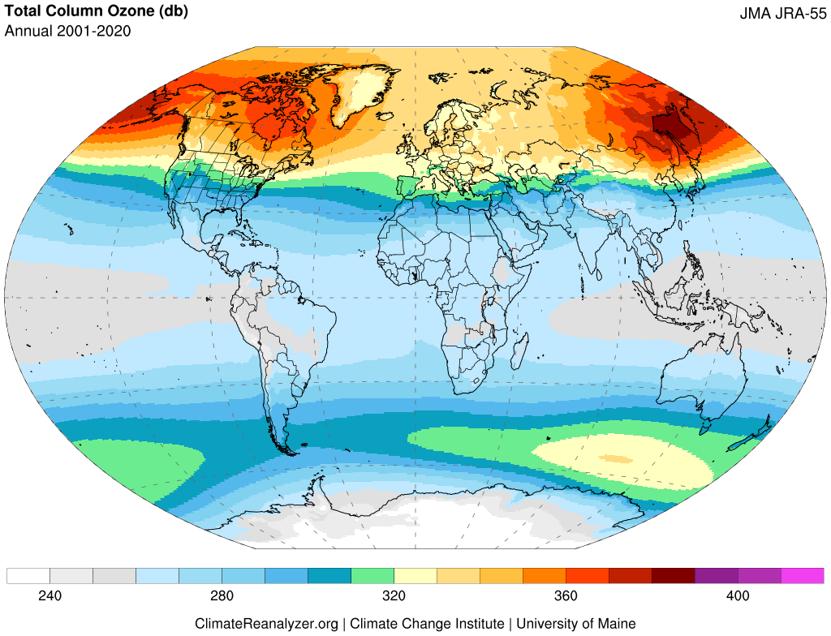
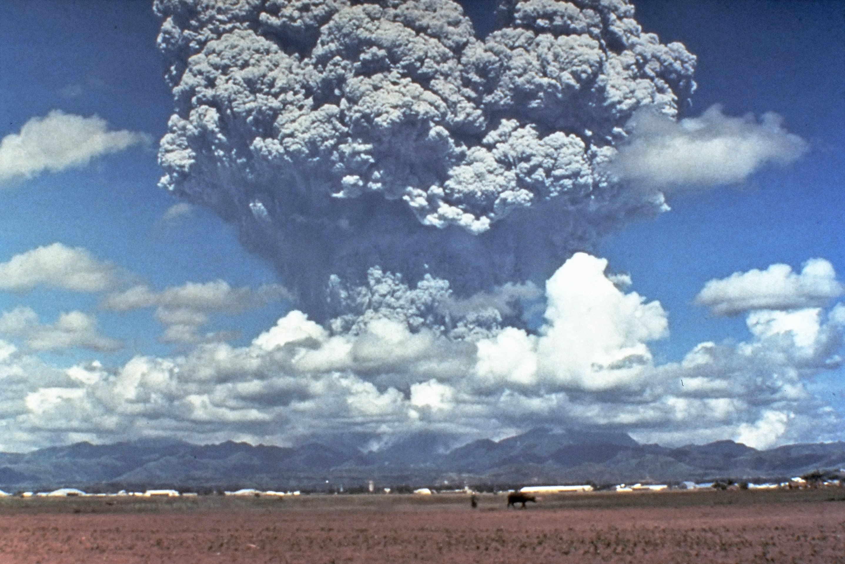
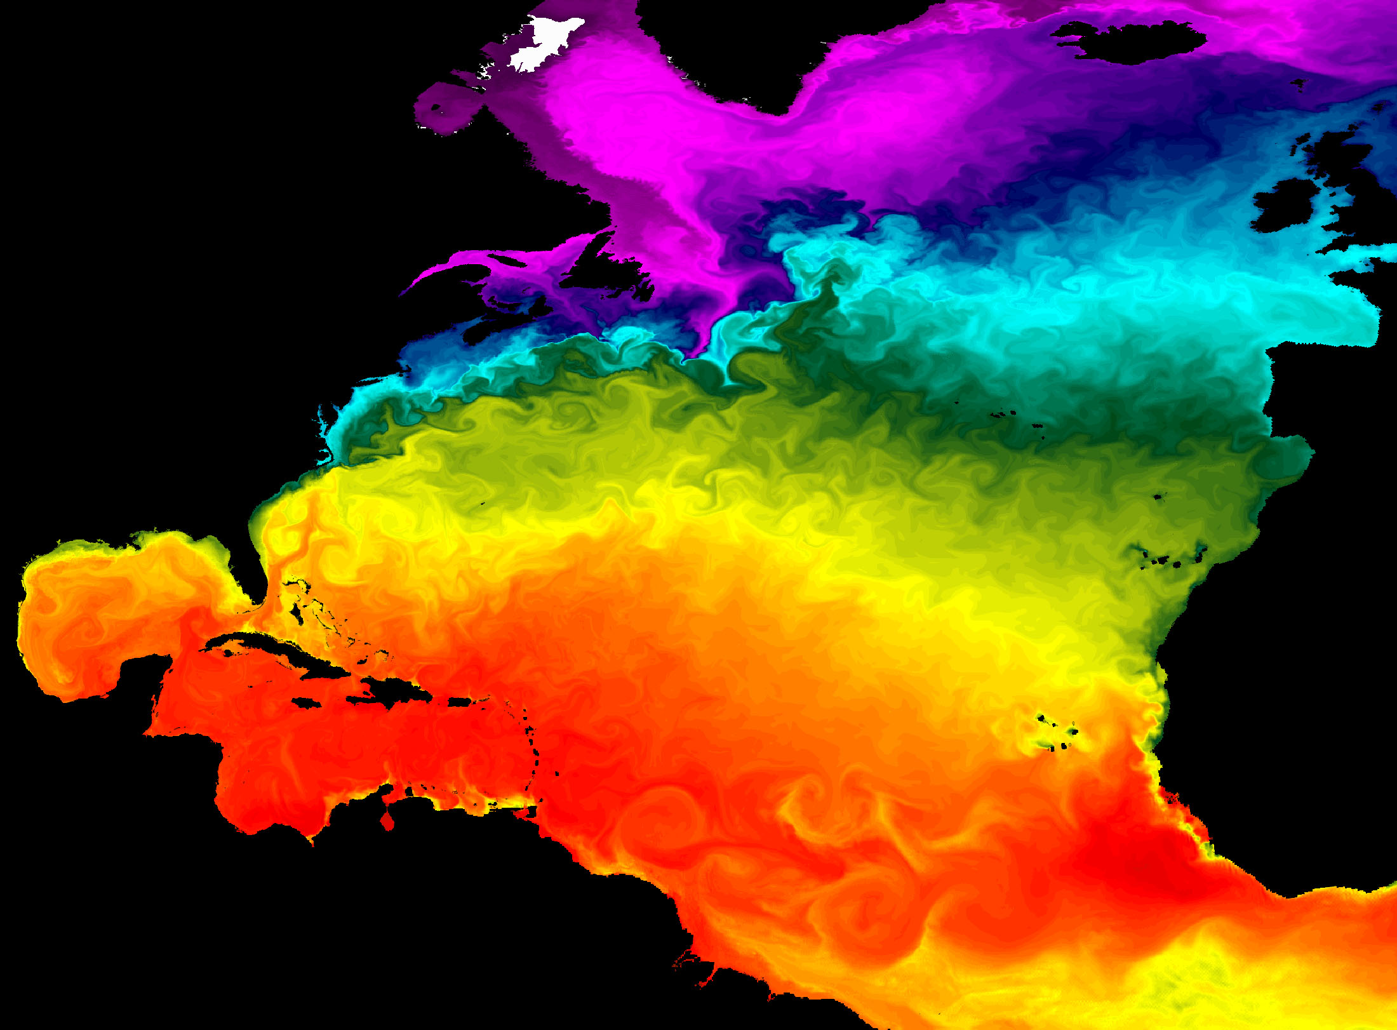
Solar Cycle
Stratospheric Processes
Volcanic Eruptions
Coupled Ocean/Atmosphere Responses
Mt. Pinatubo, 1991 https://upload.wikimedia.org/wikipedia/commons/4/4e/Pinatubo91eruption_plume.jpg

Slide 8
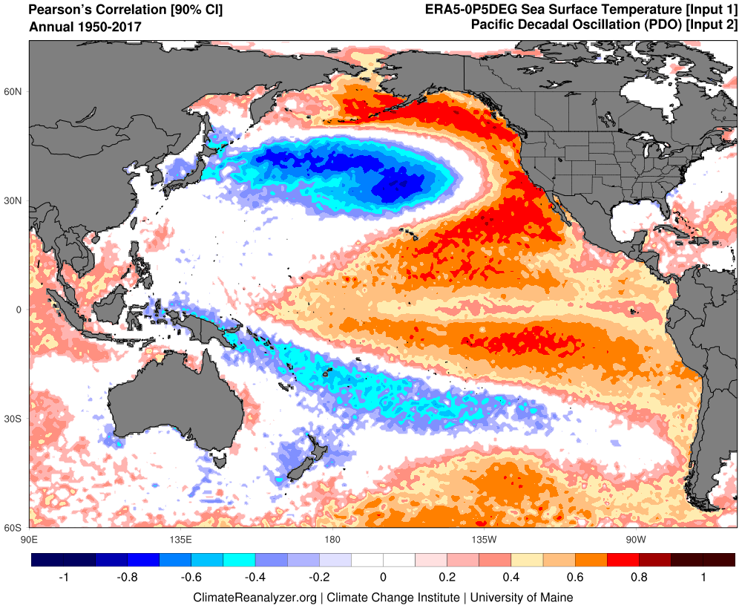
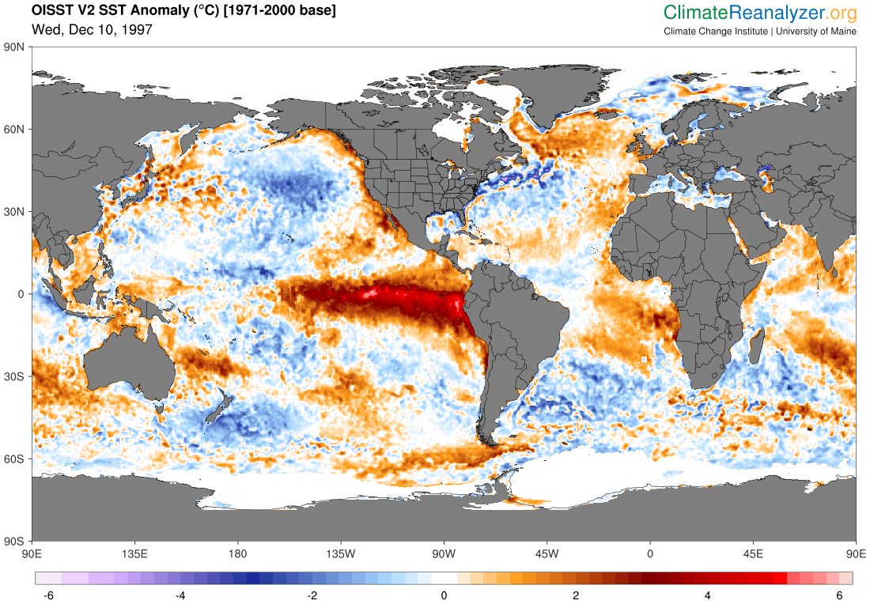
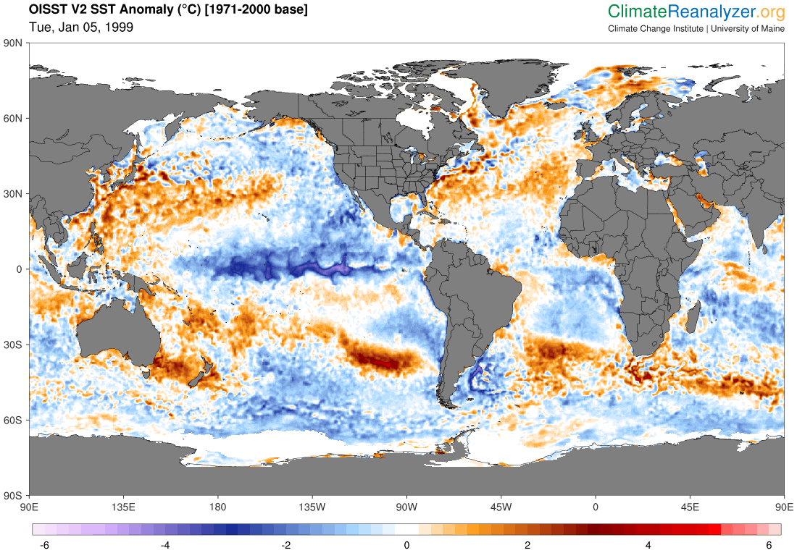
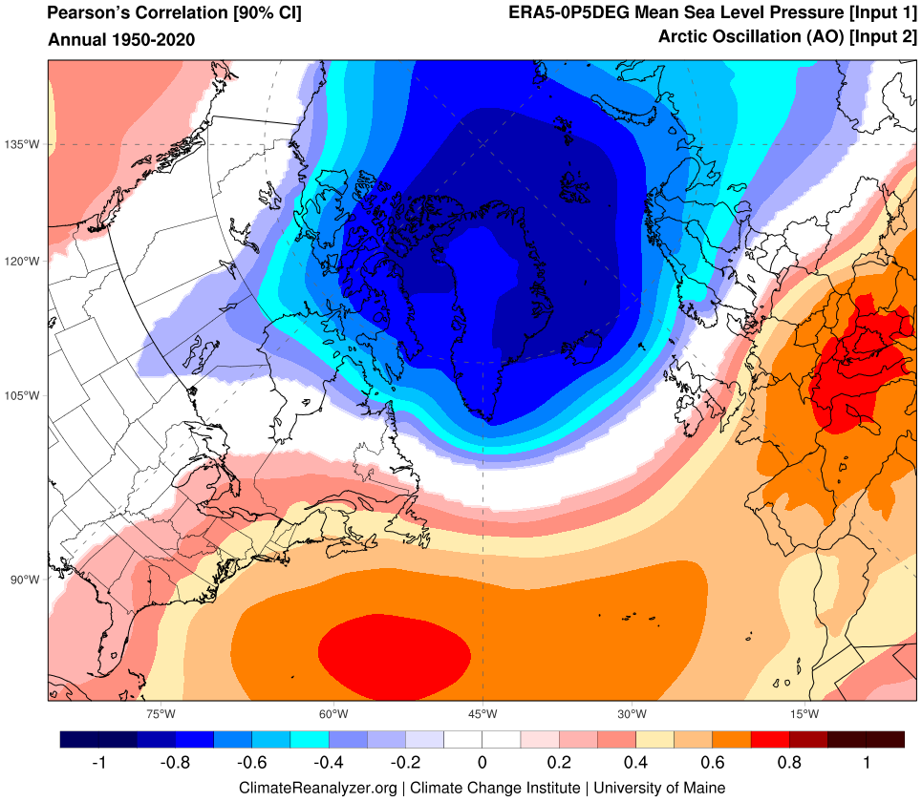
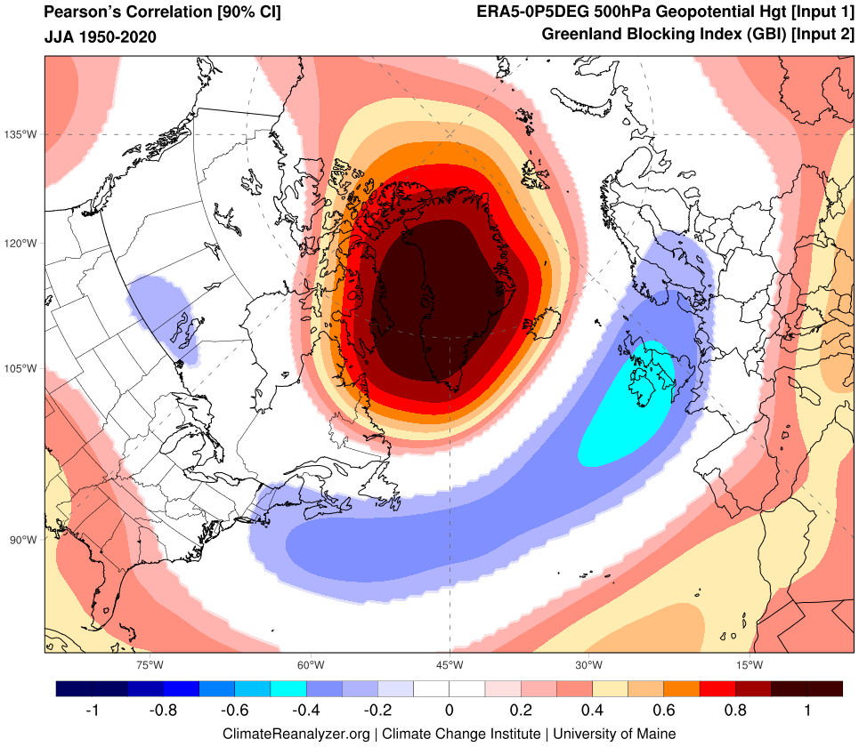
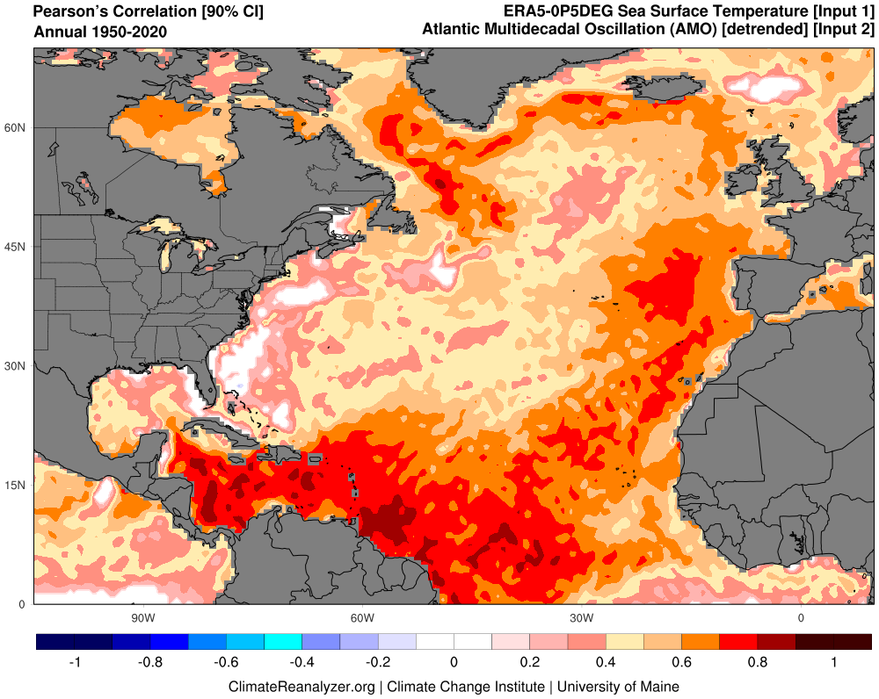
Teleconnections
Pacific Decadal Oscillation (PDO)
El Niño-Southern Oscillation (ENSO)
Atlantic Multidecadal Oscillation/Variability (AMO/AMV)
North Atlantic Oscillation (NAO)
Greenland Blocking Index (GBI)

Slide 9
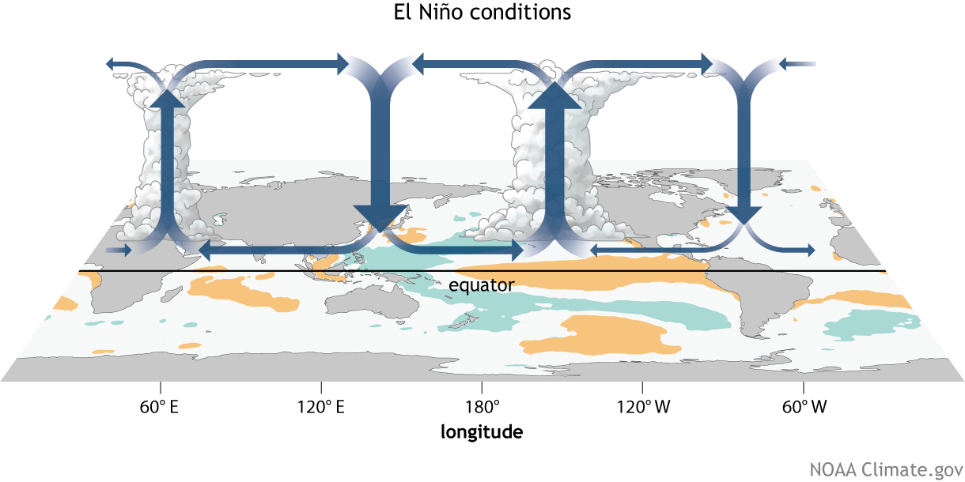
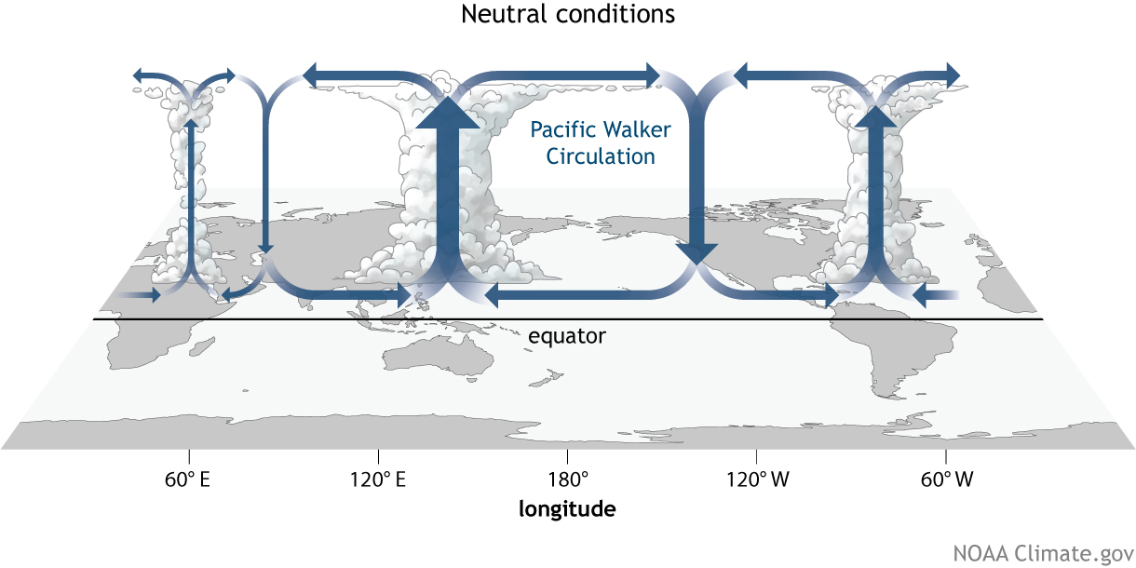
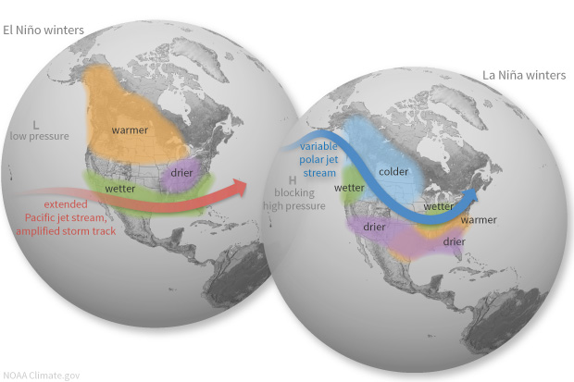
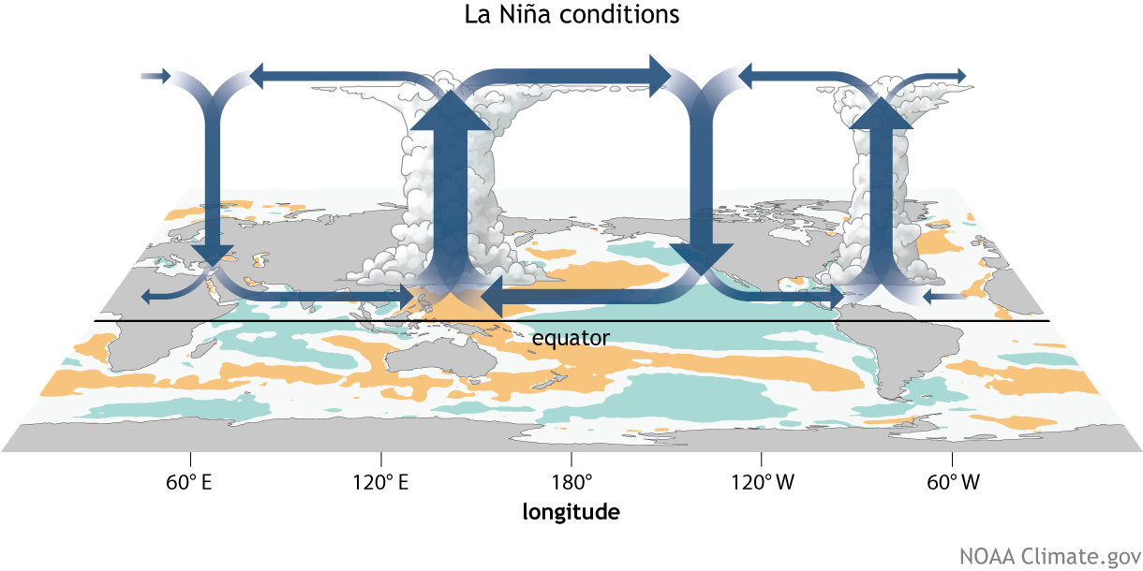
El Niño-Southern Oscillation (ENSO)
Coupled ocean-atmosphere response with irregular period of 2–7 years between El Niño (warm) and La Niña (cool) phases.
ENSO impacts weather worldwide, particularly during boreal winter.
Atmospheric response known as Walker circulation.
https://www.climate.gov/enso

Slide 10
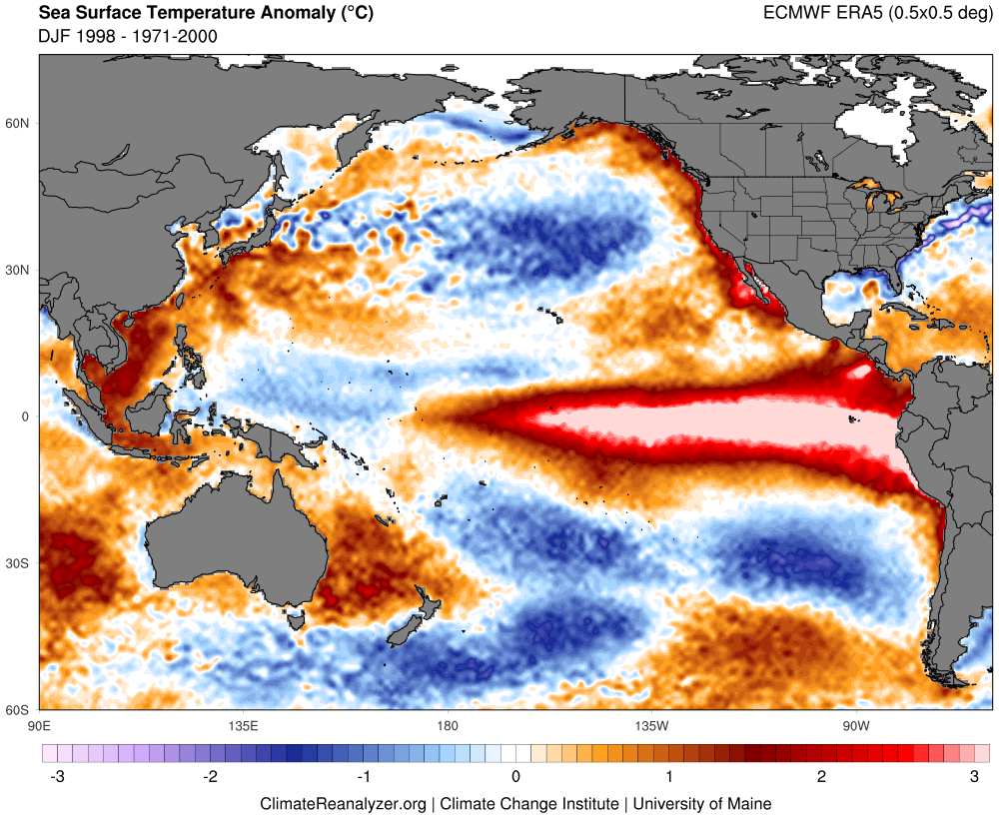
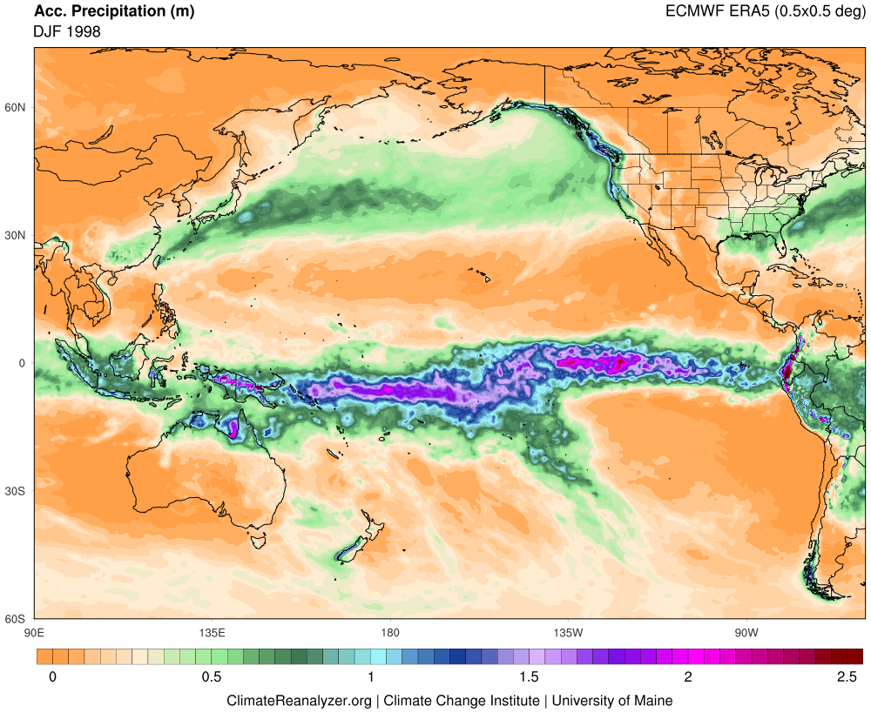
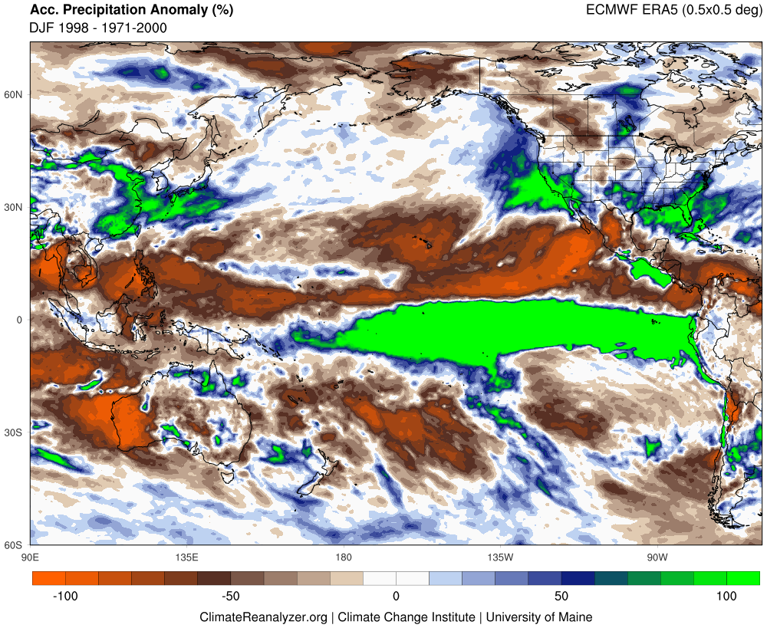
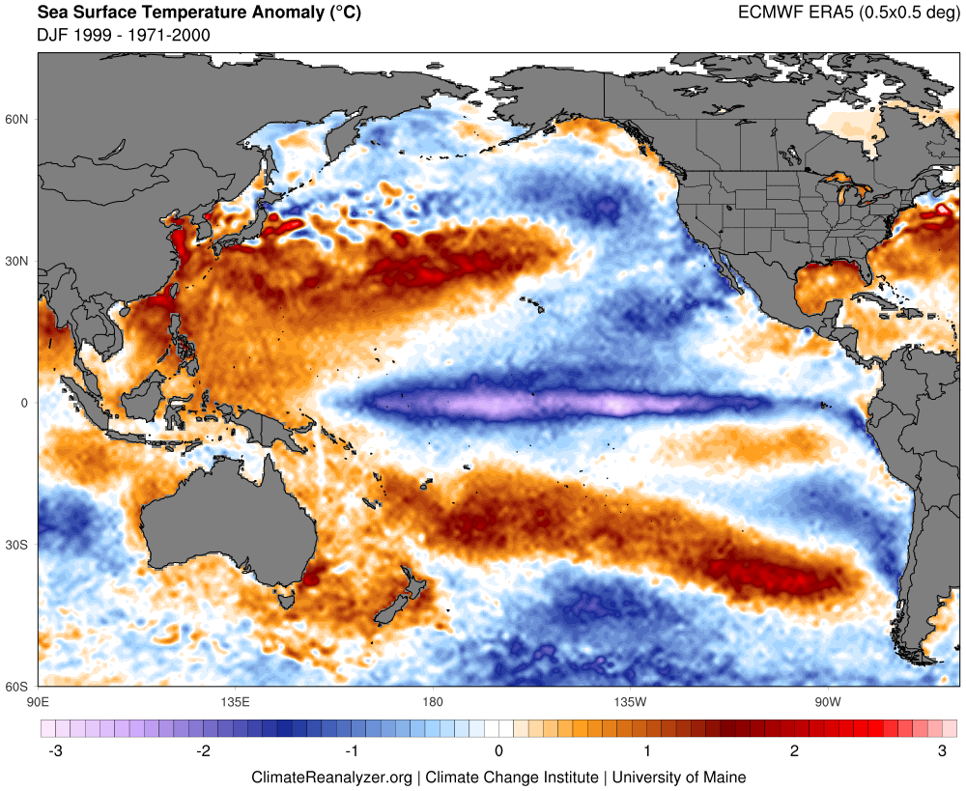
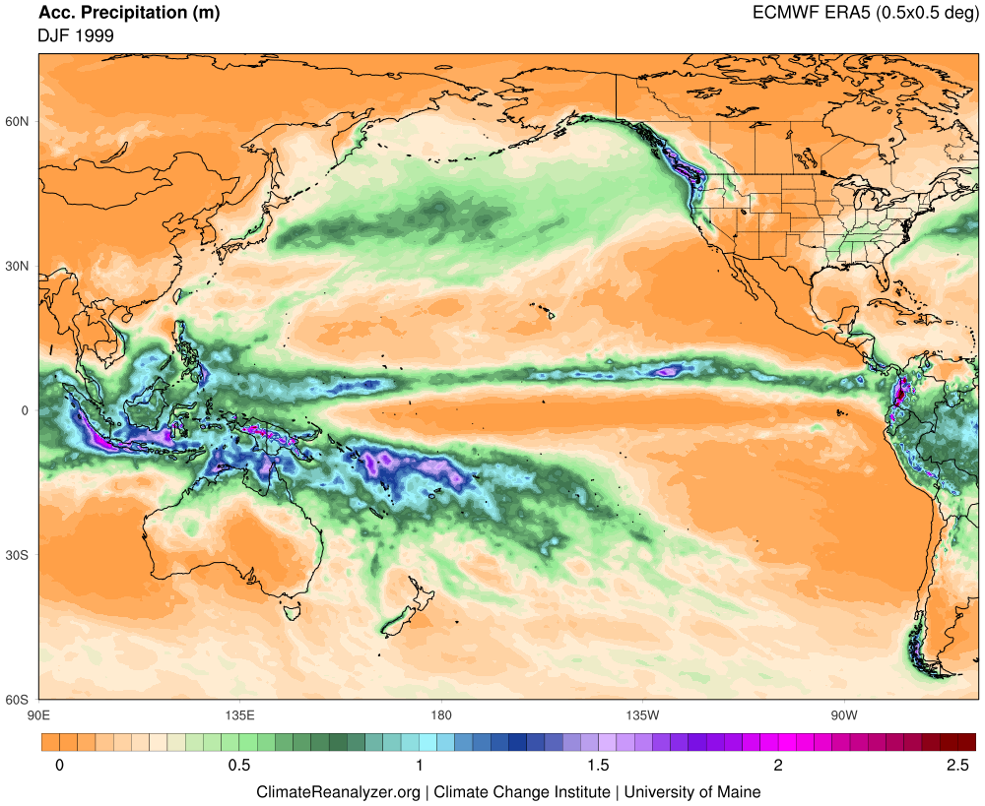
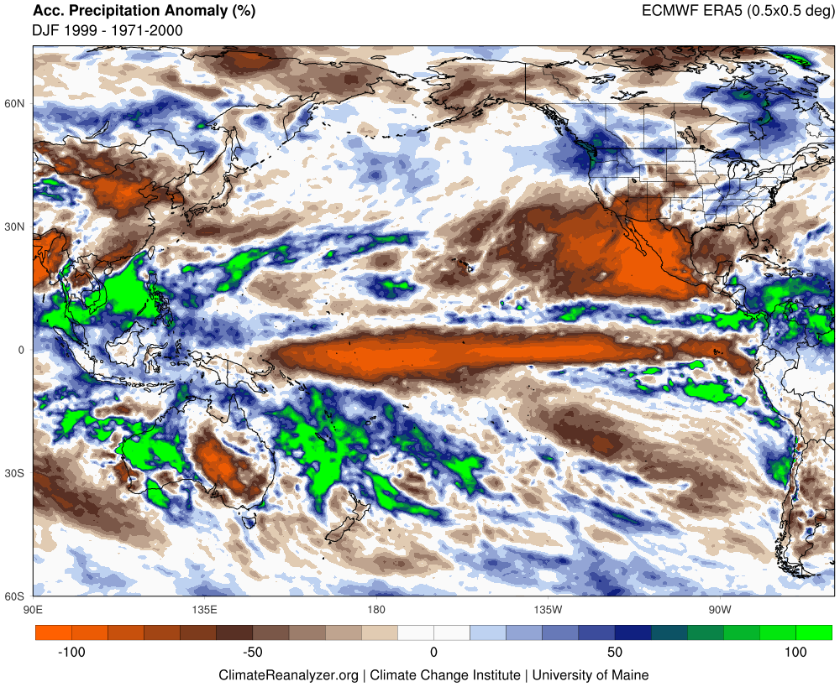
SST Anomaly
Precipitation
Precipitation Anomaly
DJF 1998 El Niño
DJF 1999 La Niña

Slide 11
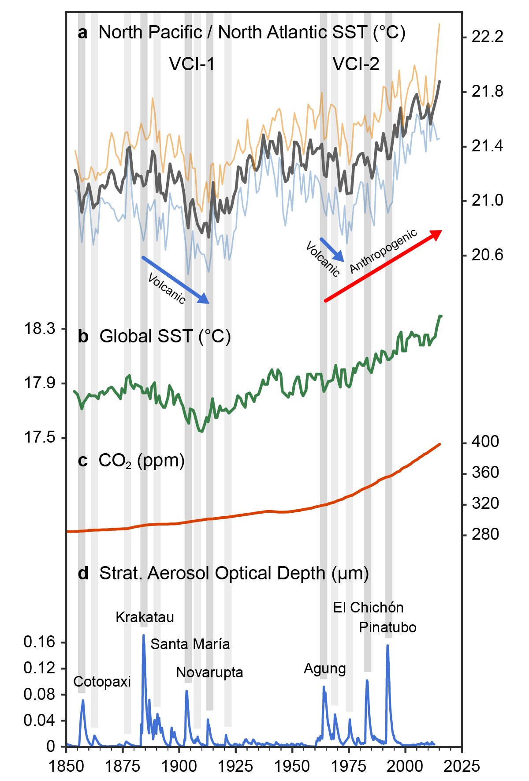
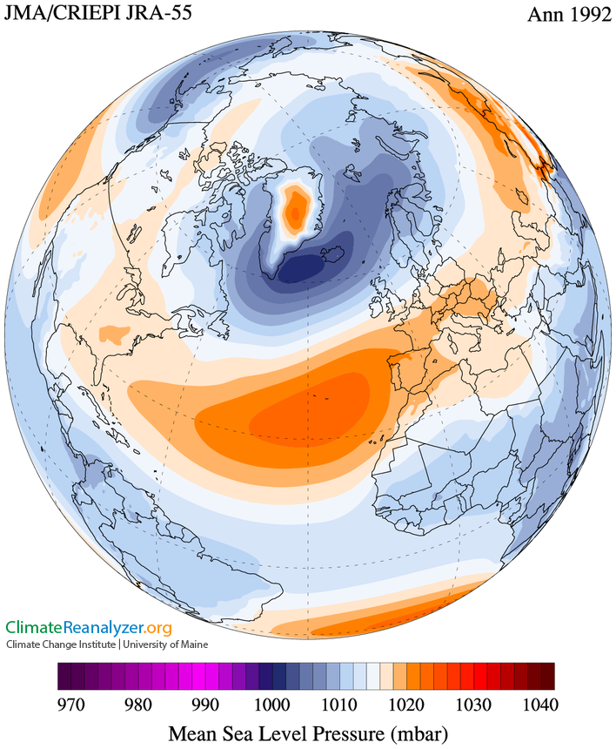
Evidence for a Volcanic Underpinning of the Atlantic Multidecadal Oscillation
Sean D. Birkel, Paul A. Mayewski, Kirk A. Maasch, Andrei V. Kurbatov, Bradfield Lyon
NPJ Climate and Atmospheric Science (2018)

Slide 12
