Slide 1



Maine Climate Office Update
American Association of State Climatologists
June 23rd, 2023
Sean Birkel
Assistant Professor & Maine State Climatologist
Climate Change Institute
Cooperative Extension
University of Maine

Slide 2

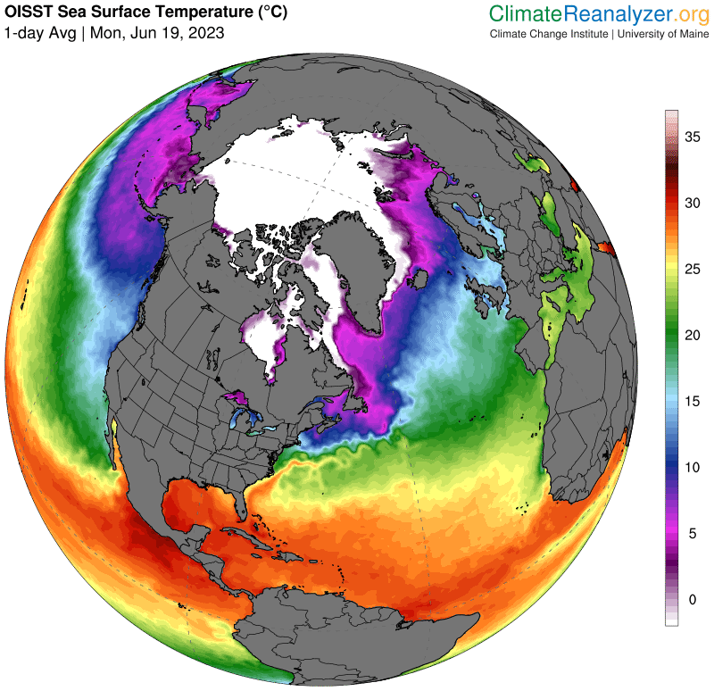





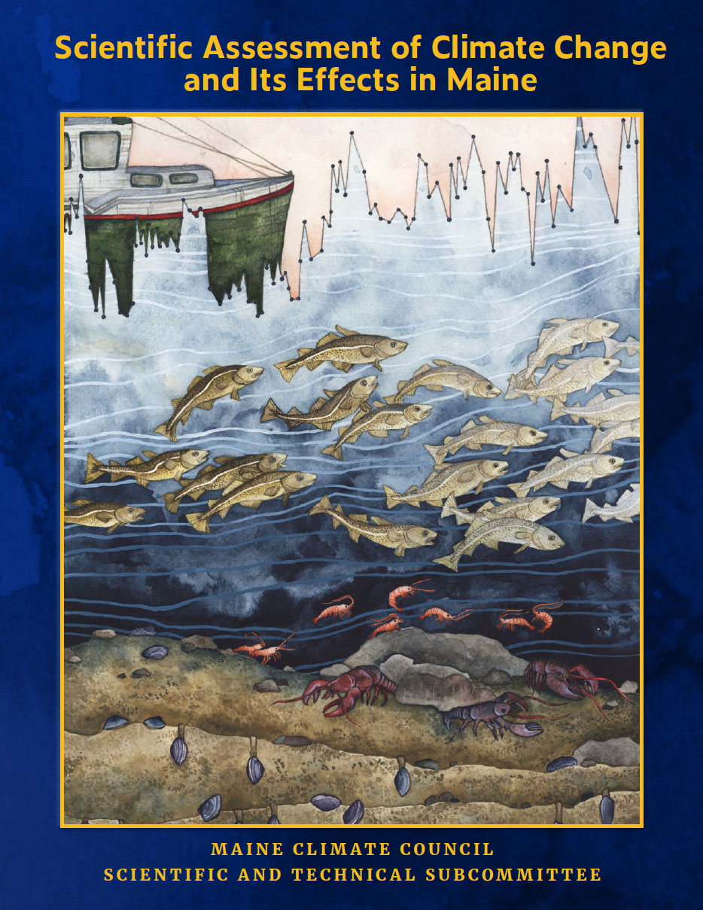

Maine Climate Office Activities
Projects
NOAA Climate Adaptation Partnerships 1-year grant: Manufactured home communities climate hazards resiliency
ME, NH, VT state climate offices
Senior undergraduate student Max Valentine
UMaine Arctic NSF Research Traineeship (NRT)
MS. student Ana Trueba
Private funding to support data analysis/visualization
PhD. student Mac Creamer
Anticipated
Maine Mesonet – FY24 earmark request is advancing
26 stations across Maine’s 16 counties
10-meter height with soil temp and moisture
Will be hiring mesonet manager, data scientist, and technician
Other
Serving on Maine Climate Council’s scientific & technical subcommittee
Extension agriculture weather/climate forecast projects

Slide 3
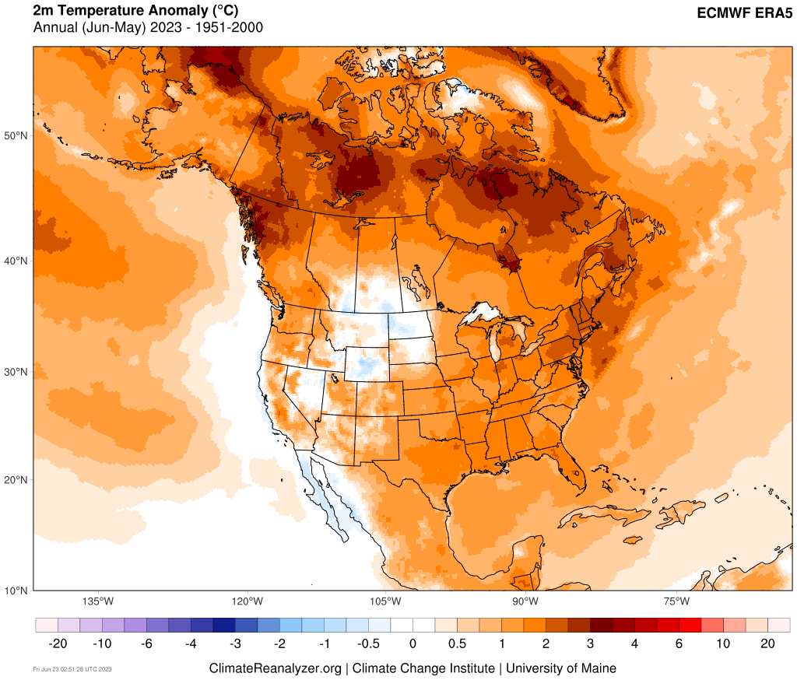
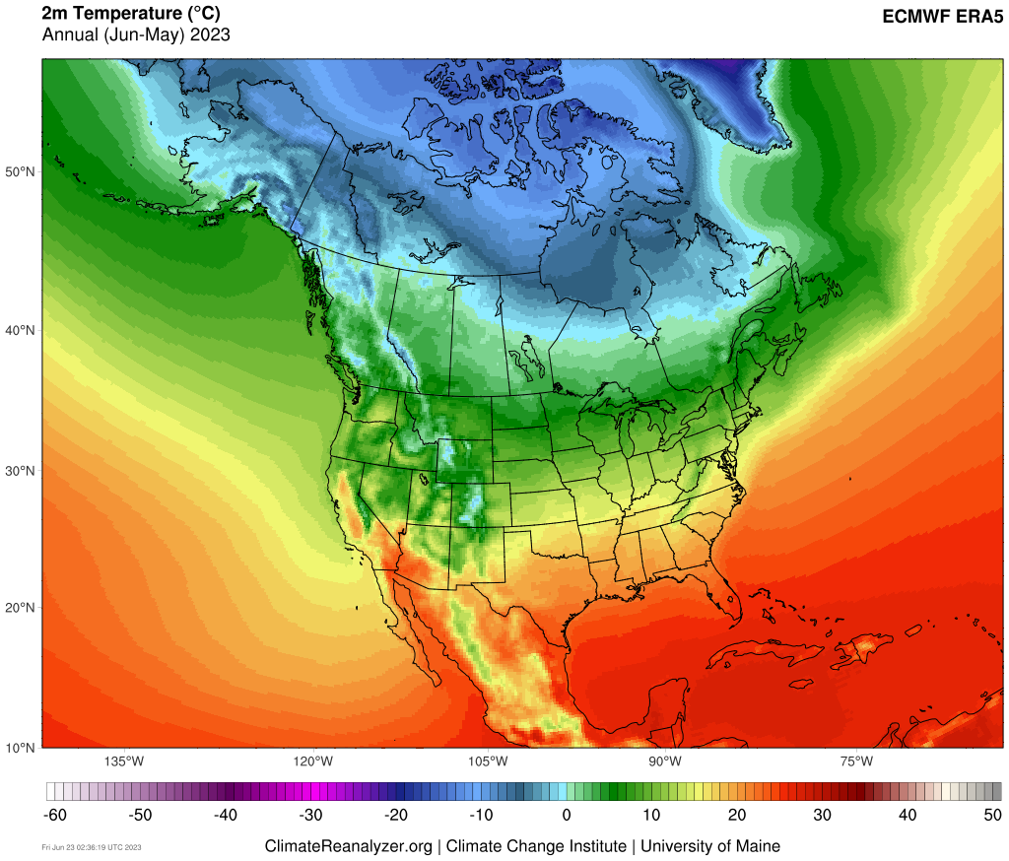
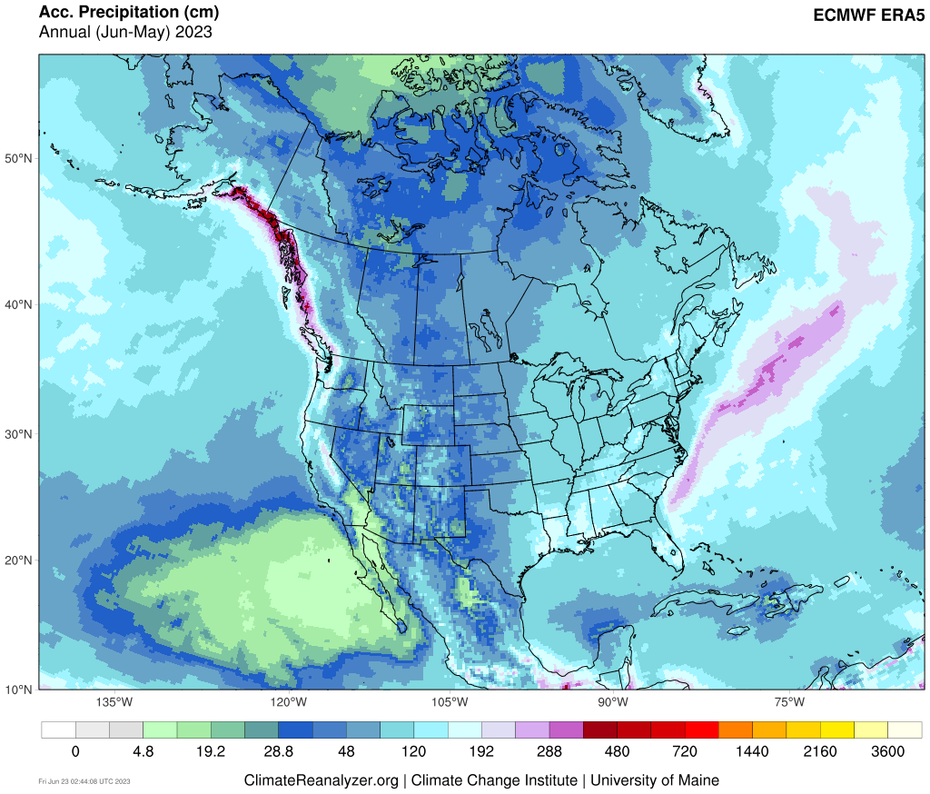
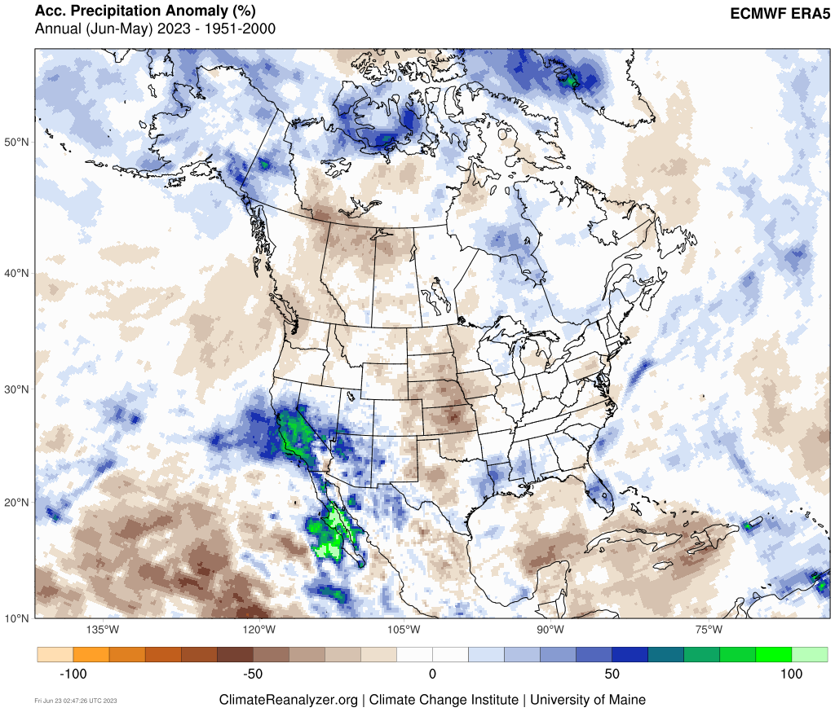
A look at the last 12 months…

Slide 4
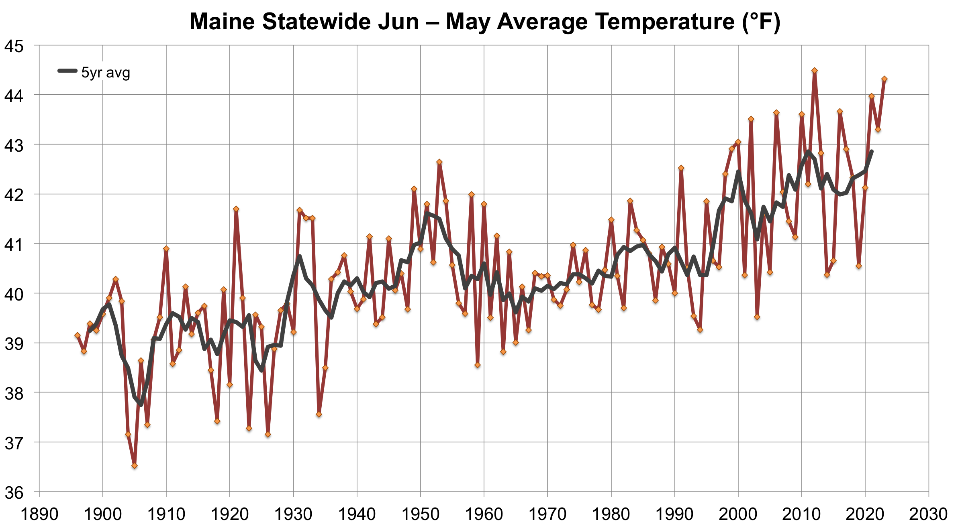
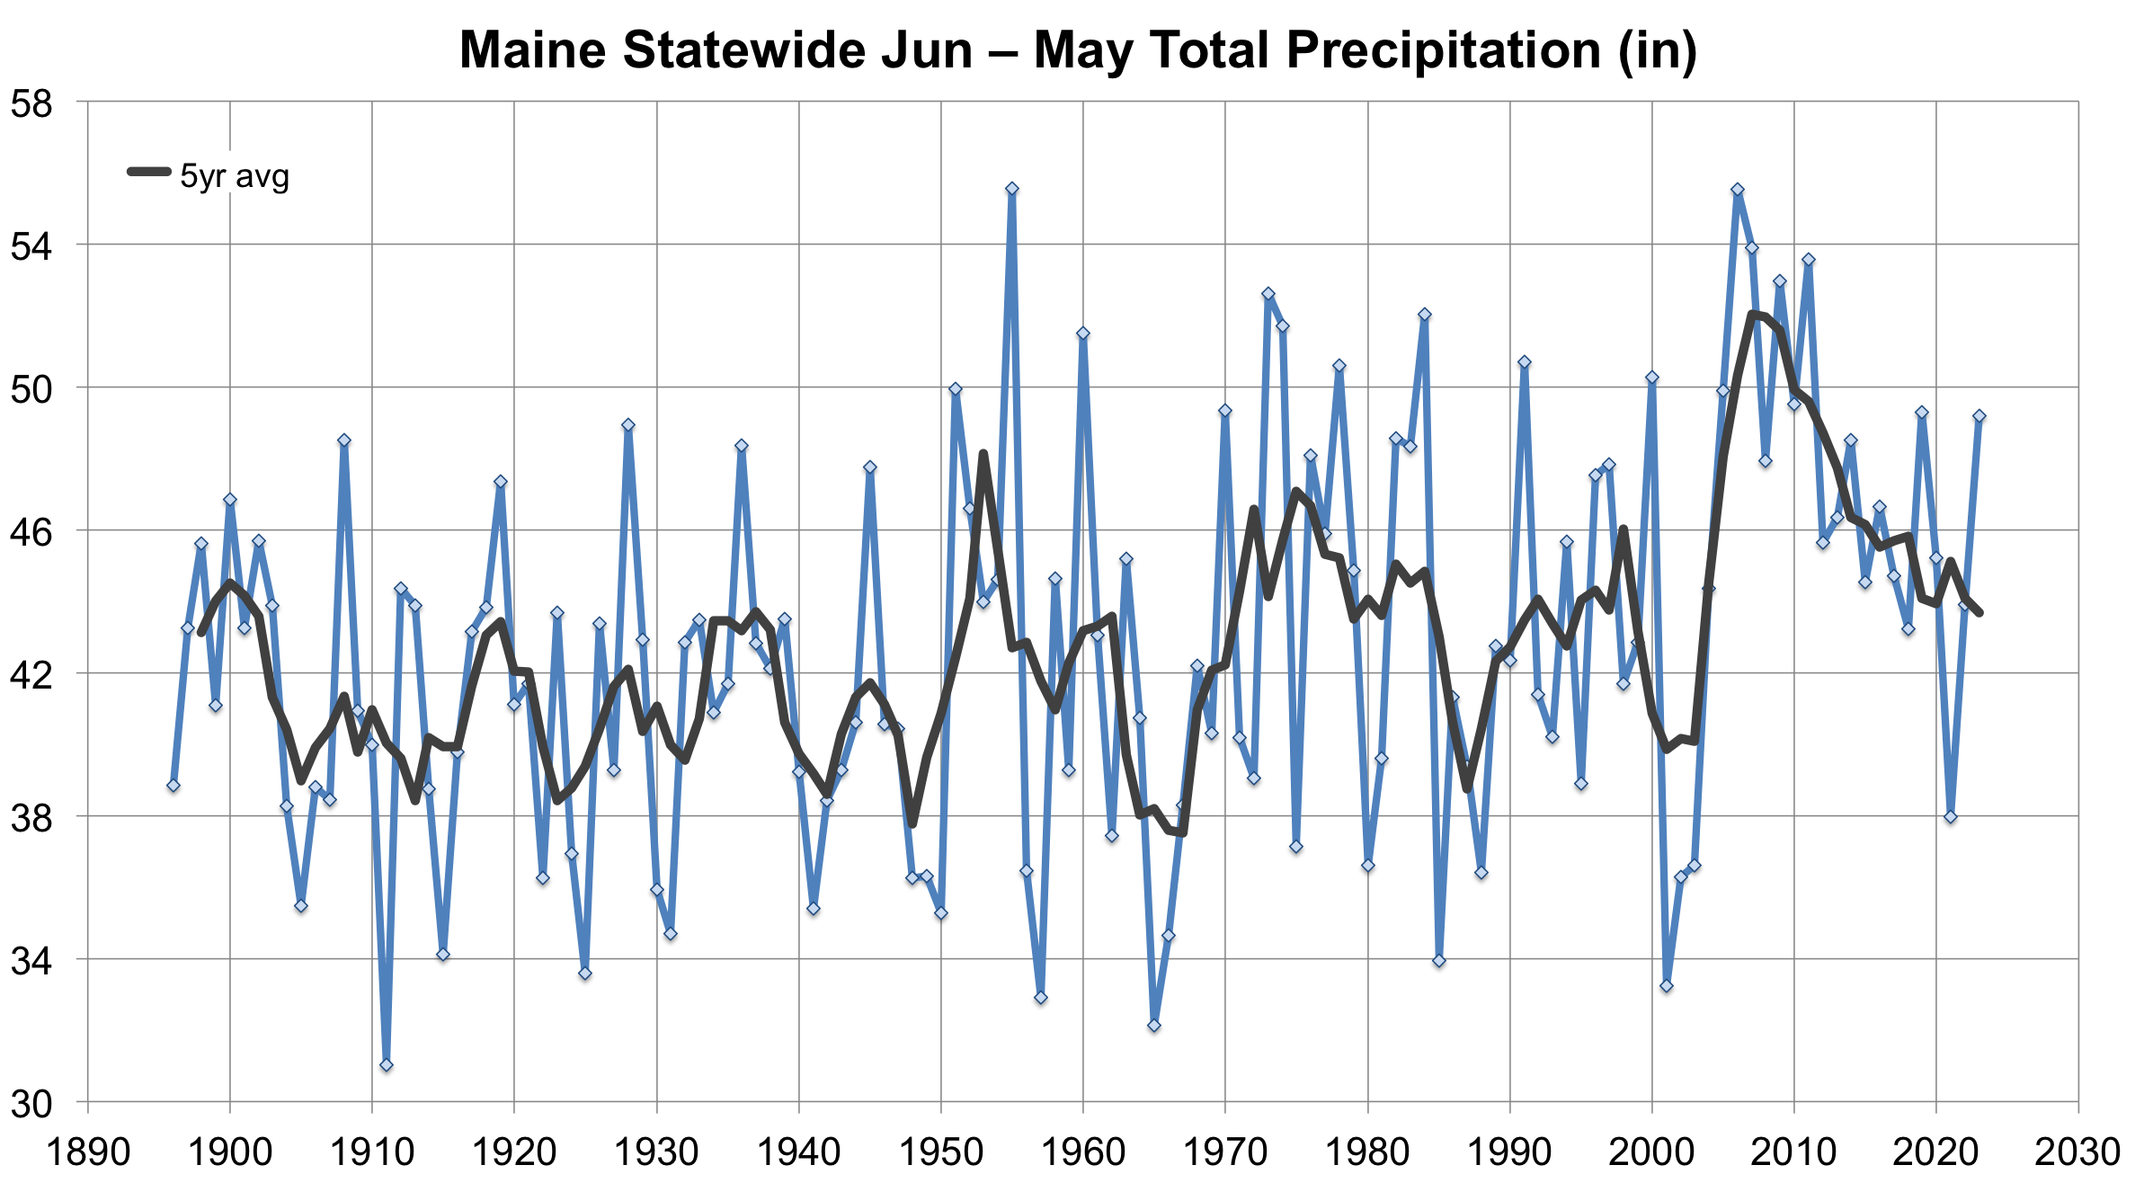
Notable Stats & Extremes 2022 – 2023
Maine Statewide
2nd warmest June–May, 2022–2023
1st warmest January, 2023
3rd warmest DJF, 2023
Gulf of Maine (SST)
1st warmest November, 2022
1st warmest DJF and JFM, 2023
NOAA Climate Divisional Database
18th wettest
Extremes
Rainstorm October 14–15, 2022
Overnight warmth November 6–7, 2022
Late season freeze/frost May 18, 2023*
Stalled low pressure / Quebec wildfire smoke June 6–9, 2023*
* Associated with anomalous long-wave pattern over North America
NOAA Climate Divisional Database

Slide 5
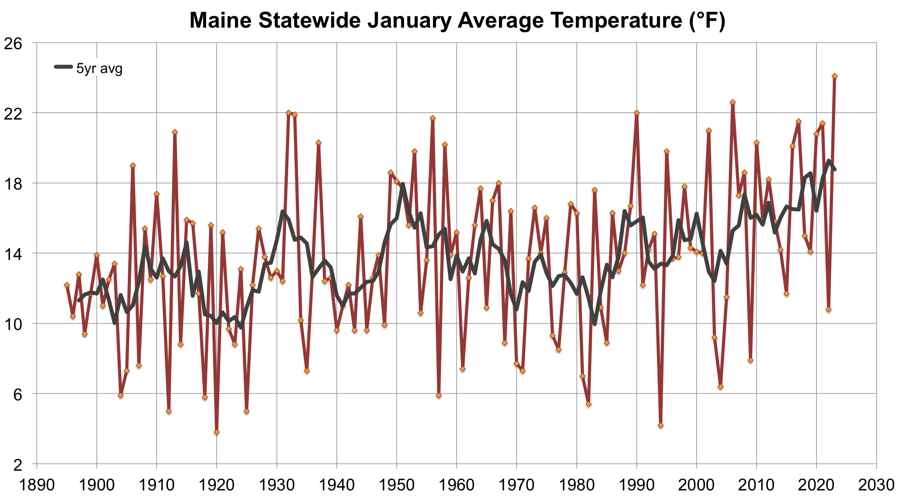
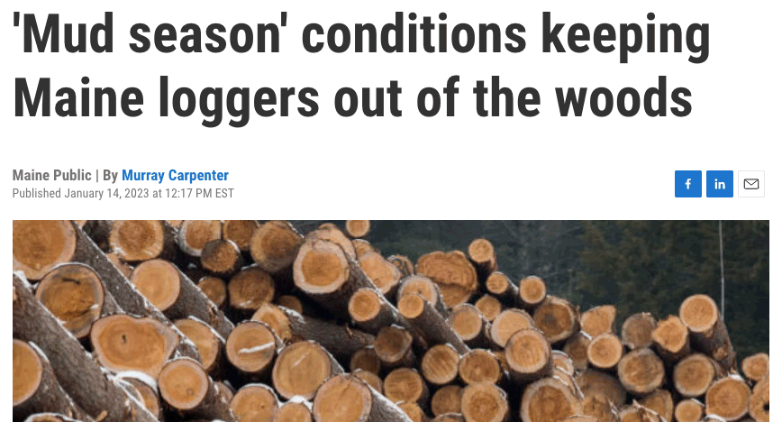
Notable Stats & Extremes 2022 – 2023
Maine Statewide
2nd warmest June–May, 2022–2023
1st warmest January, 2023
3rd warmest DJF, 2023
Gulf of Maine (SST)
1st warmest November, 2022
1st warmest DJF and JFM, 2023
NOAA Climate Divisional Database
Extremes
Rainstorm October 14–15, 2022
Overnight warmth November 6–7, 2022
Late season freeze/frost May 18, 2023*
Stalled low pressure / Quebec wildfire smoke June 6–9, 2023*
* Associated with anomalous long-wave pattern over North America

Slide 6
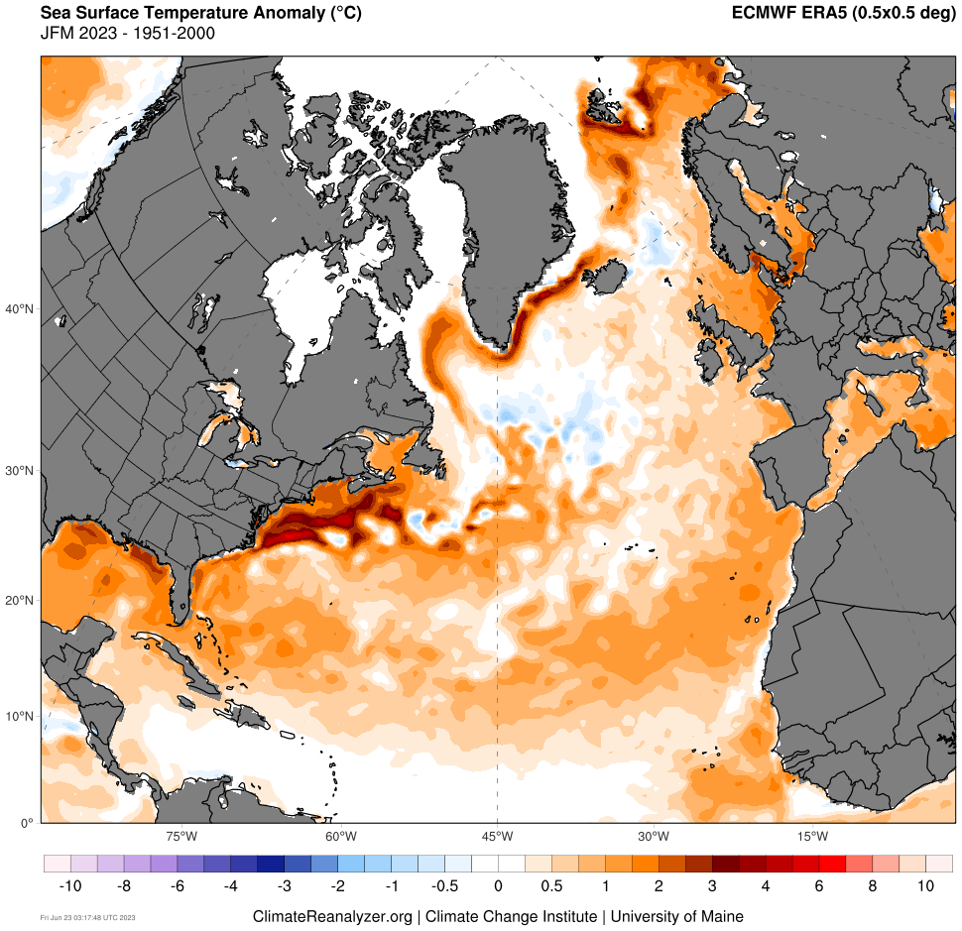
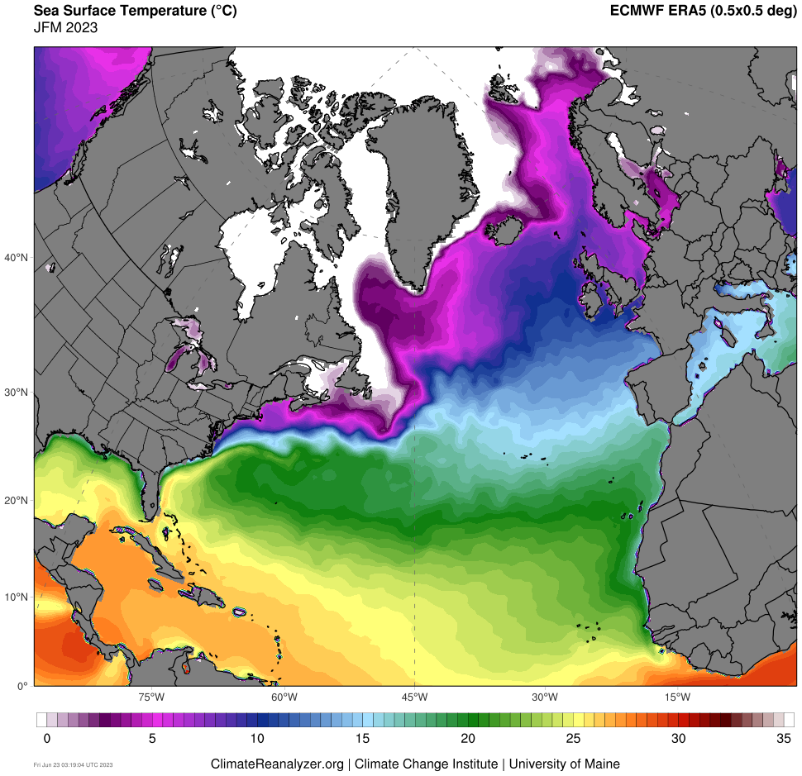
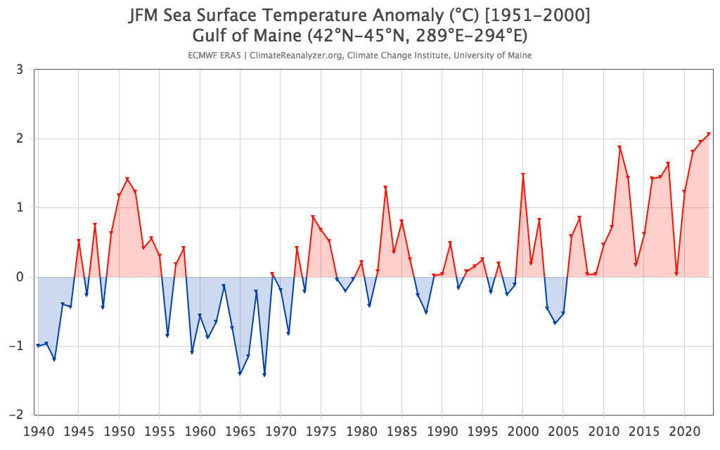
Notable Stats & Extremes 2022 – 2023
Maine Statewide
2nd warmest June–May, 2022–2023
1st warmest January, 2023
3rd warmest DJF, 2023
Gulf of Maine (SST)
1st warmest November, 2022
1st warmest DJF and JFM, 2023
Extremes
Rainstorm October 14–15, 2022
Overnight warmth November 6–7, 2022
Late season freeze/frost May 18, 2023*
Stalled low pressure / Quebec wildfire smoke June 6–9, 2023*
* Associated with anomalous long-wave pattern over North America

Slide 7
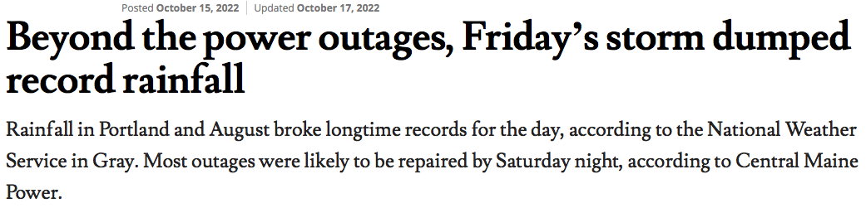
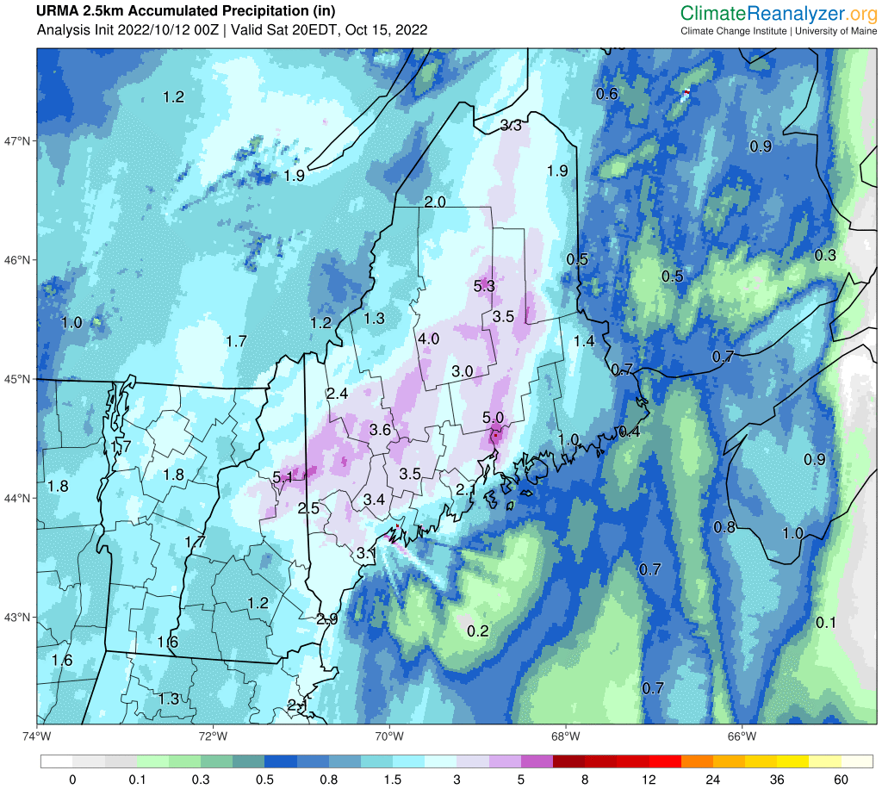
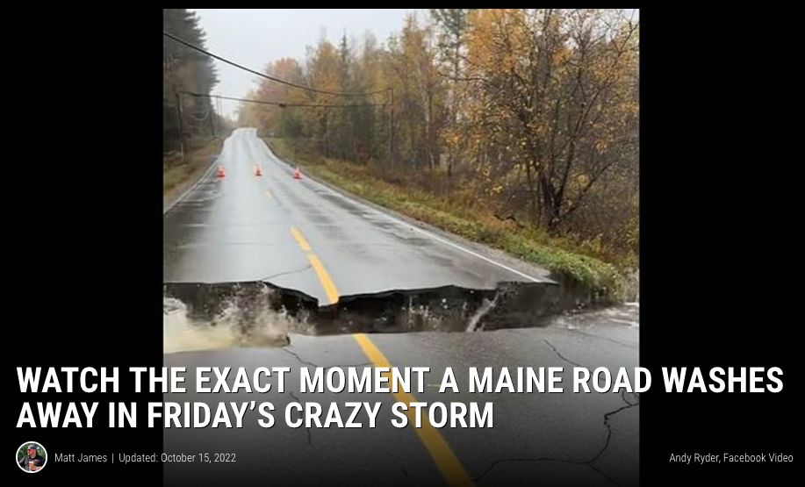
Notable Stats & Extremes 2022 – 2023
Portland Press Herald
Maine Statewide
2nd warmest June–May, 2022–2023
1st warmest January, 2023
3rd warmest DJF, 2023
Gulf of Maine (SST)
1st warmest November, 2022
1st warmest DJF and JFM, 2023
Extremes
Rainstorm October 14–15, 2022
Overnight warmth November 6–7, 2022
Late season freeze/frost May 18, 2023*
Stalled low pressure / Quebec wildfire smoke June 6–9, 2023*
* Associated with anomalous long-wave pattern over North America

Slide 8
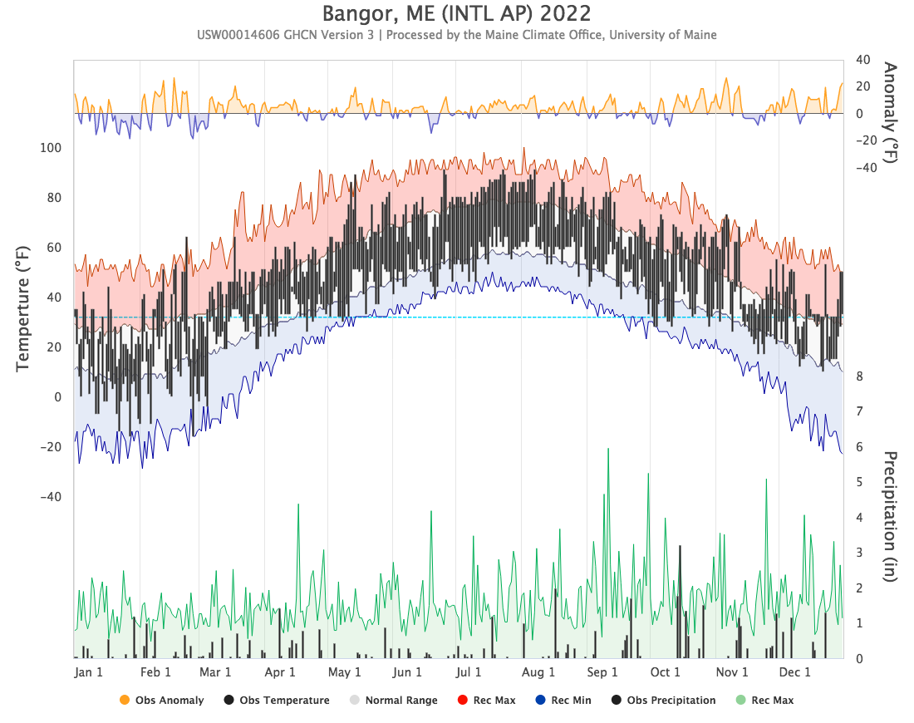
Oct 14–15
5”
95th percentile daily records
3.2”
1.8”

Slide 9
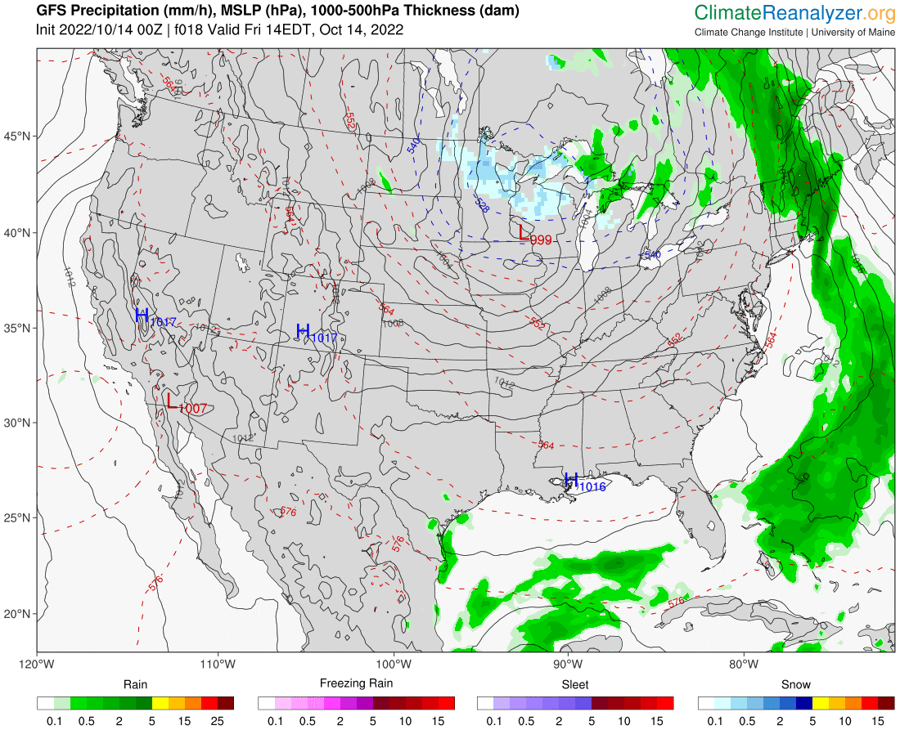
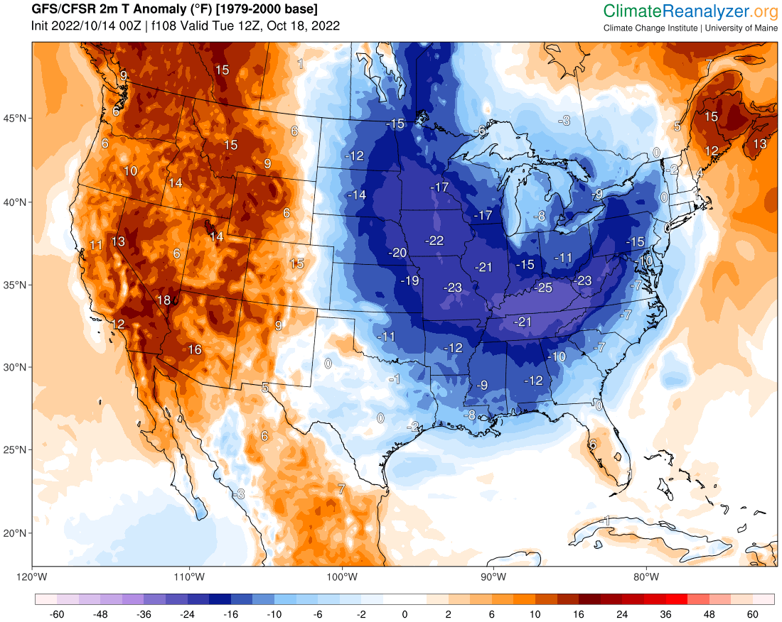

Slide 10
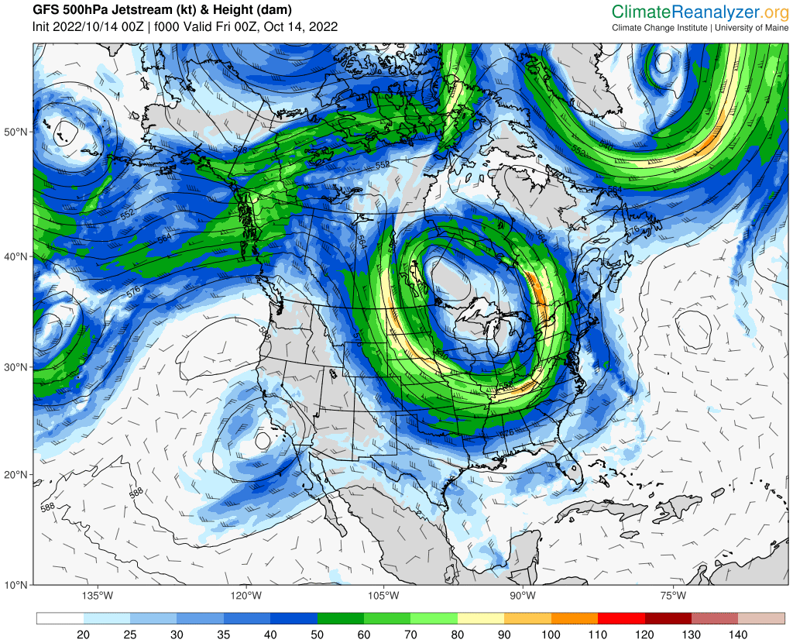
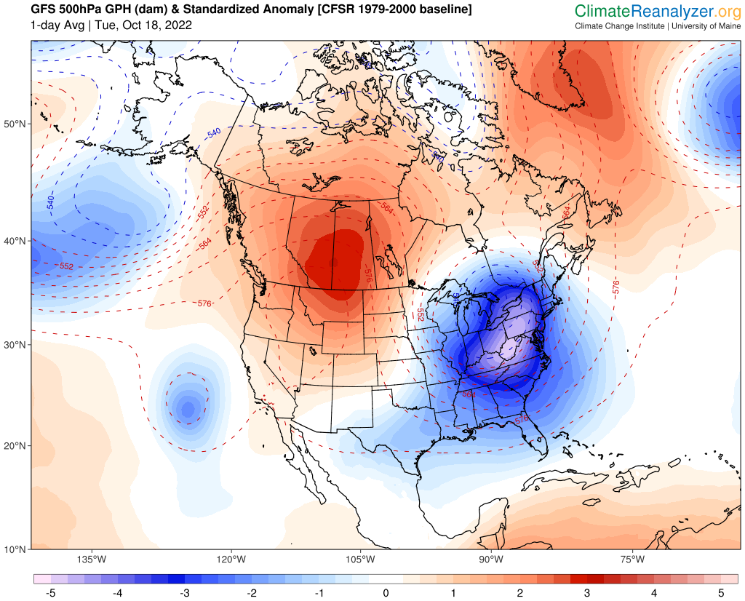
GPH 500mb Std. Anomaly, Oct. 18th

Slide 11
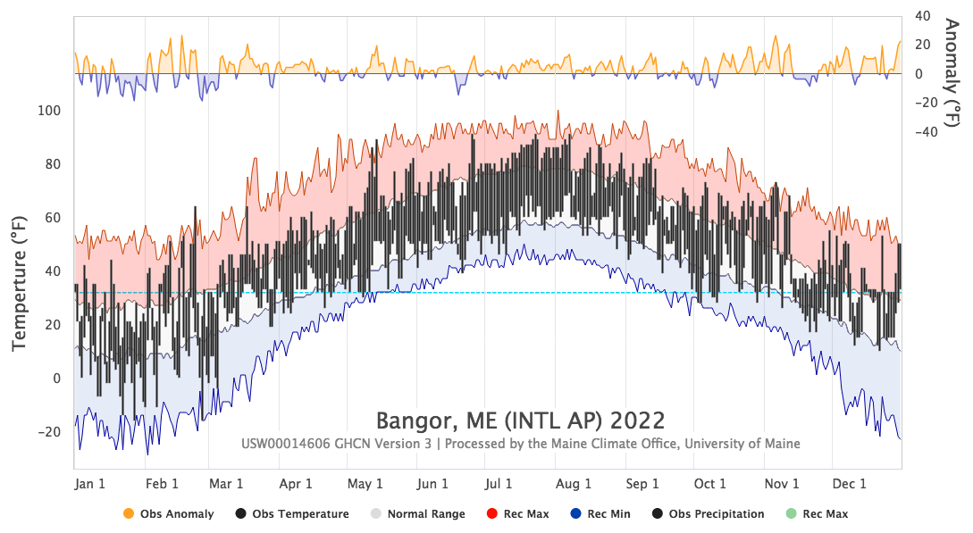
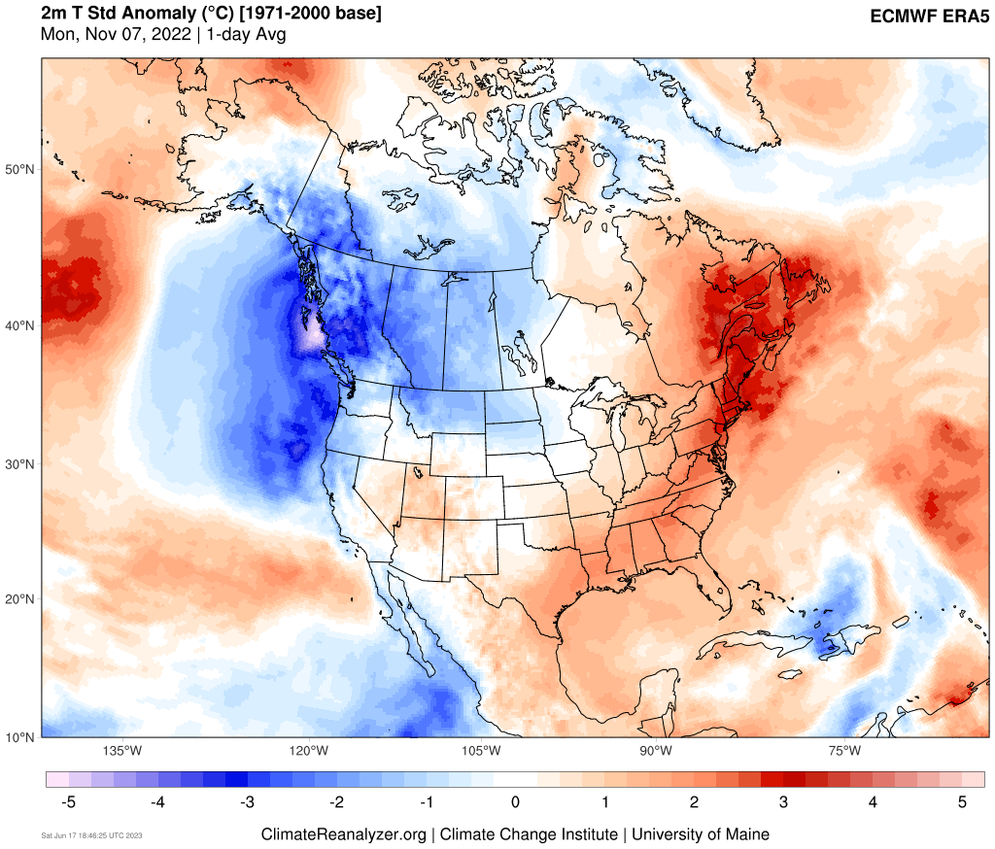
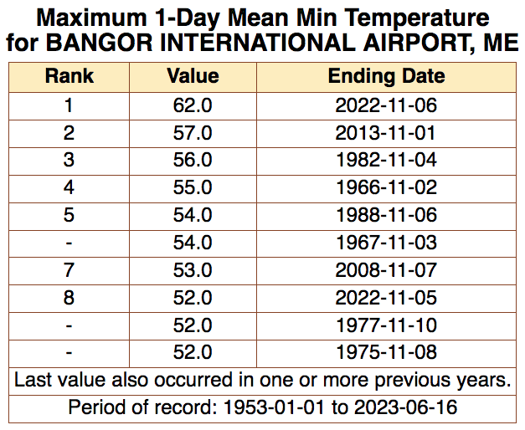
Notable Stats & Extremes 2022 – 2023
Maine Statewide
2nd warmest June–May, 2022–2023
1st warmest January, 2023
3rd warmest DJF, 2023
Gulf of Maine (SST)
1st warmest November, 2022
1st warmest DJF and JFM, 2023
Daily max temp records set Nov 4–7
74°F max temp on Nov 6 is record for the month
Normal high is 51°F
Extremes
Rainstorm October 14–15, 2022
Record temps November 4–7, 2022
Late season freeze/frost May 18, 2023*
Stalled low pressure / Quebec wildfire smoke June 6–9, 2023*
* Associated with anomalous long-wave pattern over North America
2m T Std. Anomaly
ACIS2

Slide 12
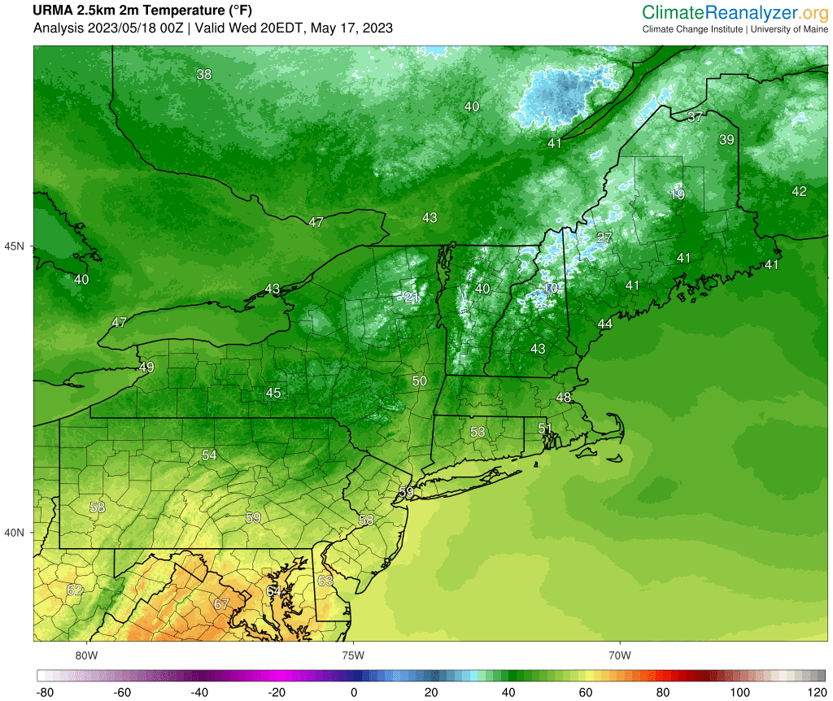
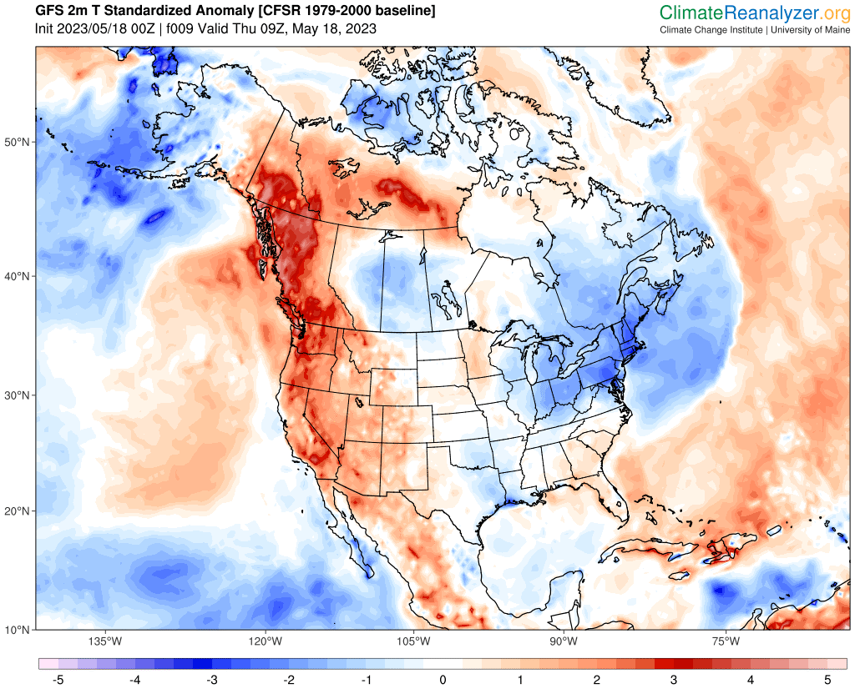
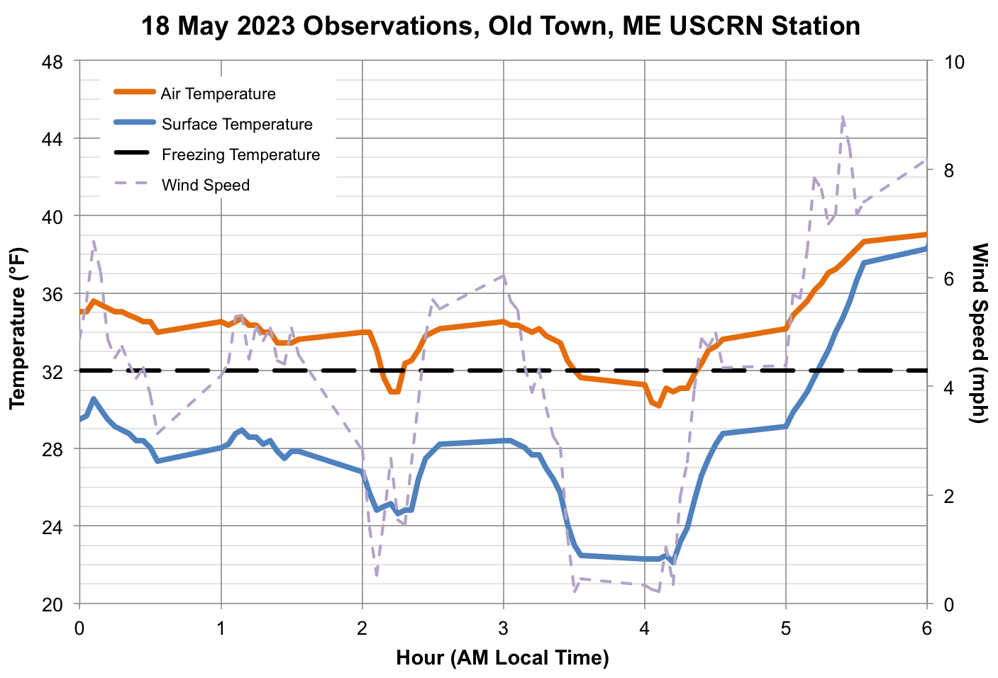
Notable Stats & Extremes 2022 – 2023
Maine Statewide
2nd warmest June–May, 2022–2023
1st warmest January, 2023
3rd warmest DJF, 2023
Gulf of Maine (SST)
1st warmest November, 2022
1st warmest DJF and JFM, 2023
2m T Standardized Anomaly
2-meter Temperature
Extremes
Rainstorm October 14–15, 2022
Record temps November 4–7, 2022
Late season freeze/frost May 18, 2023*
Stalled low pressure / Quebec wildfire smoke June 6–9, 2023*
* Associated with anomalous long-wave pattern over North America
22°F
Notes:
Damaged fruit blossoms and vines

Slide 13
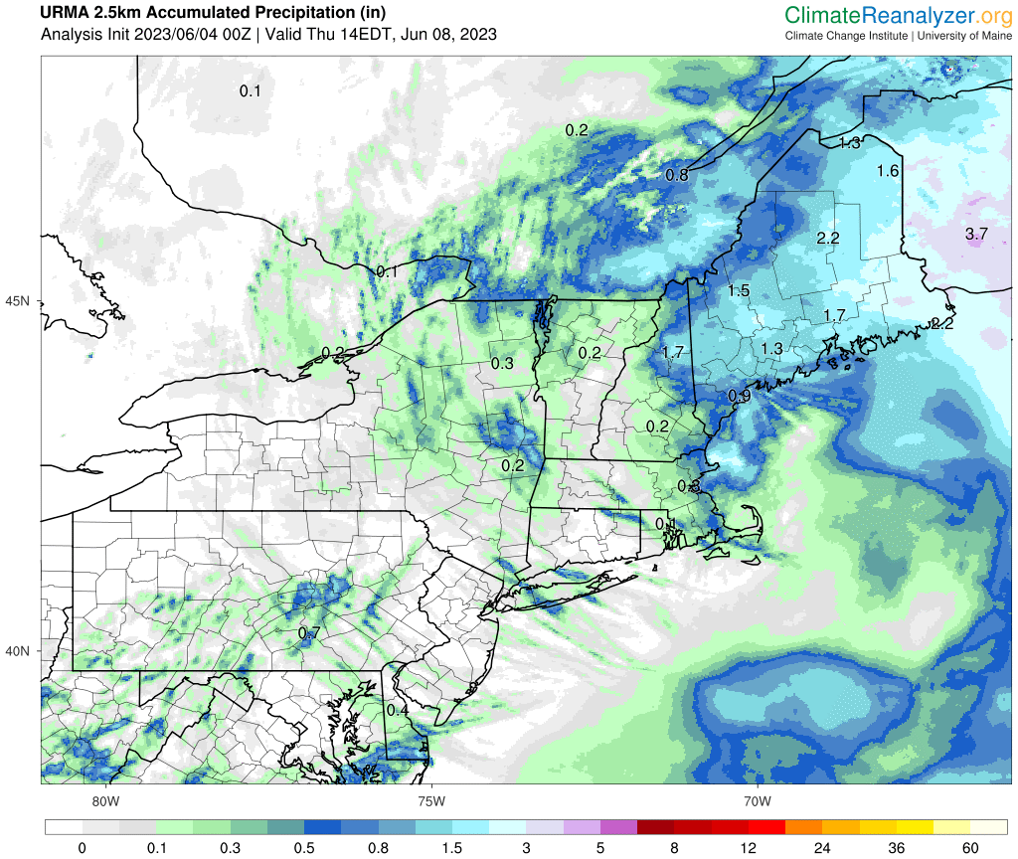
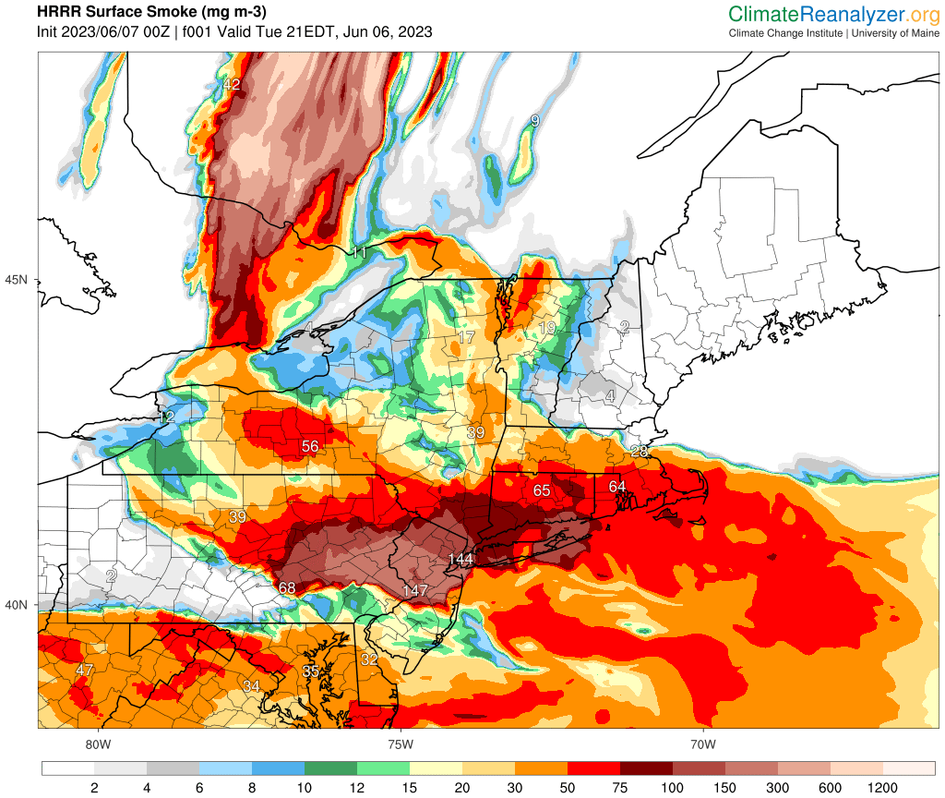
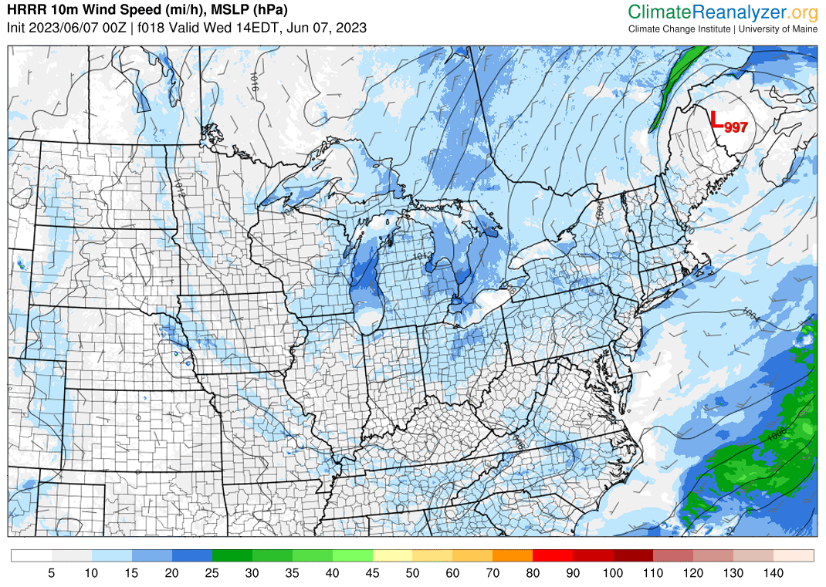
Notable Stats & Extremes 2022 – 2023
Acc. Precipitation
HRRR Smoke
Maine Statewide
2nd warmest June–May, 2022–2023
1st warmest January, 2023
3rd warmest DJF, 2023
Gulf of Maine (SST)
1st warmest November, 2022
1st warmest DJF and JFM, 2023
Extremes
Rainstorm October 14–15, 2022
Record temps November 4–7, 2022
Late season freeze/frost May 18, 2023*
Stalled low pressure / Quebec wildfire smoke June 6–9, 2023*
* Associated with anomalous long-wave pattern over North America

Slide 14
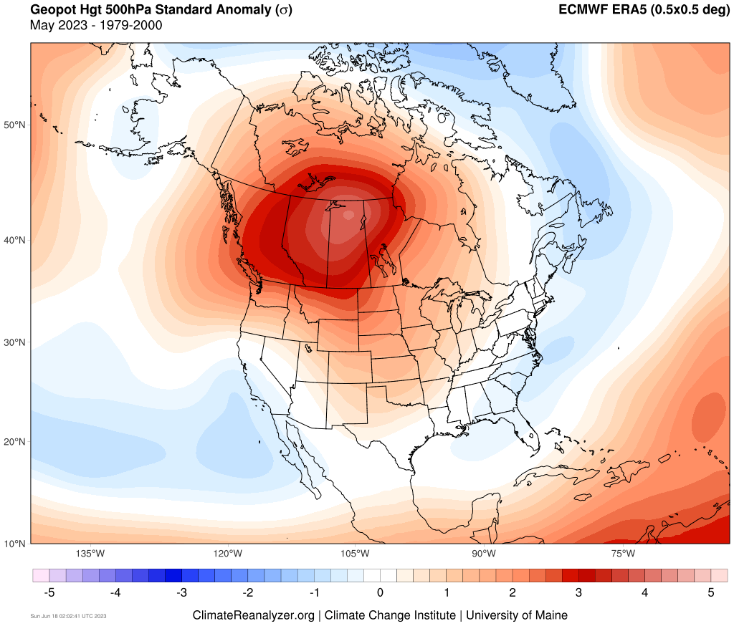
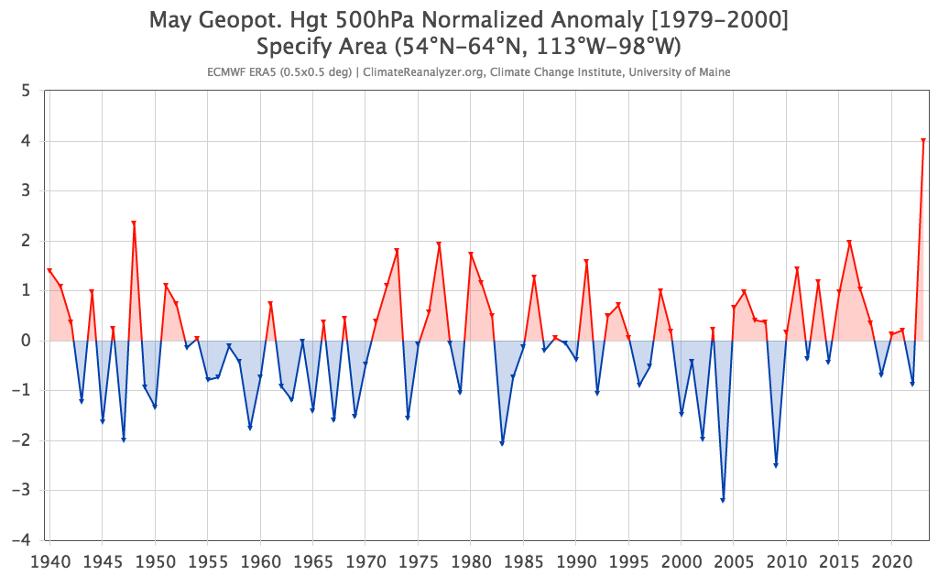
Final thoughts…

Slide 15
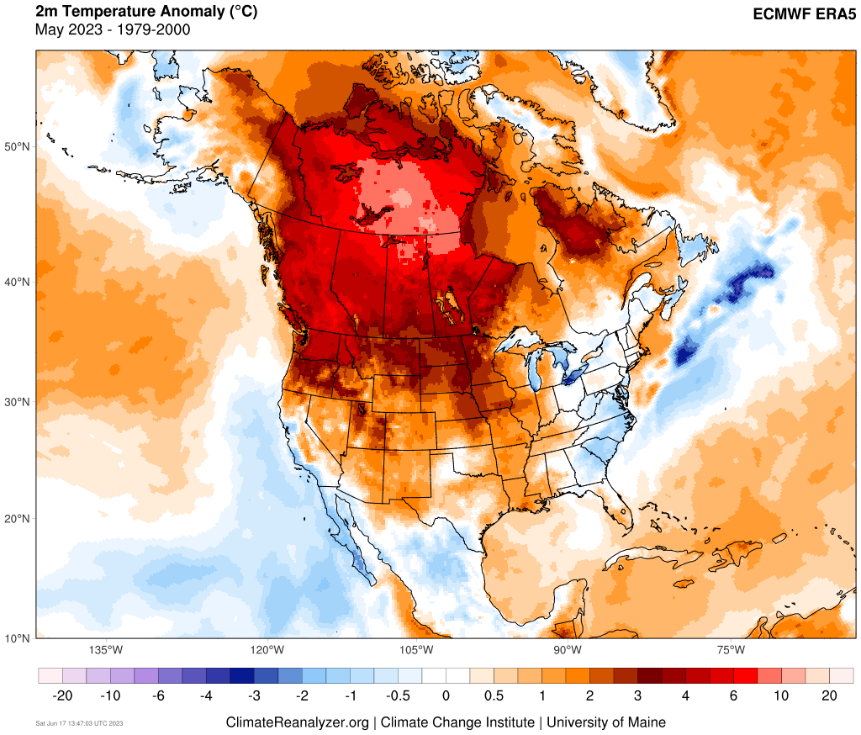
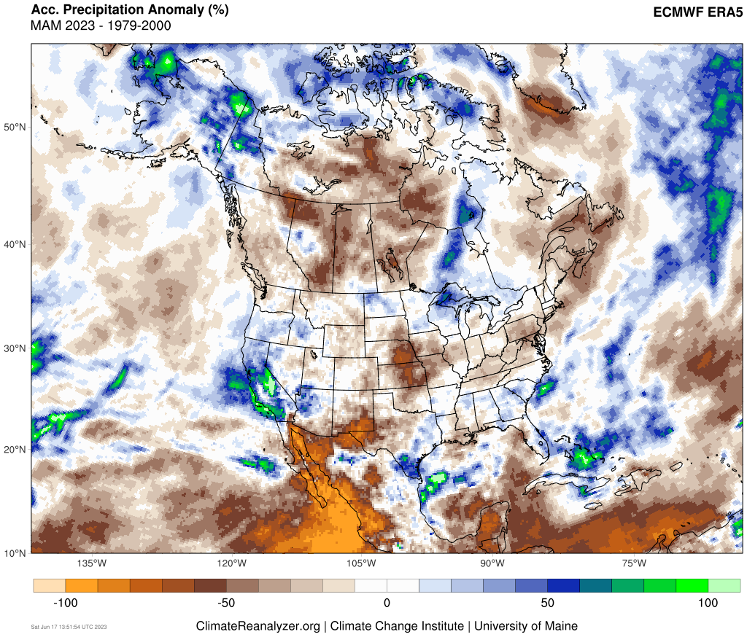

Slide 16
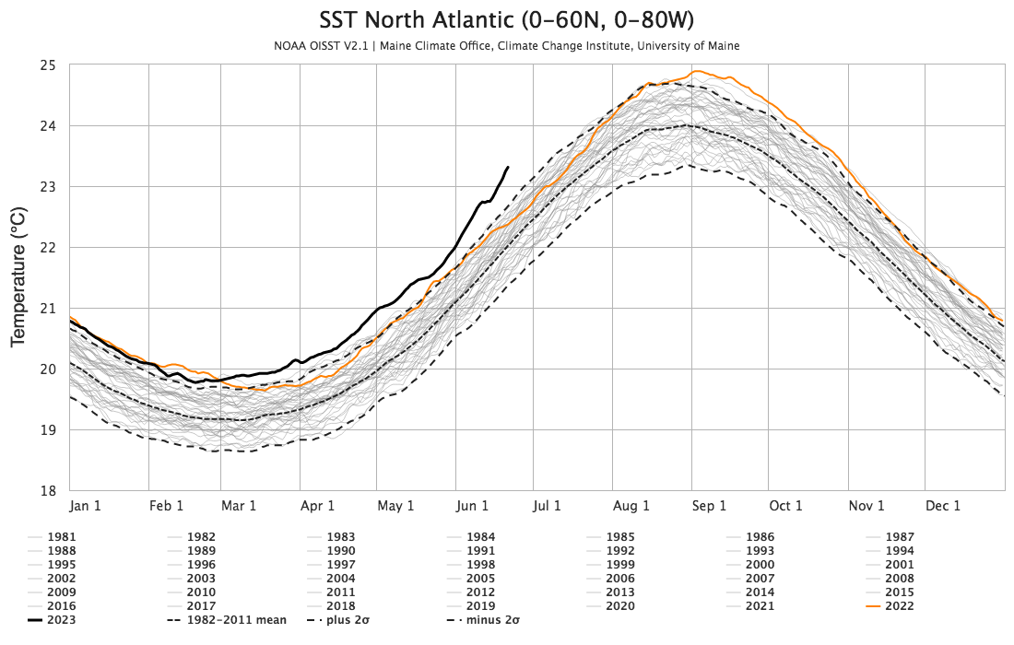
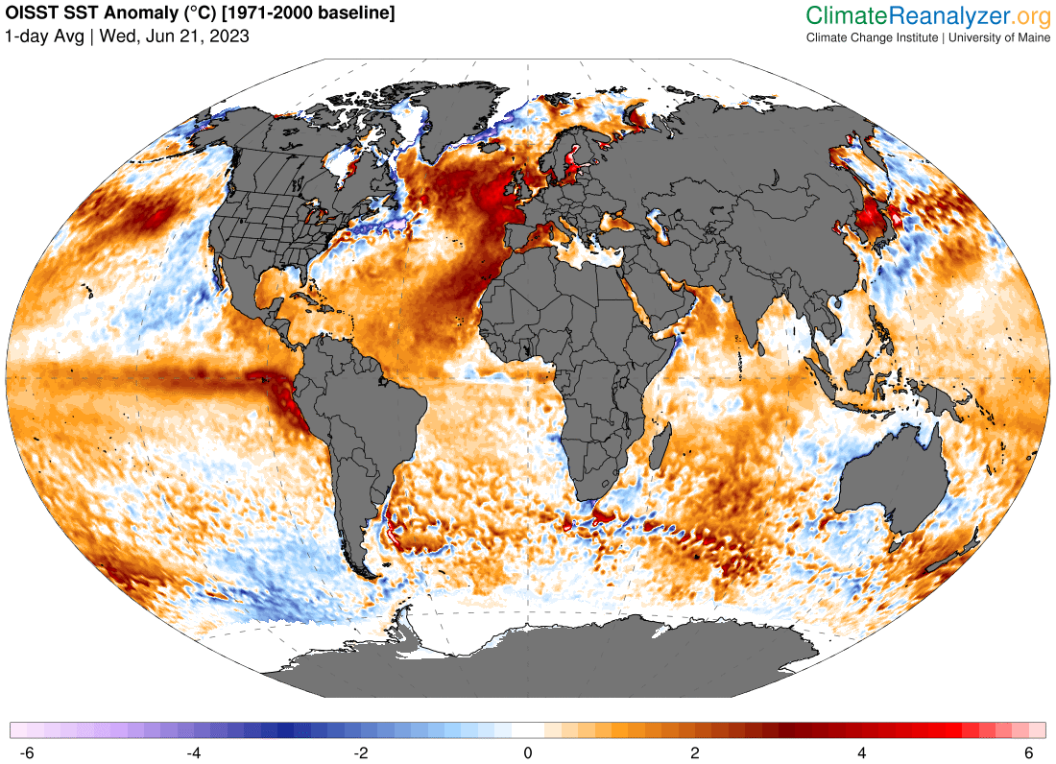
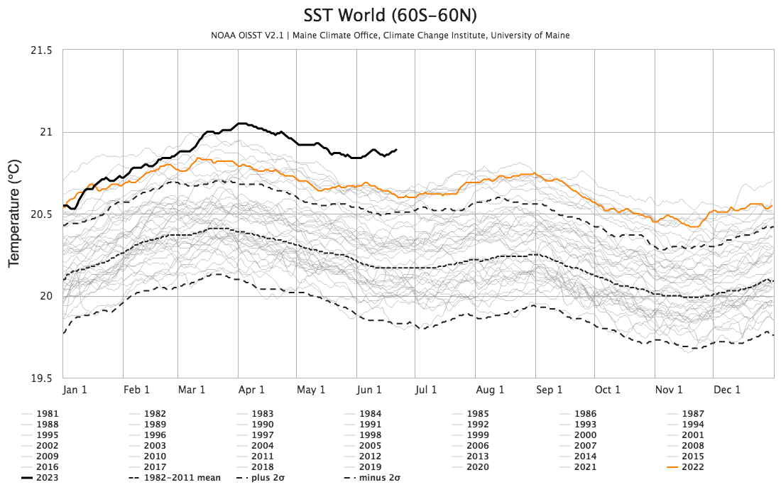

Slide 17
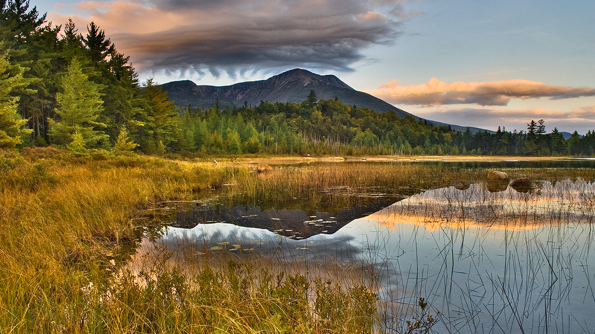


Thank You
Sean Birkel
Assistant Professor
Maine State Climatologist
birkel@maine.edu

