Slide 1
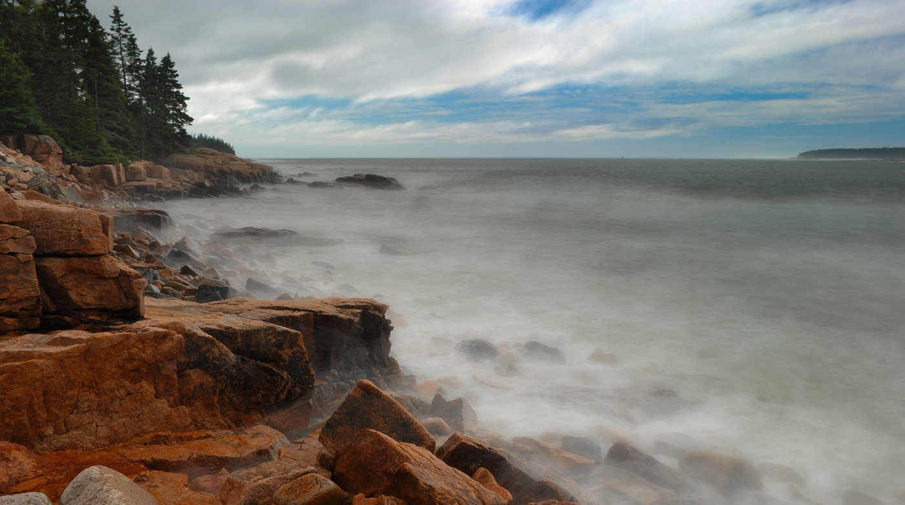


Maine’s Changing Climate
30 March, 2021
Dr. Sean Birkel
Research Assistant Professor
Maine State Climatologist
University of Maine
Climate Change Institute

Slide 2
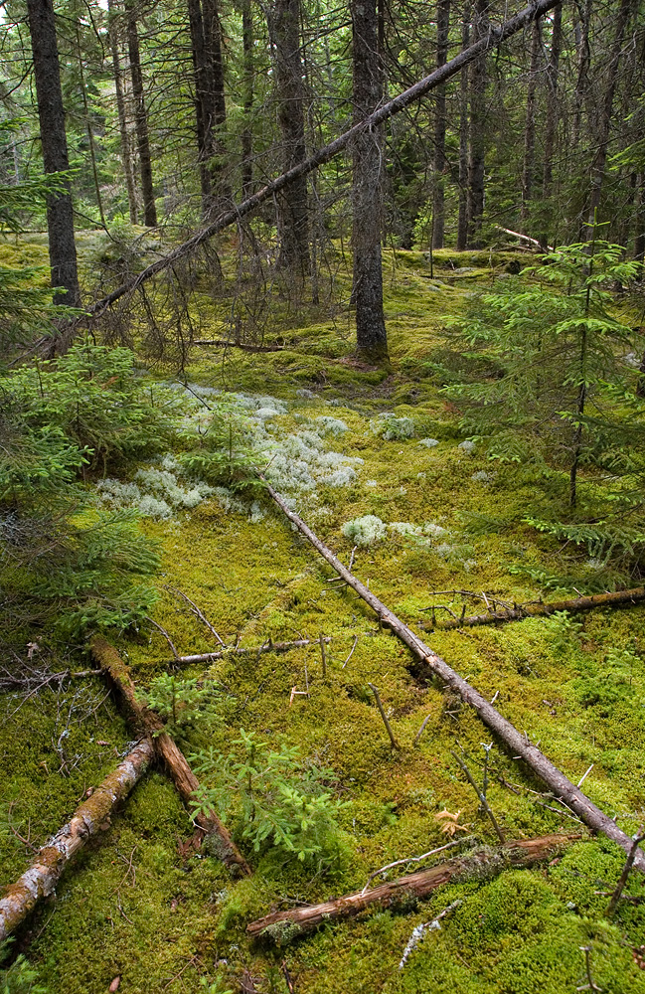
Presentation Outline
Temperature
Season Indicators
Precipitation and Drought
Extreme Weather
Snow and Hydrology
Sea Level Rise

Slide 3
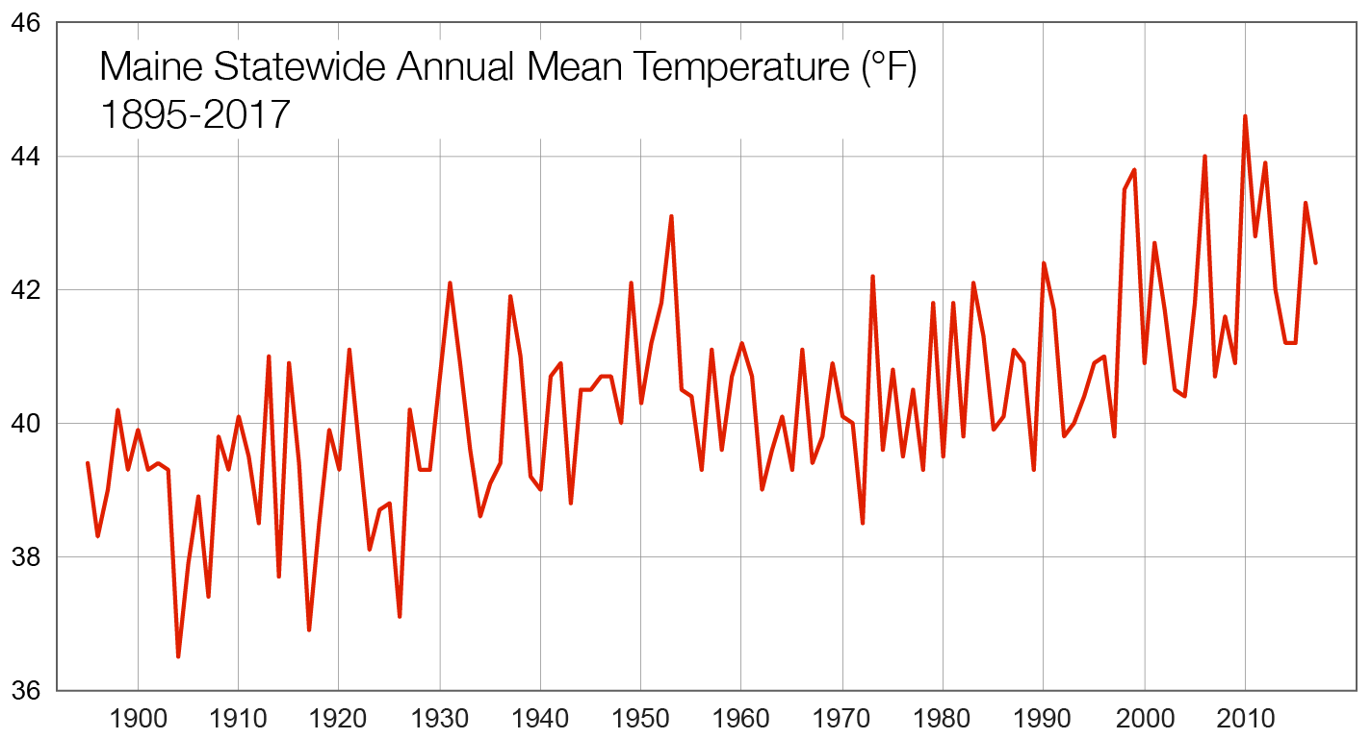
Temperature
+3°F
Fernandez et al. (2020)
Annual increase of 3°F since 1895
Overnight lows have risen more than daytime highs
The six warmest years occurred since 1998

Slide 4
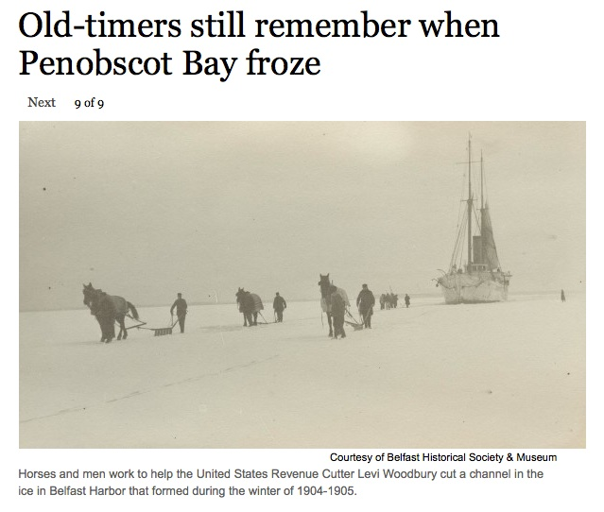
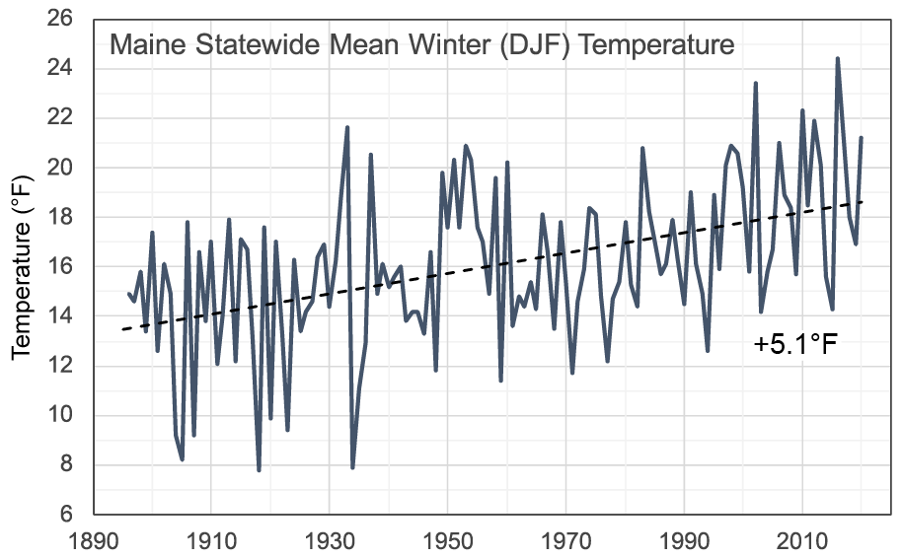
Bangor Daily News, Feb. 19, 2015
Abigail Curtis

Slide 5
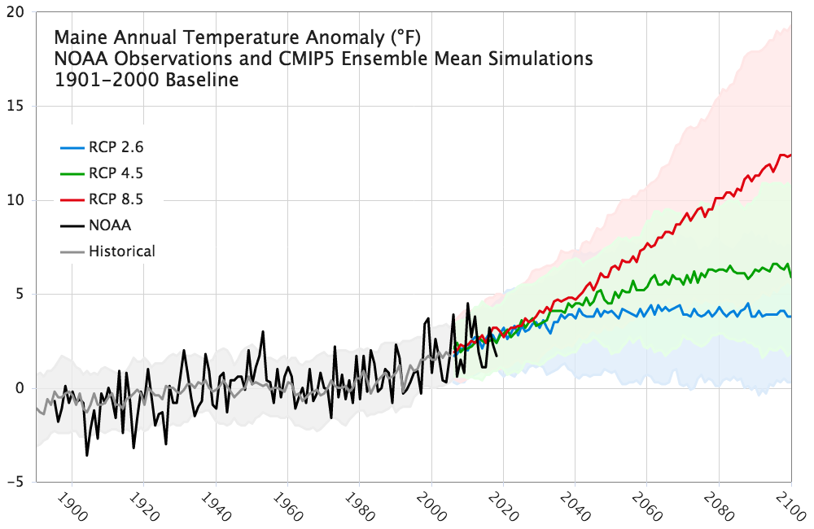
Warming of 2-10°F by 2100 depending on future scenario
High Emissions Scenario
Low Emissions Scenario
Fernandez et al. (2020)

Slide 6
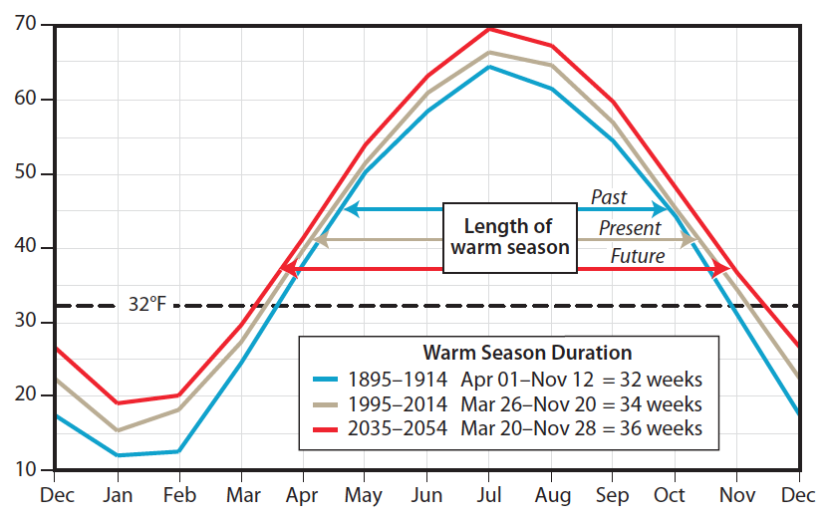
Season Lengths are Changing
Statewide Mean Monthly Temperature Cycle (°F)
Summer is longer and winter is shorter than a century ago.
Since 1950, the growing season has lengthened by ~16 days (Fernandez, 2020).
Summer weather & growing season extension mostly into fall.
Trends projected to continue, but some years will bring unexpected late spring or early fall frosts.
Photo: Tori L. Jackson
Fernandez et al. (2015)

Slide 7
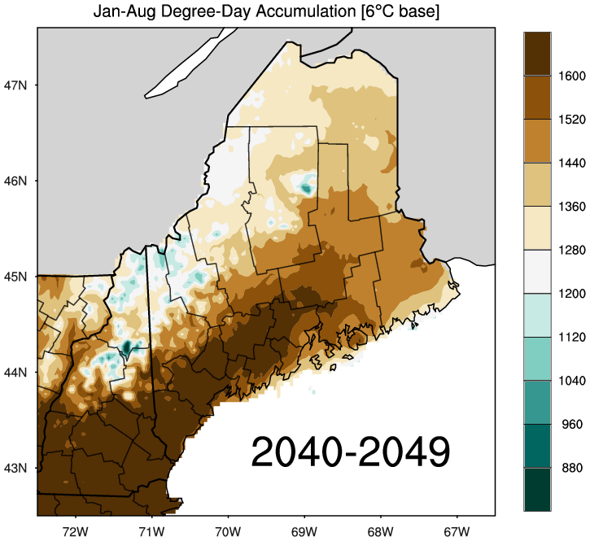
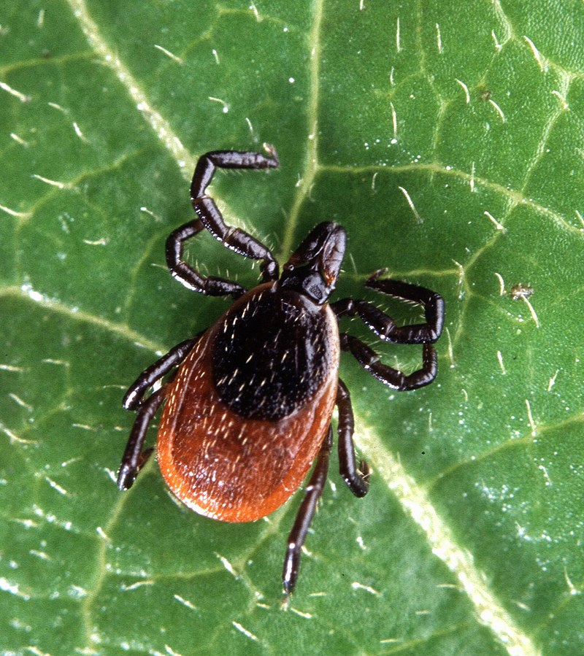
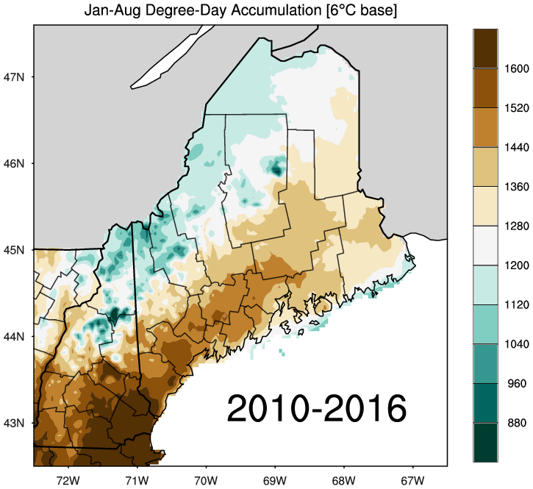
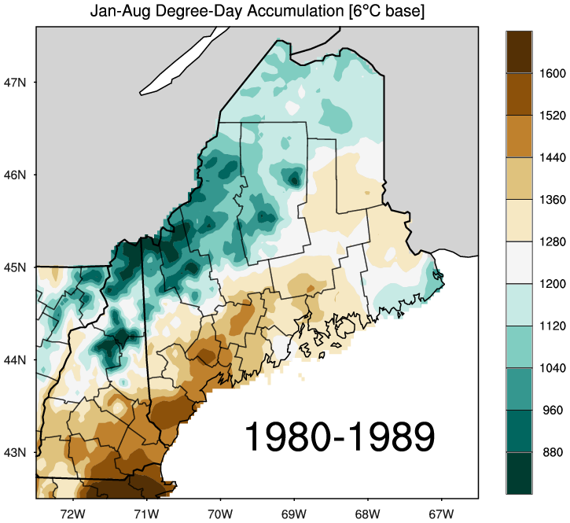
Longer summers and shorter winters drive habitat expansion for black-legged tick
Projected 1 °C (1.8 °F)
warming compared to 2010-2016
Larval emergence and tick survival requires ~1240 degree days (6°C baseline).

Slide 8

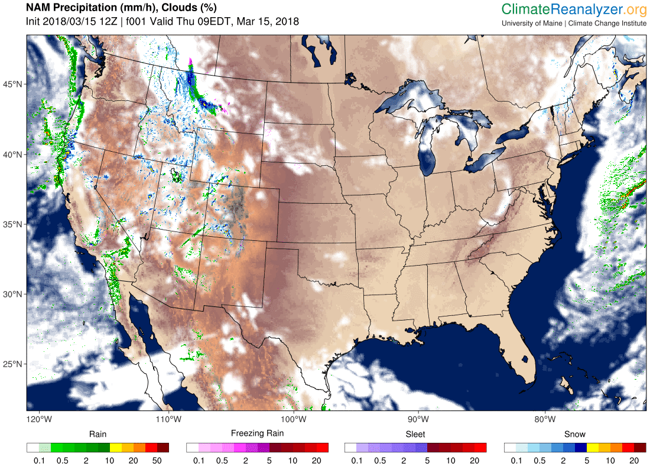
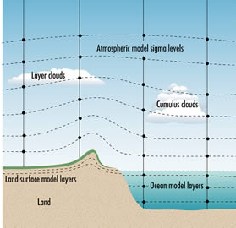
Future climate is projected using physics-based models of the atmosphere, ocean, cryosphere, and biosphere. The model climate can be perturbed by changes in GHG emissions, volcanic activity, solar output, and other factors.
www.bom.gov.au/info/GreenhouseEffectAndClimateChange.pdf

Slide 9
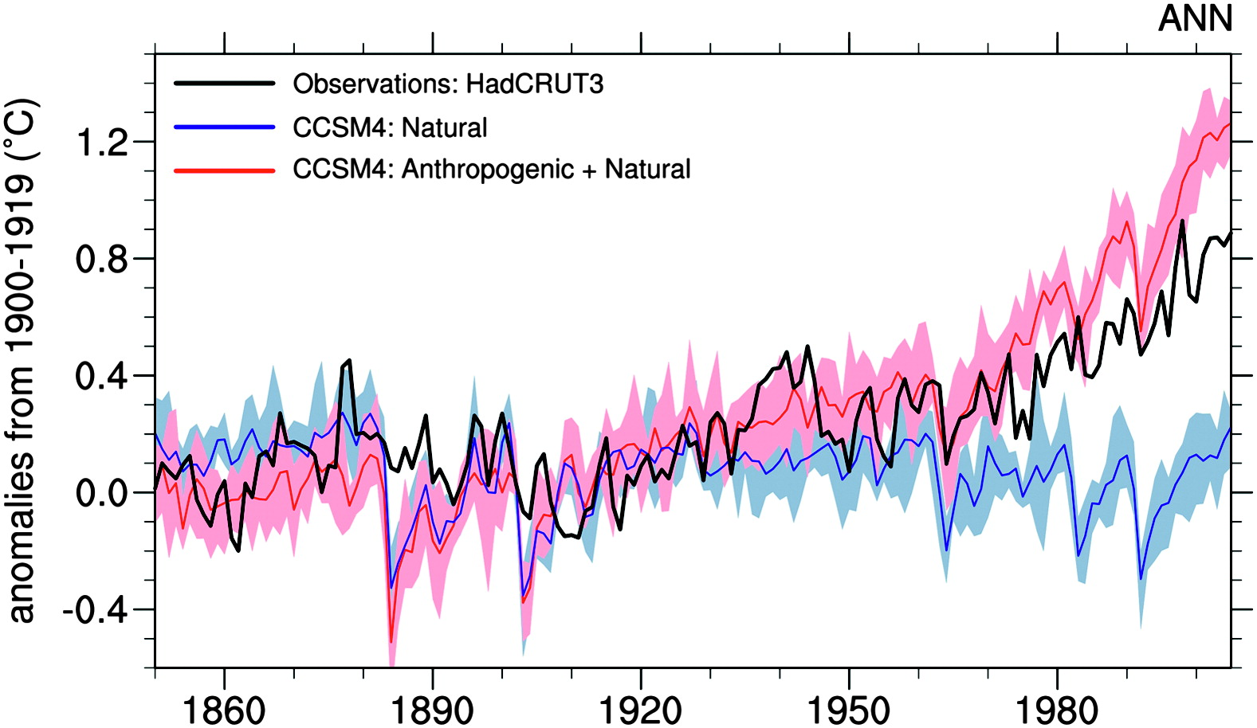
Natural forcings cannot account for the
observed warming since at least 1960
Meehl et al, 2012

Slide 10
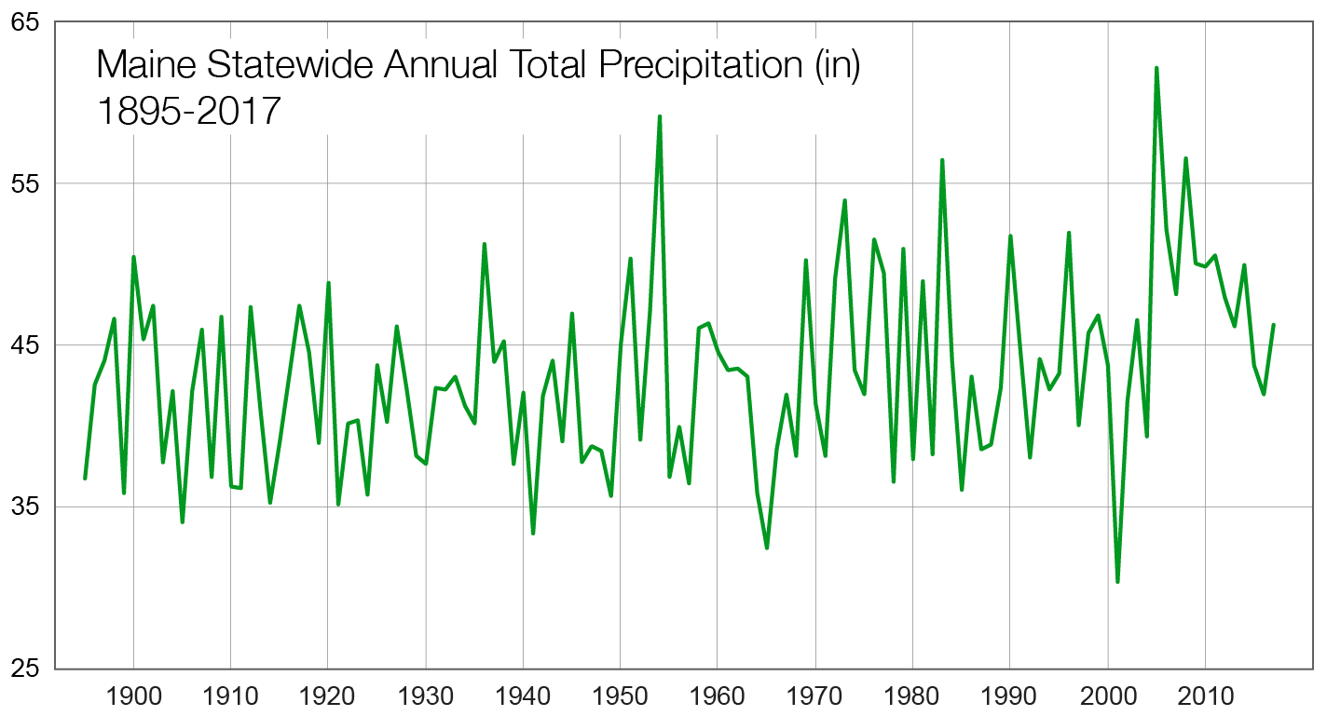
Precipitation & Drought
Maine’s annual precipitation increased 6” since 1895. Largest increase last 20 years.
Trend expected to continue.
Drought occurrence has not increased, but rising temps can exacerbate droughts that develop.
Uncertain whether intermittent drought will be or more or less likely in the future.
+ 6 in
Fernandez et al. (2020)

Slide 11
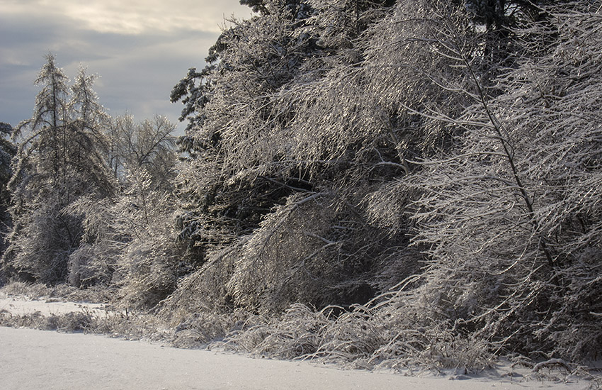
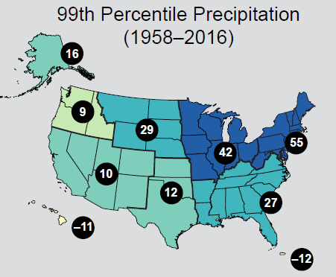
Extreme Weather
Extreme weather becoming more common around the Northern Hemisphere due to changes in atmospheric circulation.
Increased likelihood of heat/cold waves, intense storms.
Large increases (55%) in annual heavy daily precipitation across the USNE.
In Maine, the last 10-15 years have seen the highest occurrence of 2”, 3”, and 4” precipitation events (Fernandez et al., 2020).
Easterling et al., 2017

Slide 12
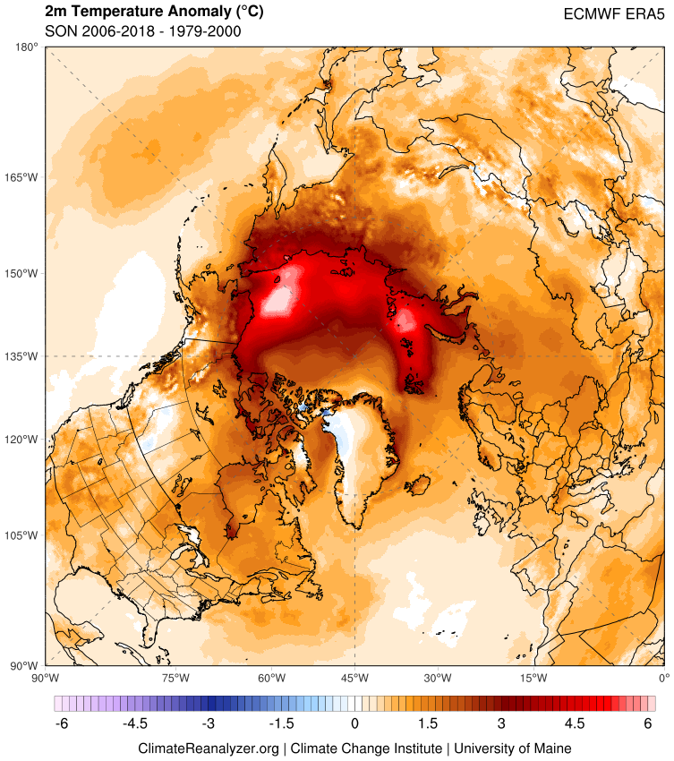
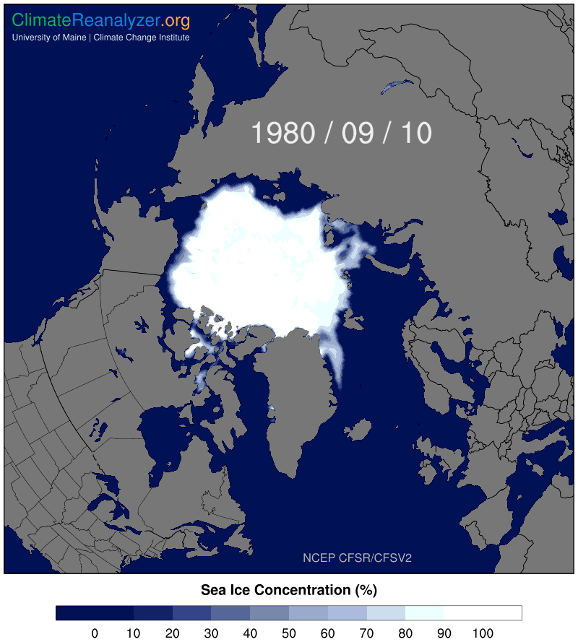
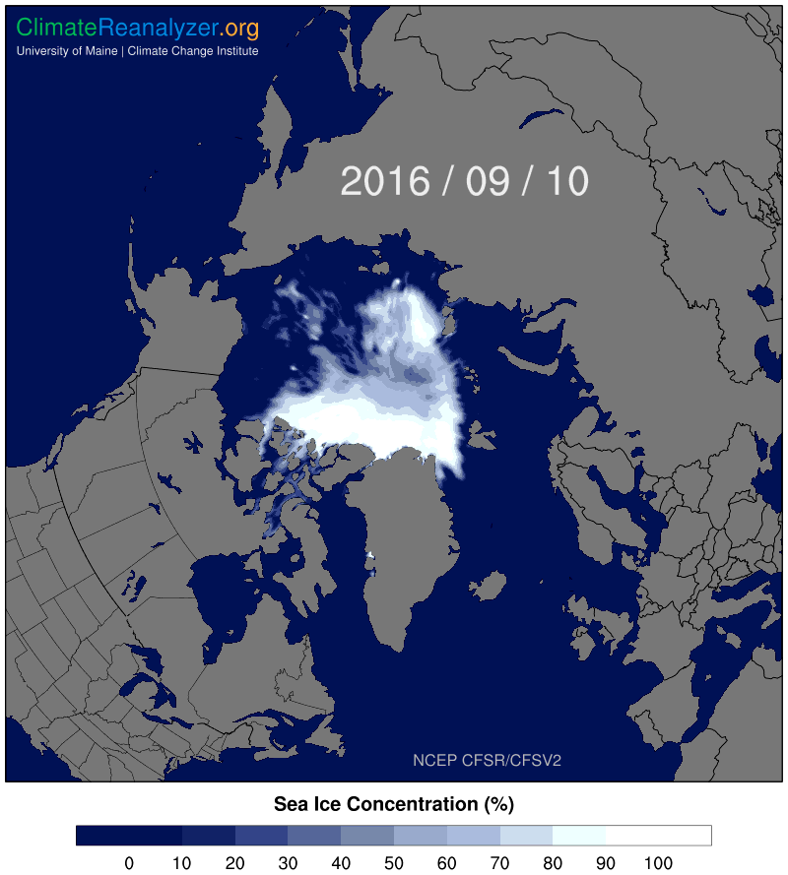
What is driving extreme weather events?

Slide 13
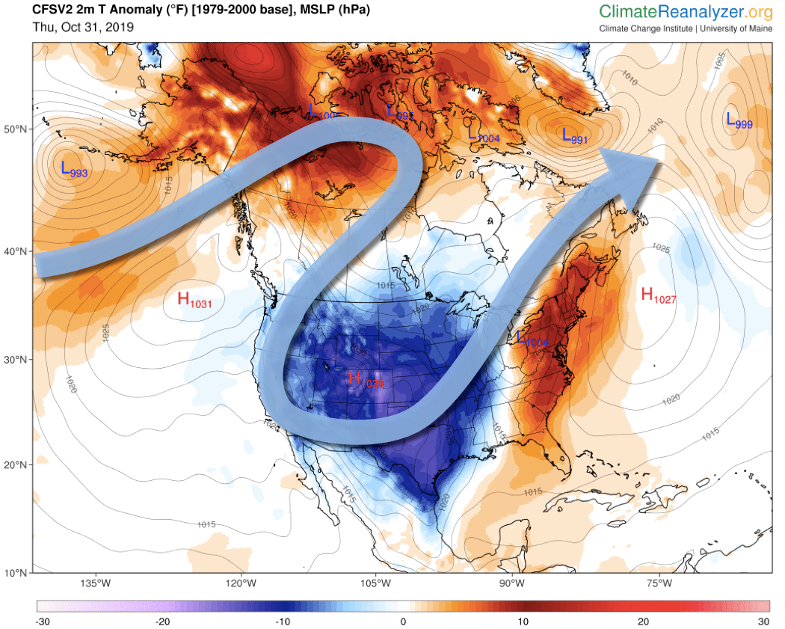
Temperature anomaly and Jetstream
Wind Storm
Nov 1, 2019

Slide 14
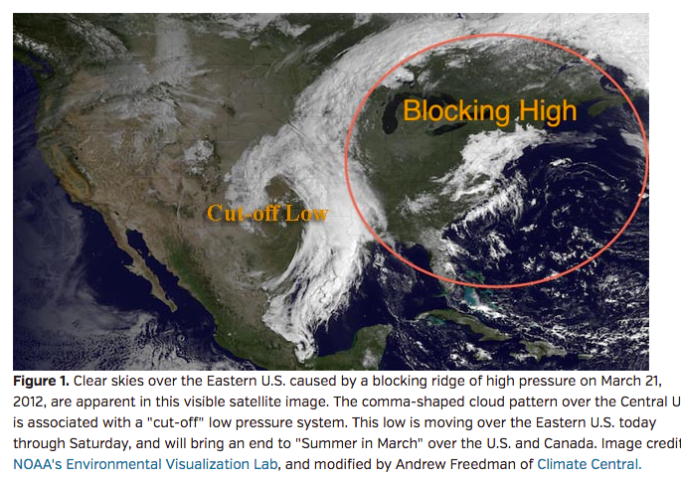
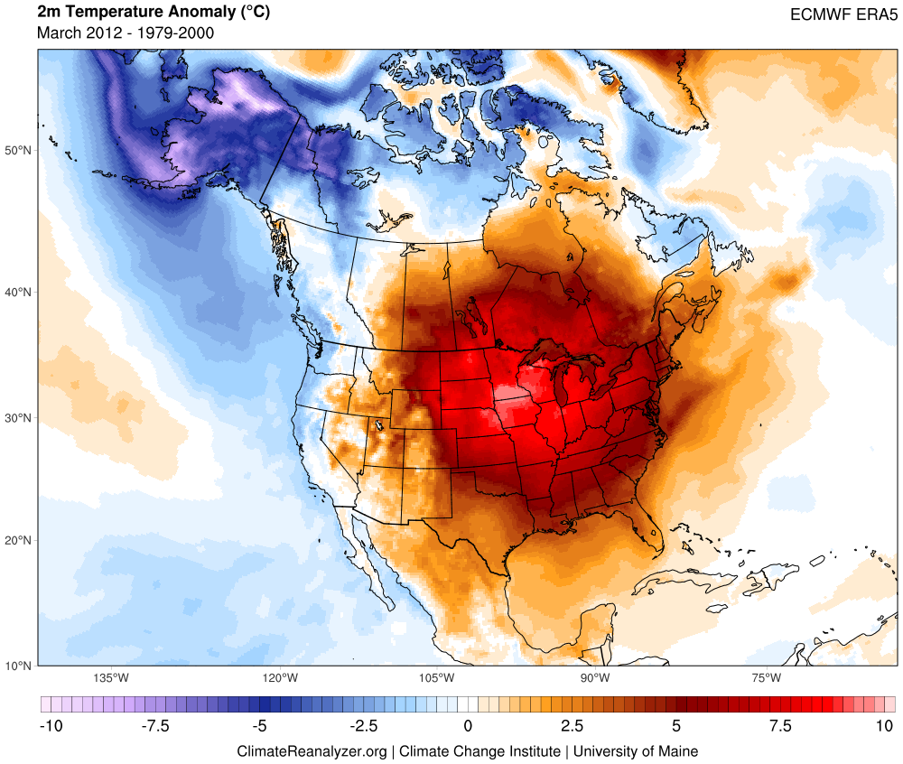
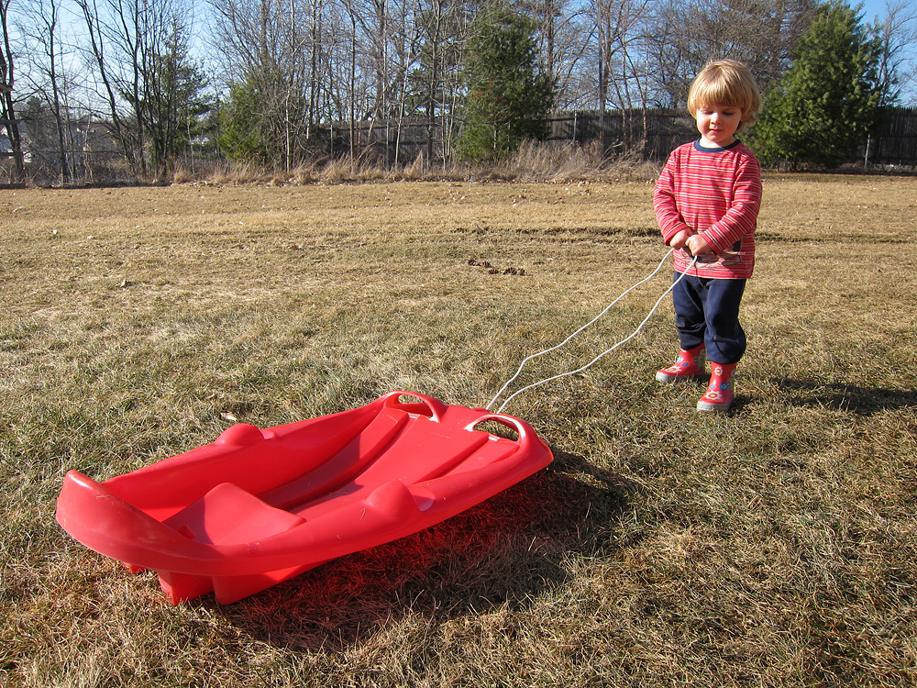
Summer in March, 2012
Temperatures into the 80s across southern half of Maine 22-23 March with no historical equivalent.
Farmington 83°F March 23rd – a daily high record set by 17°F!
18 March, 2012

Slide 15
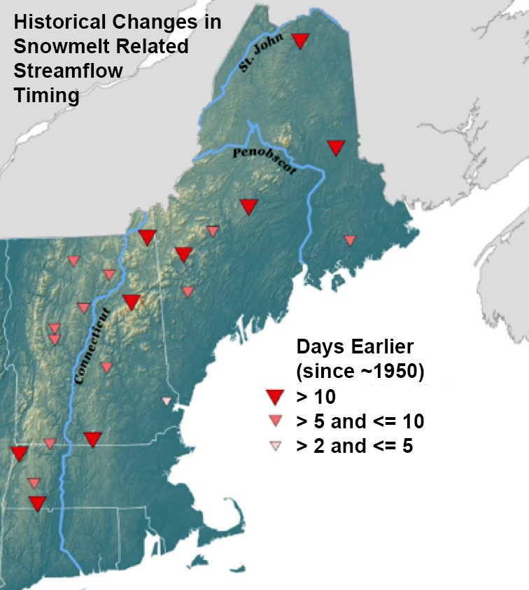
Maine’s Snow is
Melting Earlier
Trend toward earlier winter-spring melt runoff
  7-14 days earlier than ca. 1950
  Related to small increases in February–May air temps
Trends projected to continue
  Hayhoe et al., 2007;
  Demaria et al., 2016b
Dupigny-Giroux et al., 2018
Dudley, Hodgkins, et al., 2017

Slide 16
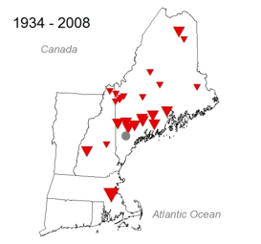
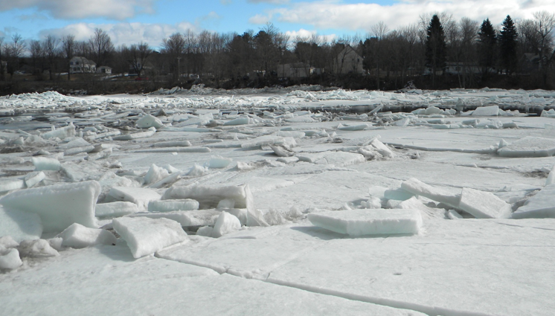
Ice-Out on Maine Lakes is Occurring Earlier
USGS Photo
Hodgkins, 2013

Slide 17
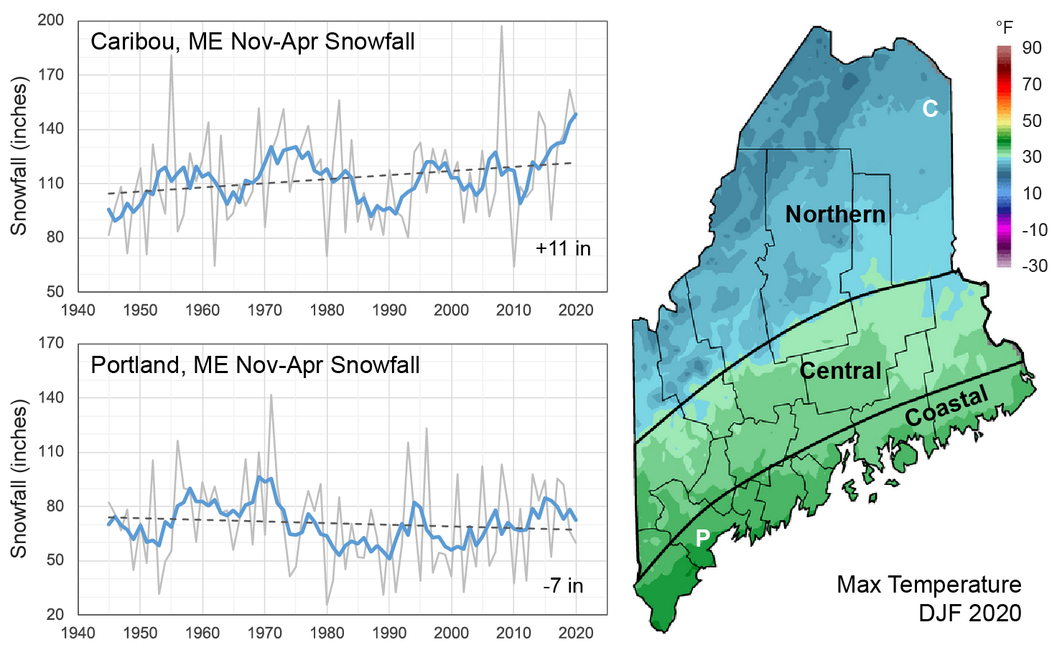
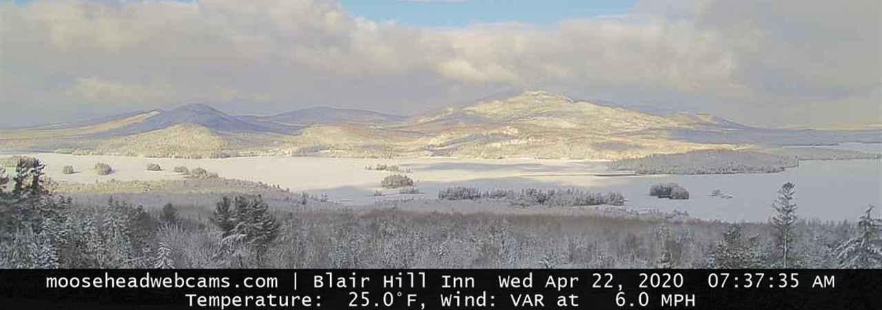
However…
Despite the overall warming trend, variability can bring unexpected cold winters (e.g., 2013/14 and 2014/15), and occasional very good snow seasons.
This is especially true in the northern climate division owing to the steep S-N temperature gradient across the state.

Slide 18
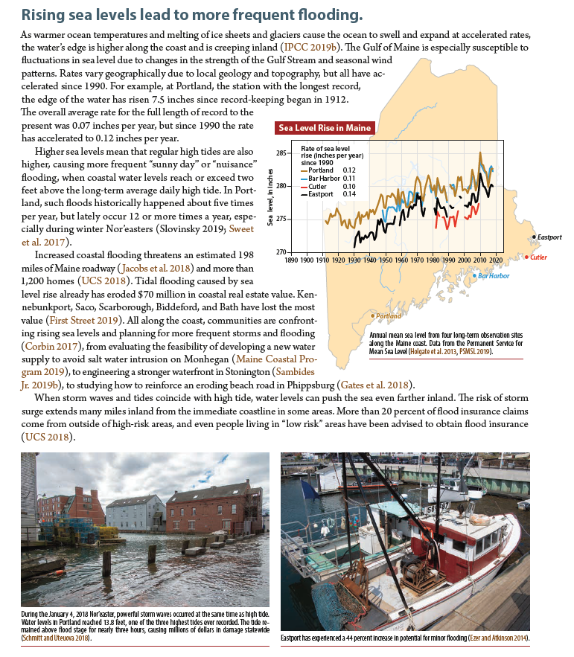
Sea Level Rise
Sea level has risen about 7.5 inches along the Maine coast over the past century.
High tide “nuisance” flooding becoming more common in some places.
Increased coastal erosion.
Changes to coastal habbitats, namely salt marshes.
Concerns about salt-water intrusion in drinking water supplies.
Maine’s Climate Future 2020 Update
Fernandez et al. (2020)

Slide 19
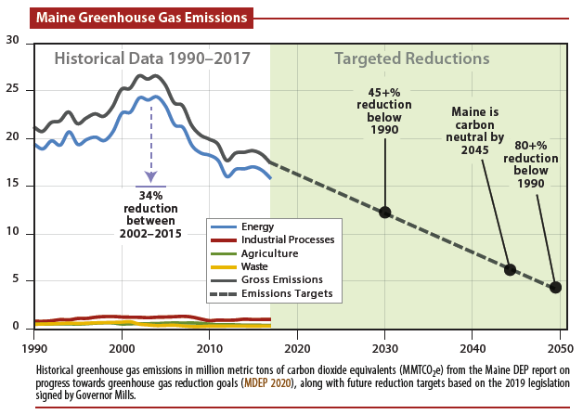
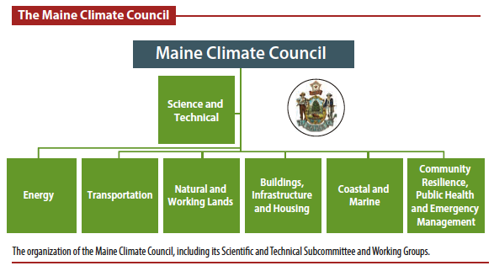
Action in Maine
In 2019, Maine joined the now 25-member U.S. Climate Alliance.
  Commitments to reduce GHG emissions to ~26% below 2005 levels by 2025.
Bills signed into law to reduce GHG emissions by enhancing renewable energy, and to establish the Maine Climate Council (MCC).
  The MCC developed an integrated Maine Climate Action Plan in 2020 called MAINE WON’T WAIT.
  Critical goals for reducing annual emissions in Maine by 45% below 1990 levels by 2030, and 80% percent below 1990 levels by 2050
Fernandez et al. (2020)

Slide 20
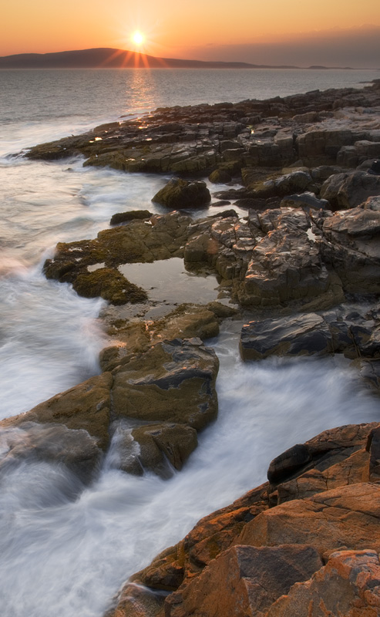
Thank You

Slide 22
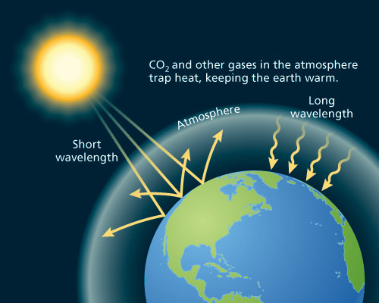
The Greenhouse Effect
http://www.oxfordpresents.com/ms/krohne/global-warming-and-ecological-communities/

Slide 23
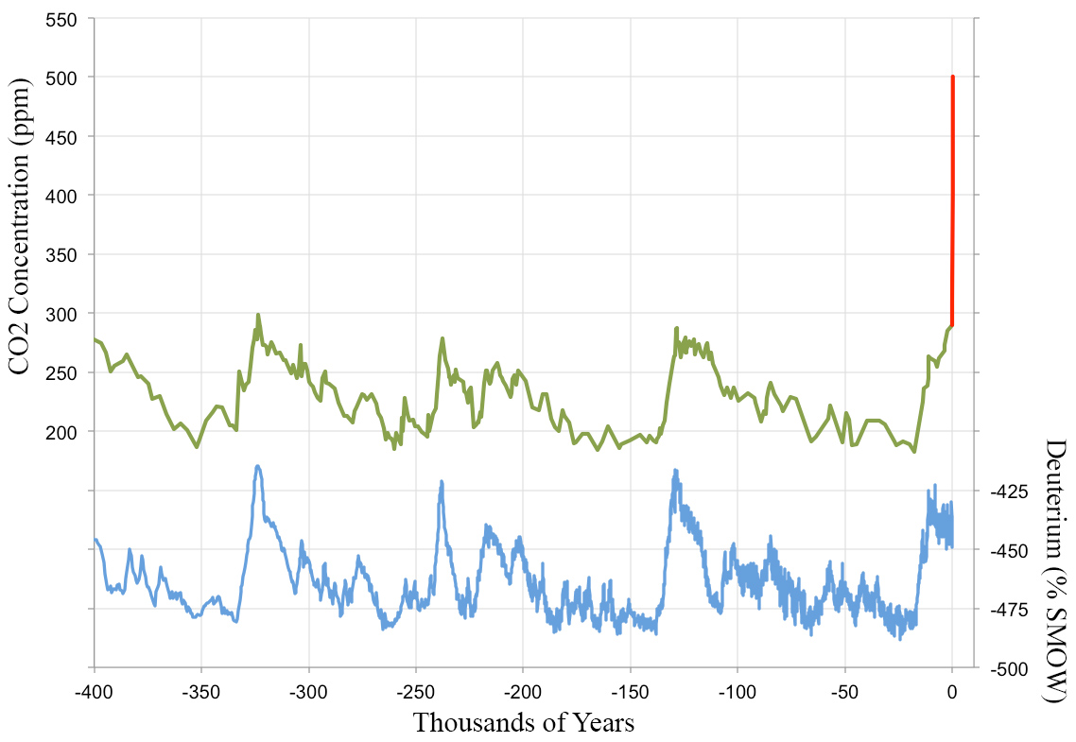
Ice Core Record
Vostok Station, Antarctica
Mauna Loa Observations
500 ppm 2100
400 ppm 2015
Warm
290 ppm Natural
Cold

Slide 24
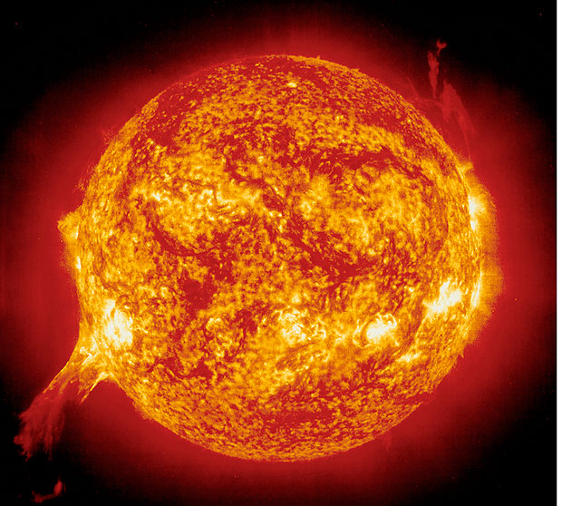
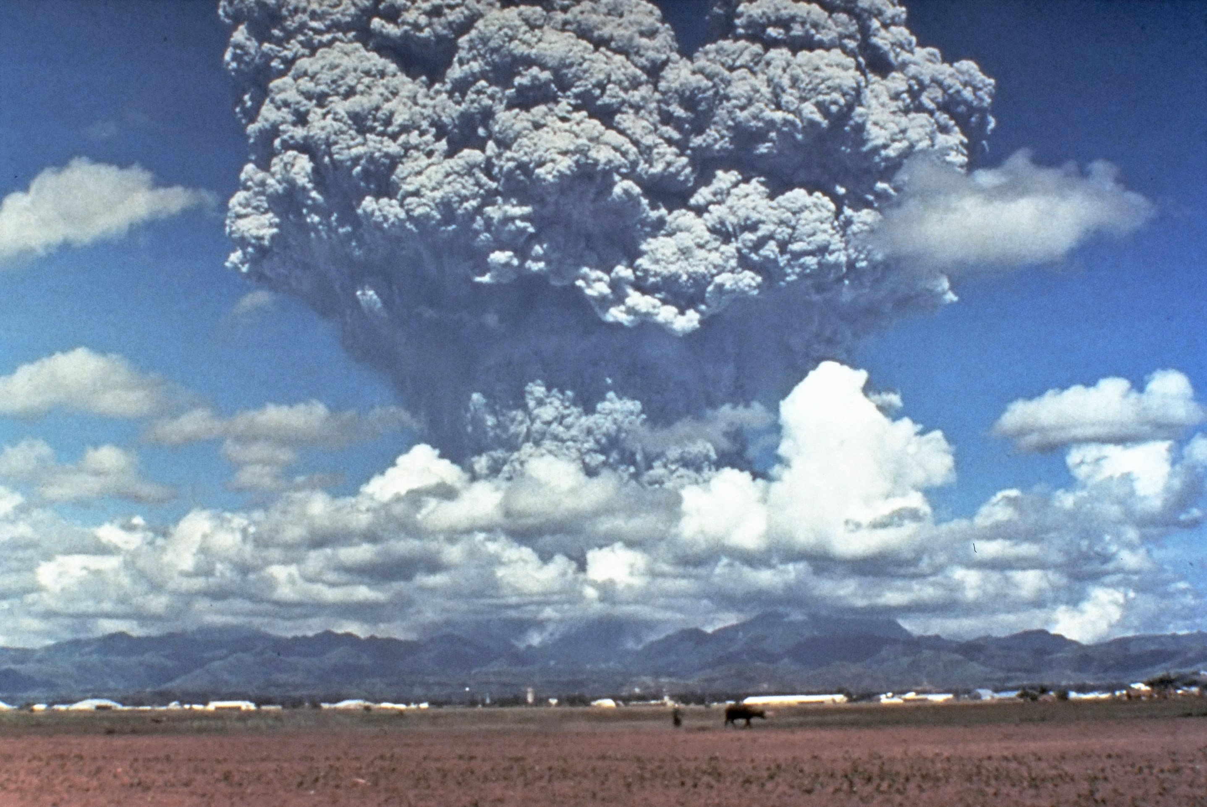
Solar Variability
Dynamical Feedbacks
Volcanic Eruptions
Mt. Pinatubo, 1991
https://upload.wikimedia.org/wikipedia/commons/4/4e/Pinatubo91eruption_plume.jpg

Slide 25
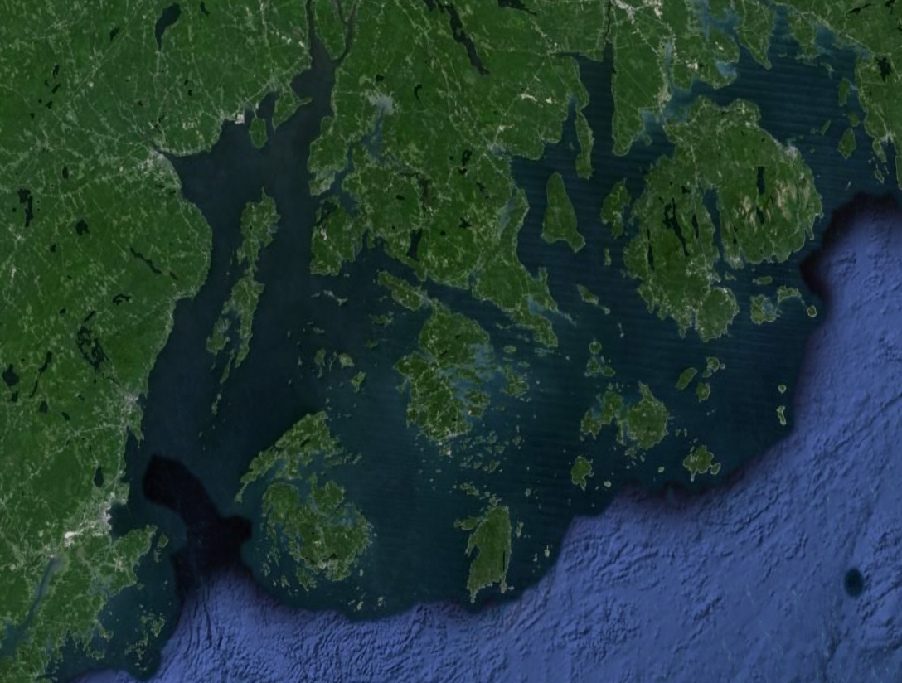
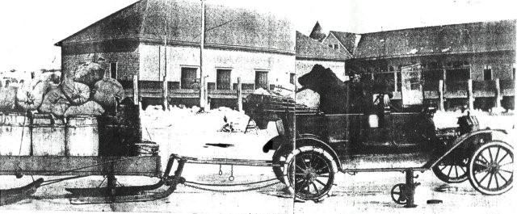
Belfast
Captain Albert Gray
12 miles by ice from Harborside to Belfast in a Ford Pathfinder
Frenchman Bay
Brooksville
Islesboro
“Belfast, Feb 24 – Automobiling [sic] across the bay from Brooksville and the Castine has come to be a regular thing now. The pathfinder Ford which made history Friday by being the first car to cross the bay on the ice, made four trips Saturday to Brooksville, towing a horse-sled loaded with over a ton of grain and provisions and making the 12 miles across in about 25 minutes. The car took to the ice at Goose Falls, or Harborside, and same across to Turtle Head, then up the Belfast harbor…Other cars came over Sunday and Penobscot Bay turned into something of a boulevard. (Bangor Daily News, Feb. 1918)”
Vinalhaven
Rockland
http://gen3antiqueauto.com/bayfroze.htm

Slide 26
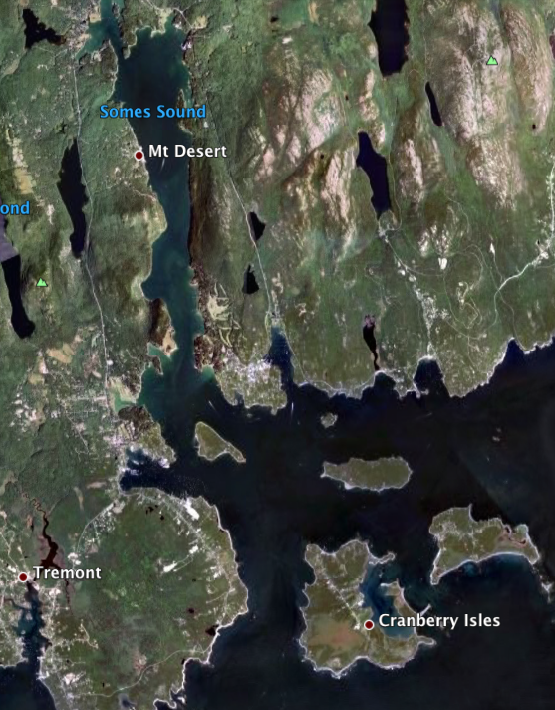
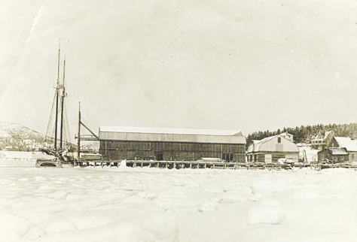
“Branscom’s Coal and Wood wharf in the winter of 1923, the last year all of Somes Sound and the Great Harbor froze over, making it possible to walk to Islesford.”
Maine Memory Network
Somes Sound
Great
Harbor
Islesford
NOAA Climate Division Dataset
Cranberry Isles

Slide 27
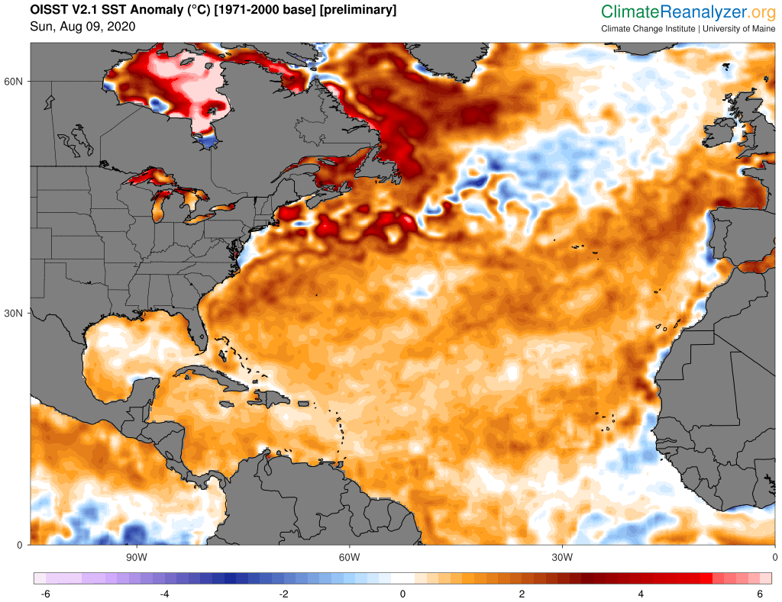
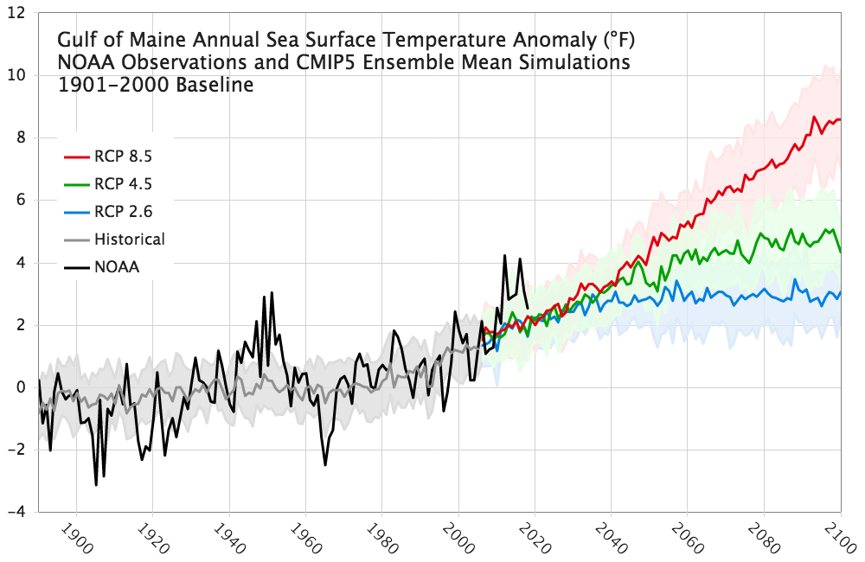
Gulf of Maine
Sea Surface Temperature
SST Anomaly, 8/9/2020
High Emissions Scenario
Warming of 1-6°F by 2100 depending on future scenario
Low Emissions Scenario
NOAA OISST v2.1
Warming affecting fisheries (e.g., lobster and cod), and marine flora such as kelp.
Ocean acidification could impact shellfish.
Fernandez et al. (2020)

Slide 28
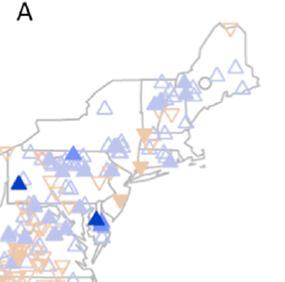
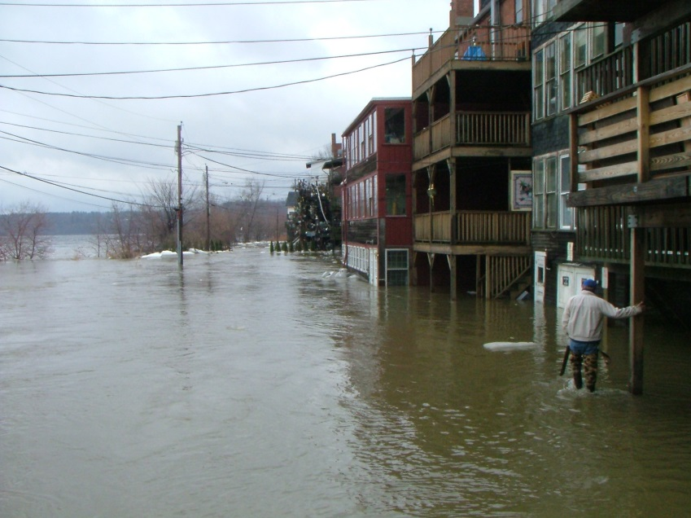
Increasing Magnitude & Frequency of Small Floods
1941-2015 (75 yrs): average 29% increase
1966-2015 (50 yrs): average 19% increase
Blue triangles, increases
Brown triangles, decreases
Open symbols, < 25%
Light solid, 25-50%
Medium solid, 50-75% Dark solid, > 75%
April, 2005, Hallowell, ME
USGS Photo
Hodgkins, Dudley, et al., 2019

Slide 29
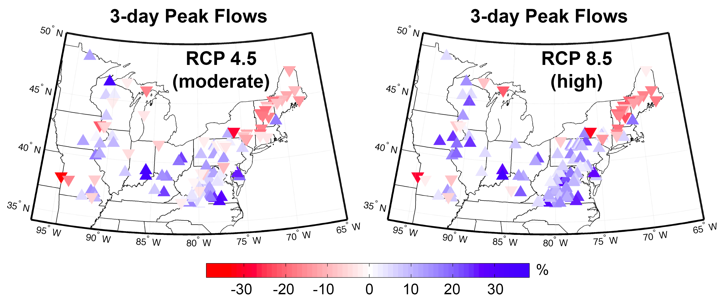
100-year, 3-day Peak Flows are Projected to Decrease
Demaria et al., 2016
Likely linked to decreasing late winter snowpack

Slide 30
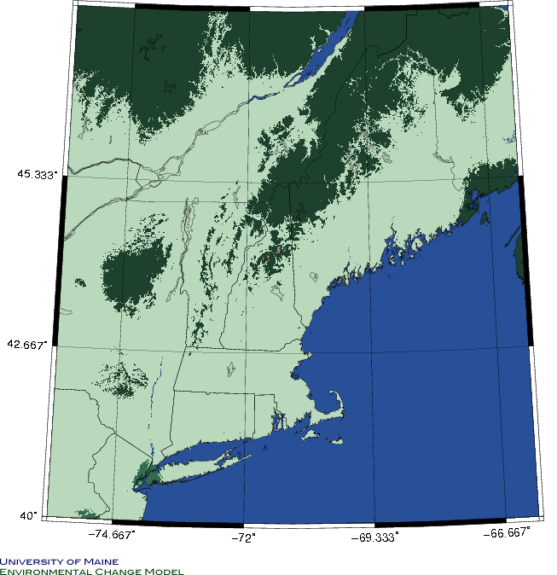
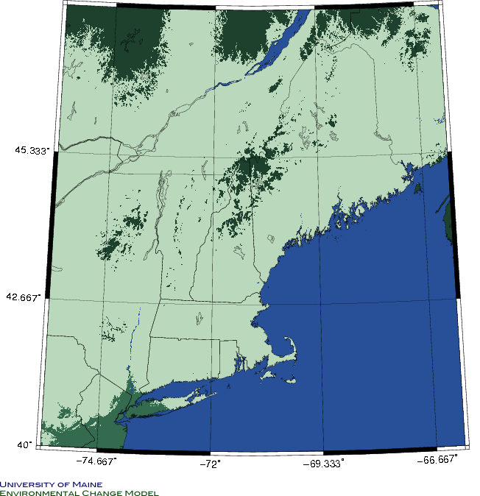
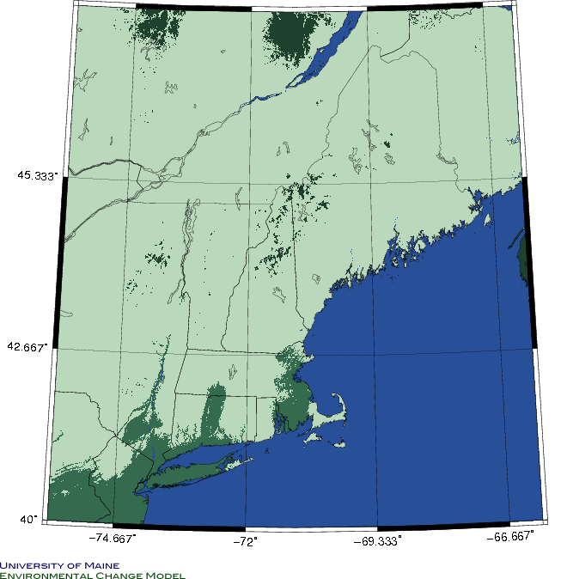
Boreal
Mixed
Broadleaf
1850
2000
Forest Biomes will shift northward over next couple hundred years
Future
Potential Equilibrium Biomes
UMaine Environmental Change Model

