Slide 1
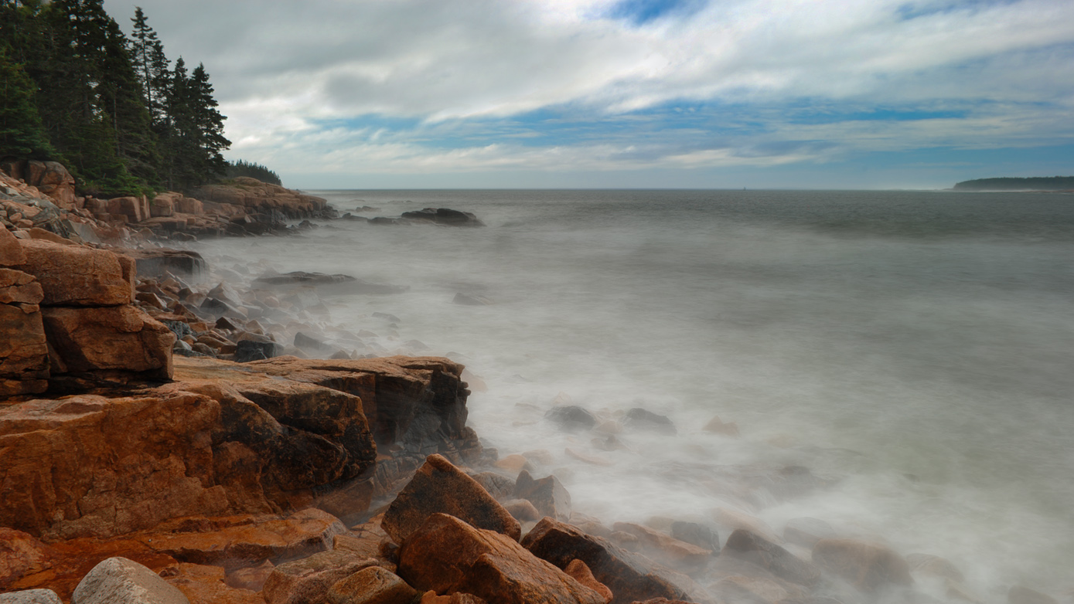


Arctic-Maine Climate Connections
SAUNNA NRT Retreat
17 September, 2021
Sean Birkel
Research Assistant Professor
Maine State Climatologist

Slide 2
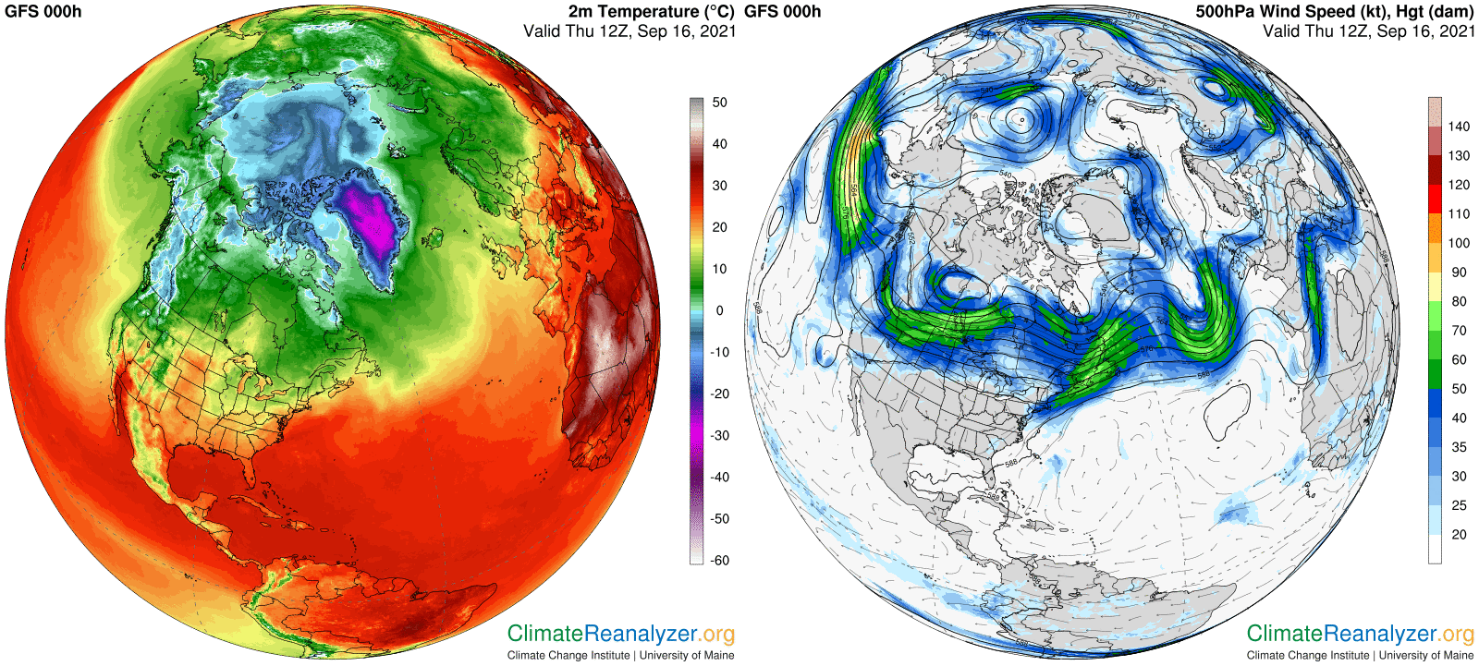

Slide 3
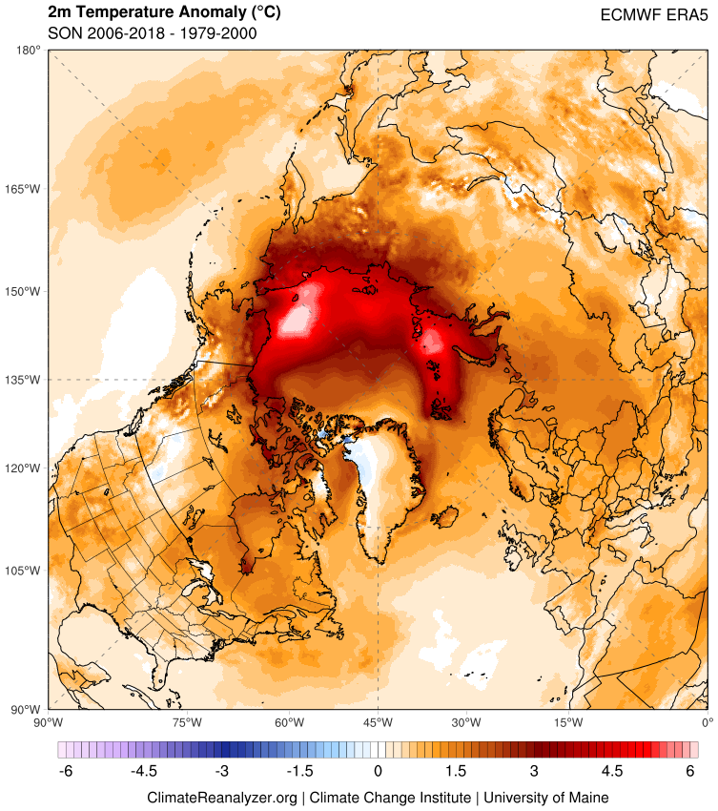
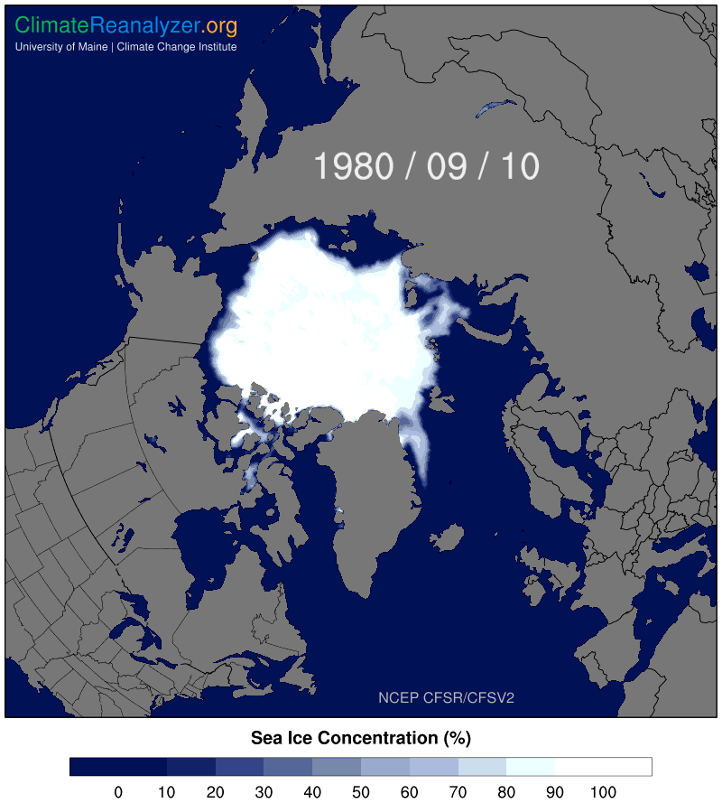
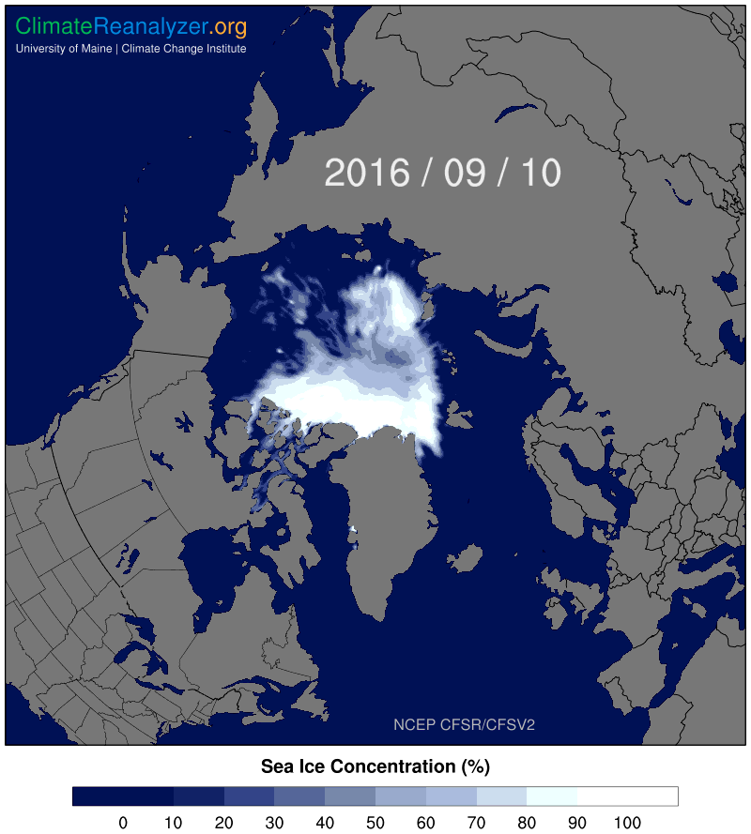

Slide 4
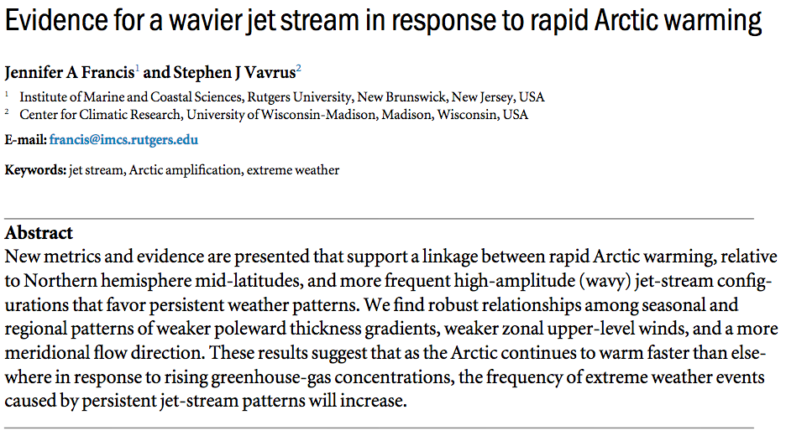
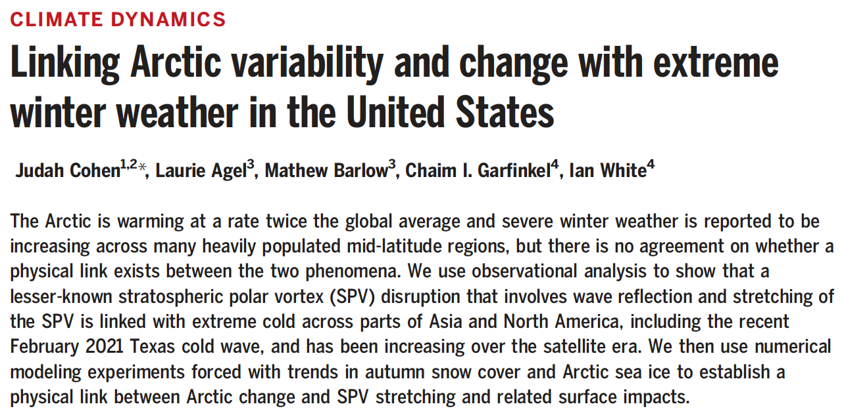
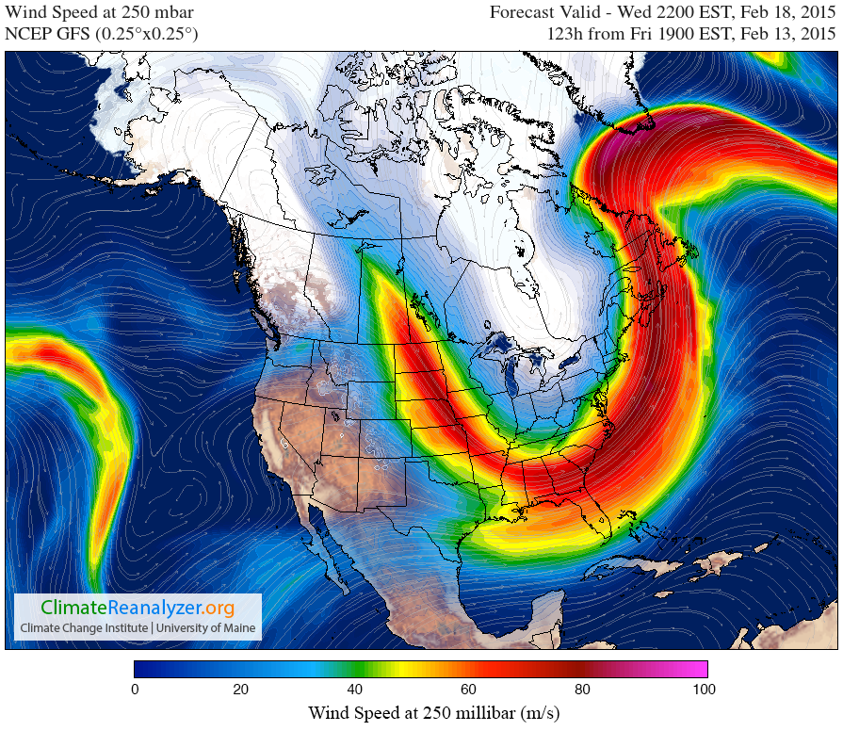
Francis and Vavrus, 2014
Cohen et al., 2021

Slide 5
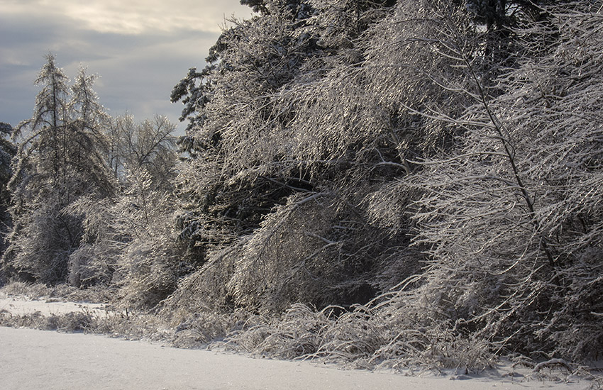
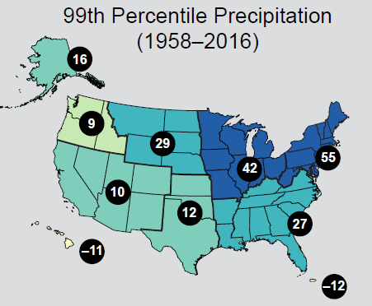
Extreme Weather
Extreme weather becoming more common around the Northern Hemisphere due to changes in atmospheric circulation.
Increased likelihood of heat/cold waves, intense storms.
Large increases (55%) in annual heavy daily precipitation across the USNE.
In Maine, the last 10-15 years have seen the highest occurrence of 2”, 3”, and 4” precipitation events (Fernandez et al., 2020).
Easterling et al., 2017

Slide 6
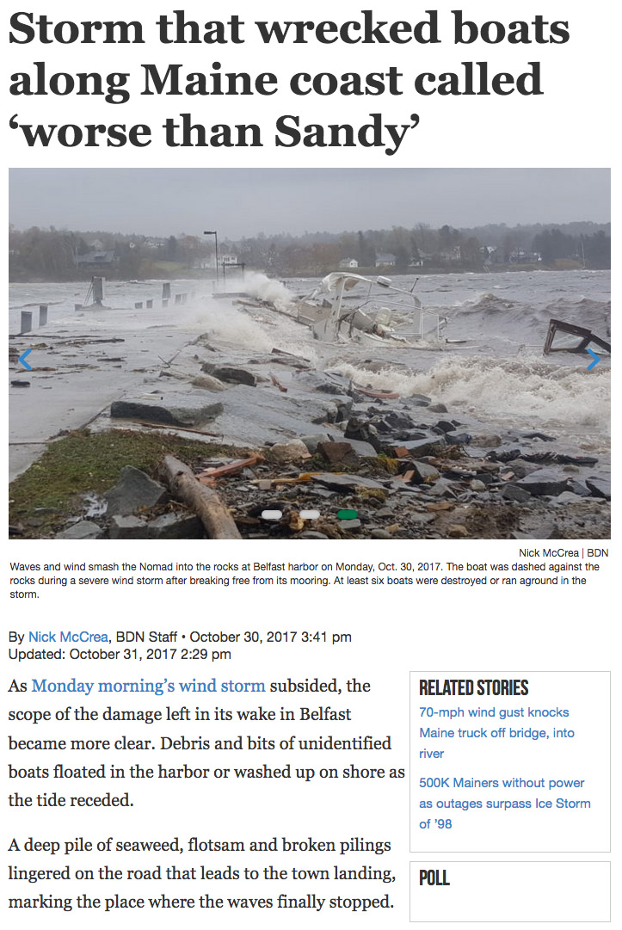
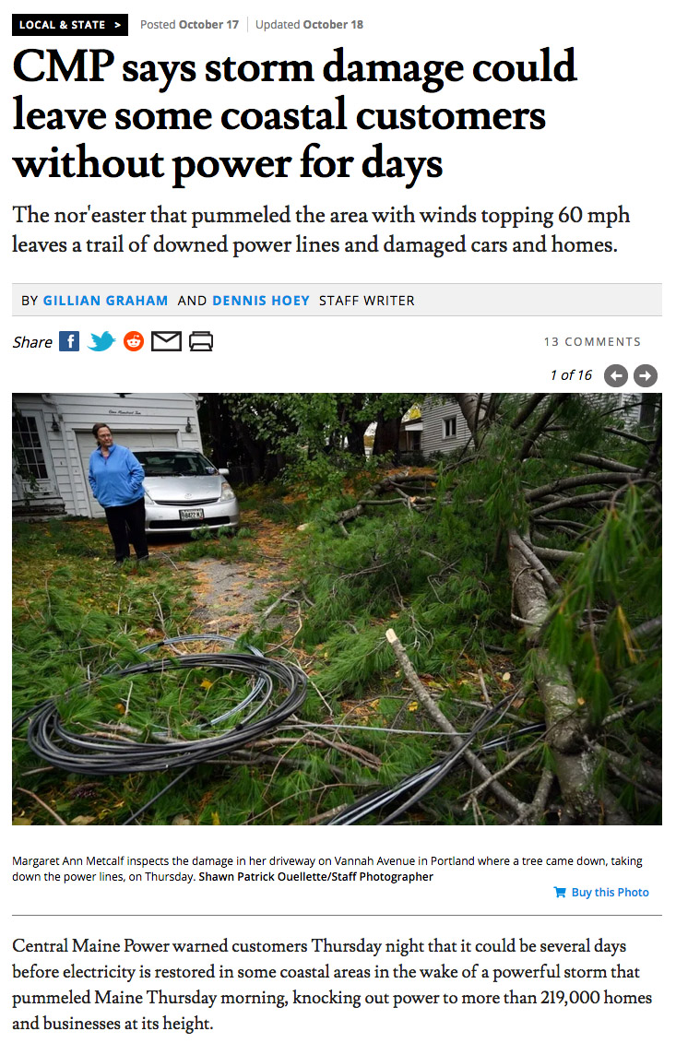
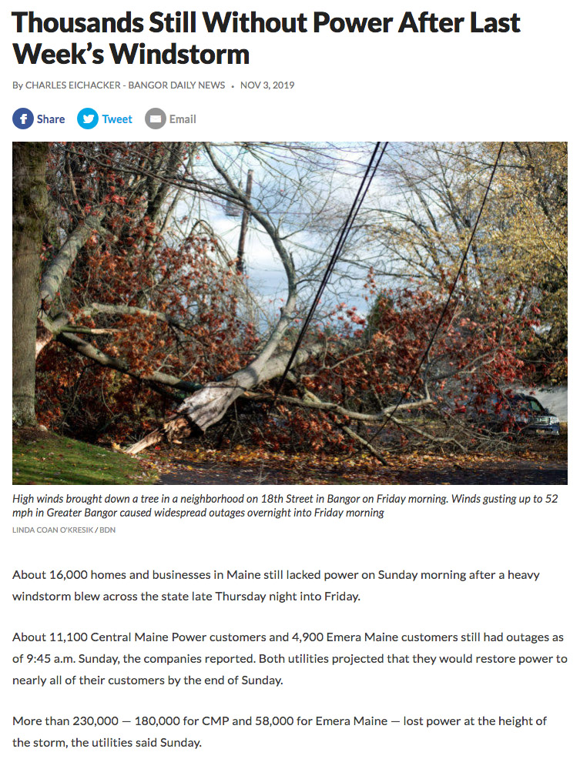
(Bomb Cyclone)
Oct. 17th, 2019
Gusts BGR 43, PWM 62 mph
219k power outages
Nov. 1st, 2019
Gusts 53 BGR, PWM 49 mph
230k power outages
(Bomb Cyclone)
Oct. 30th, 2017
Gusts BGR 66, PWM 69 mph
500k power outages

Slide 7
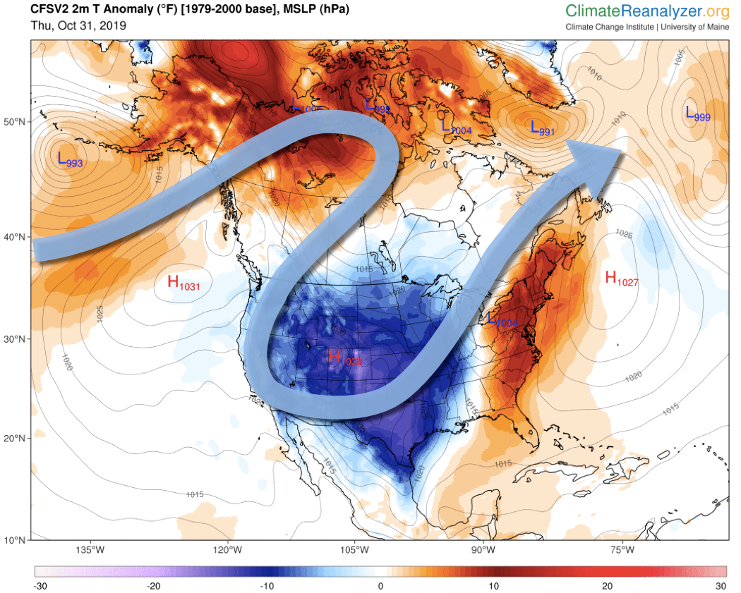
Temperature anomaly and Jetstream
Wind Storm
Nov 1, 2019

Slide 8
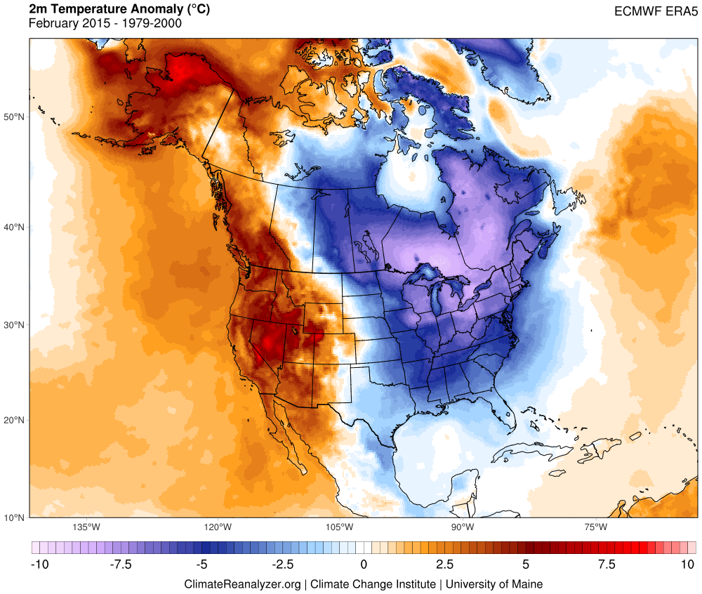
The 2014/15 winter saw unusual persistence of ridging across western North America leading to record high air and ocean temperatures. Downstream of this ridge, parts of the eastern U.S. saw record cold. Maine saw it’s coldest February since 1934.

Slide 9
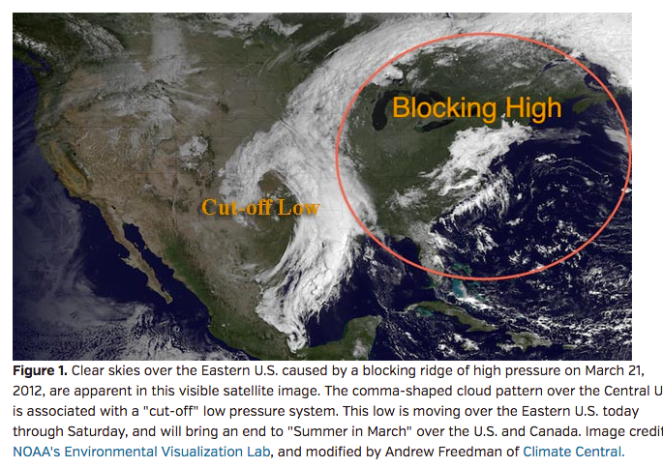
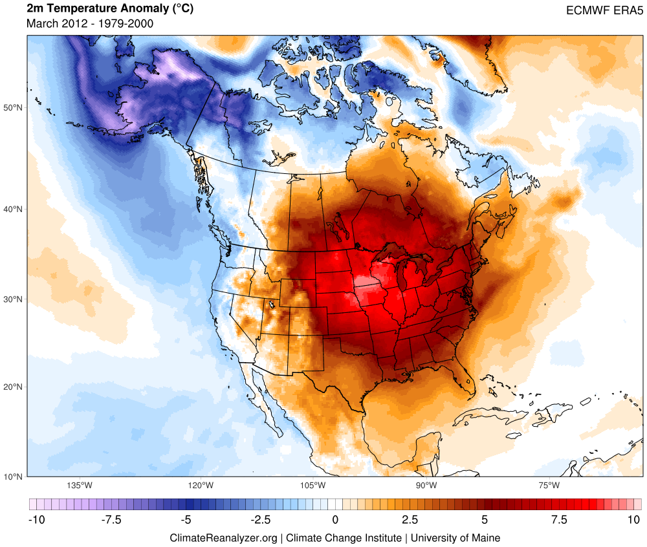
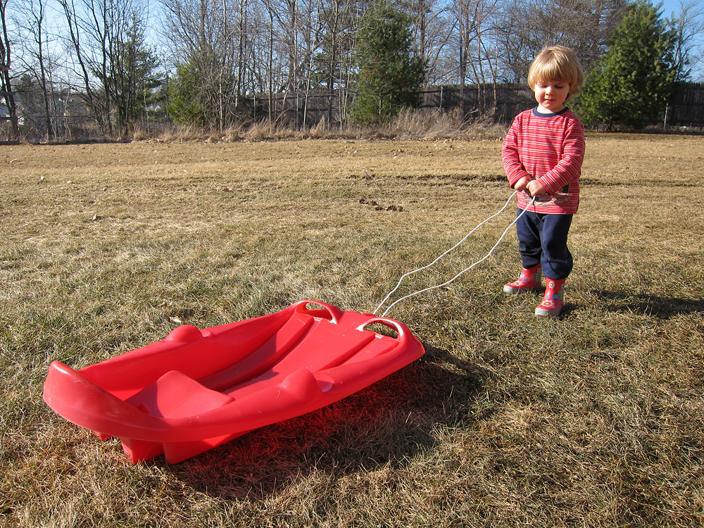
Summer in March, 2012
Temperatures into the 80s across southern half of Maine 22-23 March with no historical equivalent.
Farmington 83°F March 23rd – a daily high record set by 17°F!
18 March, 2012

Slide 10
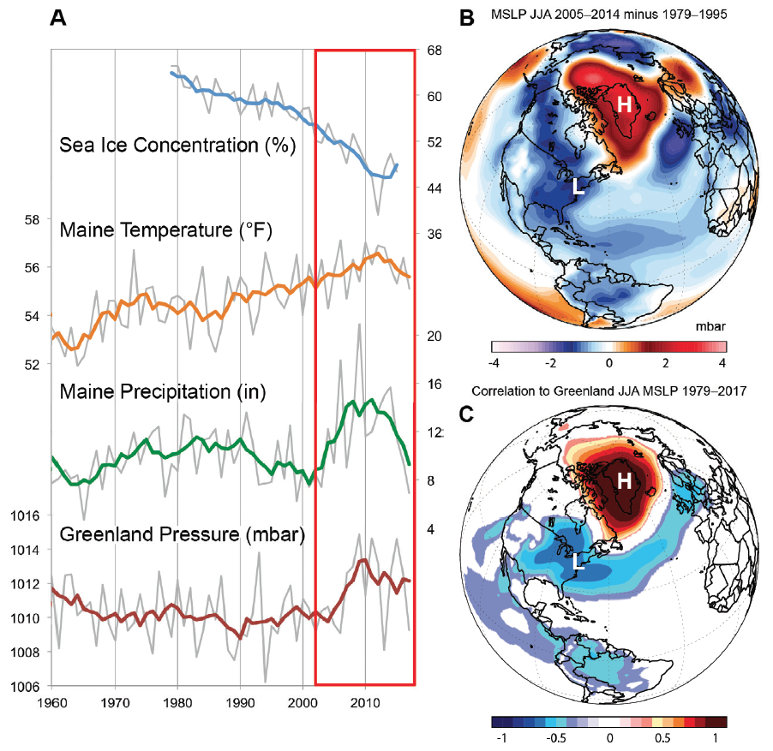
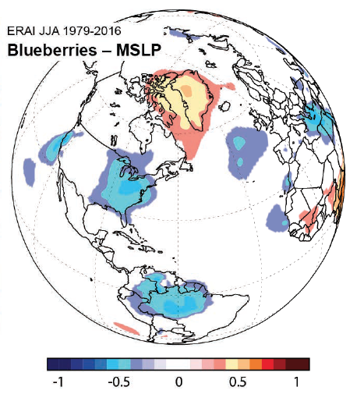
Maine JJA Precipitation and Greenland Blocking High Pressure
Birkel and Mayewski, 2018
Simonson et al. in Revision

Slide 11
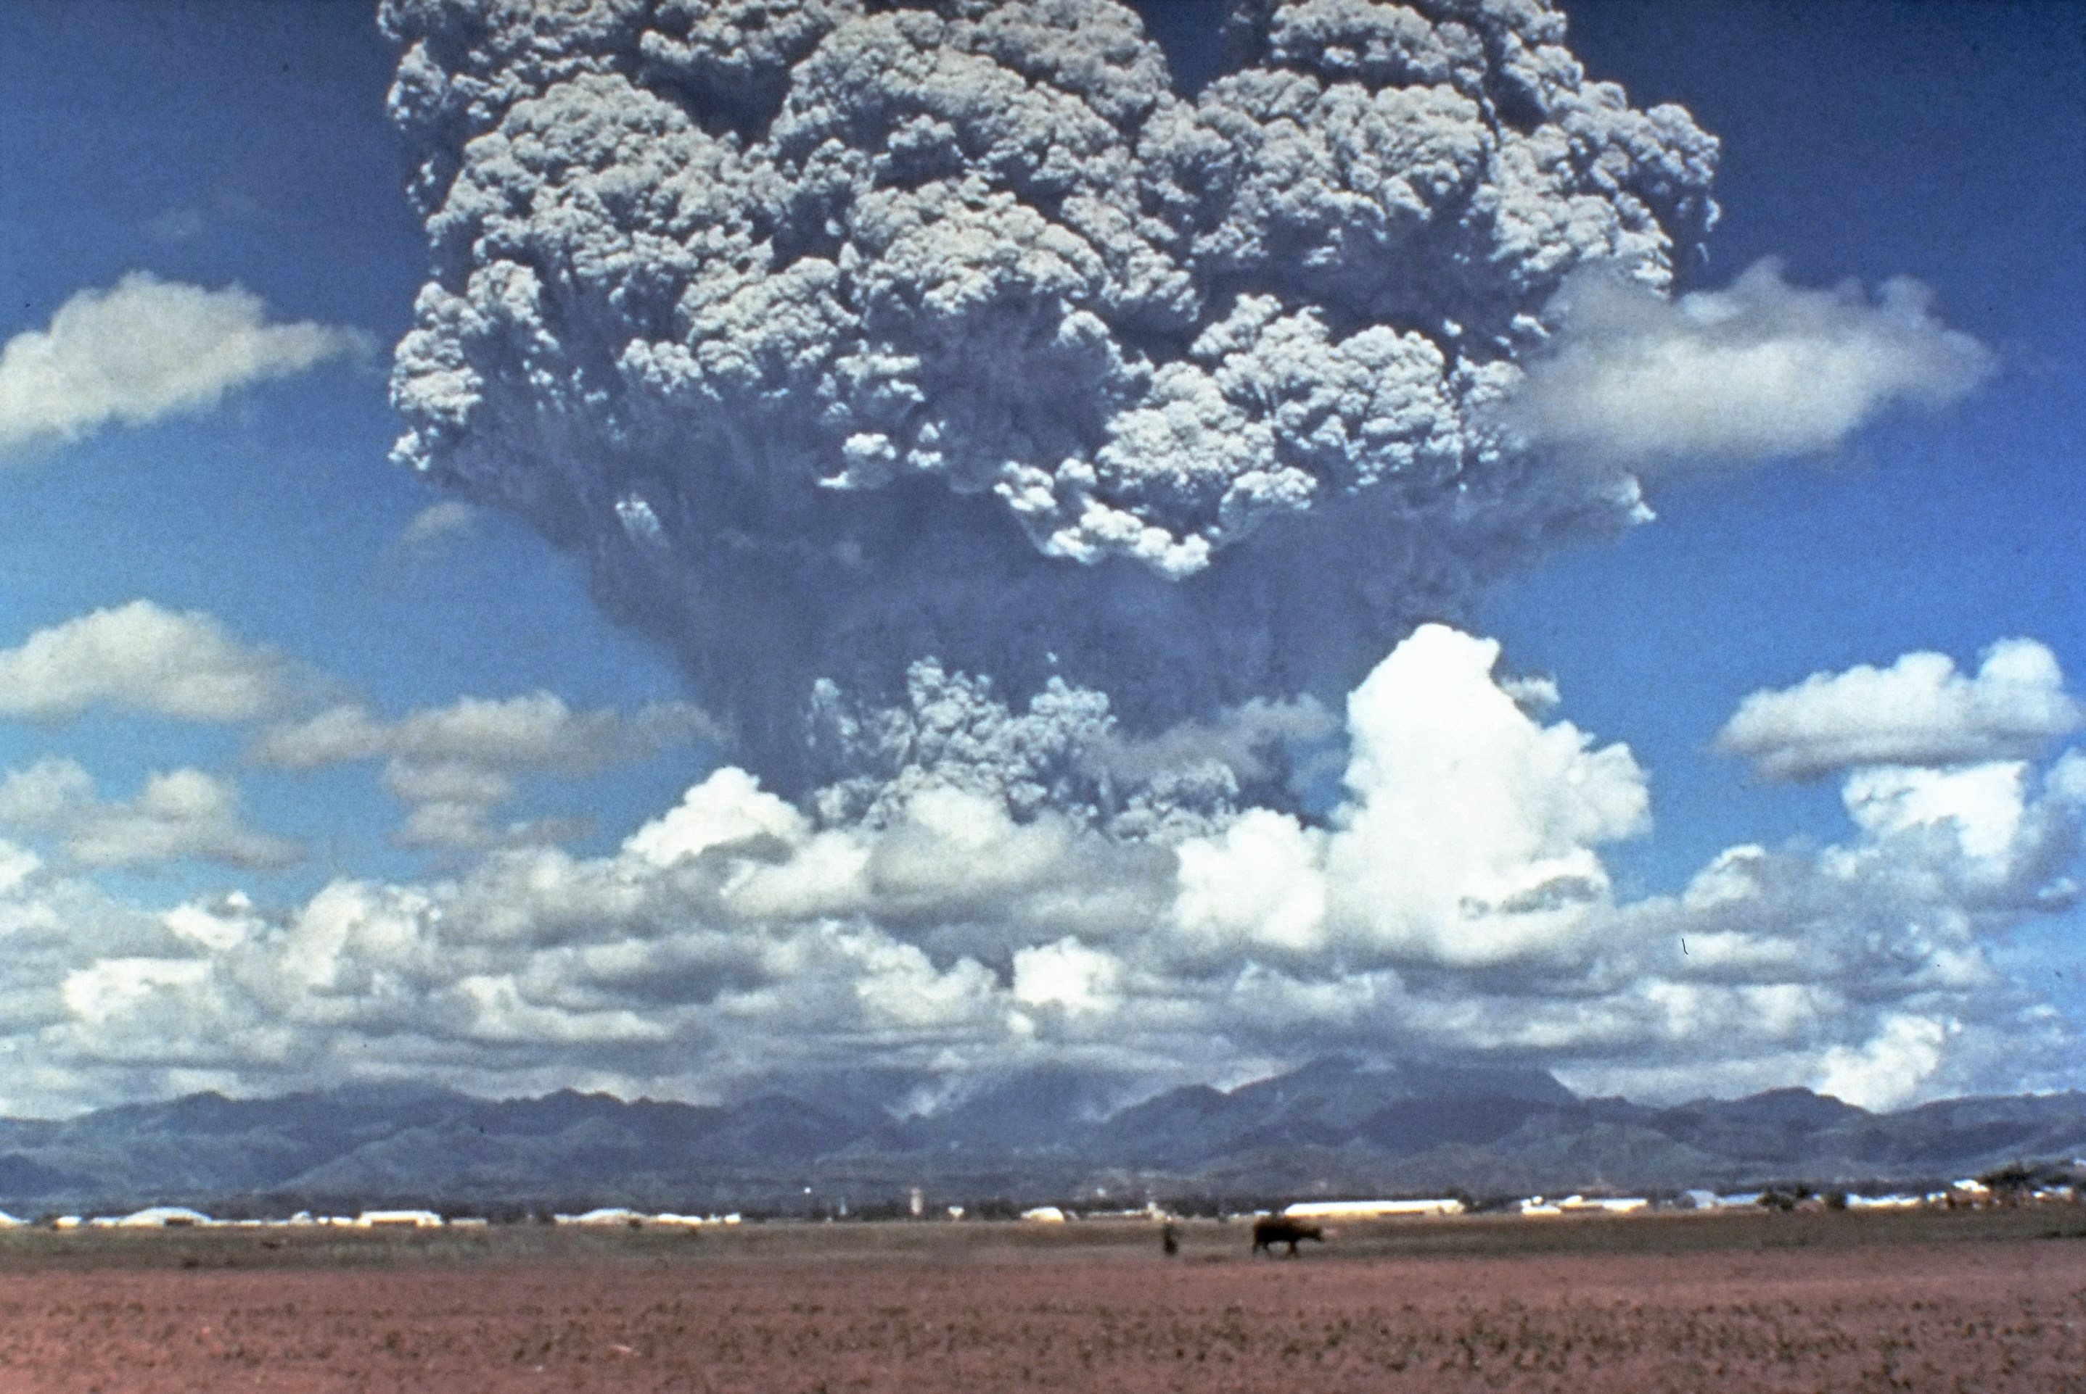
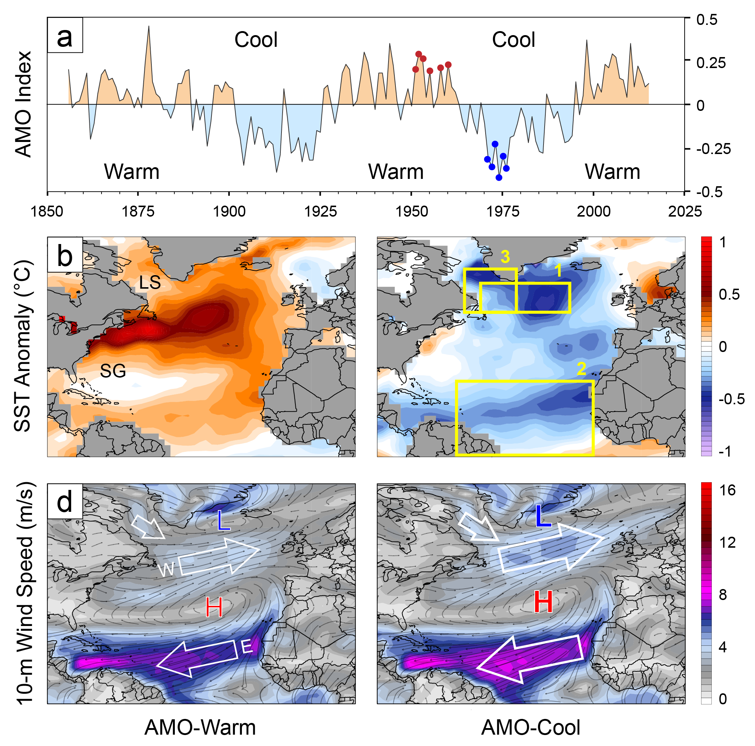
Evidence for a Volcanic Underpinning of the Atlantic Multidecadal Oscillation
Birkel, S.D., Mayewski, P.A., Maasch, K.A., Kurbatov, A.V., Lyon, B. (2018)
1991 Mt. Pinatubo (wikipedia/commons)
Utilizes historical sea surface temperature (SST), reanalysis, and stratospheric aerosol optical depth data.
Cool periods in the North Atlantic coincide with increased explosive volcanic activity.
Eruptions project onto the NAO, eliciting coupled atmosphere-ocean response.
Subpolar SSTs decline as northwesterly winds advect cold water from the Labrador Sea.

Slide 12
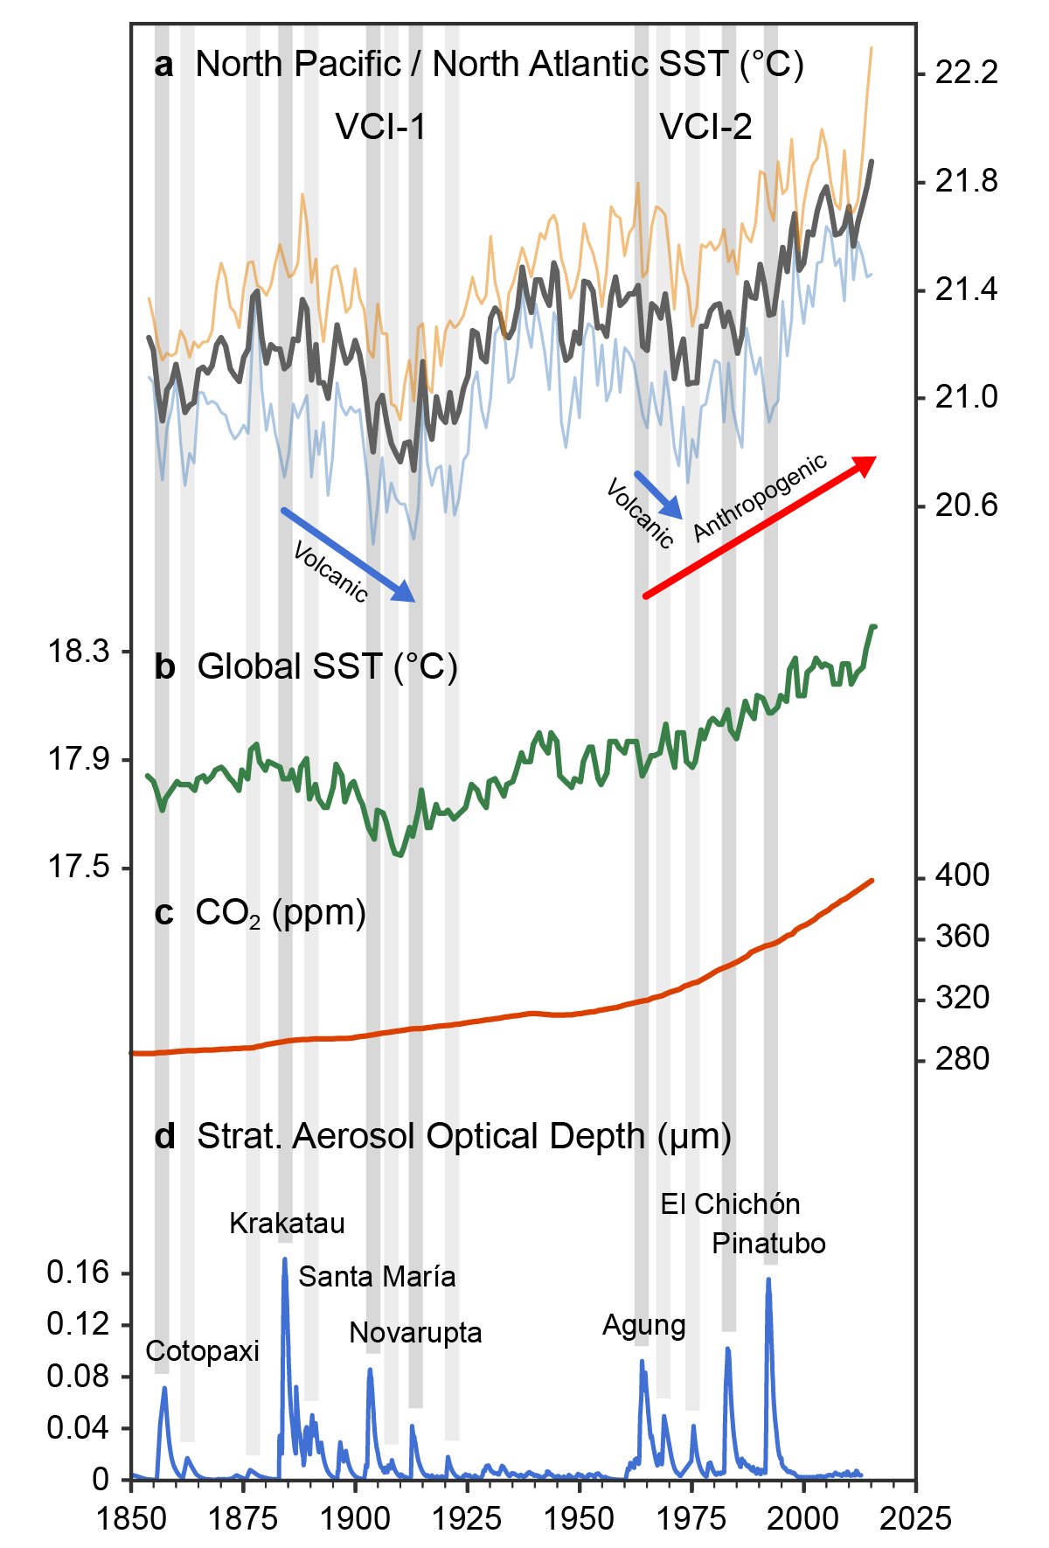
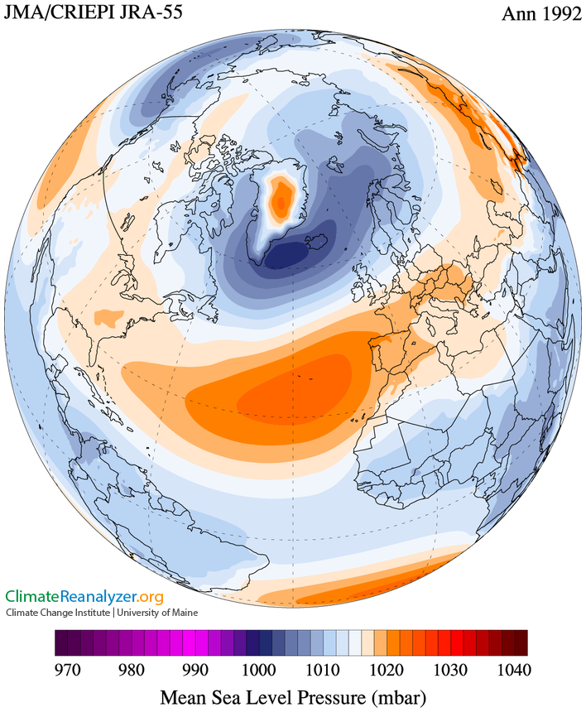

Slide 13
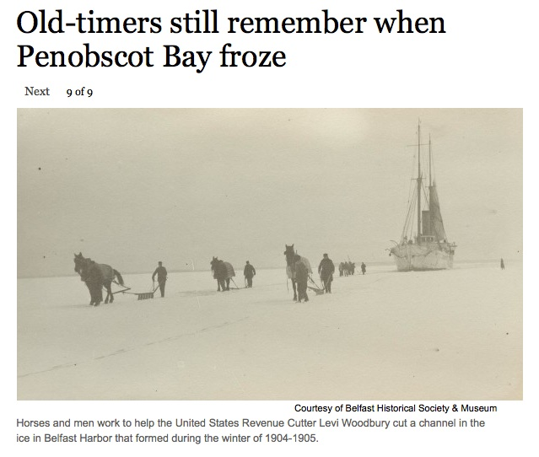
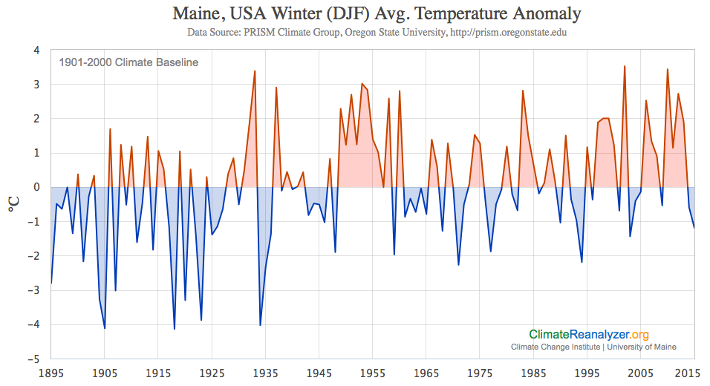
Penobscot Bay froze several times during the early 1900s when the North Atlantic region climate was impacted by major volcanic eruptions.
Belfast Harbor, 1905
Observed early 20th century freeze-overs:
1904, 1905, 1918, 1923, 1934
Bangor Daily News, Feb. 19, 2015

Slide 15
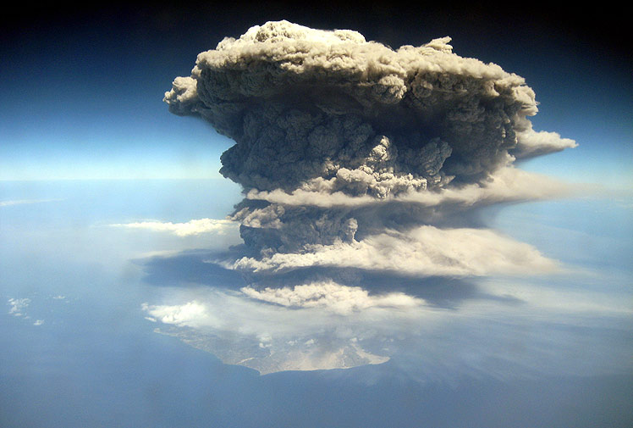
Lower Stratosphere
~12 km
Troposphere
Sea Level
Soufrière Hills, Caribbean, Feb, 2010
https://feww.files.wordpress.com/2010/03/mi-sh.jpg

