Slide 1
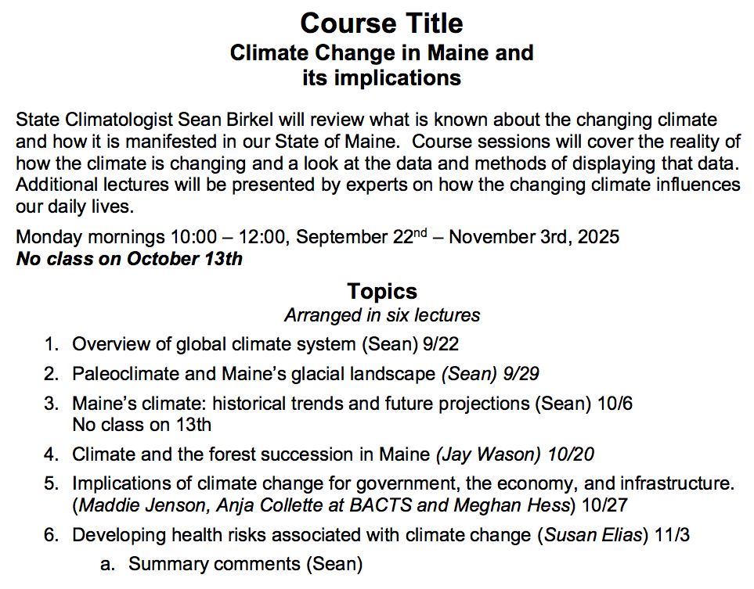

Slide 2
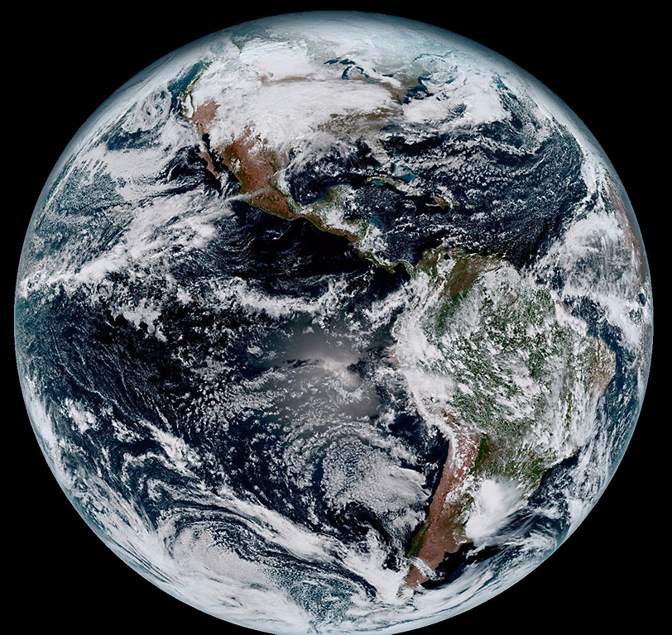


Overview of the Global Climate System
Penobscot Valley Senior College
22 September, 2025
Sean Birkel, Ph.D.
Assistant Professor &
Maine State Climatologist
NOAA/NASA GOES-16

Slide 3
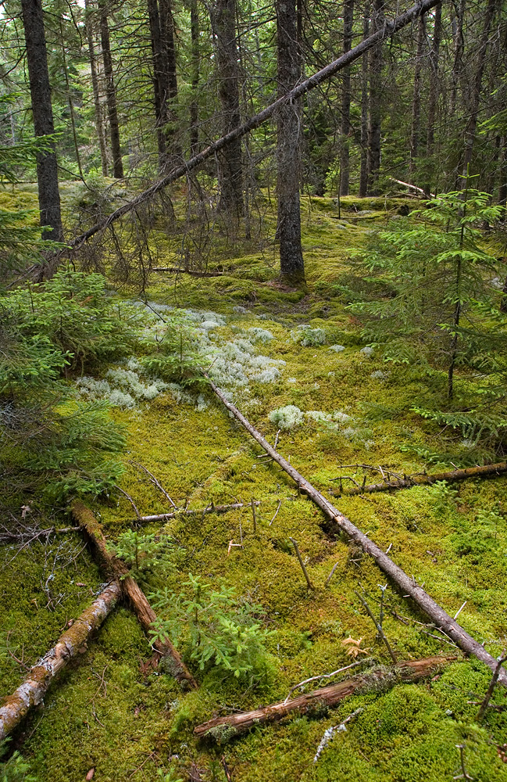
Presentation Outline
Introduction
Defining Climate & the Climate System
The Atmosphere
Energy Imbalances & Climate Change
  Internal variability vs. external forcing
  (e.g., CO₂ emissions)
Atmospheric Circulation
El Nino–Southern Oscillation (ENSO) & the North Atlantic Oscilation (NAO)

Slide 4


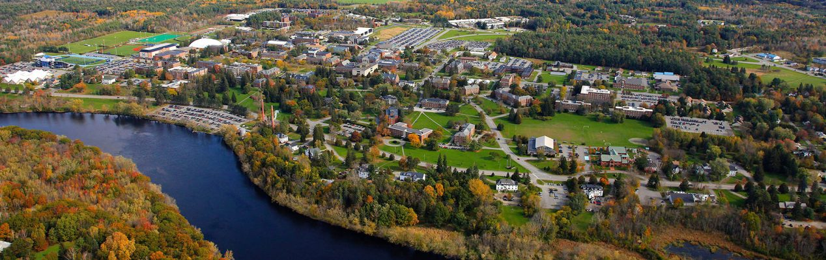
About
As a researcher I study climate variability, particularly across the North Atlantic and Arctic. I use climate models, gridded data, and observations to explore trends and teleconnections.
I also develop data visualization tools.
As the Maine State Climatologist I provide climate services – the production and delivery of climate and weather data to Maine stakeholders to inform decision-making and planning.
University of Maine, Orono

Slide 5
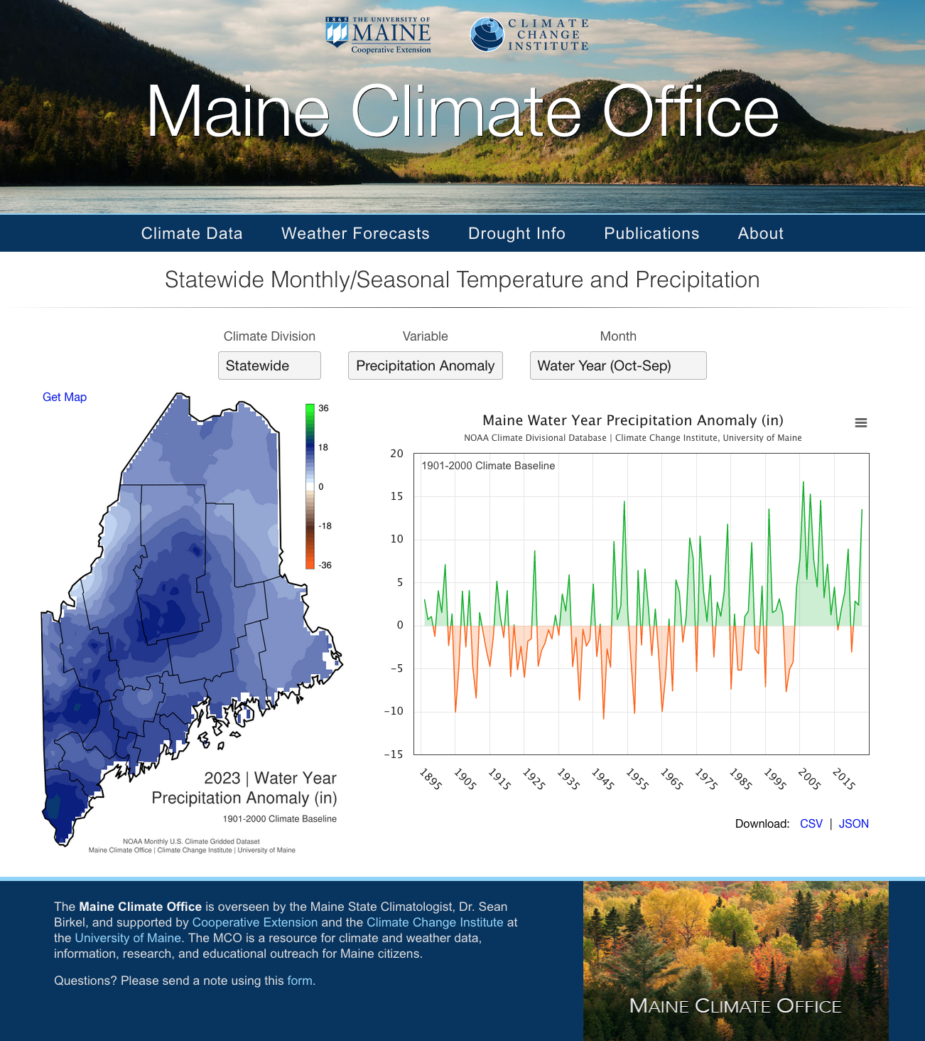
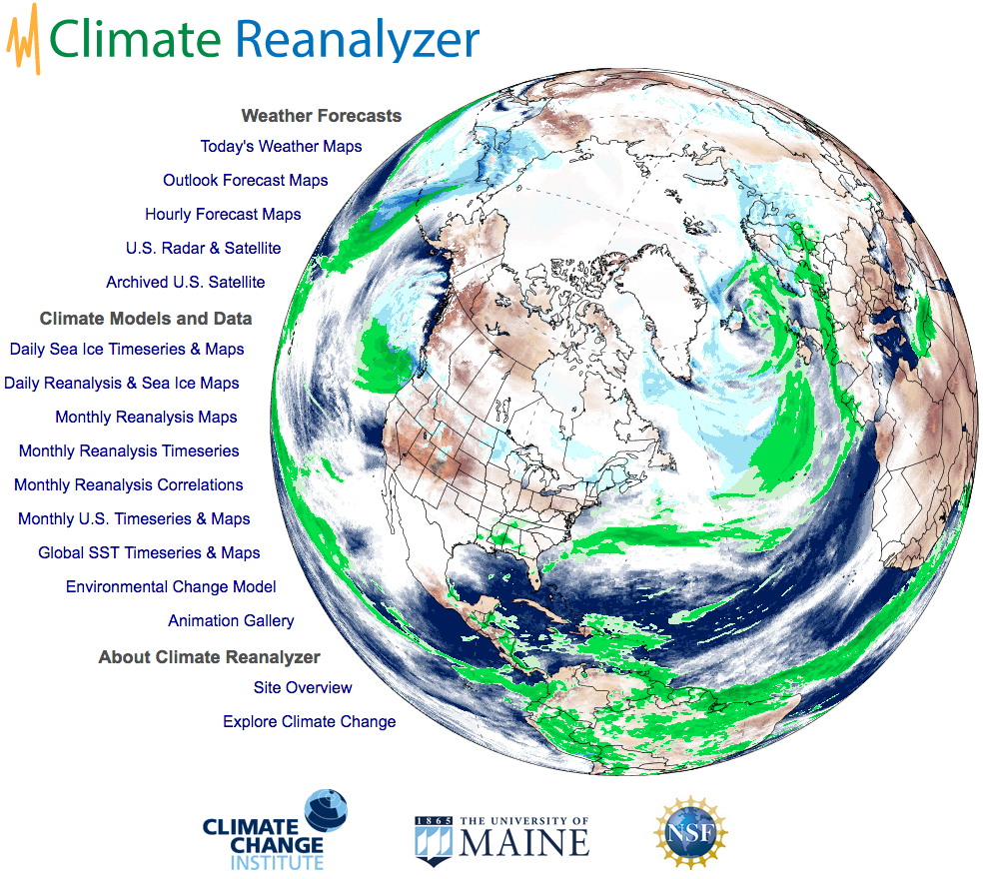
ClimateReanalyzer.org
mco.umaine.edu

Slide 6
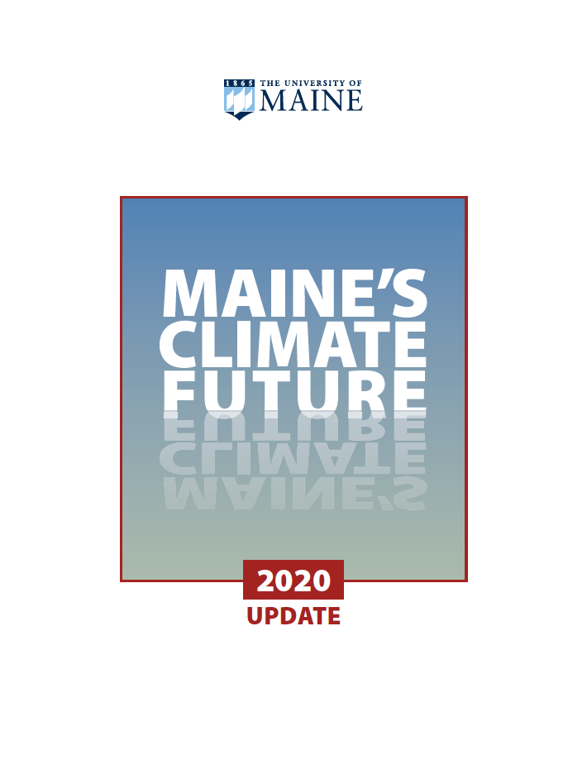
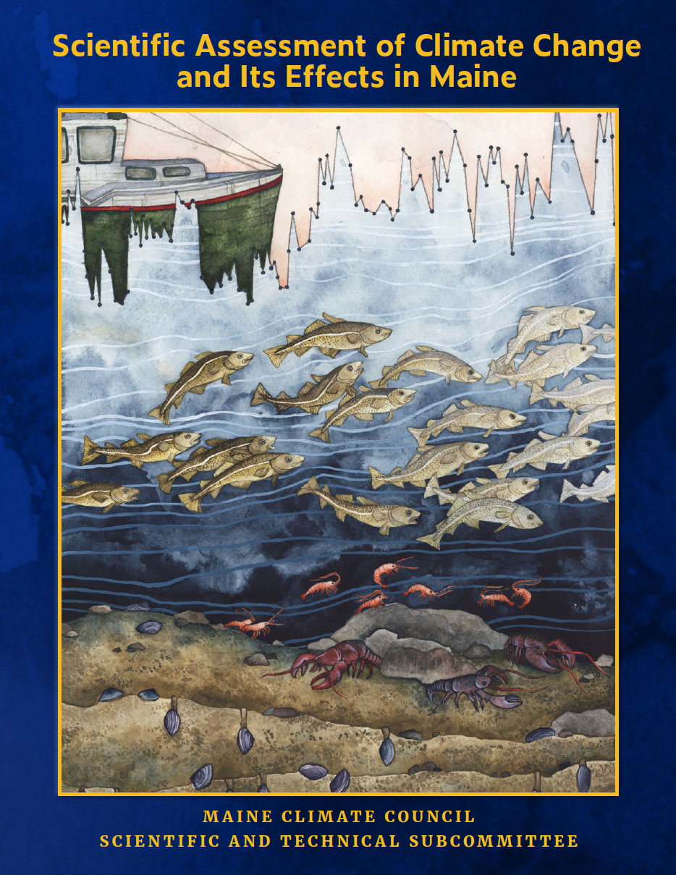
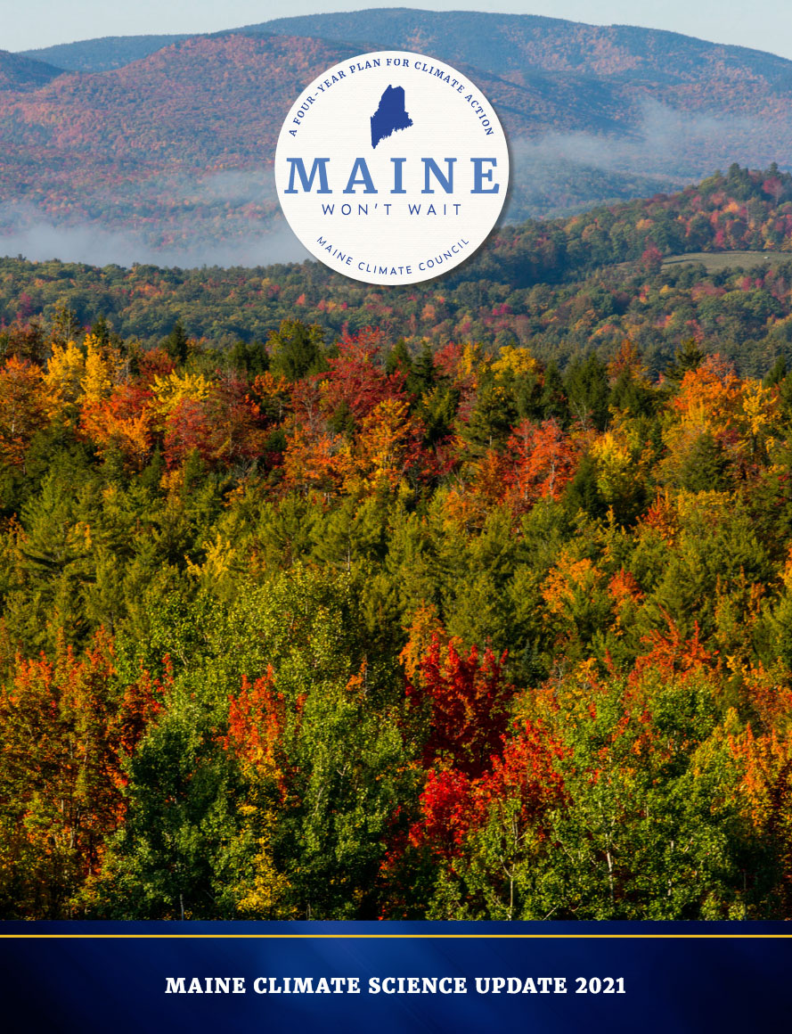



Slide 7
Maine Mesonet
UMaine-led Congressionally Directed Spending project to build a new
26-station weather monitoring network across Maine. Supported by Senators Collins and King.
Project Team:
Dr. Lily Calderwood, Wild Blueberry Specialist, Cooperative Extension
Dr. Sean Birkel, Climate Scientist & Maine State Climatologist
Dr. Phillip Fanning, Agricultural Entomologist, School of Food & Agriculture
University of Maine, Orono

Slide 8
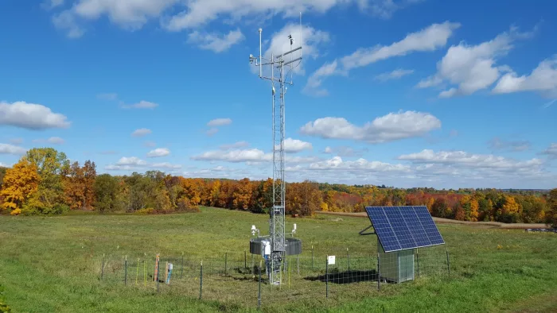
New York State Mesonet 10-meter tower site, courtesy of Jerald Brotzge

Slide 9
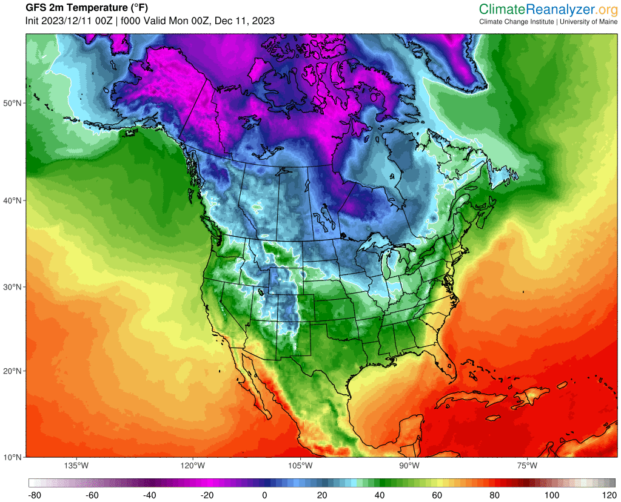
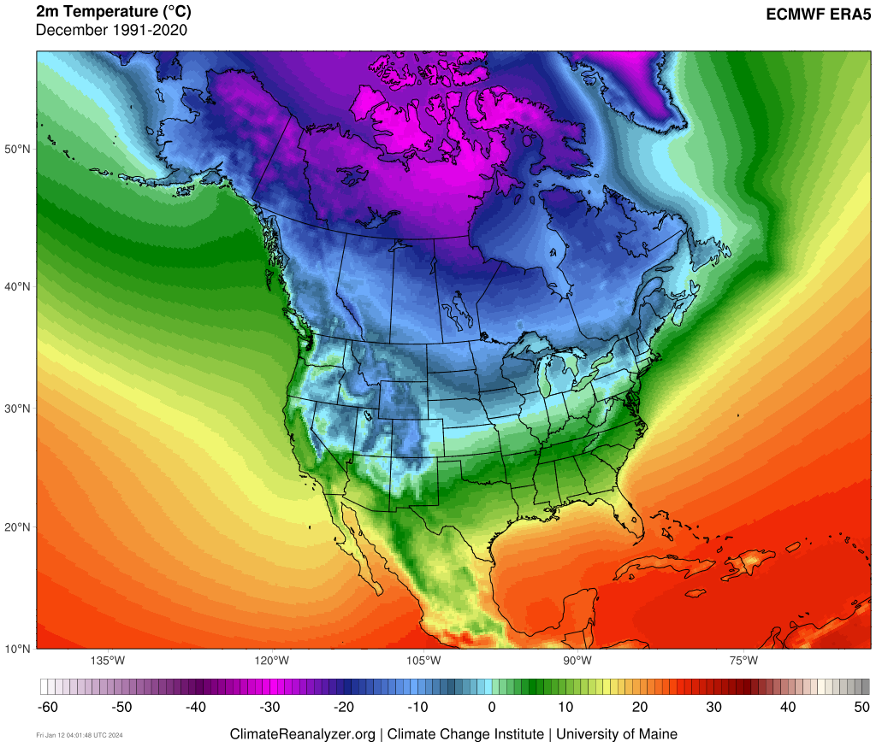
What is Climate?
Climate is the statistical representation of prevailing meteorological conditions – typically over a period of 30 years. In short, “climate is average weather”.

Slide 10
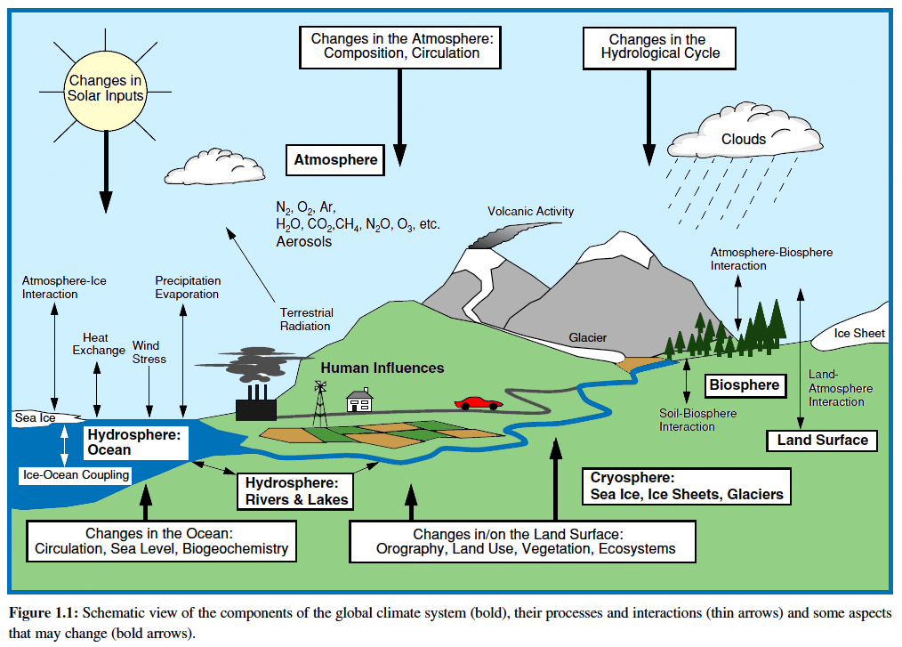
What is the Climate System?
IPCC AR3
The climate system is the interaction of component systems that affect life
on Earth:
Atmosphere
Hydrosphere
Cryosphere
Biosphere
Lithosphere

Slide 11
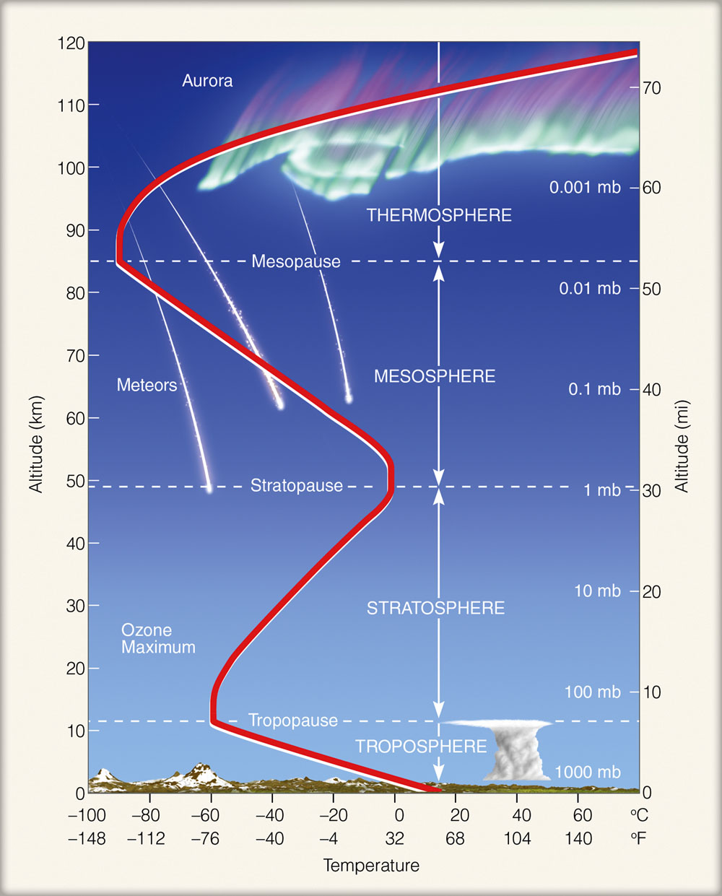
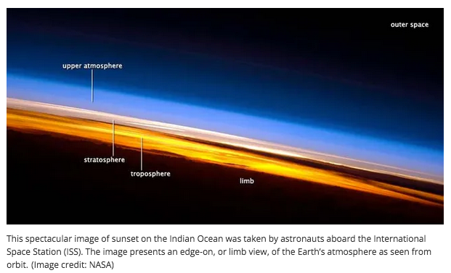
Atmosphere
ghsearth.weebly.com/uploads/2/3/2/8/23284064/atm_layers_1.jpg
Major
Nitrogen 78%
Oxygen 21%
Argon 0.93%
Water Vapor 0–4%
Carbon Dioxide 0.04%
Trace Gases
Neon
Helium
Methane
Ozone
Chlorofluorocarbons (CFCs)
www.space.com/8596-earth-colorful-atmospheric-layers-photographed-space.html

Slide 12
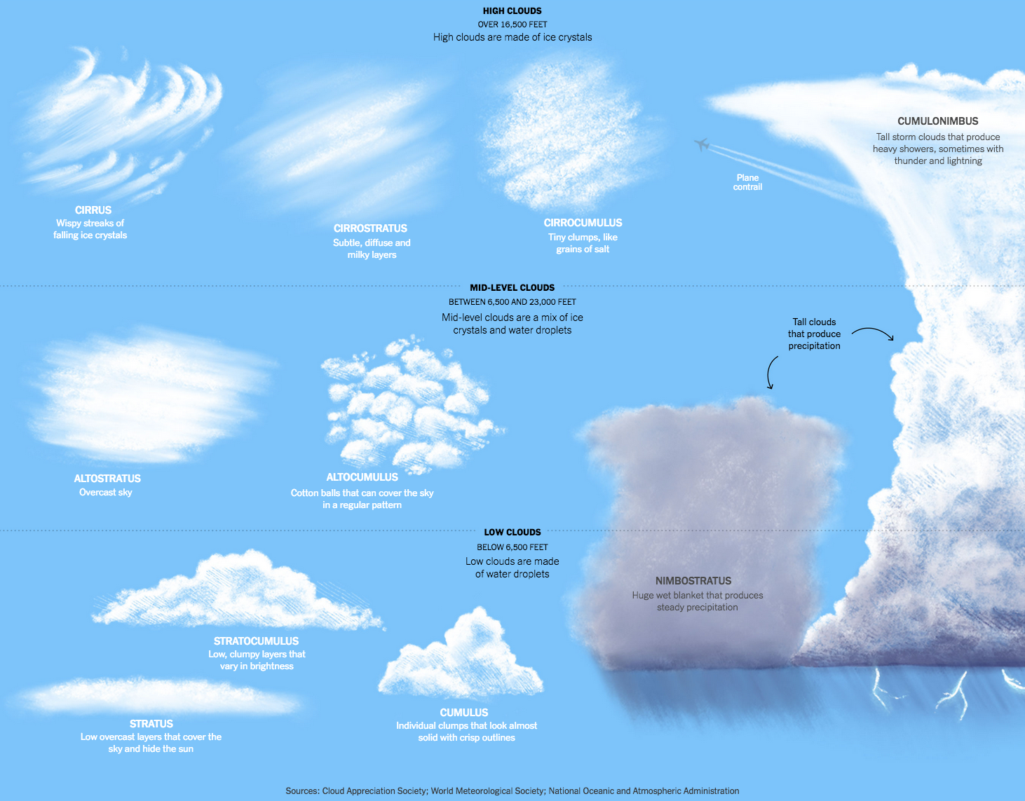
New York Times, “We Take Clouds for Granted” 9/10/2025
High-Level
Clouds
Over
16,500 ft
23,000 ft
to
6,500 ft
Mid-Level
Clouds
Low-Level
Clouds
Below
6,500 ft

Slide 13
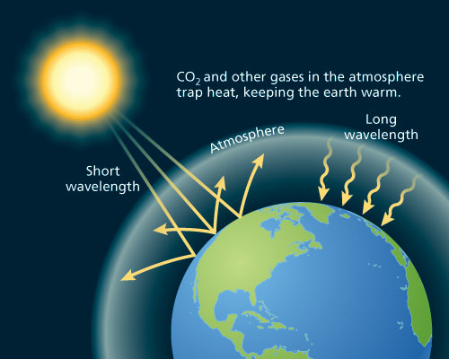
Energy from the Sun drives the climate system
www.oxfordpresents.com/ms/krohne/global-warming-and-ecological-communities/
Incoming solar radiation is mostly
short wavelength and does not heat
the atmosphere directly
However, these short waves are absorbed by the surface, which then emits longwave (infrared thermal) radiation back into the atmosphere
This heat is then absorbed by greenhouse gases such as water vapor and CO2, heating the air
Reemitted longwaves can in turn be absorbed by and heat the surface

Slide 14
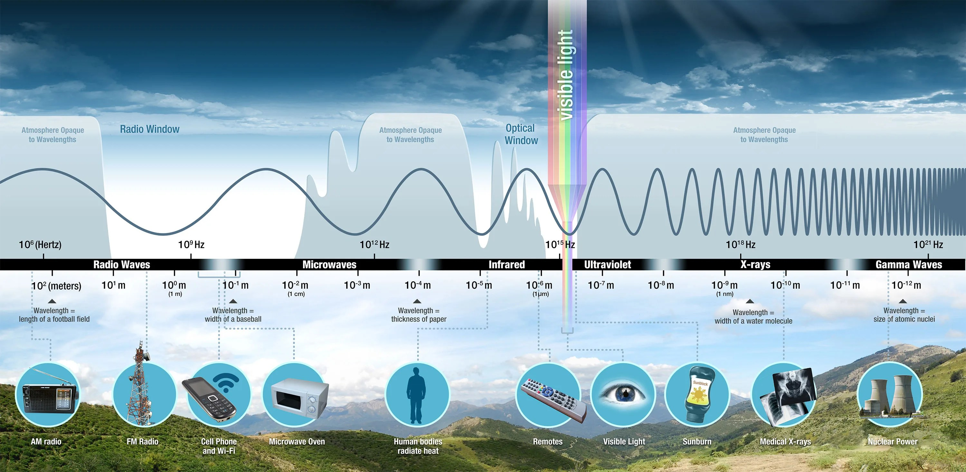
www.oxfordpresents.com/ms/krohne/global-warming-and-ecological-communities/

Slide 15
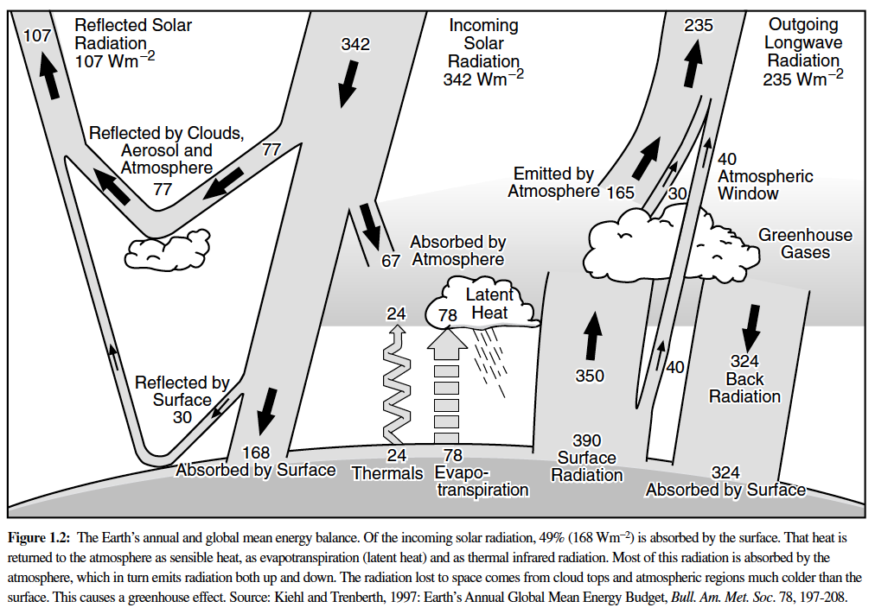
Equilibrium Climate
Outgoing Longwave
+
Reflected
Shortwave
=
Total Incoming Solar Radiation
IPCC AR3
Latent Heat: energy absorbed or released during phase change
Thermal: convective current of air that transfers heat energy vertically

Slide 16
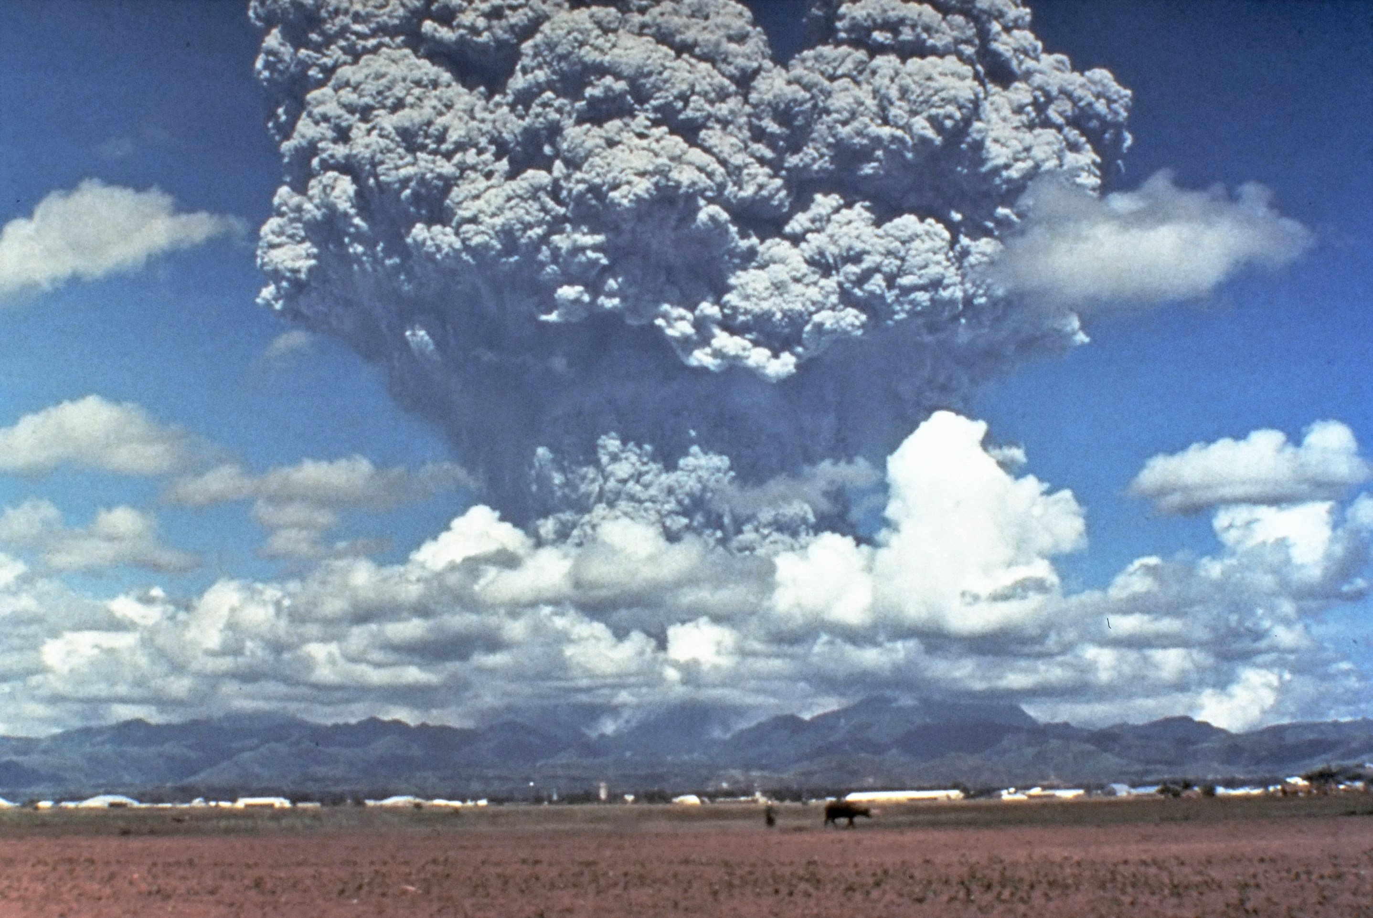
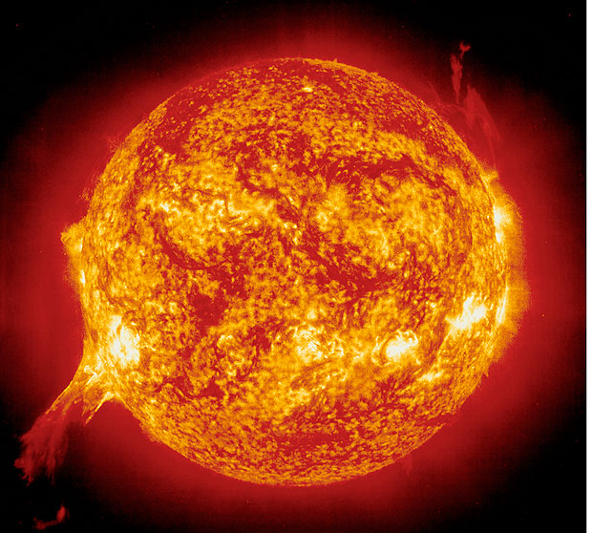
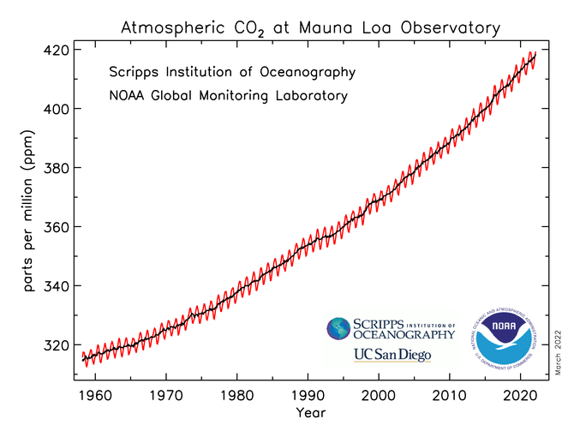
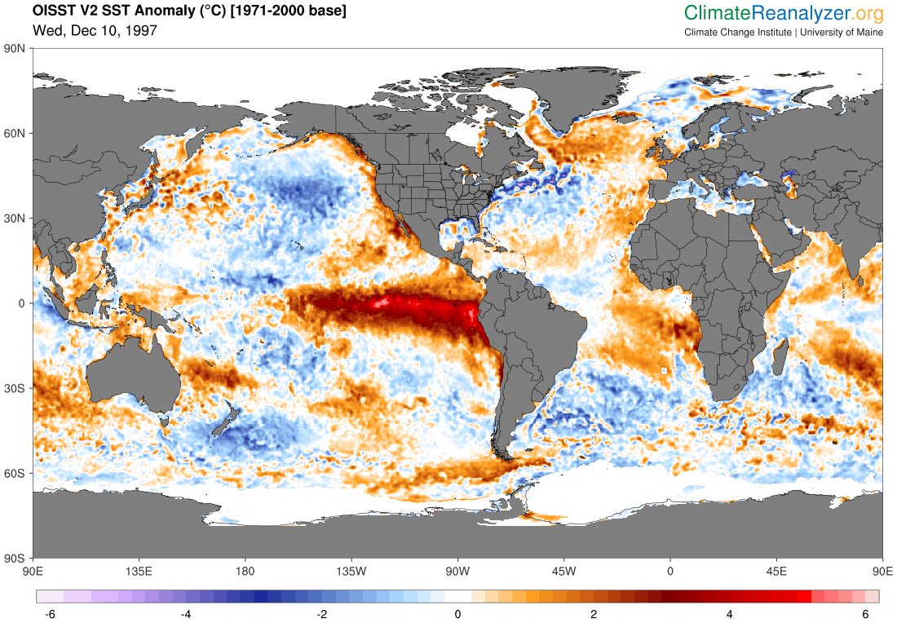
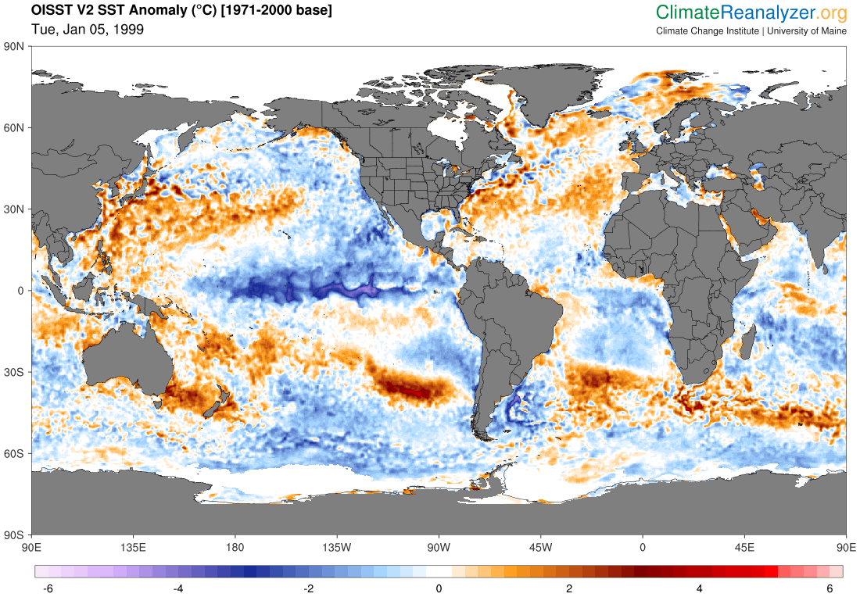
Climate Change Results from
Energy Imbalances
Volcanic Aerosols
Solar Cycle
Greenhouse Gas Emissions
El Niño-Southern Oscillation (ENSO)

Slide 17
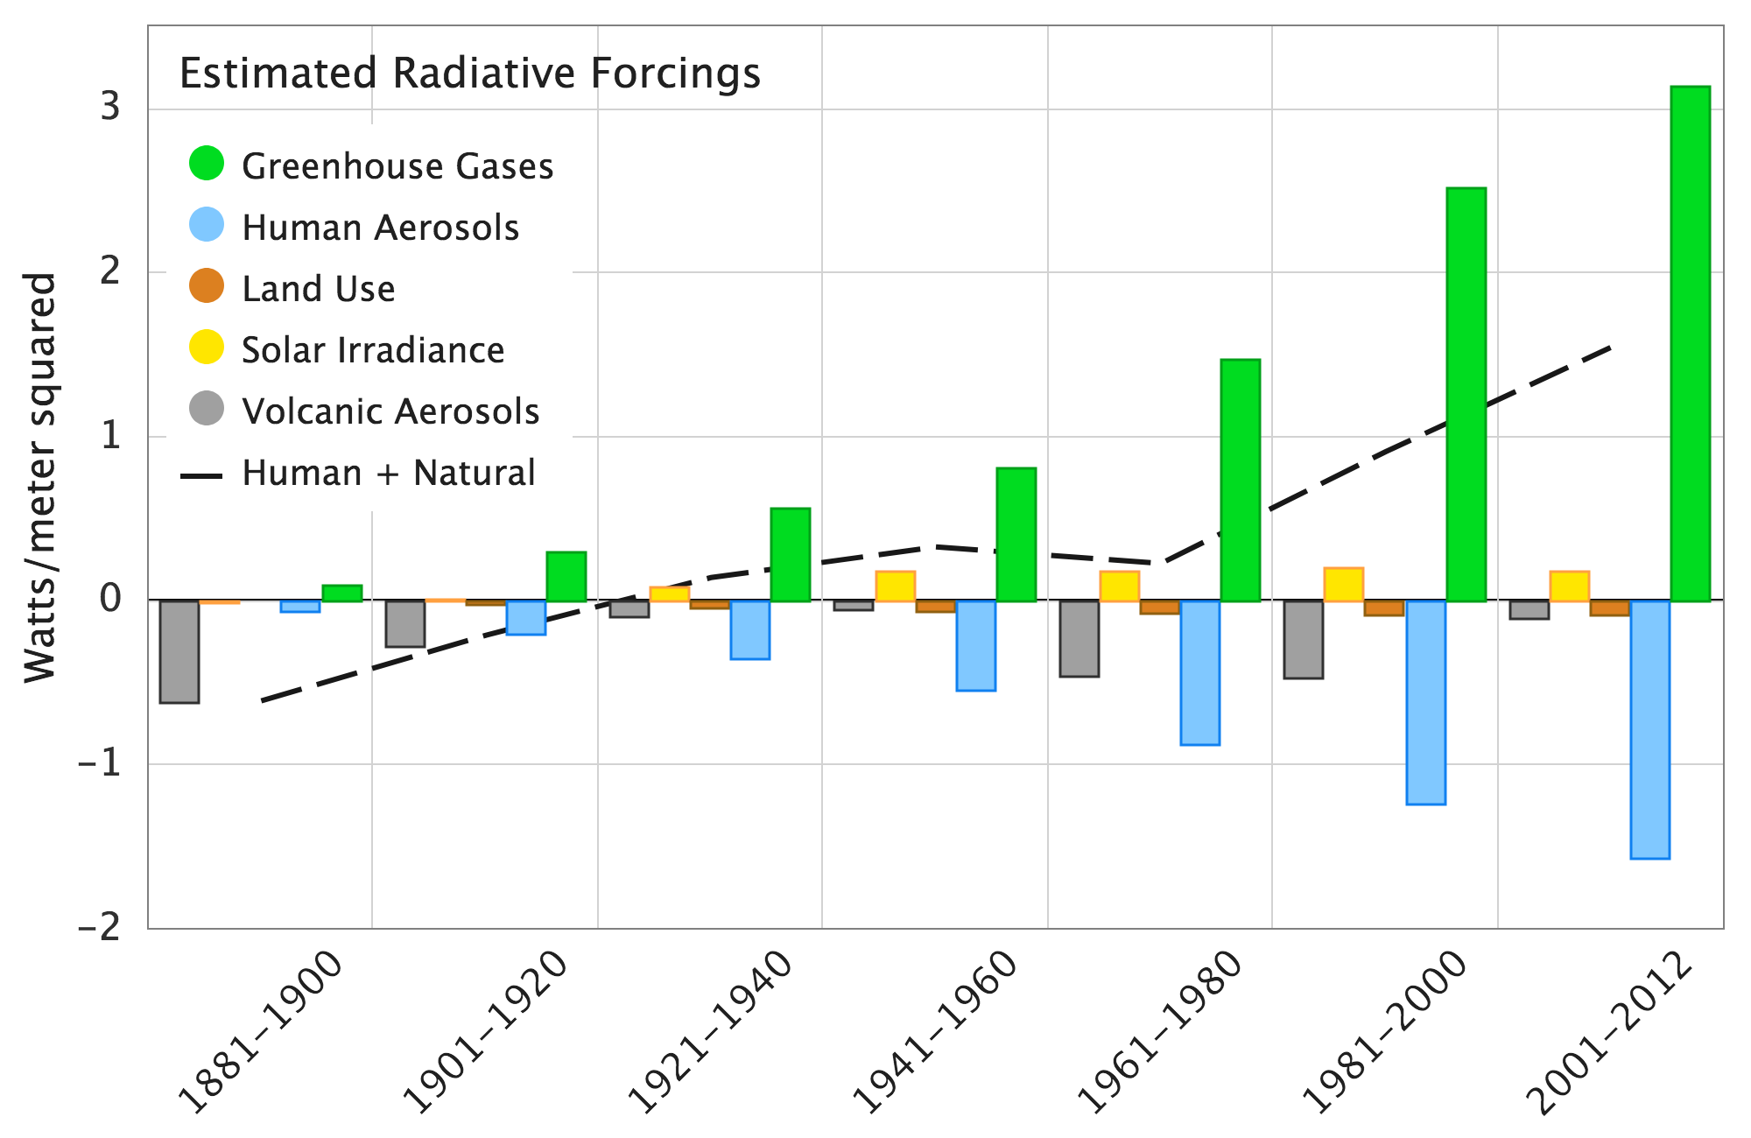
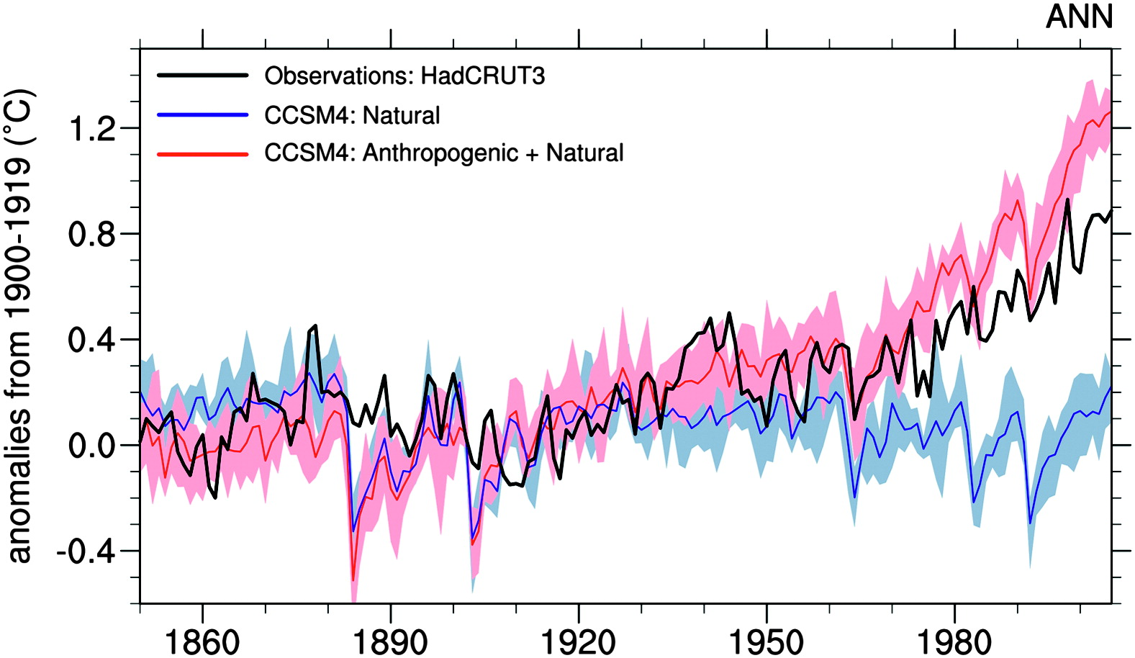
Natural forcings cannot account for the
observed warming since at least 1960
Data from Hansen et al. 2011
Volcanic aerosols and solar variability cause the largest natural climate perturbations
Meehl et al, 2012
Mt. Pinatubo, 1991
USGS pubs.usgs.gov/fs/1997/fs113-97/

Slide 18
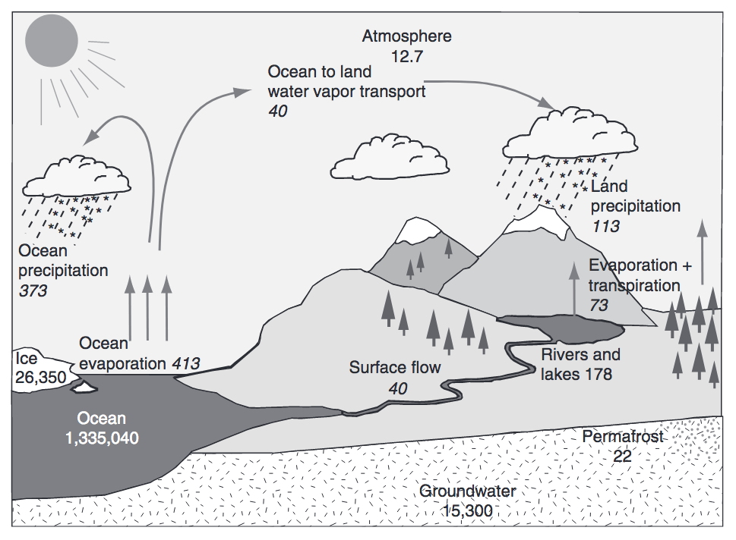
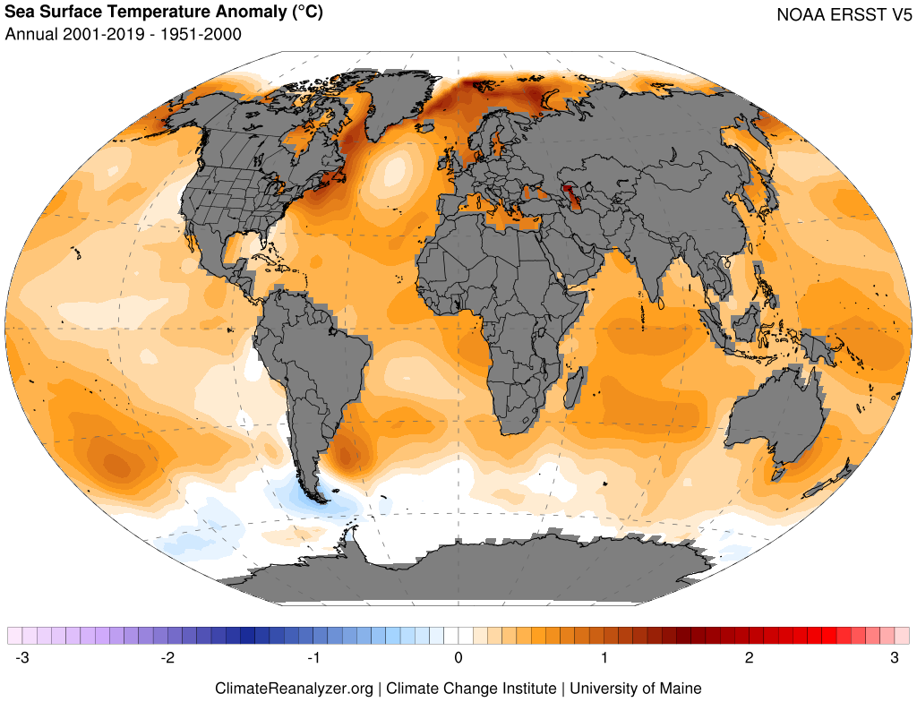
Warming Oceans and an Intensifying Hydrologic Cycle
Trenberth et al. (2007), Huntington (2010)
Warming drives increased ocean evaporation, atmospheric water vapor content, and changes in circulation leading to greater potential for weather extremes.
The water holding capacity of air increases 7% for 1°C (1.8°F) warming

Slide 19
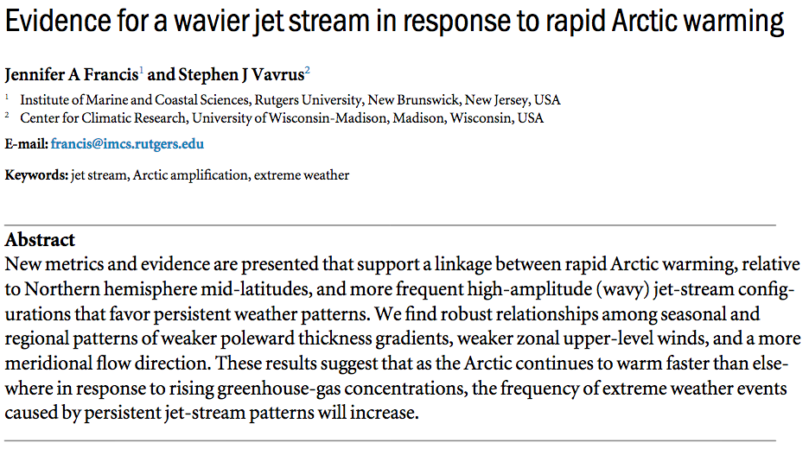
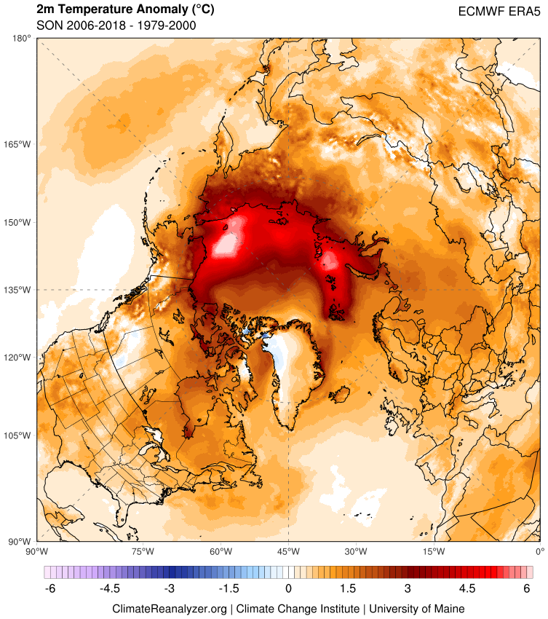
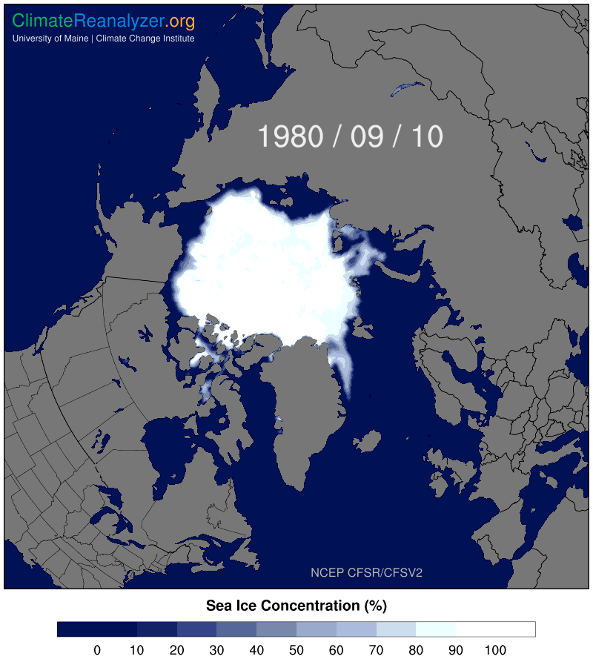
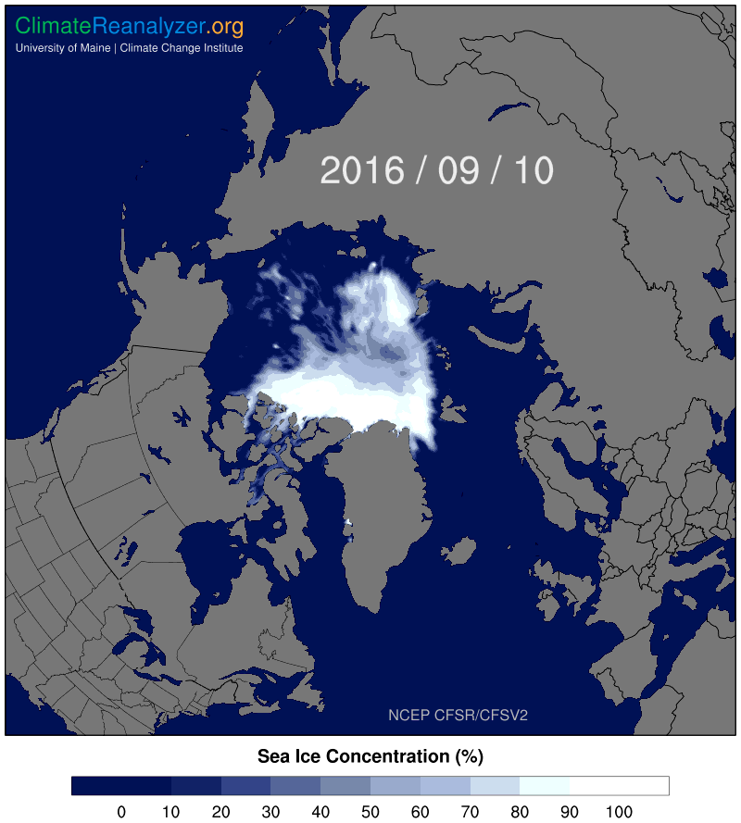
Arctic Amplification

Slide 20
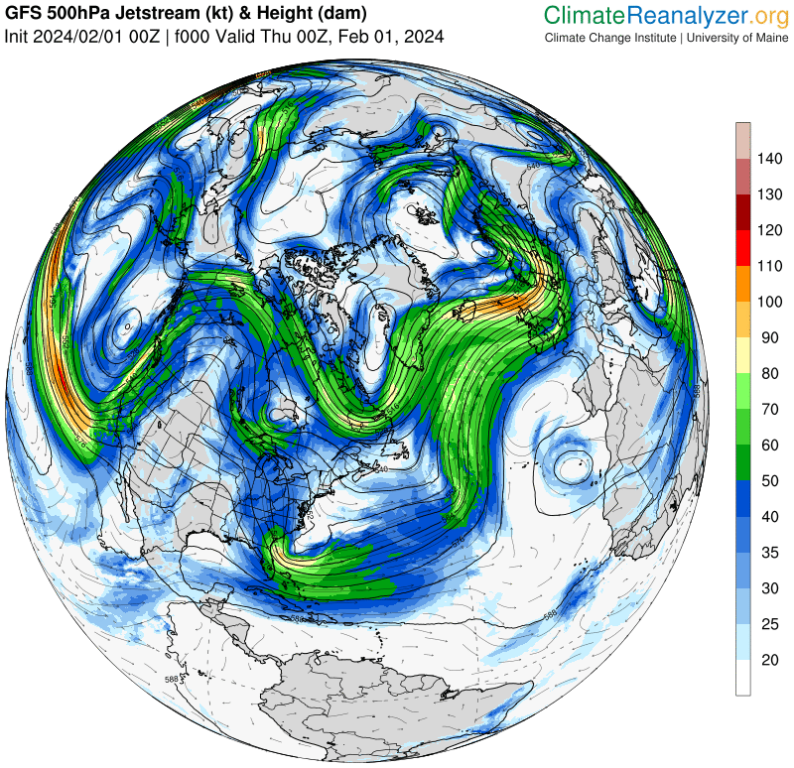
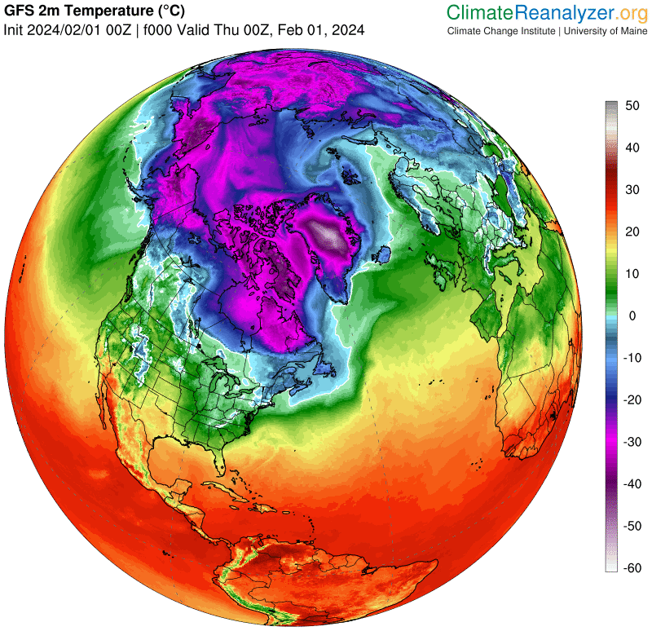
Atmospheric Circulation

Slide 21
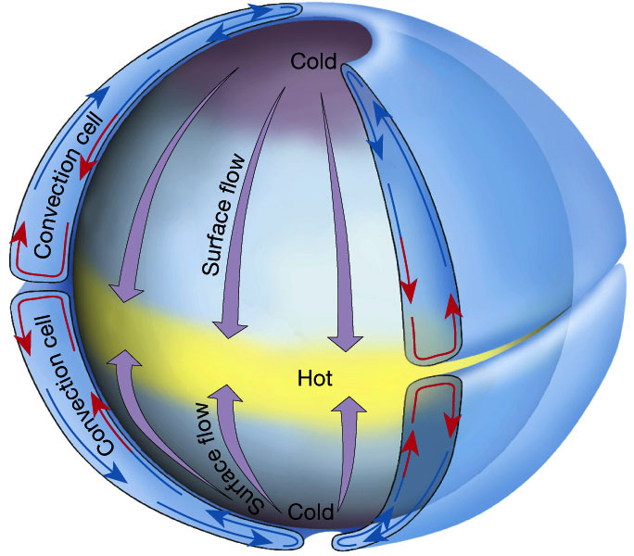
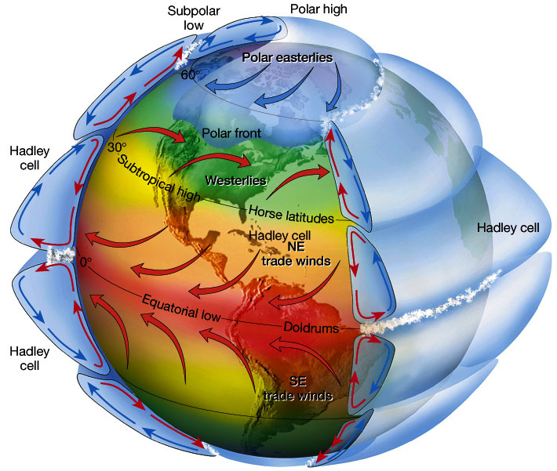
Atmospheric Circulation
Idealized single-cell atmospheric convection
Three-cell atmospheric convection on rotating frame of reference.
Wind deflections in each cell N & S of the equator due to the Coriolis force.
The Atmosphere, 8th edition, Lutgens and Tarbuck, 8th edition, 2001
www.ux1.eiu.edu/~jpstimac/1400/circulation.html

Slide 22
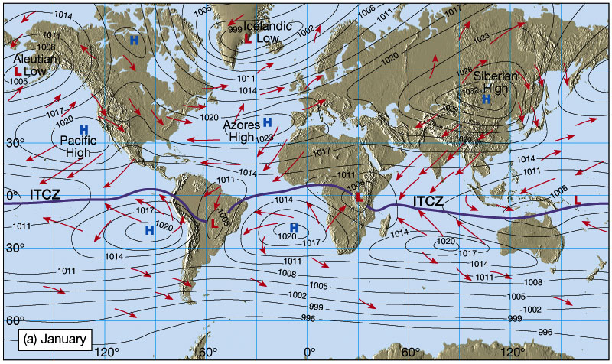
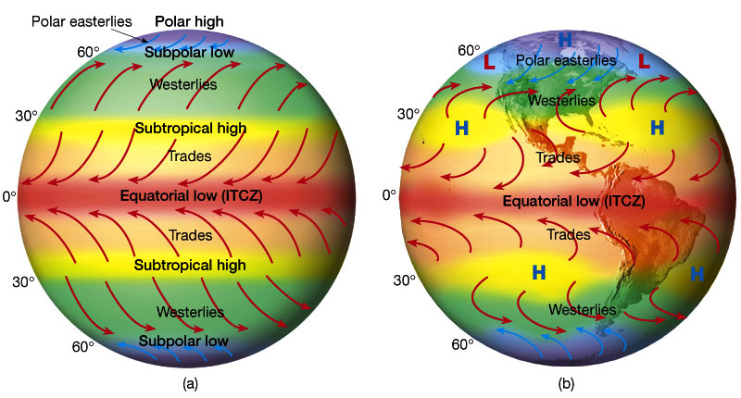
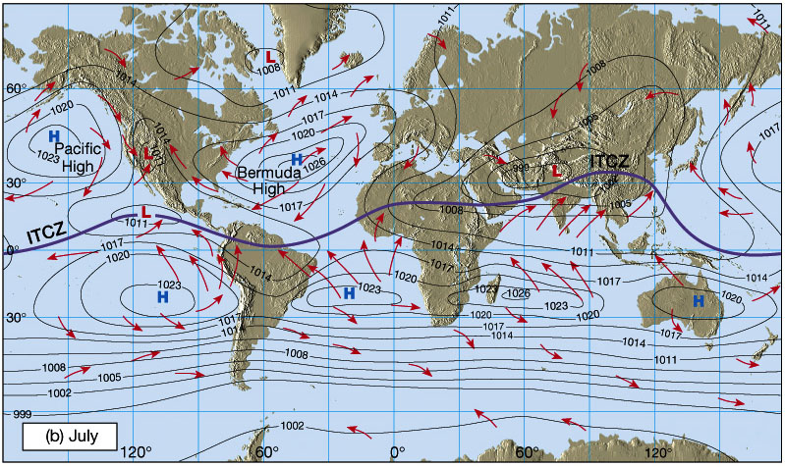
Atmospheric Circulation
Idealized winds from pressure gradient and Coriolis force
Wind patterns due to distribution of land masses
The Atmosphere, 8th edition, Lutgens and Tarbuck, 8th edition, 2001
www.ux1.eiu.edu/~jpstimac/1400/circulation.html

Slide 23
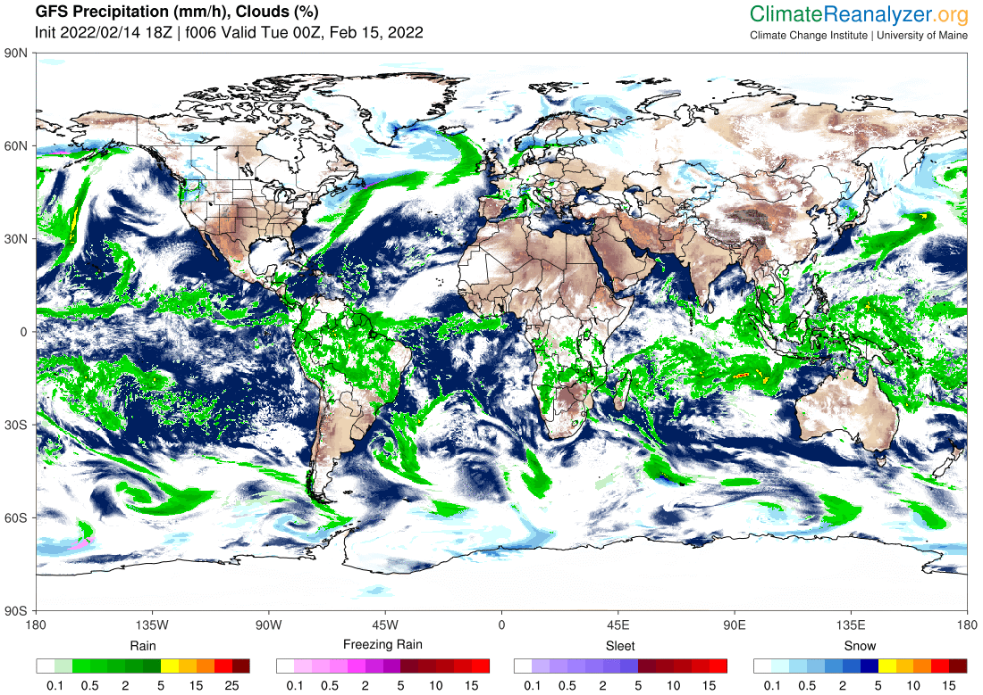
Westerlies
Subtropical High
Intertropical
Convergence Zone
Subtropical High
Westerlies

Slide 24
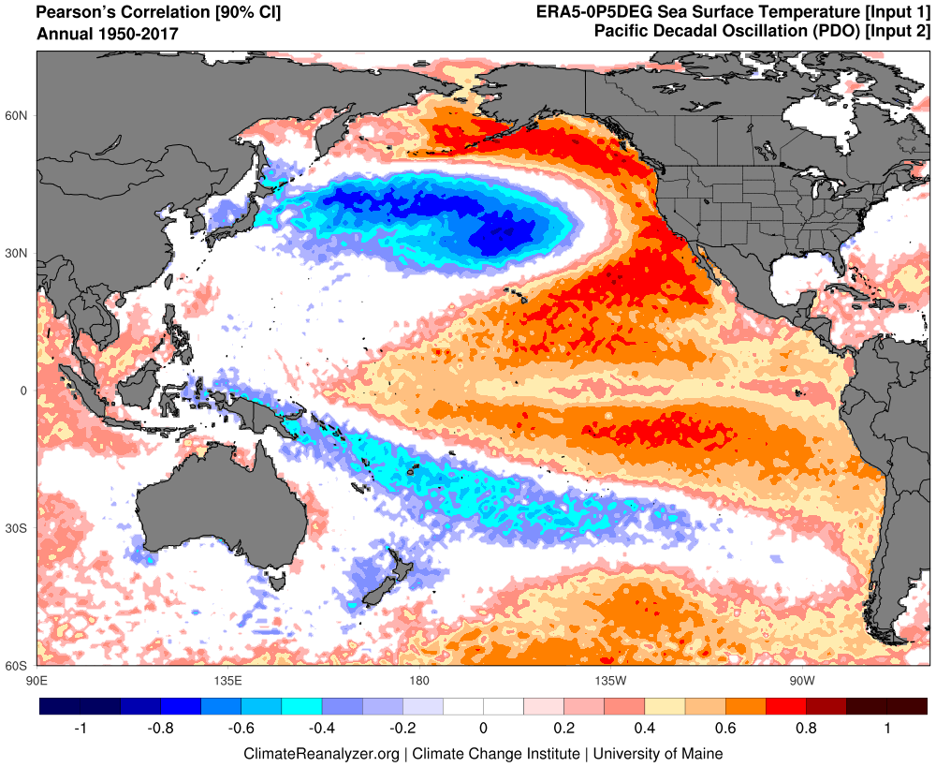
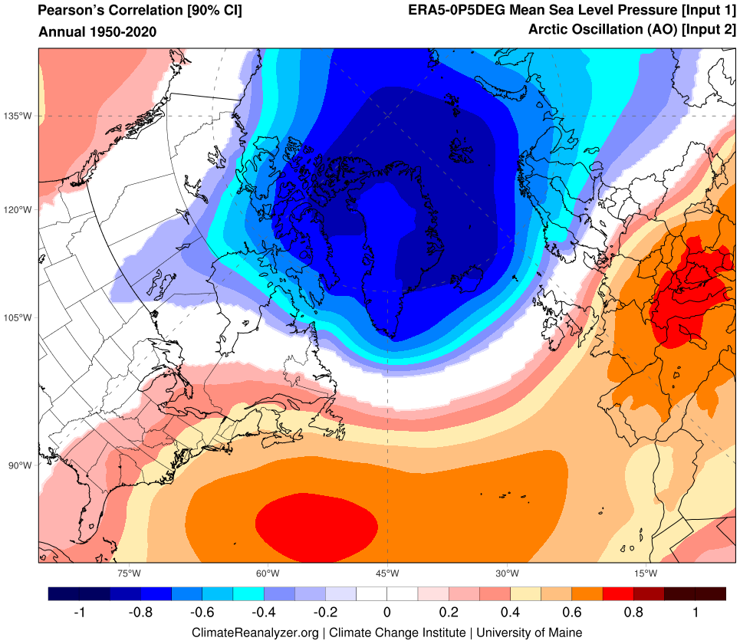
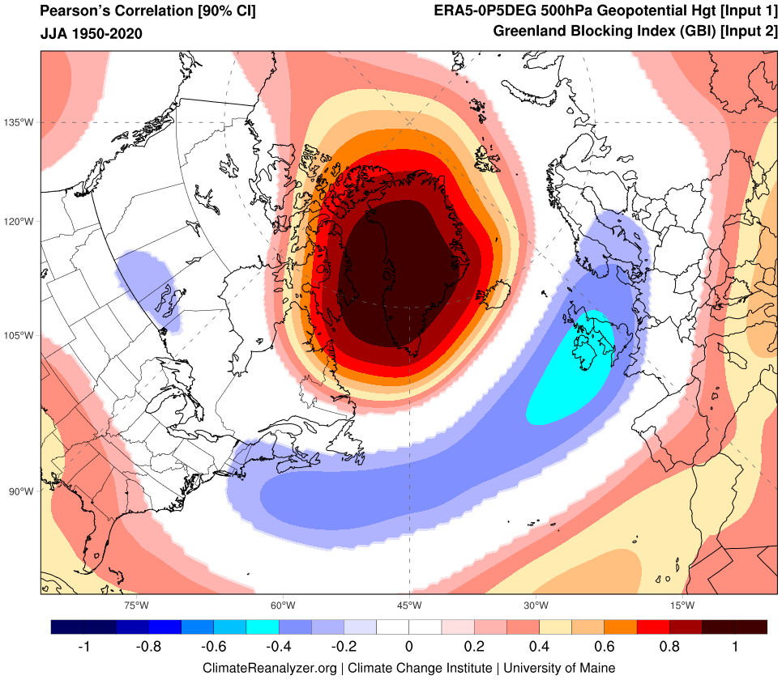
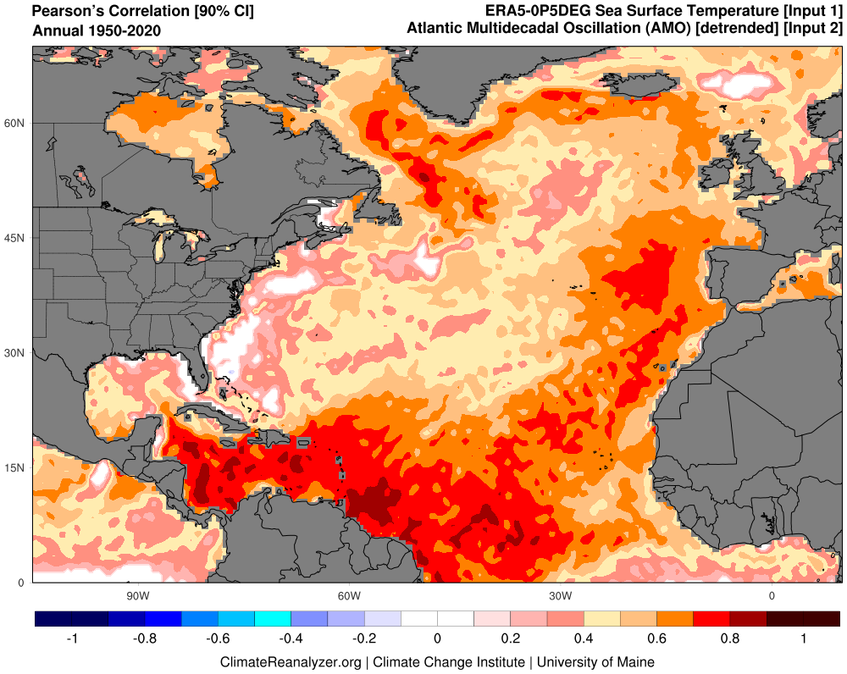
Modes of Climate Variability
Pacific Decadal Oscillation (PDO)
El Niño-Southern Oscillation (ENSO)
Atlantic Multidecadal Oscillation/Variability (AMO/AMV)
North Atlantic Oscillation (NAO)
Greenland Blocking Index (GBI)

Slide 25
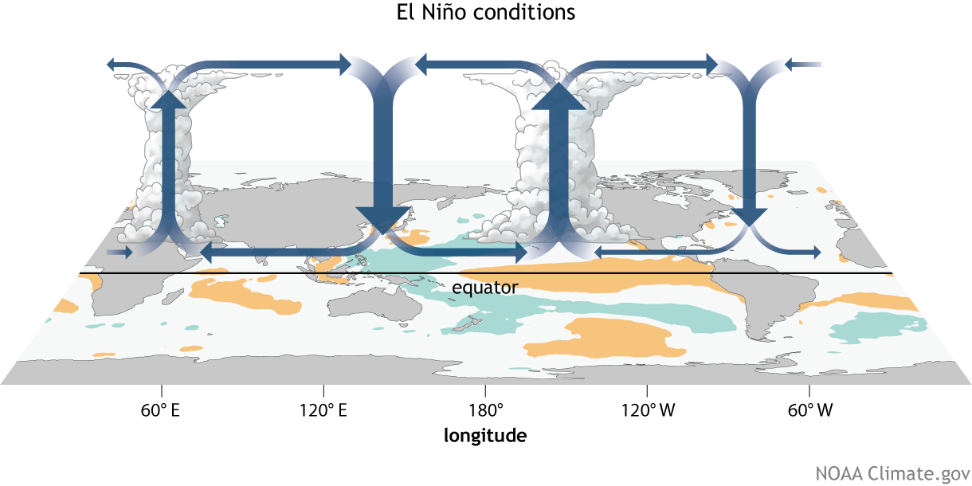
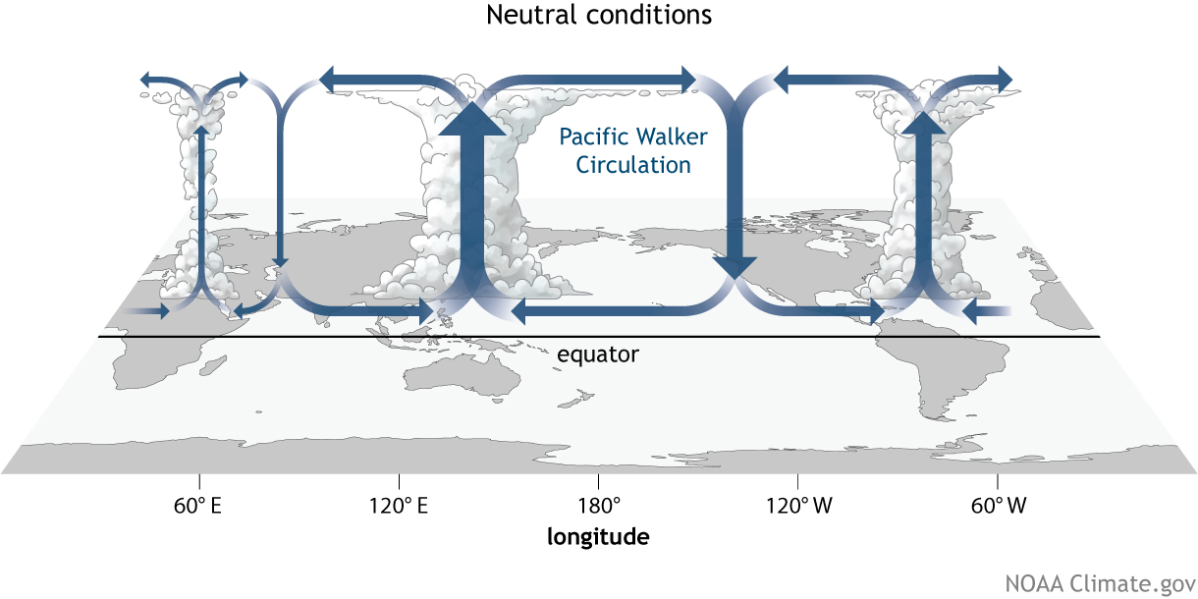
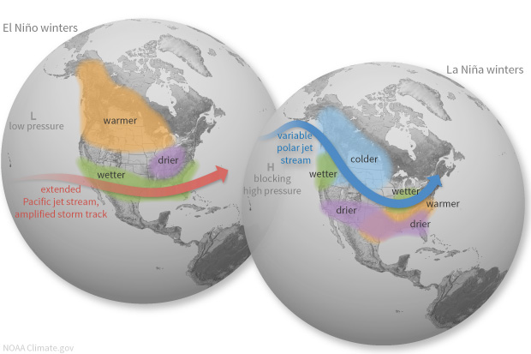
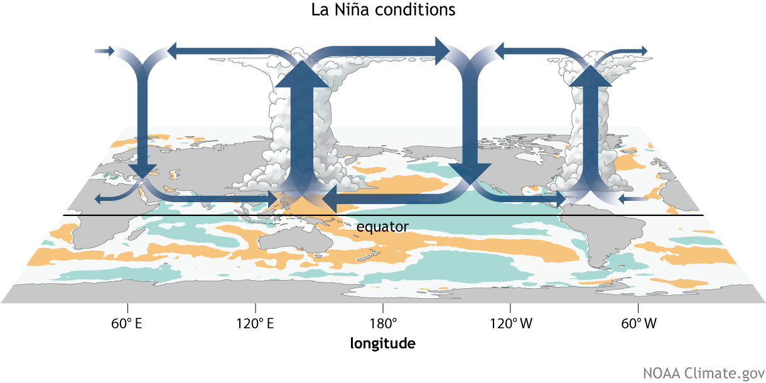
El Niño-Southern Oscillation (ENSO)
Coupled ocean-atmosphere response with irregular period of 2–7 years between El Niño (warm) and La Niña (cool) phases.
ENSO impacts weather worldwide, particularly during boreal winter.
Atmospheric response known as Walker circulation.
https://www.climate.gov/enso

Slide 26
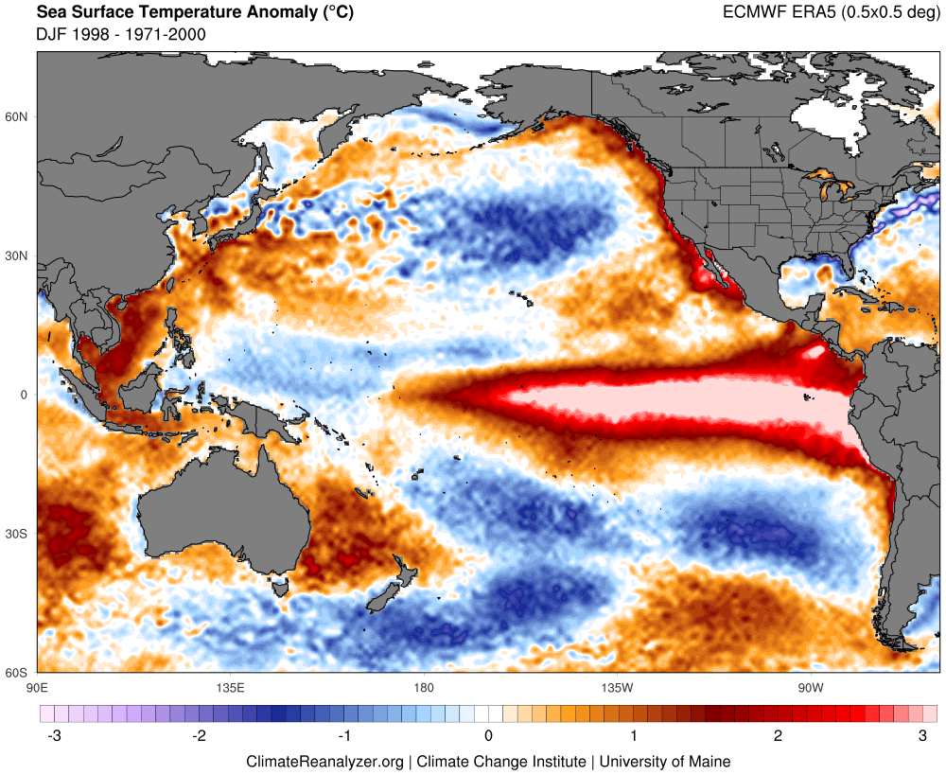
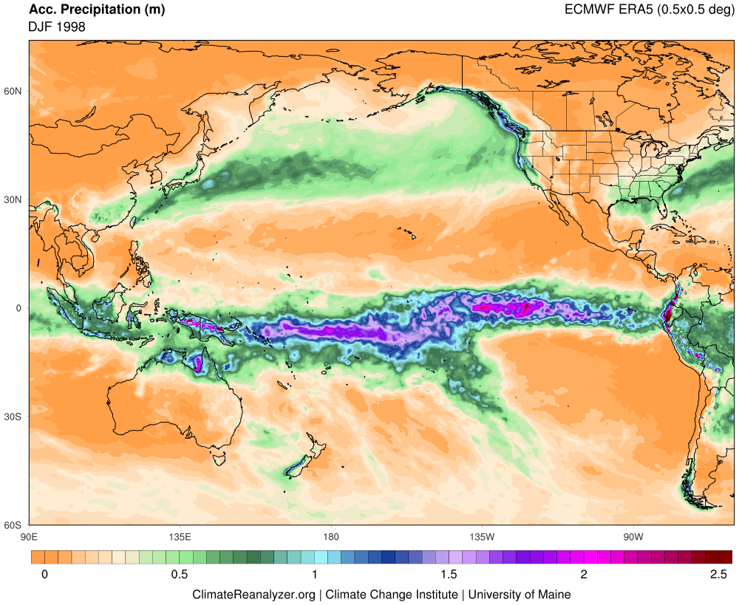




SST Anomaly
Precipitation
Precipitation Anomaly
DJF 1998
El Niño
DJF 1999
La Niña

Slide 27




North Atlantic Oscillation (NAO)
Mean Sea Level Pressure (hPa)
Dominant mode of weather variability across the North Atlantic with primary expression in winter months
NAO Index represents the difference in mean sea level pressure between Azores and Iceland
NAO+ (steep poleward gradient) and NAO- (weak poleward
gradient) are
associated with
shifted jet stream
and storm tracks
NAO is associated
with multi-decade
temperature shifts
DJF 2010
DJF 2015
2015
Precip Anomaly
2015 – 2010
2010

Slide 28


Slide 29


Evidence for a Volcanic Underpinning of the Atlantic Multidecadal Oscillation
Sean D. Birkel, Paul A. Mayewski, Kirk A. Maasch,
Andrei V. Kurbatov, Bradfield Lyon
NPJ Climate and Atmospheric Science (2018)

Slide 30


Slide 32

Thank You
Sean Birkel
Assistant Professor
Maine State Climatologist
birkel@maine.edu

Slide 33


500 ppm 2100
Ice Core Record
Vostok Station, Antarctica
400 ppm 2015
290 ppm Natural
Warm
Cold

