Slide 1
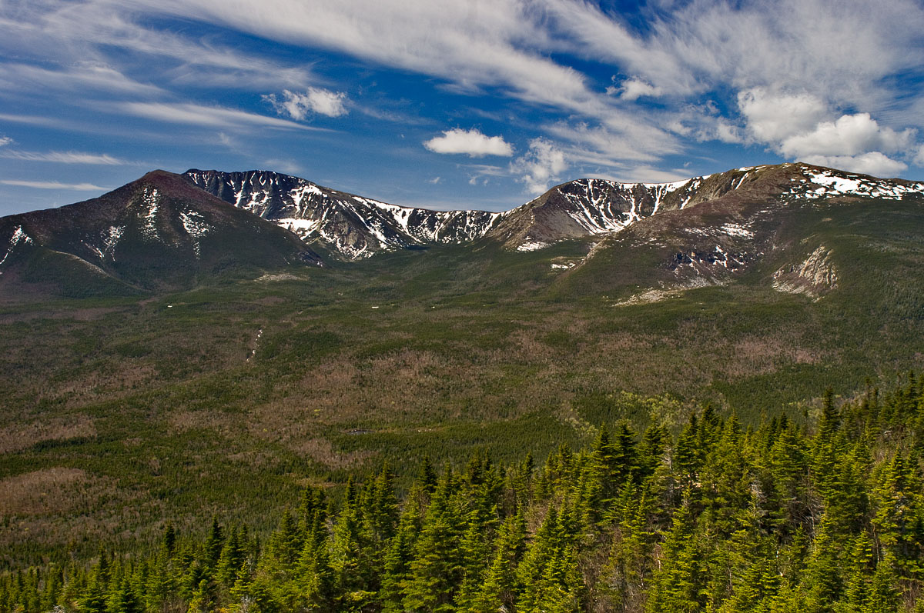
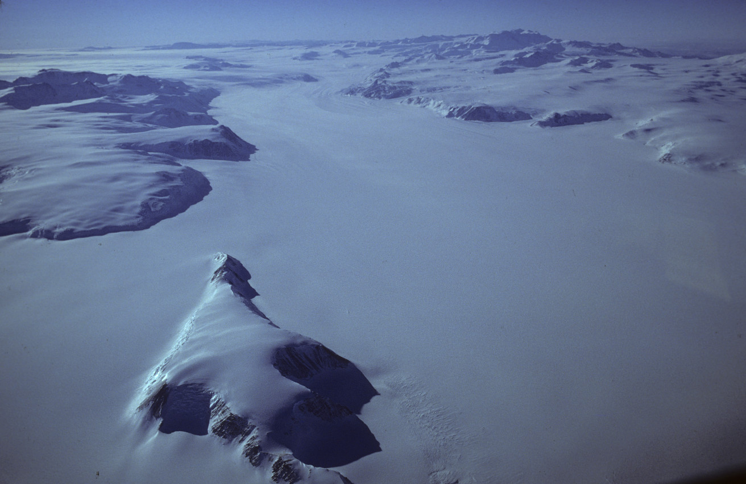


Ice Ages and Maine’s Landscape
Sean Birkel, Ph.D.
Assistant Professor & Maine State Climatologist
Penobscot Valley Senior College
September 29, 2025

Slide 2
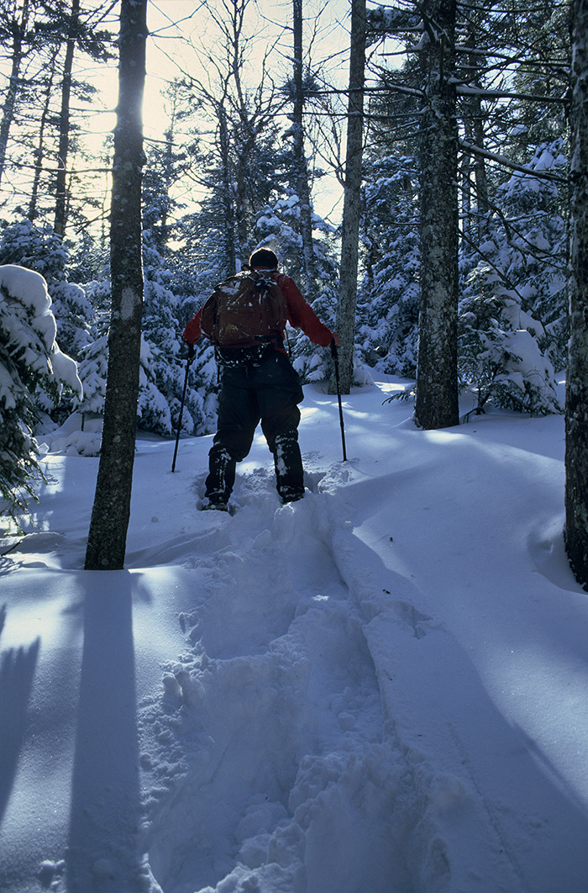
Presentation Outline
Introduction
Pleistocene Ice Ages
The Laurentide Ice Sheet
Exploring Maine’s Glacial Landscape

Slide 3
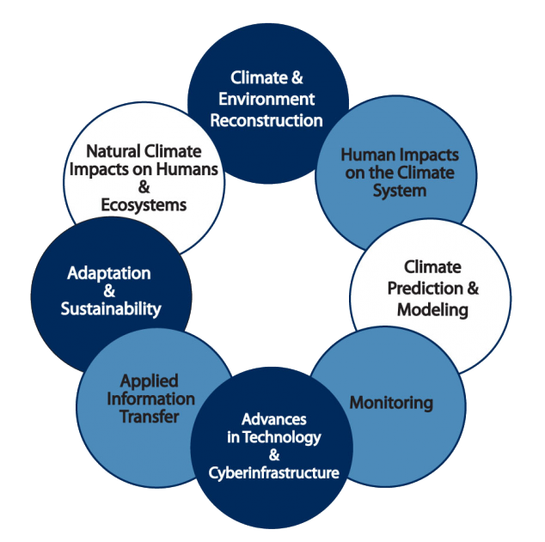
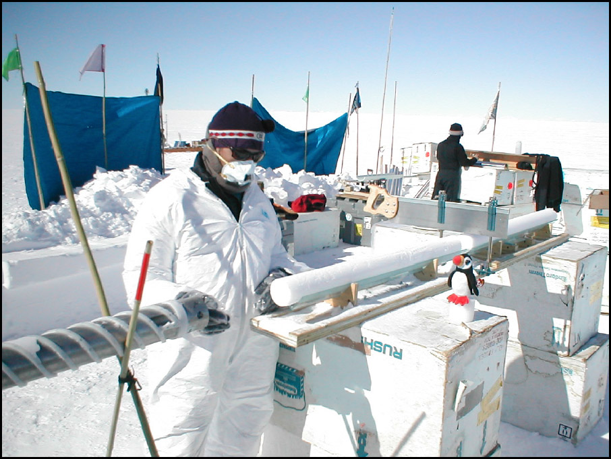
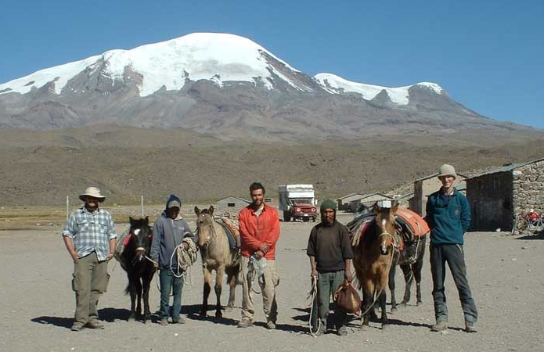
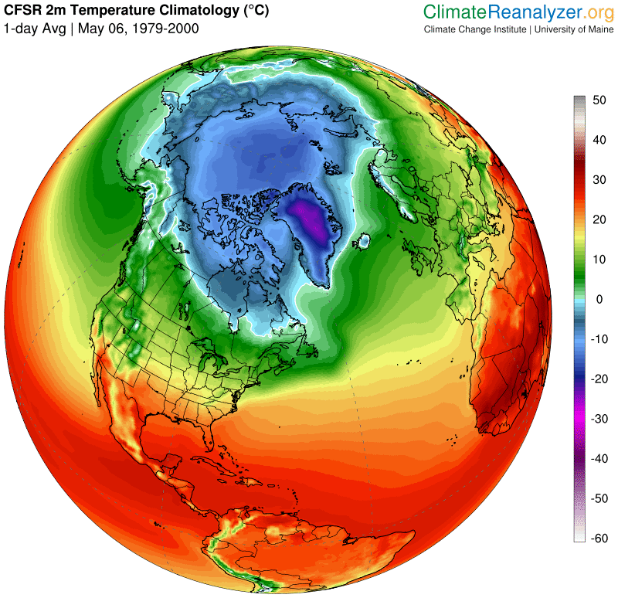
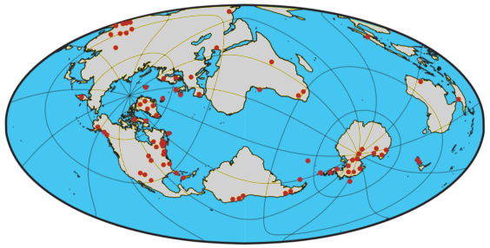
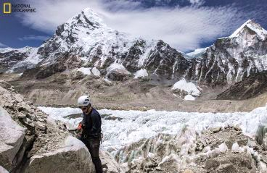
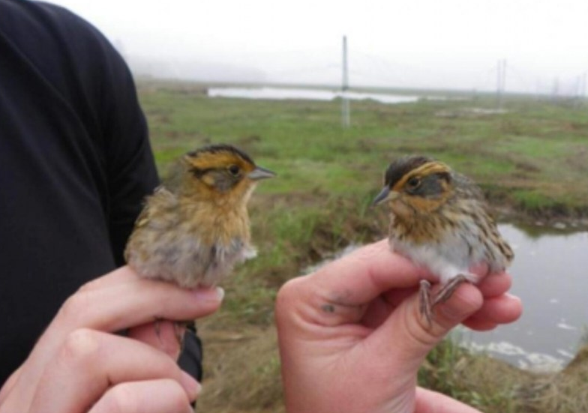
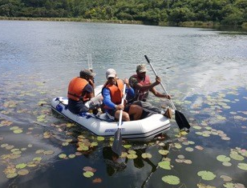
Climate Change Institute
We conduct interdisciplinary research on the physical, biological, and human dimensions of climate over the Quaternary period (past 2 million years). Our field projects are located in Maine and around the world, involving both faculty and graduate students. CCI has more than 130 members and associates, including about 60 graduate students supported through grants.

Slide 4
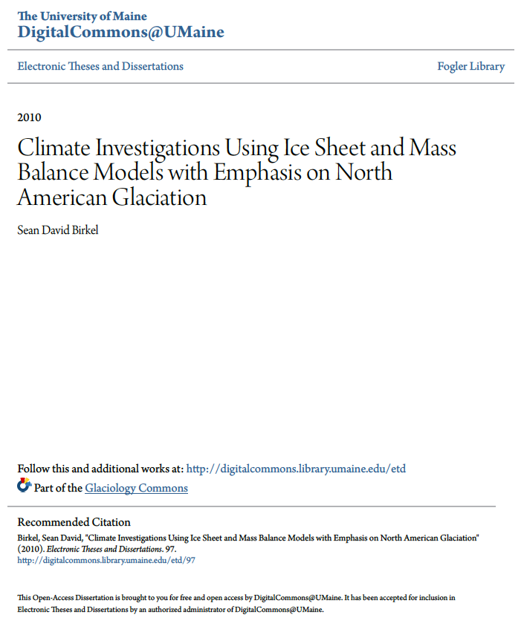
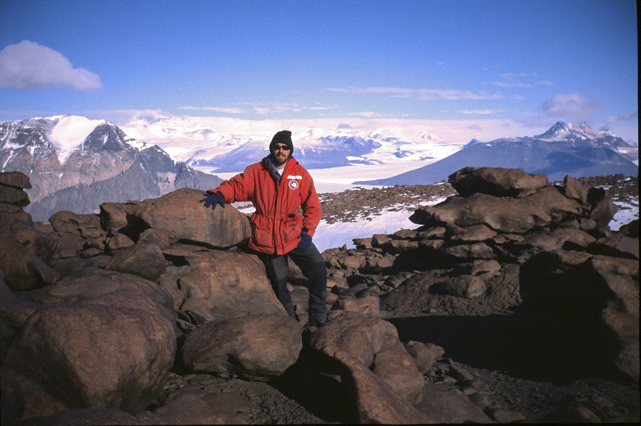
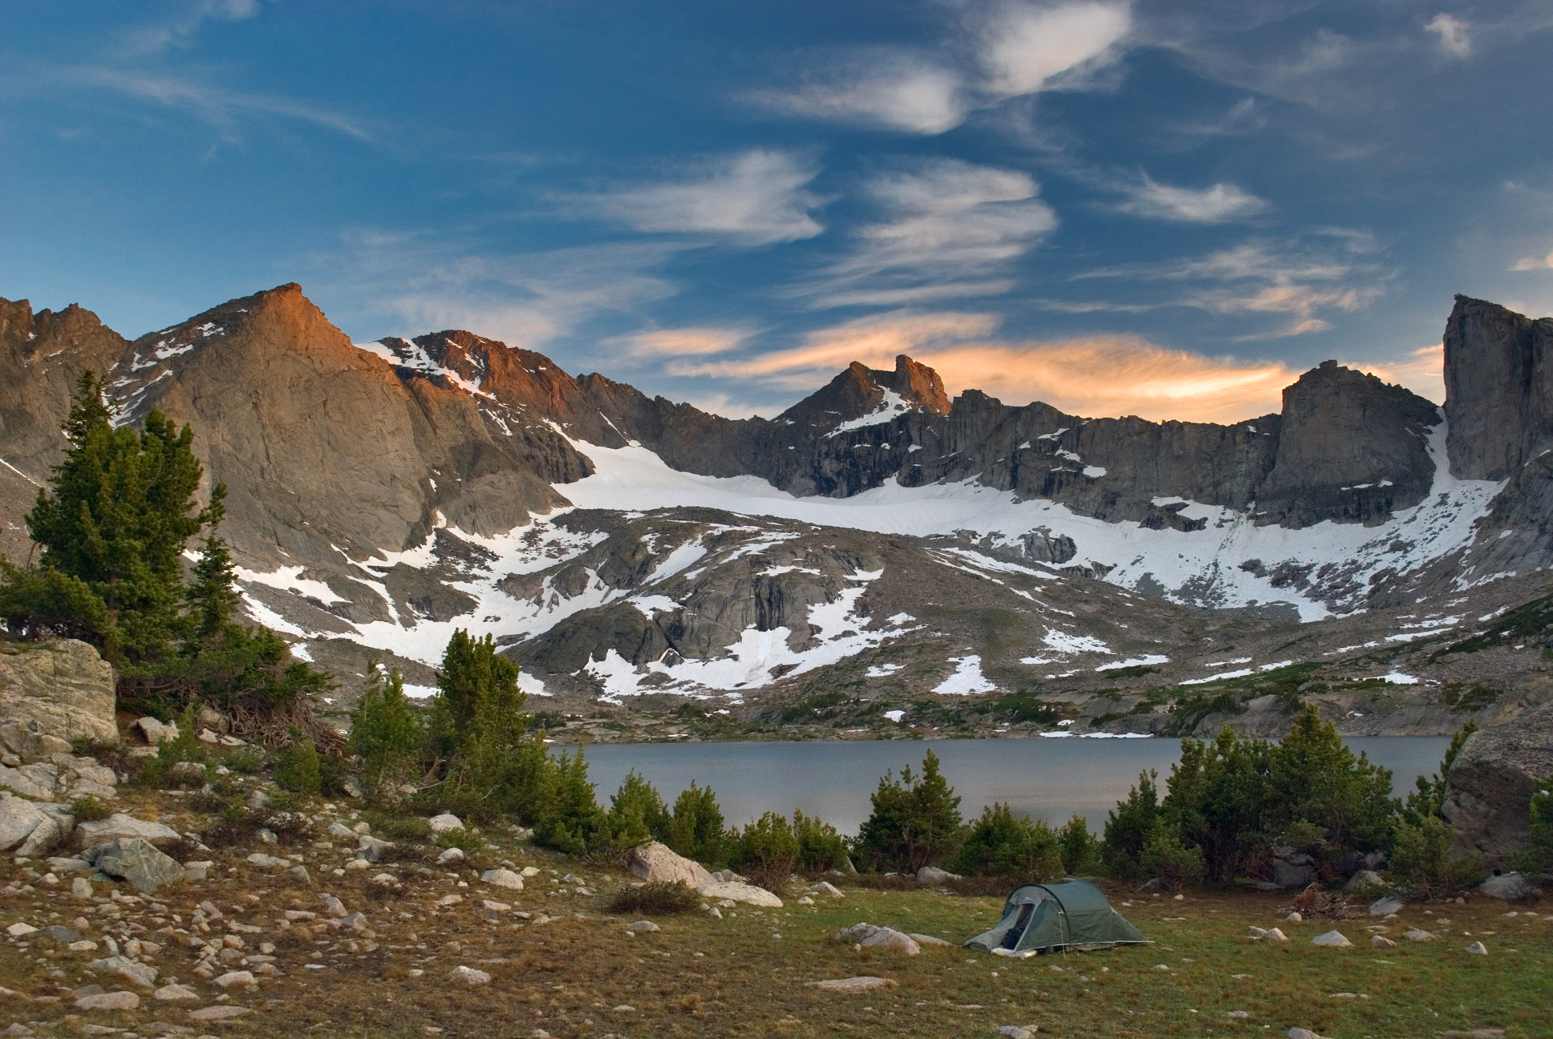
Dry Valleys, Antarctica Jan/Feb 2003
Mentors:
George Denton
Terry Hughes
Brenda Hall
Harold (Hal) Borns
Peter Koons
James Fastook
Kirk Maasch
Paul Mayewski
Wind River Range, WY July 2008 & 2009

Slide 5
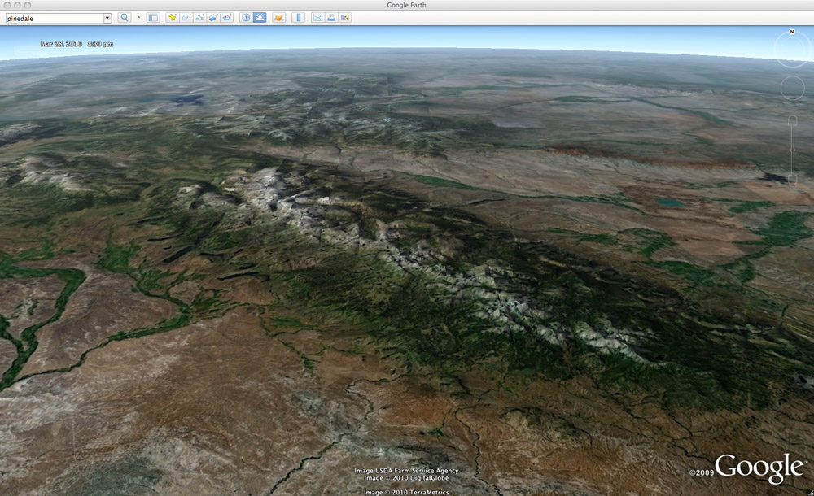
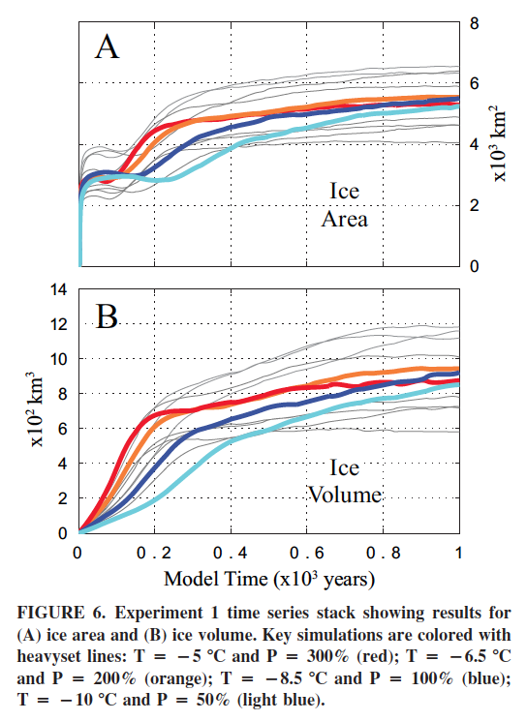
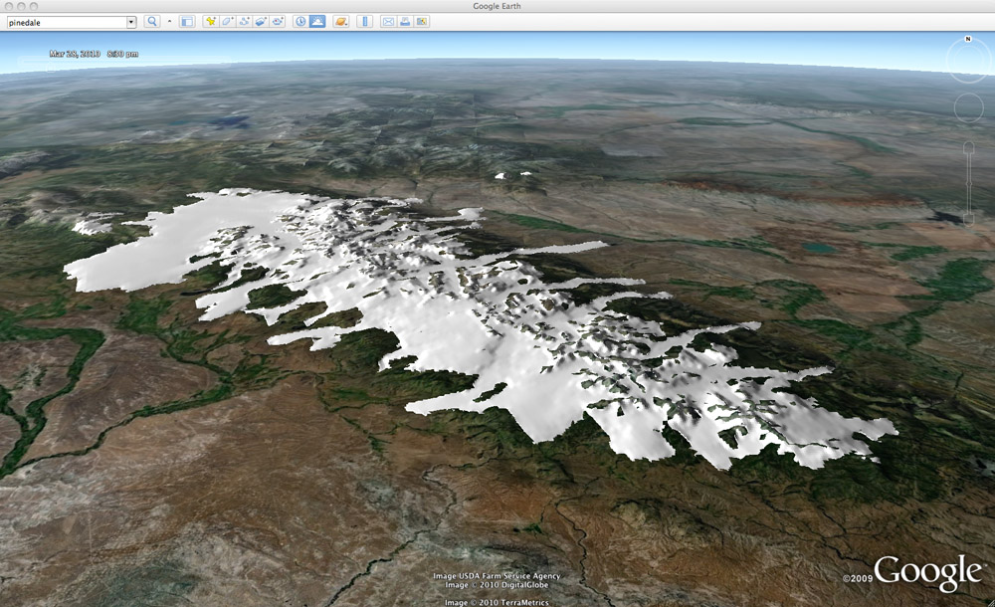
UMaine Ice Sheet Model
Wind River Range Simulation
Birkel et al., 2012
Modern
LGM

Slide 6
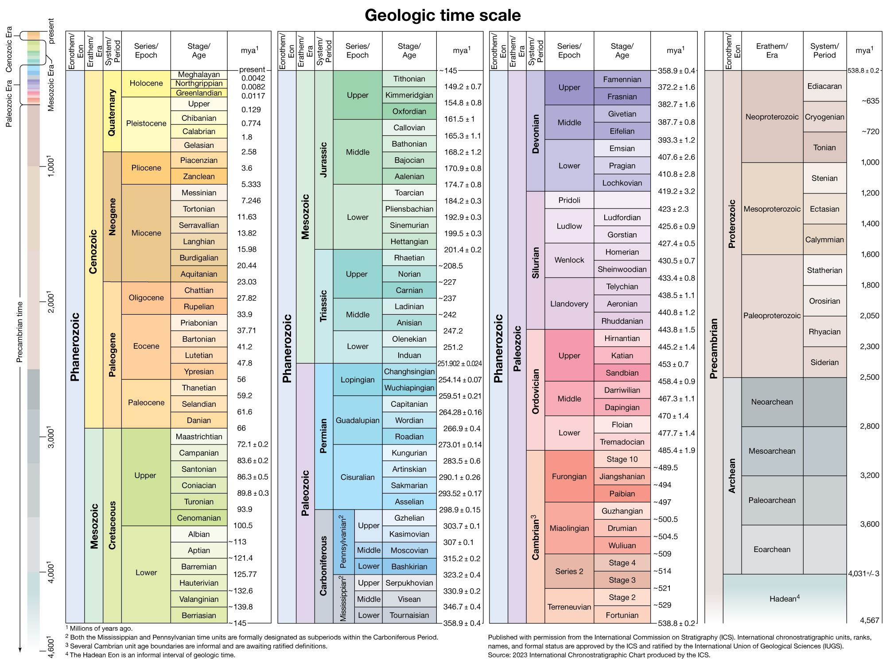
Quaternary Period
Last 2.6 million yrs
Pleistocene Epoch
2.6–0.1 Mya
Holocene Epoch
Last ~10 kyrs
Encyclopedia Britannica, Inc. Source: International Commission on Stratigraphy https://www.britannica.com/science/Quaternary#/media/1/486563/66800

Slide 7
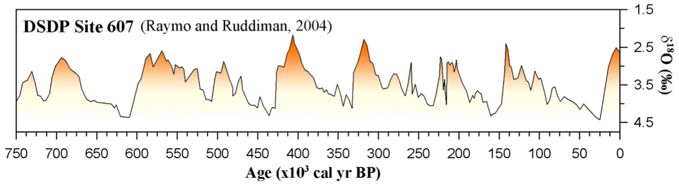
Broecker and Denton (1989)
Last Glacial Maximum (LGM) 18k – 24k years ago
Pleistocene
Glacial Cycles
Global Ice Volume Proxy
Interglacial
Glacial

Slide 8
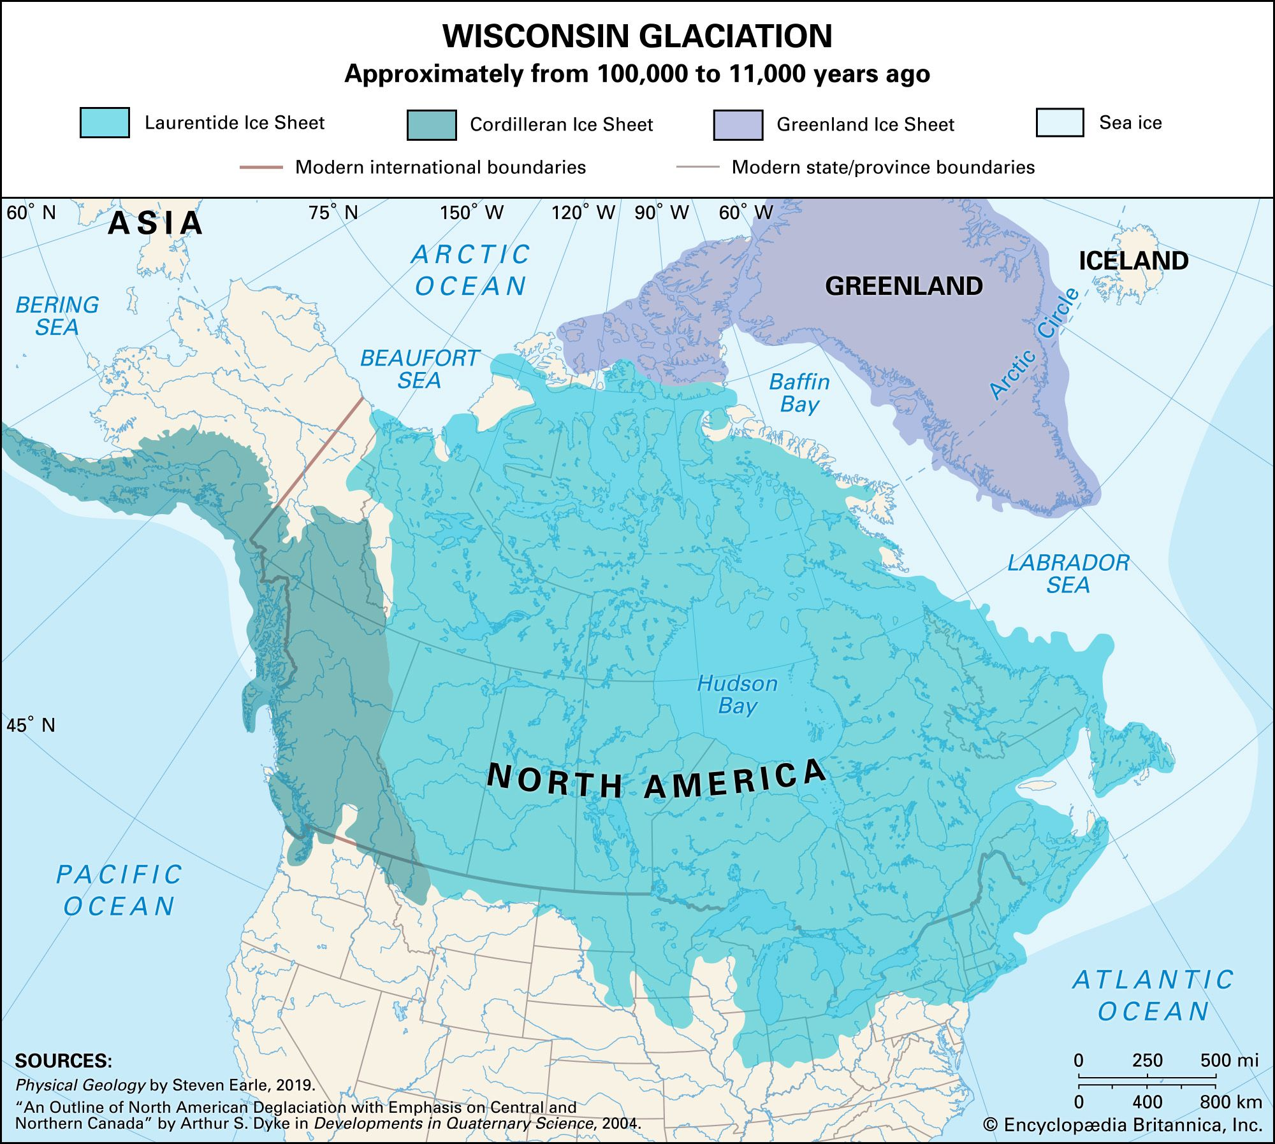
Encyclopedia Britannica, Inc./Kenny Chmielewski https://www.britannica.com/science/Pleistocene-Epoch/Pleistocene-events-and-environments#/media/1/464579/258684

Slide 9
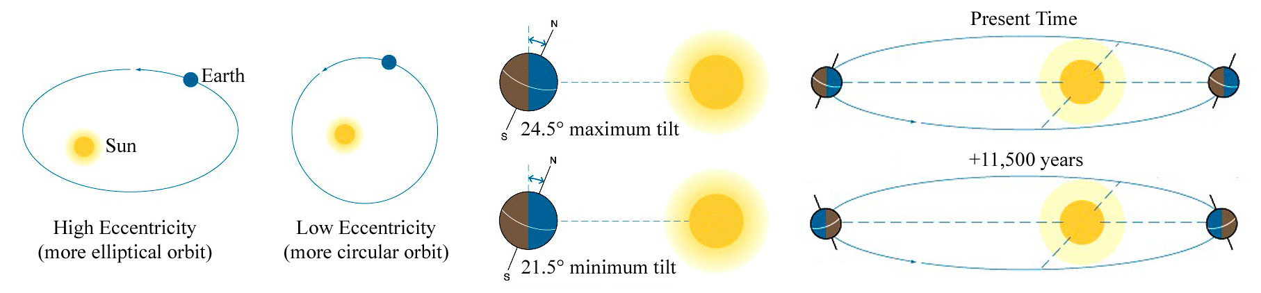
The Role of Orbital Variations
Eccentricity (~100 kyr)
Obliquity (41 kyr)
Precession (19-23 kyrs)
Adapted from Exploring Earth, Second Edition

Slide 10
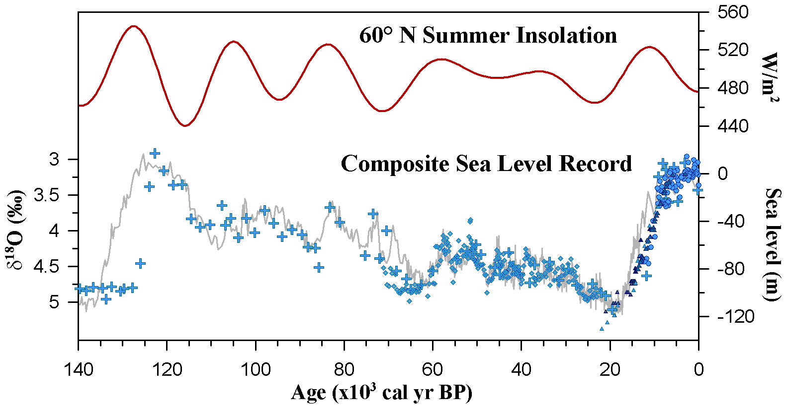
The Role of Orbital Variations
Interglacial
Glacial
Sea level data: Fairbanks, 1989; Bard et al., 1990; Shackleton, 2000; Siddall et al., (2003)
Insolation data: Berger and Loutre (1991)

Slide 11
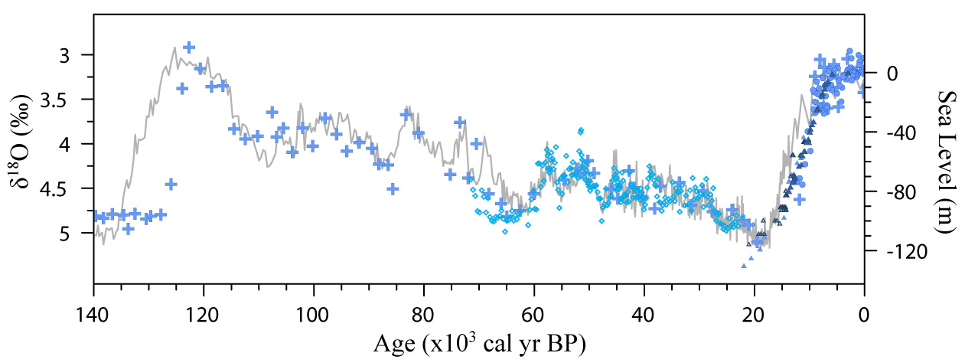
The Last Glacial Cycle
Holocene Interglacial
Glacial Termination
Composite Global Sea Level
Last Glacial Maximum ~18–24 kyrs BP
Sea level data: Fairbanks, 1989; Bard et al., 1990; Shackleton, 2000; Siddall et al., (2003)

Slide 12
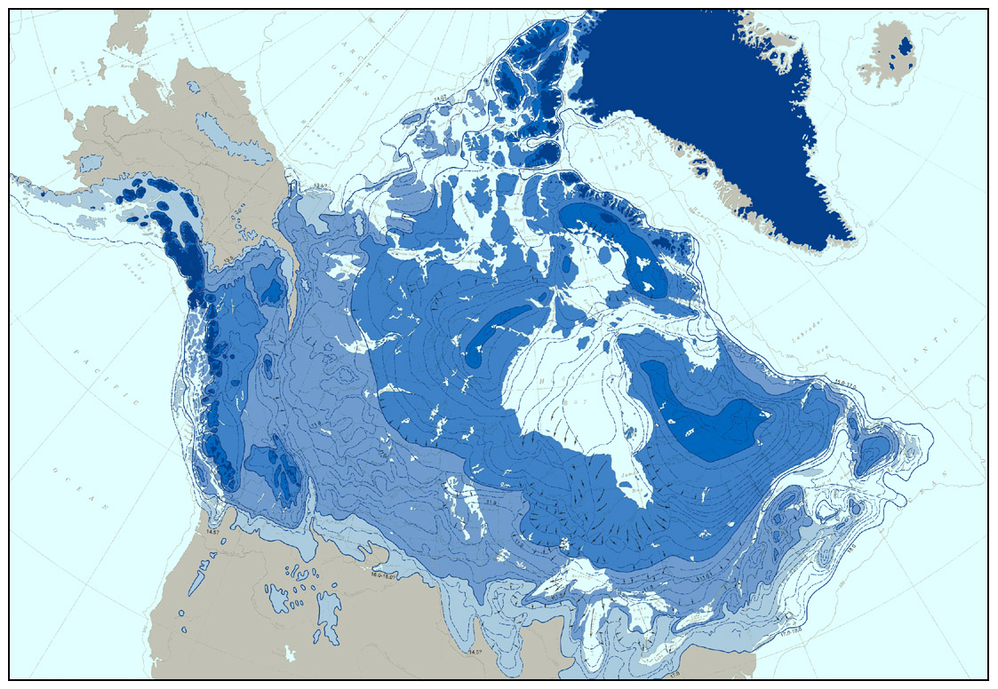
Innuitian Ice Sheet
Greenland Ice Sheet
6–7 ka
Cordilleran Ice Sheet
7–10 ka
L a u r e n t i d e I c e S h e e t
10-13 ka
Modified from Prest (1973)
13-18 ka

Slide 13
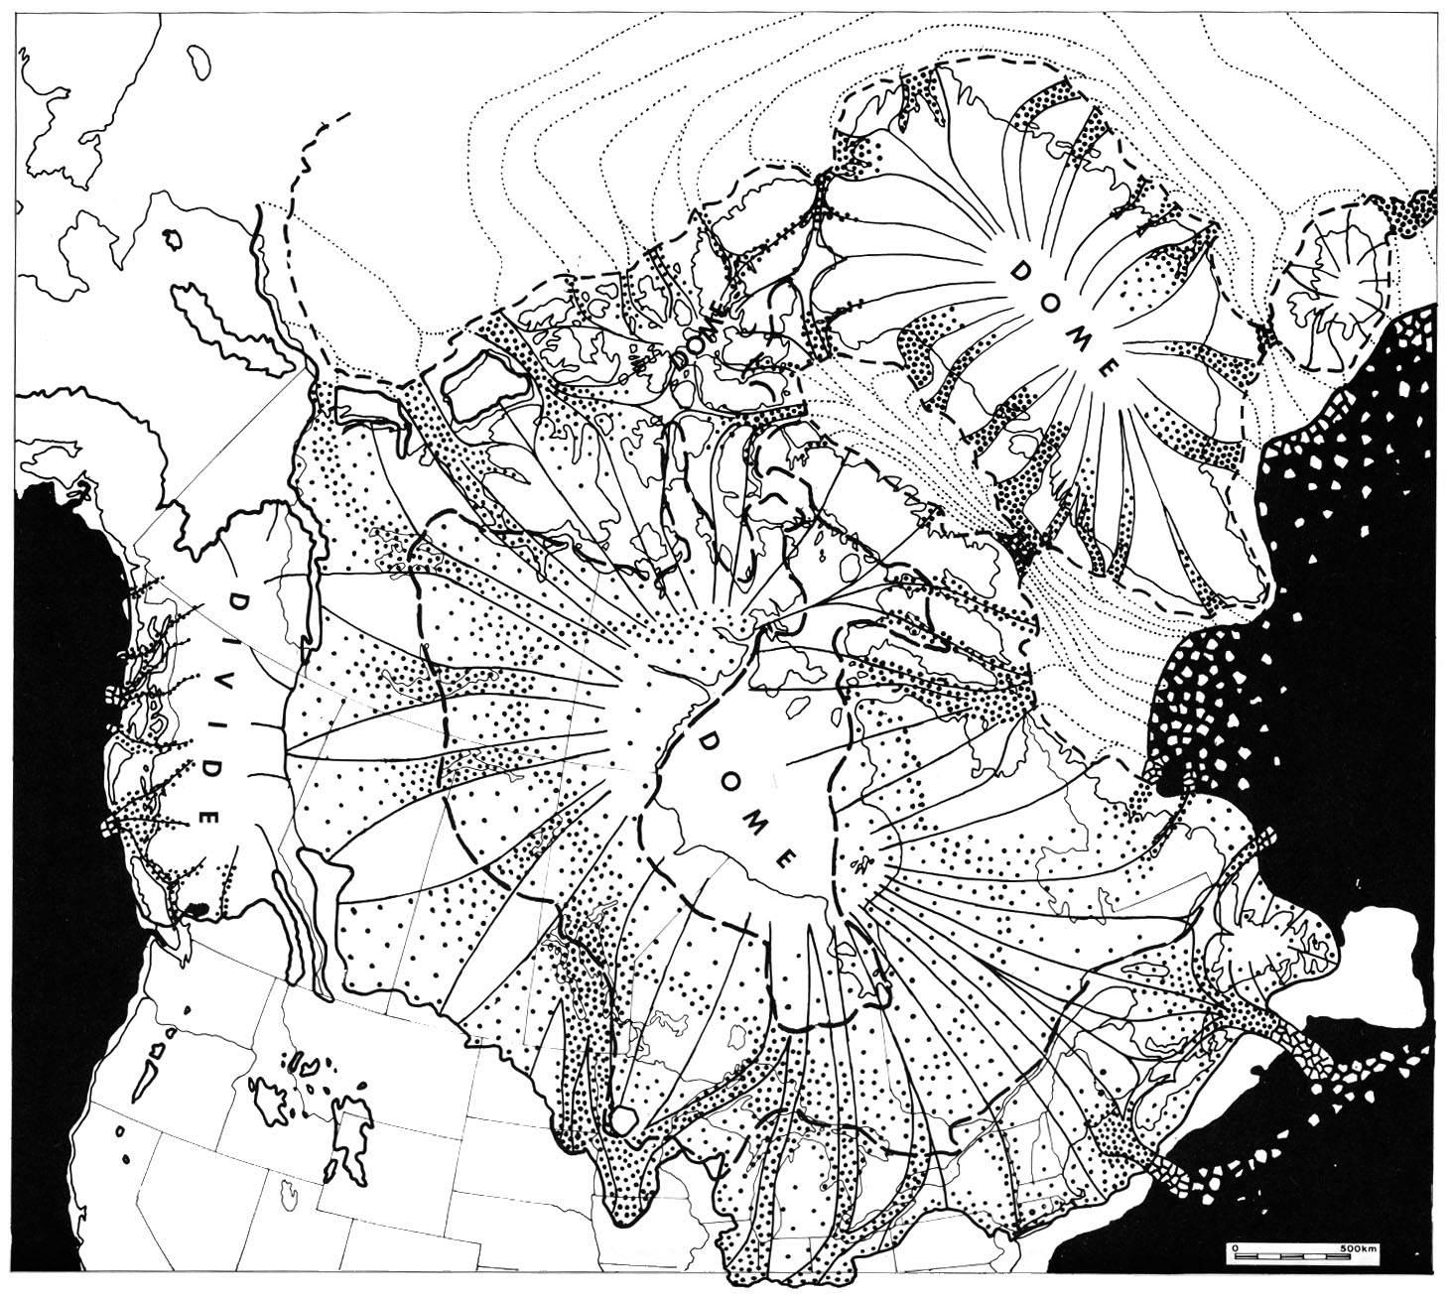
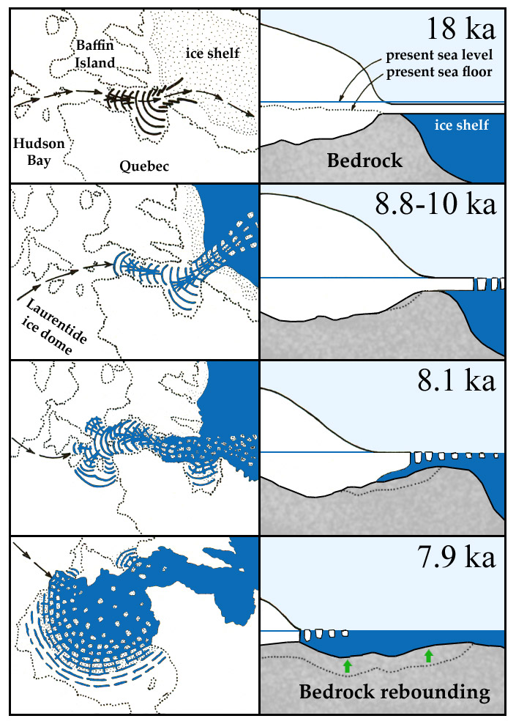
Marine Instability Hypothesis
Denton and Hughes (1981)
Hughes et al. (1977)

Slide 14
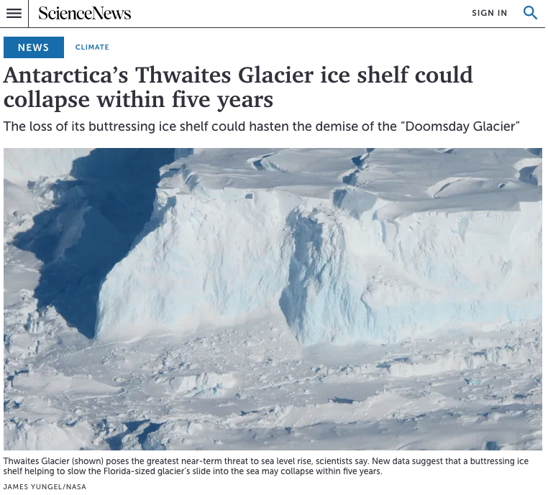

Slide 15
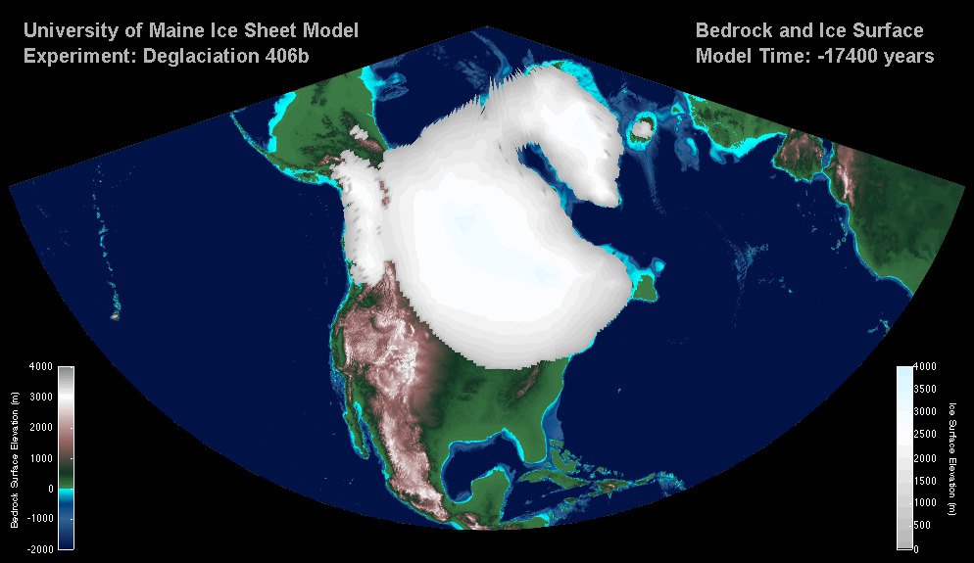

Slide 16
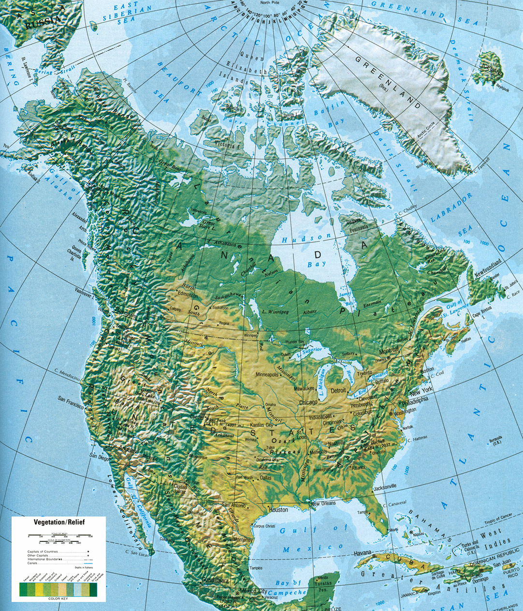
Hammond World Atlas (2002)

Slide 17
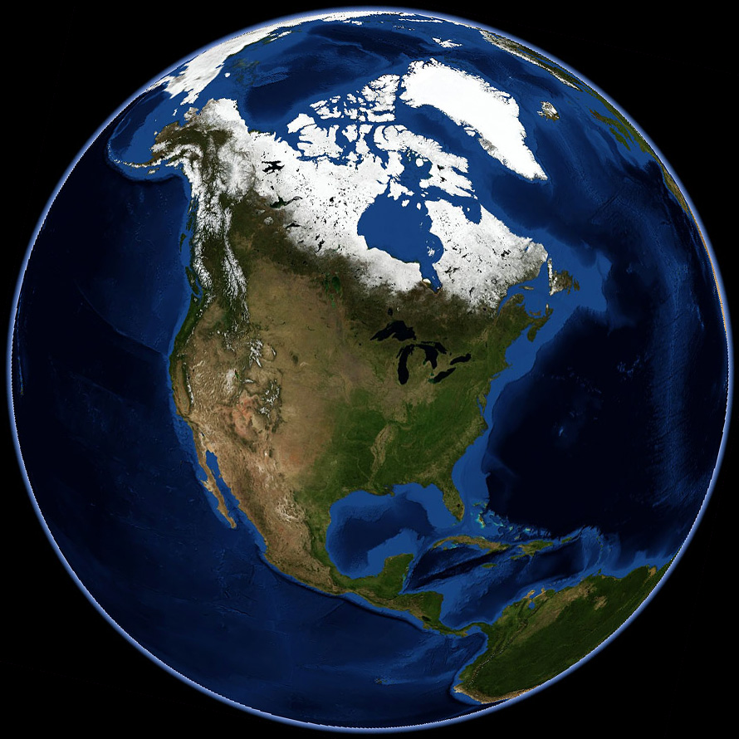
May, 2004 NASA World Wind
Composite Satellite Imagery

Slide 18
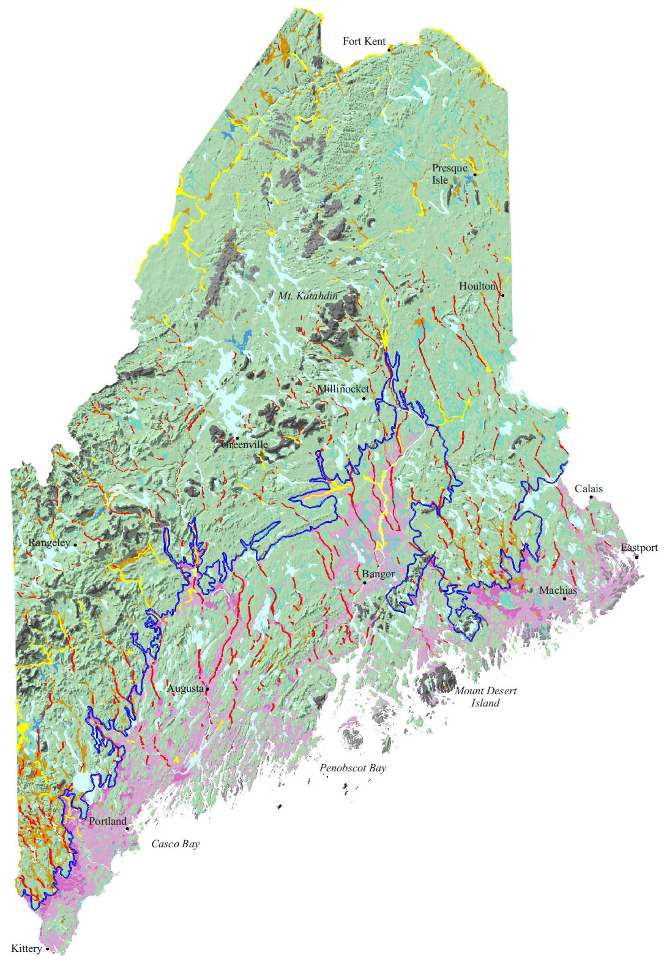
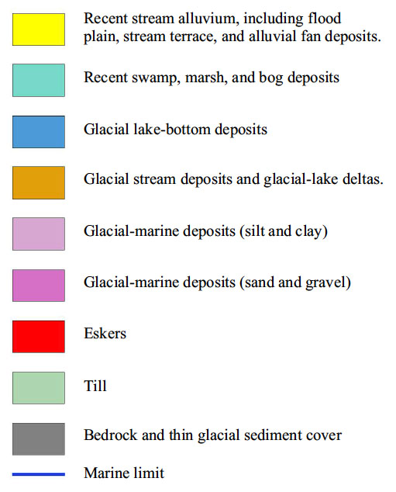
Maine Surficial Geologic Map
Deglaciation ~14.5 to 10 kyrs BP south to north
Department of Conservation Maine Geological Survey
100 km

Slide 19
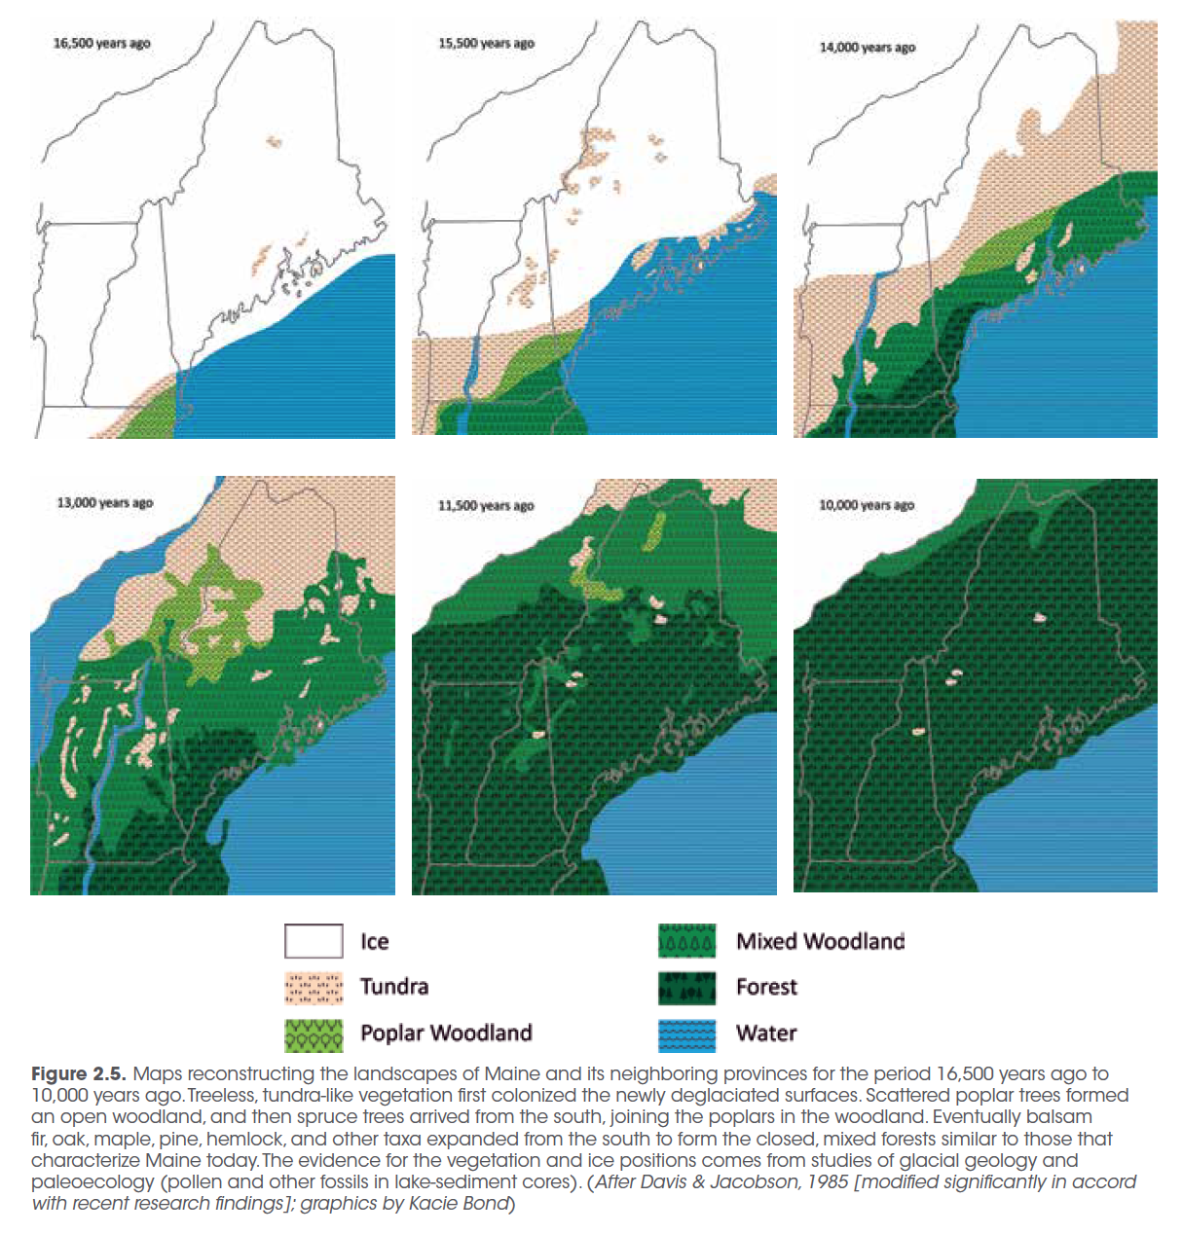
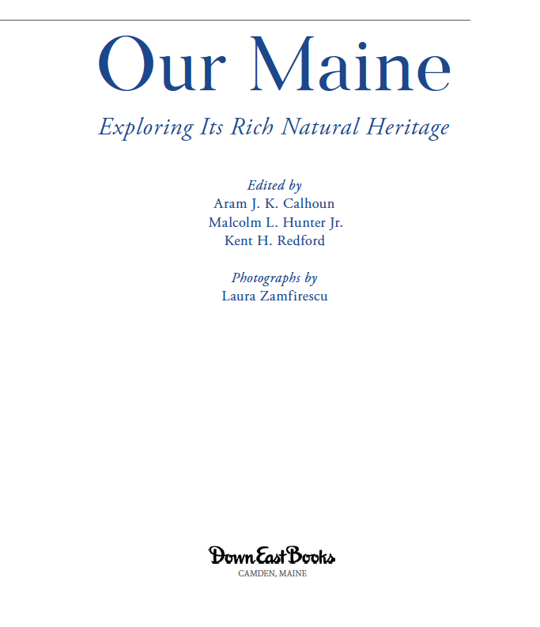
16,500
15,500
14,000
13,000
11,500
10,000

Slide 20
Photo by G. Denton

Slide 21
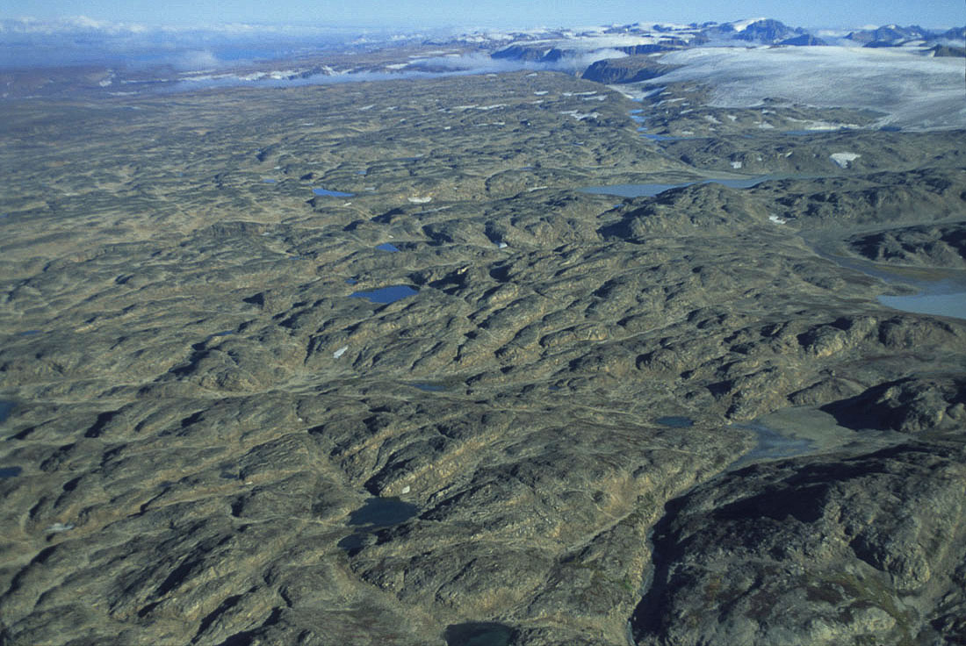
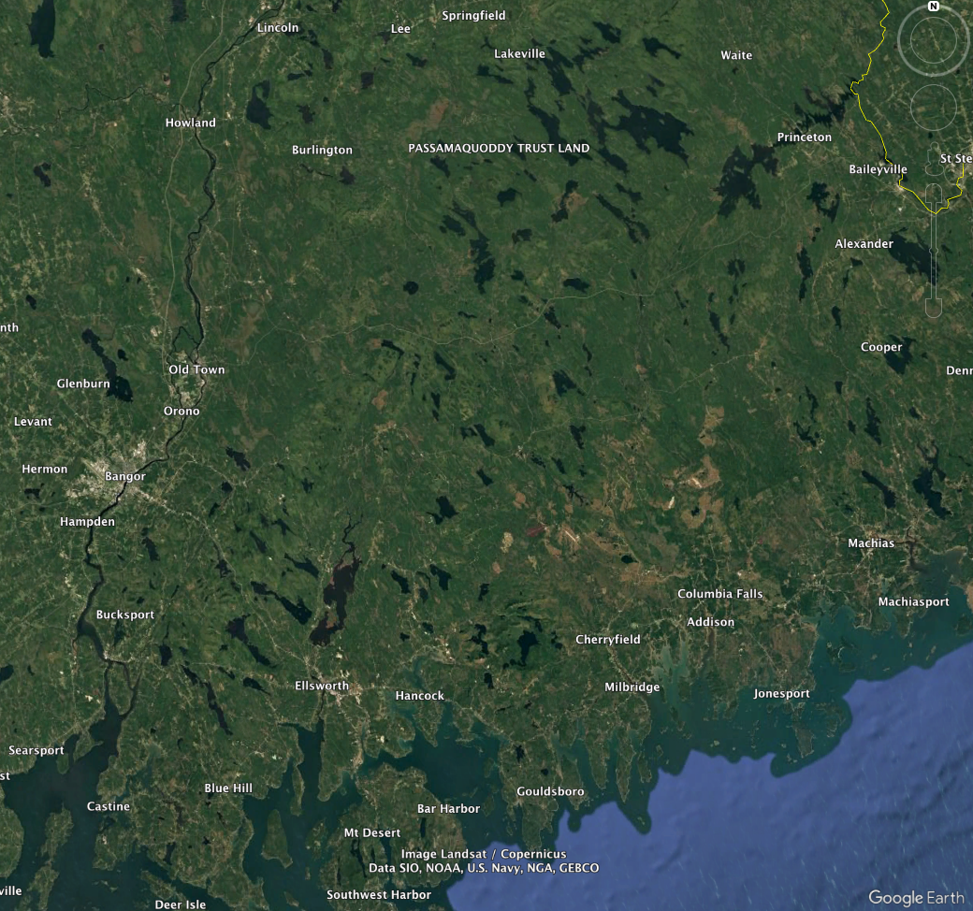
Aerial scour/lake landscape
East Greenland aerial scour
Downeast Maine aerial scour

Slide 22
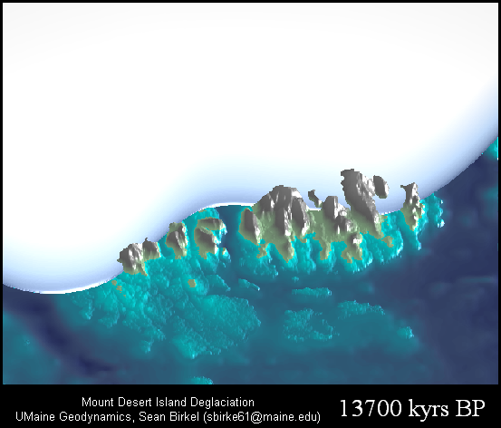
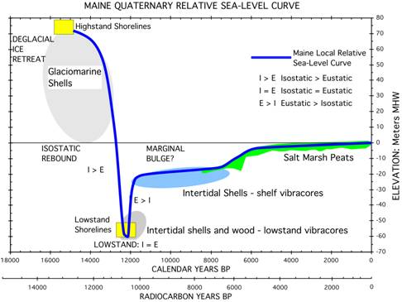
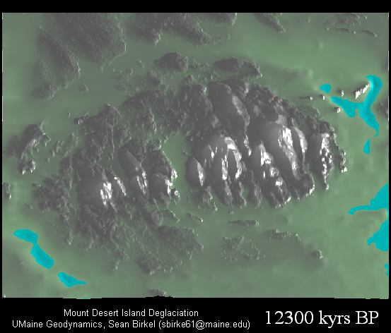
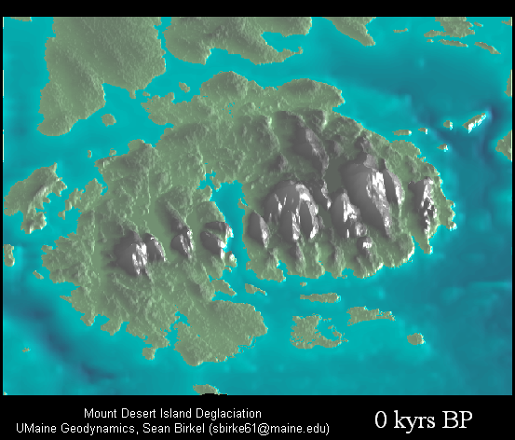
+65 m
-60 m
0 m

Slide 23
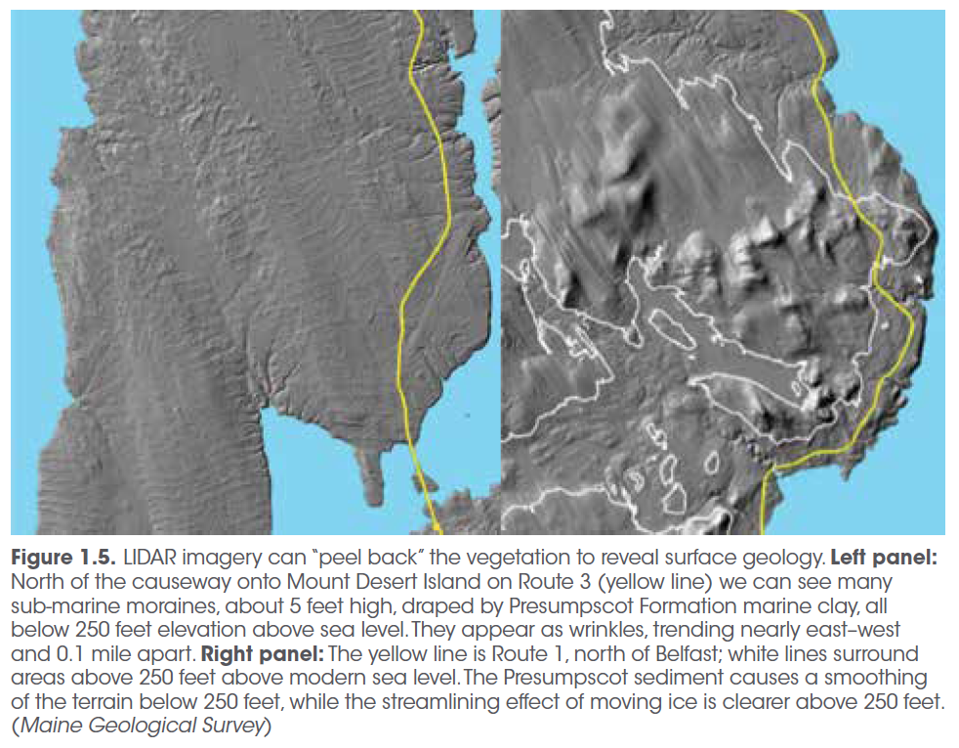
From “Our Maine” (2024), edited by Aram Calhoun, Malcolm Hunter Jr., Kent Redford
Trenton
Lincolnville

Slide 24
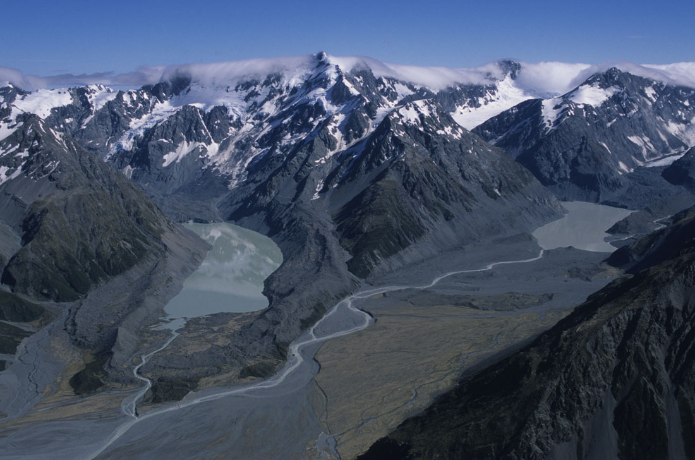
Lateral Moraine
Trimline
Proglacial Lake
Terminal Moraines
Outwash
Photo by G. Denton

Slide 25
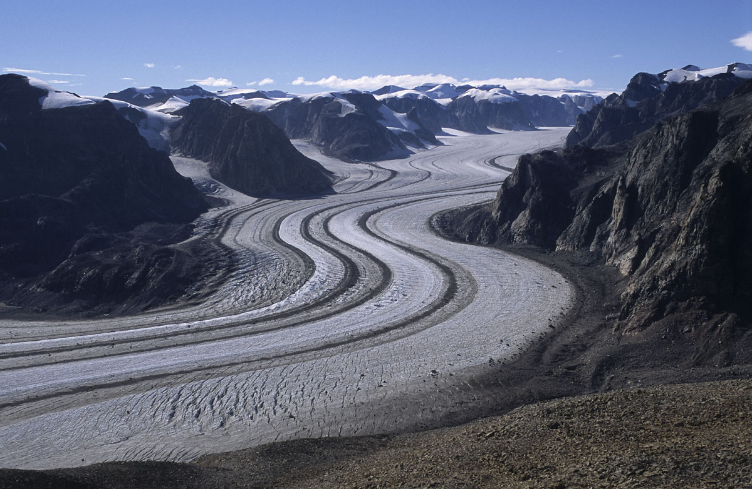
Lateral Moraine
Photo by G. Denton
Trunk glacier draining ice caps
Photo by G. Denton

Slide 26
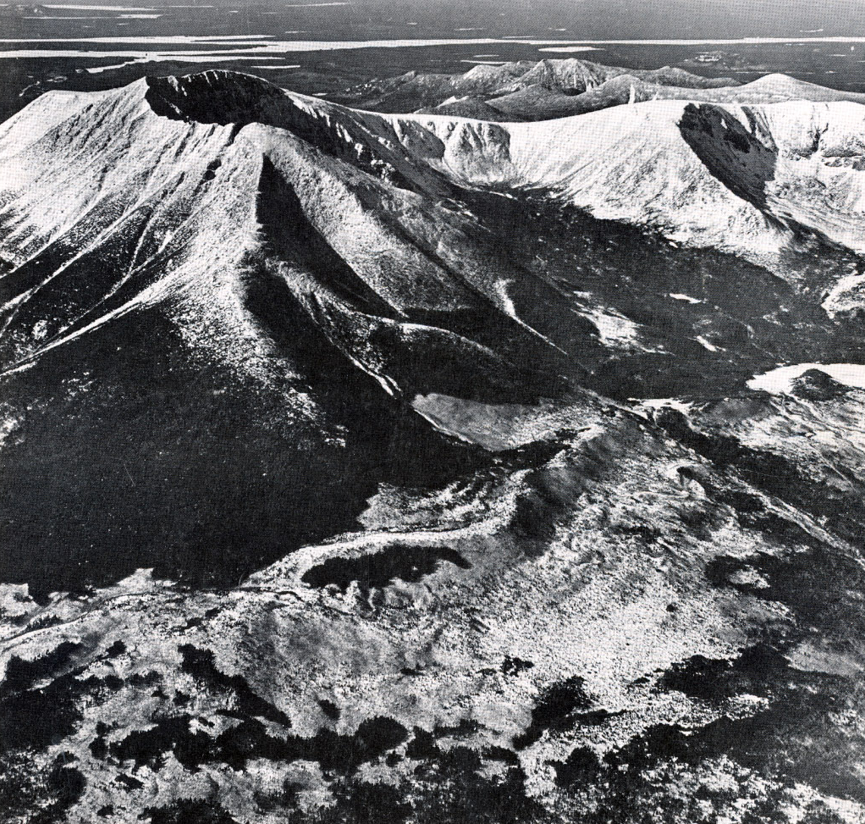
Lateral Moraine
Maine Geological Survey

Slide 27
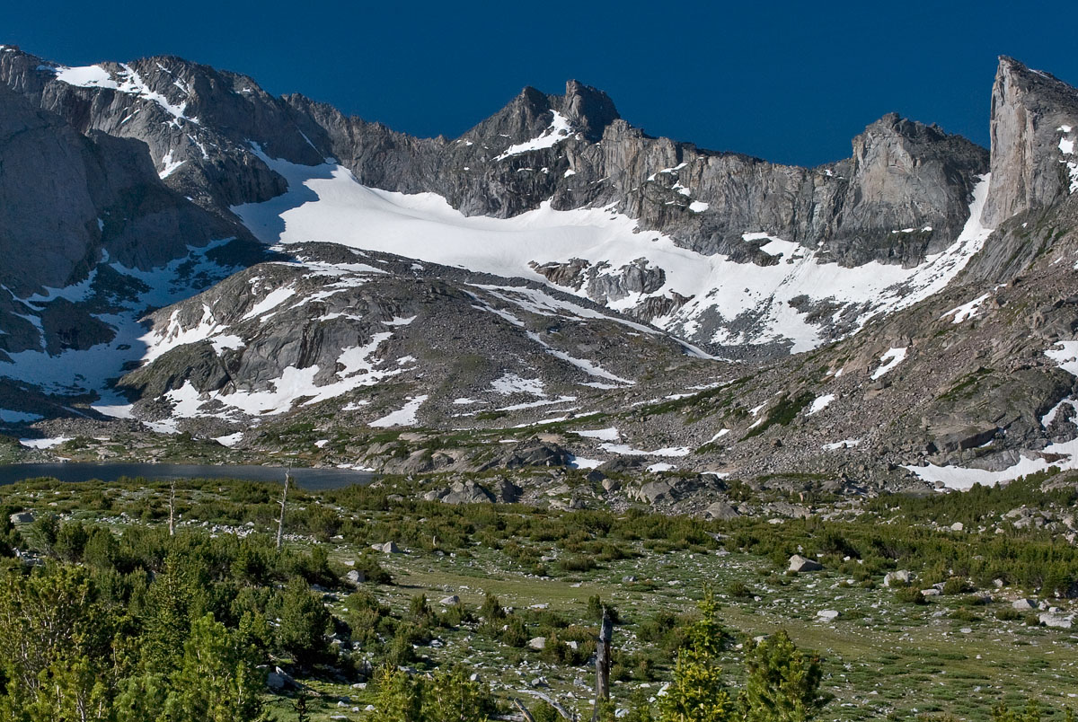
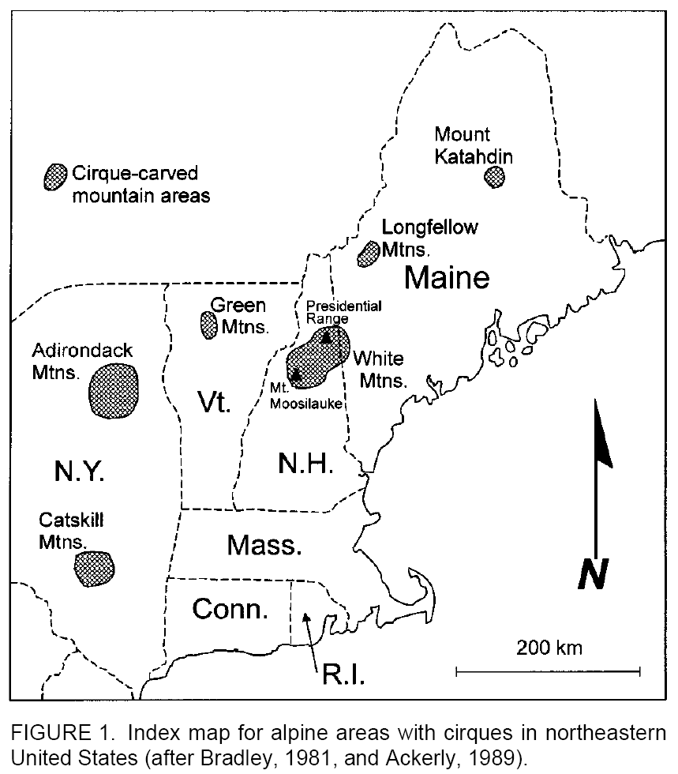
Wind River Range, WY
Katahdin

Slide 28
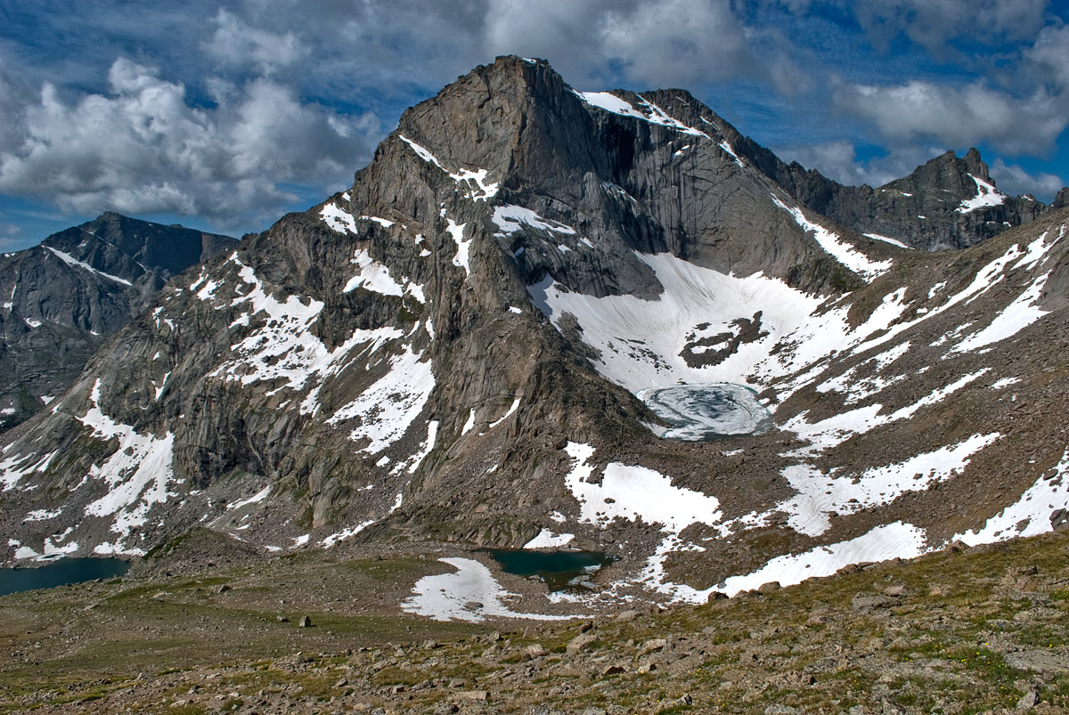
Lizard Head Peak Wind River Range, Wyoming

Slide 29
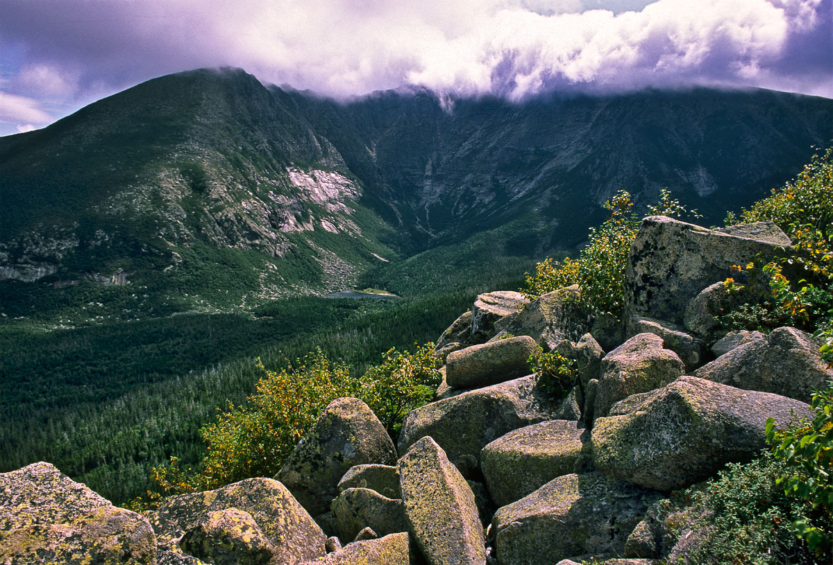
Cirque – North Basin, Katahdin

Slide 30
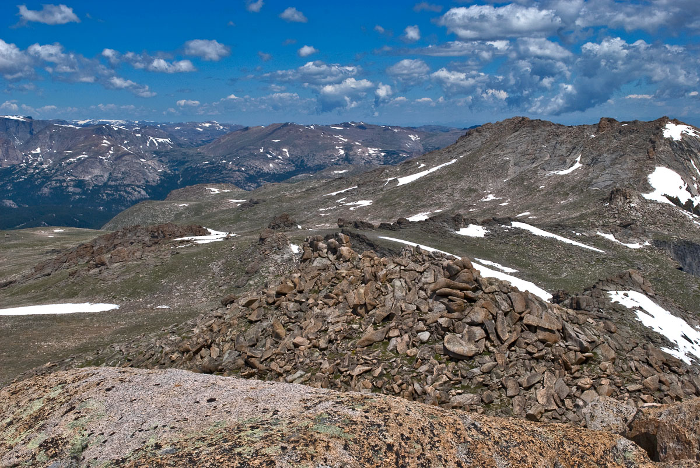
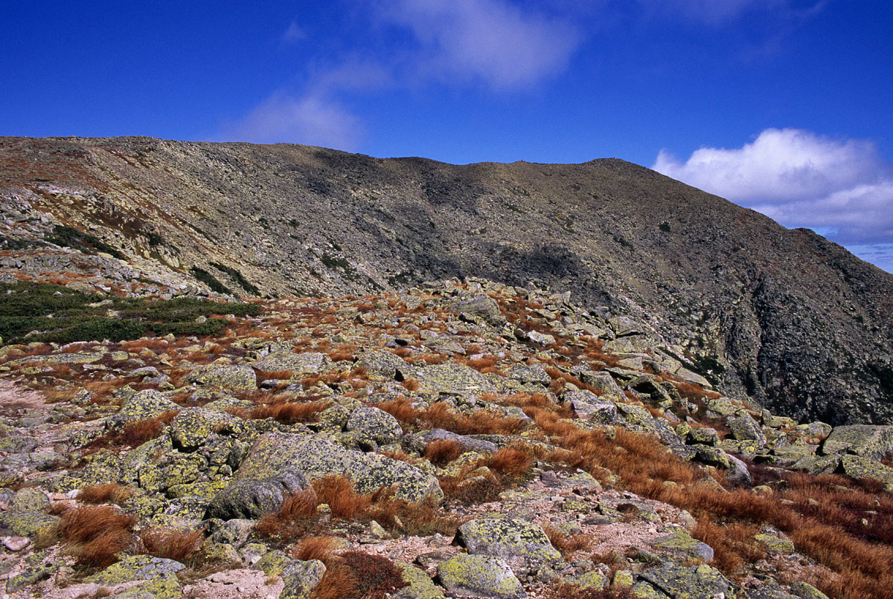
Wind River Range, WY
Tableland, Katahdin
Frost-shattered bedrock
Frost shattering occurs where T_{annual} is below -10 °C, and where there are extreme freeze-thaw events during winter.

Slide 31

Tableland, Katahdin, Maine

Slide 32



Ice Flow
STOSS
LEE
Photo by G. Denton

Slide 33


Erratic boulders in the Maine Woods

Slide 34

Classic U-shaped valley, southern Greenland
Photo by G. Denton

Slide 35

Doubletop Mt., Baxter Park, Maine

Slide 36


Slide 37

Thank You
Sean Birkel
Assistant Professor
Maine State Climatologist
birkel@maine.edu

Slide 39


Photo by G. Denton
Photo by G. Denton

Slide 40

Cirques and mountain glaciers

