Slide 1
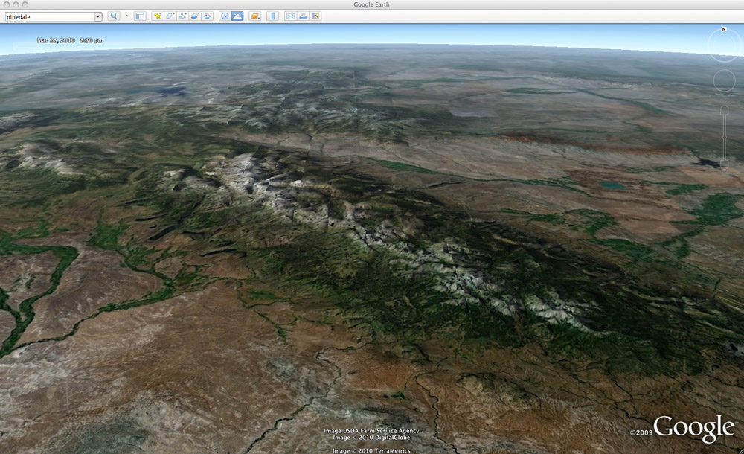
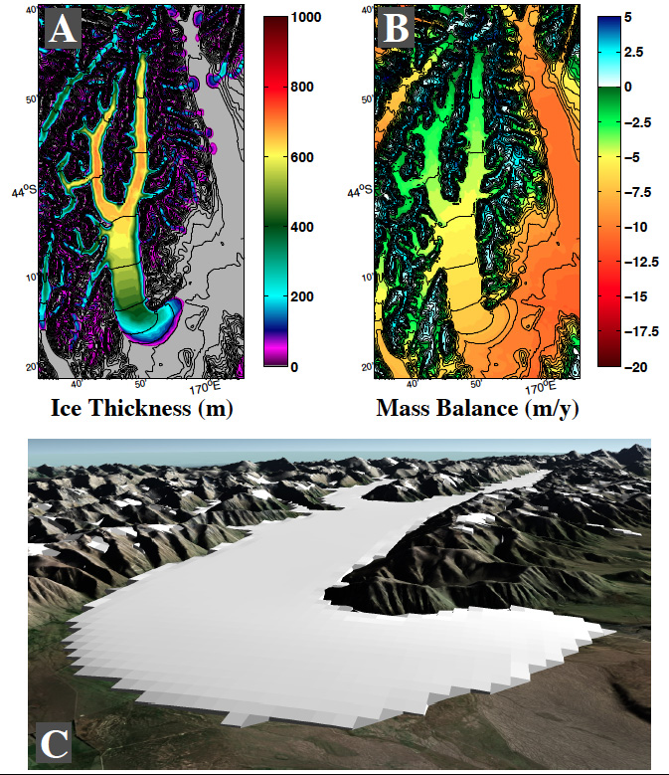
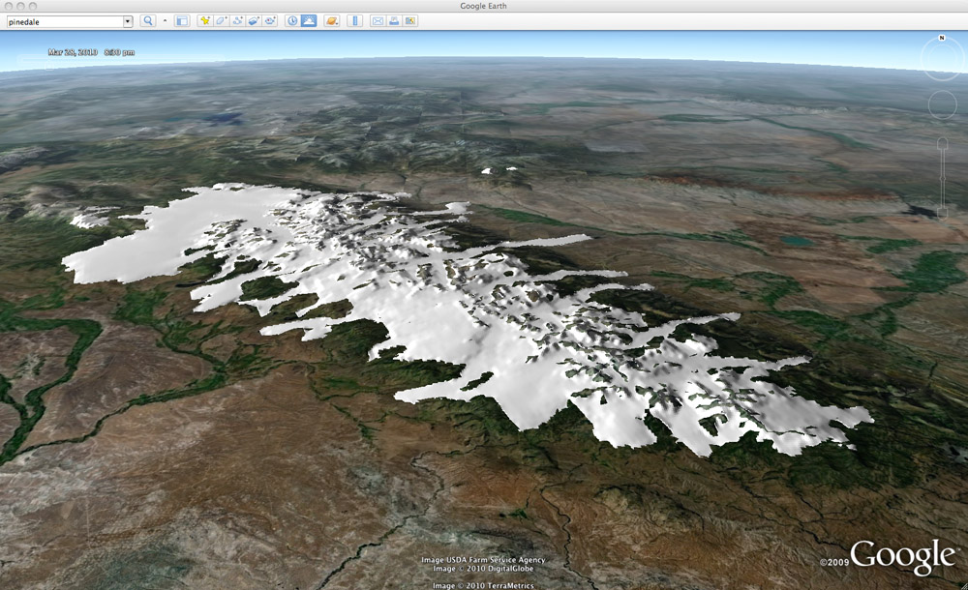
Ohau Basin, NZ
Putnam et al., 2013
Wind Rivers, WY
Birkel et al., 2012
Modern
LGM

Slide 2
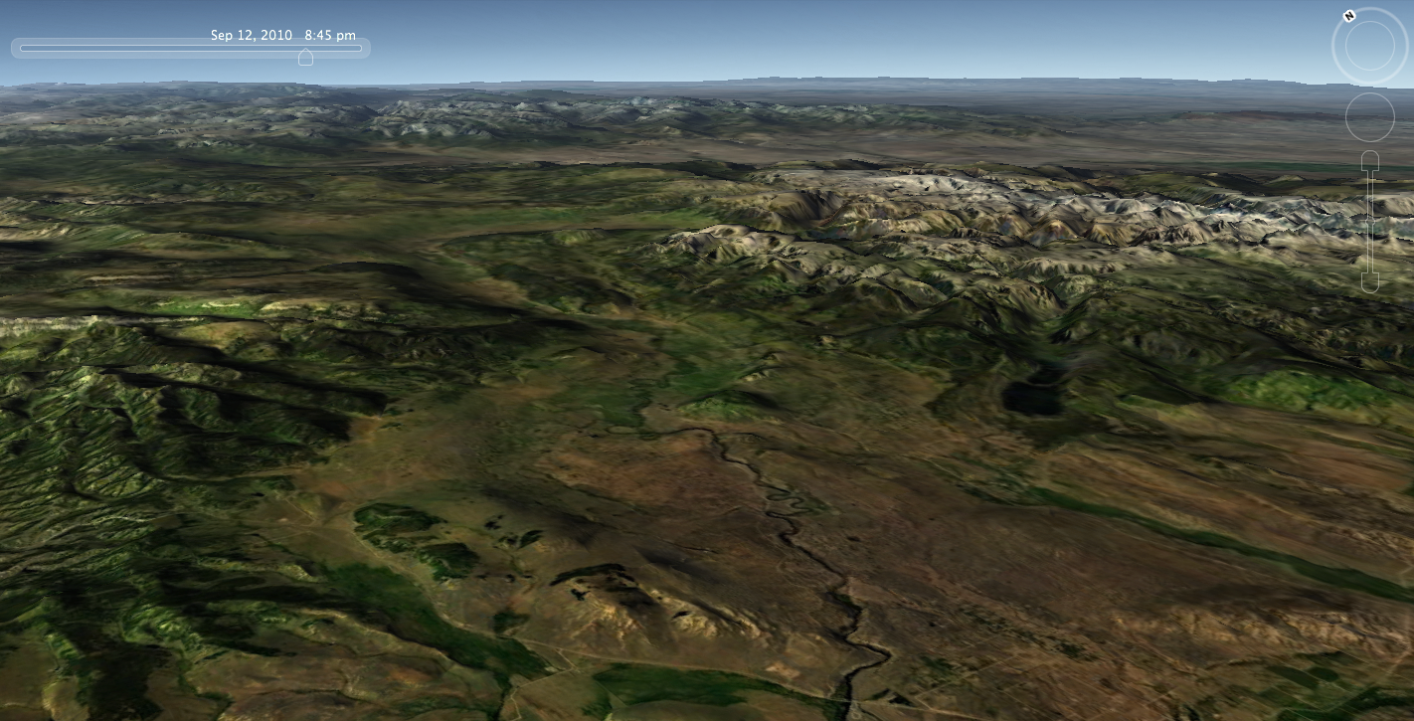
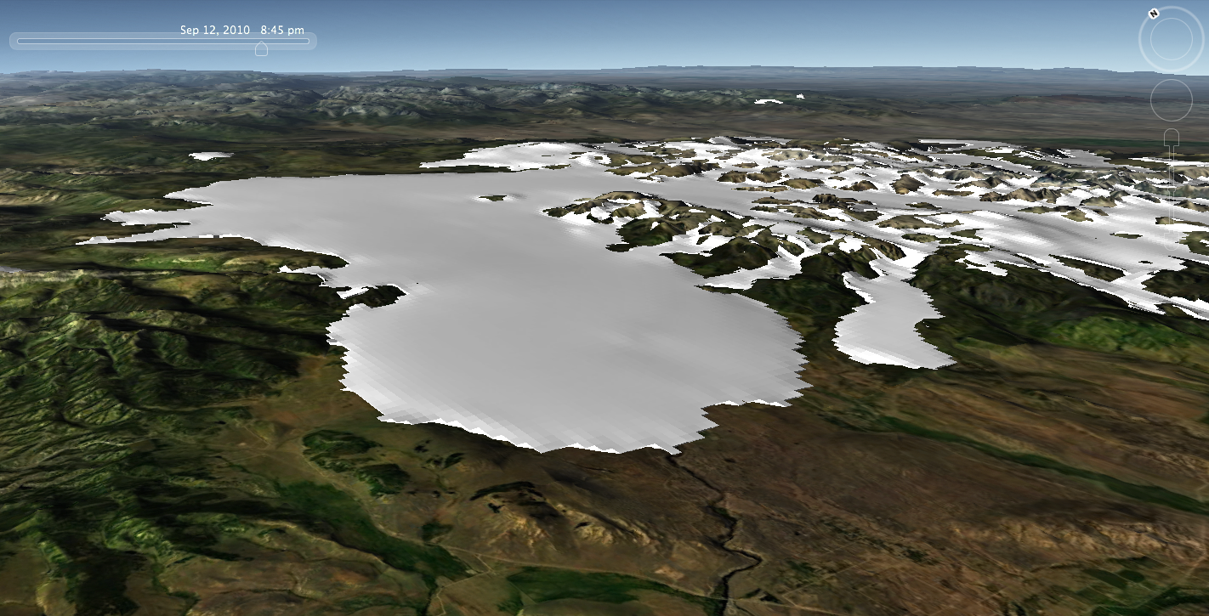
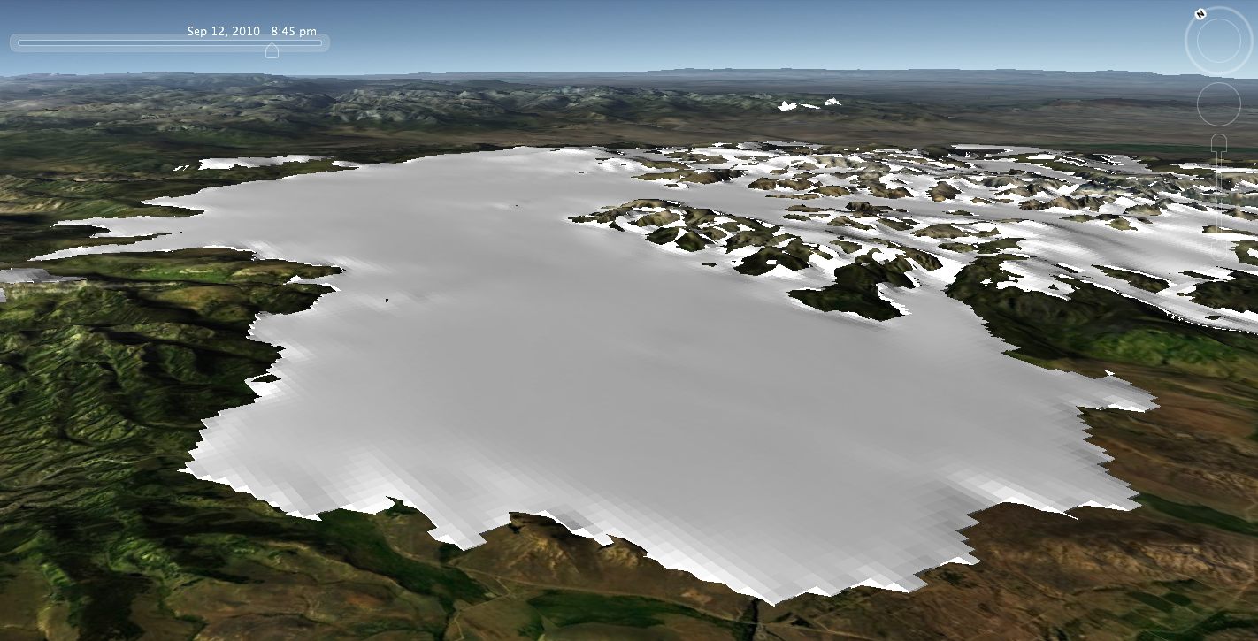
Green River Lobe of the Wind River Ice Cap
Pinedale – Bull Lake

Slide 3
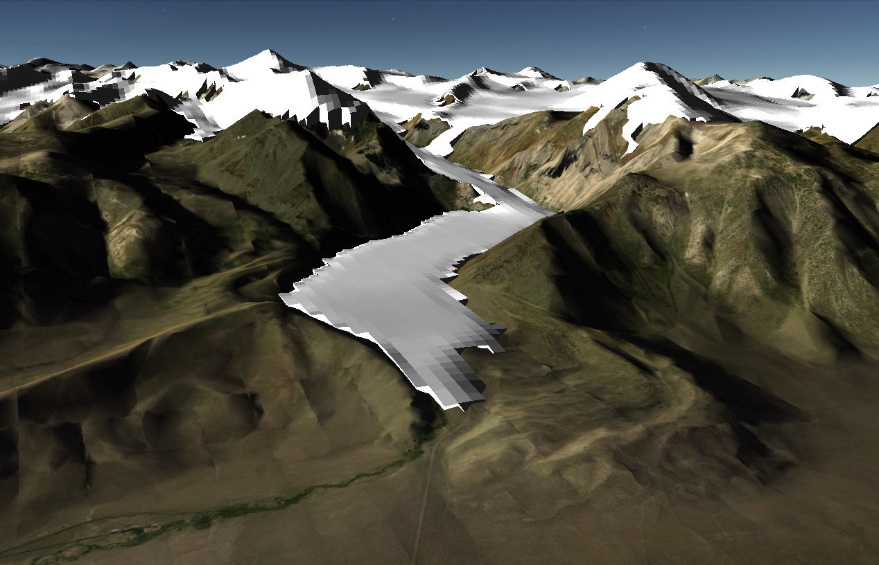
Pre-LGM
(Tahoe Glaciation)
LGM
(Tioga Glaciation)
University of Maine Ice Sheet Model (UMISM)
Convict Lake, Sierra Nevada
ΔT = -7 °C, P = 200%
From 1971-2000 PRISM climatology

Slide 4
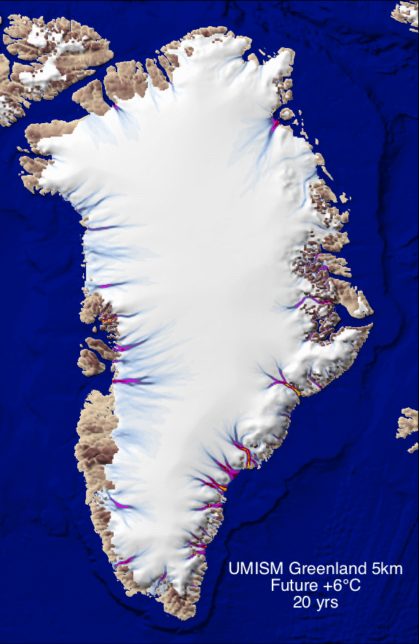
University of Maine Ice Sheet Model
Greenland Future Scenario
(surface ablation only, no calving instability)

Slide 5
The next 5 slides show results from a snow/ice mass balance model (used for paleo hydrology reconstruction in Putnam et al., 2014) for the Kunlun Sham adjacent to the Tarim Basin.

Slide 6
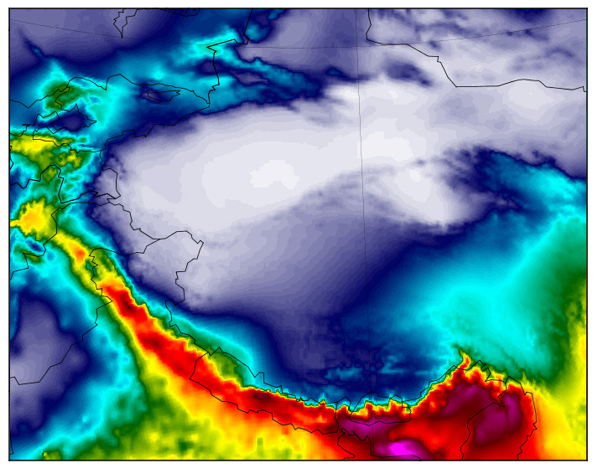
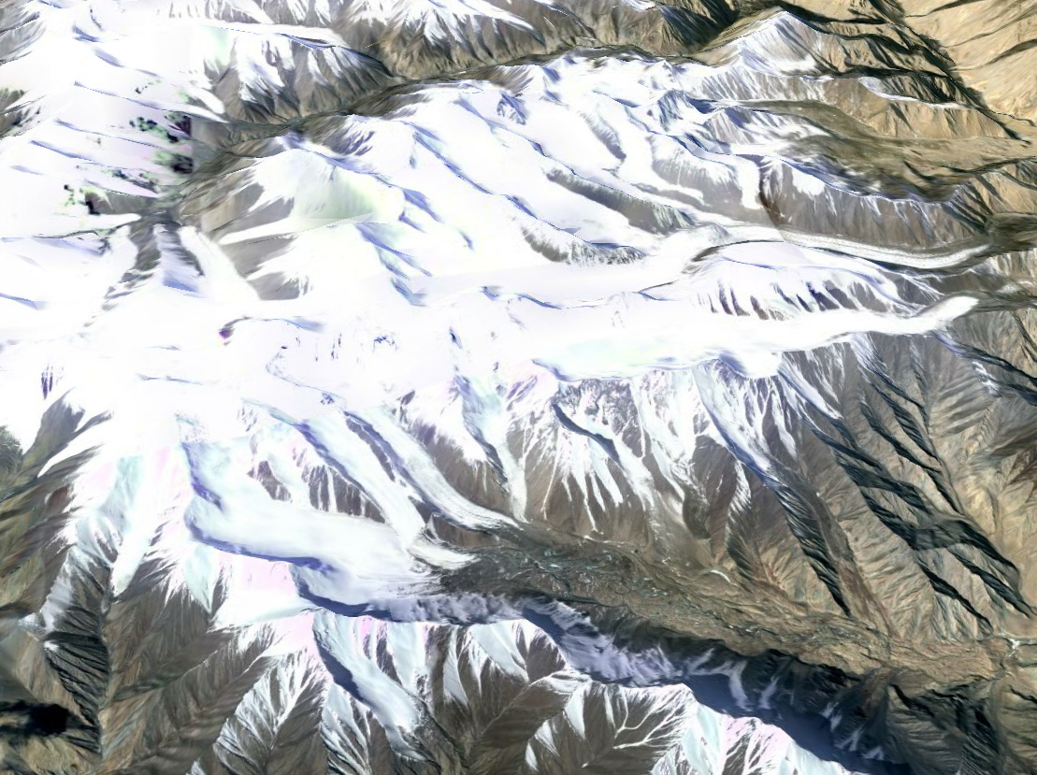
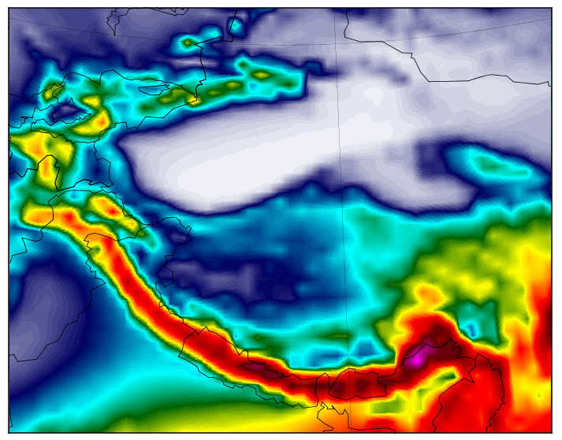
WorldClim
(data interpolation)
Kunlun Sham Glaciers
MERRA
(reanalysis)

Slide 7
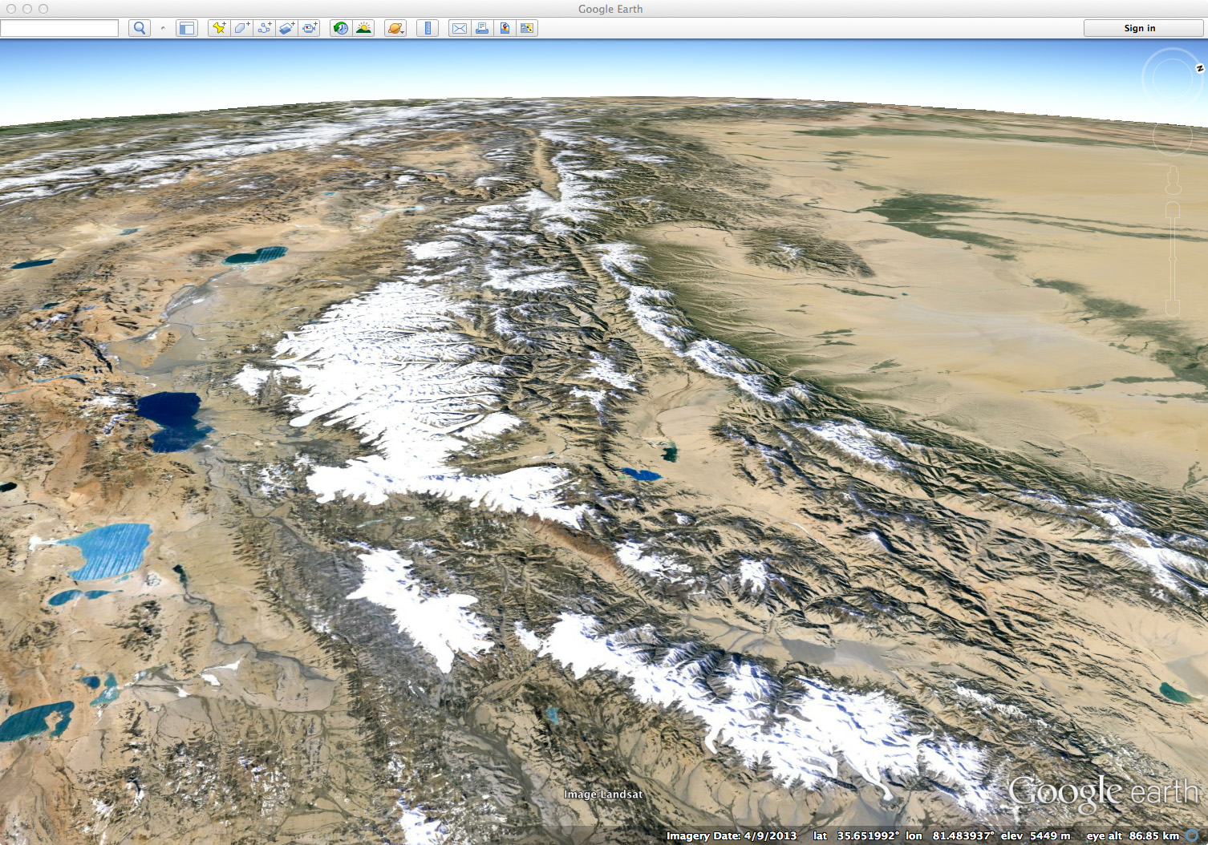
Tarim Basin
N
Kunlun Sham

Slide 8
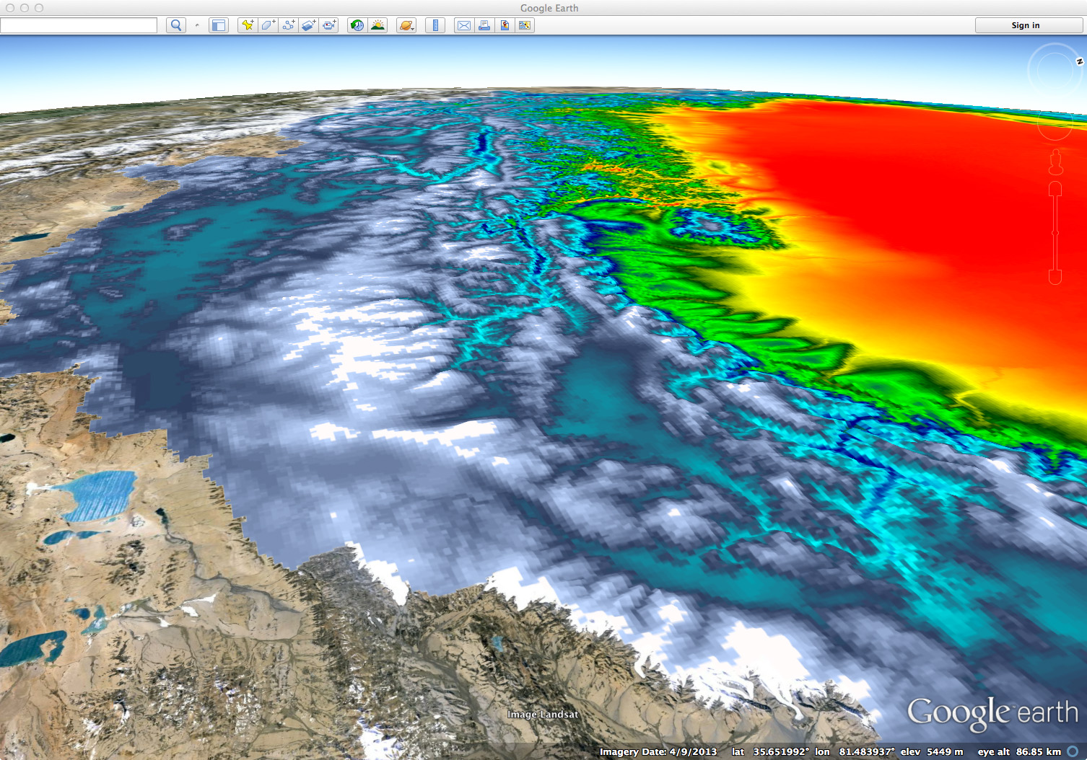
WorldClim
Mass Balance

Slide 9
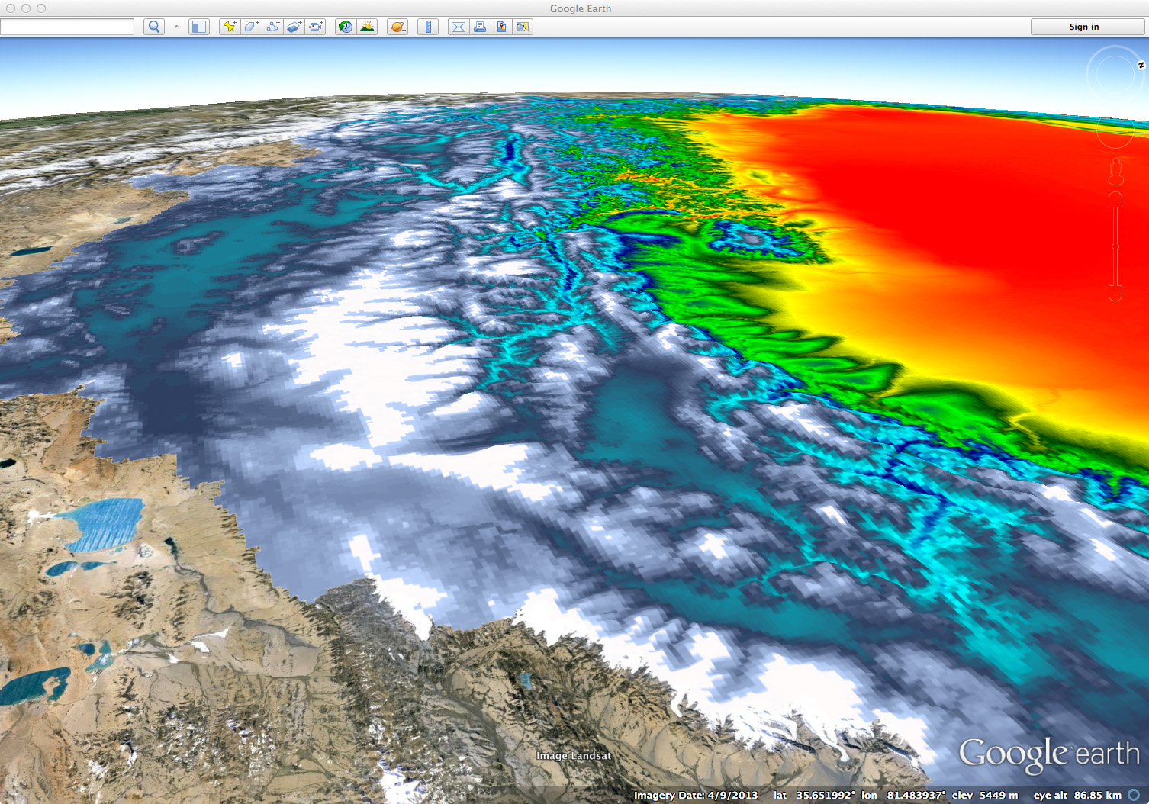
MERRA
Mass Balance

Slide 10
The next slide shows output (clouds/precip) from a 16km WRF downscale of a GFS forecast for the Tibetan Plateau region.

Slide 11
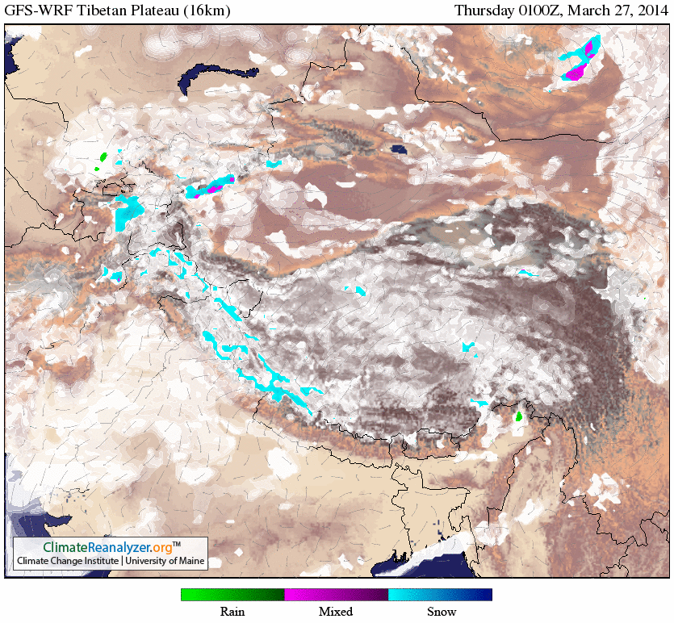

Slide 12
The next slide shows the difference in topographic resolution for a 36km-12km nested WRF configuration. WRF can downscale coarse reanalysis or forecast model output from ~60km to 3km (or finer) to reproduce orographic precipitation and vertical temperature variations (i.e., due to lapse rate and temperature inversions).

Slide 13
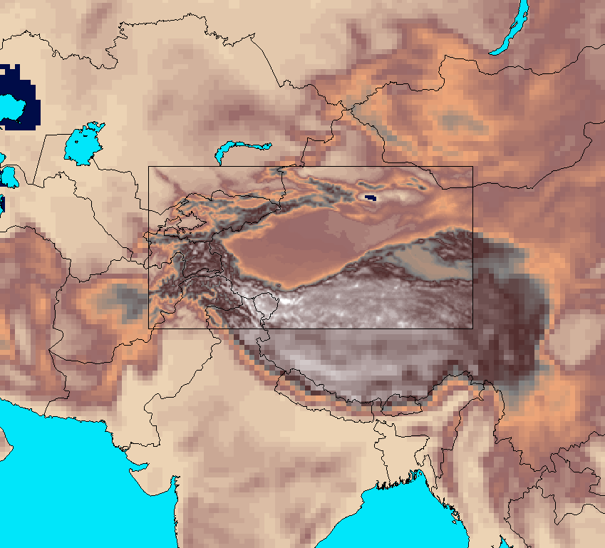
Weather Research and Forecasting (WRF) model
D01 36 km
d02 12 km

