Slide 1
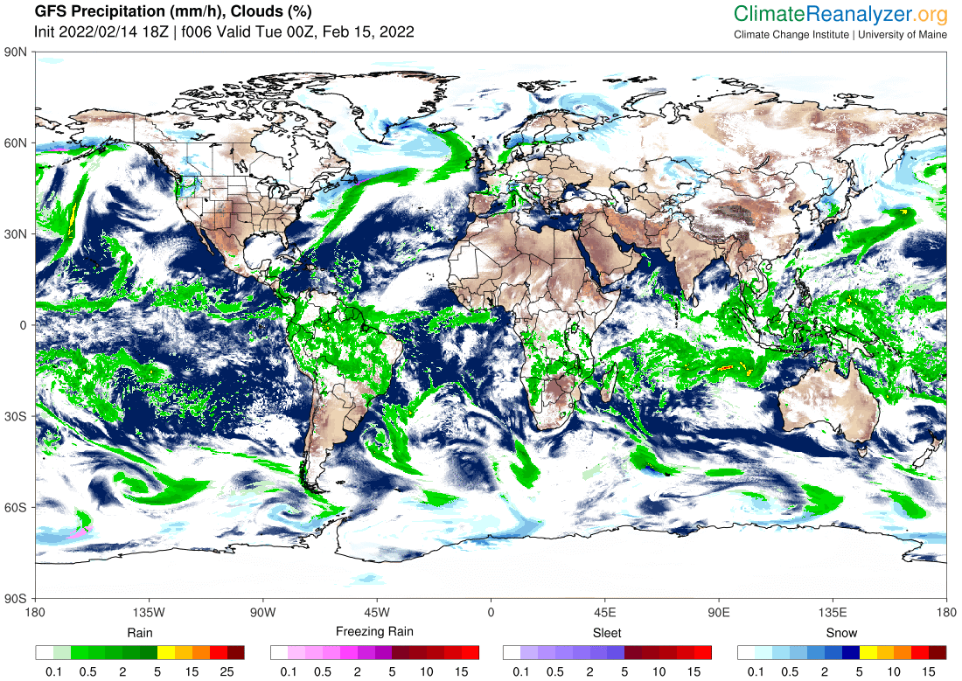



Climate System Overview
Sean Birkel
Cooperative Extension
Climate Change Institute
University of Maine
Climate Adaptation and Mitigation Fellowship
www.adaptationfellows.net

Slide 2
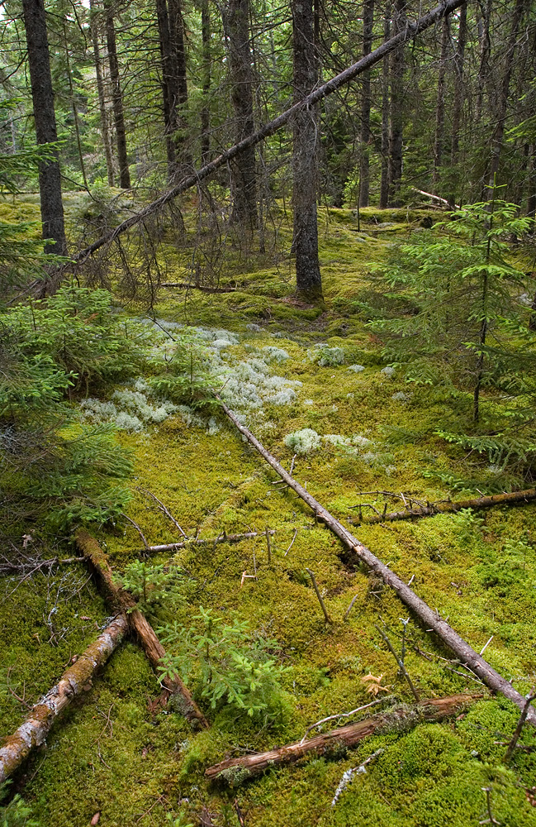
Presentation Outline
View from Space
Temperature and precipitation trends and projections
Enhanced hydrologic cycle and extreme events
Sea level rise

Slide 3
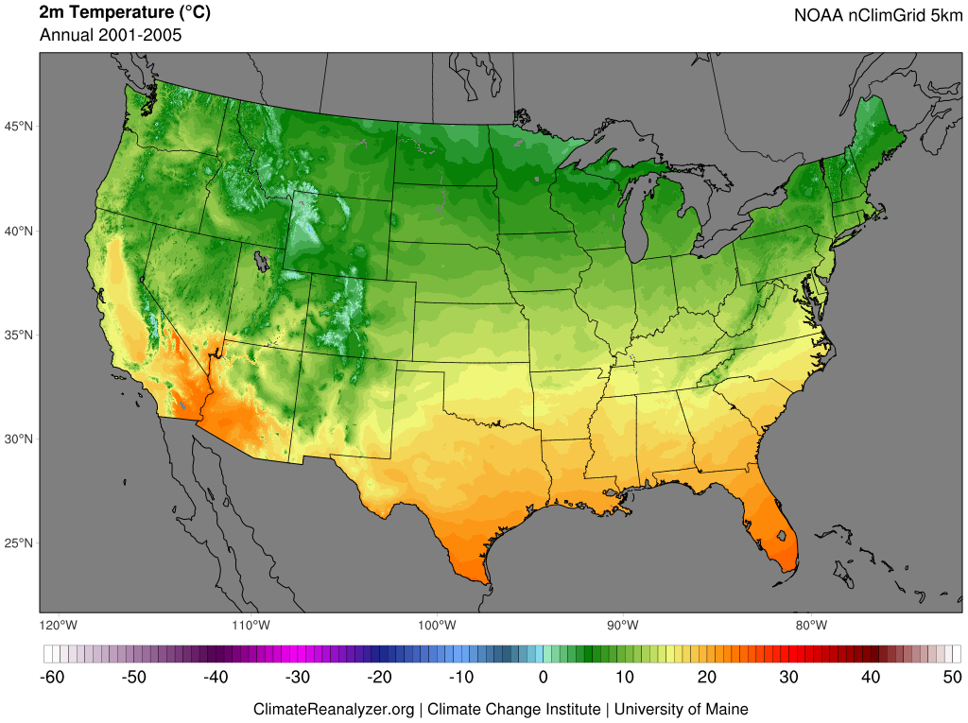
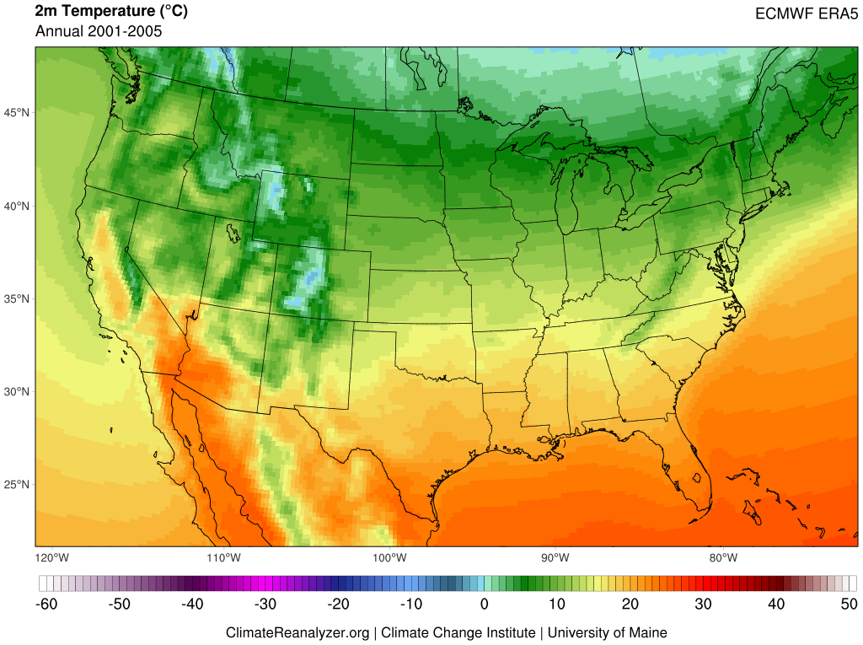
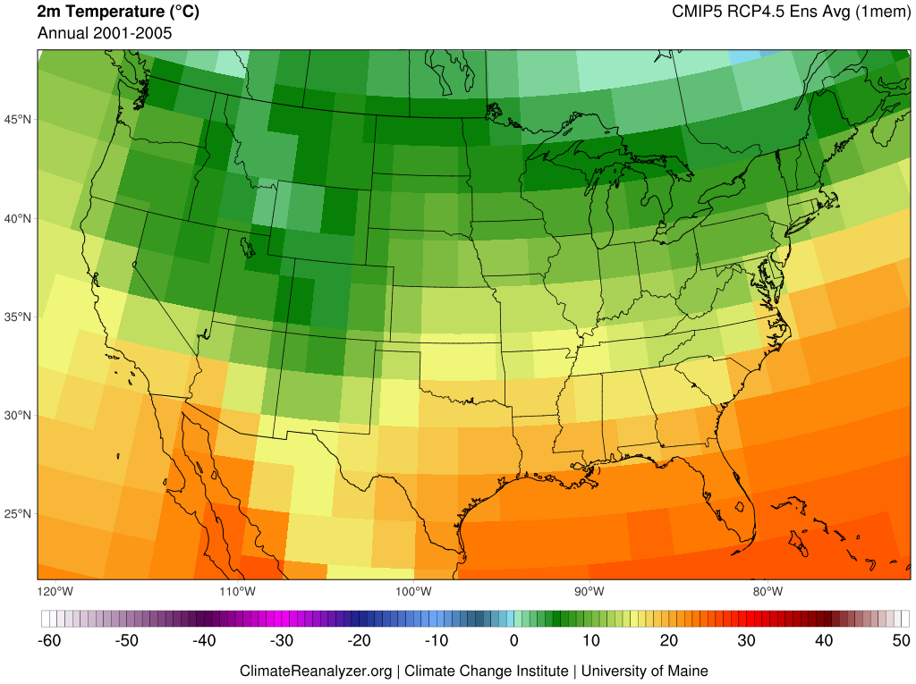
Gridded data products place point-based or spatially discontinuous observations of Earth's climate (e.g., temperature, precipitation, wind, and sea surface temperature) onto time-registered grids and fill in data gaps using methods of interpolation. Gridded datasets are useful for climate study in areas that may not have direct observations, but where the intersection of surrounding input data can provide meaningful information.
Reanalysis refers to physically-based numerical frameworks that simulate the state Earth's climate through time, guided by frequent input of real-world observations (e.g., weather stations, radiosonde, satellite, and ocean buoys). Reanalysis products are used for understanding climate variability and change, including across areas where direct observations are not available.
Climate models afford physically-based simulations of energy and material flows through the atmosphere, ocean, and other parts of the earth system. The most complex of these frameworks are earth system models, where multiple systems are coupled and yield dynamic interactions. Climate and earth system models are used for investigating past, present, and future climate evolution based on changes in radiative forcing, such as from greenhouse-gas emissions.
Coupled Model Intercomparison Project (CMIP) 5 and 6
Representative Concentration Pathways (RCPs) and Shared Socioeconomic Pathways (SSPs)

Slide 4

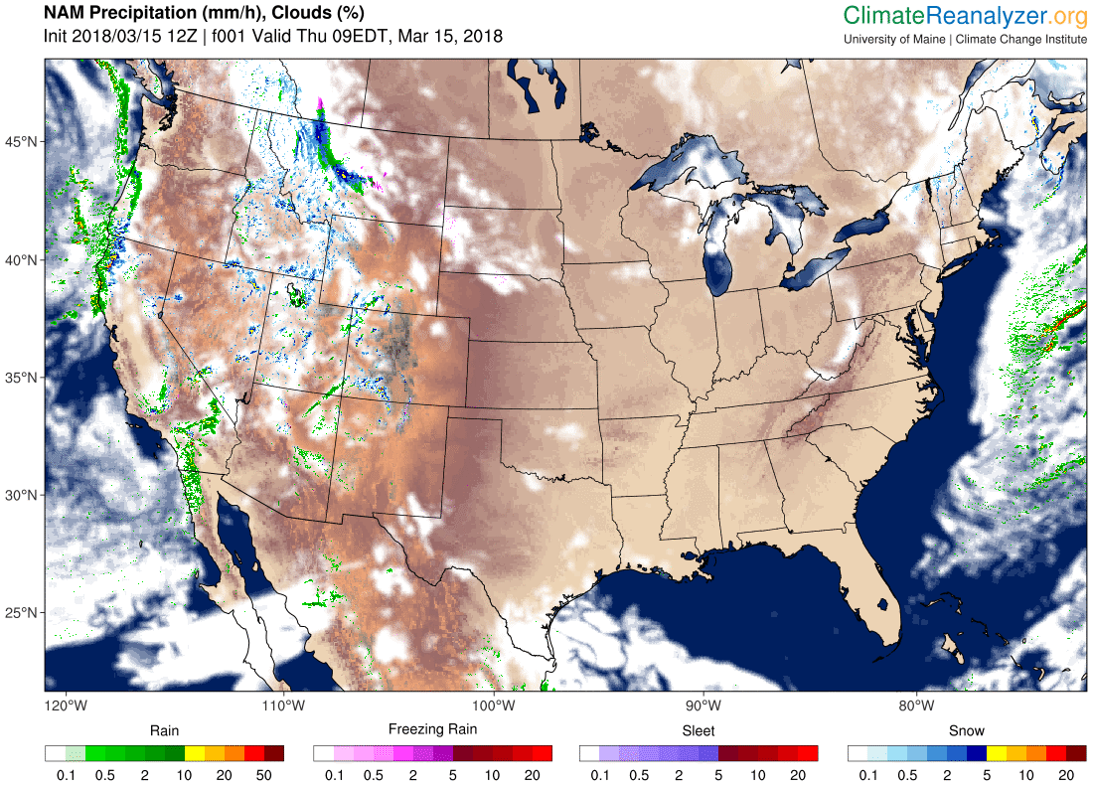
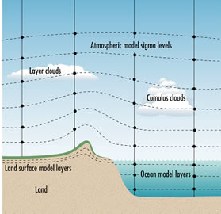
Future climate is projected using physics-based models of the atmosphere, ocean, cryosphere, and biosphere. The model climate can be perturbed by changes in GHG emissions, volcanic activity, solar output, and other factors.
www.bom.gov.au/info/GreenhouseEffectAndClimateChange.pdf

Slide 5
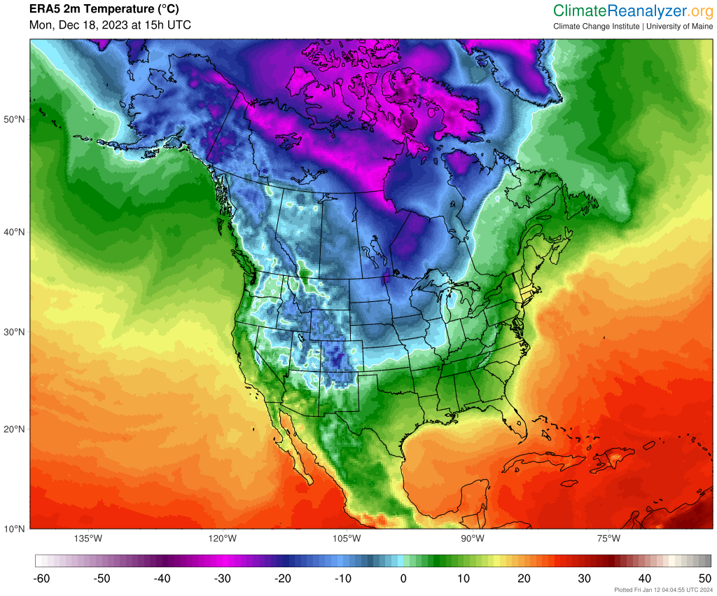
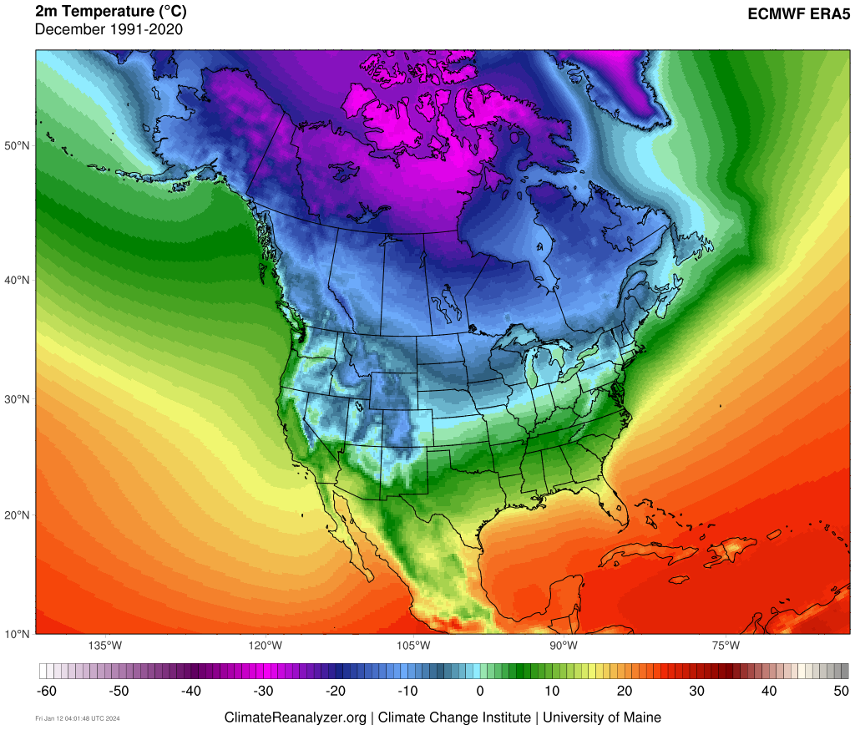
Defining Climate
Climate is the statistical representation of prevailing meteorological conditions – typically over a period of 30 years.
The climate system is composed of five interacting components: atmosphere, hydrosphere, cryosphere, lithosphere, biosphere.
Circulation within the climate system is driven by incoming solar radiation. Greenhouse gases in the atmosphere absorb some of this radiation and warm the planet.
Changes in climate represent imbalance between incoming solar radiation and energy loss to space.
These changes occur due to internal variability and external forcing.

Slide 6
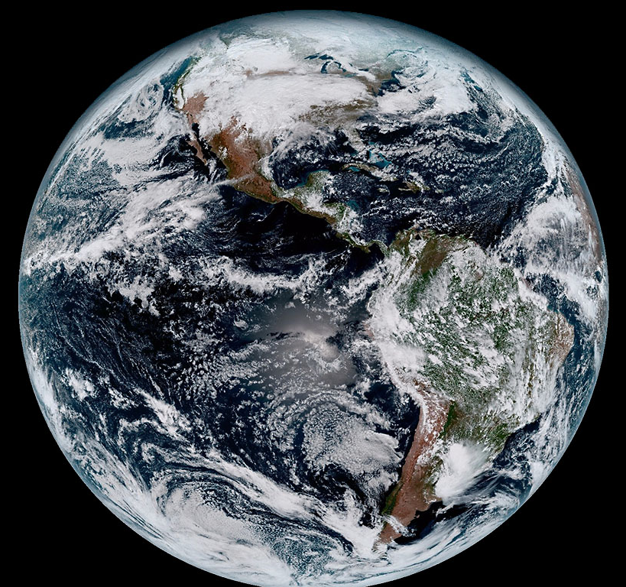
Defining Climate
Climate is the statistical representation of prevailing meteorological conditions – typically over a period of 30 years.
The climate system is composed of five interacting components: atmosphere, hydrosphere, cryosphere, lithosphere, biosphere.
Circulation within the climate system is driven by incoming solar radiation. Greenhouse gases in the atmosphere absorb some of this radiation and warm the planet.
Changes in climate represent imbalance between incoming solar radiation and energy loss to space.
These changes occur due to internal variability and external forcing.

Slide 7
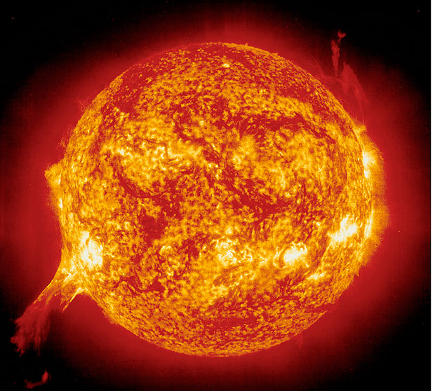
Defining Climate
Climate is the statistical representation of prevailing meteorological conditions – typically over a period of 30 years.
The climate system is composed of five interacting components: atmosphere, hydrosphere, cryosphere, lithosphere, biosphere.
Circulation within the climate system is driven by incoming solar radiation. Greenhouse gases in the atmosphere absorb some of this radiation and warm the planet.
Changes in climate represent imbalance between incoming solar radiation and energy loss to space.
These changes occur due to internal variability and external forcing.

Slide 8
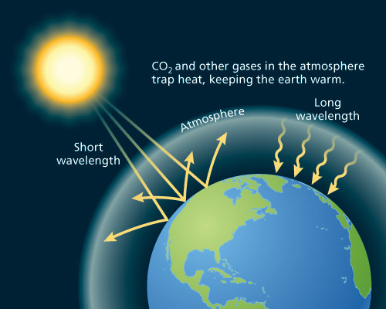
The Greenhouse Effect
http://www.oxfordpresents.com/ms/krohne/global-warming-and-ecological-communities/

Slide 9
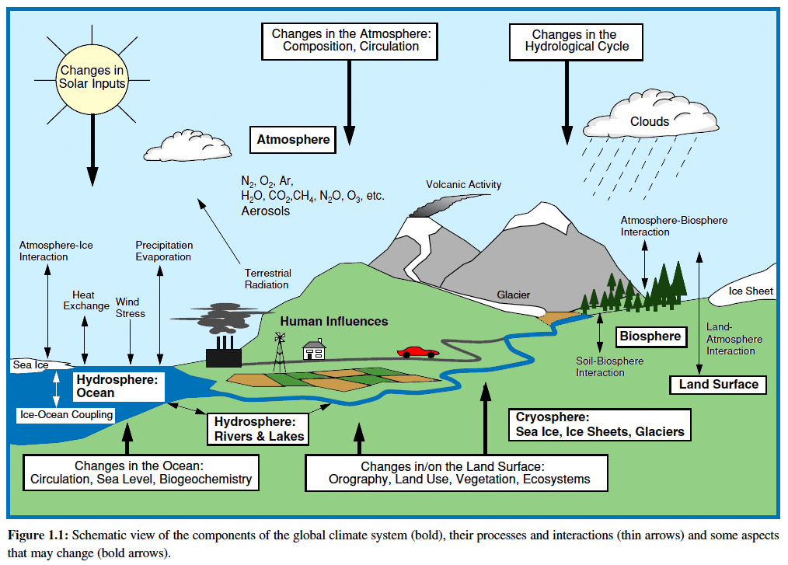
Atmosphere
Hydrosphere
ocean, lakes, rivers
Cryosphere
glaciers, sea ice
Biosphere
Adapted from IPCC AR3

Slide 10
Defining Climate
Climate is the statistical representation of prevailing meteorological conditions – typically over a period of 30 years.
The climate system is composed of five interacting components: atmosphere, hydrosphere, cryosphere, lithosphere, biosphere.
Circulation within the climate system is driven by incoming solar radiation. Greenhouse gases in the atmosphere absorb some of this radiation and warm the planet.
Changes in climate represent imbalance between incoming solar radiation and energy loss to space.
These changes occur due to internal variability and external forcing.

Slide 11
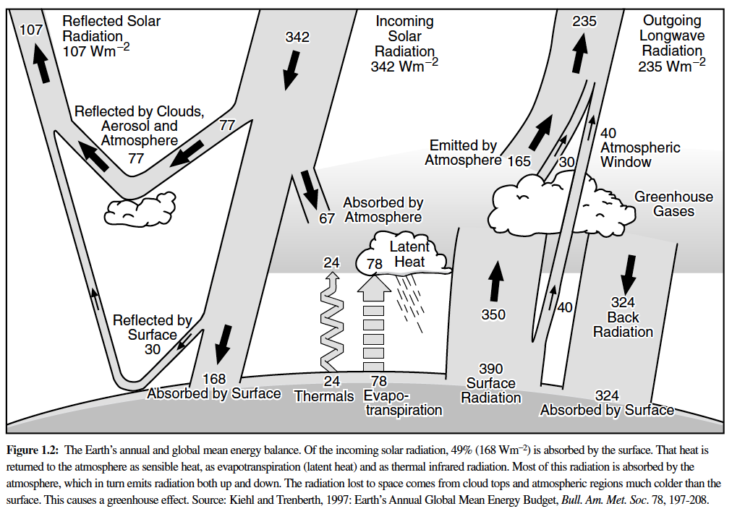
Equilibrium Climate
Outgoing Longwave
+
Reflected
Shortwave
=
Total Incoming Solar Radiation
IPCC AR3

Slide 12
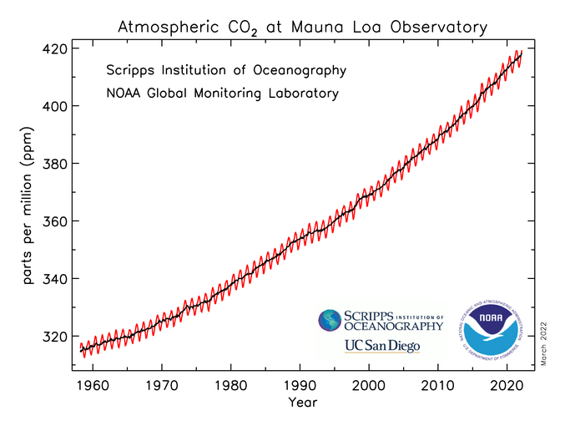
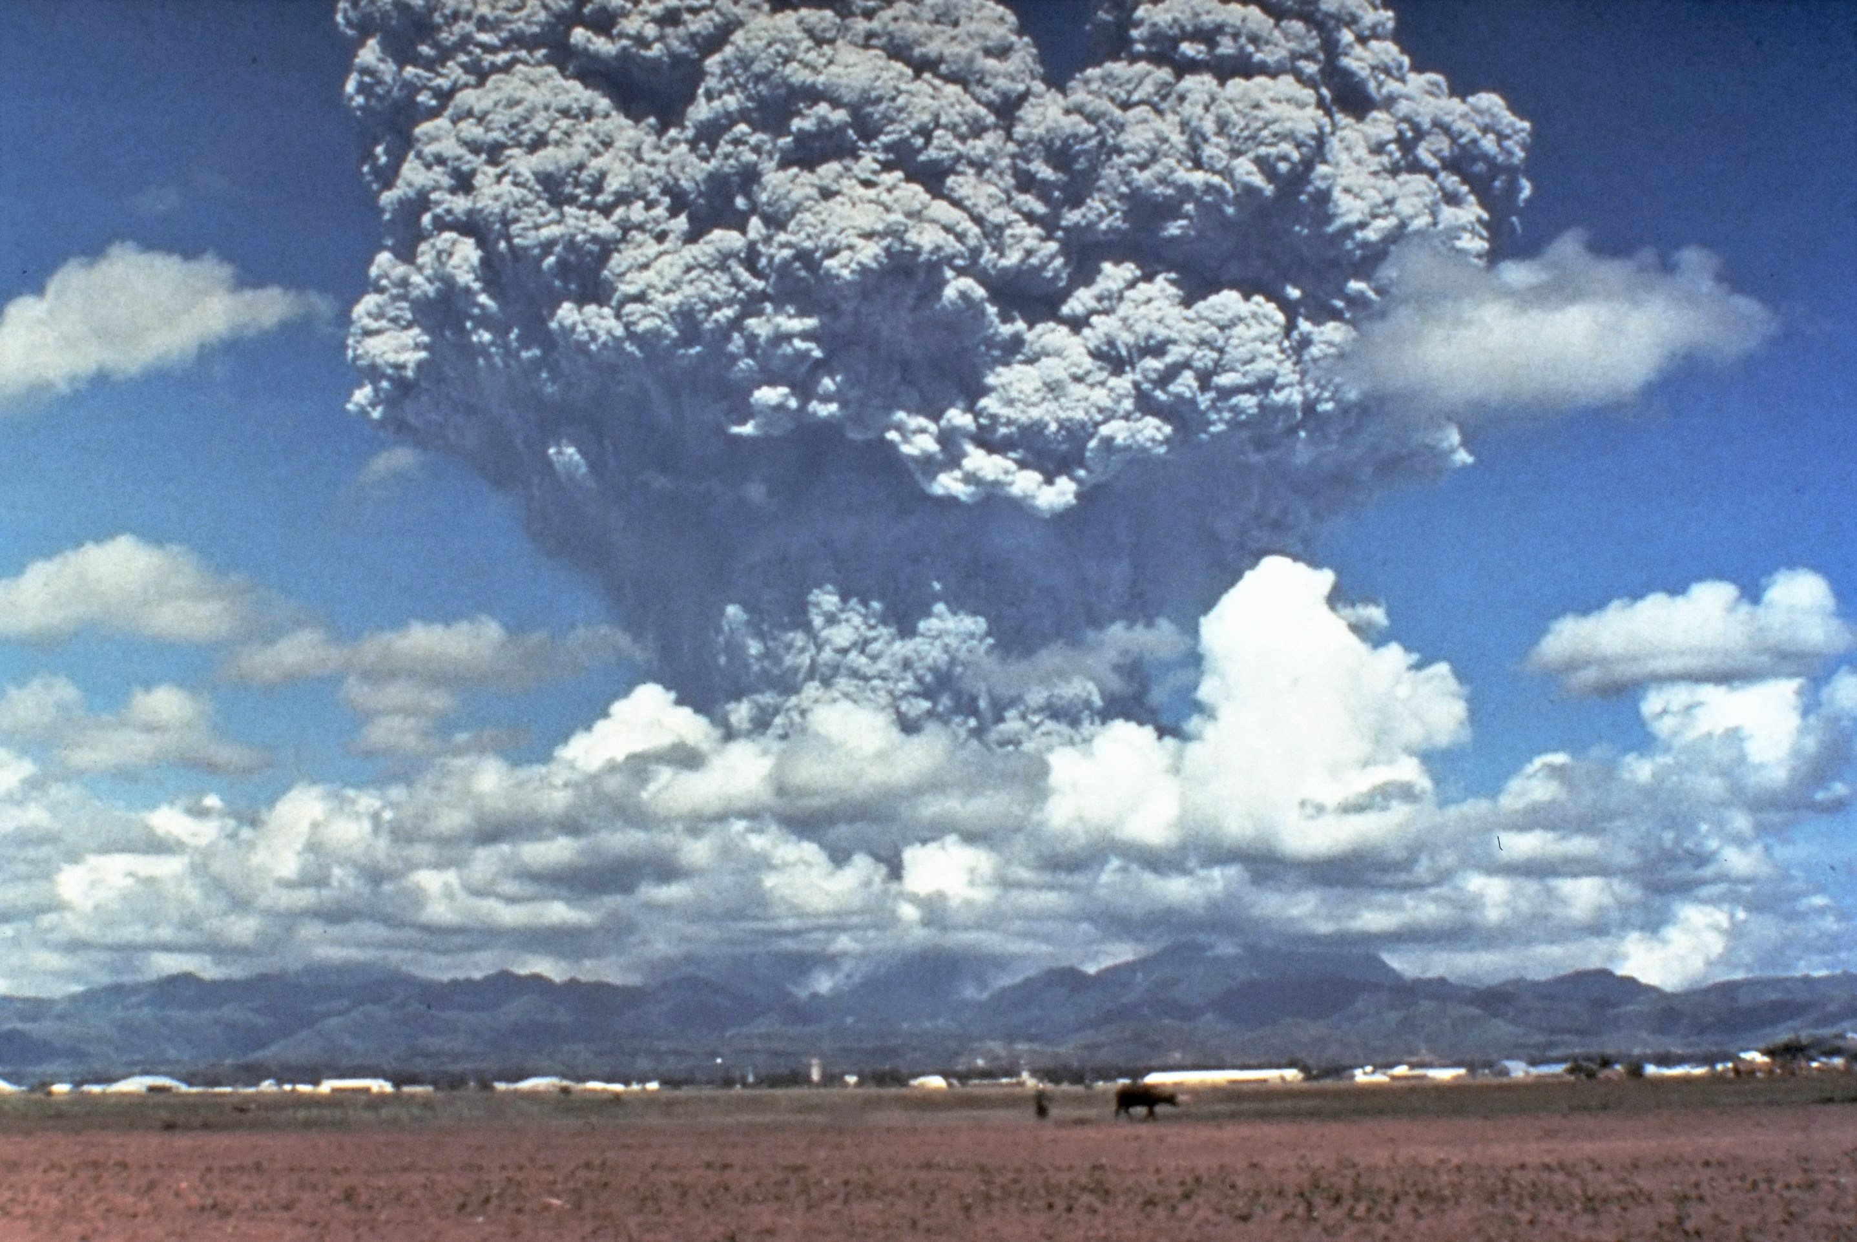
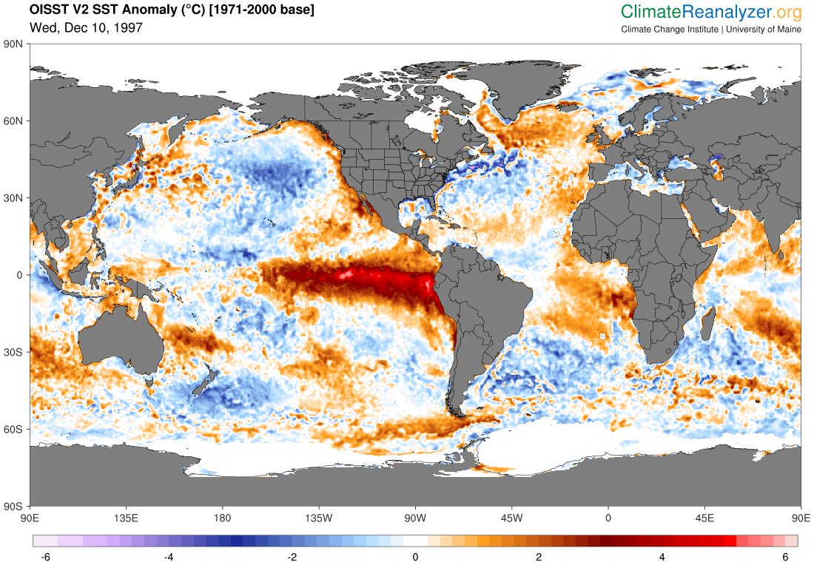
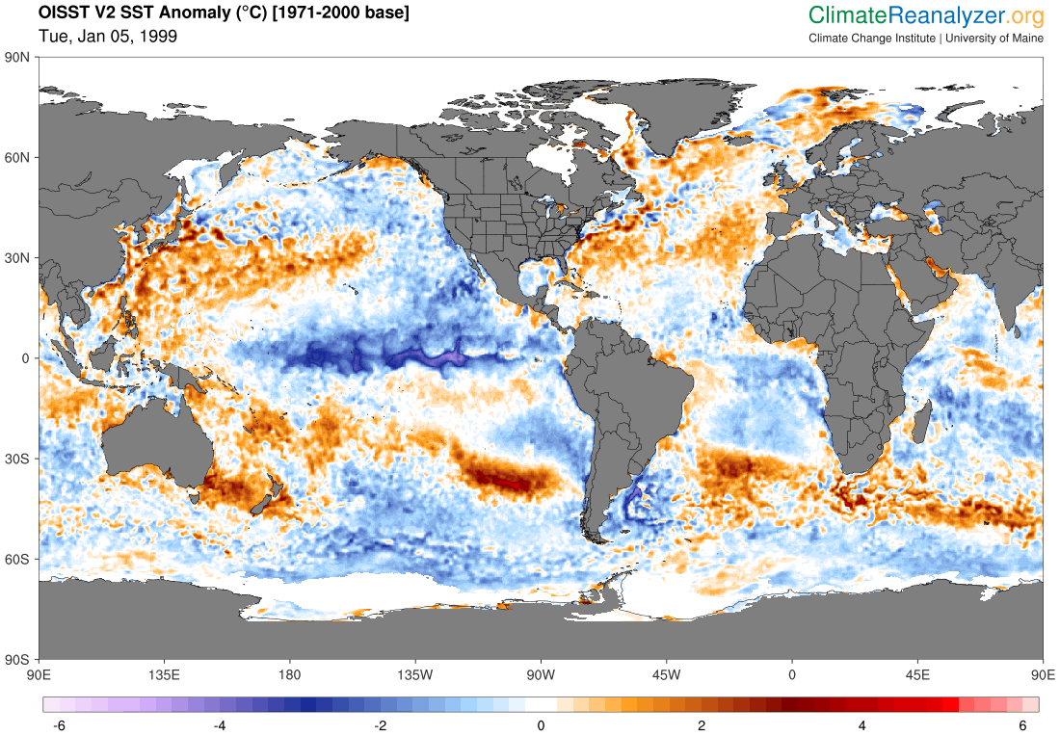
Defining Climate
Greenhouse Gas Emissions
Climate is the statistical representation of prevailing meteorological conditions – typically over a period of 30 years.
Volcanic Aerosols
Solar Cycle
The climate system is composed of five interacting components: atmosphere, hydrosphere, cryosphere, lithosphere, biosphere.
Circulation within the climate system is driven by incoming solar radiation. Greenhouse gases in the atmosphere absorb some of this radiation and warm the planet.
El Niño-Southern Oscillation (ENSO)
Changes in climate represent imbalance between incoming solar radiation and energy loss to space.
These changes occur due to internal variability and external forcing.

Slide 13
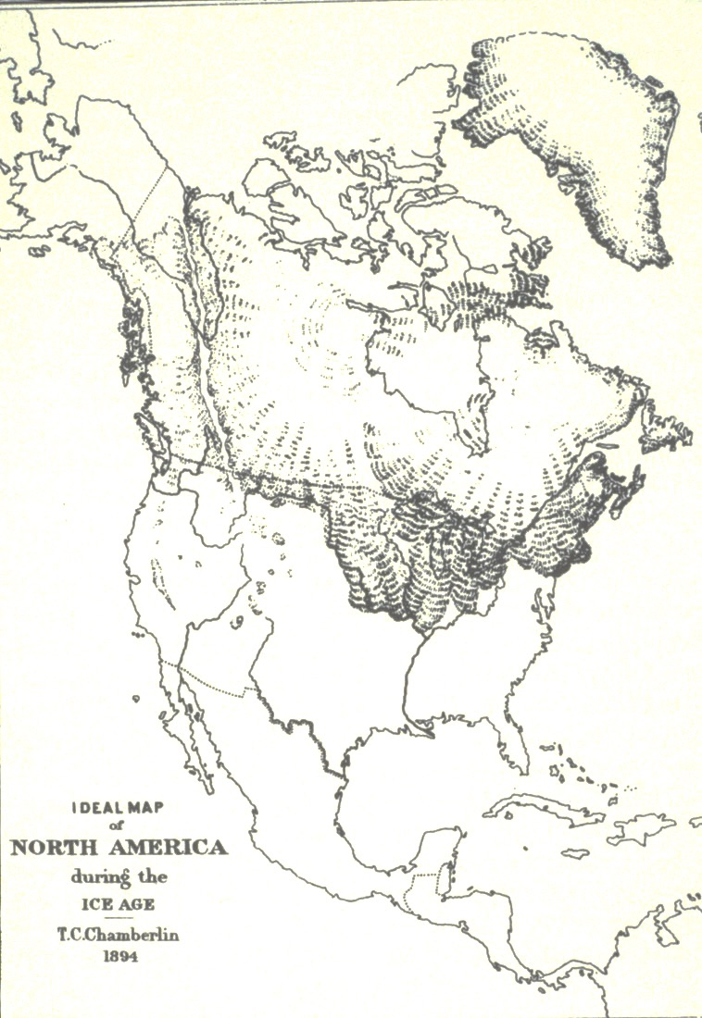
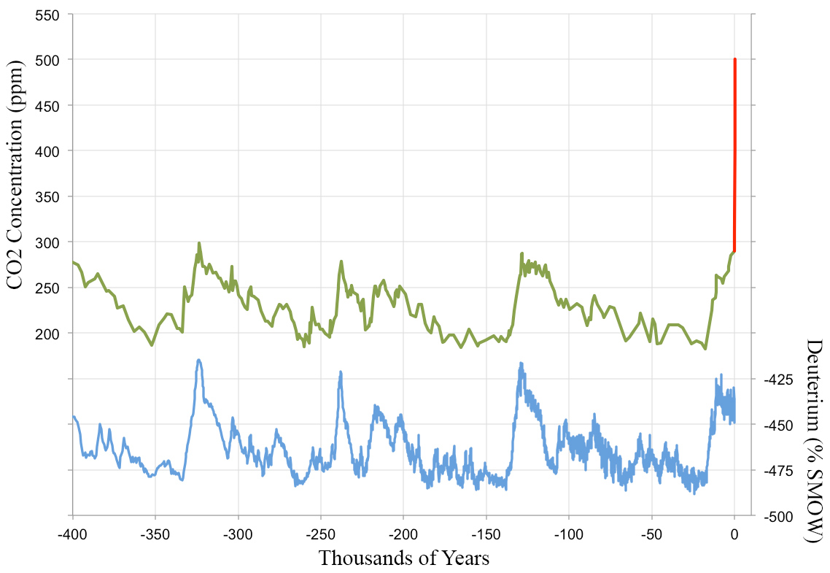
NOAA Global Monitoring Laboratory
https://gml.noaa.gov/ccgg/trends/mlo.html
500 ppm 2100
Ice Core Record Vostok Station, Antarctica
400 ppm 2015
290 ppm Natural
Warm
Cold

Slide 14
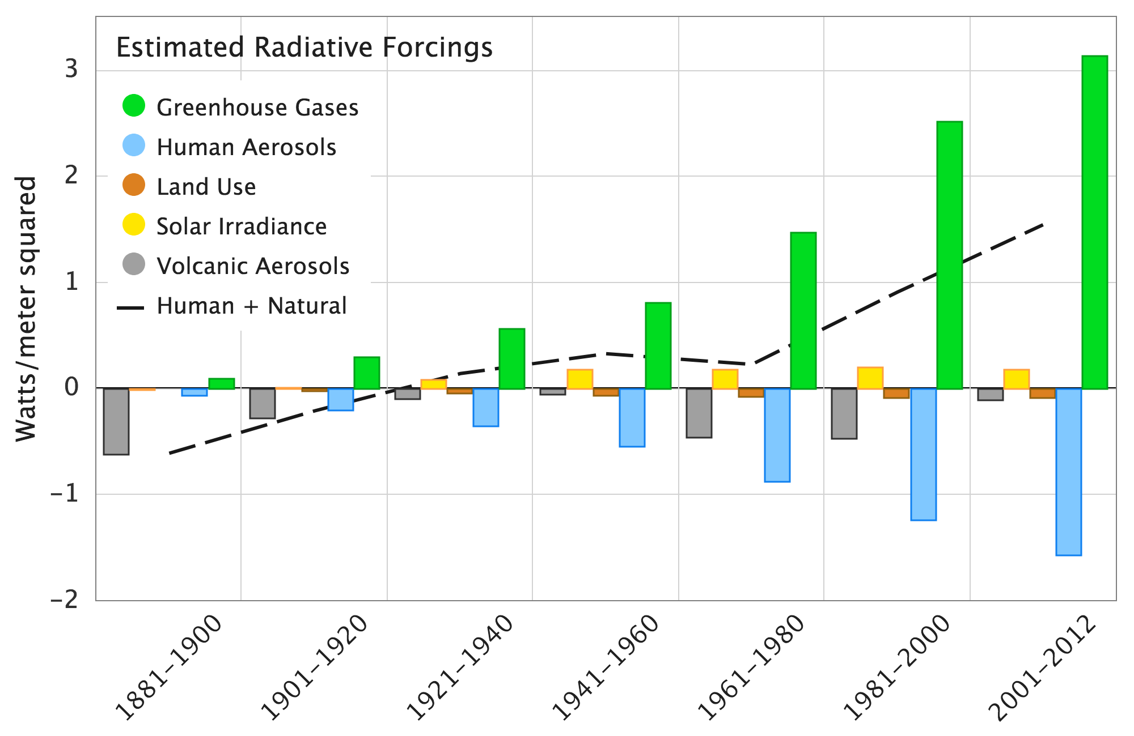
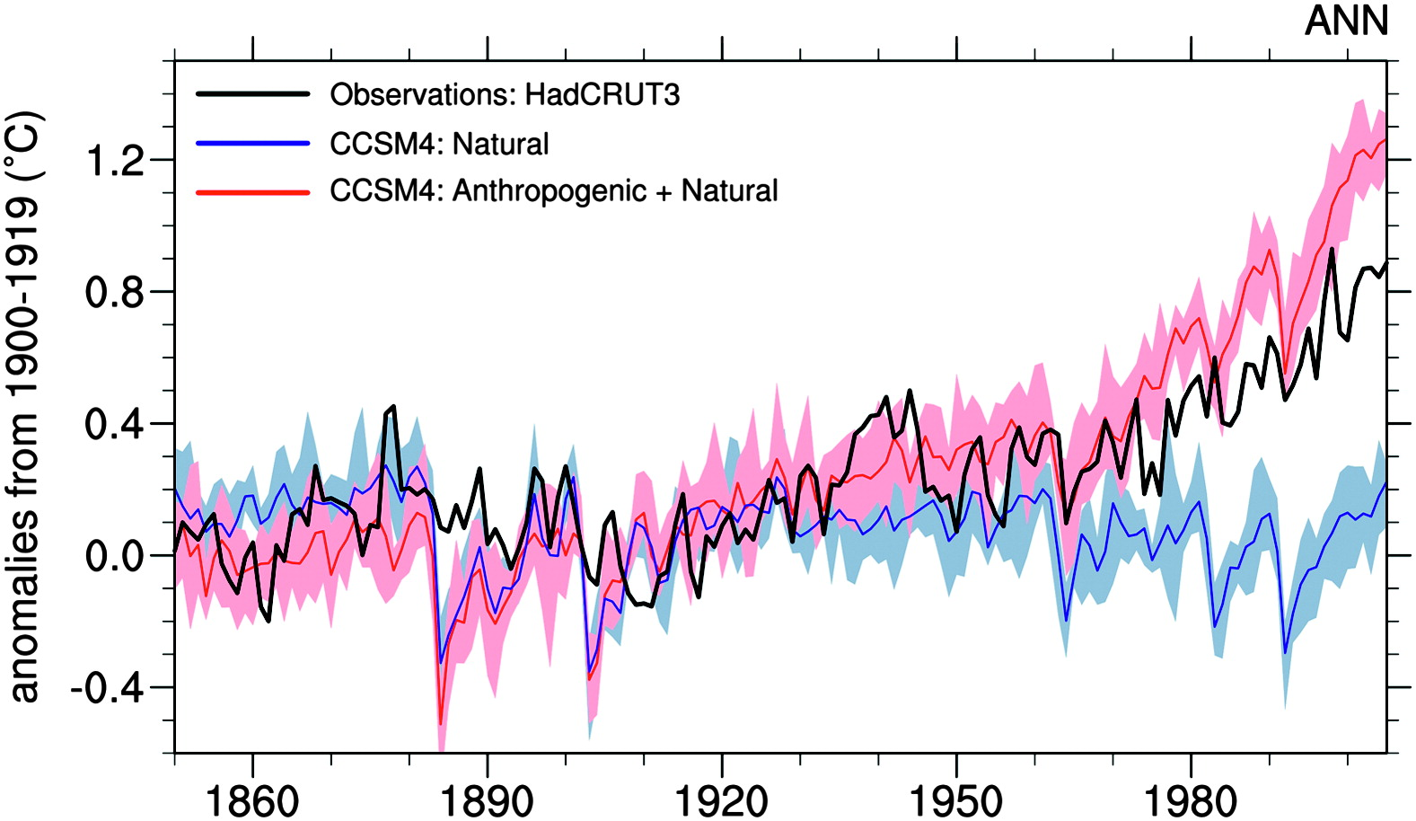
Natural forcings cannot account for the observed warming since at least 1960
Data from Hansen et al. 2011
Volcanic aerosols and solar variability constitute the most significant natural climate perturbations
Meehl et al, 2012
Mt. Pinatubo, 1991 USGS https://pubs.usgs.gov/fs/1997/fs113-97/

Slide 15
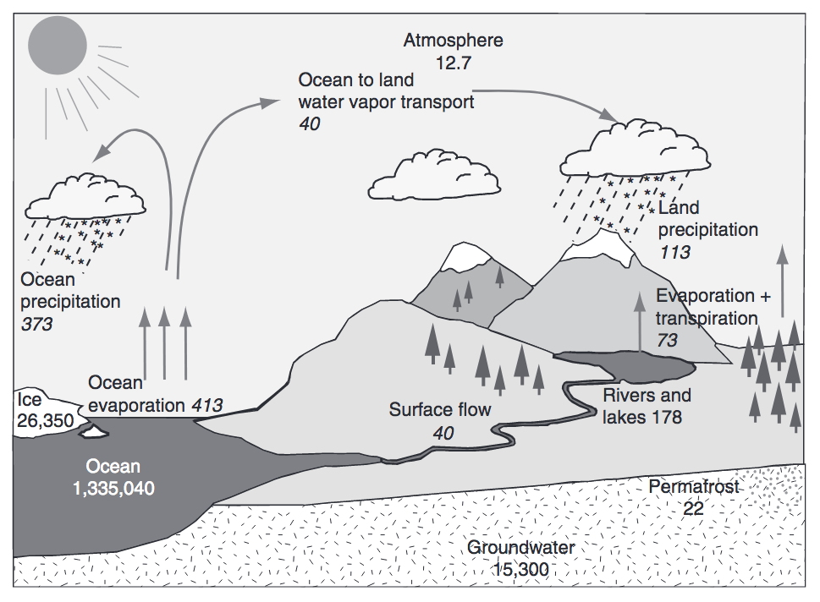
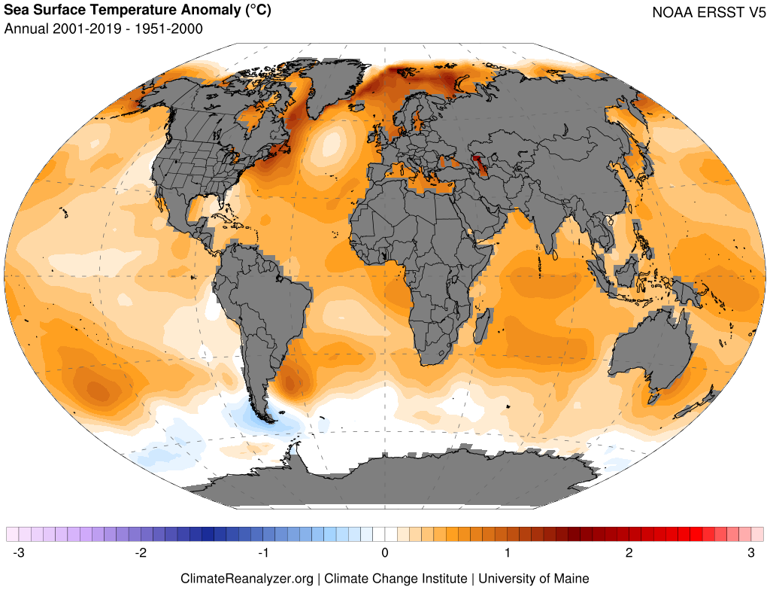
Warming Oceans, Water Vapor Feedback, and Intensifying Hydrologic Cycle
Trenberth et al. (2007), Huntington (2010)
Warming drives increased evaporation, atmospheric water-vapor content, and potential for greater extremes (e.g., heavy precipitation, drought)

Slide 16
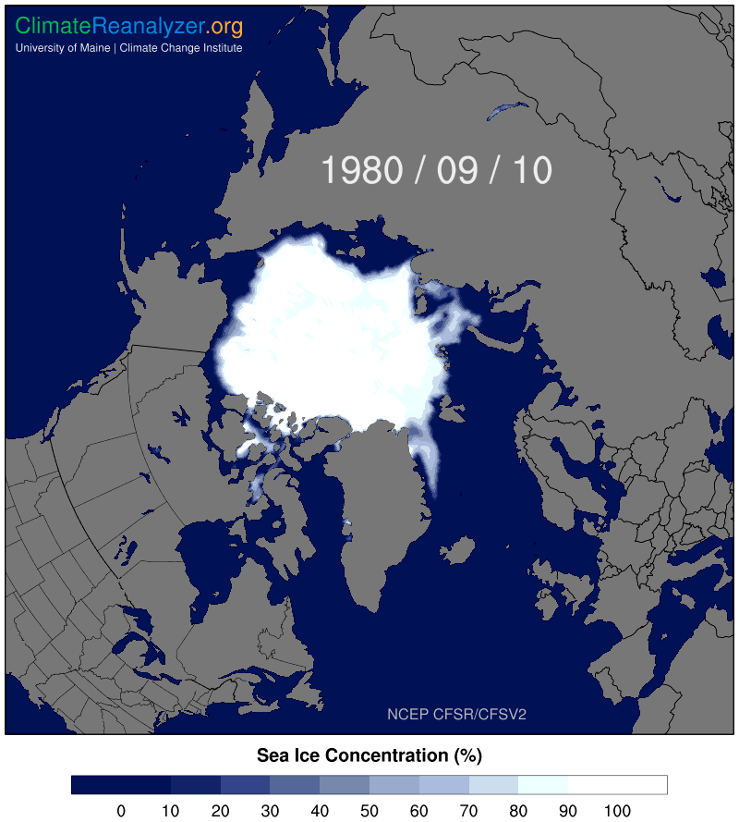
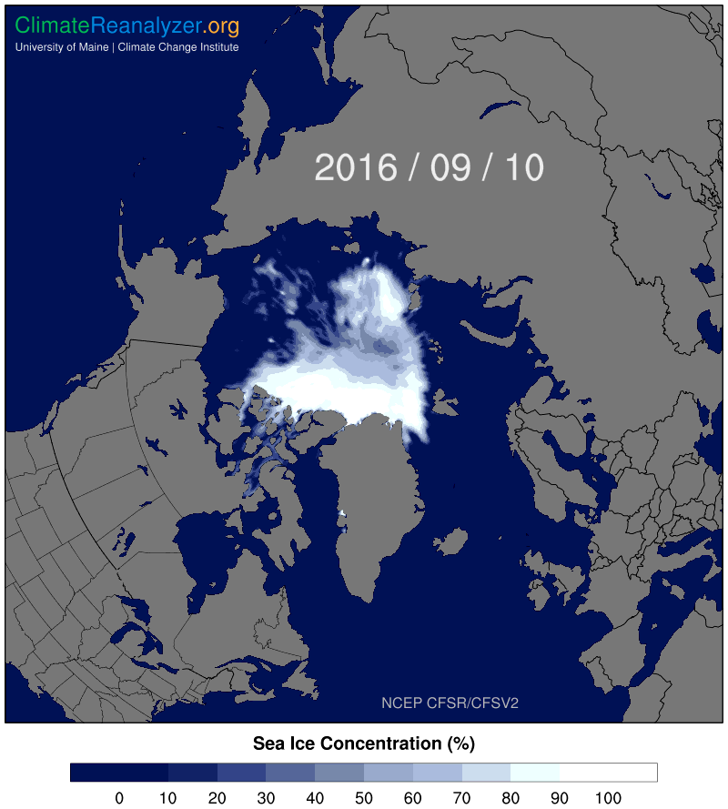
Sea Ice Decline & Arctic Amplification

Slide 17
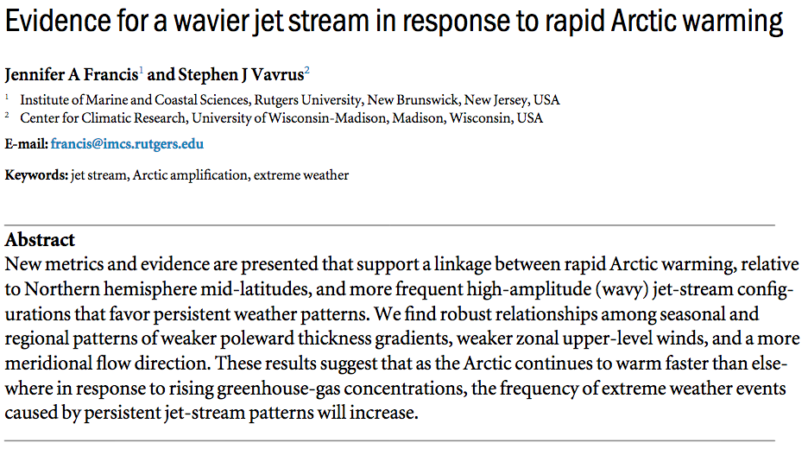
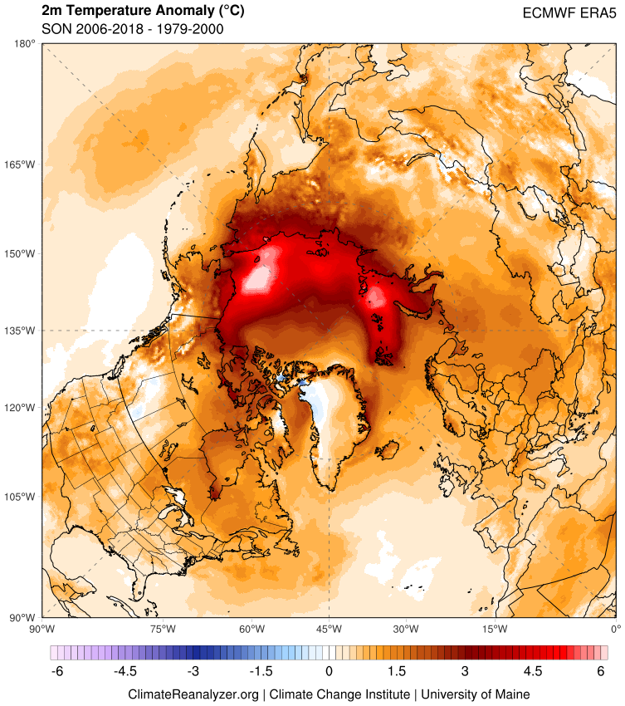
What is driving extreme weather events?

Slide 18
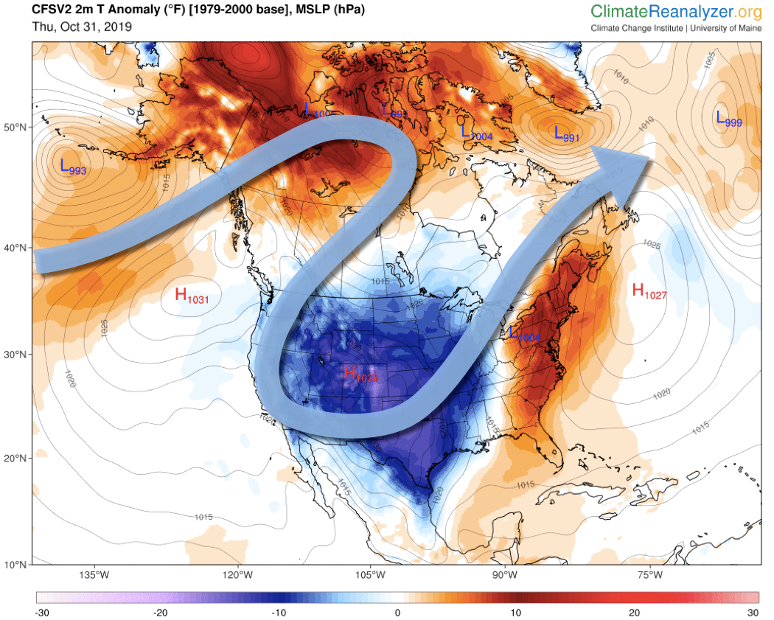
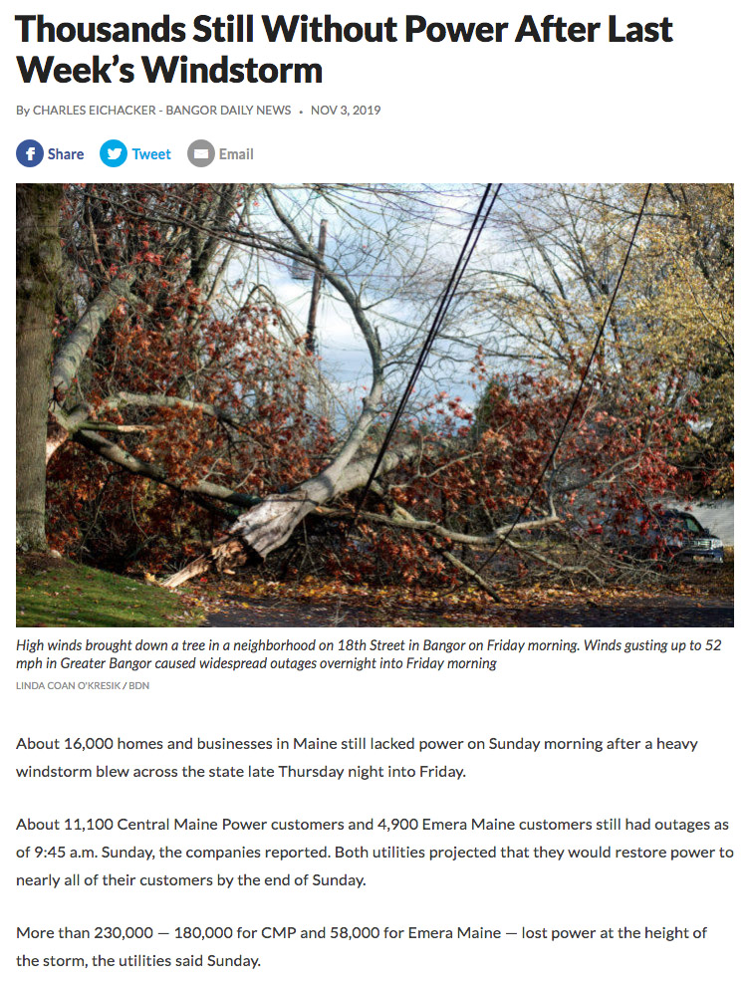
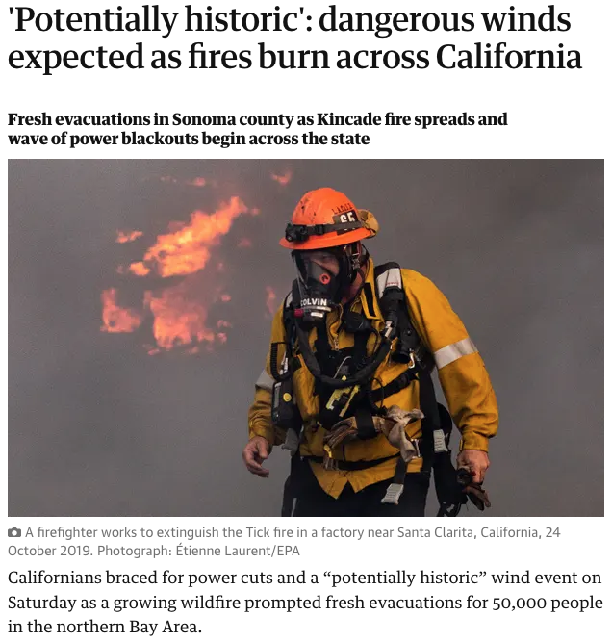
Connecting Extremes via the Jetstream
Late October /
Early November
2019
The Guardian 10/26/2019

Slide 19
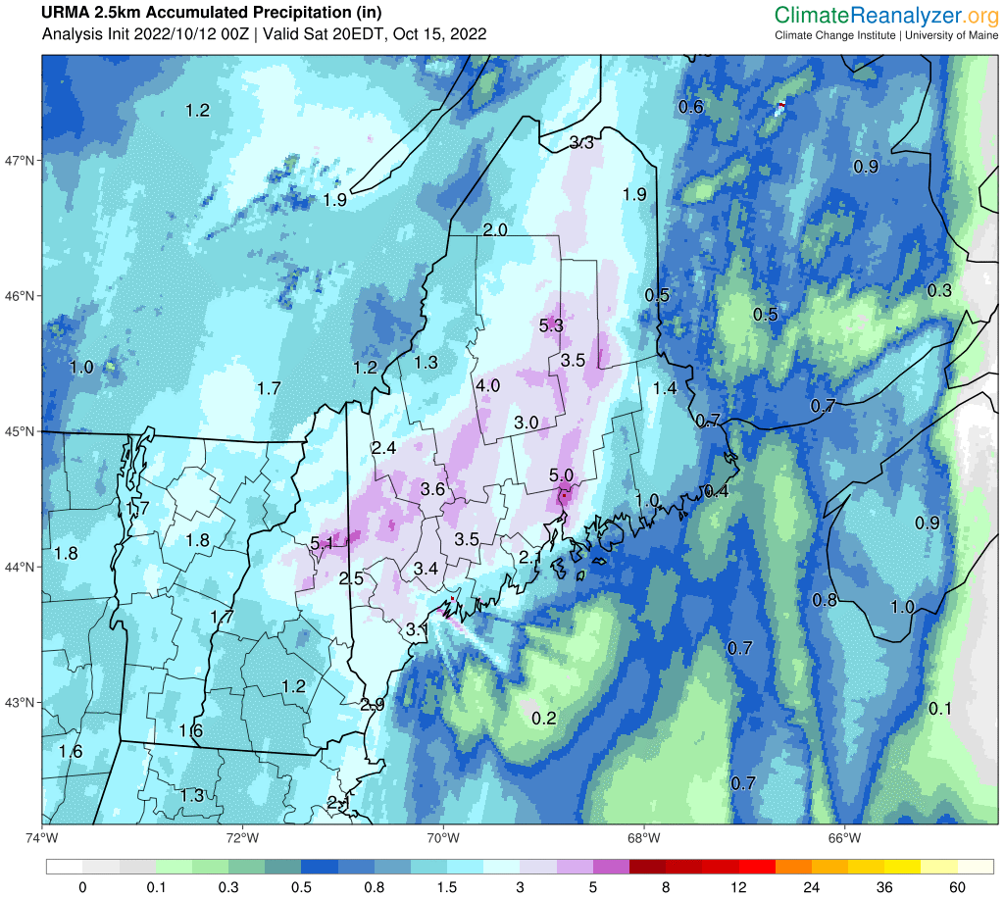
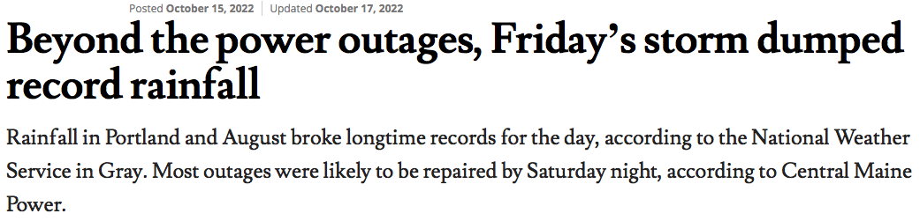
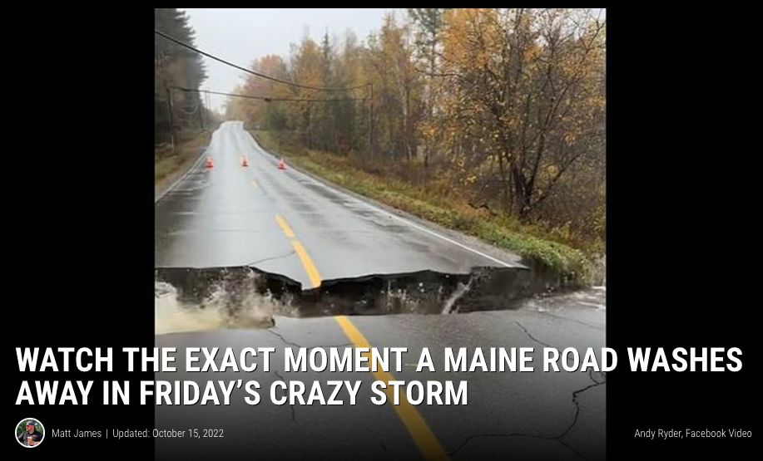
Heavy Rainfall October 14–15, 2022
Portland Press Herald

Slide 20
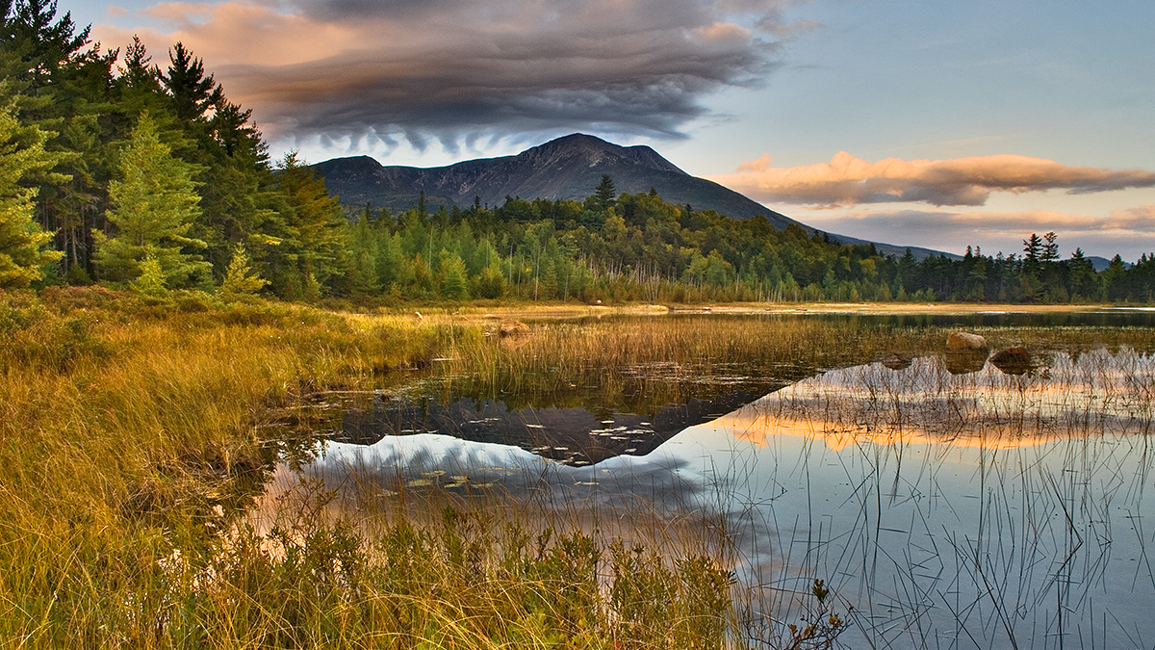
Questions?
Sean Birkel
Assistant Professor
Maine State Climatologist
birkel@maine.edu

Slide 22
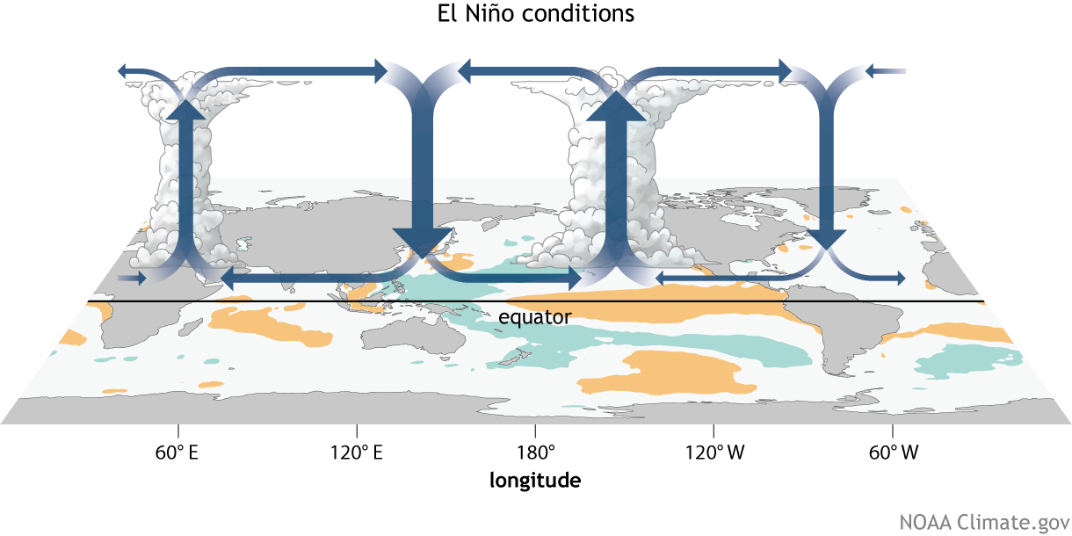
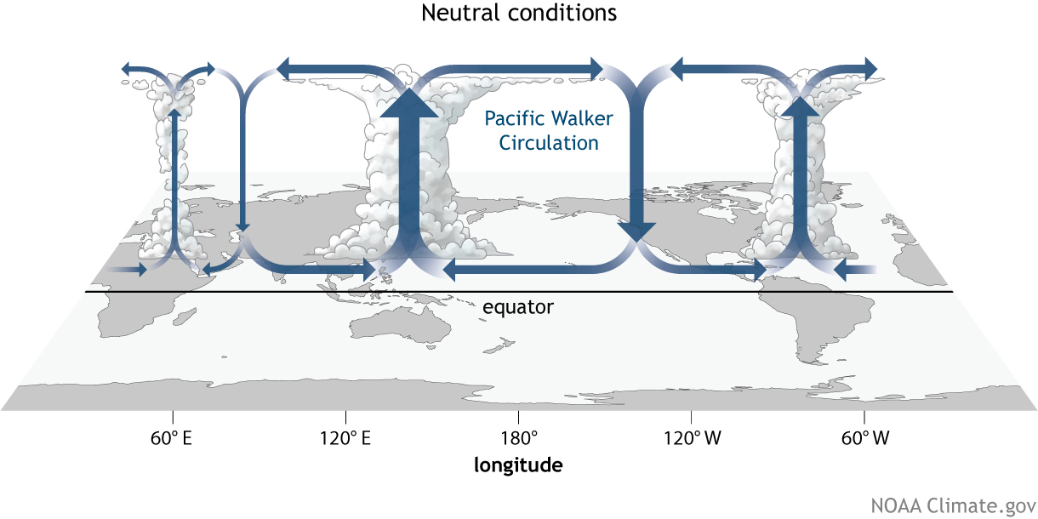
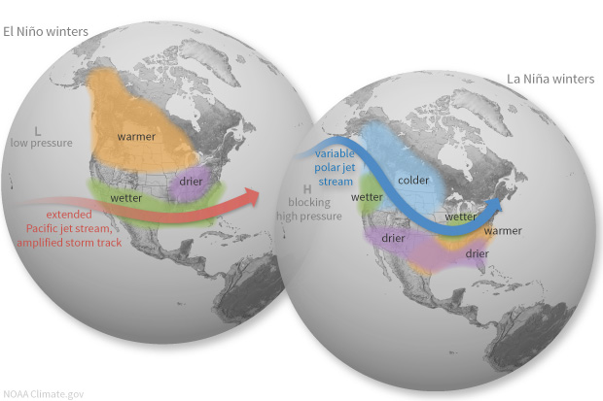
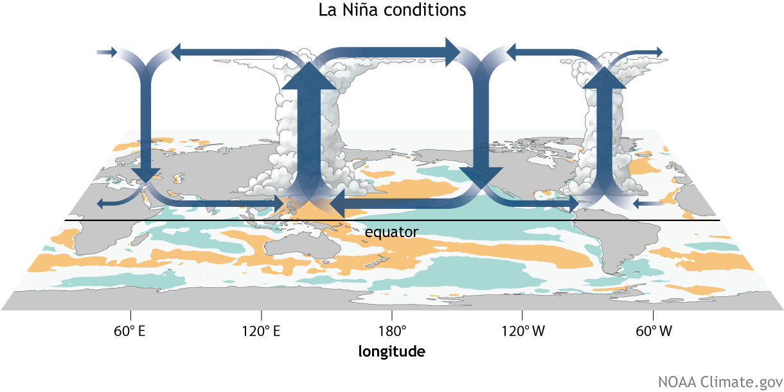
El Niño-Southern Oscillation (ENSO)
Coupled ocean-atmosphere response with irregular period of 2–7 years between El Niño (warm) and La Niña (cool) phases.
ENSO impacts weather worldwide, particularly during boreal winter.
Atmospheric response known as Walker circulation.
https://www.climate.gov/enso

Slide 23
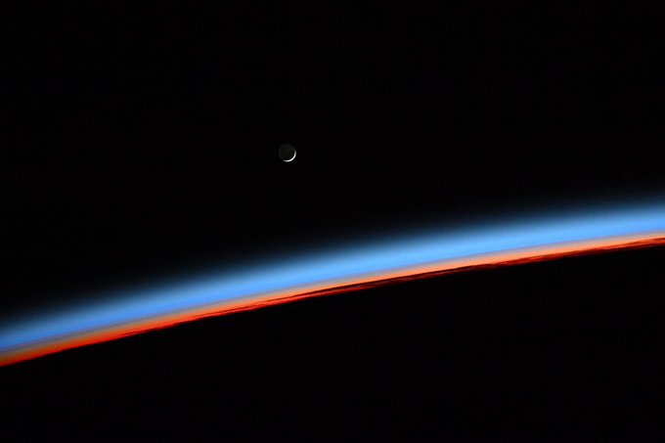

Slide 24
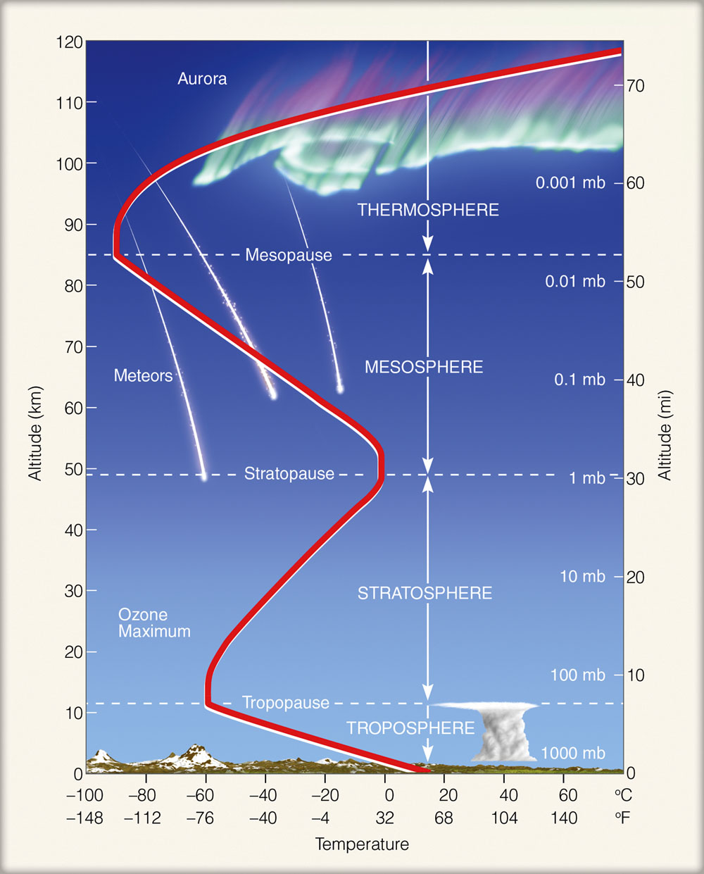
https://ghsearth.weebly.com/uploads/2/3/2/8/23284064/atm_layers_1.jpg

Slide 25
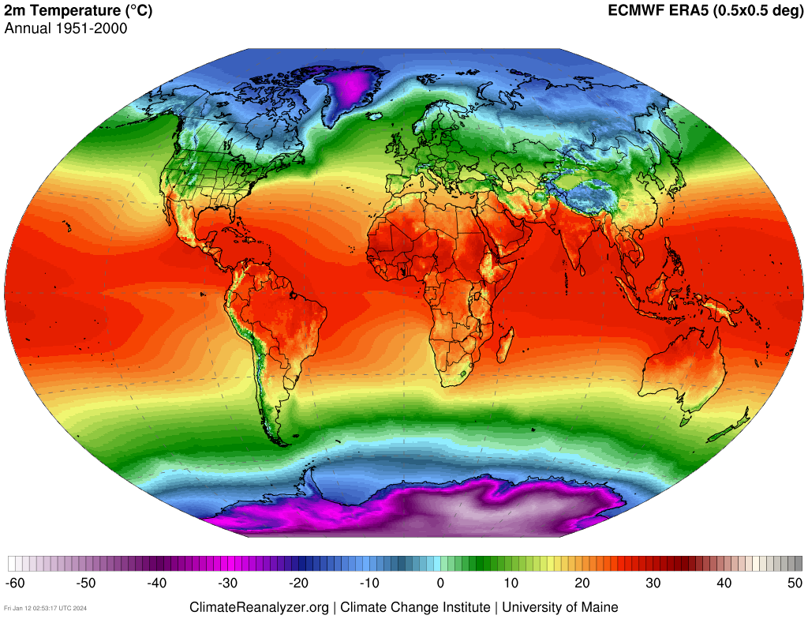
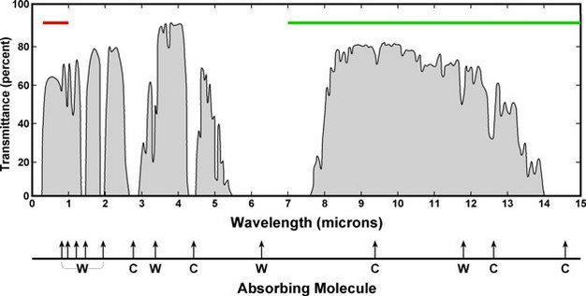
Equilibrium Climate
Outgoing Longwave
+
Reflected
Shortwave
=
Total Incoming Solar Radiation
IPCC AR3

Slide 26
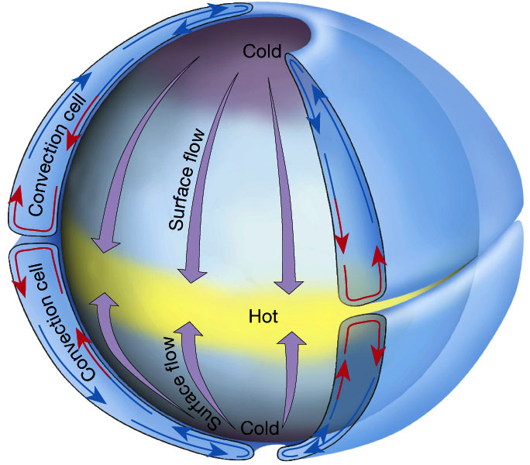
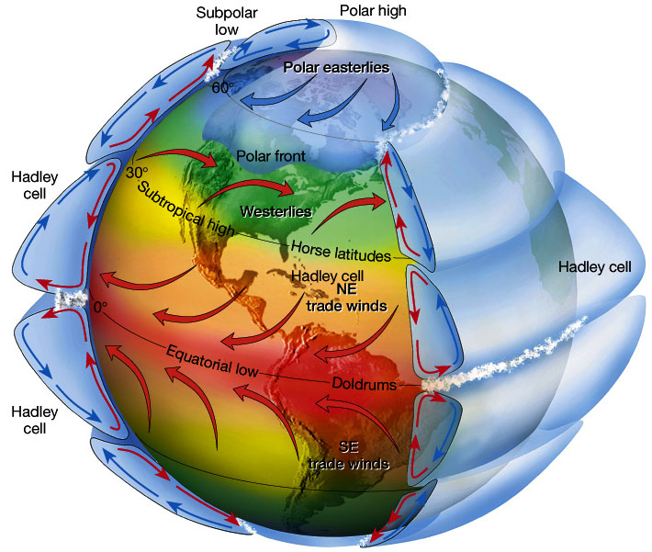
Atmospheric Circulation
Idealized single-cell atmospheric convection.
Three-cell atmospheric convection on rotating frame of reference. Wind deflections in each cell N & S of the equator due to the Coriolis force.
Figure 7.5 in The Atmosphere, 8th edition, Lutgens and Tarbuck, 8th edition, 2001
Downloaded from https://www.ux1.eiu.edu/~jpstimac/1400/circulation.html

Slide 27
Westerlies
Subtropical High
Intertropical Convergence Zone (ITCZ)
Subtropical High
Westerlies

Slide 28
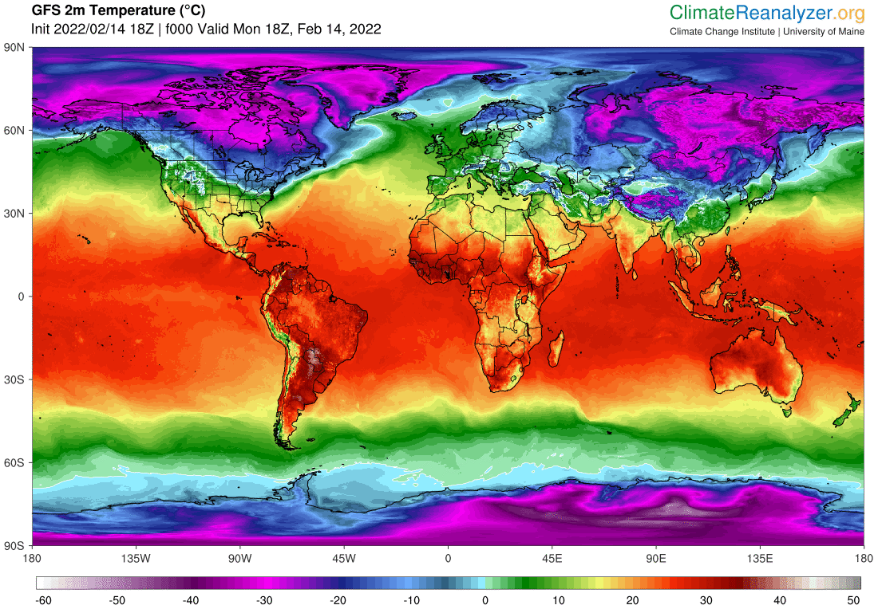
Westerlies
Subtropical High
Intertropical Convergence Zone (ITCZ)
Subtropical High
Westerlies

Slide 29
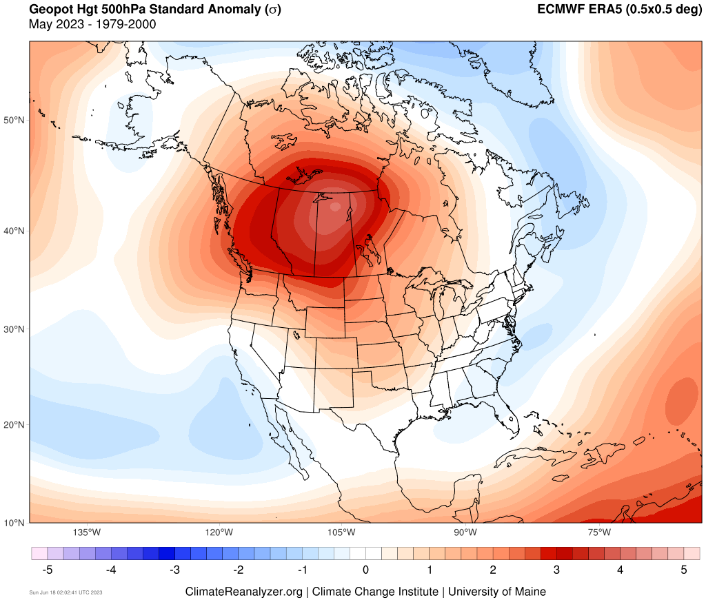
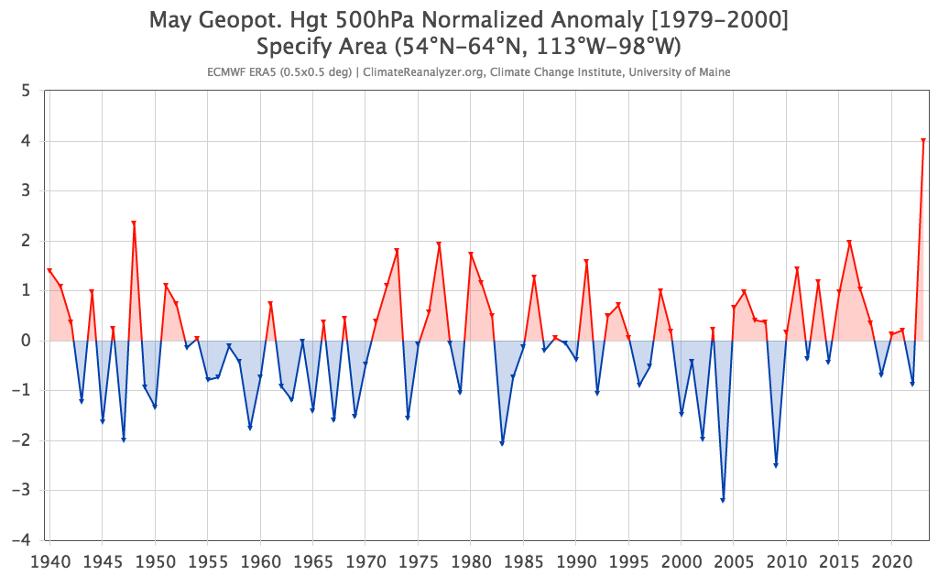
2023 Extremes

Slide 30
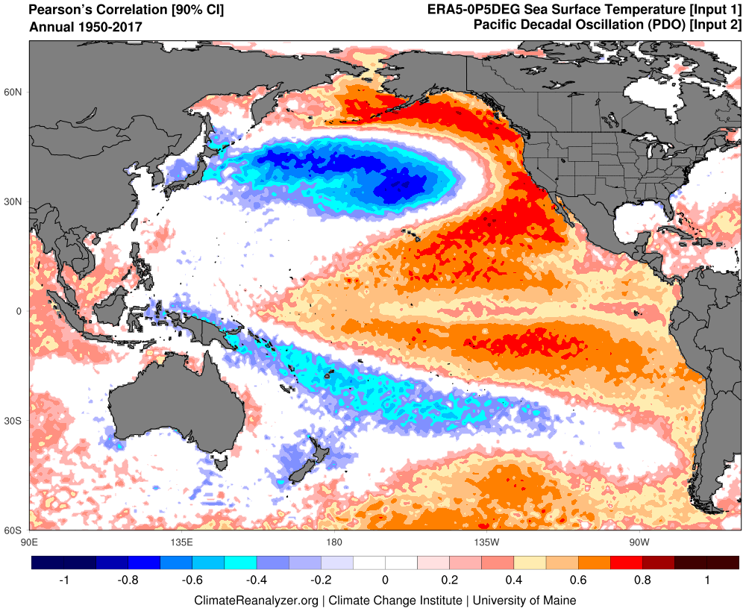
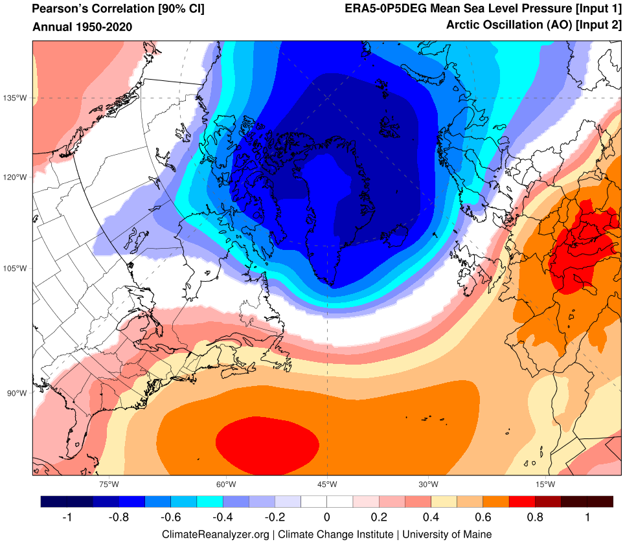


Teleconnections
Pacific Decadal Oscillation (PDO)
El Niño-Southern Oscillation (ENSO)
Atlantic Multidecadal Oscillation/Variability (AMO/AMV)
North Atlantic Oscillation (NAO)
Greenland Blocking Index (GBI)

Slide 31


Global Historical Climatology Network (GHCN)
Un-Restricted Mesoscale Analysis (URMA)
NCAR Climate Data Guide

Slide 32

Warming of 2-10°F by 2100 depending on future scenario
High GHG Emissions
Low GHG Emissions
Maine’s Climate Future 2020 Update
Maine Climate Council STS Report, 2020

Slide 33

Season Lengths are Changing
Statewide Mean Annual Temperature (°F)
MCF 2015 Update
Summer weather and growing season extension mostly into fall.
Trends projected to continue, but some years will bring unexpected late spring or early fall frosts.
The warm season has increased and snow season has decreased by about 2 weeks over the past century.

Slide 34


1981-2000
Northward Shift of Plant Hardiness Zones
Based on PRISM annual extreme minimum temperatures and USDA key
2001-2020

Slide 35

Oct 14–15
5”
95th percentile daily records
3.2”
1.8”

Slide 36



Slide 37


GPH 500mb Std. Anomaly, Oct. 18th

Slide 38

IPCC AR5

Slide 39


U.S. Drought Monitor
https://droughtmonitor.unl.edu/
NOAA Climate Divisional Database

Slide 40



Boreal
Mixed
Broadleaf
1850
2000
Forest Biomes will shift northward over next couple hundred years
Future
Potential Equilibrium Biomes UMaine Environmental Change Model

Slide 41




Summer in March, 2012
Temperatures into the 80s across southern half of Maine 22-23 March with no historical equivalent.
Farmington 83°F March 23rd – a daily high record set by 17°F!
18 March, 2012

