Slide 1
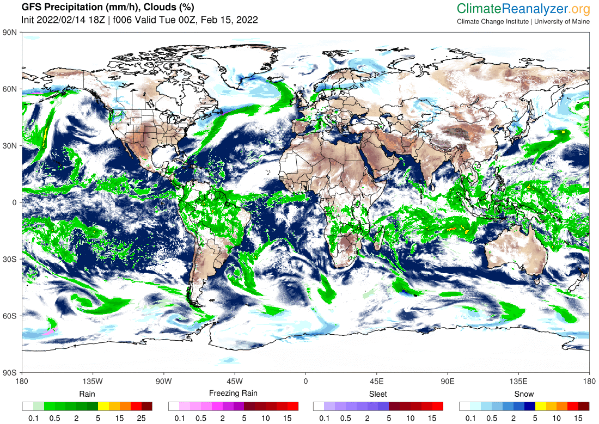



Climate System
Introduction
Sean Birkel
Cooperative Extension
Climate Change Institute
University of Maine
Climate Adaptation &
Mitigation Fellowship
www.adaptationfellows.net

Slide 2
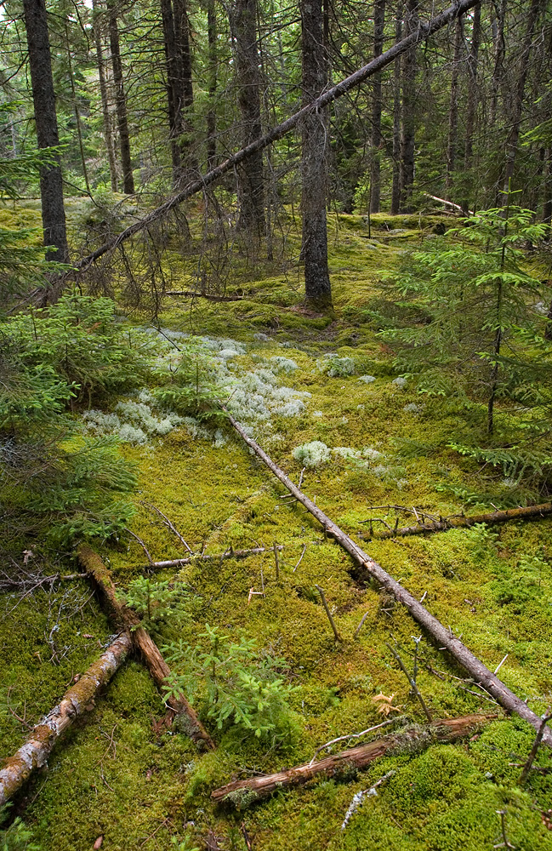
Presentation Outline
Data and Models
Defining Climate
Climate Change
  Internal variability (e.g., El Niño/La Niña)
  External forcing (e.g., CO² emissions)
  Arctic Amplification
Extreme Events

Slide 3
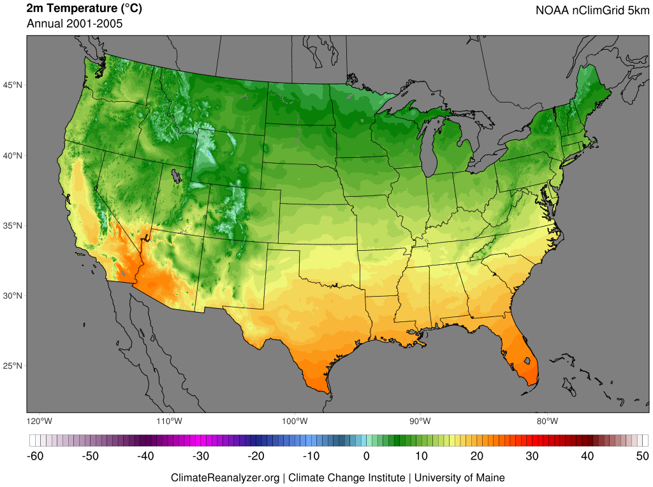
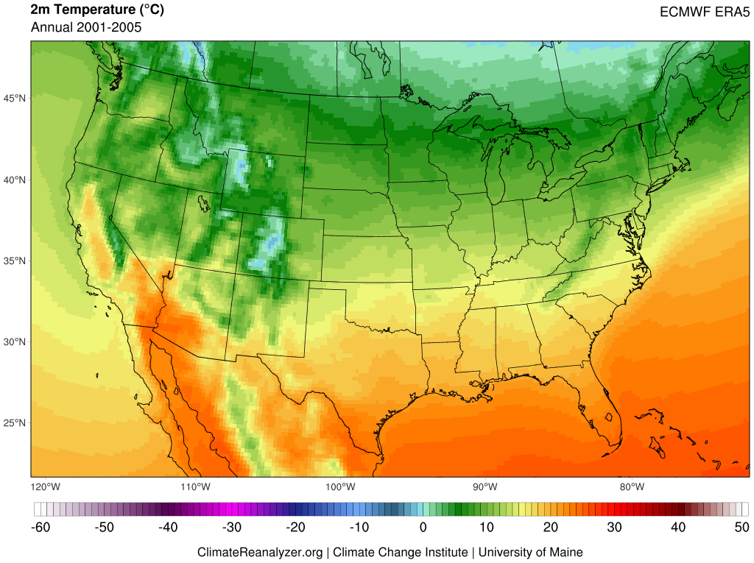
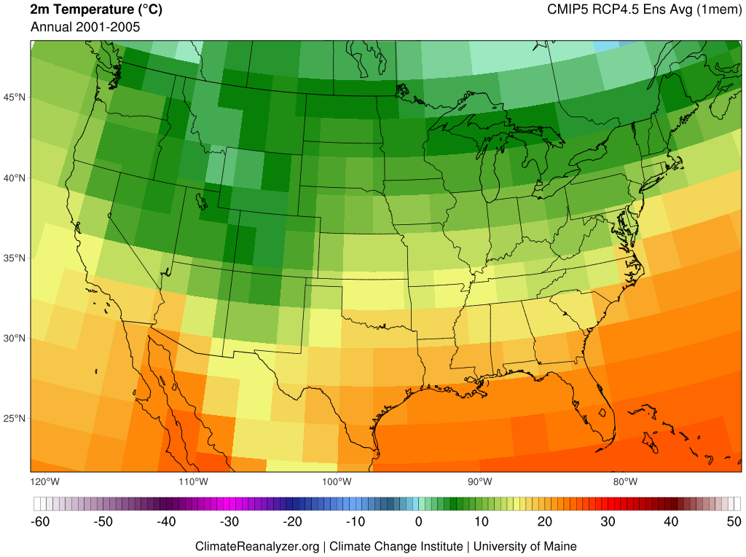
Gridded data products place point-based or spatially discontinuous observations of Earth's climate (e.g., temperature, precipitation, wind, and sea surface temperature) onto time-registered grids and fill in data gaps using methods of interpolation. Gridded datasets are useful for climate study in areas that may not have direct observations, but where the intersection of surrounding input data can provide meaningful information.
Reanalysis refers to physically-based numerical frameworks that simulate the state Earth's climate through time, guided by frequent input of real-world observations (e.g., weather stations, radiosonde, satellite, and ocean buoys). Reanalysis products are used for understanding climate variability and change, including across areas where direct observations are not available.
Climate models afford physically-based simulations of energy and material flows through the atmosphere, ocean, and other parts of the earth system. The most complex of these frameworks are earth system models, where multiple systems are coupled and yield dynamic interactions. Climate and earth system models are used for investigating past, present, and future climate evolution based on changes in radiative forcing, such as from greenhouse-gas emissions.
  Coupled Model Intercomparison Project (CMIP) 5 and 6
  Representative Concentration Pathways (RCPs) and Shared Socioeconomic Pathways (SSPs)

Slide 4

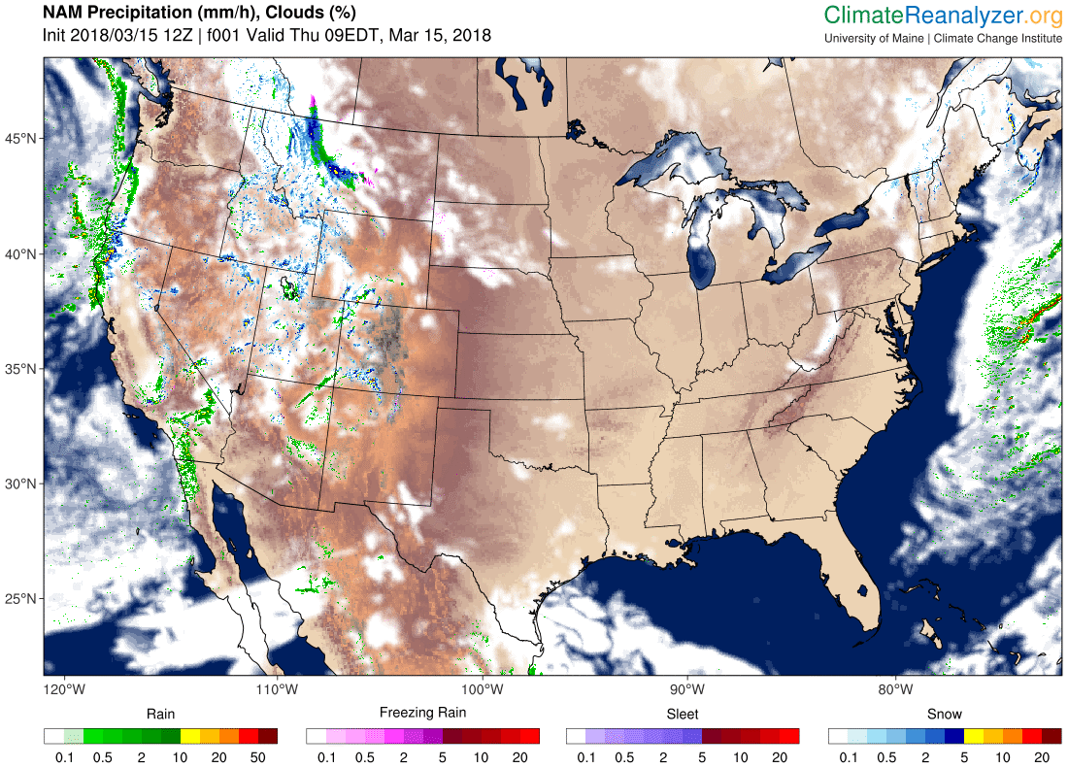
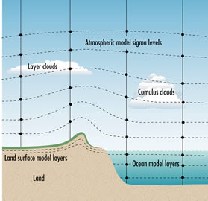
Future climate is projected using physics-based models of the atmosphere, ocean, cryosphere, and biosphere. The model climate can be perturbed by changes in GHG emissions, volcanic activity, solar output, and other factors.
www.bom.gov.au/info/GreenhouseEffectAndClimateChange.pdf

Slide 5
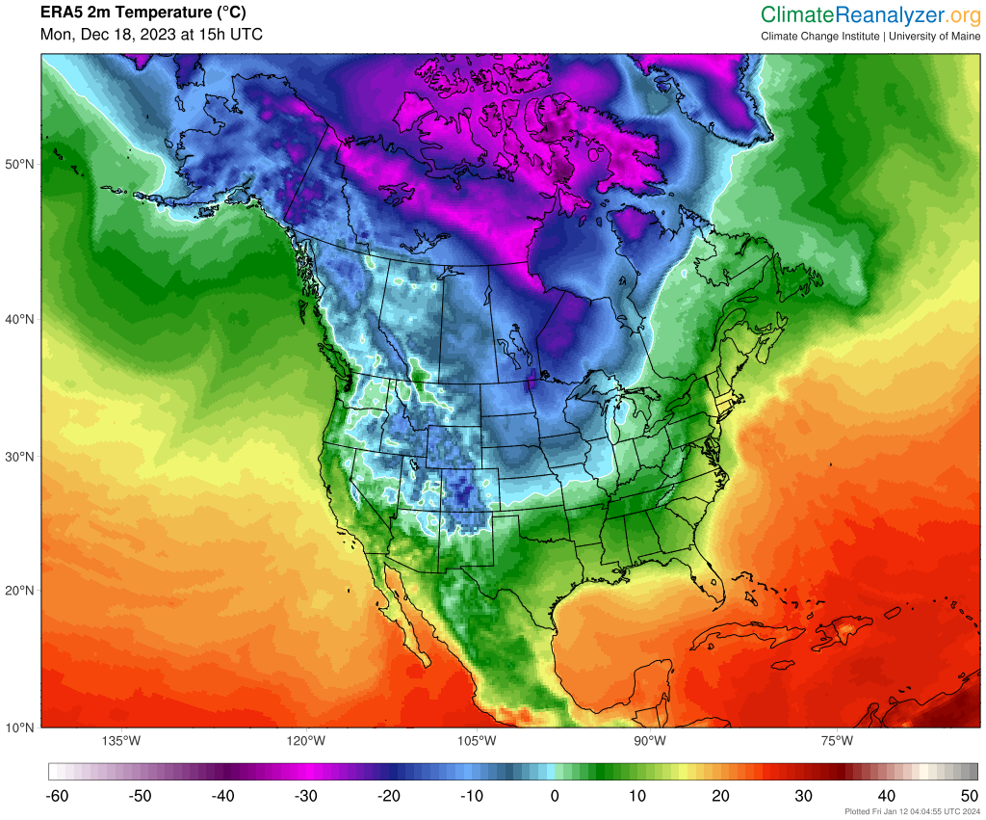
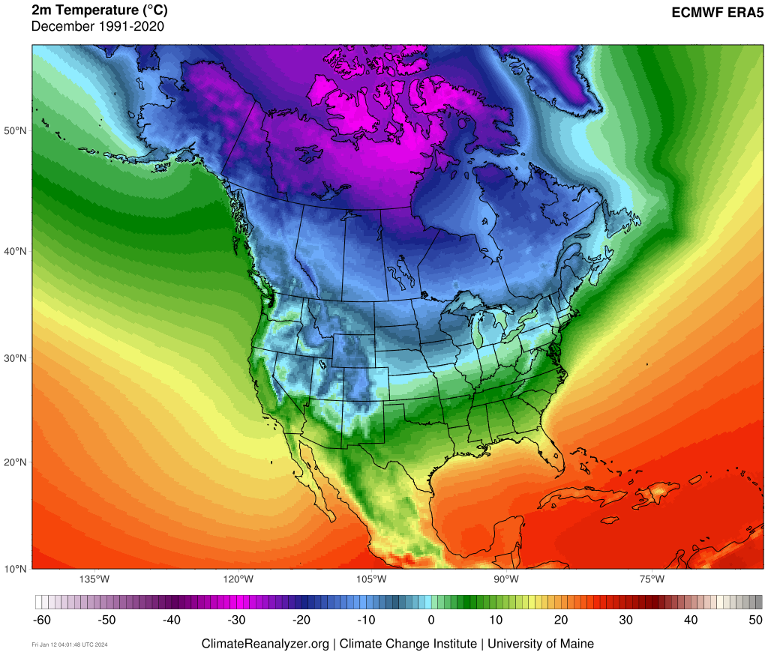
Defining Climate
Climate is the statistical representation of prevailing meteorological conditions – typically over a period of 30 years. In short, “climate is average weather.”
The climate system is composed of five interacting components: atmosphere, hydrosphere, cryosphere, biosphere, lithosphere.
Circulation within the climate system is driven by
incoming solar radiation. Greenhouse gases in the atmosphere absorb some of this radiation and warm the planet.
Changes in climate represent imbalance between incoming solar radiation and energy loss to space.
These changes occur due to internal variability and external forcing.

Slide 6
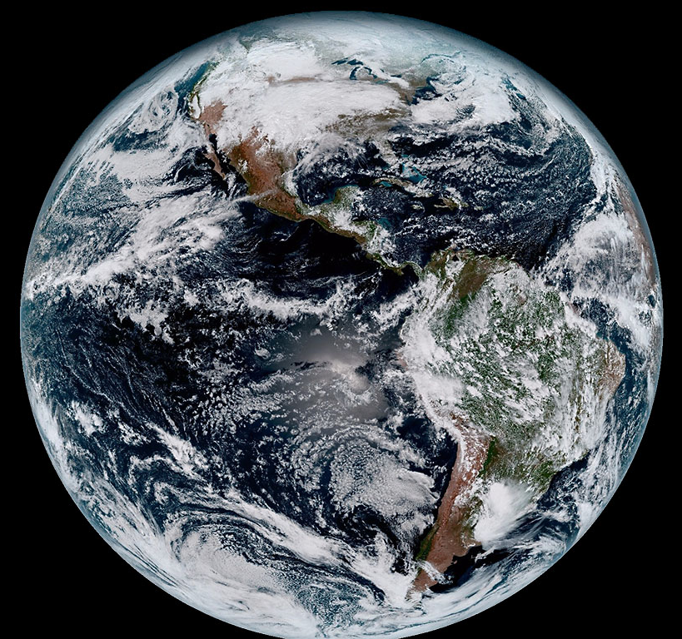
Defining Climate
Climate is the statistical representation of prevailing meteorological conditions – typically over a period of 30 years. In short, “climate is average weather.”
The climate system is composed of five interacting components: atmosphere, hydrosphere, cryosphere, biosphere, lithosphere.
Circulation within the climate system is driven by
incoming solar radiation. Greenhouse gases in the atmosphere absorb some of this radiation and warm the planet.
Changes in climate represent imbalance between incoming solar radiation and energy loss to space.
These changes occur due to internal variability and external forcing.

Slide 7
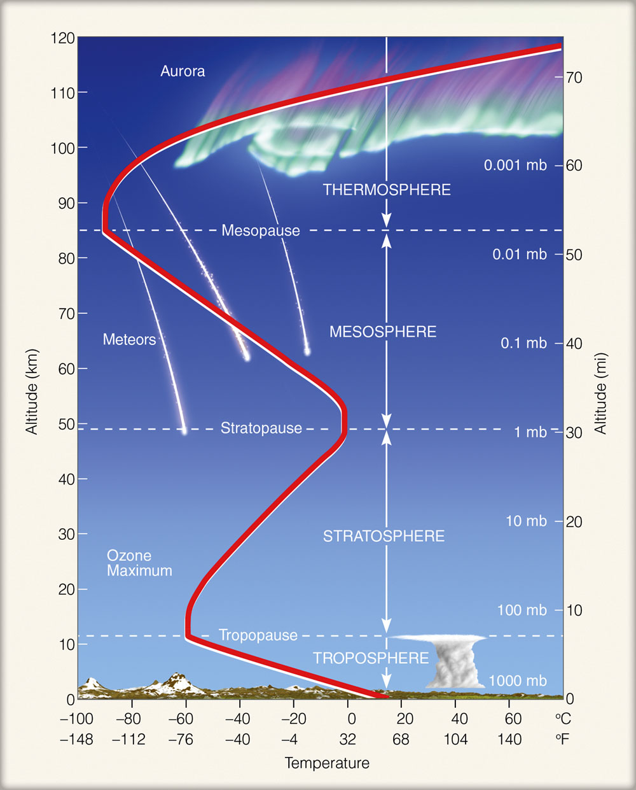
https://ghsearth.weebly.com/uploads/2/3/2/8/23284064/atm_layers_1.jpg

Slide 8
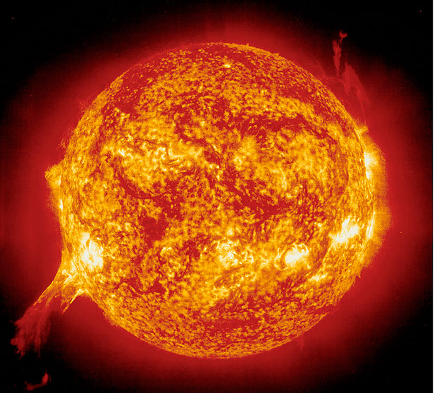
Defining Climate
Climate is the statistical representation of prevailing meteorological conditions – typically over a period of 30 years. In short, “climate is average weather.”
The climate system is composed of five interacting components: atmosphere, hydrosphere, cryosphere, biosphere, lithosphere.
Circulation within the climate system is driven by
incoming solar radiation. Greenhouse gases in the atmosphere absorb some of this radiation and warm the planet.
Changes in climate represent imbalance between incoming solar radiation and energy loss to space.
These changes occur due to internal variability and external forcing.

Slide 9
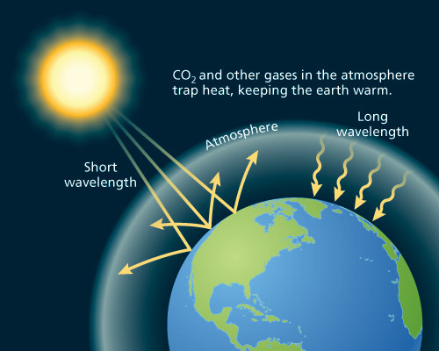
The Greenhouse Effect
http://www.oxfordpresents.com/ms/krohne/global-warming-and-ecological-communities/

Slide 10
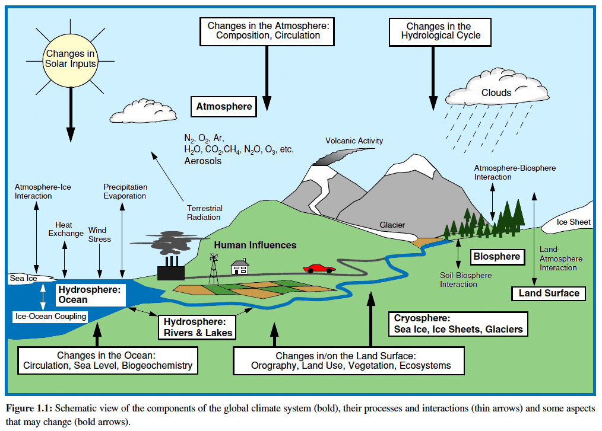
Atmosphere
Hydrosphere
ocean, lakes, rivers
Cryosphere
glaciers, sea ice
Biosphere
Lithosphere
solid earth
Adapted from IPCC AR3

Slide 11
Defining Climate
Climate is the statistical representation of prevailing meteorological conditions – typically over a period of 30 years. In short, “climate is average weather.”
The climate system is composed of five interacting components: atmosphere, hydrosphere, cryosphere, biosphere, lithosphere.
Circulation within the climate system is driven by
incoming solar radiation. Greenhouse gases in the atmosphere absorb some of this radiation and warm the planet.
Changes in climate represent imbalance between incoming solar radiation and energy loss to space.
These changes occur due to internal variability and external forcing.

Slide 12
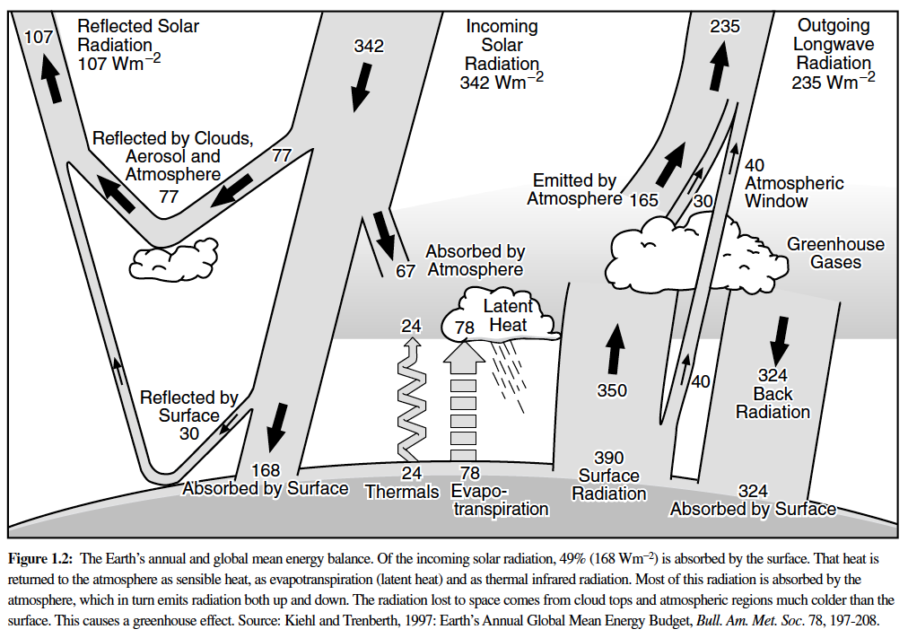
Equilibrium Climate
Outgoing Longwave
+
Reflected
Shortwave
=
Total Incoming Solar Radiation
IPCC AR3

Slide 13
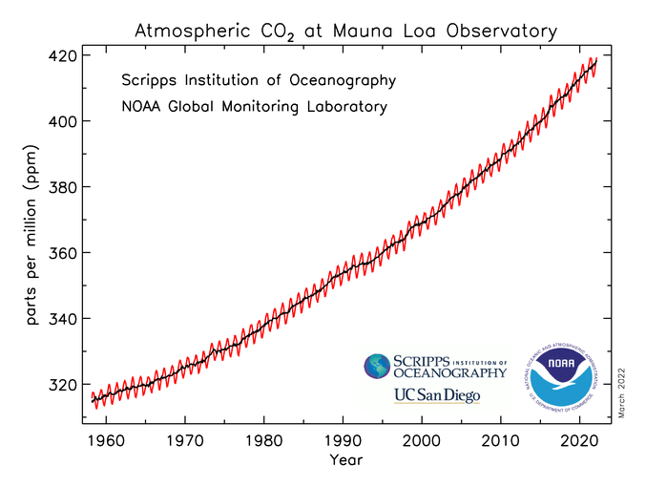
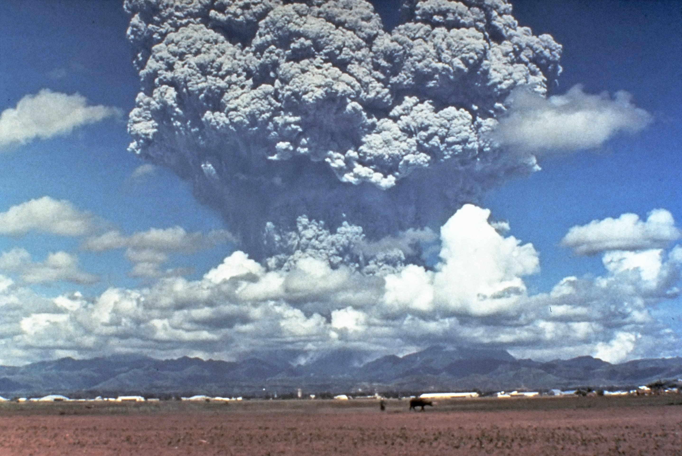
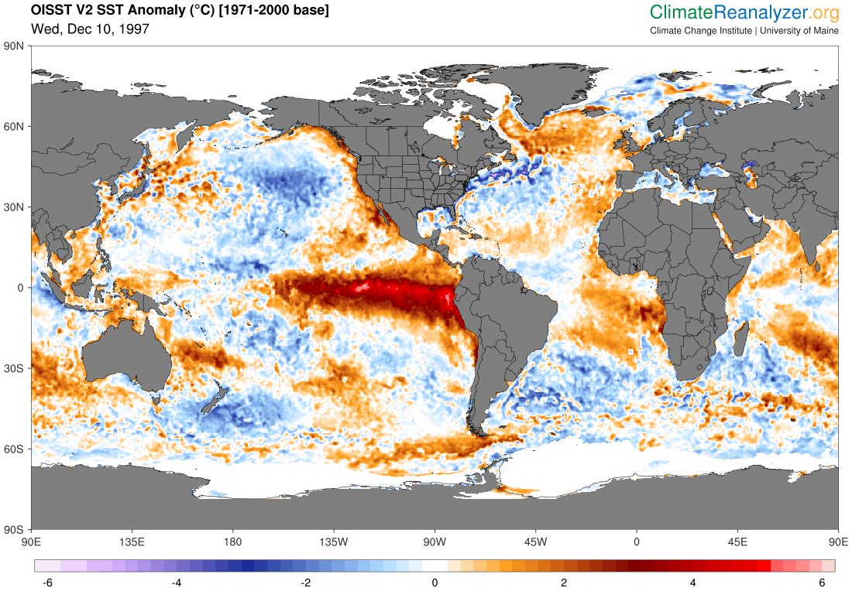
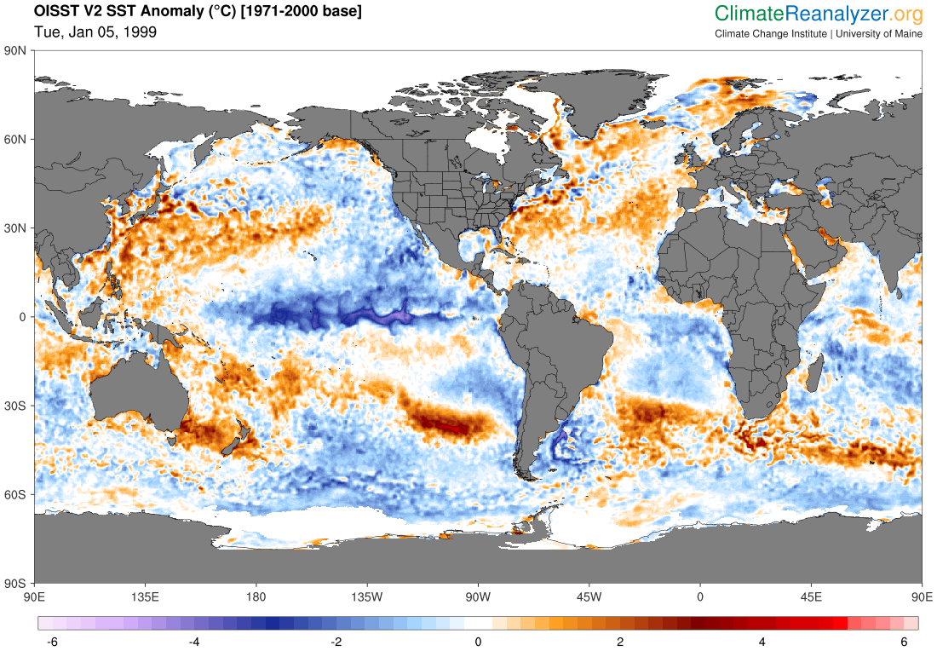
Defining Climate
Greenhouse Gas Emissions
Climate is the statistical representation of prevailing meteorological conditions – typically over a period of 30 years. In short, “climate is average weather.”
Volcanic Aerosols
Solar Cycle
The climate system is composed of five interacting components: atmosphere, hydrosphere, cryosphere, biosphere, lithosphere.
Circulation within the climate system is driven by
incoming solar radiation. Greenhouse gases in the atmosphere absorb some of this radiation and warm the planet.
El Niño-Southern Oscillation (ENSO)
Changes in climate represent imbalance between incoming solar radiation and energy loss to space.
These changes occur due to internal variability and external forcing.

Slide 14
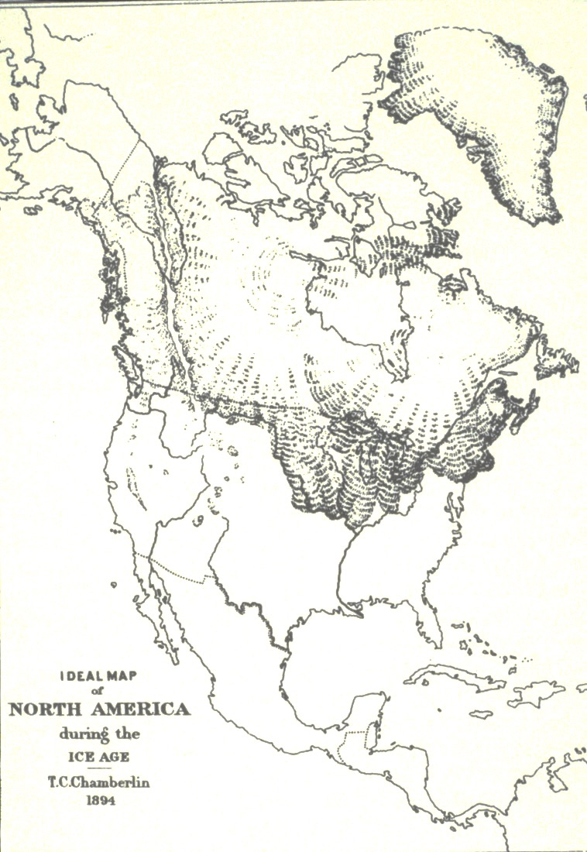
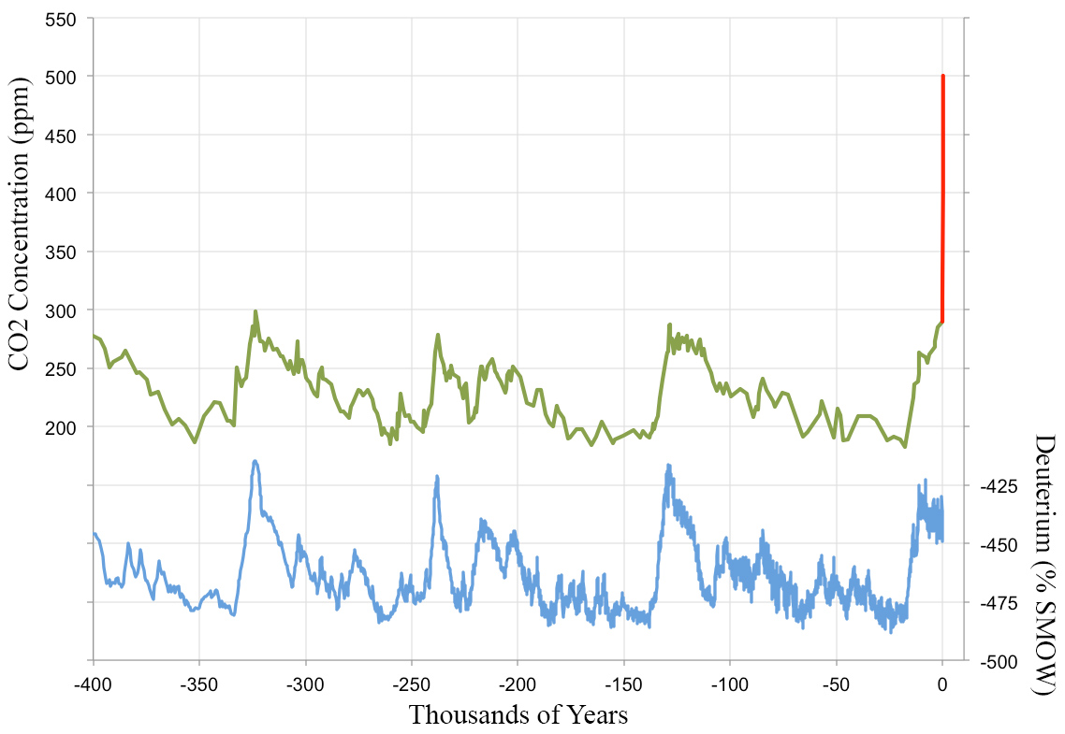
NOAA Global Monitoring Laboratory
https://gml.noaa.gov/ccgg/trends/mlo.html
500 ppm 2100
Ice Core Record
Vostok Station, Antarctica
400 ppm 2015
290 ppm Natural
Warm
Cold

Slide 15
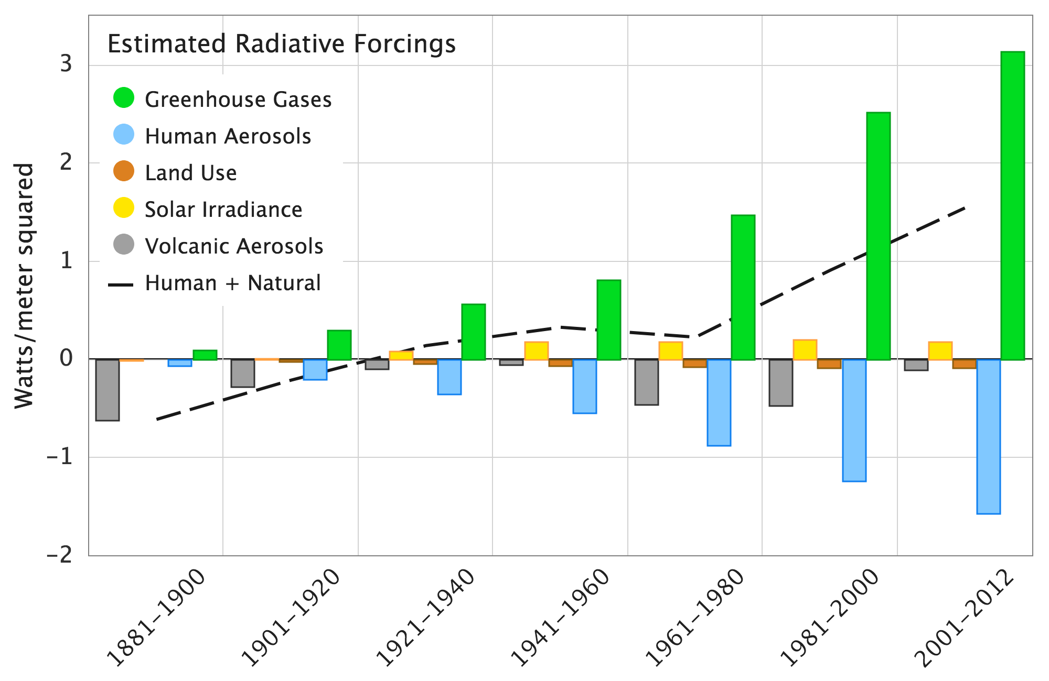
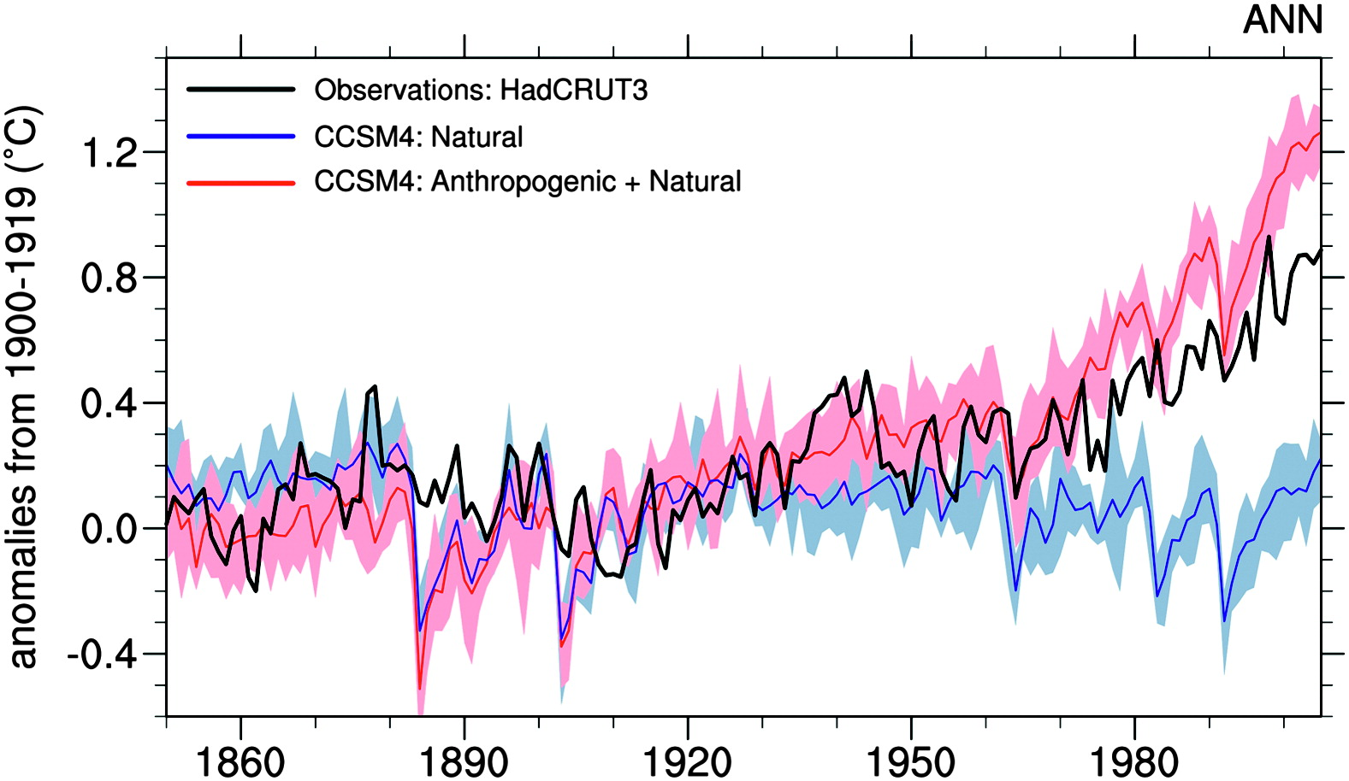
Natural forcings cannot account for the
observed warming since at least 1960
Data from Hansen et al. 2011
Volcanic aerosols and solar variability cause the largest natural climate perturbations
Meehl et al, 2012
Mt. Pinatubo, 1991
USGS https://pubs.usgs.gov/fs/1997/fs113-97/

Slide 16
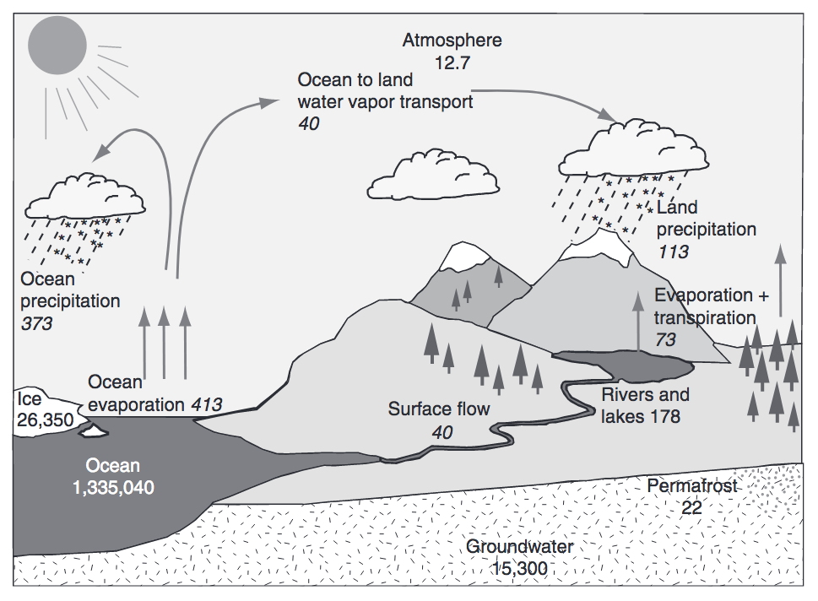
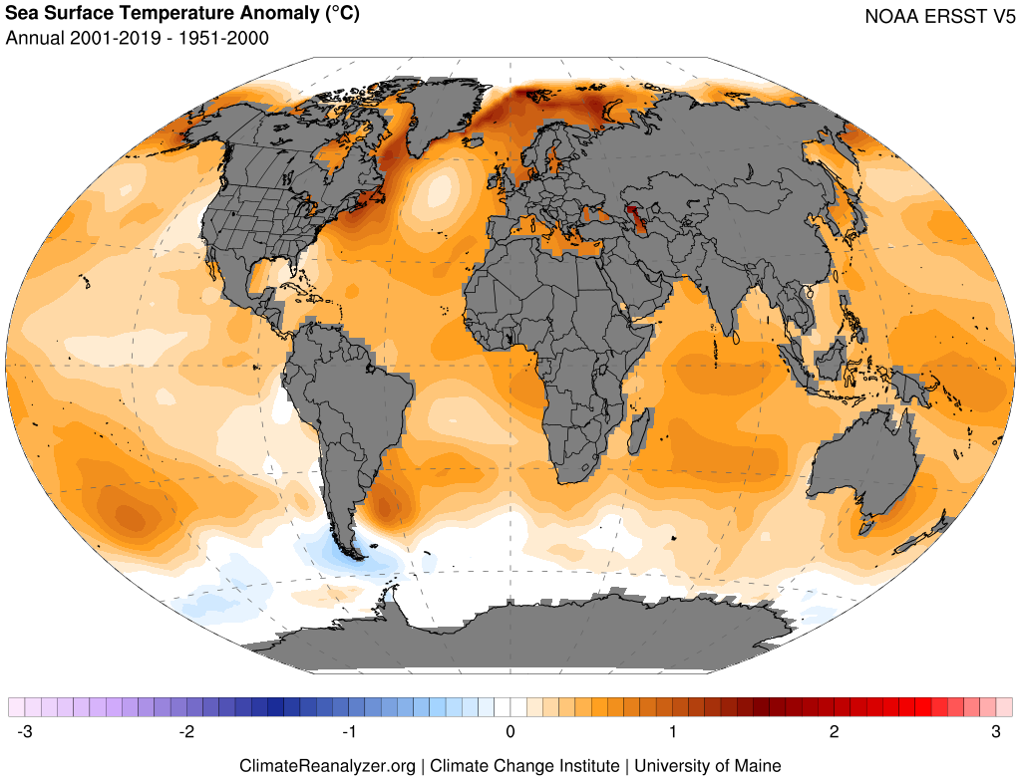
Warming Oceans, Water Vapor Feedback, and Intensifying Hydrologic Cycle
Trenberth et al. (2007), Huntington (2010)
Warming drives increased evaporation, atmospheric water-vapor content, and potential for greater extremes (e.g., heavy precipitation, drought)

Slide 17
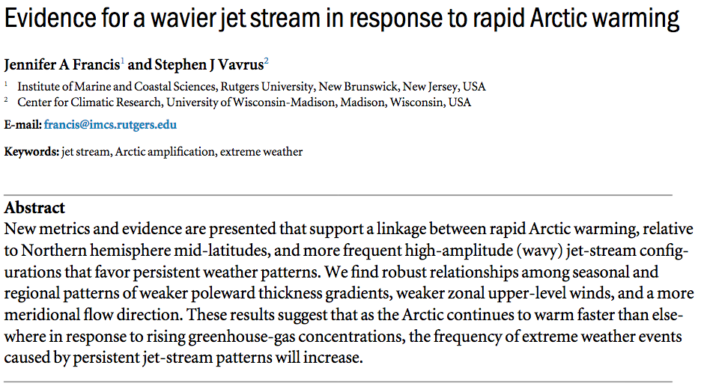
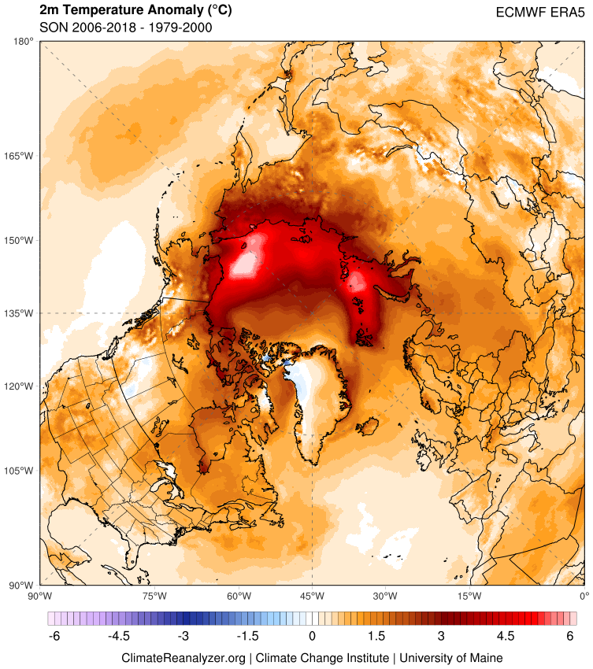
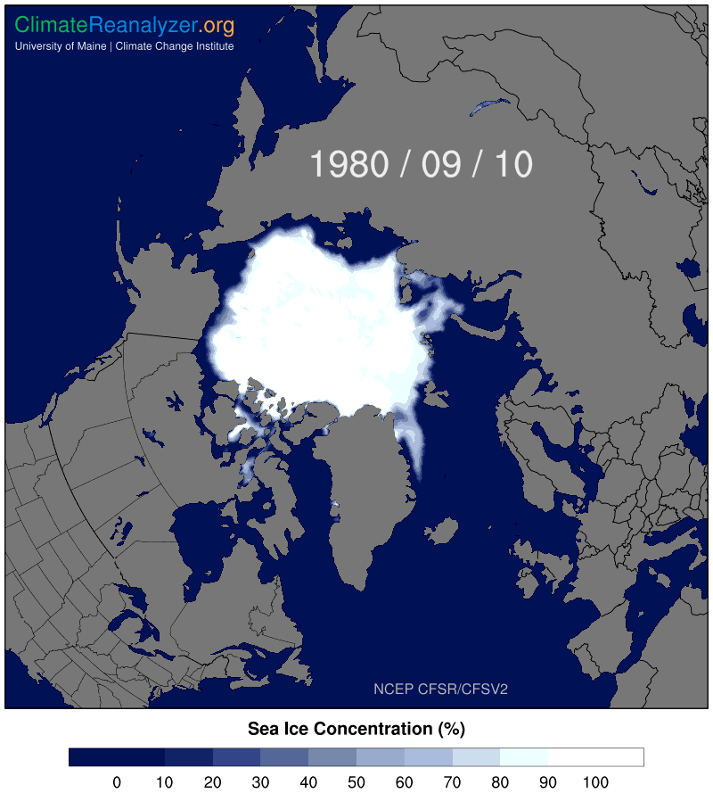
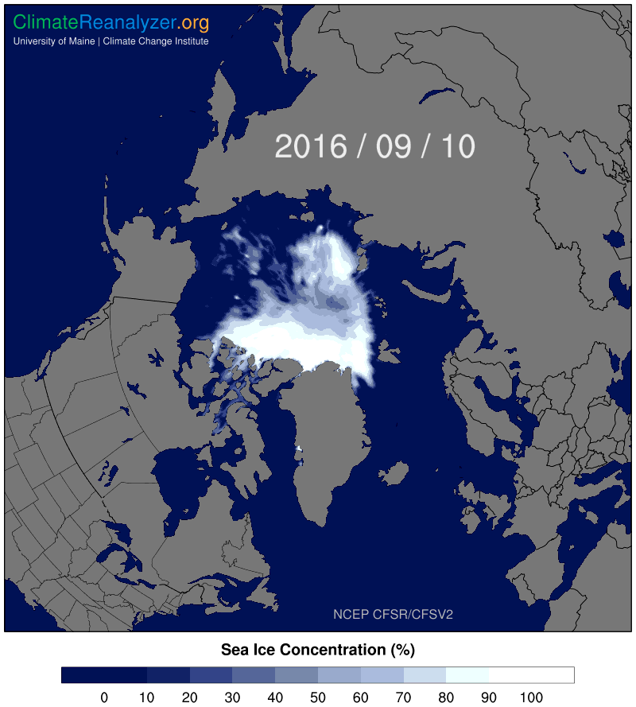
What is driving extreme weather events?

Slide 18
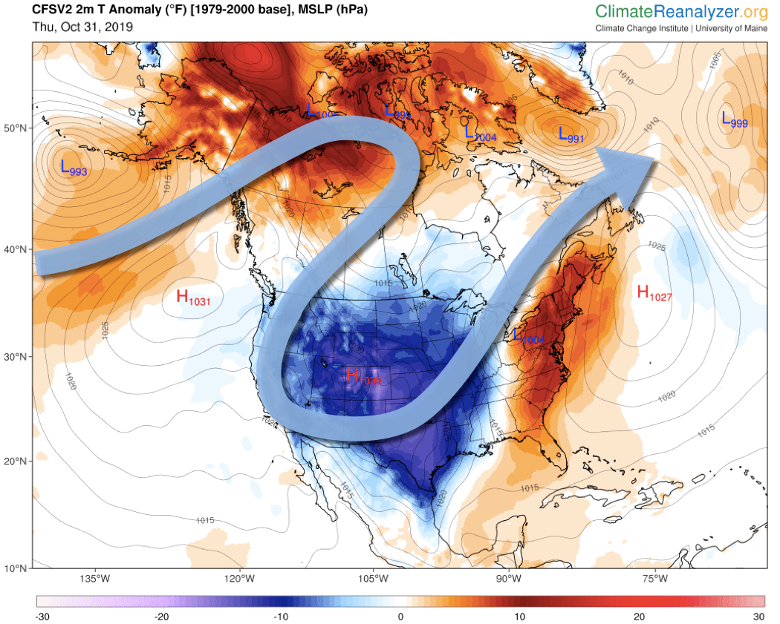
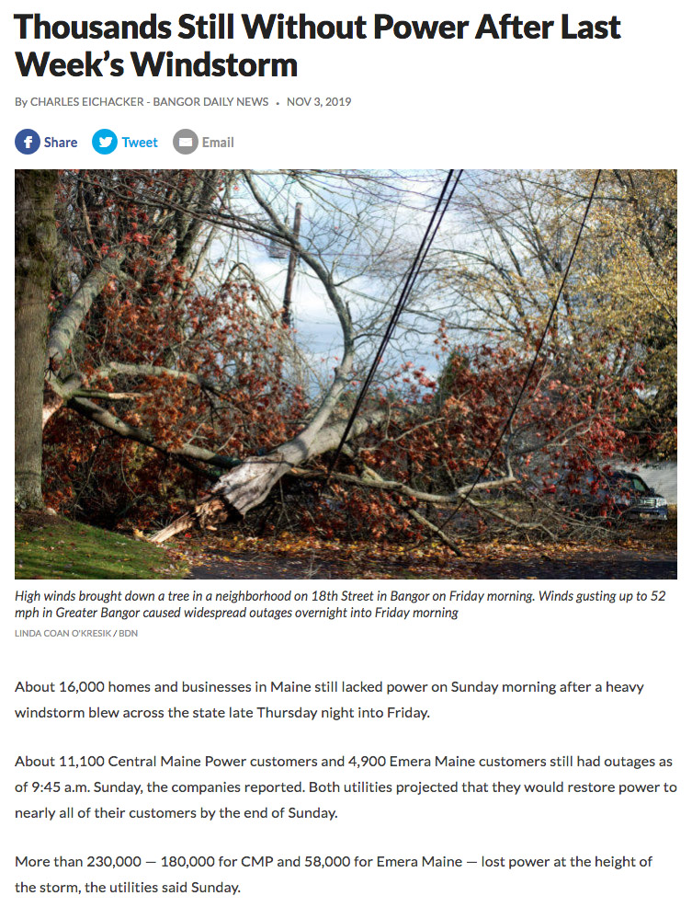
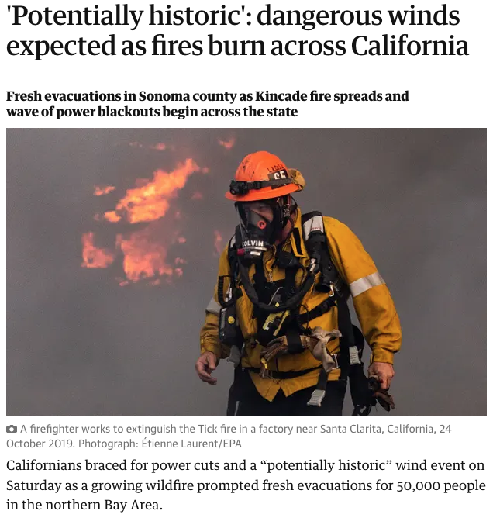
Connecting Extremes via the Jetstream
Late October /
Early November
2019
The Guardian
10/26/2019

Slide 19
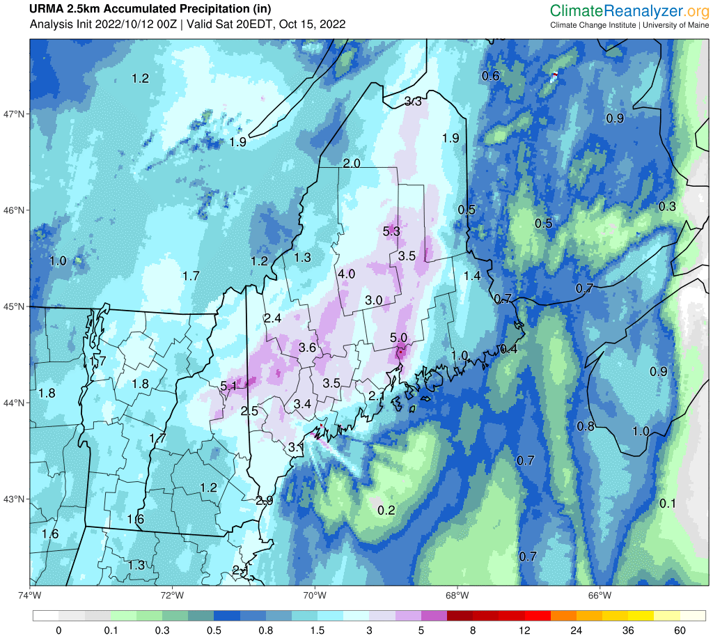
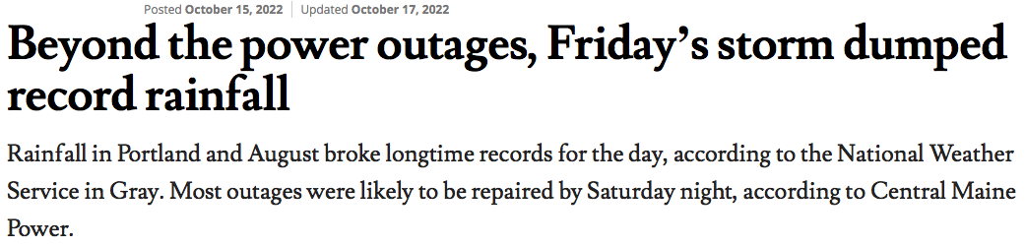
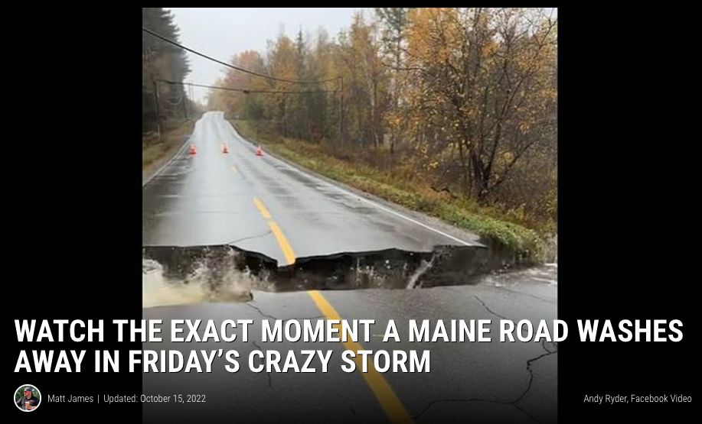
Heavy Rainfall
October 14–15, 2022
Portland Press Herald

Slide 20
Questions?
Sean Birkel
Assistant Extension Professor
Maine State Climatologist
birkel@maine.edu
Climate Adaptation Mitigation Fellowship
www.adaptationfellows.net

Slide 22
Add information on upcoming topics in the CAMF program

Slide 23
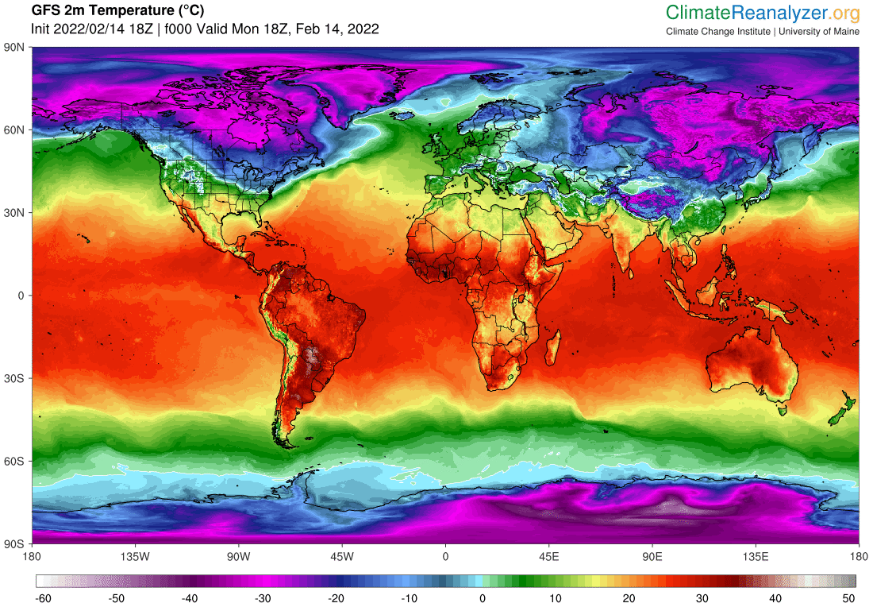

Slide 24
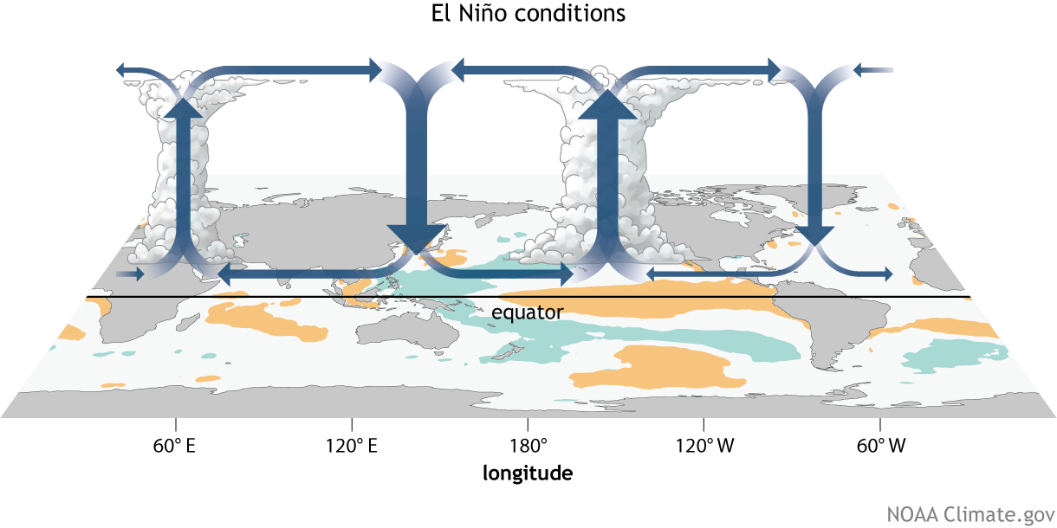
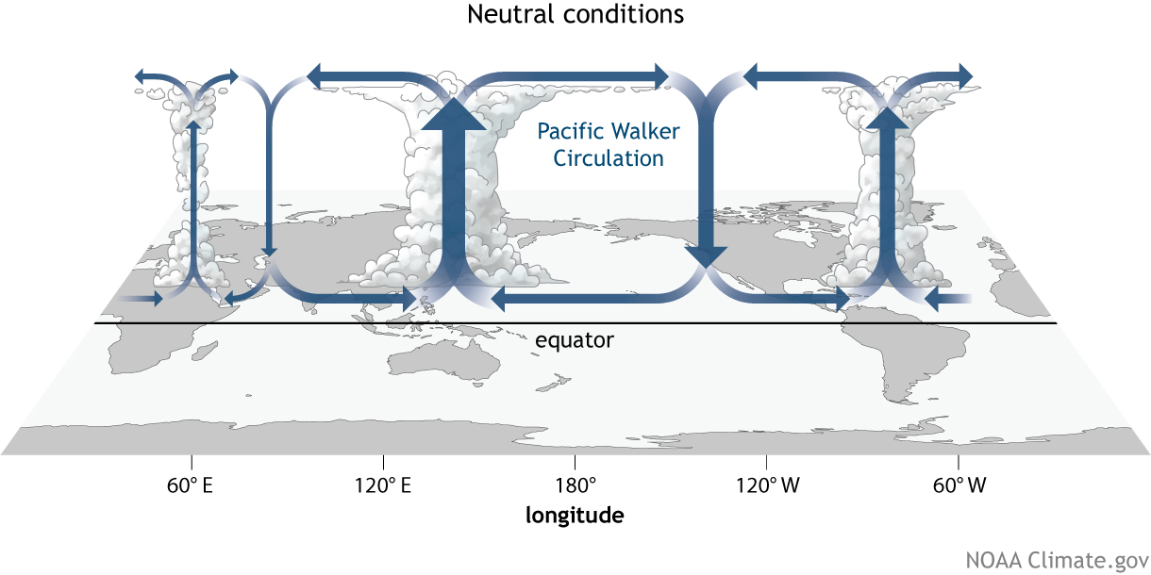
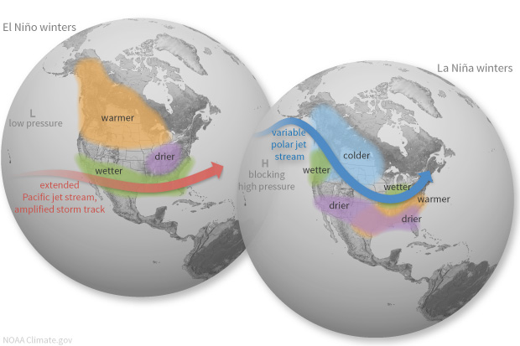
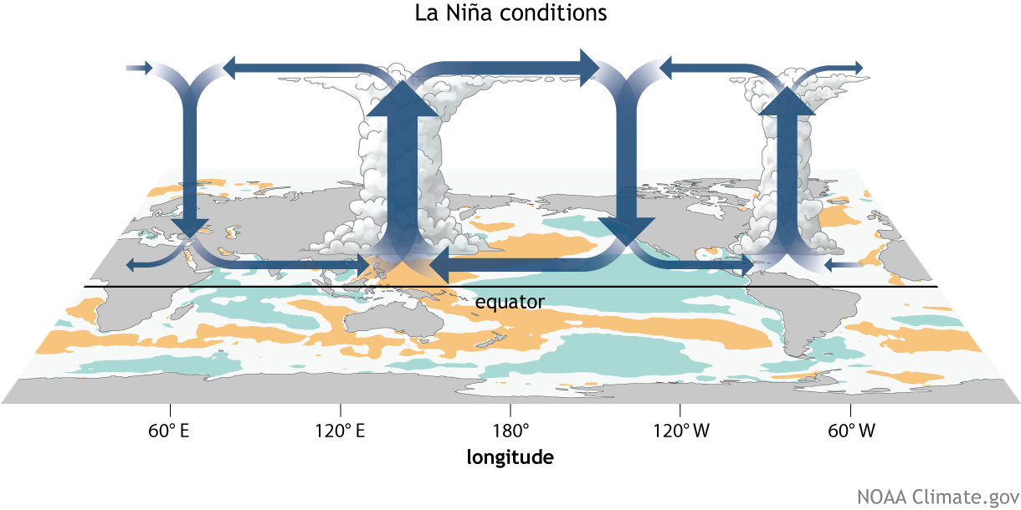
El Niño-Southern Oscillation (ENSO)
Coupled ocean-atmosphere response with irregular period of 2–7 years between El Niño (warm) and La Niña (cool) phases.
ENSO impacts weather worldwide, particularly during boreal winter.
Atmospheric response known as Walker circulation.
https://www.climate.gov/enso

Slide 25
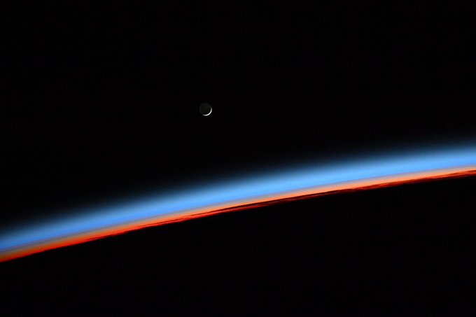

Slide 26
Sea Ice Decline & Arctic Amplification

Slide 27
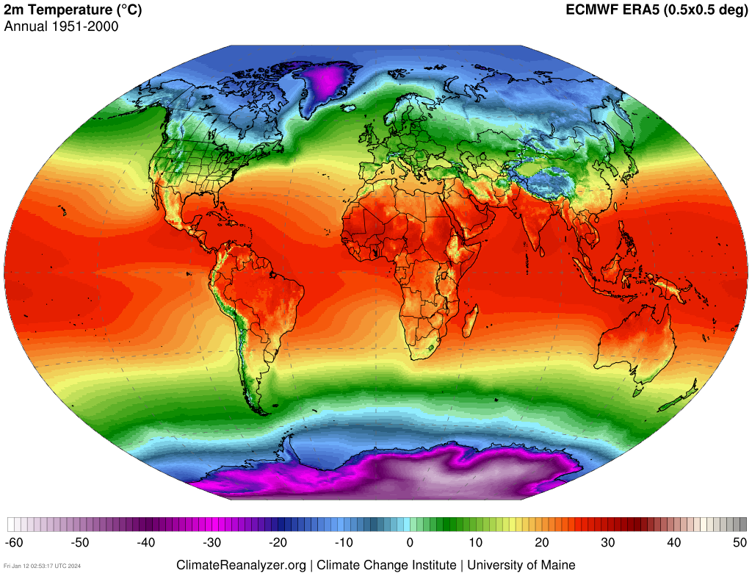
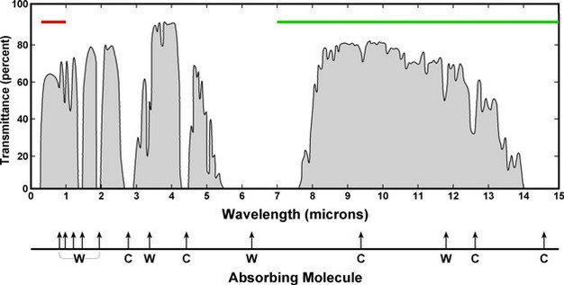
Equilibrium Climate
Outgoing Longwave
+
Reflected
Shortwave
=
Total Incoming Solar Radiation
IPCC AR3

Slide 28
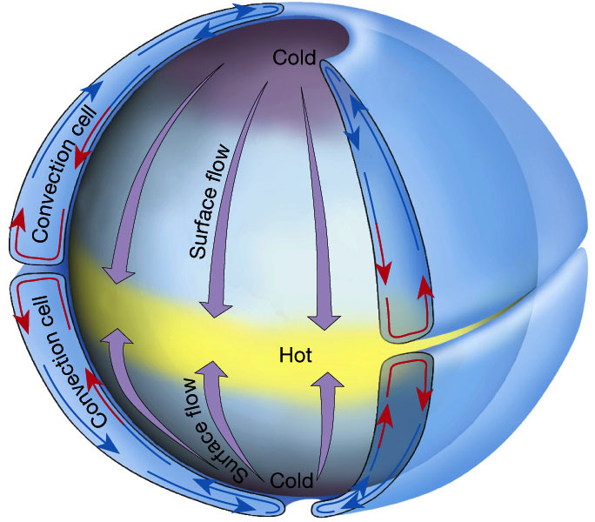
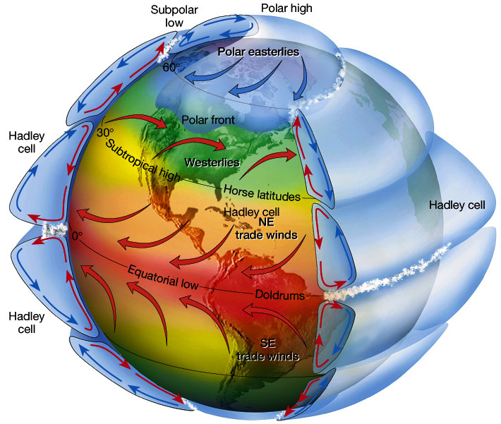
Atmospheric Circulation
Idealized single-cell atmospheric convection.
Three-cell atmospheric convection on rotating frame of reference. Wind deflections in each cell N & S of the equator due to the Coriolis force.
Figure 7.5 in The Atmosphere, 8th edition, Lutgens and Tarbuck, 8th edition, 2001
Downloaded from https://www.ux1.eiu.edu/~jpstimac/1400/circulation.html

Slide 29
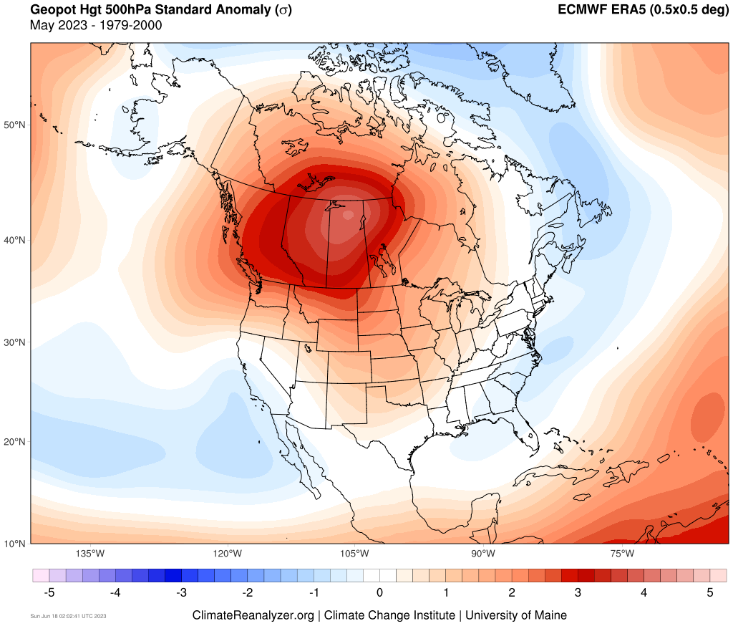
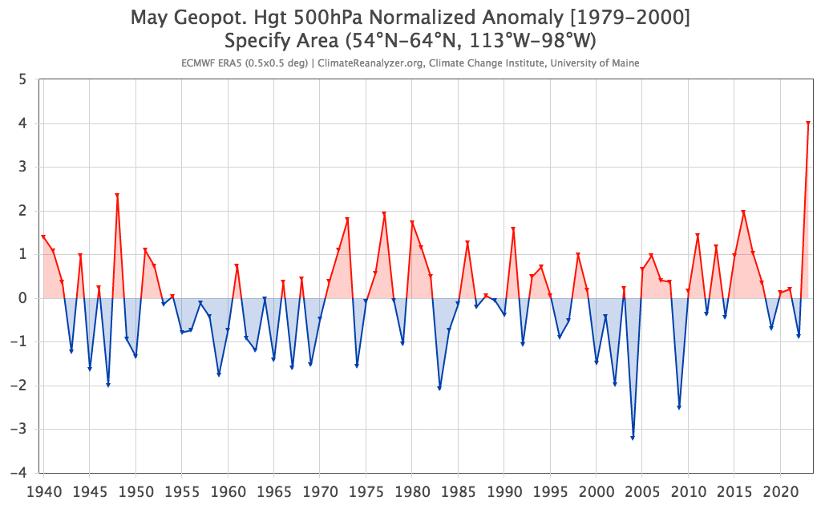
2023 Extremes

Slide 30
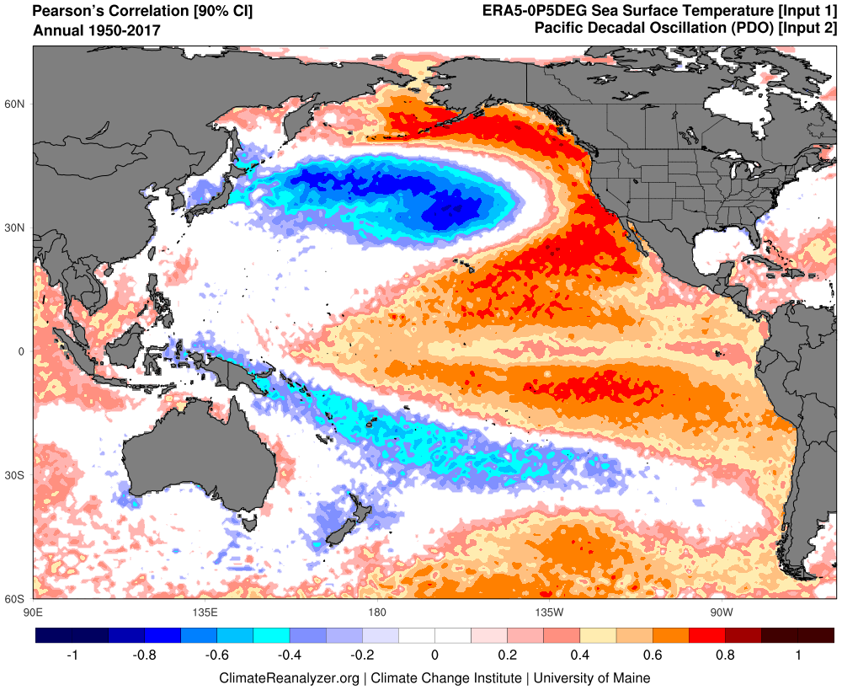
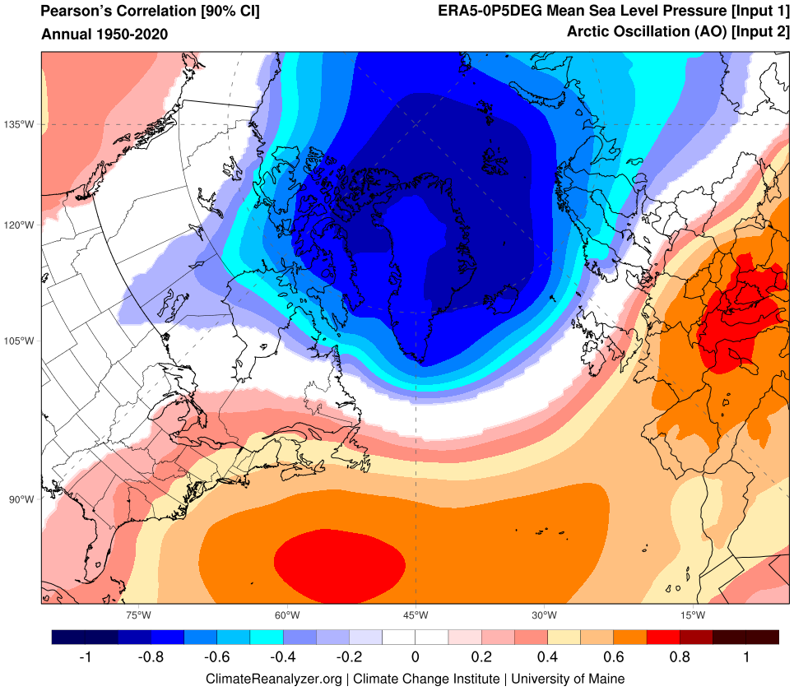
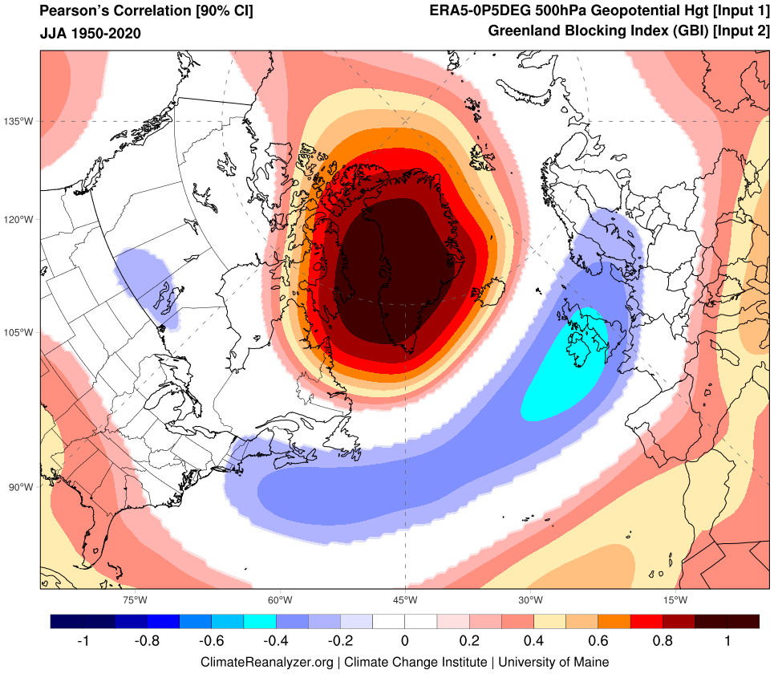

Teleconnections
Pacific Decadal Oscillation (PDO)
El Niño-Southern Oscillation (ENSO)
Atlantic Multidecadal Oscillation/Variability (AMO/AMV)
North Atlantic Oscillation (NAO)
Greenland Blocking Index (GBI)

Slide 31


Global Historical Climatology Network (GHCN)
Un-Restricted Mesoscale Analysis (URMA)
NCAR Climate Data Guide

Slide 32

Oct 14–15
5”
95th percentile daily records
3.2”
1.8”

Slide 33

IPCC AR5

