Slide 1
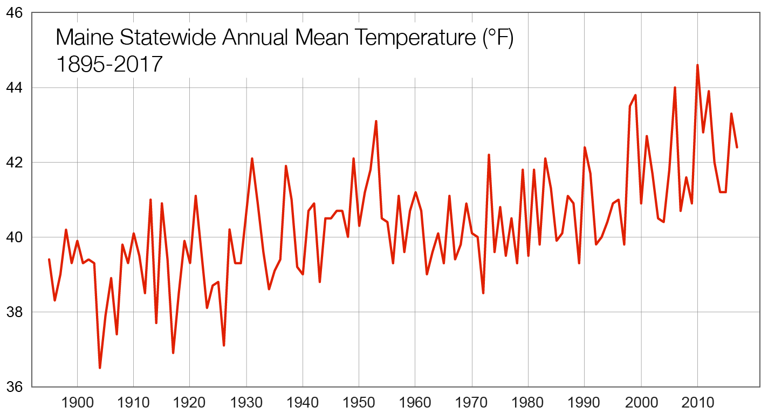
Temperature
+3°F
NOAA Climate Divisional Database
Annual increase of 3°F since 1895
Overnight lows have risen more than daytime highs
The eight warmest years occurred since 1998

Slide 2
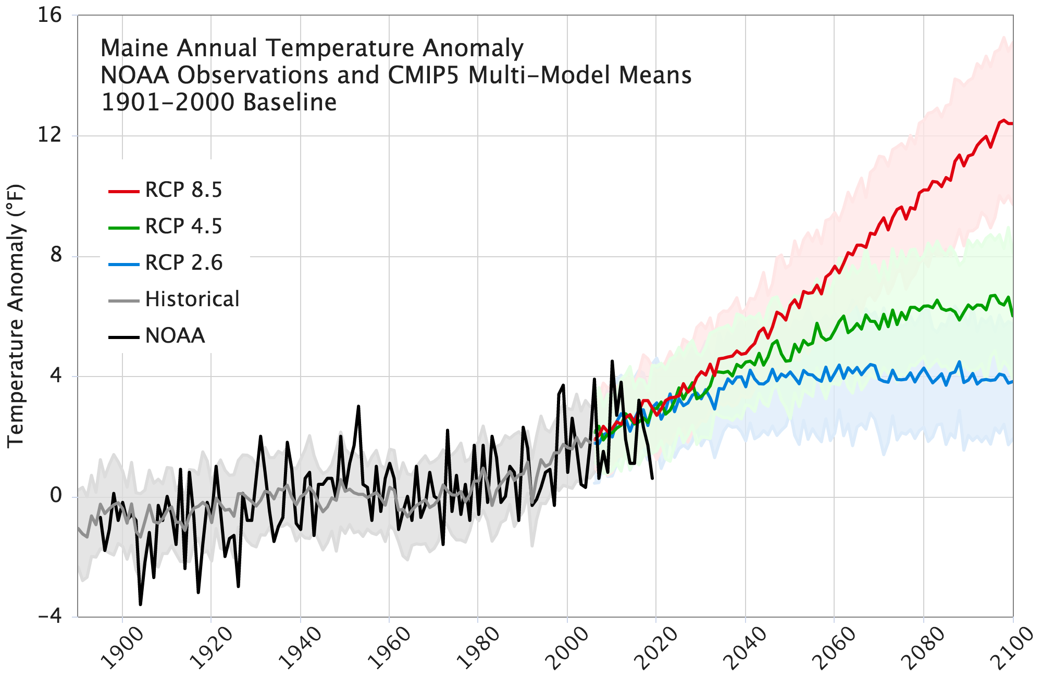
Warming of 2-10°F by 2100 depending on future scenario
High GHG Emissions
Low GHG Emissions
Maine’s Climate Future 2020 Update
Maine Climate Council STS Report, 2020

Slide 3
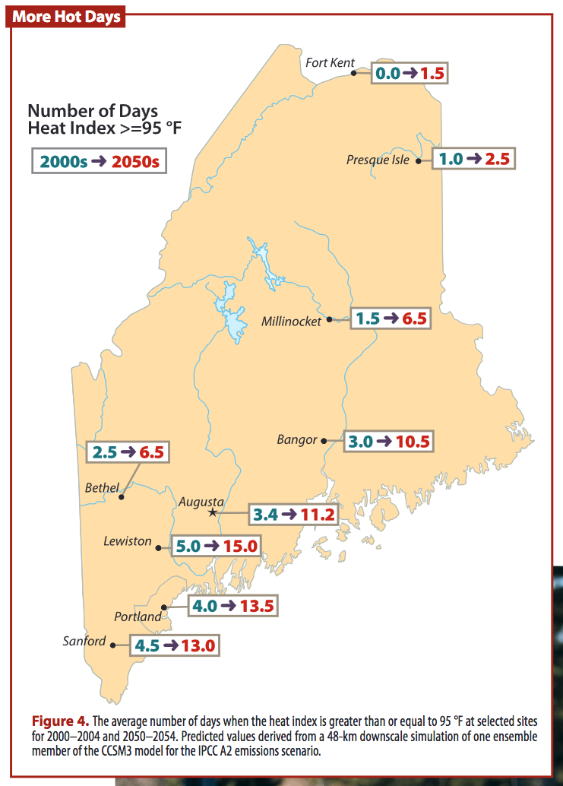
MCF 2015 Update

Slide 4
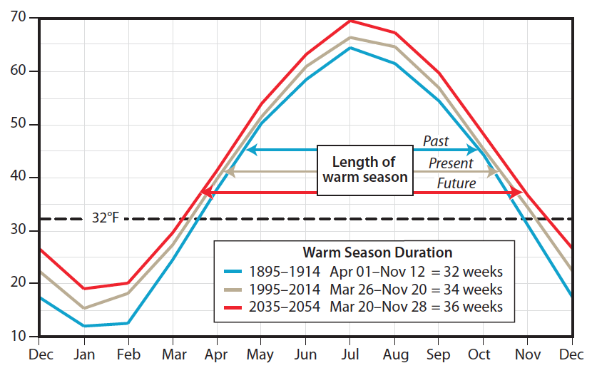
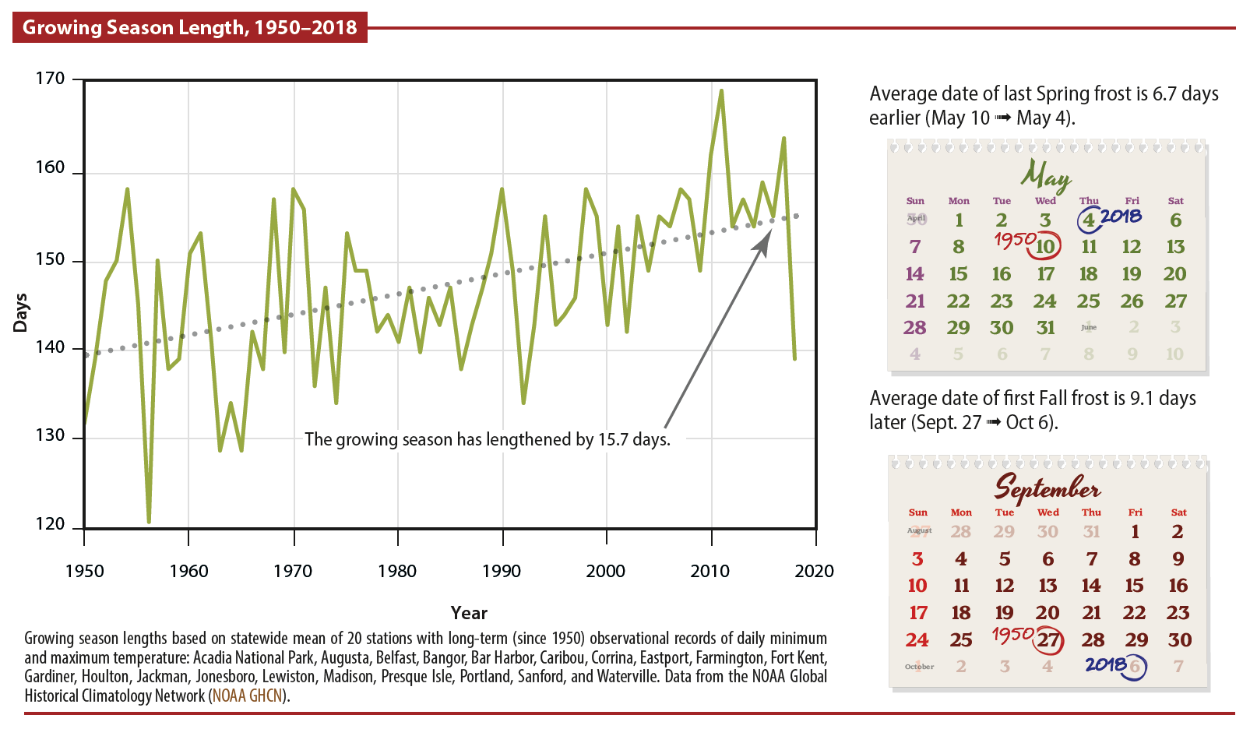
Season Lengths are Changing
Statewide Mean Annual Temperature (°F)
MCF 2015 Update
The warm season has increased and snow season has decreased by about 2 weeks over the past century.
Since 1950, the growing season has lengthened by ~16 days (Fernandez, 2020).
Summer weather and growing season extension mostly into fall.
Trends projected to continue, but some years will bring unexpected late spring or early fall frosts.
MCF 2020 Update

Slide 5
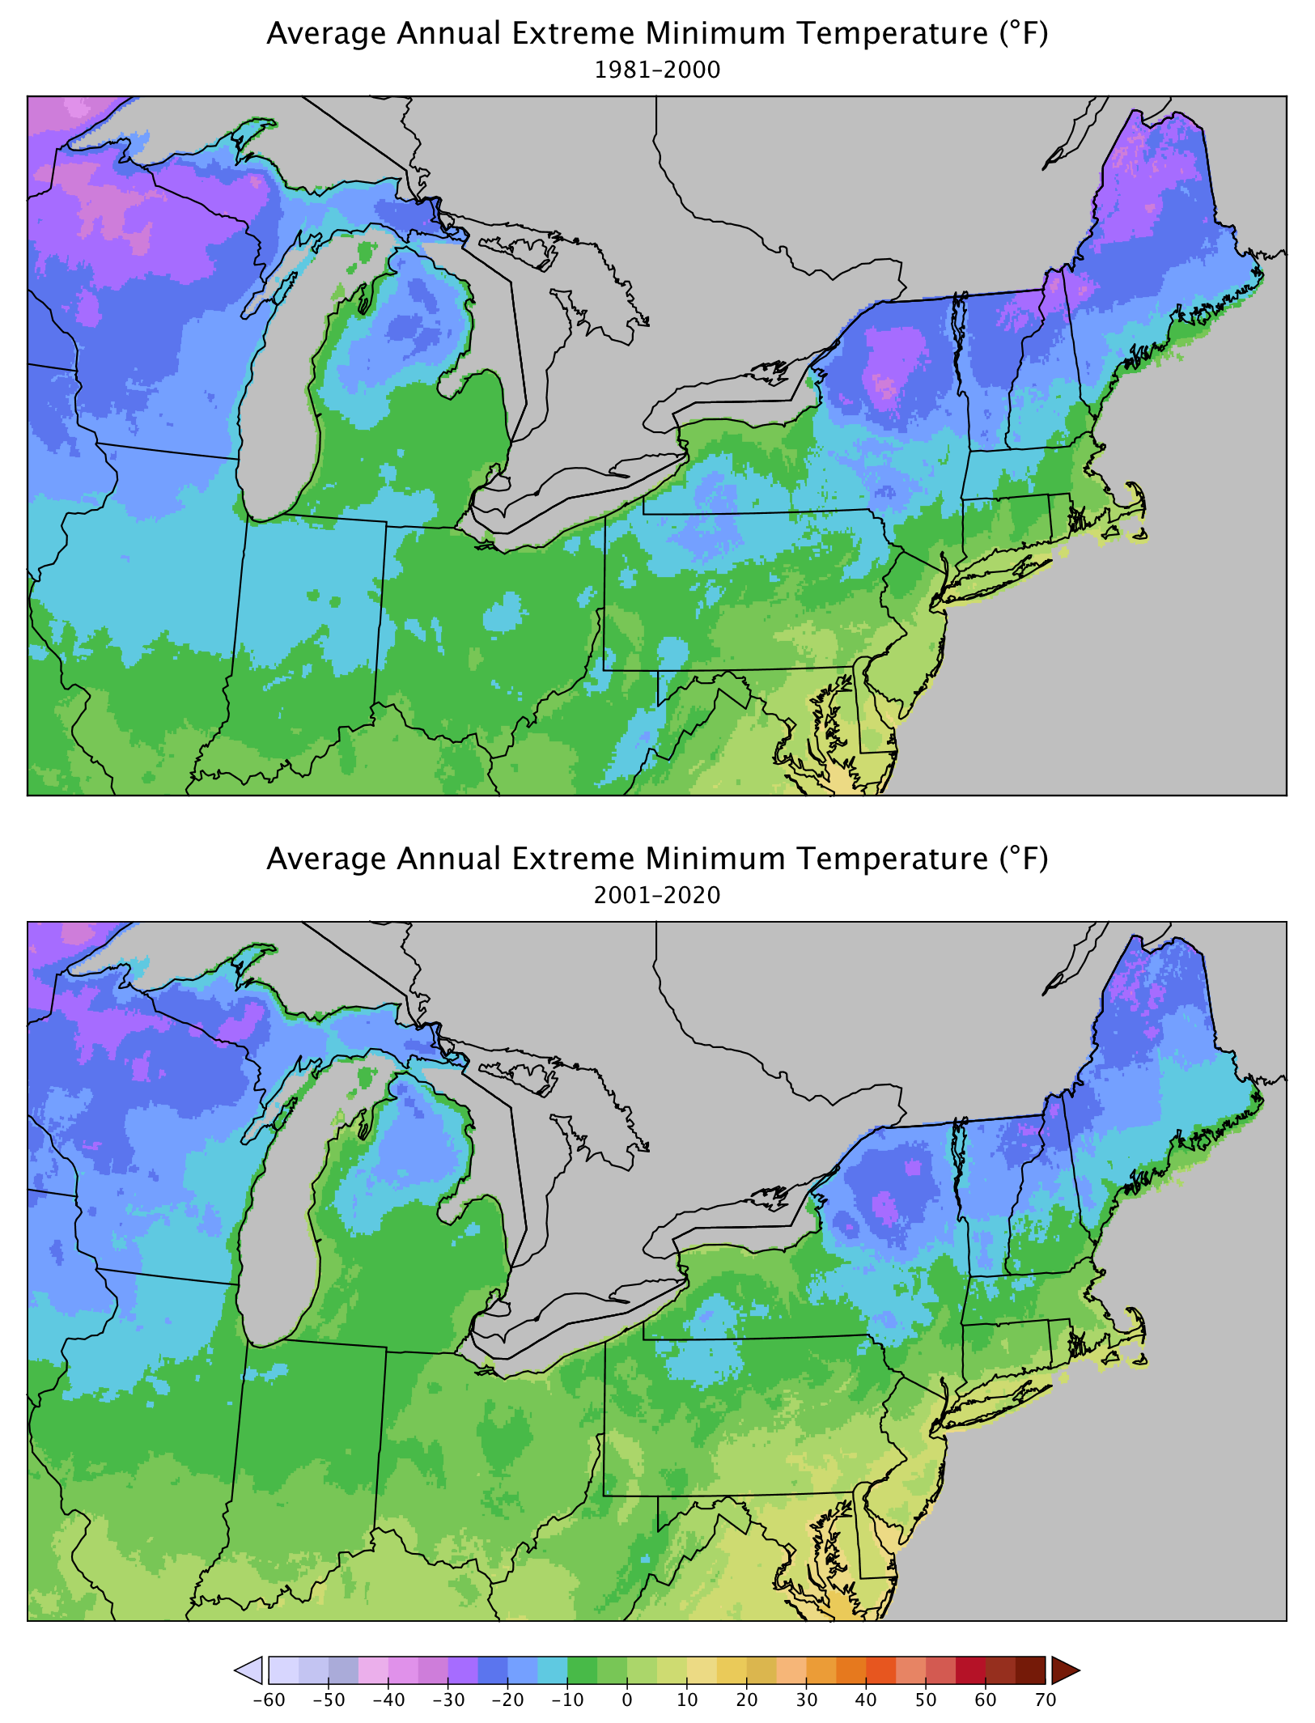
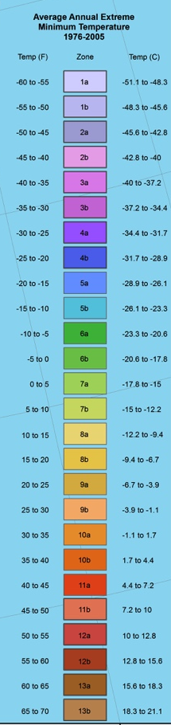
1981-2000
Northward Shift of Plant Hardiness Zones
Based on PRISM annual extreme minimum temperatures and USDA key
2001-2020

Slide 6
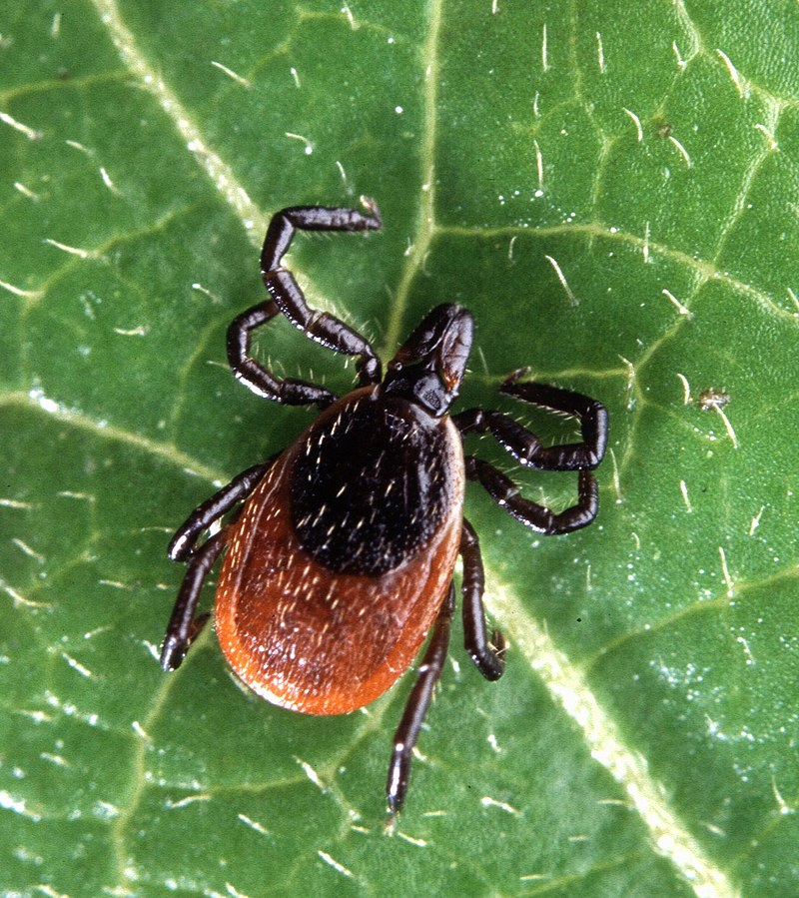
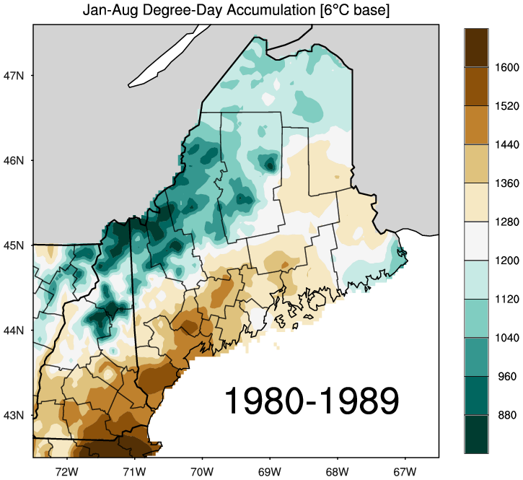
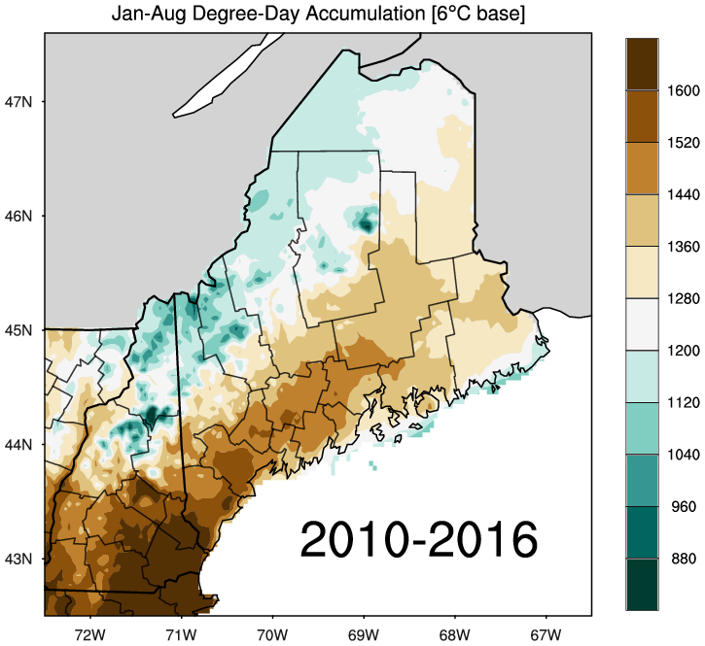
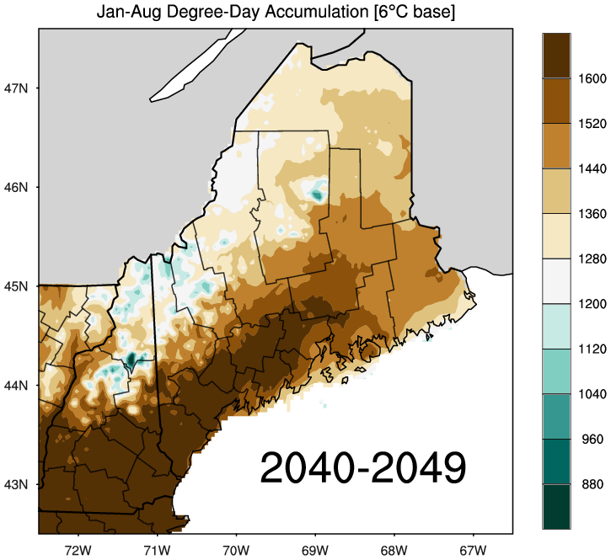
Longer summers and shorter winters drive black-legged tick habitat expansion
Elias et al. (2020)
Larval emergence and tick survival is associated with attainment of ~1240 degree days from a 6°C baseline.

Slide 7
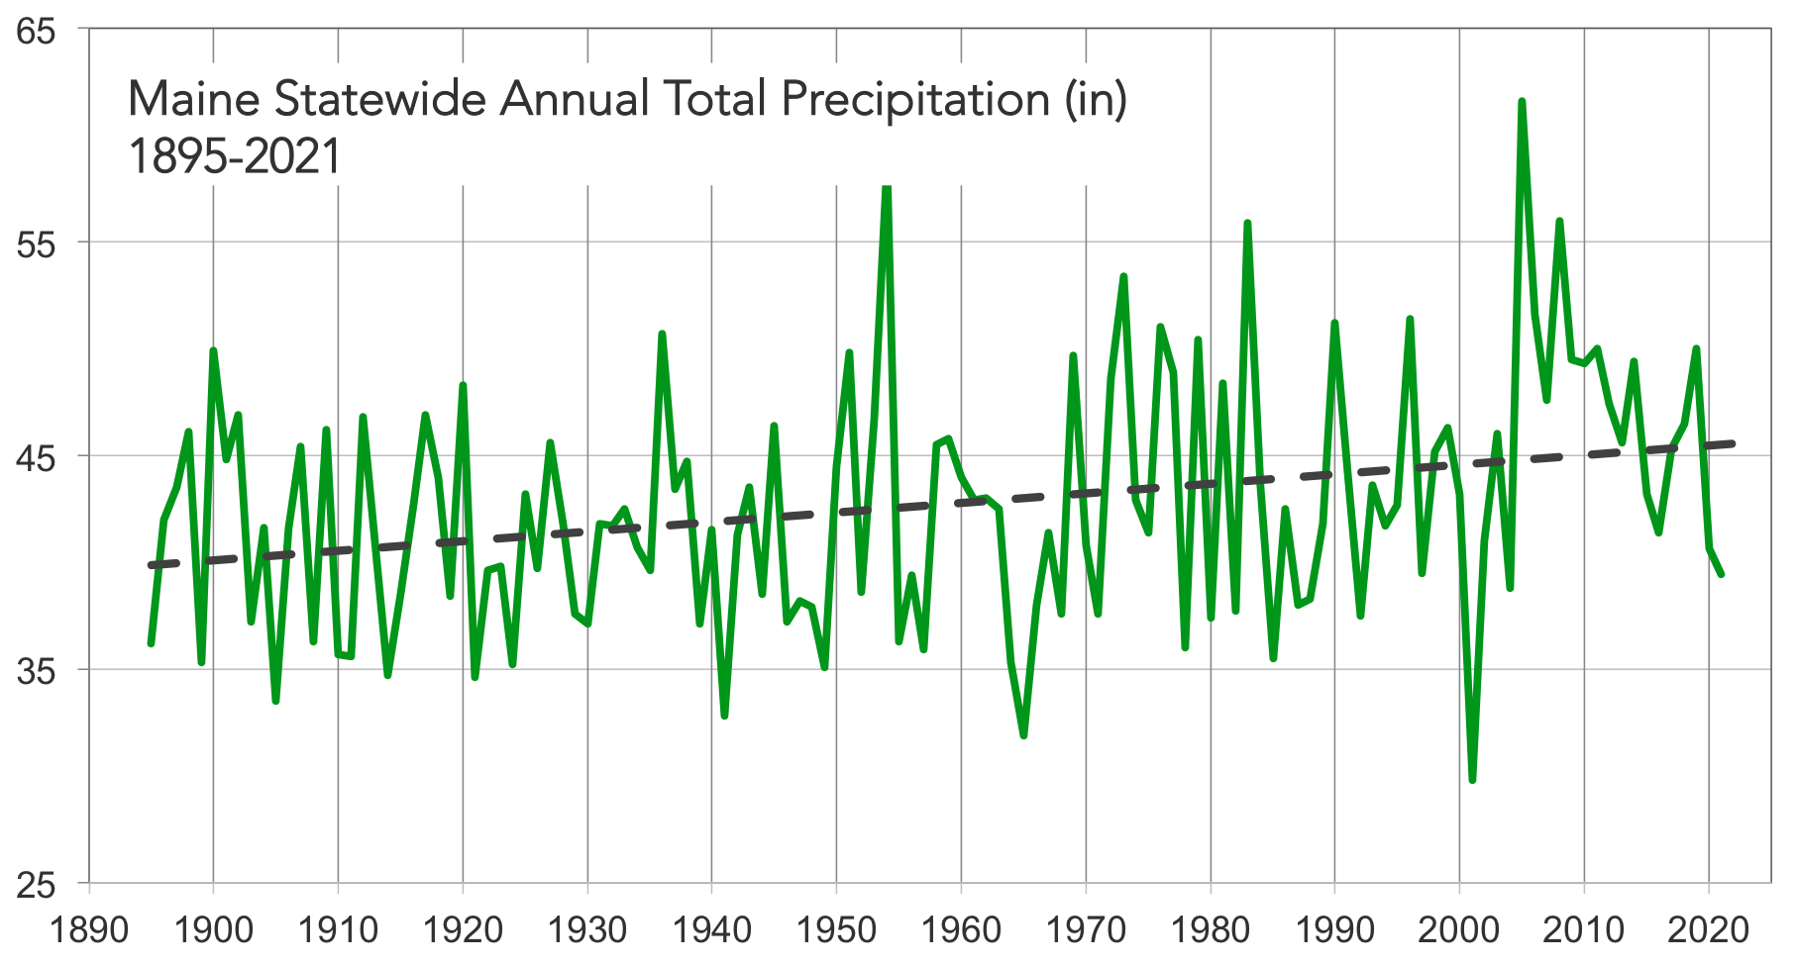
Precipitation
Maine’s annual precipitation increased 6” since 1895. Largest increase last 20 years.
Heavy precipitation events (> 2 in/day) have become more common.
Trends expected to continue; 10% total annual increase possible by 2100.
+ 6 in
NOAA Climate Divisional Database

Slide 8
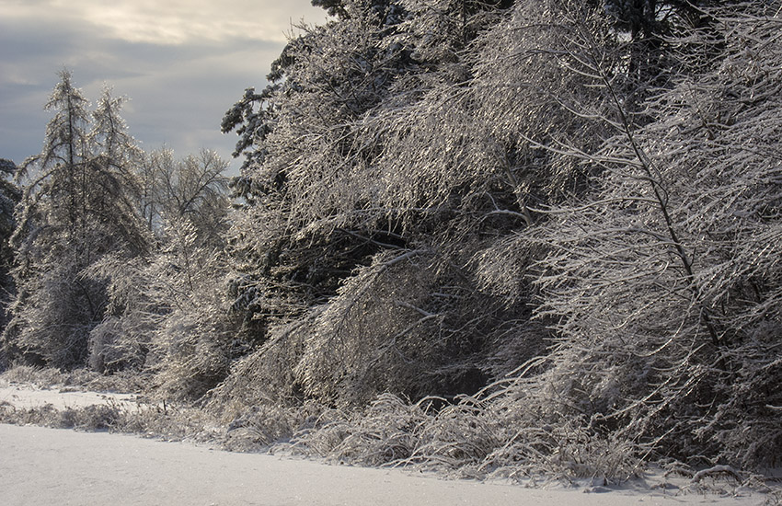
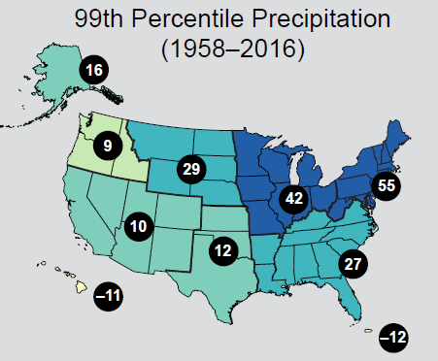
Extreme Weather
Extreme weather is becoming more common around the N. Hemisphere due to changes in atmospheric circulation.
Increased likelihood of heat/cold waves, intense storms.
Large increases (55%) in annual heavy daily precipitation across the USNE.
In Maine, the last 10-15 years have seen the highest occurrence of 2”, 3”, and 4” precipitation events (Fernandez et al., 2020).
Heavy rain and subsequent runoff can reduce water quality.
Easterling et al., 2017

Slide 9
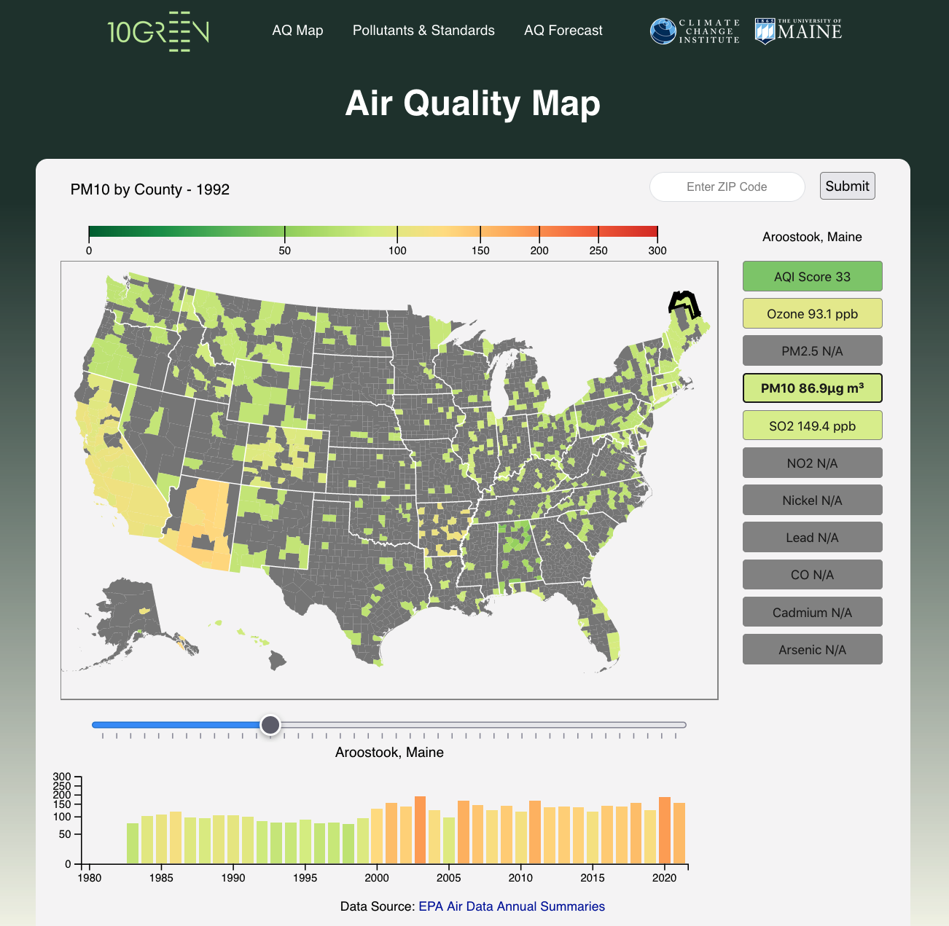

Slide 11
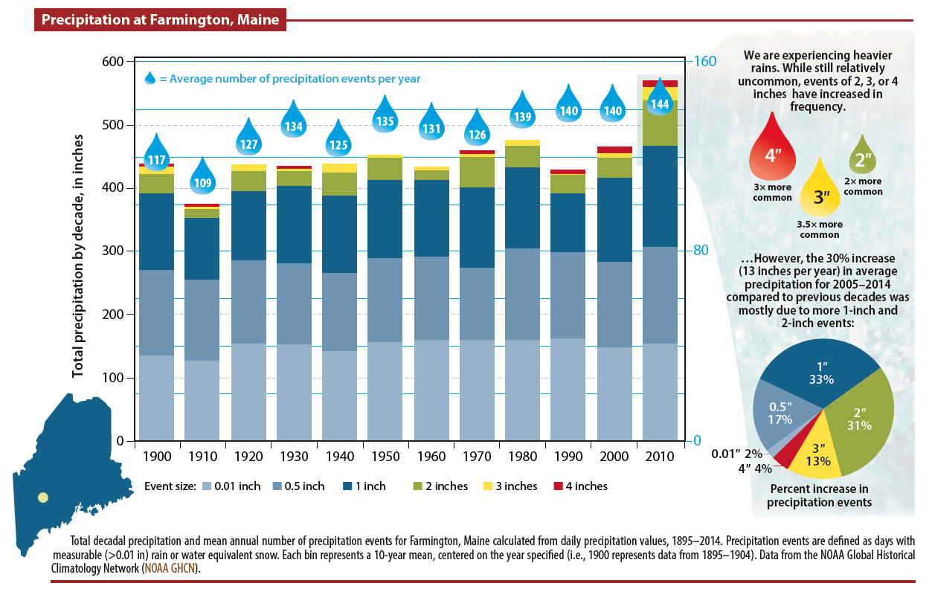
Maine’s Climate Future 2020 Update

Slide 12
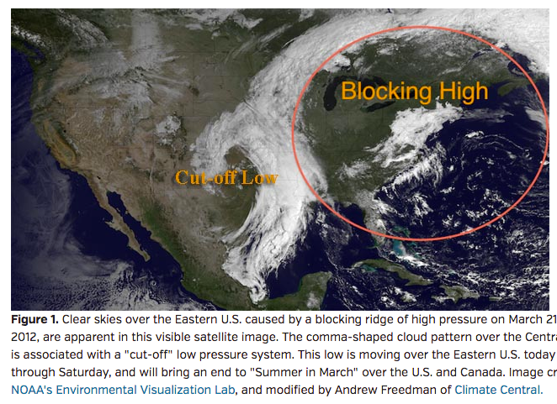
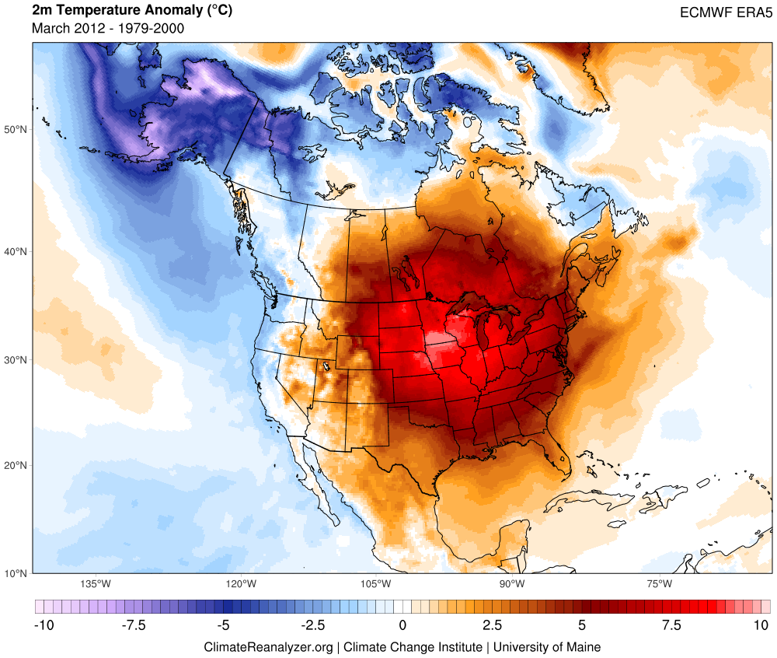
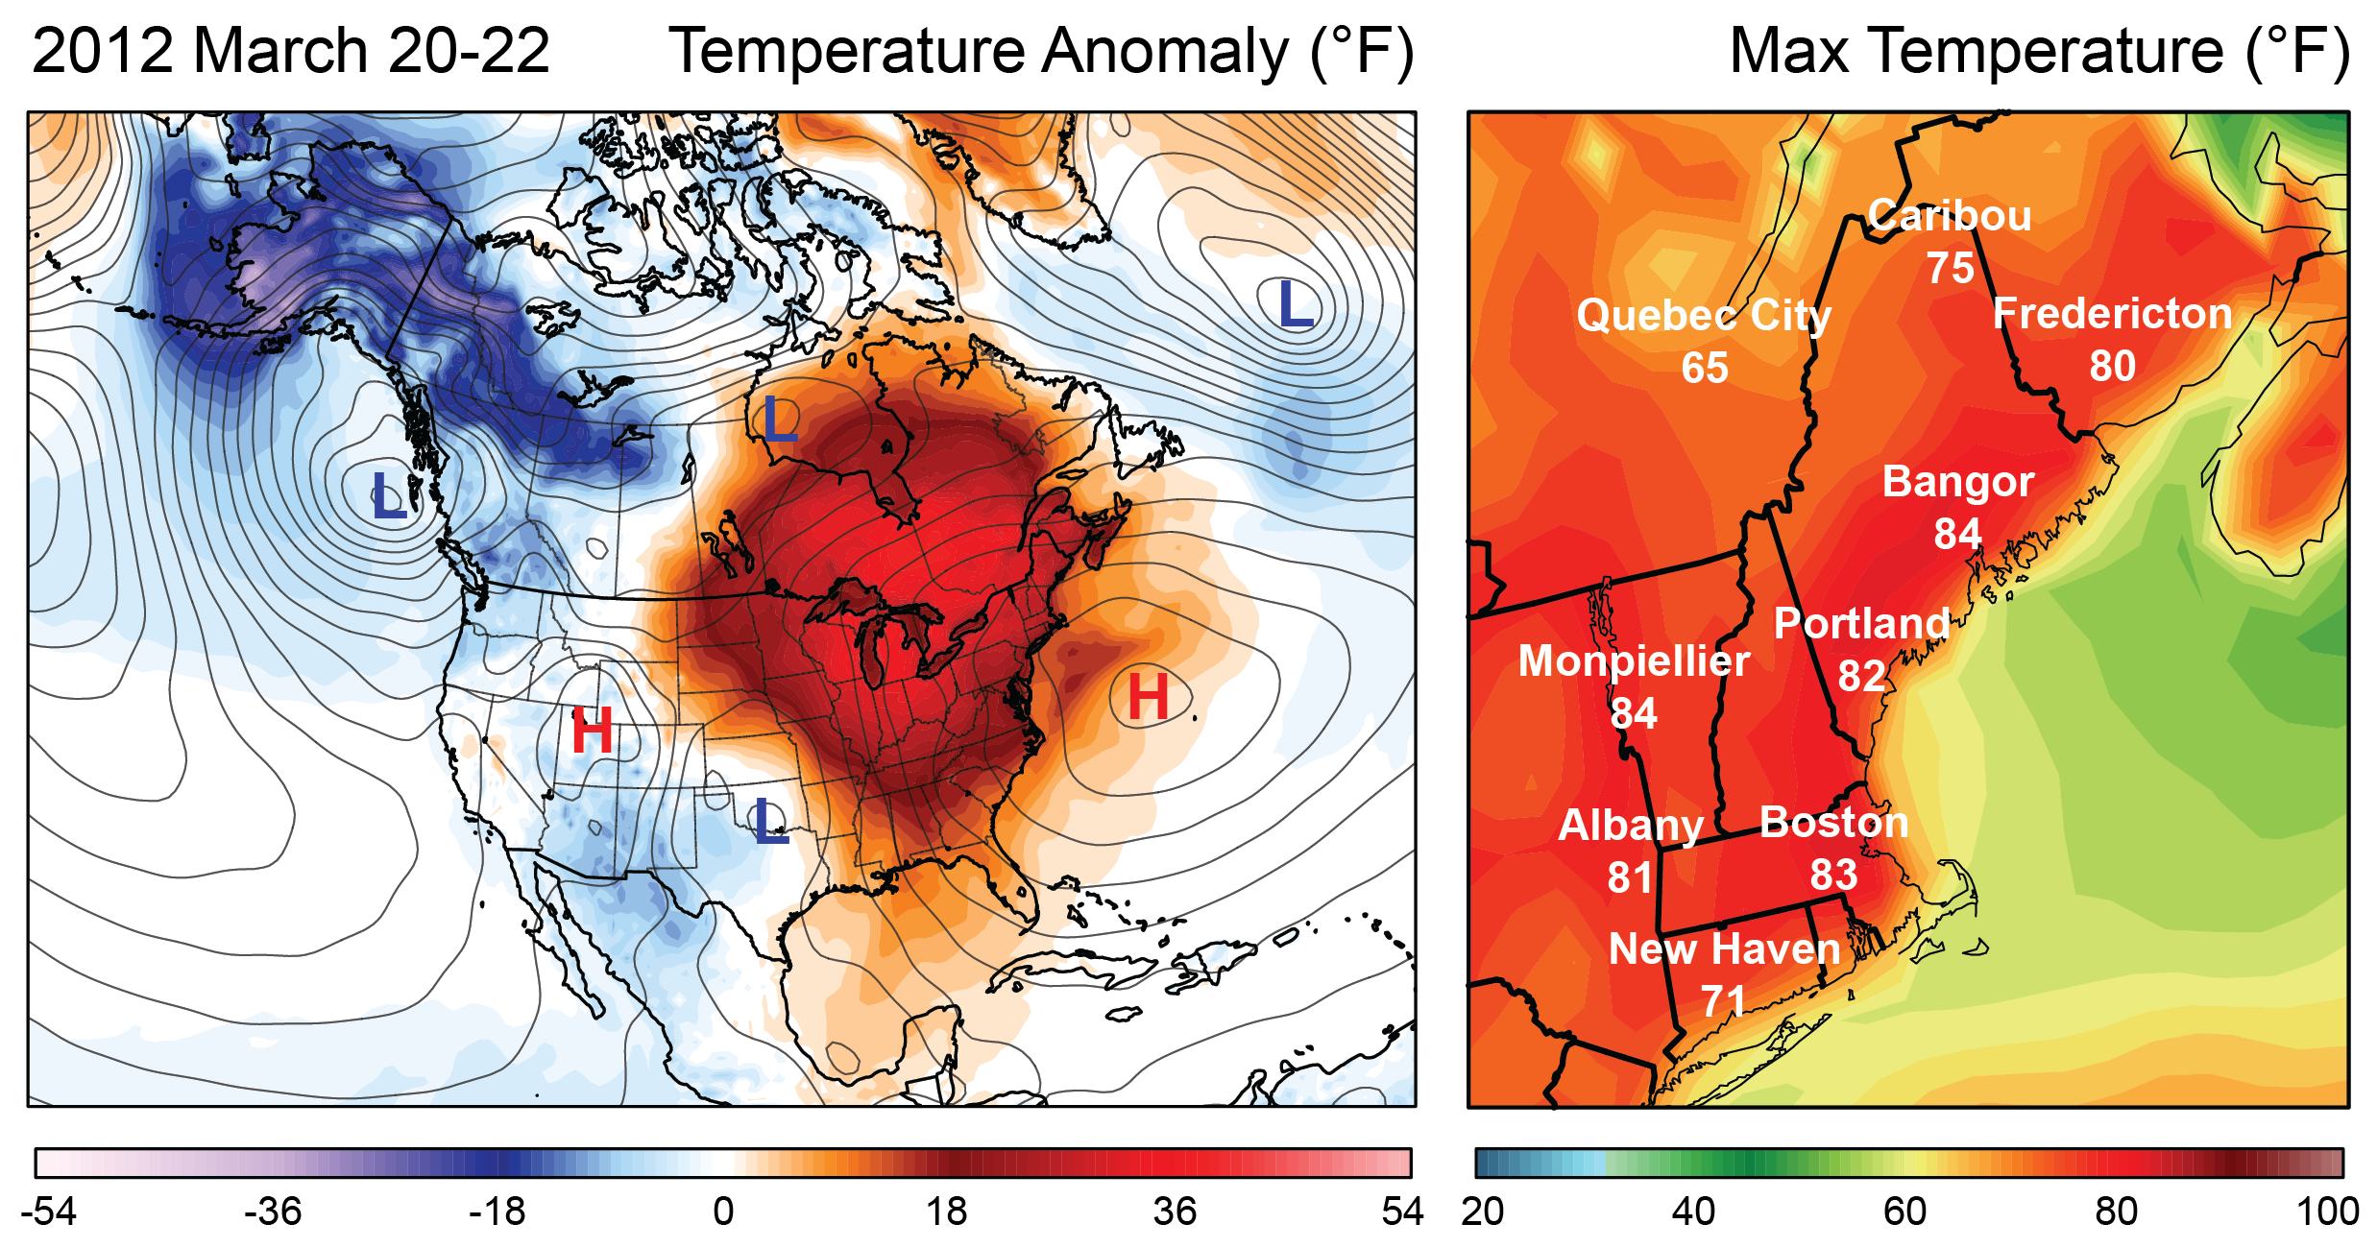
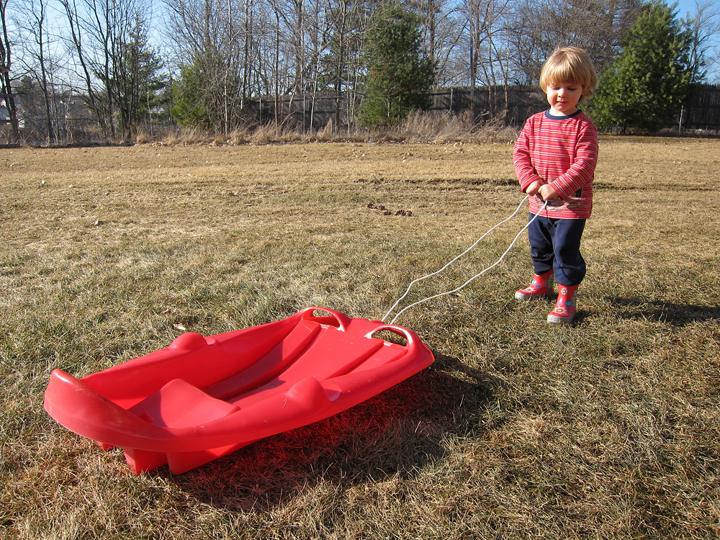
Summer in March, 2012
Temperatures into the 80s across southern half of Maine 22-23 March with no historical equivalent.
Farmington 83°F March 23rd – a daily high record set by 17°F!
18 March, 2012

Slide 13
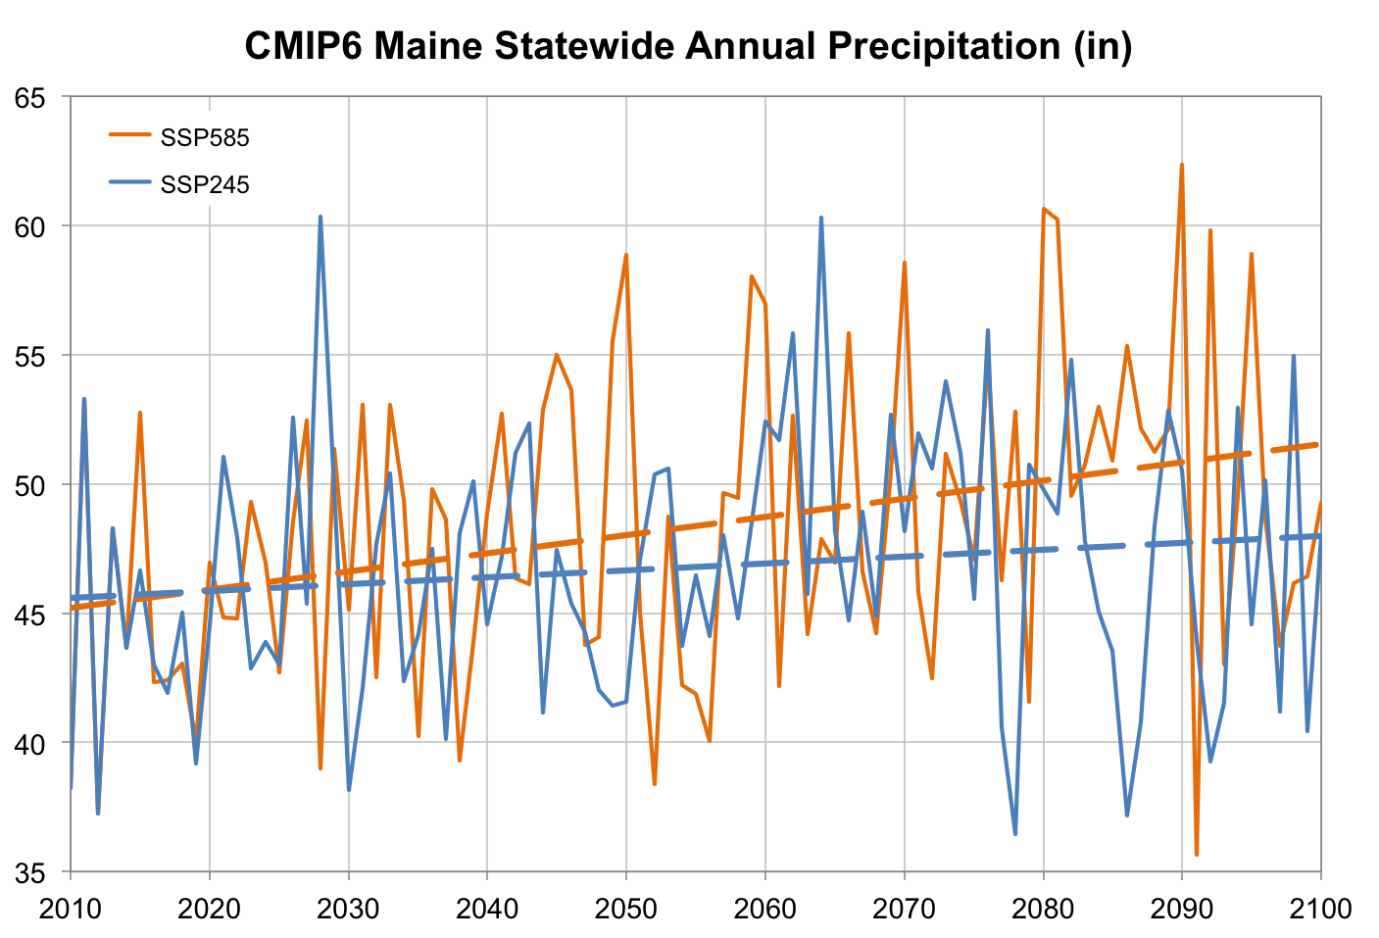
CMIP6 projections suggest annual precipitation could increases 2–7” (5–14%) over this century.
Future seasonal distribution of surpluses and deficits is uncertain.
+7”
+2”
CMIP6 = Coupled Model Intercomparison Project version 6
SSP = Shared Socio-econmic Pathways
CMIP6 SSP 245, 585 are similar to CMIP5 RCP 4.5, 8.5
Ensemble average of 13 models (one member each: AWI-CM-1-1-MR, BCC-CSM2-MR, CAMS-CSM1-0, CanESM5 p1, CanESM5 p2, CESM2, CESM2-WACCM, FGOALS-g3, MCM-UA-1-0 f2, MIROC6, MIROC-ES2L f2, MRI-ESM2-0, UKESM1-0-LL f2). Gridded data downloaded from KNMI Climate Explorer; processed via UMaine Climate Reanalyzer.

Slide 14
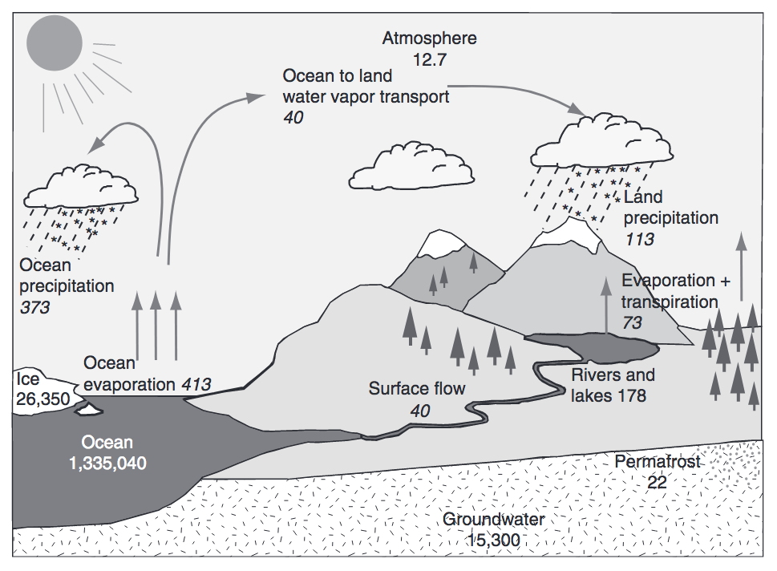
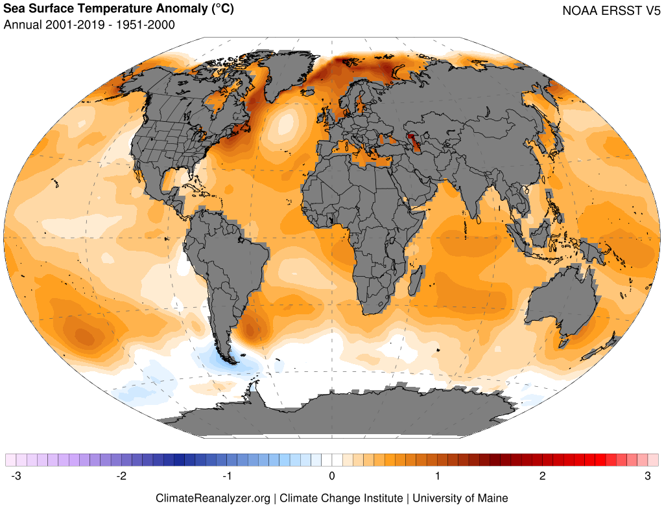
Warming Oceans, Water Vapor Feedback, and Intensifying Hydrologic Cycle
Trenberth et al. (2007), Huntington (2010)
Warming drives increased evaporation, atmospheric water-vapor content, and potential for greater extremes (e.g., heavy precipitation, drought)

Slide 15
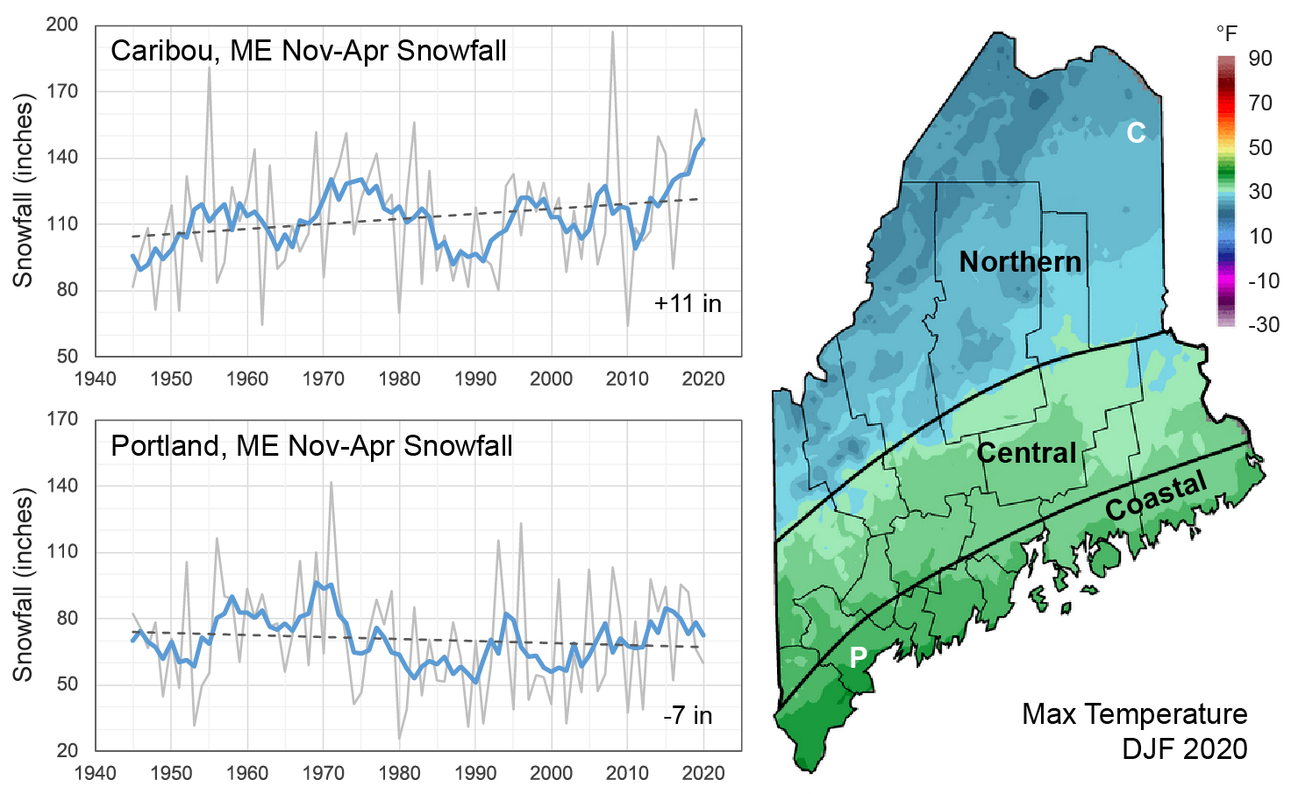
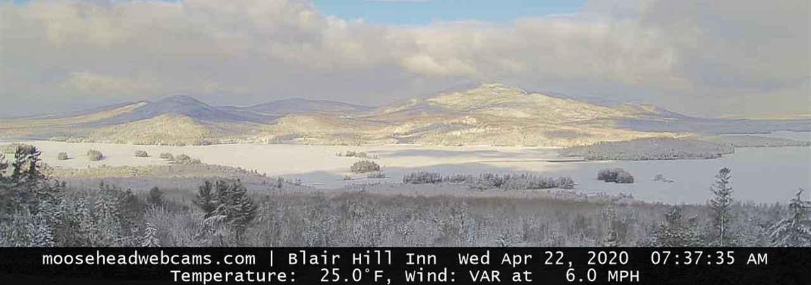
However…
Despite the overall warming trend, variability can bring unexpected cold winters (e.g., 2013/14 and 2014/15), and occasional very good snow seasons.
This is especially true in the northern climate division owing to the steep S-N temperature gradient across the state.

Slide 16
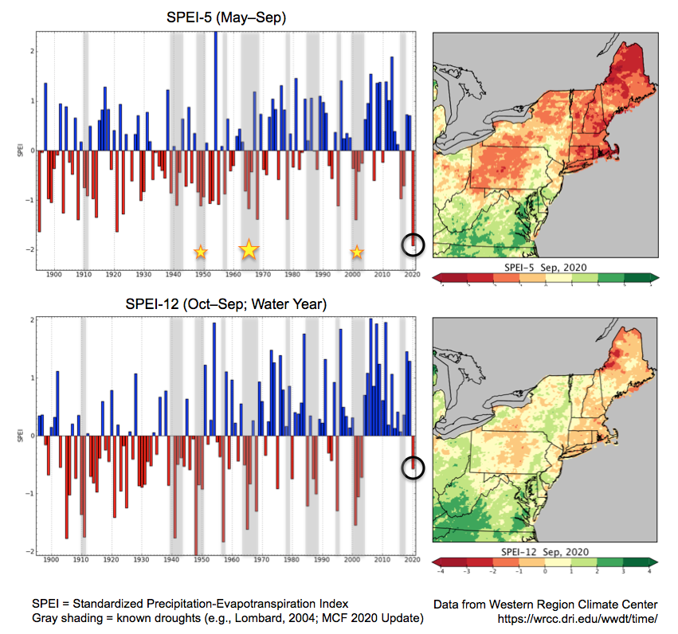
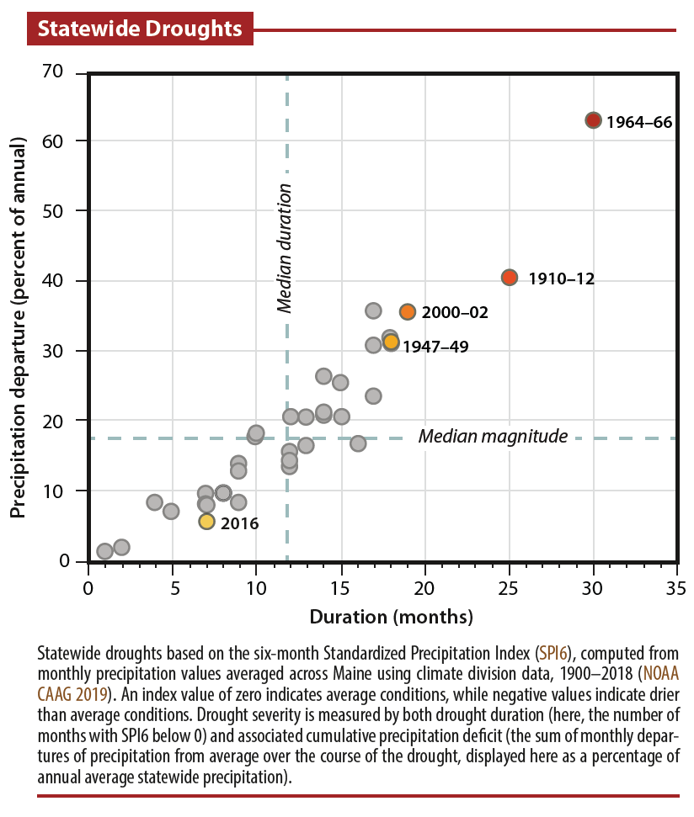
Meteorological drought has not increased over the past century.
Uncertain whether drought will become more or less common in the future.
However, when droughts develop, warmer temperatures will likely exacerbate dryness through increased evaporative losses.
MCF 2020 Update, MCC STS 2020

Slide 17
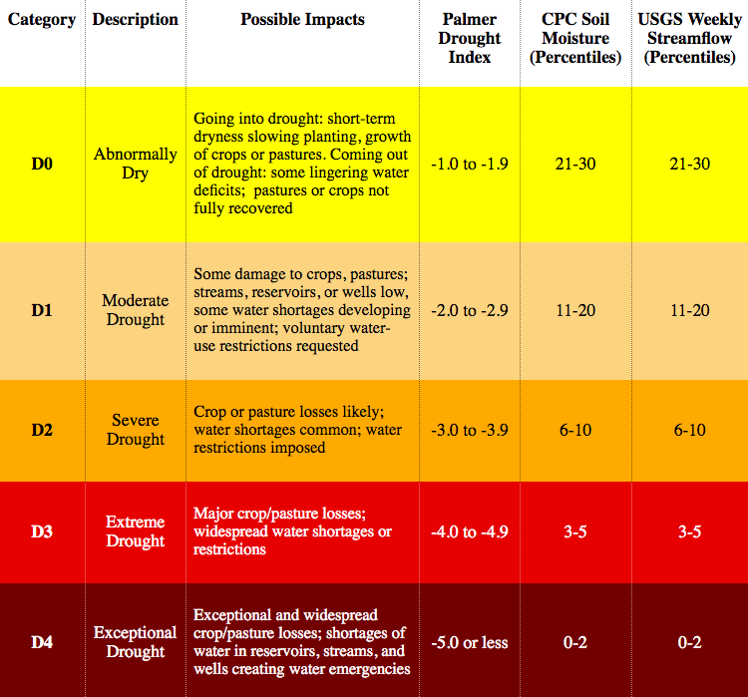
Drought Overview
U.S. Drought Index Descriptions
General Categories
Meteorological (precipitation)
Agricultural (soil moisture)
Hydrologic (runoff, streamflow, and groundwater)
Drought Indices
Palmer Drought Severity Index (PDSI)
Standardized Precipitation Index (SPI)
SPEI = SPI + evapotranspiration
Short-term or “flash” droughts (2-6 months), followed by quick return to normal or above normal precipitation, are common in the USNE.
National Weather Service & U.S. Drought Monitor
https://www.weather.gov/riw/drought_index
https://droughtmonitor.unl.edu/

Slide 18
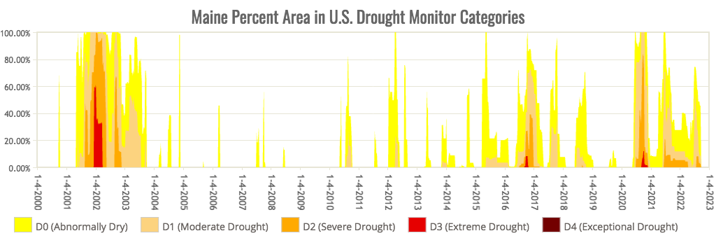
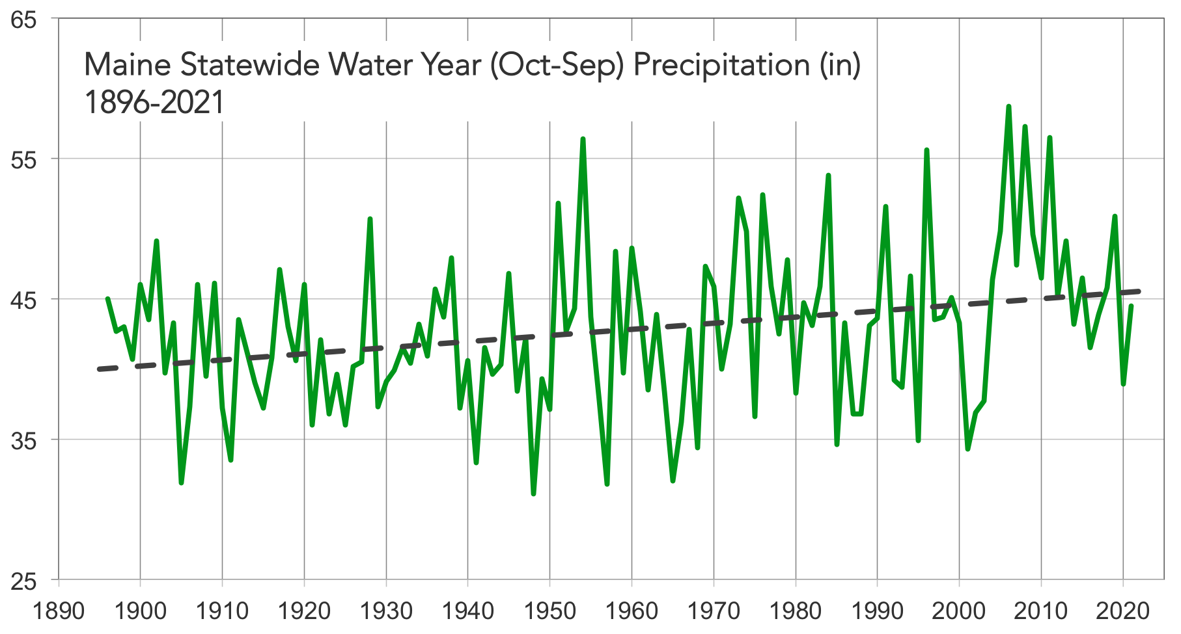
U.S. Drought Monitor
https://droughtmonitor.unl.edu/
NOAA Climate Divisional Database

Slide 19
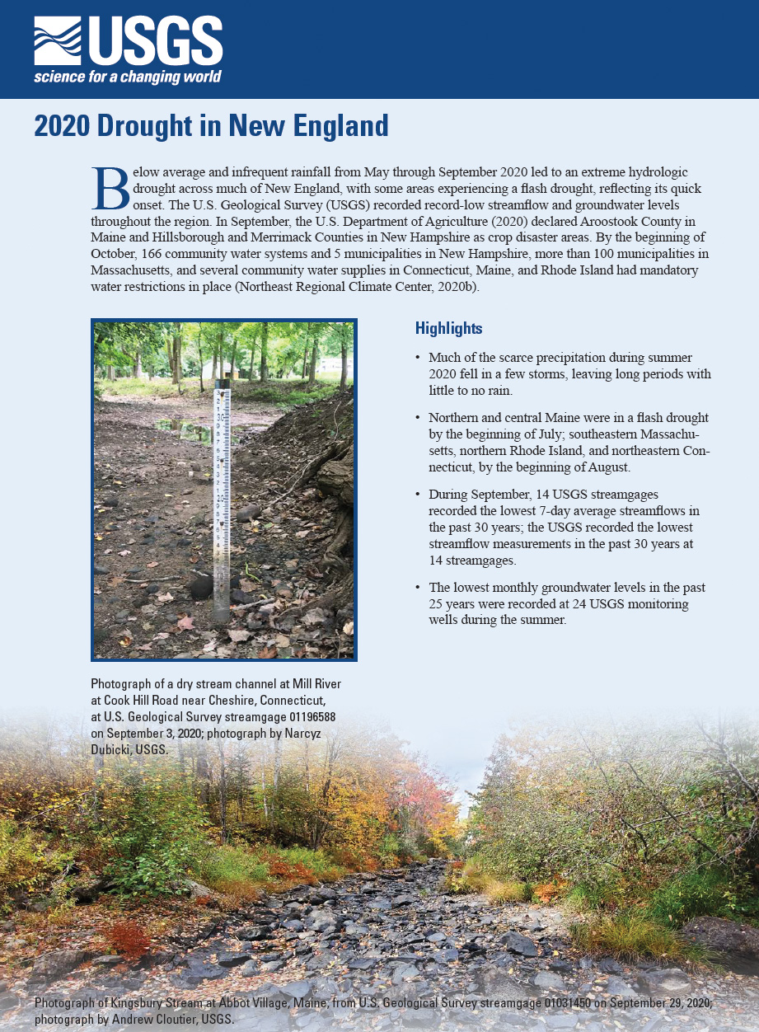
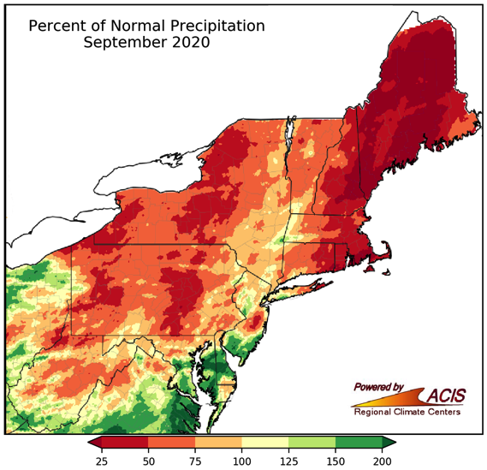
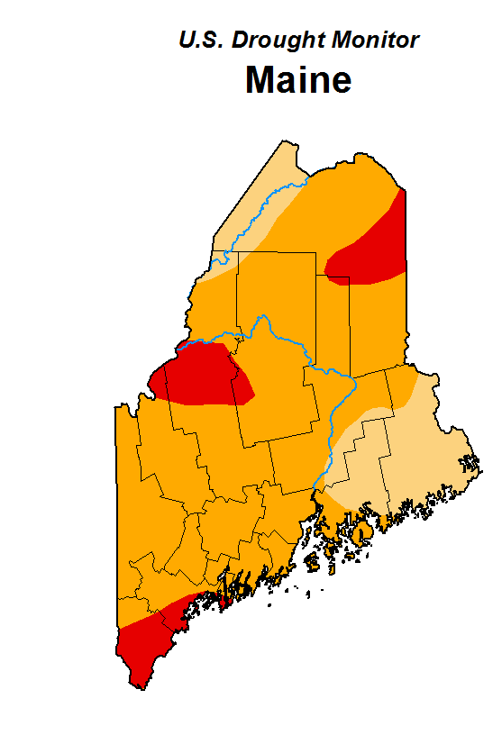
Lombard et al., 2020
2020/21 Drought
After a cool spring with late snowfall and good snowpack, dryness set in quickly middle of May. Drought conditions developed and persisted for several months with significant impact to water resources and agriculture.
September, ranked as the driest month on record, saw the most severe conditions and drought disaster declarations made by the U.S. Secretary of Agriculture.
During September the Piscataquis, Saint John, and Aroostook Rivers had record low flows and significant riverbed exposure.
Beneficial rains in October and November brought conditions to near-norm.
Drought signal carried into 2021 due to warm winter with below normal snowfall, and early spring snowmelt.
D0 (abnormal dryness)
D1 (moderate drought)
D2 (severe)
D3 (extreme)

