Slide 1
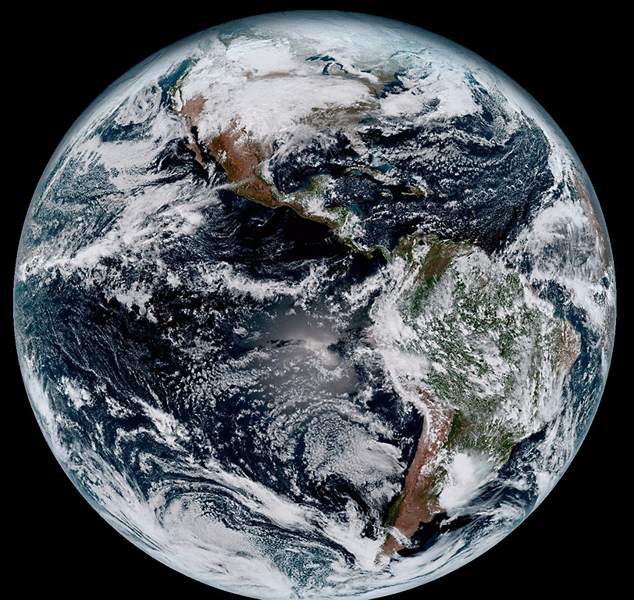



EES 590 Arctic Complex Systems:
Climate System Overview
15 February, 2022
Sean Birkel
Assistant Professor
Climate Change Institute &
Cooperative Extension
NOAA/NASA GOES-16

Slide 2
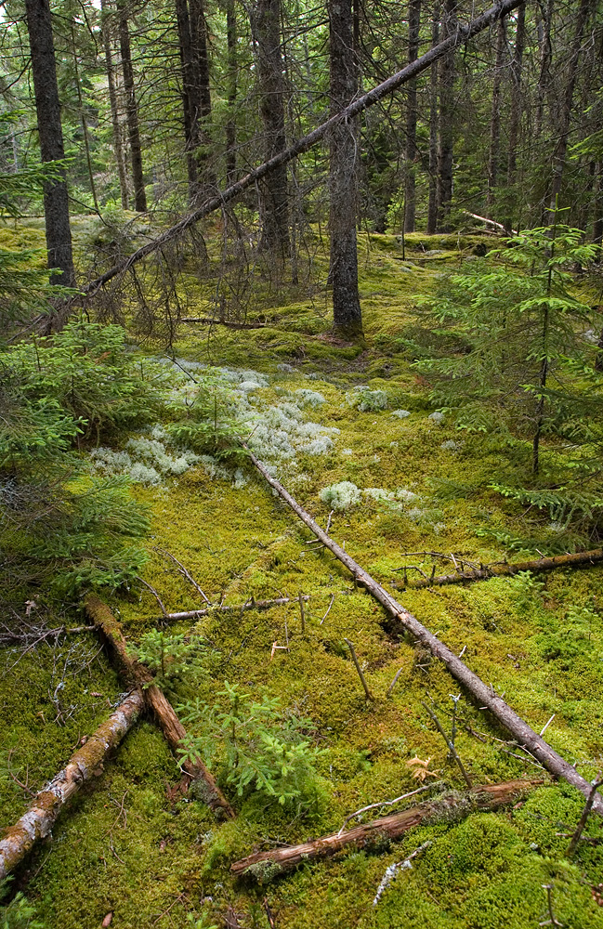
Talk Outline
Weather & Climate
The Climate System
  Atmospheric Circulation
Variability
  Teleconnections
Climate Reanalyzer

Slide 3
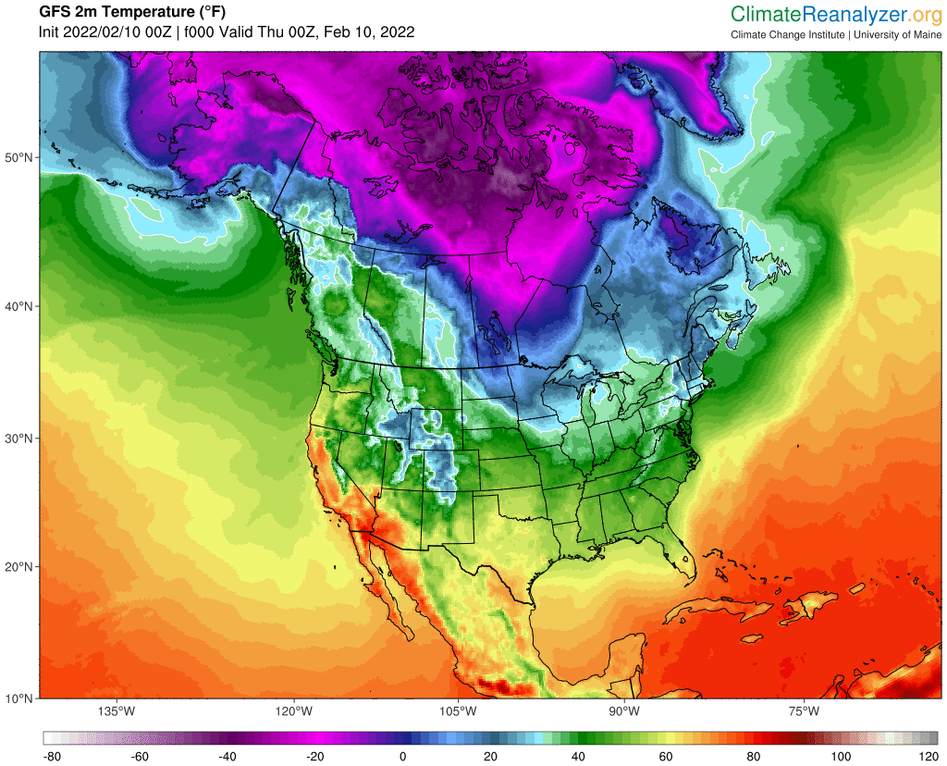
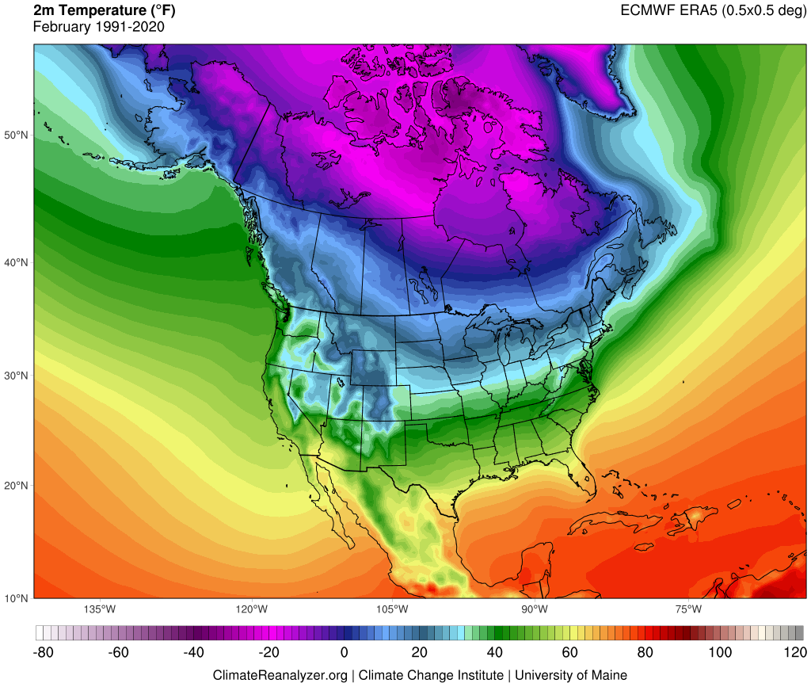
Weather & Climate
Weather is the fluctuating state of the atmosphere, characterized by temperature, precipitation, wind, clouds, and etc.
Limited predictability of individual weather systems beyond 1–2 weeks.
Climate is average of weather and its variability over some time period and defined region.
Large variations of the mean state of climate and its variability (over decades or longer) constitute climate change.
Changes due to external forcings (natural & human) partly predictable.

Slide 4
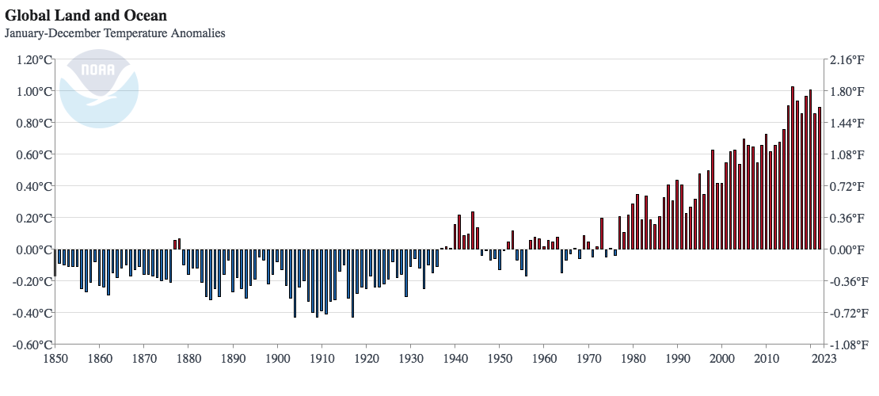

Slide 5
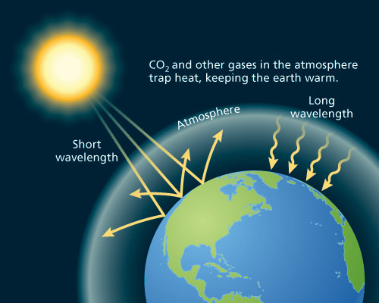
The Greenhouse Effect
http://www.oxfordpresents.com/ms/krohne/global-warming-and-ecological-communities/

Slide 6
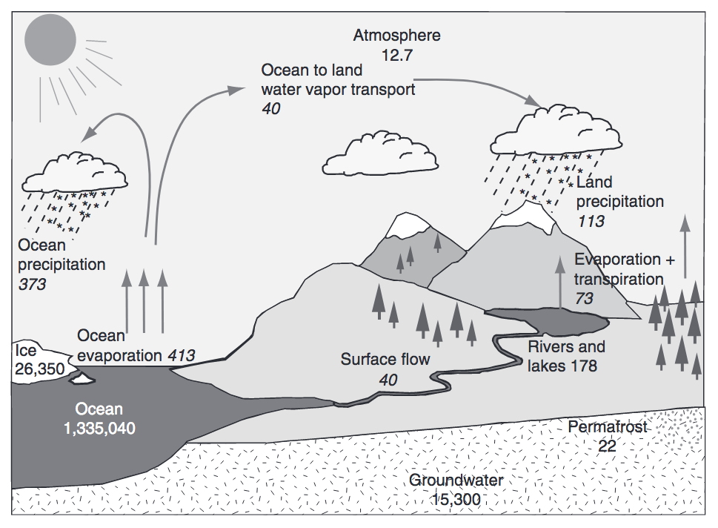
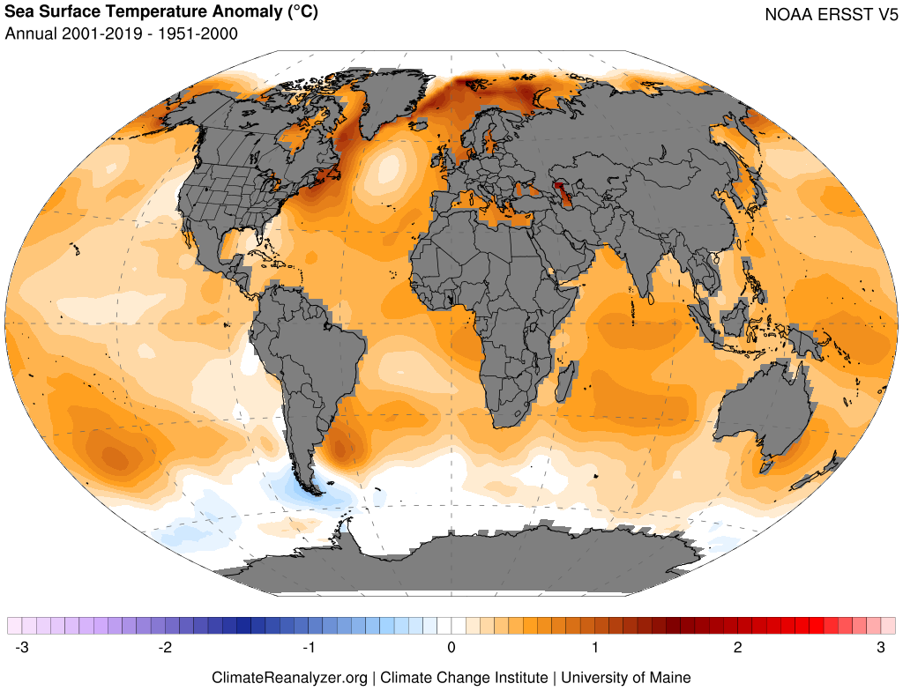
Warming Oceans, Water Vapor Feedback, and Intensifying Hydrologic Cycle
Trenberth et al. (2007), Huntington (2010)
Warming drives increased evaporation, atmospheric water-vapor content, and potential for greater extremes (e.g., heavy precipitation, drought)

Slide 7
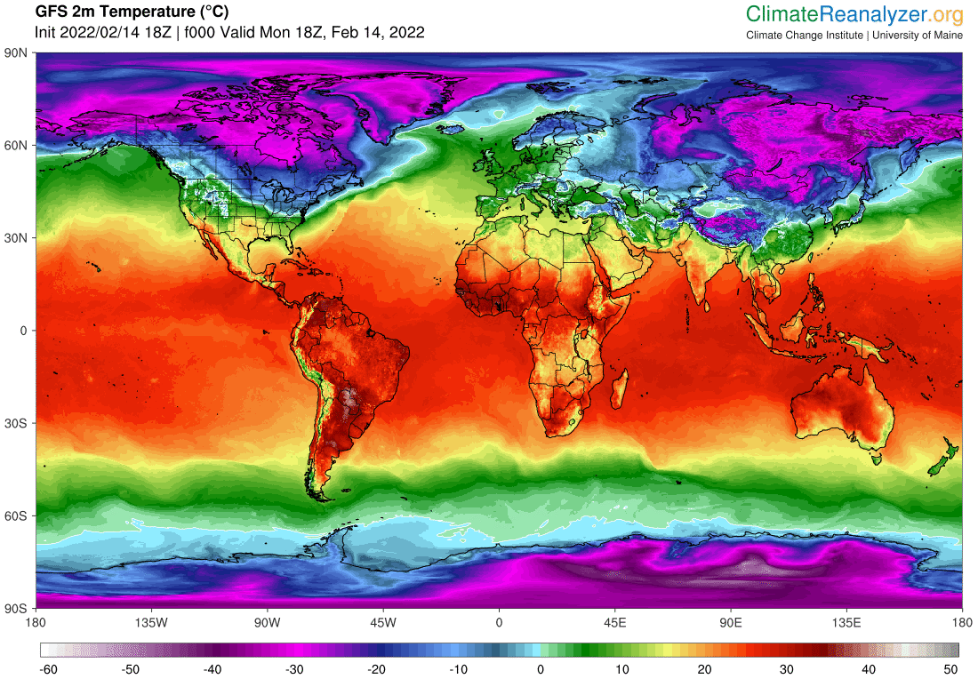
Westerlies
Subtropical High
Intertropical Convergence Zone (ITCZ)
Subtropical High
Westerlies

Slide 8
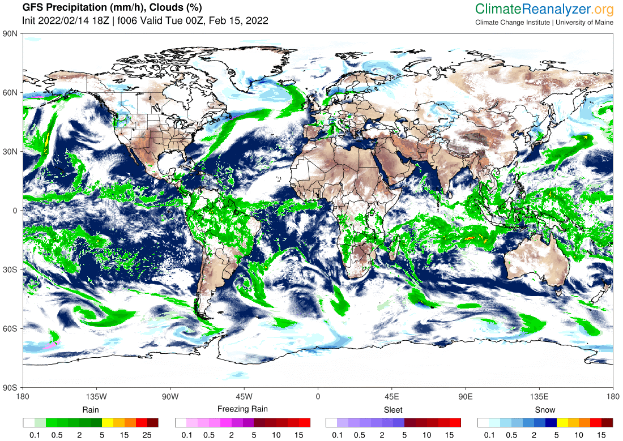
Westerlies
Subtropical High
Intertropical Convergence Zone (ITCZ)
Subtropical High
Westerlies

Slide 9
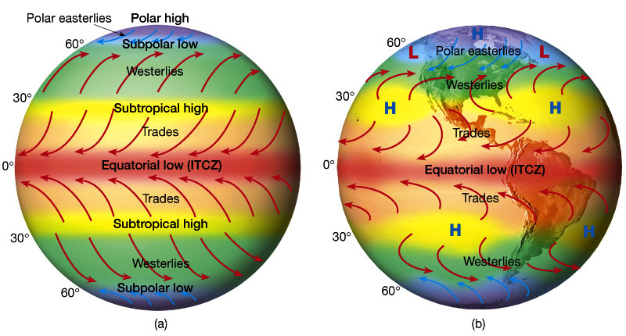
Atmospheric Circulation
Idealized winds from pressure gradient
and Coriolis force.
Wind patterns due to distribution of land masses.
Figures 7.7 and 7.9 in The Atmosphere, 8th edition, Lutgens and Tarbuck, 8th edition, 2001
Downloaded from https://www.ux1.eiu.edu/~jpstimac/1400/circulation.html

Slide 10
MSLP seasonal cycle climatology animation

Slide 11
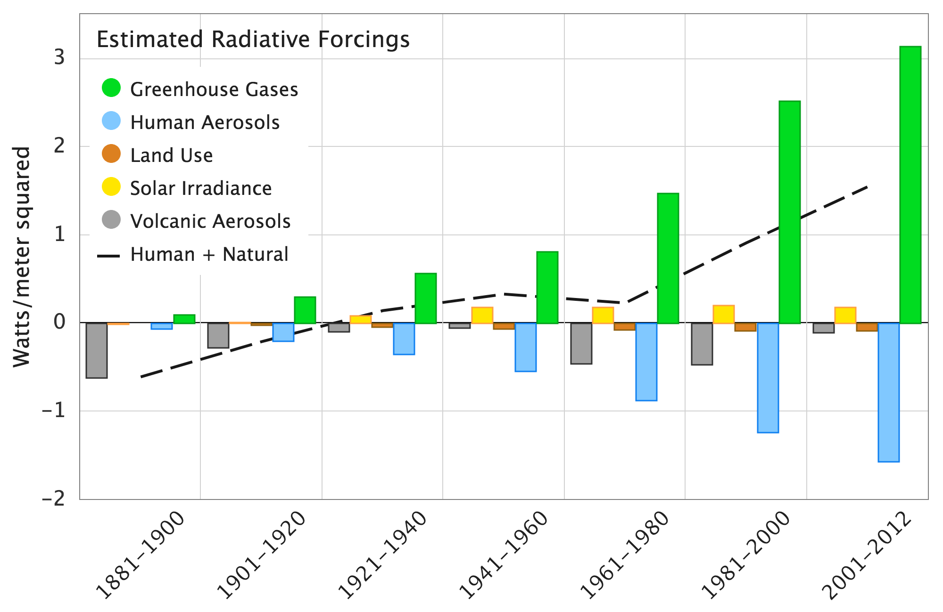
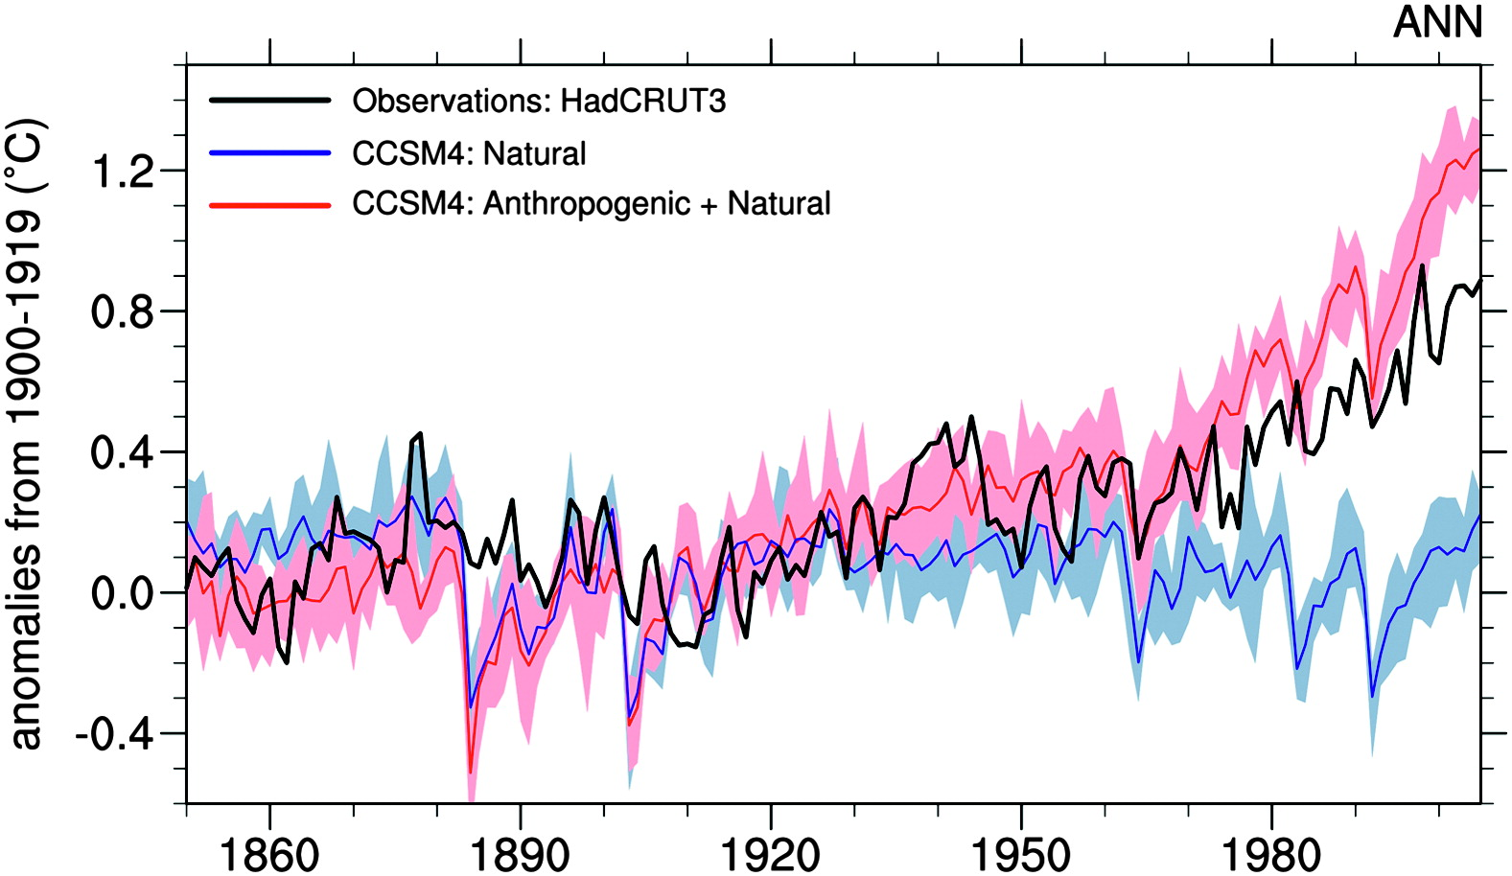
Natural forcings cannot account for the
observed warming since at least 1960
MCC STS 2020; Data from Hansen et al. 2011
Meehl et al, 2012

Slide 12
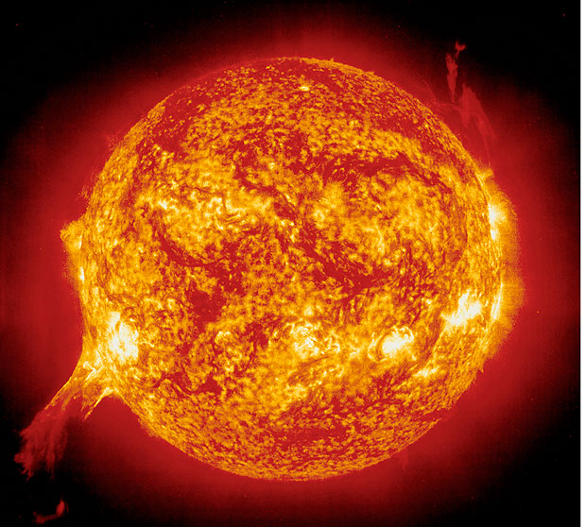
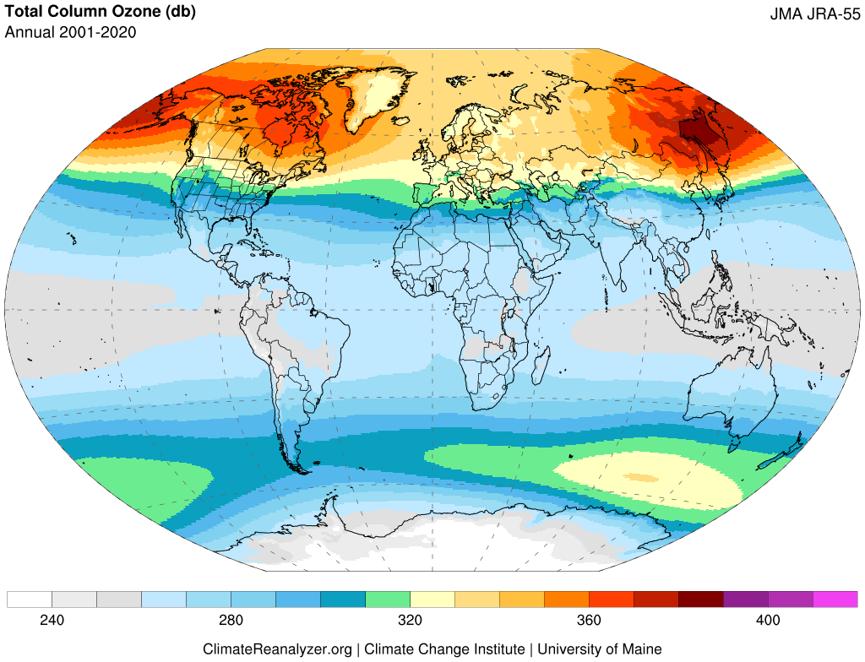
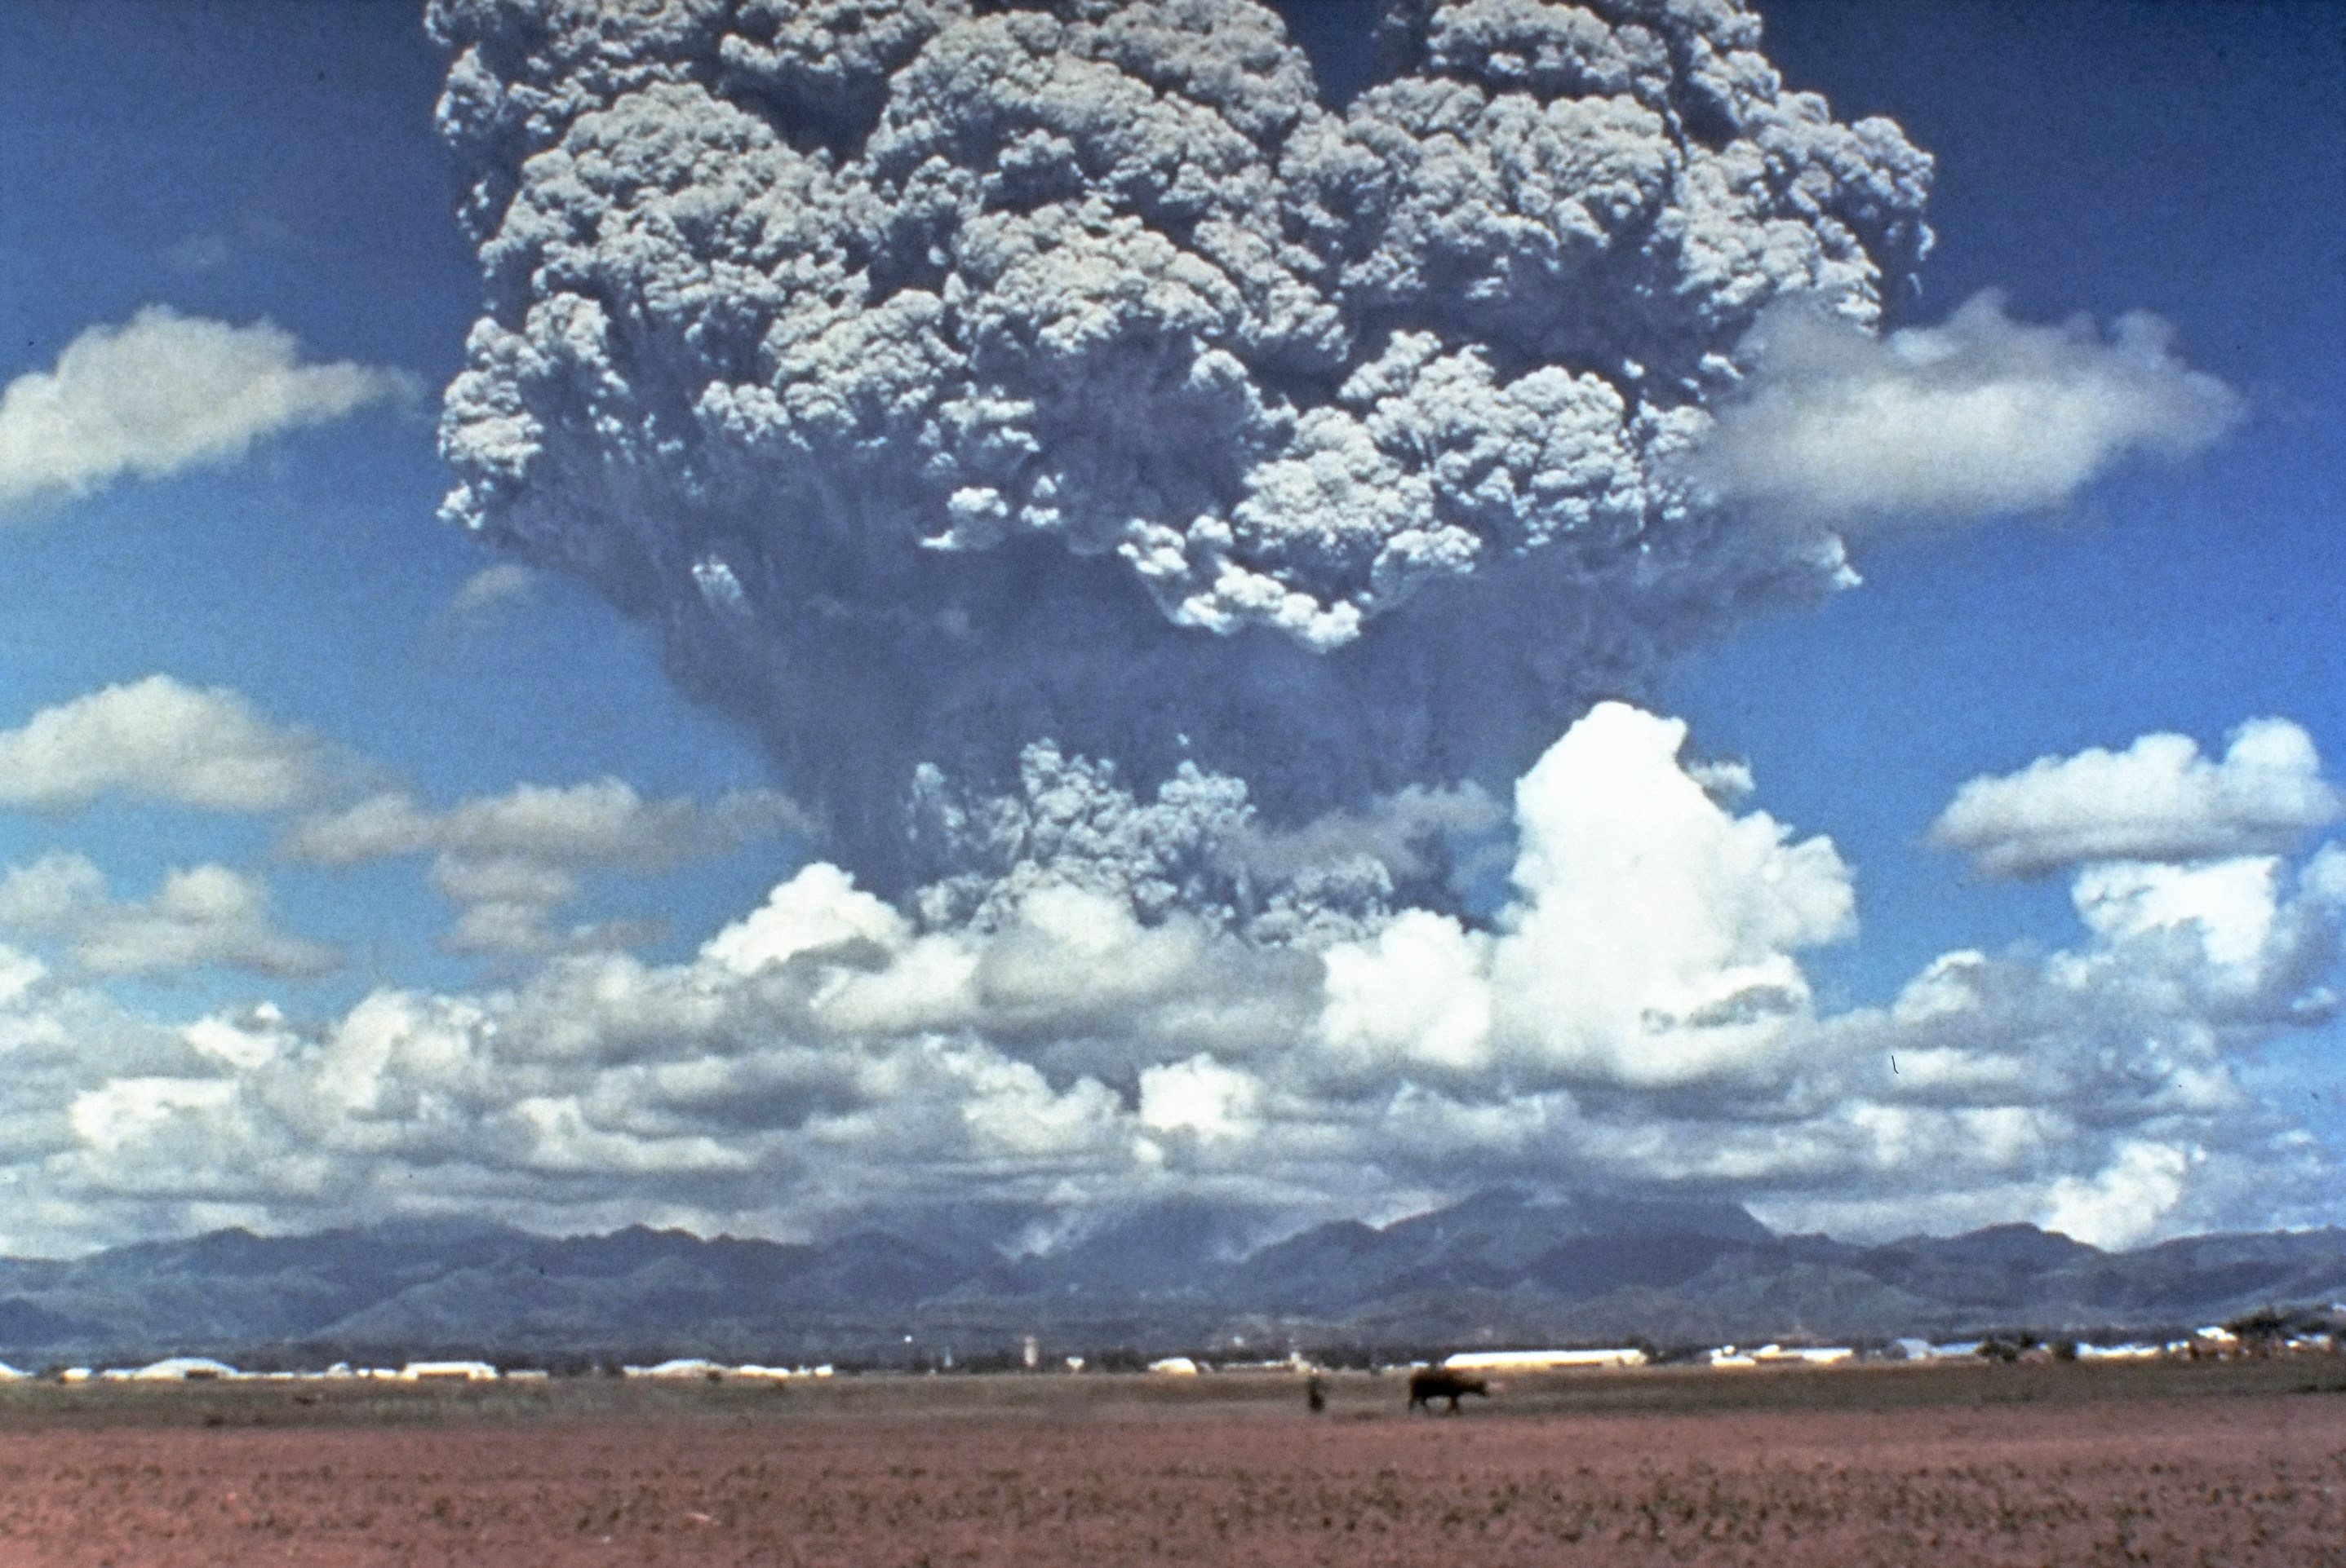
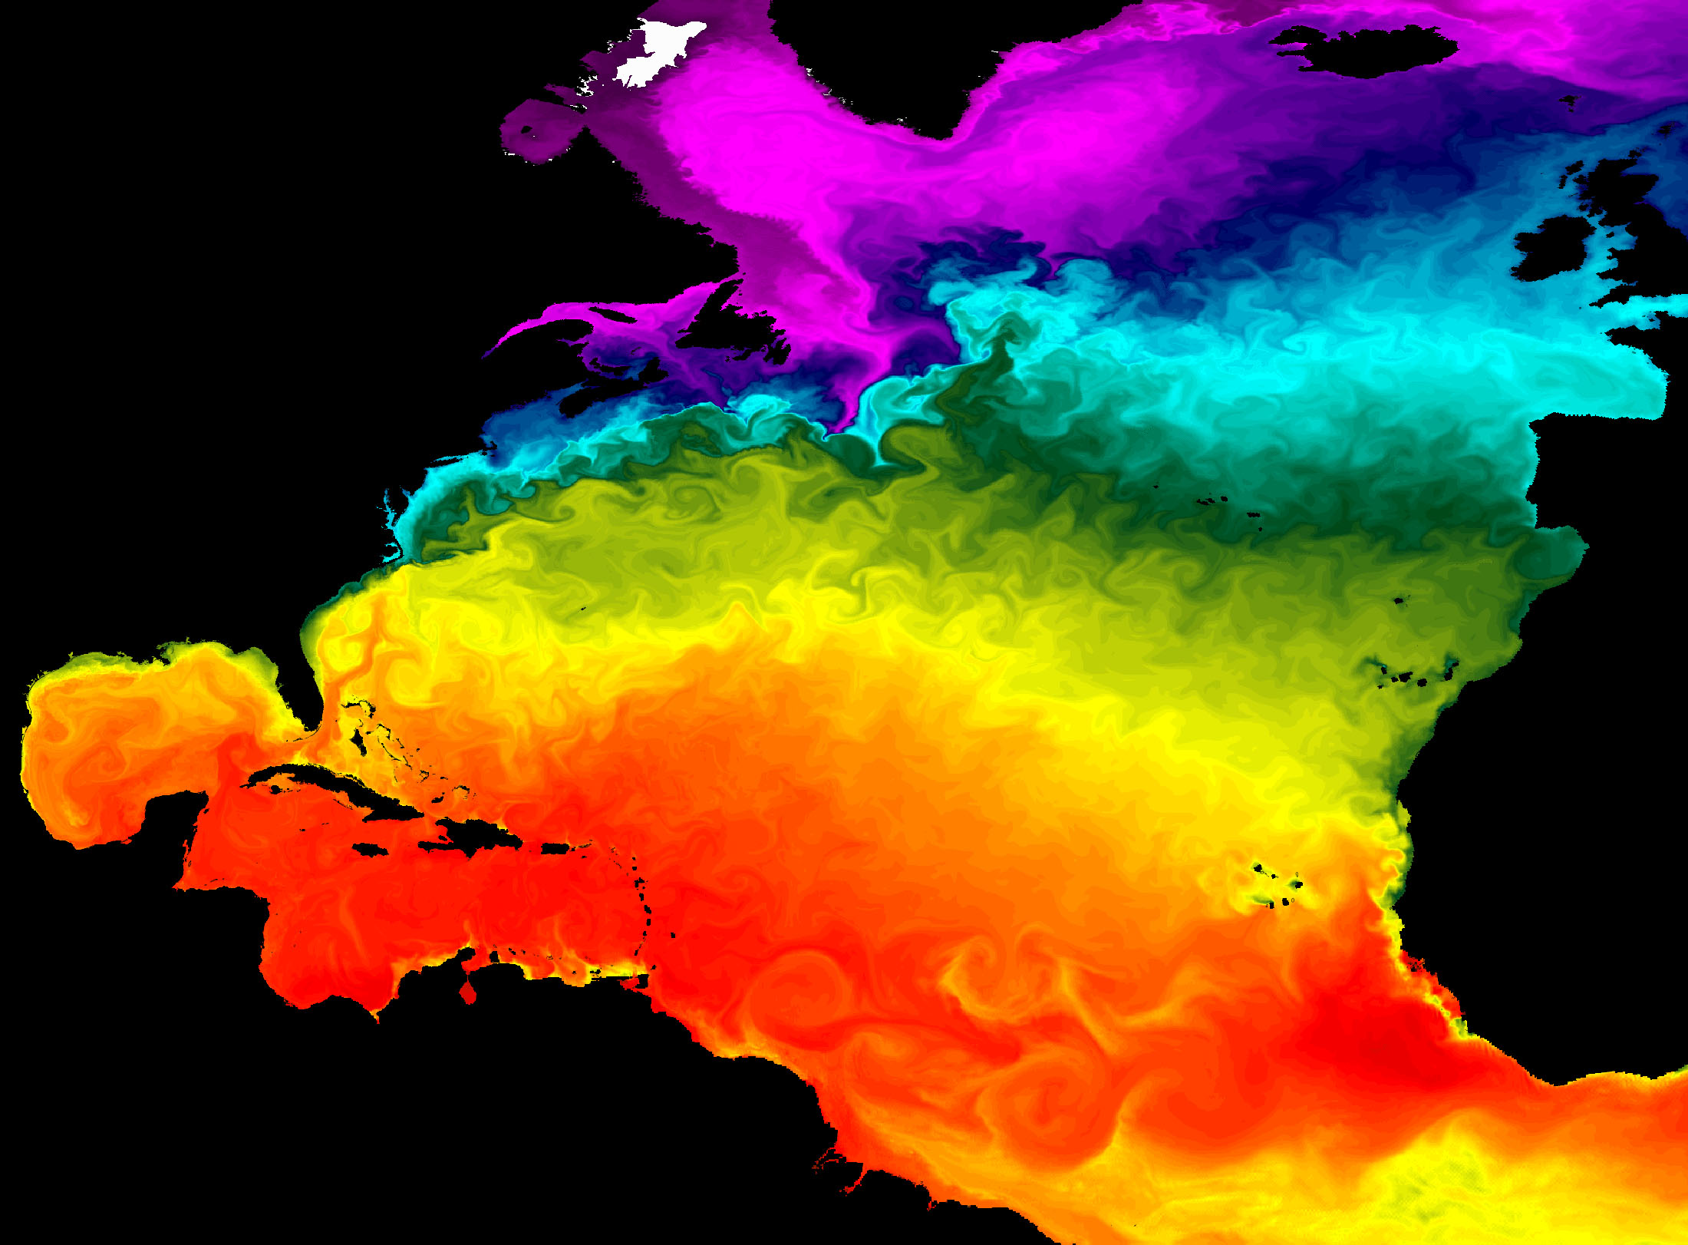
Solar Cycle
Stratospheric
Processes
Volcanic Eruptions
Coupled
Ocean/Atmosphere Responses
Mt. Pinatubo, 1991
https://upload.wikimedia.org/wikipedia/commons/4/4e/Pinatubo91eruption_plume.jpg

Slide 13
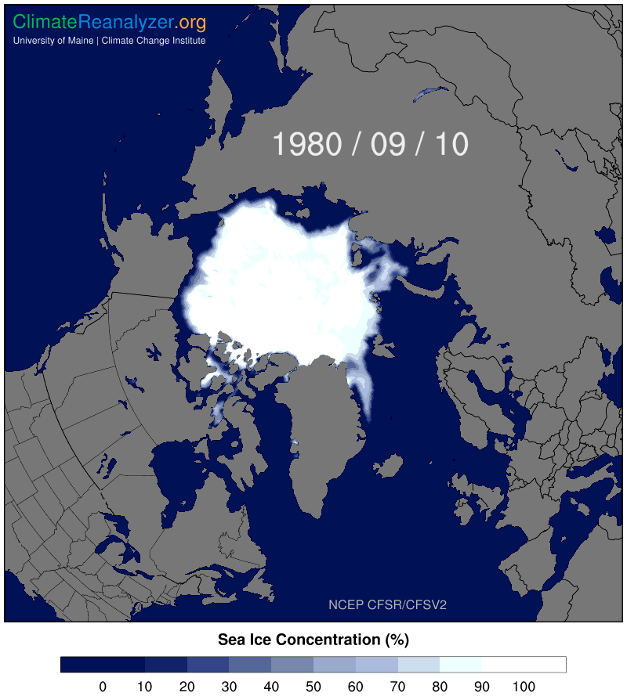
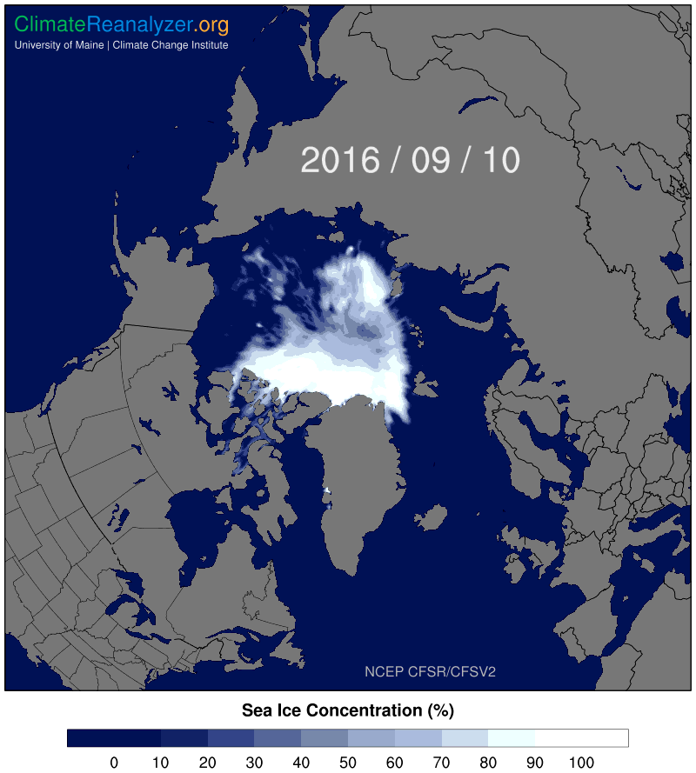

Slide 14
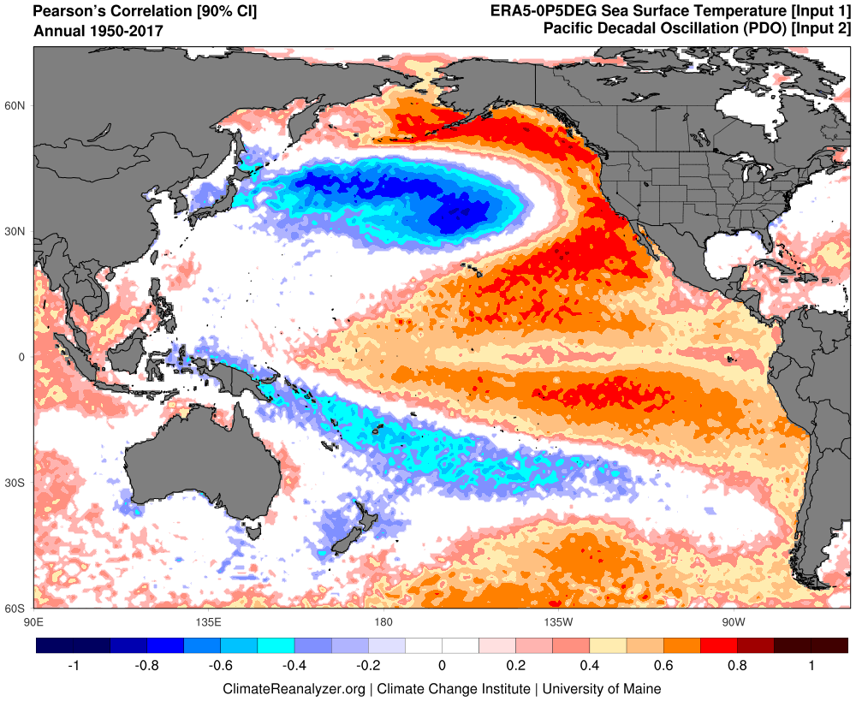
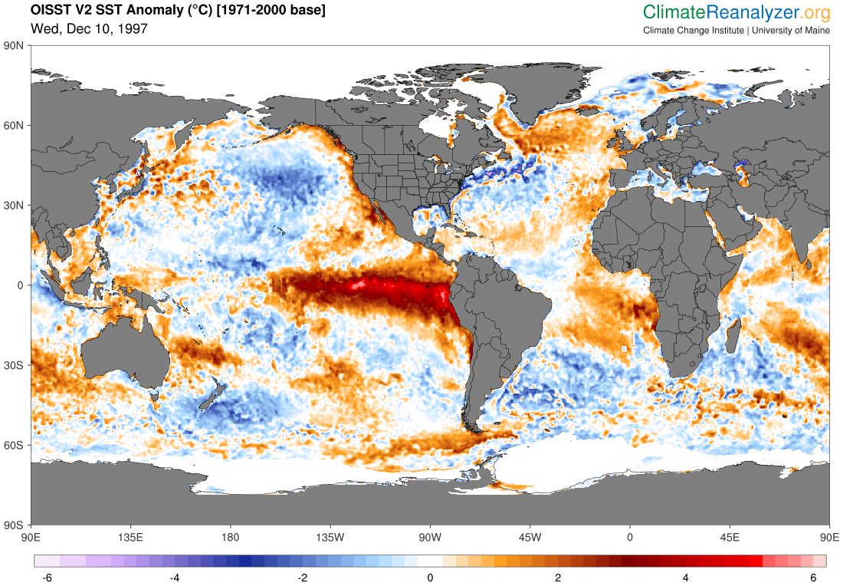
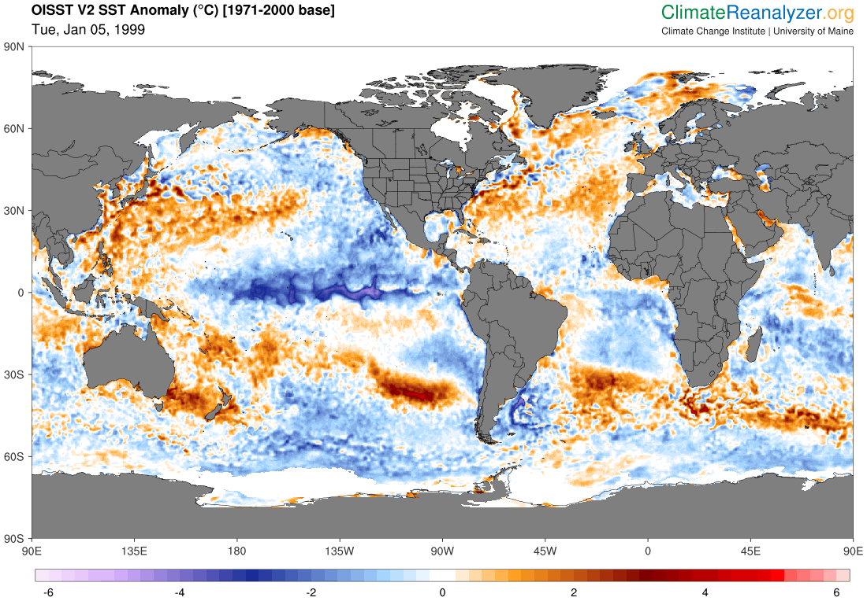
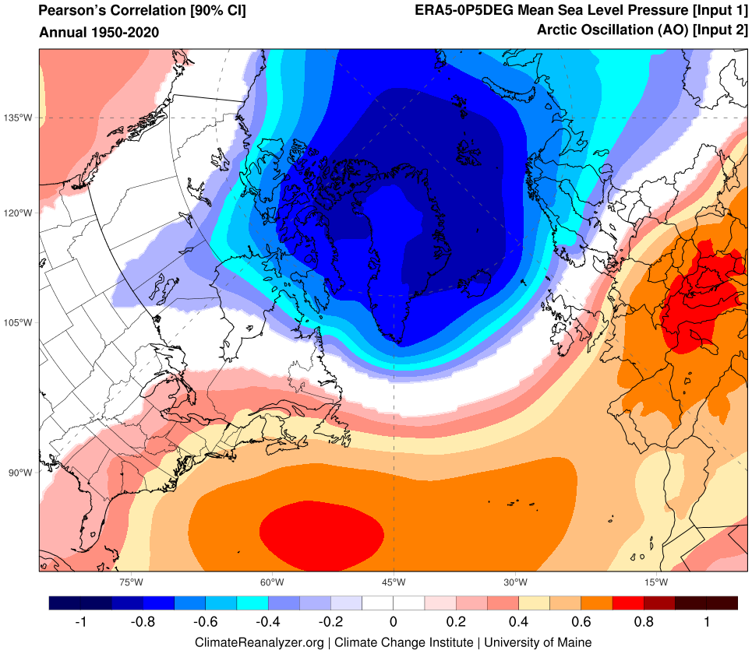
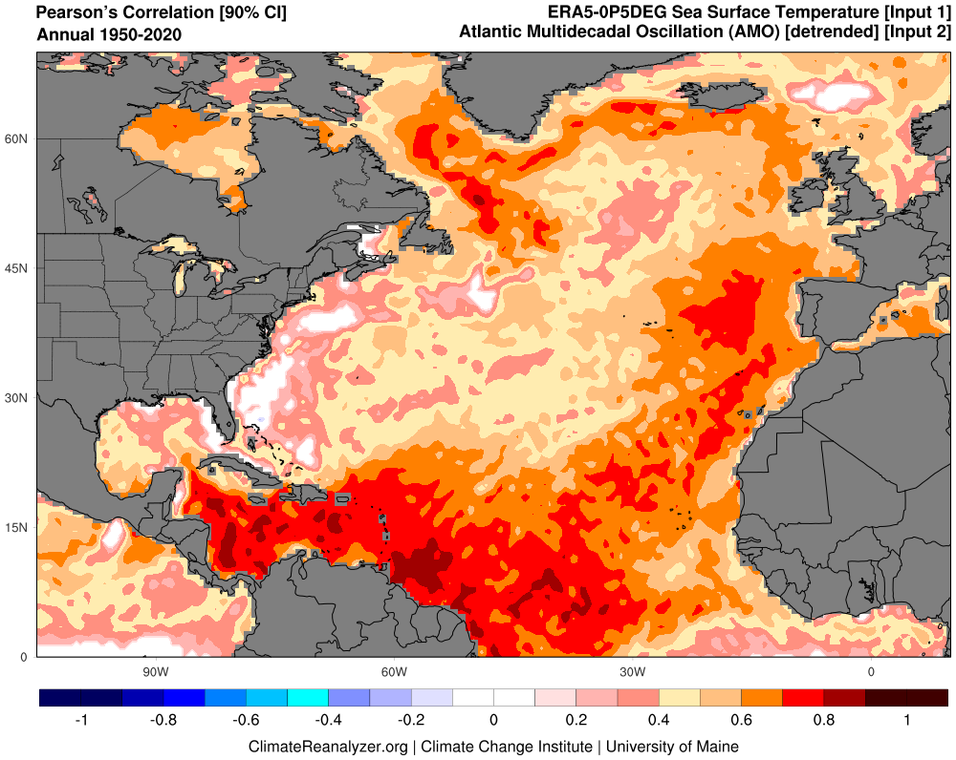
Teleconnections
Pacific Decadal Oscillation (PDO)
El Niño-Southern Oscillation (ENSO)
Atlantic Multidecadal Oscillation/Variability (AMO/AMV)
North Atlantic Oscillation (NAO)

Slide 15
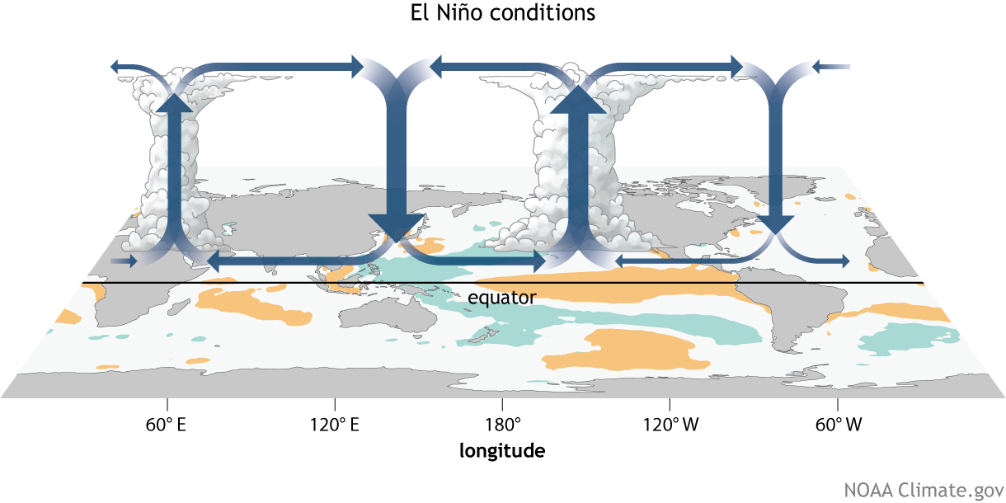
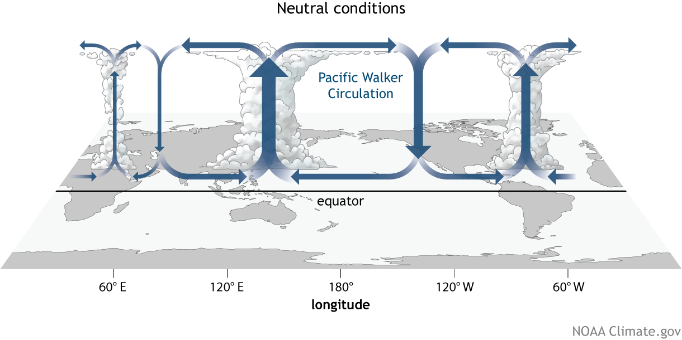
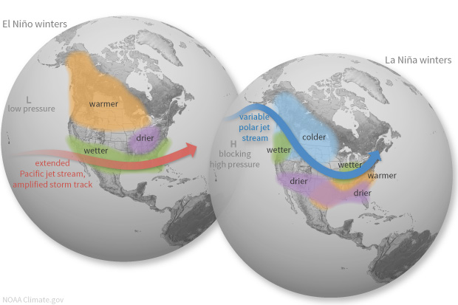
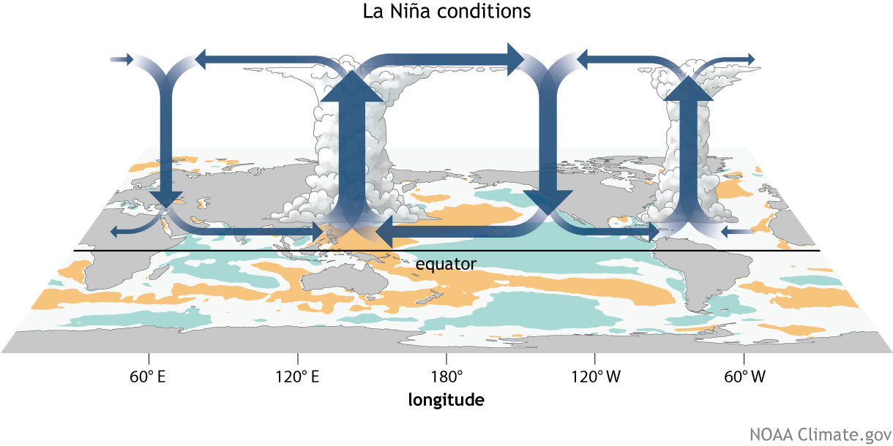
El Niño-Southern Oscillation (ENSO)
Coupled ocean-atmosphere response with irregular period of 2–7 years between El Niño (warm) and La Niña (cool) phases.
ENSO impacts weather worldwide, particularly during boreal winter.
Atmospheric response known as Walker circulation.
https://www.climate.gov/enso

Slide 16
Variability… showing global annual temp 1880-present

Slide 17
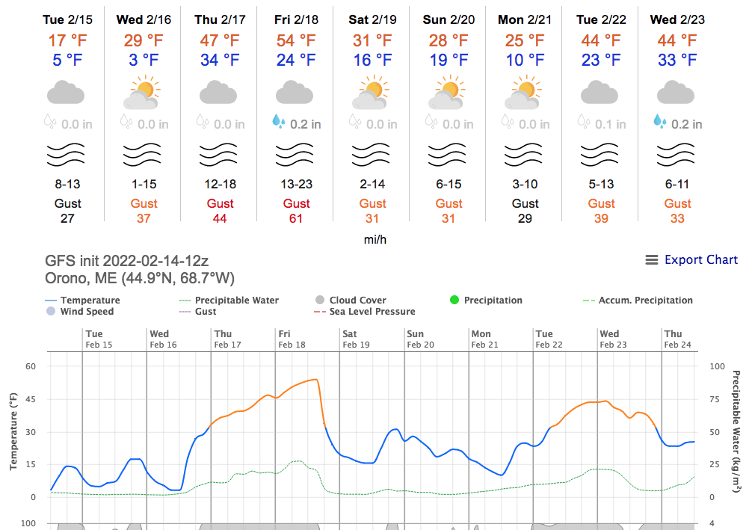
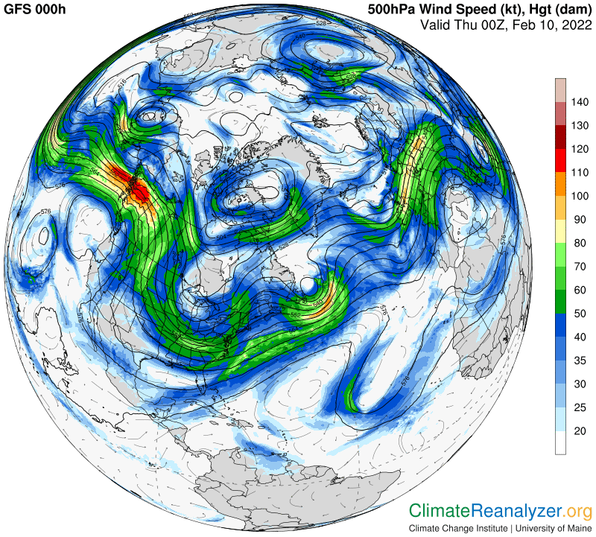
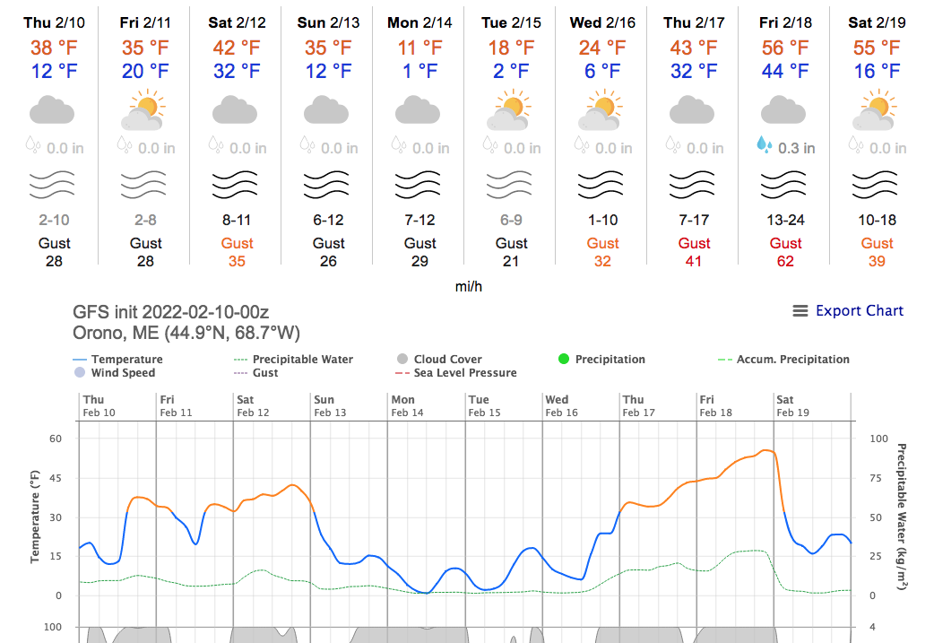
GFS 10-day
Mon 14 Feb
12 UTC
GFS 10-day
Thu 10 Feb
00 UTC

Slide 18
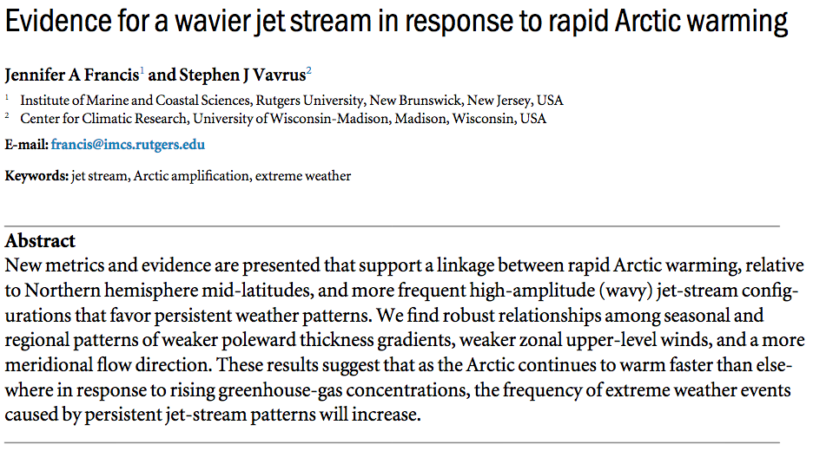
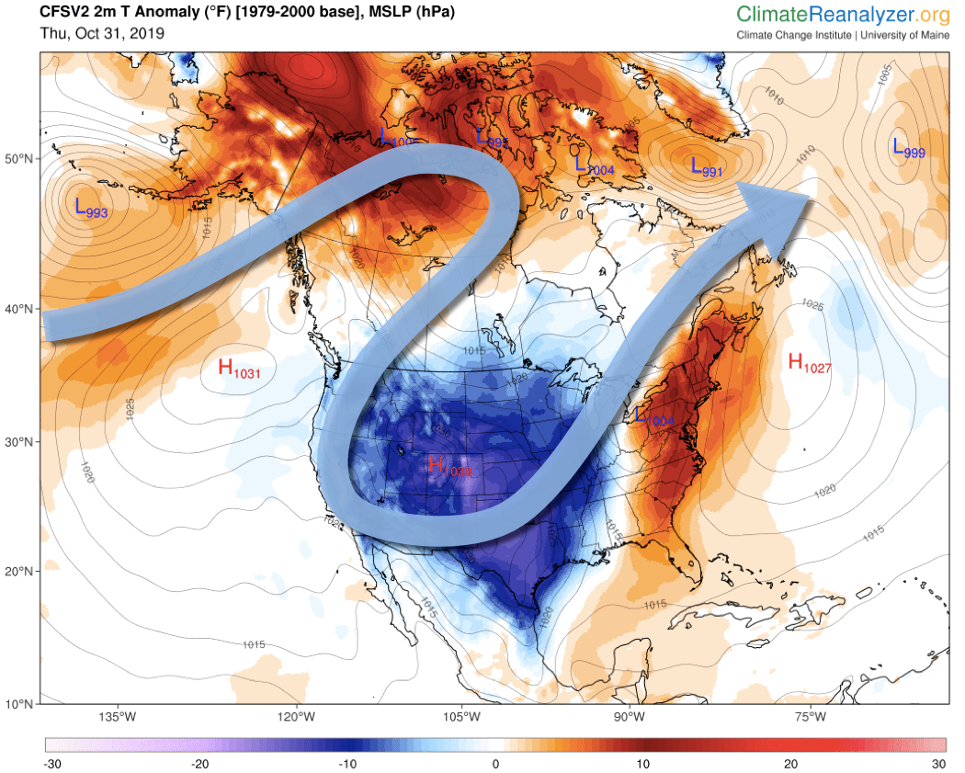
Francis and Vavrus, 2014
Temperature anomaly and Jetstream
Wind Storm
Nov 1, 2019

Slide 19
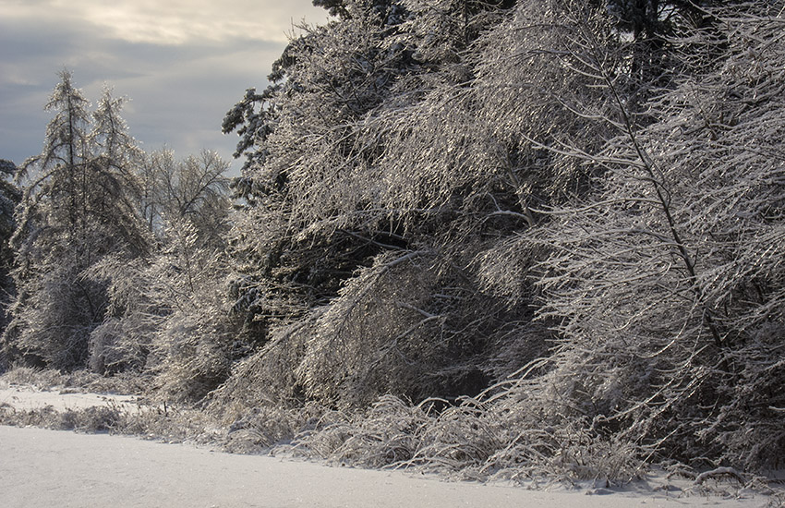
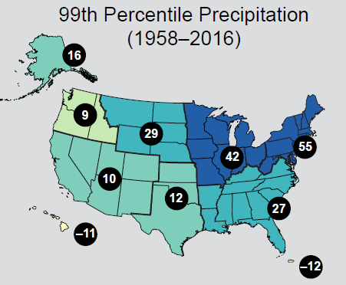
Extreme Weather
Extreme weather becoming more common around the Northern Hemisphere due to changes in atmospheric circulation.
Increased likelihood of heat/cold waves, intense storms.
Large increases (55%) in annual heavy daily precipitation across the USNE.
In Maine, the last 10-15 years have seen the highest occurrence of 2”, 3”, and 4” precipitation events (Fernandez et al., 2020).
Easterling et al., 2017

Slide 20

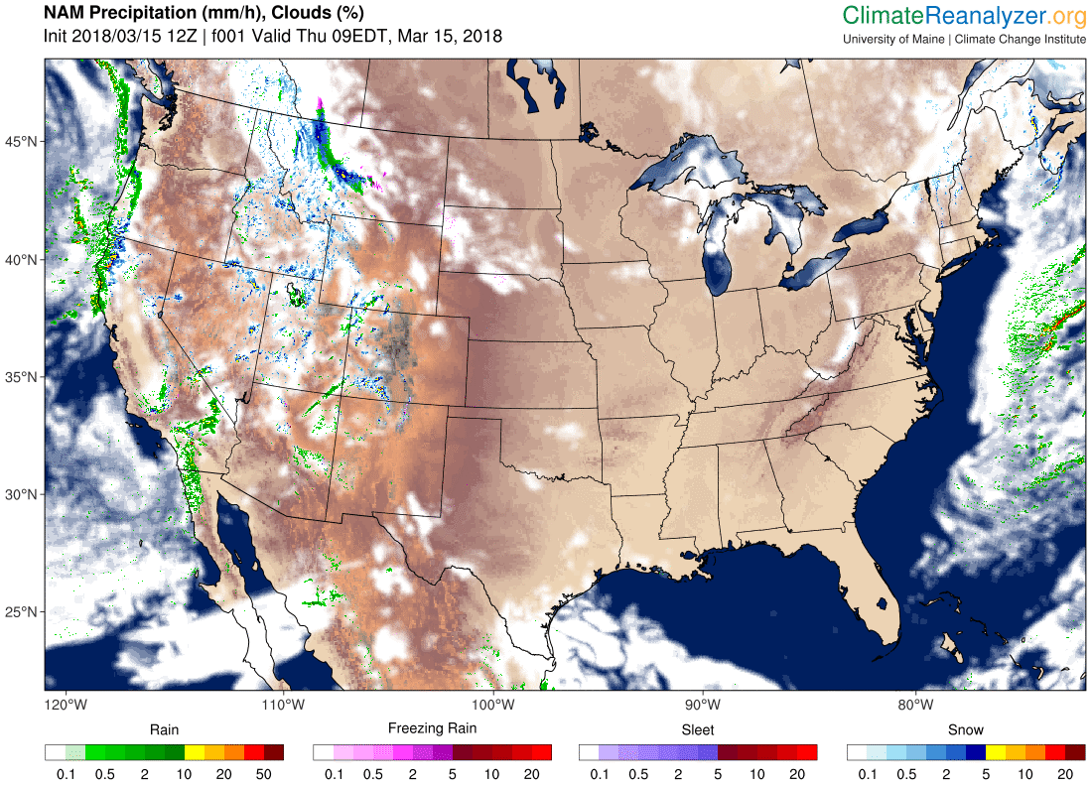
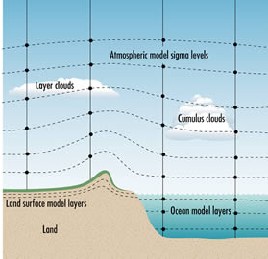
Future climate is projected using physics-based models of the atmosphere, ocean, cryosphere, and biosphere. The model climate can be perturbed by changes in GHG emissions, volcanic activity, solar output, and other factors.
www.bom.gov.au/info/GreenhouseEffectAndClimateChange.pdf

Slide 21
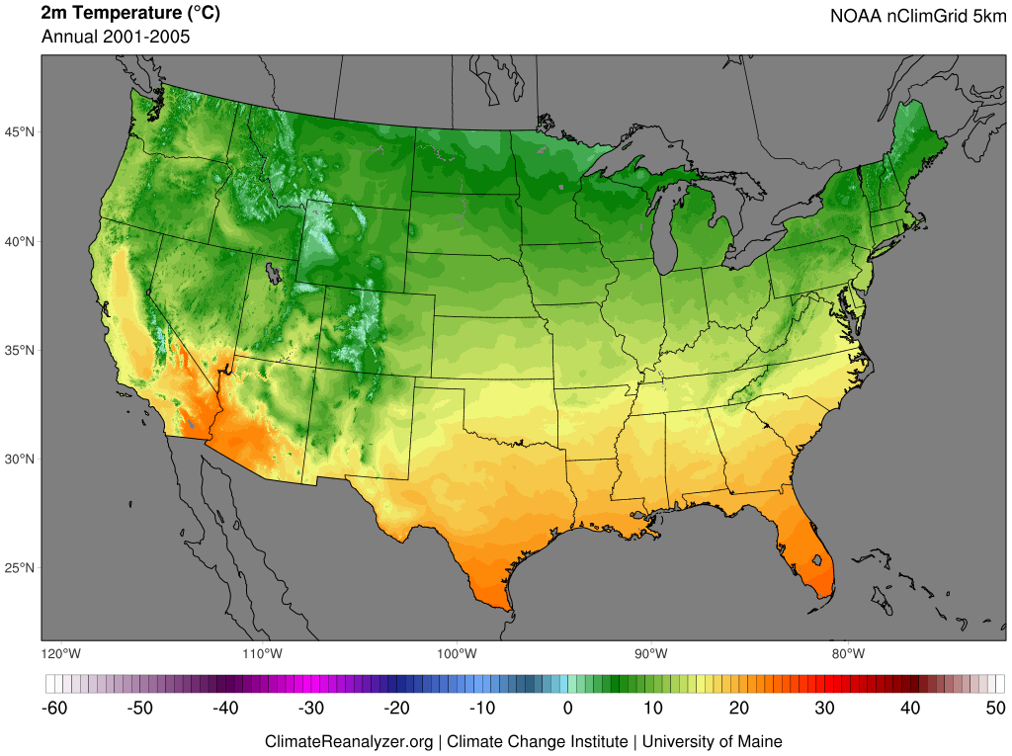
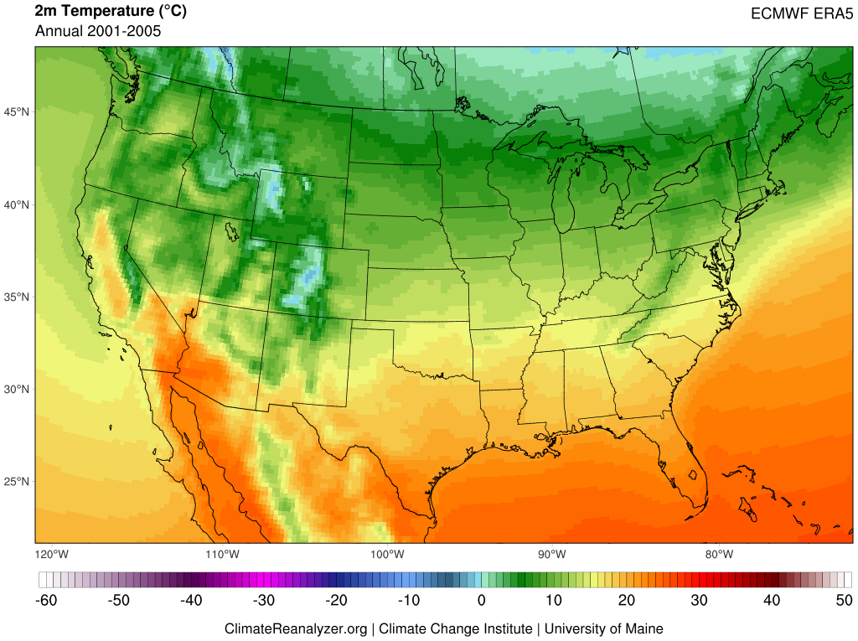
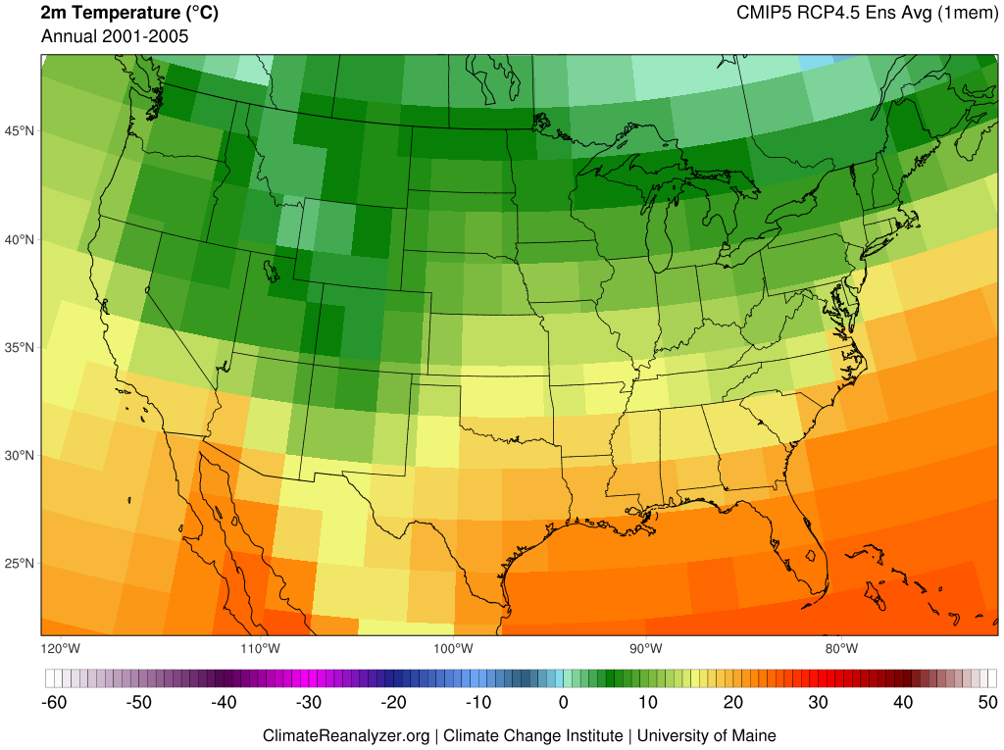
Gridded data products place point-based or spatially discontinuous observations of Earth's climate (e.g., temperature, precipitation, wind, and sea surface temperature) onto time-registered grids and fill in data gaps using methods of interpolation. Gridded datasets are useful for climate study in areas that may not have direct observations, but where the intersection of surrounding input data can provide meaningful information.
Reanalysis refers to physically-based numerical frameworks that simulate the state Earth's climate through time, guided by frequent input of real-world observations (e.g., weather stations, radiosonde, satellite, and ocean buoys). Reanalysis products are used for understanding climate variability and change, including across areas where direct observations are not available.
Climate models afford physically-based simulations of energy and material flows through the atmosphere, ocean, and other parts of the earth system. The most complex of these frameworks are earth system models, where multiple systems are coupled and yield dynamic interactions. Climate and earth system models are used for investigating past, present, and future climate evolution based on changes in radiative forcing, such as from greenhouse-gas emissions.
  Coupled Model Intercomparison Project (CMIP) 5 and 6
  Representative Concentration Pathways (RCPs) and Shared Socioeconomic Pathways (SSPs)

Slide 22
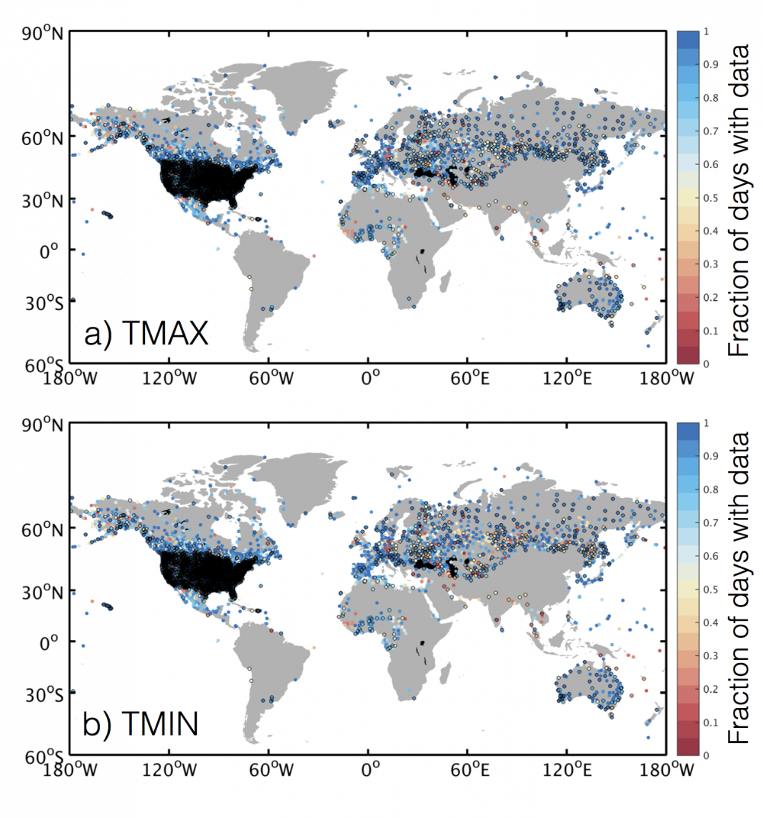
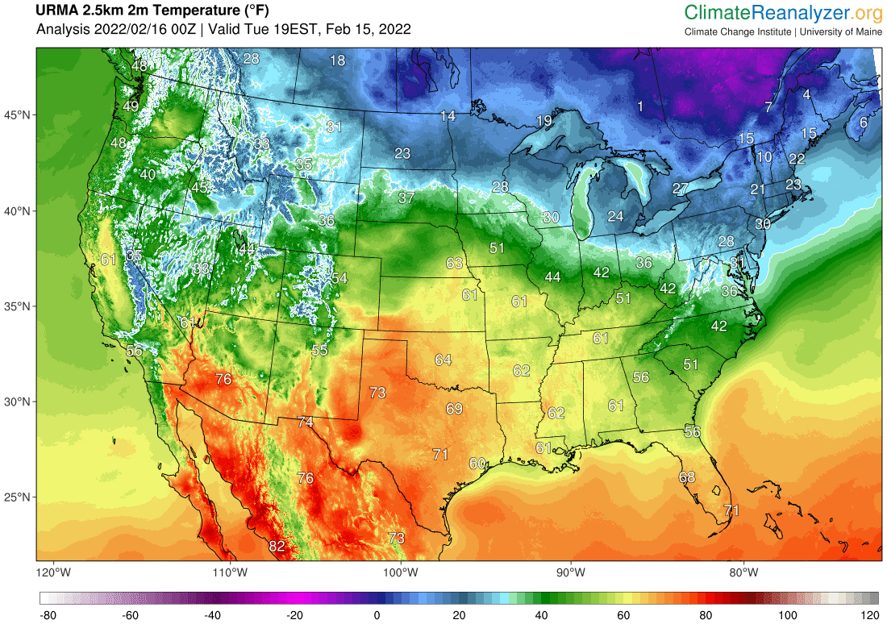
Global Historical Climatology Network (GHCN)
Un-Restricted Mesoscale Analysis (URMA)
NCAR Climate Data Guide

Slide 24
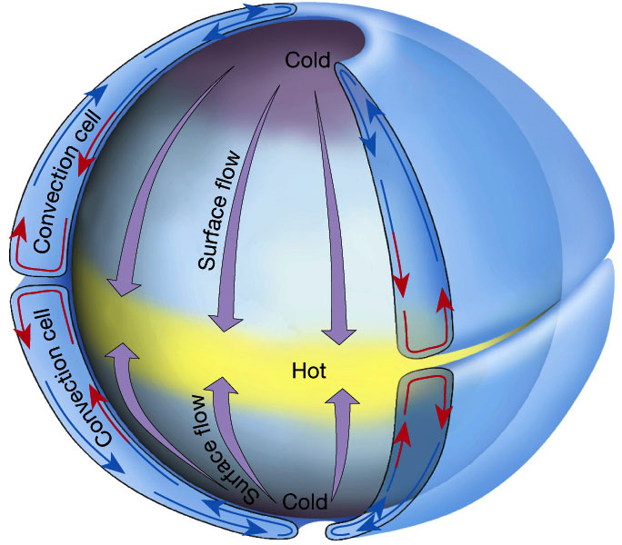
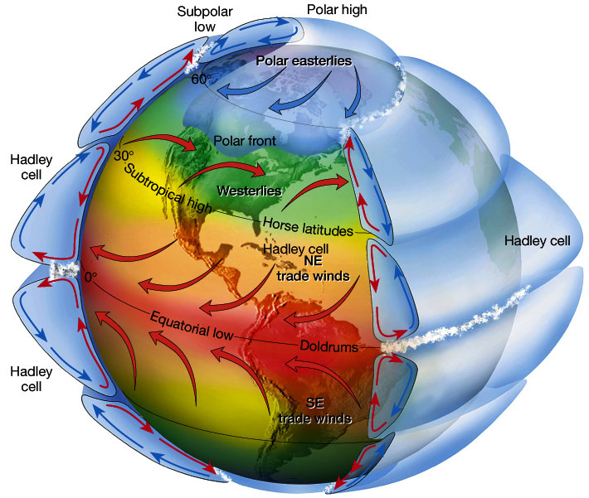
Atmospheric Circulation
Idealized single-cell atmospheric convection.
Three-cell atmospheric convection on rotating frame of reference. Wind deflections in each cell N & S of the equator due to the Coriolis force.
Figure 7.5 in The Atmosphere, 8th edition, Lutgens and Tarbuck, 8th edition, 2001
Downloaded from https://www.ux1.eiu.edu/~jpstimac/1400/circulation.html

Slide 25
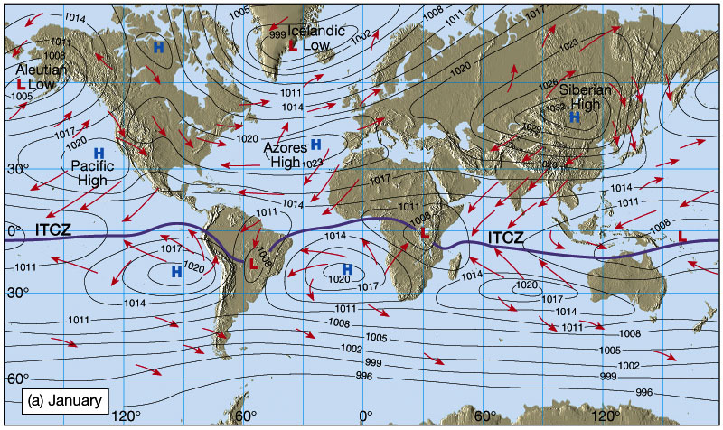
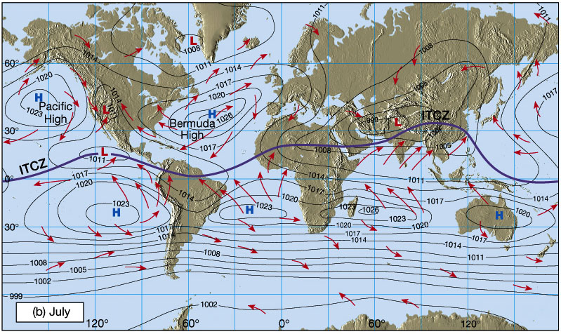
Atmospheric Circulation
Idealized winds from pressure gradient
and Coriolis force.
Wind patterns due to distribution of land masses.
Figures 7.7 and 7.9 in The Atmosphere, 8th edition, Lutgens and Tarbuck, 8th edition, 2001
Downloaded from https://www.ux1.eiu.edu/~jpstimac/1400/circulation.html

Slide 26
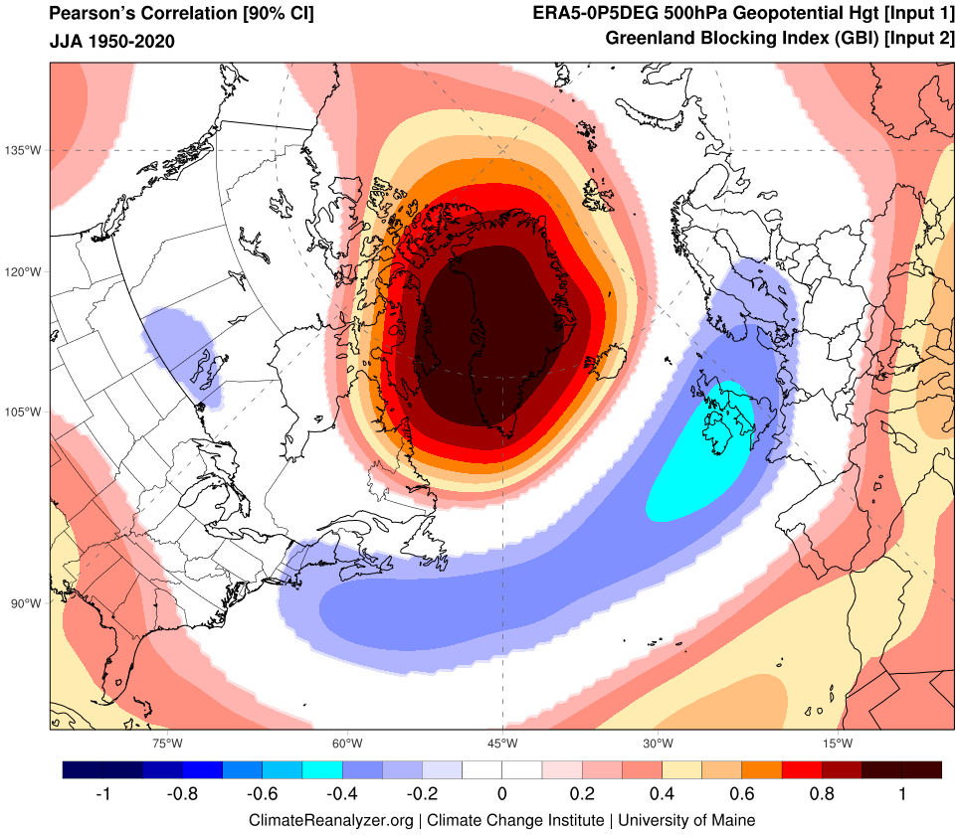
Teleconnections
Pacific Decadal Oscillation (PDO)
El Niño-Southern Oscillation (ENSO)
Atlantic Multidecadal Oscillation/Variability (AMO/AMV)
North Atlantic Oscillation (NAO)
Greenland Blocking Index (GBI)

Slide 27
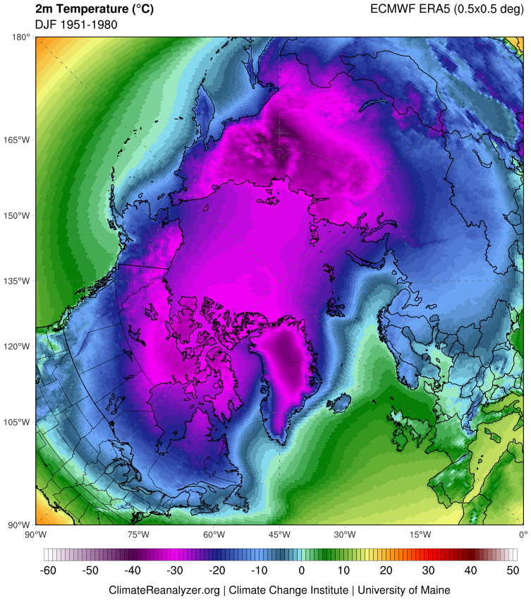
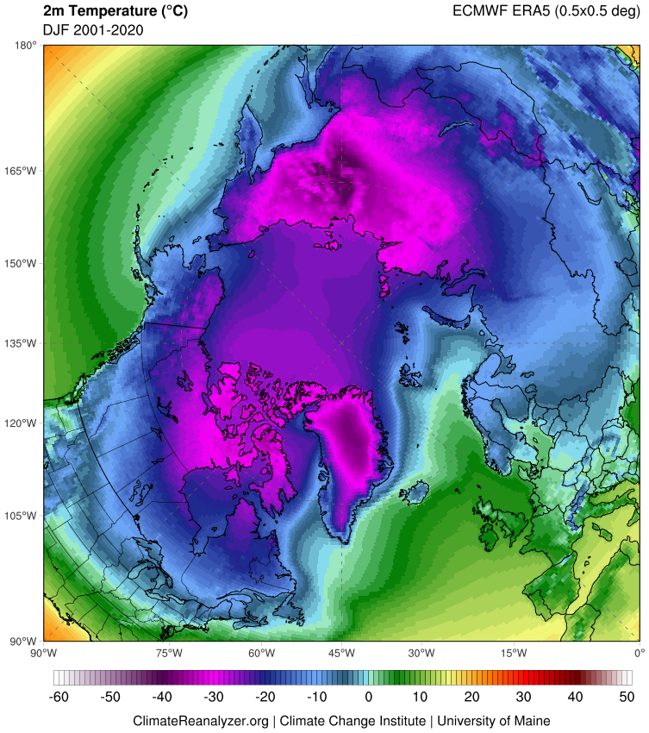
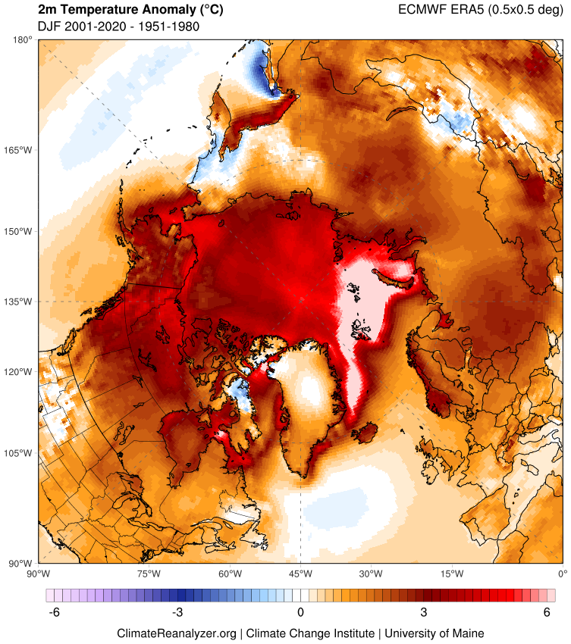
DJF 1951–1980
DJF 2001–2020
Difference

Slide 28




SST Anomaly
Precipitation
DJF 1998
El Niño
DJF 1999
La Niña

Slide 29



ERA5 Vertical Profiles

