Slide 1
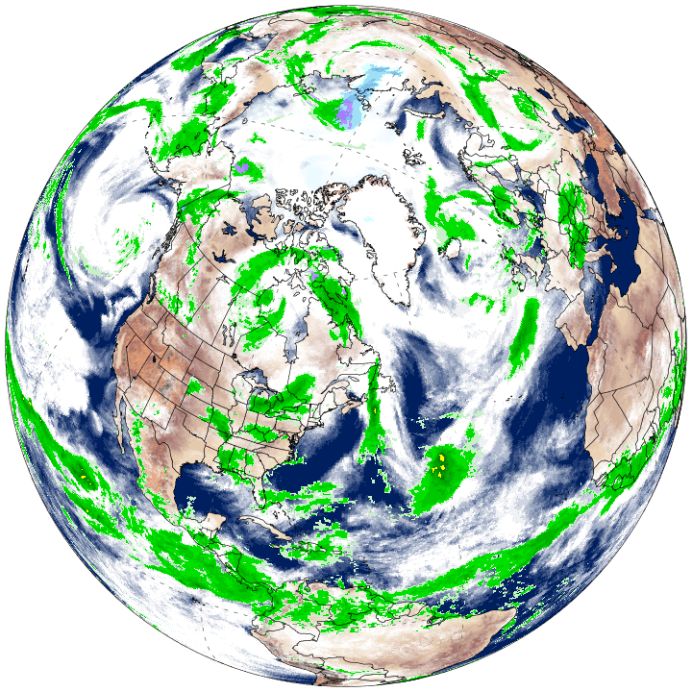




Introduction to
Climate Reanalyzer
19 July, 2022
Ana Trueba
Graduate Research Assistant
Climate Change Institute

Slide 2
10:30 – 11:25 AM
Website overview
Climate & weather datasets
Examples of how we can explore features of the climate system and climate teleconnections
Workshop Goals
Learn how to use Climate Reanalyzer to explore climate and weather datasets
Applies to classroom learning, research, and general interest
11:30 – 12:30 PM
Use Climate Reanalyzer in breakout rooms. Each group will explore a different topic (40 min)
Results & discussion (20 min)

Slide 3
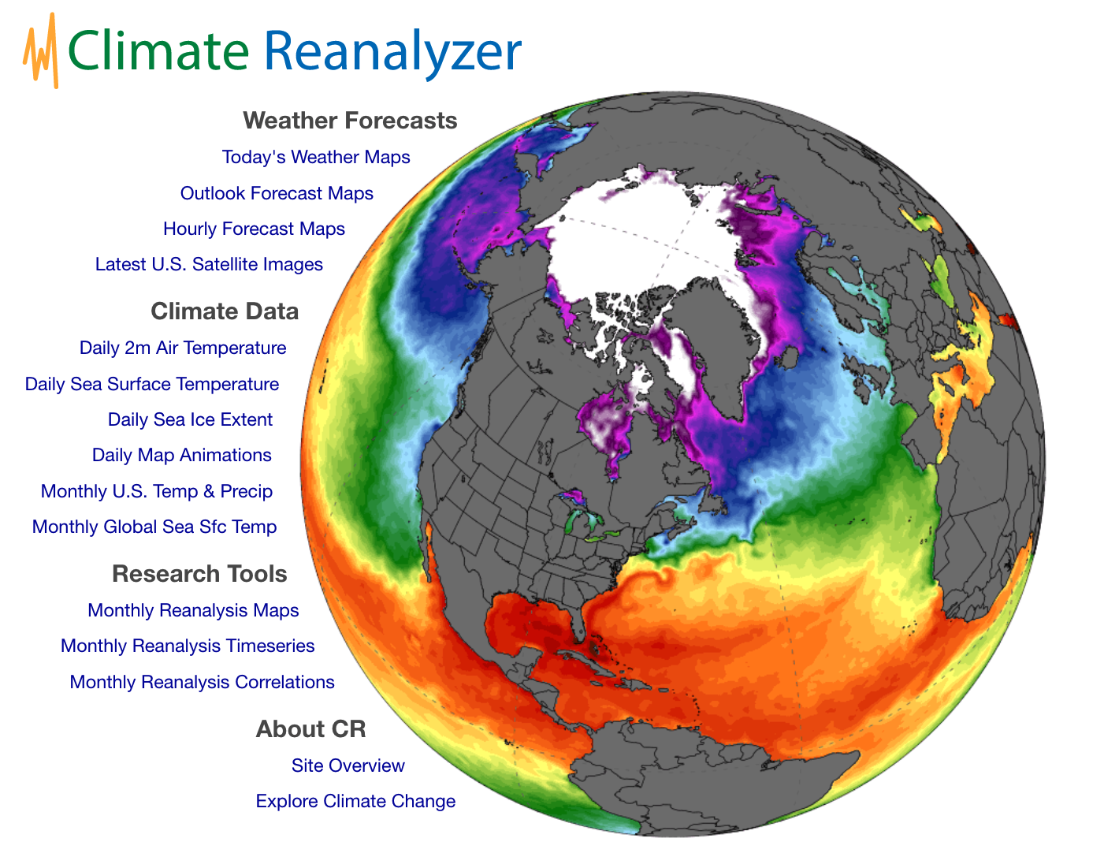
https://ClimateReanalyzer.org

Slide 4
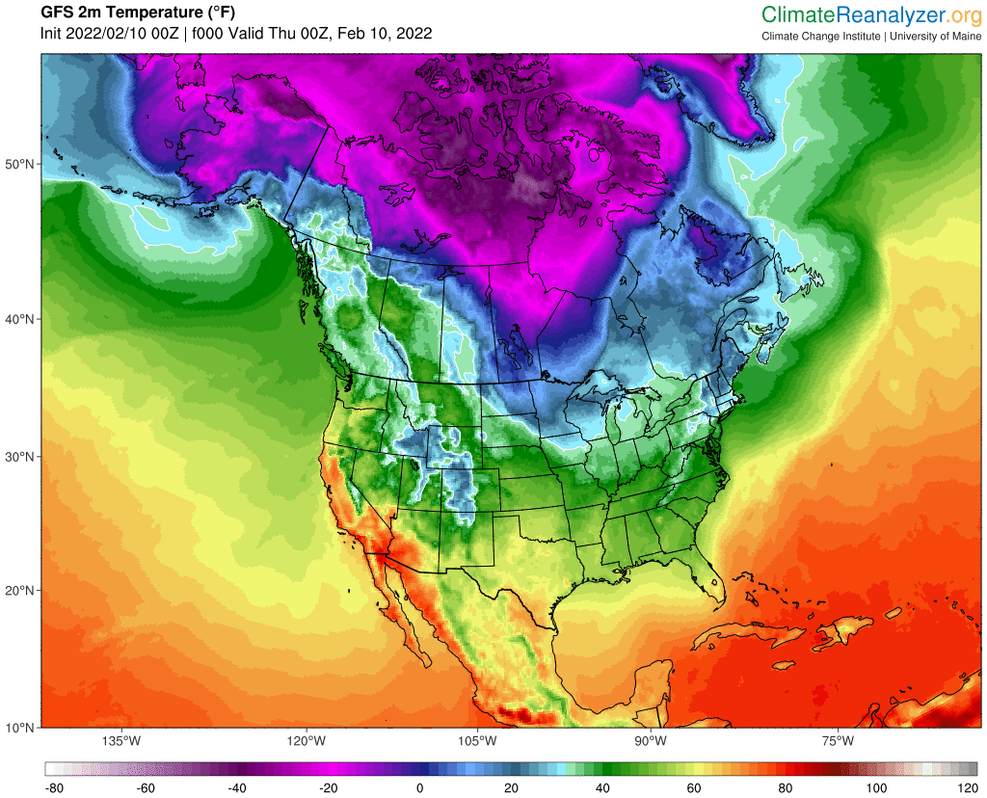
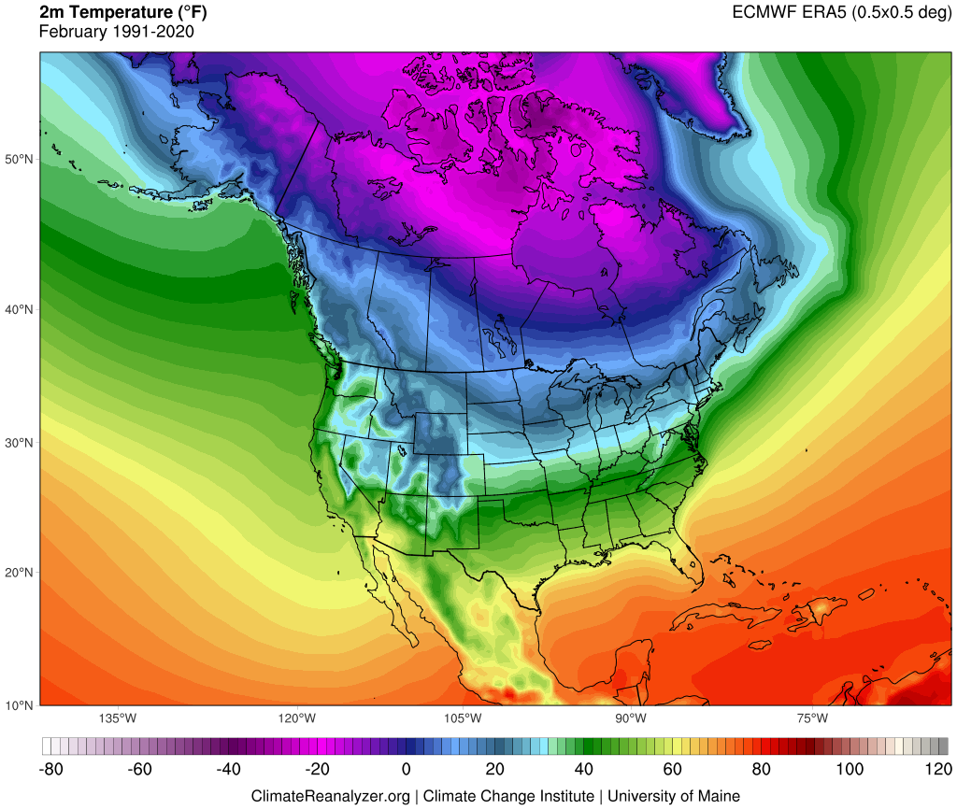
Weather & Climate
Weather is the fluctuating state of the atmosphere, characterized by temperature, precipitation, wind, etc.
Limited predictability of individual weather systems beyond 1–2 weeks.
Climate is average of weather and its variability over some time period and defined region.
Large variations of the mean state of climate and its variability (over decades or longer) constitute climate change.
Changes due to natural & human influences; partly predictable.

Slide 5
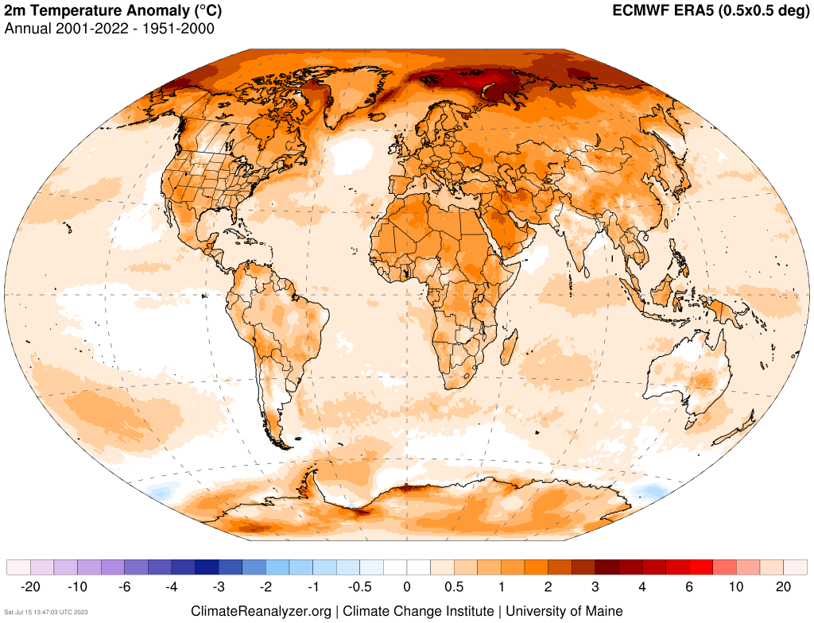
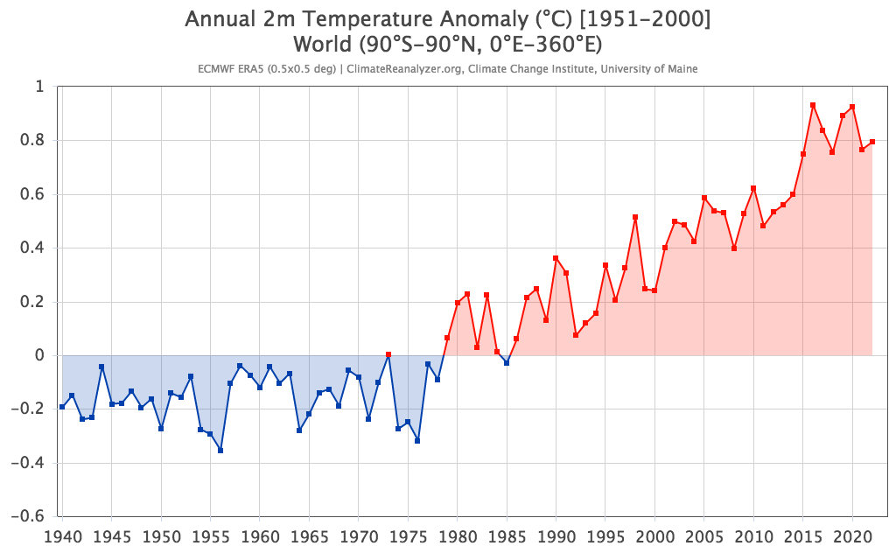

Slide 6
Datasets and Models

Slide 7
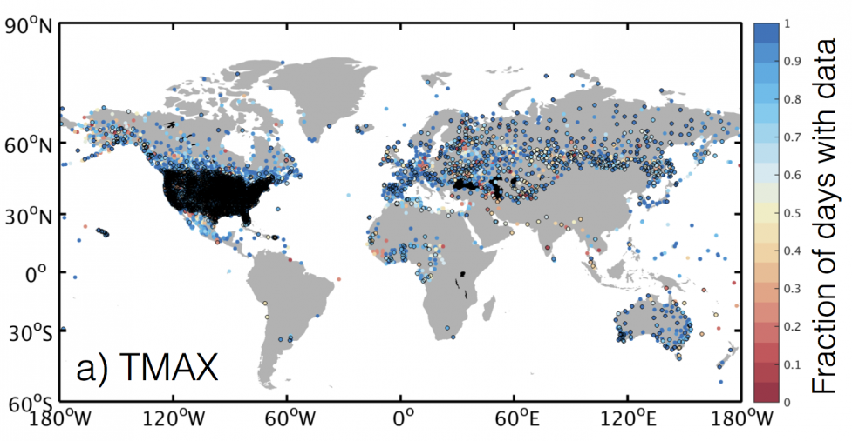
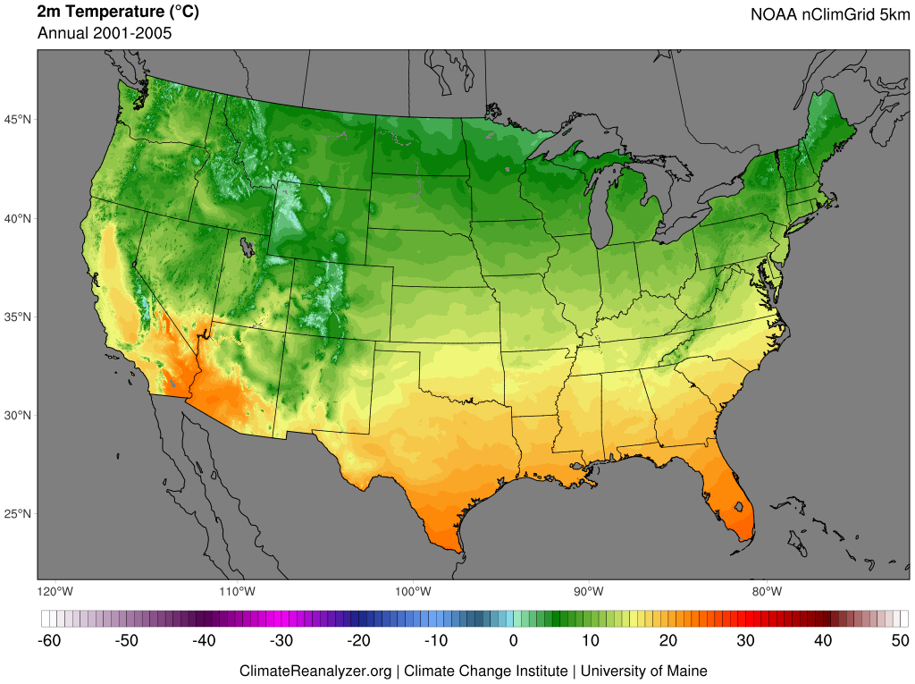
Gridded Data products place point-based or spatially discontinuous observations of Earth's climate (e.g., temperature, precipitation, wind, and sea surface temperature) onto time-registered grids and fill in data gaps using methods of interpolation.
Used for historical/recent analysis.
Surface stations can be used as input to models
Global Historical Climatology Network (GHCN)
NCAR Climate Data Guide

Slide 8
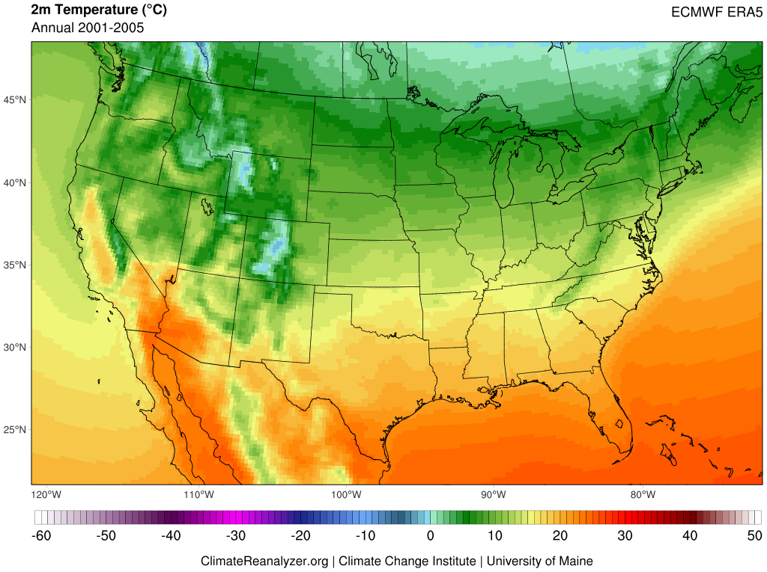
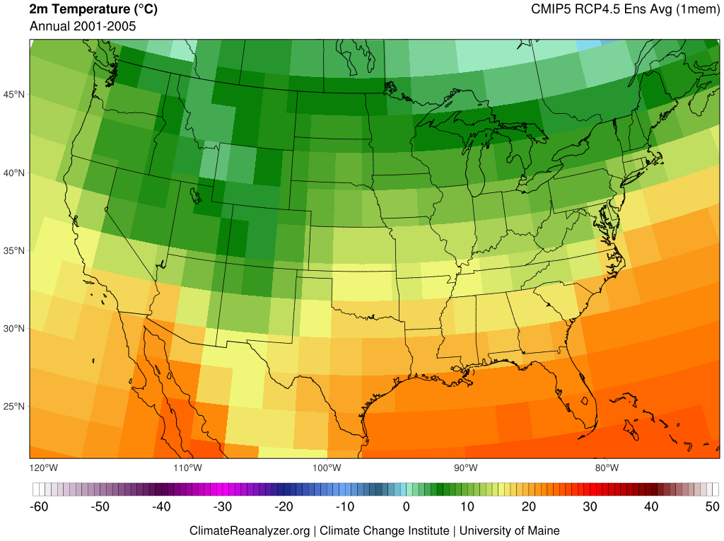
Gridded Data products place point-based or spatially discontinuous observations of Earth's climate (e.g., temperature, precipitation, wind, and sea surface temperature) onto time-registered grids and fill in data gaps using methods of interpolation.
Used for historical/recent analysis.
Reanalysis refers to physically-based numerical frameworks that simulate the state Earth's climate through time, guided by frequent input of real-world observations (e.g., weather stations, radiosonde, satellite, and ocean buoys).
Used for historical/recent analysis.
Similar to weather forecast models.
Climate models afford physically-based simulations of energy and material flows through the atmosphere, ocean, and other parts of the earth system. The most complex of these frameworks are earth system models, where multiple systems are coupled and yield dynamic interactions.
Used for projecting future climate based on changes in natural and anthropogenic forcings.

Slide 9

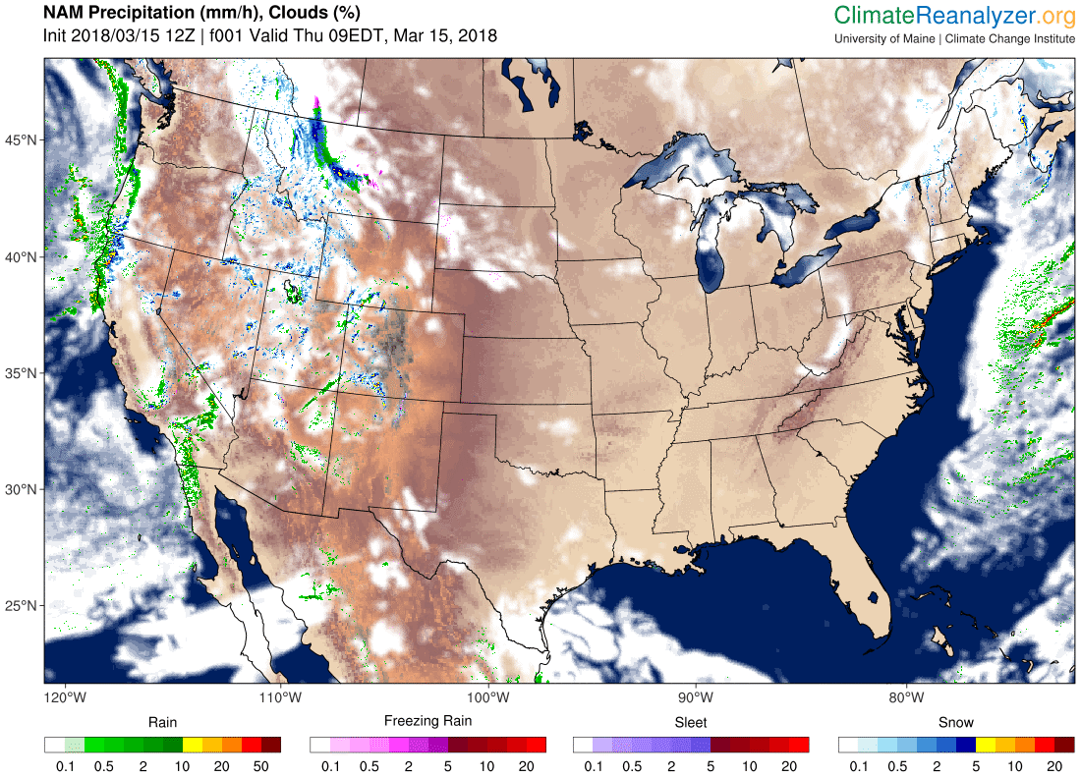
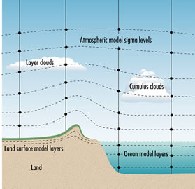
Future climate is projected using physics-based models of the atmosphere, ocean, cryosphere, and biosphere. The model climate can be perturbed by changes in GHG emissions, volcanic activity, solar output, and other factors.
www.bom.gov.au/info/GreenhouseEffectAndClimateChange.pdf

Slide 10
Atmospheric Circulation Features

Slide 11
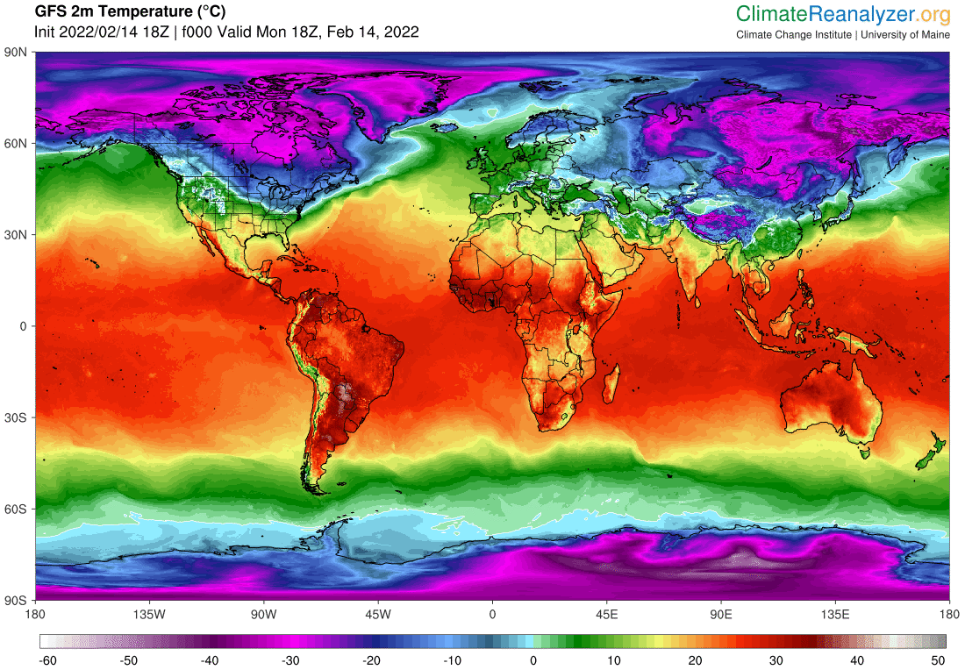
Near-surface Air Temperature
Feb 14–24, 2022
6-hourly time steps
NOAA/NCEP
Global Forecast System

Slide 12
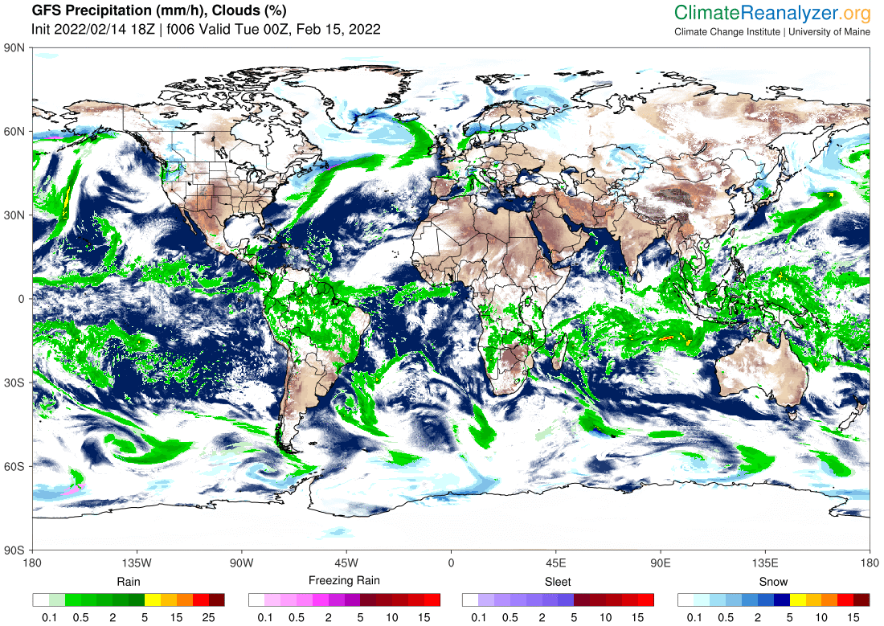
Westerlies
Intertropical Convergence Zone (ITCZ)
Westerlies

Slide 13
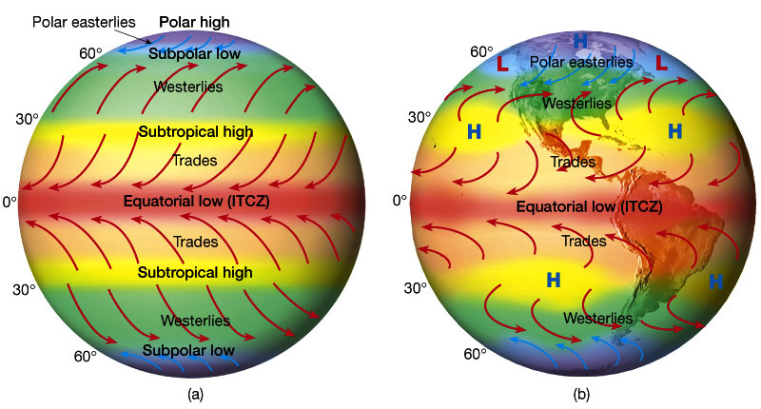
Atmospheric Circulation
Idealized winds from pressure gradient and Coriolis force.
Wind patterns due to distribution of land masses.
Figures 7.7 and 7.9 in The Atmosphere, 8th edition, Lutgens and Tarbuck, 8th edition, 2001
Downloaded from https://www.ux1.eiu.edu/~jpstimac/1400/circulation.html

Slide 14
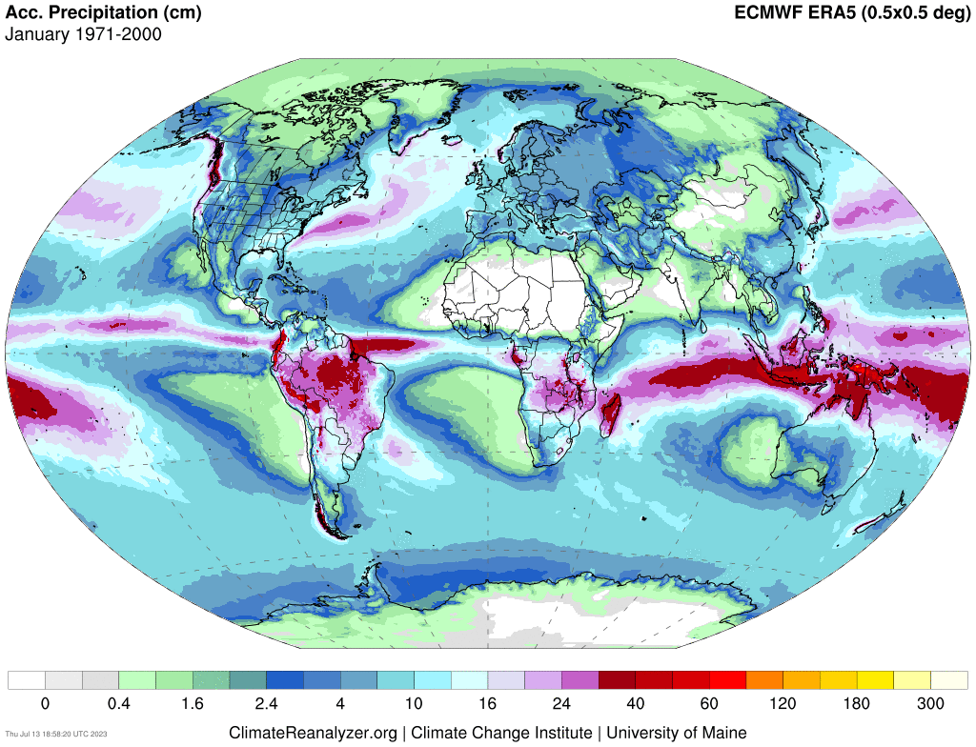

Slide 15
Arctic Sea Ice & Warming

Slide 16
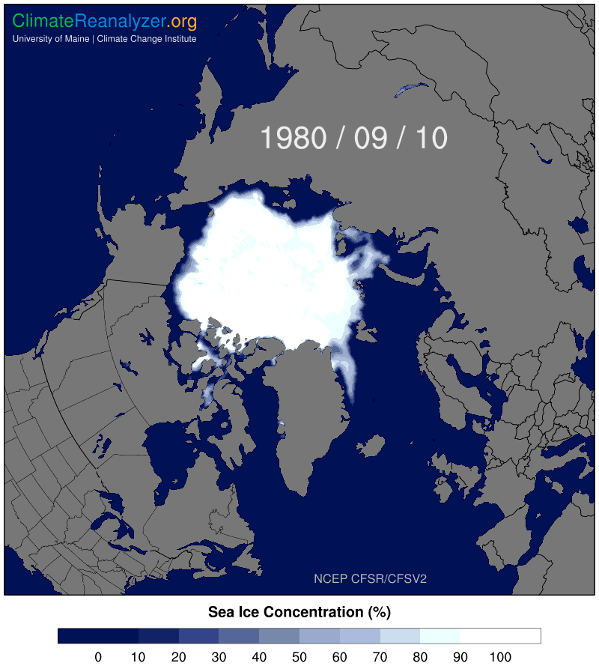
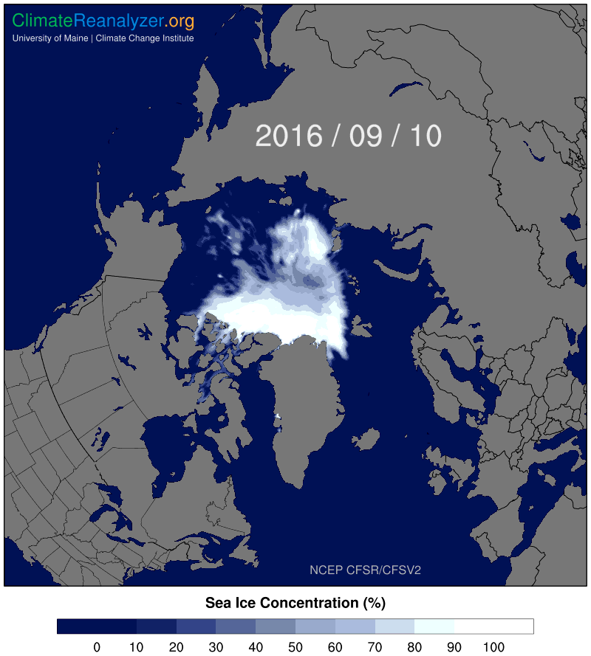

Slide 17
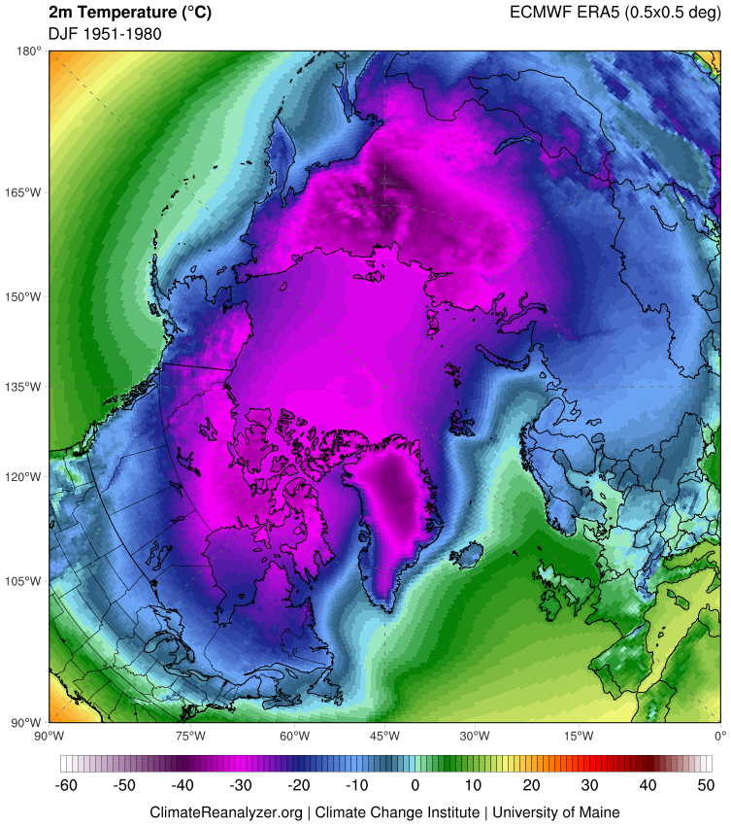
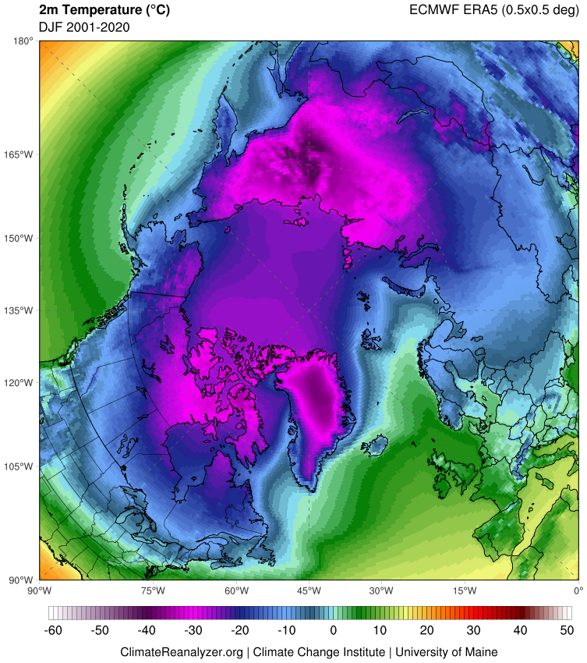
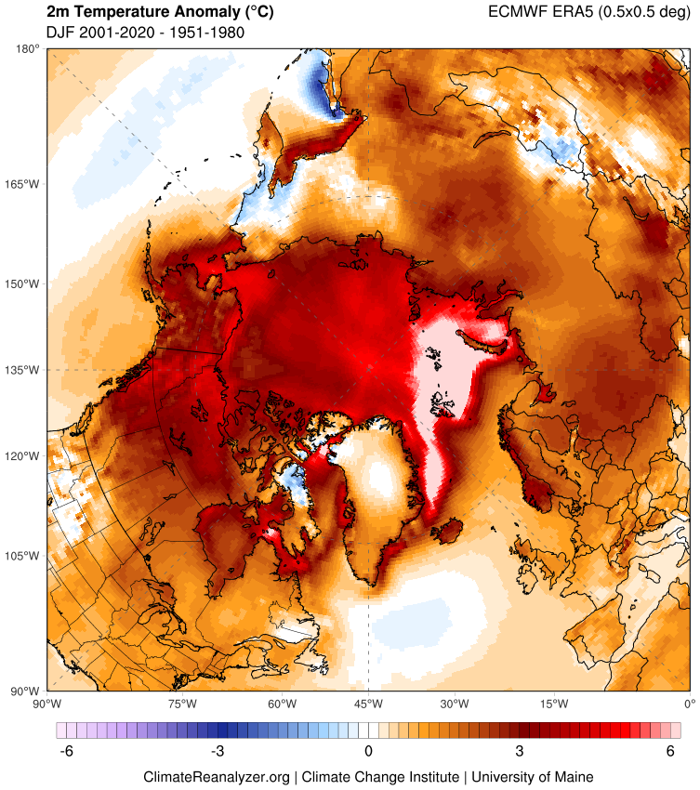
DJF 1951–1980
DJF 2001–2020
Difference

Slide 18
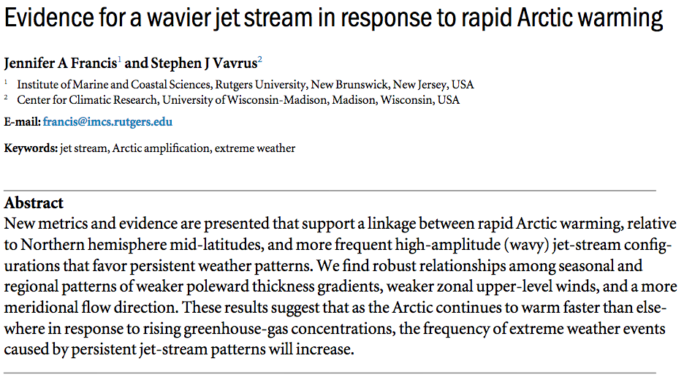
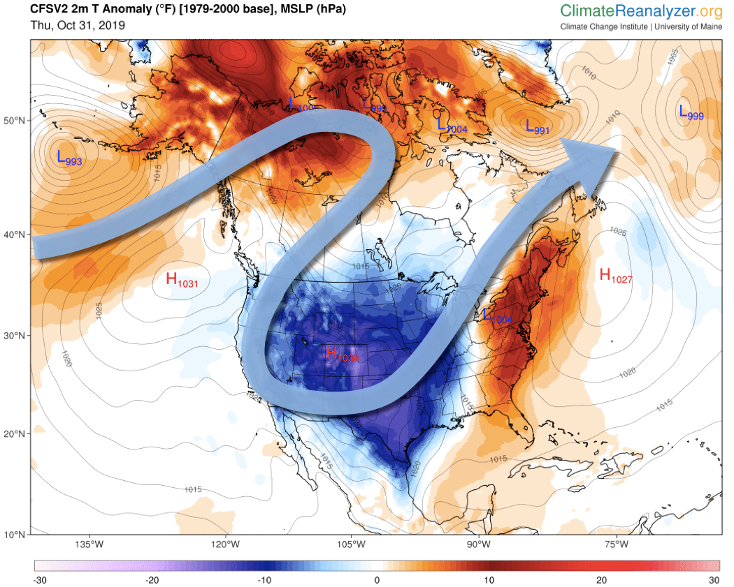
Francis and Vavrus, 2014
Temperature anomaly and Jetstream
Wind Storm
Nov 1, 2019

Slide 19
Climate Variability

Slide 20
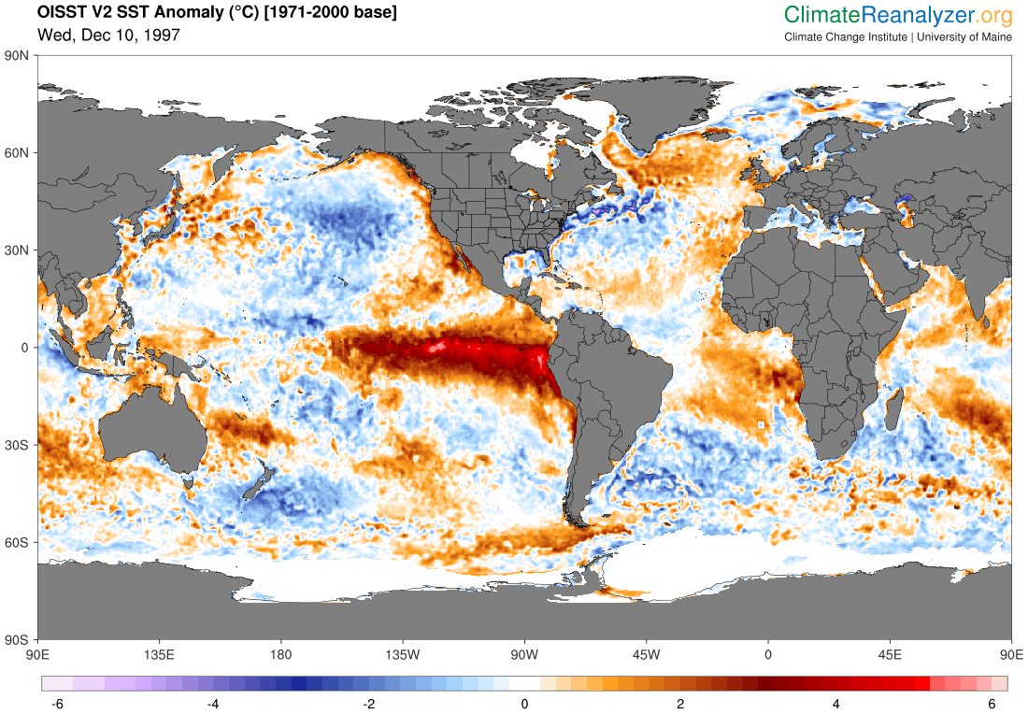
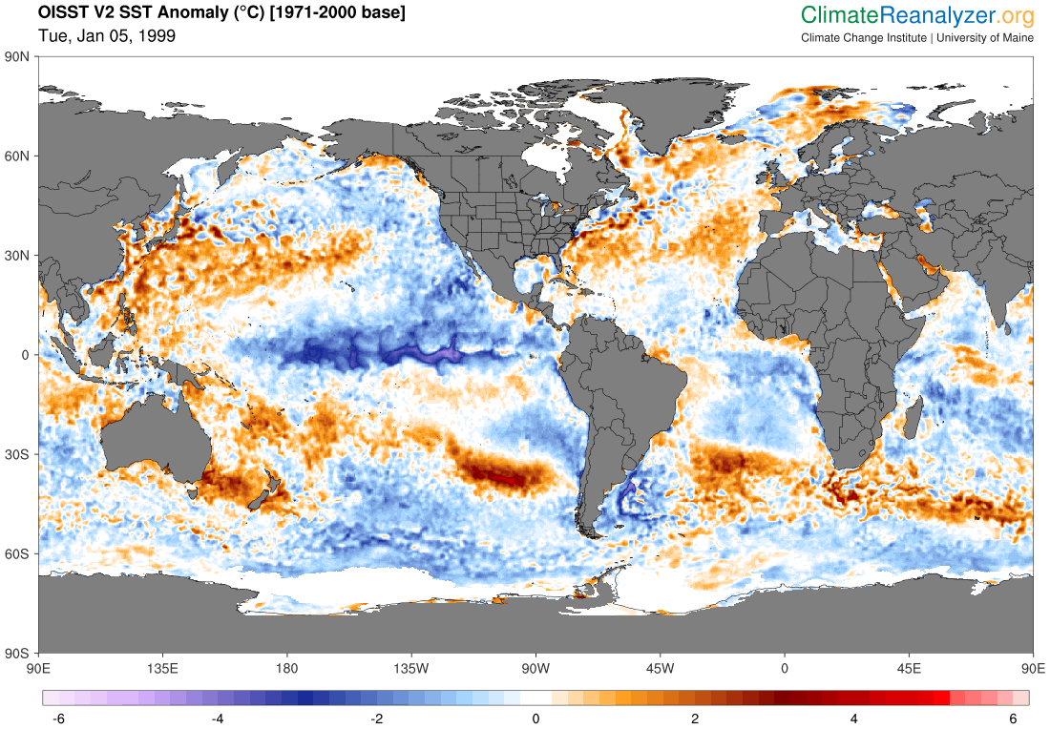
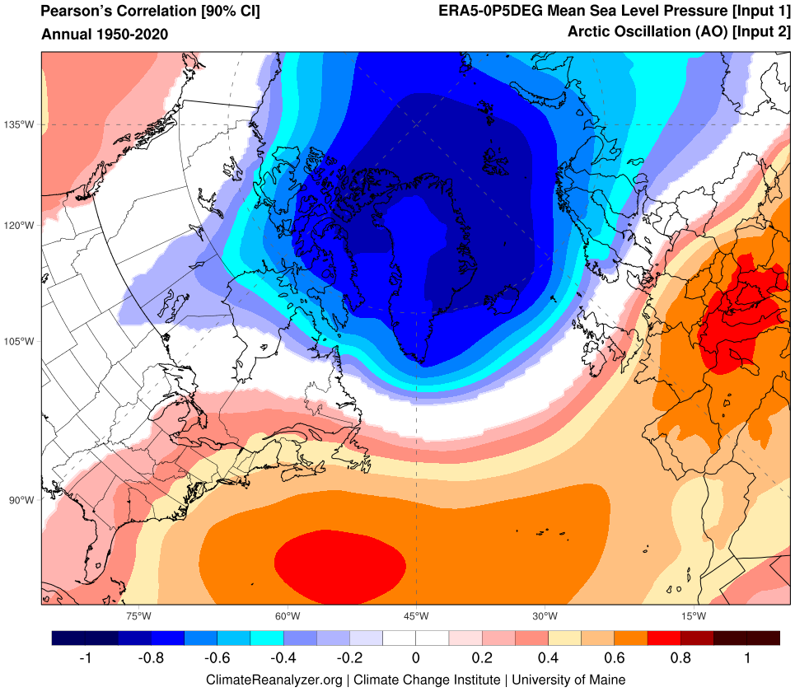
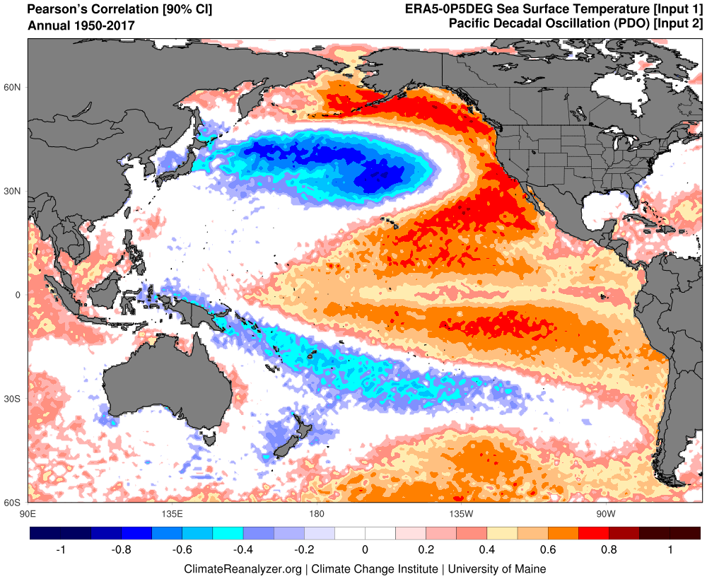
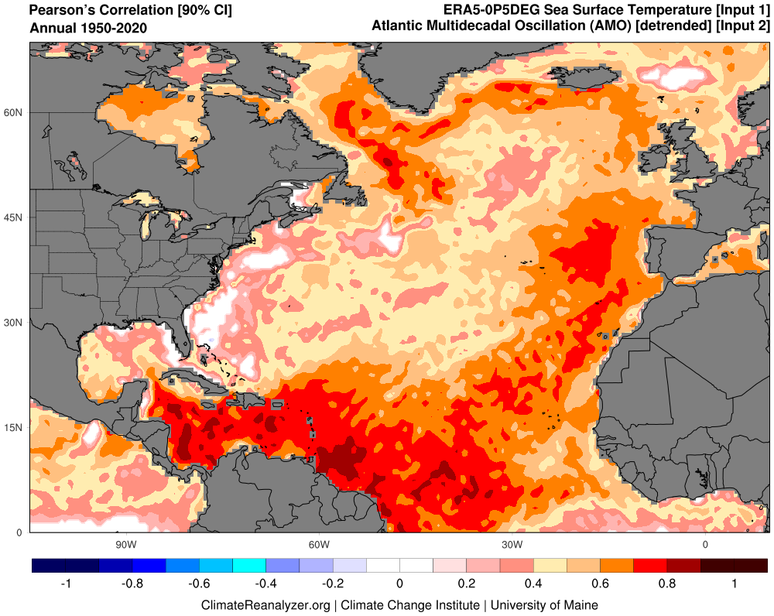
El Niño-Southern Oscillation (ENSO)
North Atlantic Oscillation (NAO)
Pacific Decadal Oscillation (PDO)
Atlantic Multidecadal Variability (AMV)

Slide 21
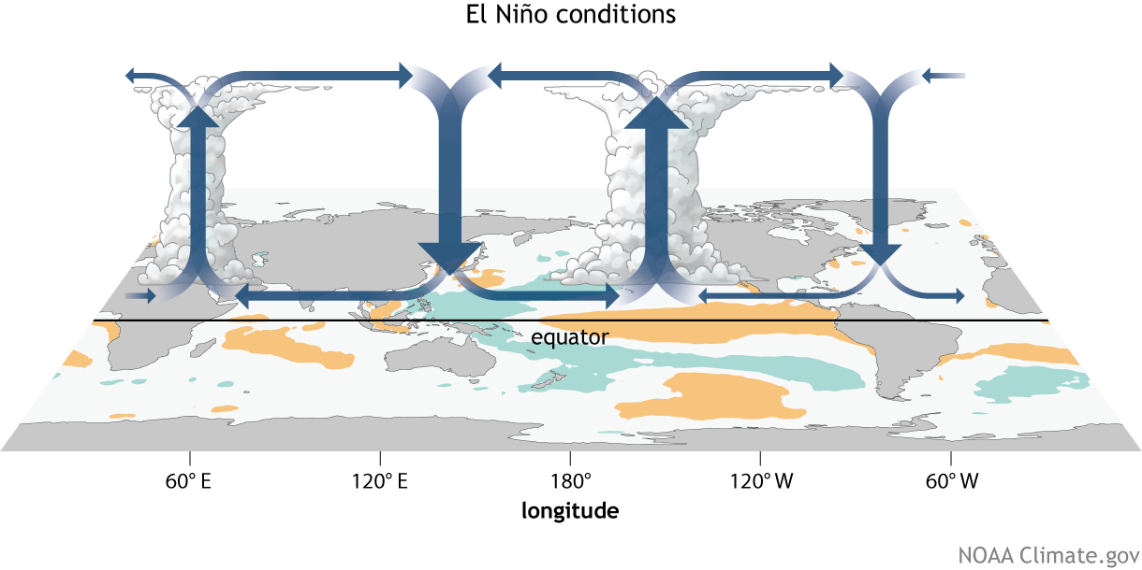
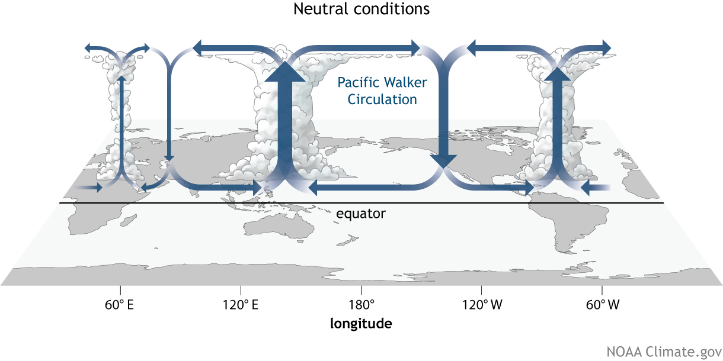
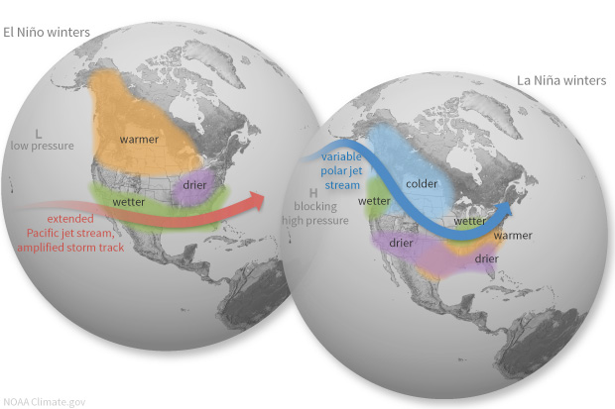
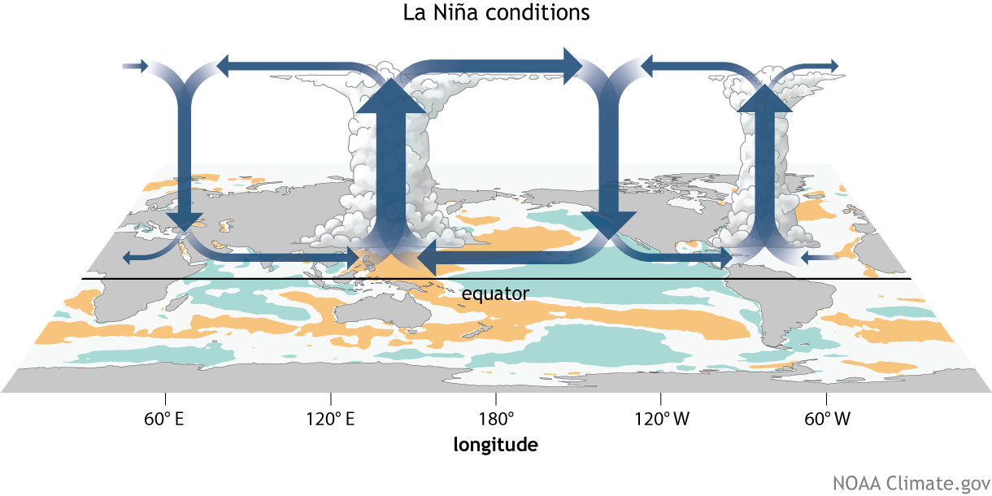
El Niño-Southern Oscillation (ENSO)
Coupled ocean-atmosphere response with irregular period of 2–7 years between El Niño (warm) and La Niña (cool) phases.
ENSO impacts weather worldwide, particularly during boreal winter.
Atmospheric response known as Walker circulation.
https://www.climate.gov/enso

Slide 22
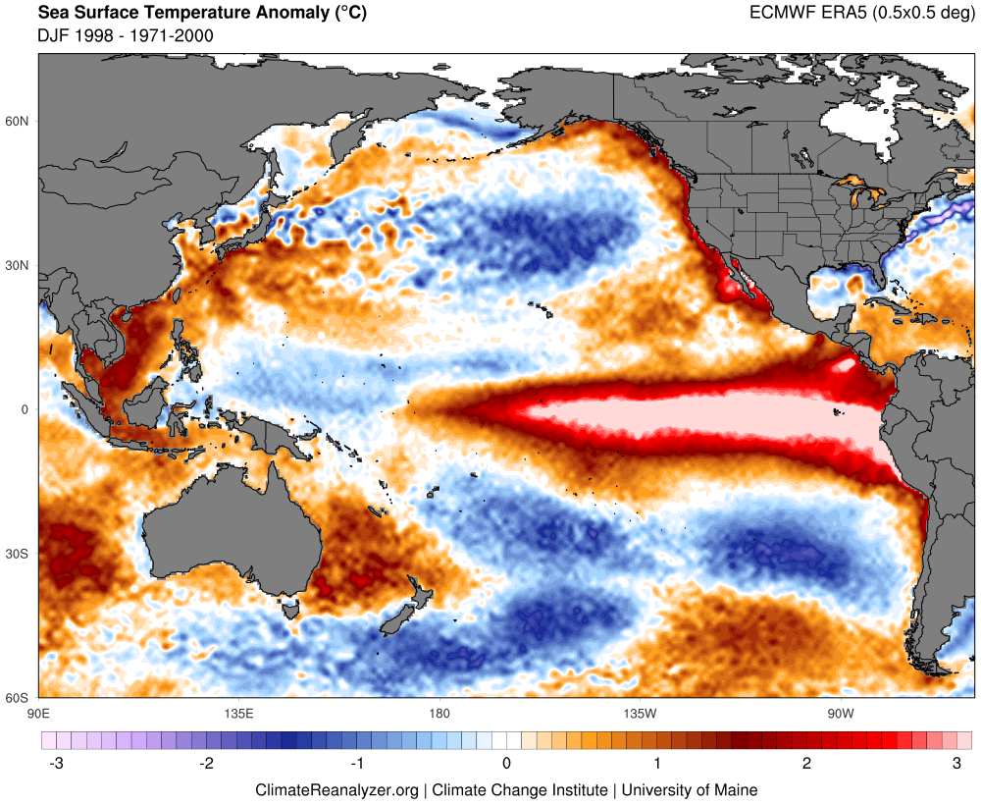
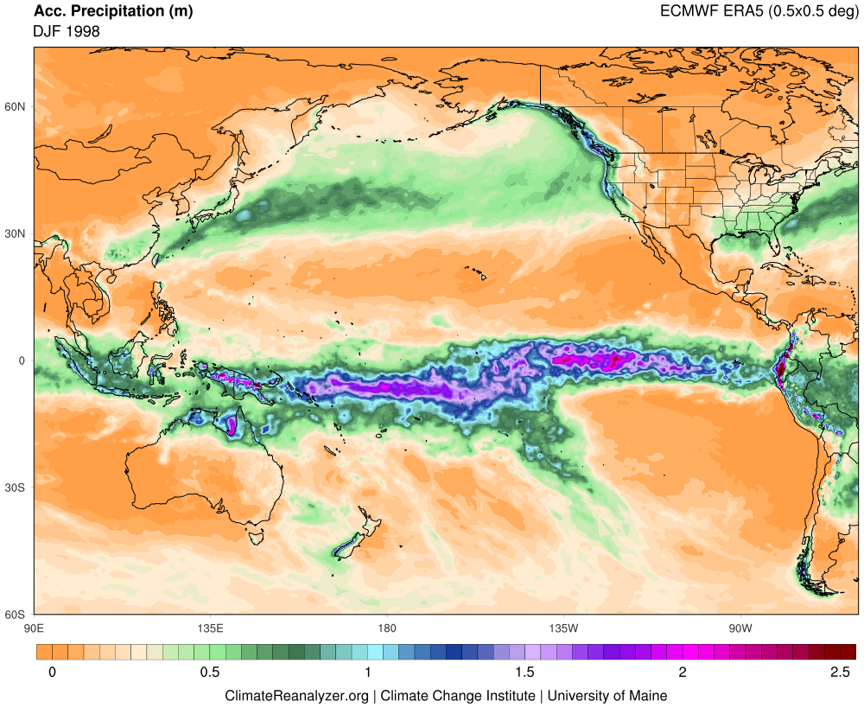
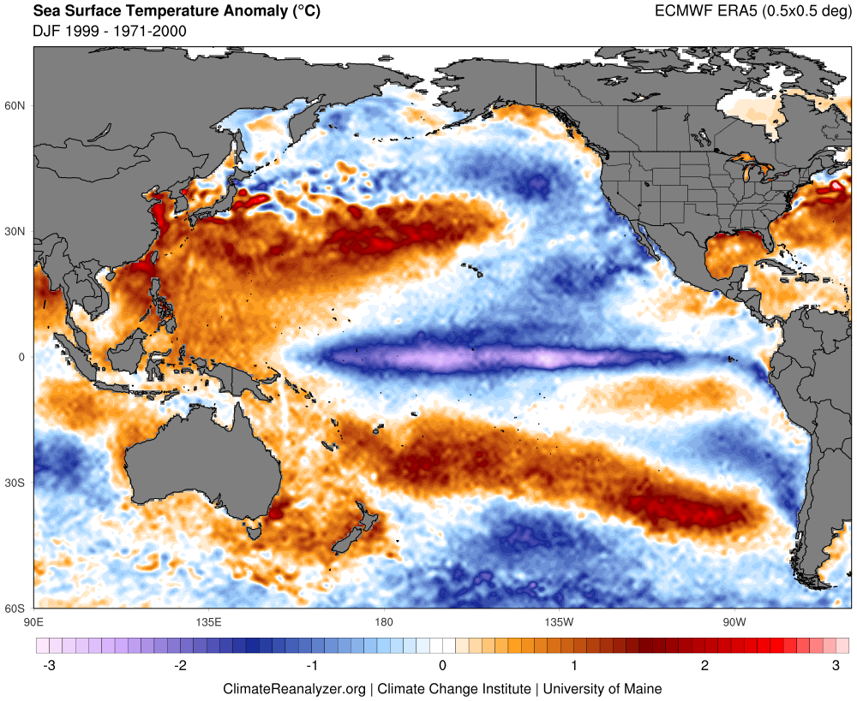
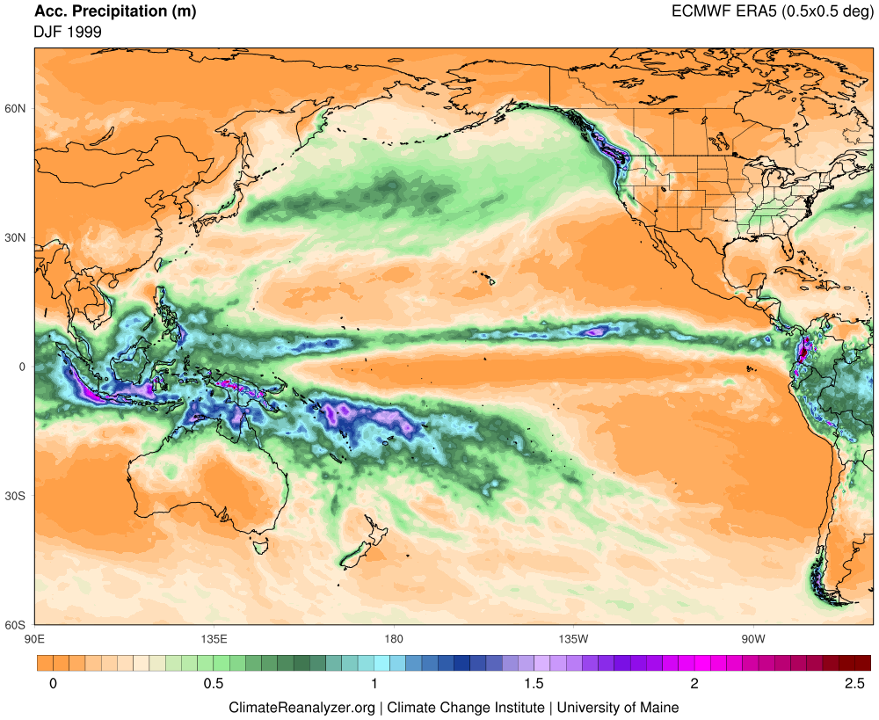
SST Anomaly
Precipitation
DJF 1998 El Niño
DJF 1999 La Niña

Slide 23
https://ClimateReanalyzer.org

Slide 25
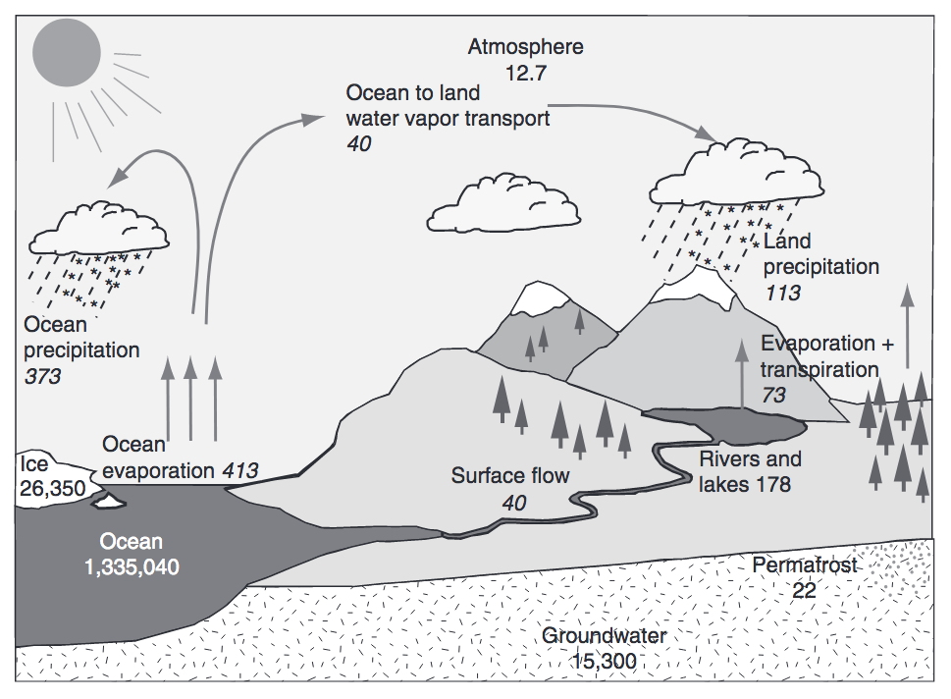
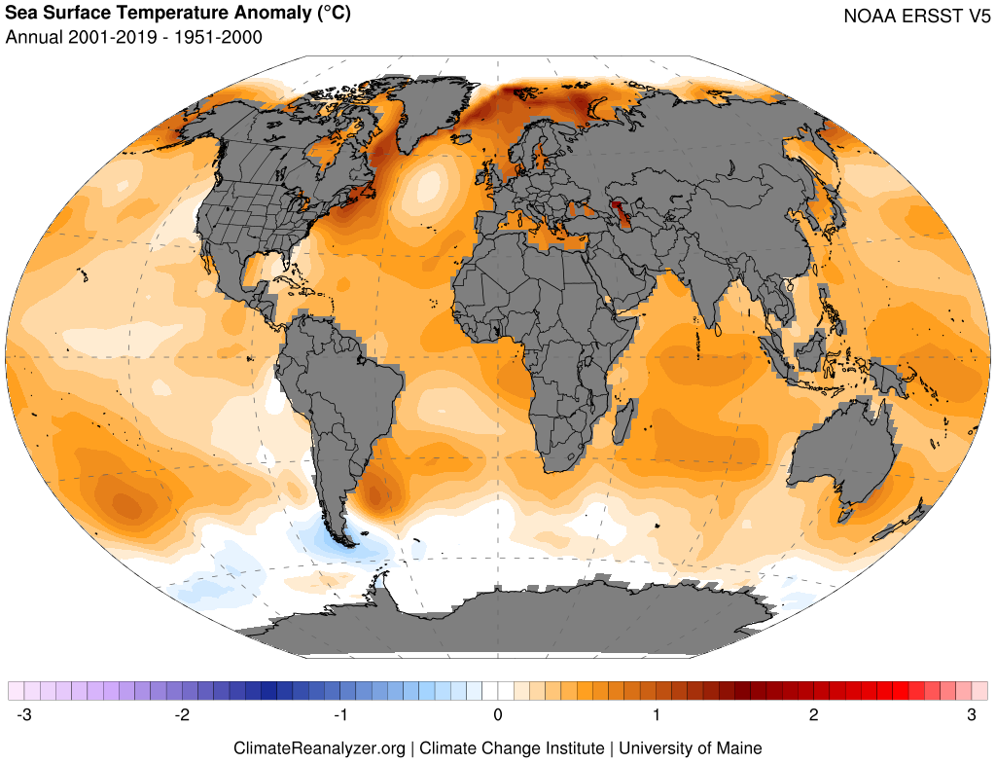
Warming Oceans, Water Vapor Feedback, and Intensifying Hydrologic Cycle
Trenberth et al. (2007), Huntington (2010)
Warming drives increased evaporation, atmospheric water-vapor content, and potential for greater extremes (e.g., heavy precipitation, drought)

Slide 26
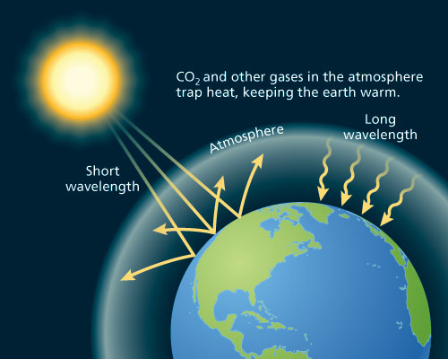
The Greenhouse Effect
http://www.oxfordpresents.com/ms/krohne/global-warming-and-ecological-communities/

