Slide 1



Climate Change in Maine /
Year of Extremes, 2023
Maine Conservation Voters February 2nd, 2024
Sean Birkel
Assistant Professor & Maine State Climatologist
Climate Change Institute
Cooperative Extension
University of Maine

Slide 2

Presentation Outline
Overview of climate change in Maine
Year of Extremes, 2023
Very warm and wet in Maine
Record warmth worldwide
December 18th, 2023 Southeaster
But on a brighter note…

Slide 3
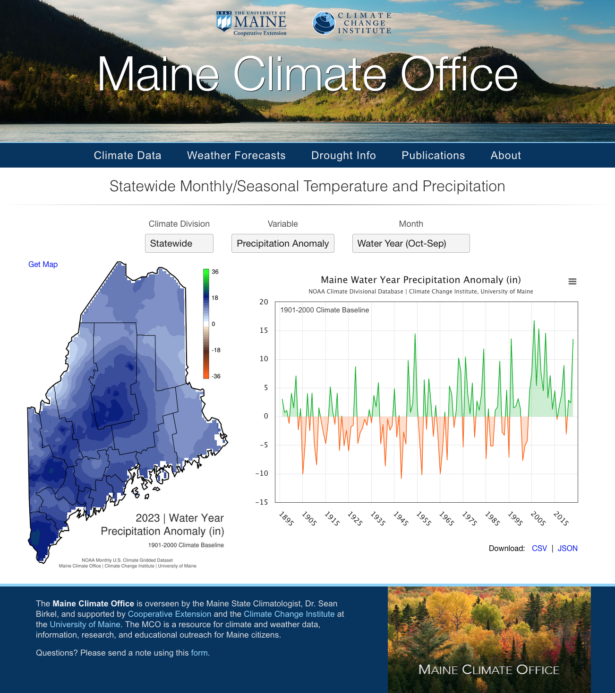
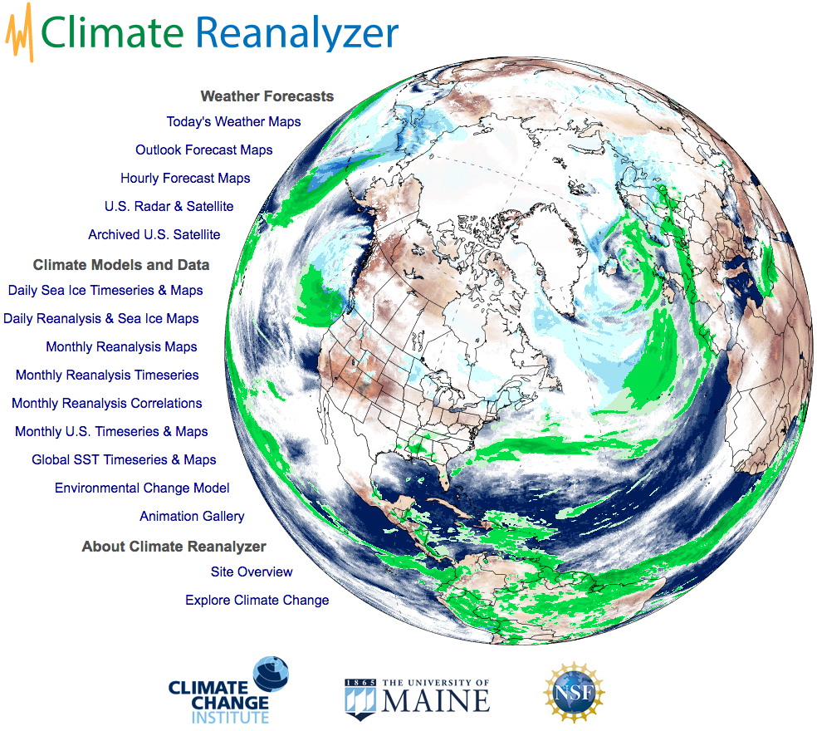
https://ClimateReanalyzer.org
https://mco.umaine.edu

Slide 4
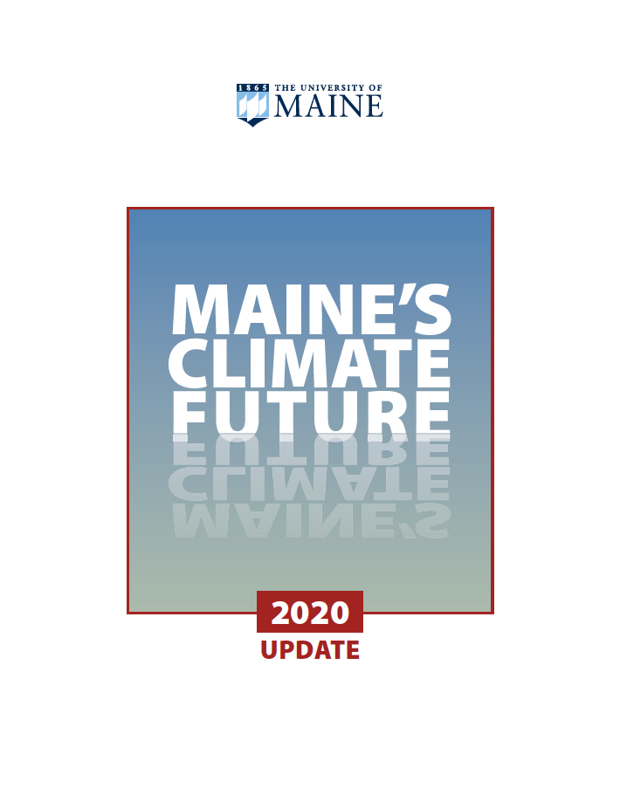
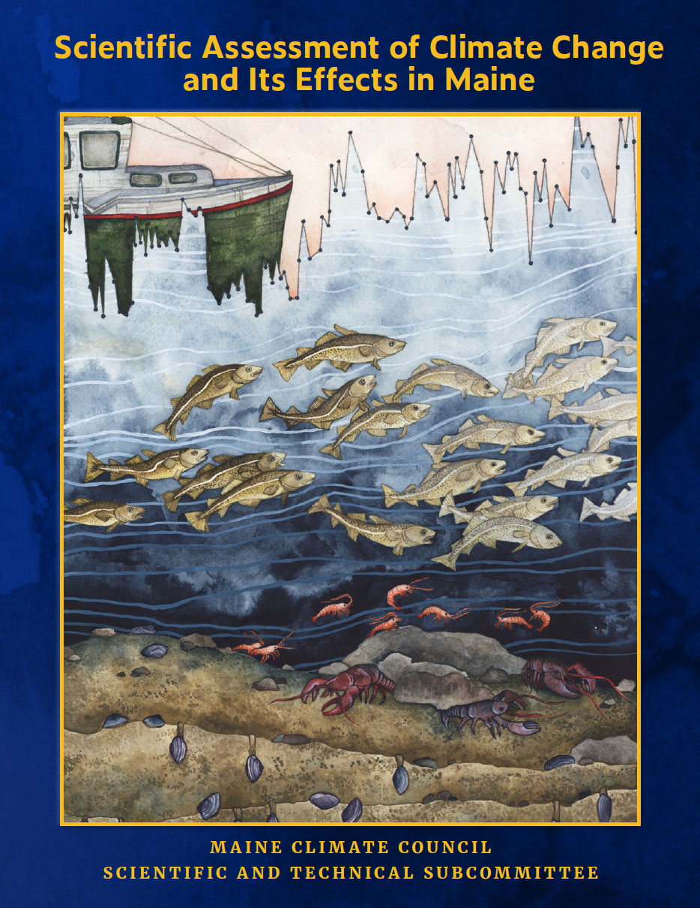
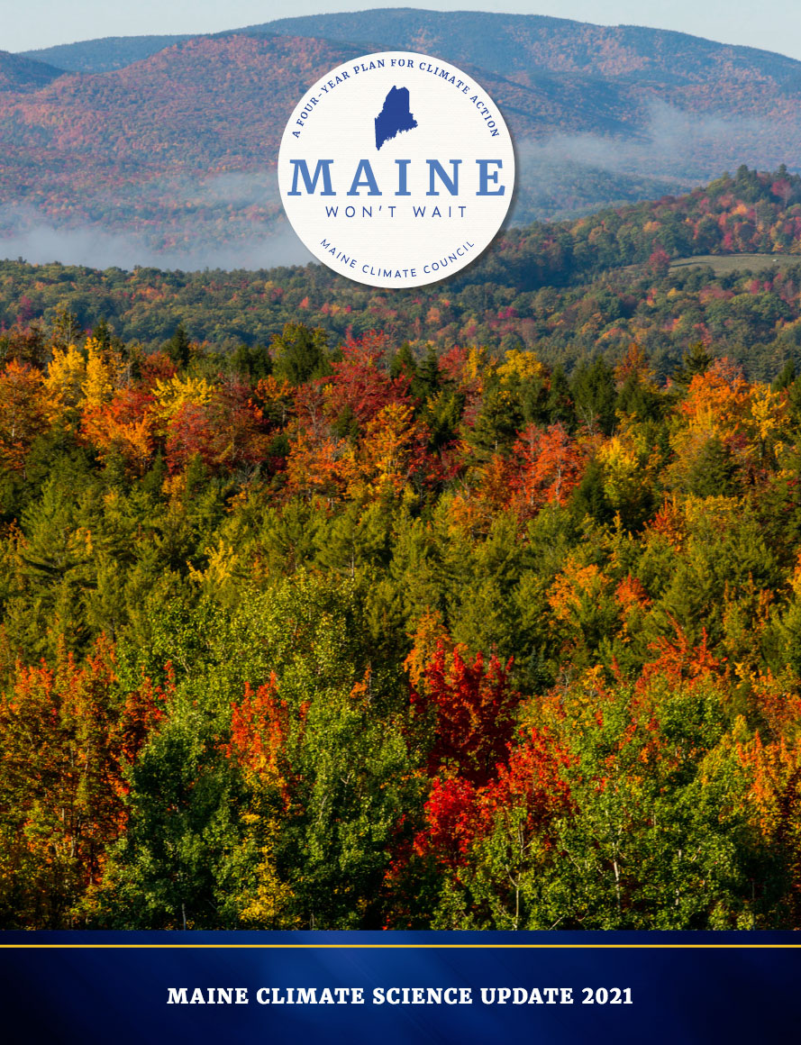



Slide 5
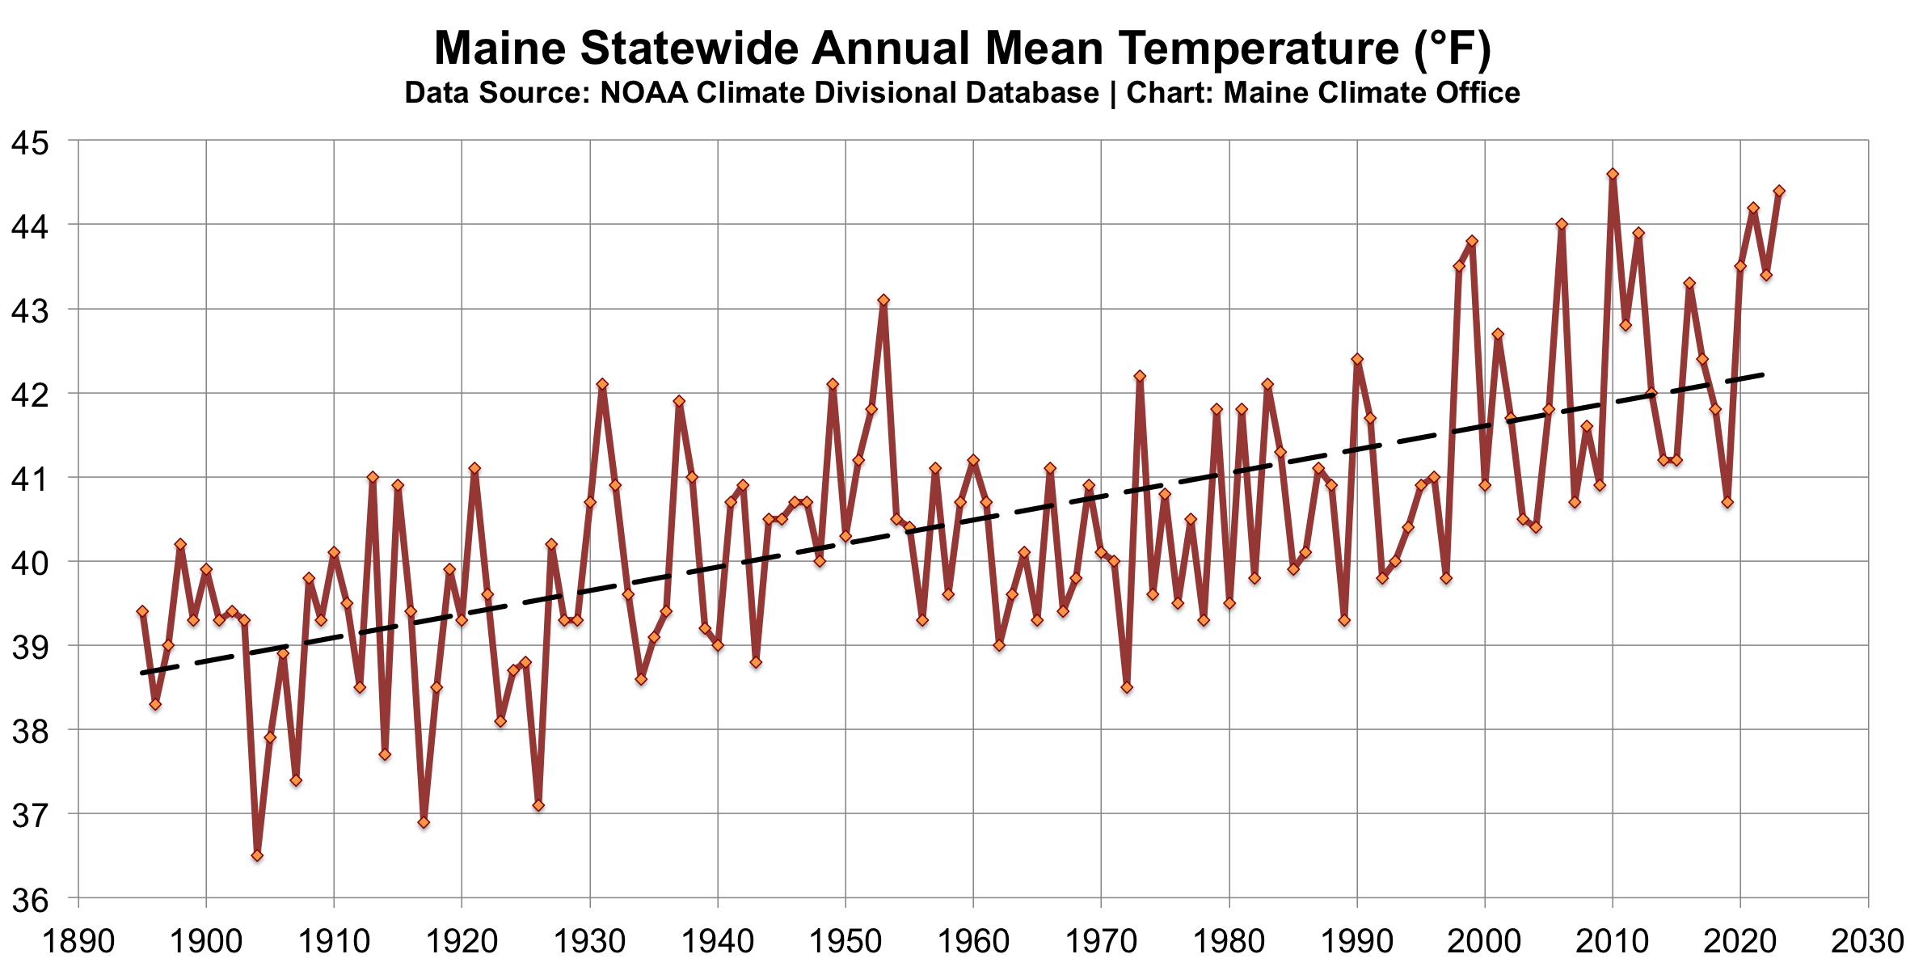
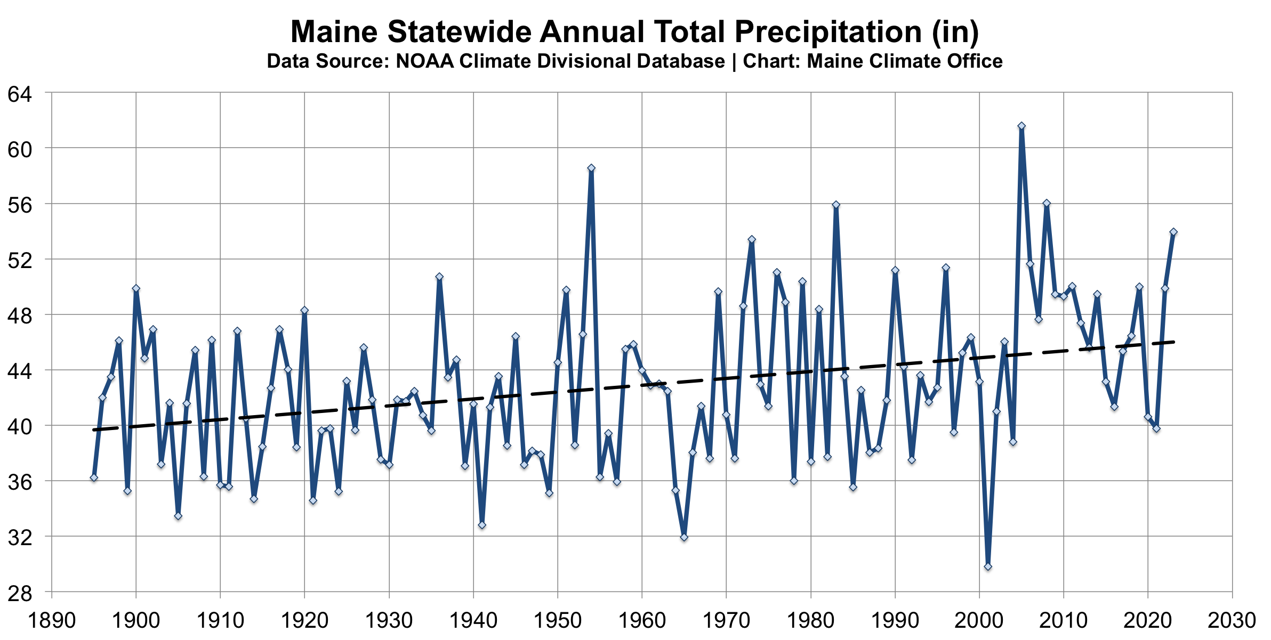
Temperature
Annual increase of about 3°F since 1895
Overnight lows have risen more than daytime highs
The 10 warmest years have occurred since 1998
Precipitation
Annual increase of about 6” since 1895
Heavy precipitation > 2” per day has become more common
Projected 5-14% annual rainfall increase by 2100 and more frequent extremes

Slide 6
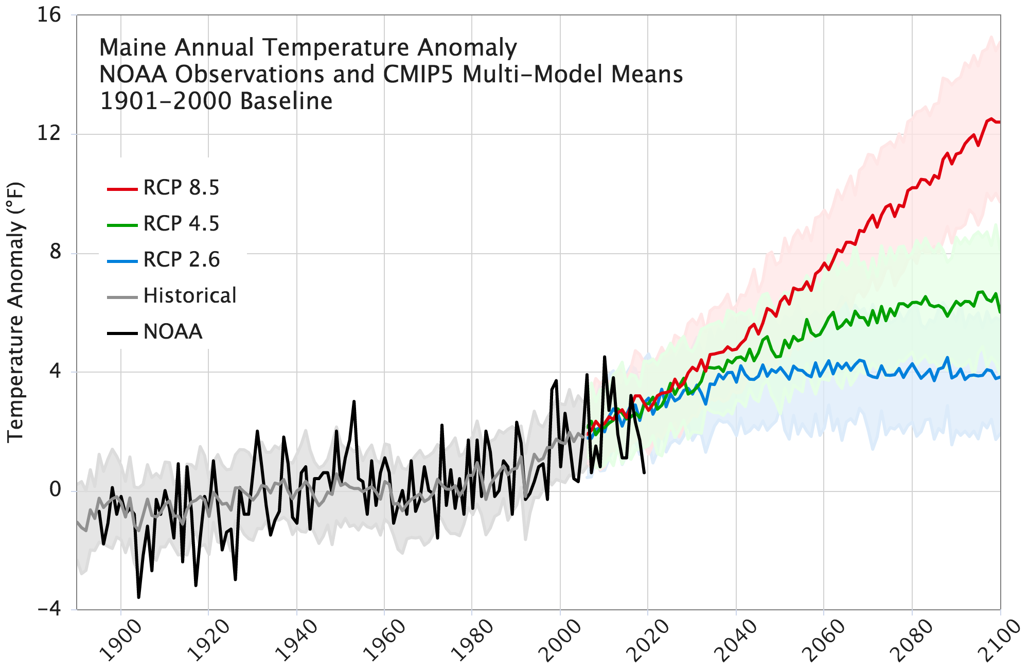
Warming of 2-10°F by 2100 depending on future scenario
High GHG Emissions
Low GHG Emissions
Maine’s Climate Future 2020 Update
Maine Climate Council STS Report, 2020

Slide 7
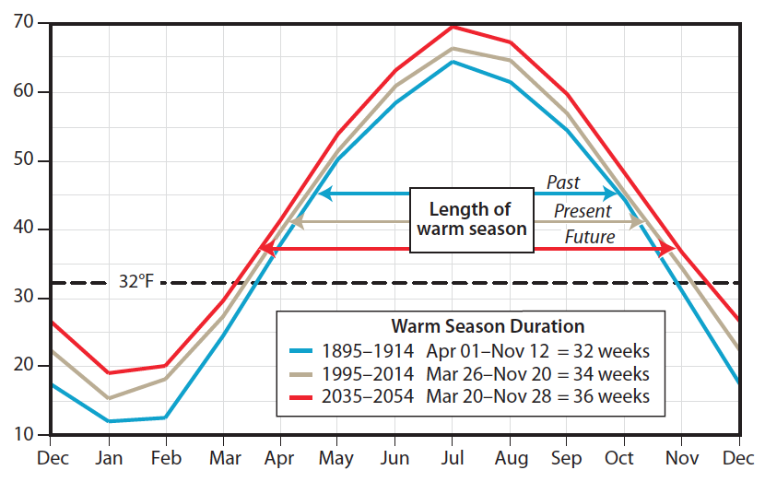
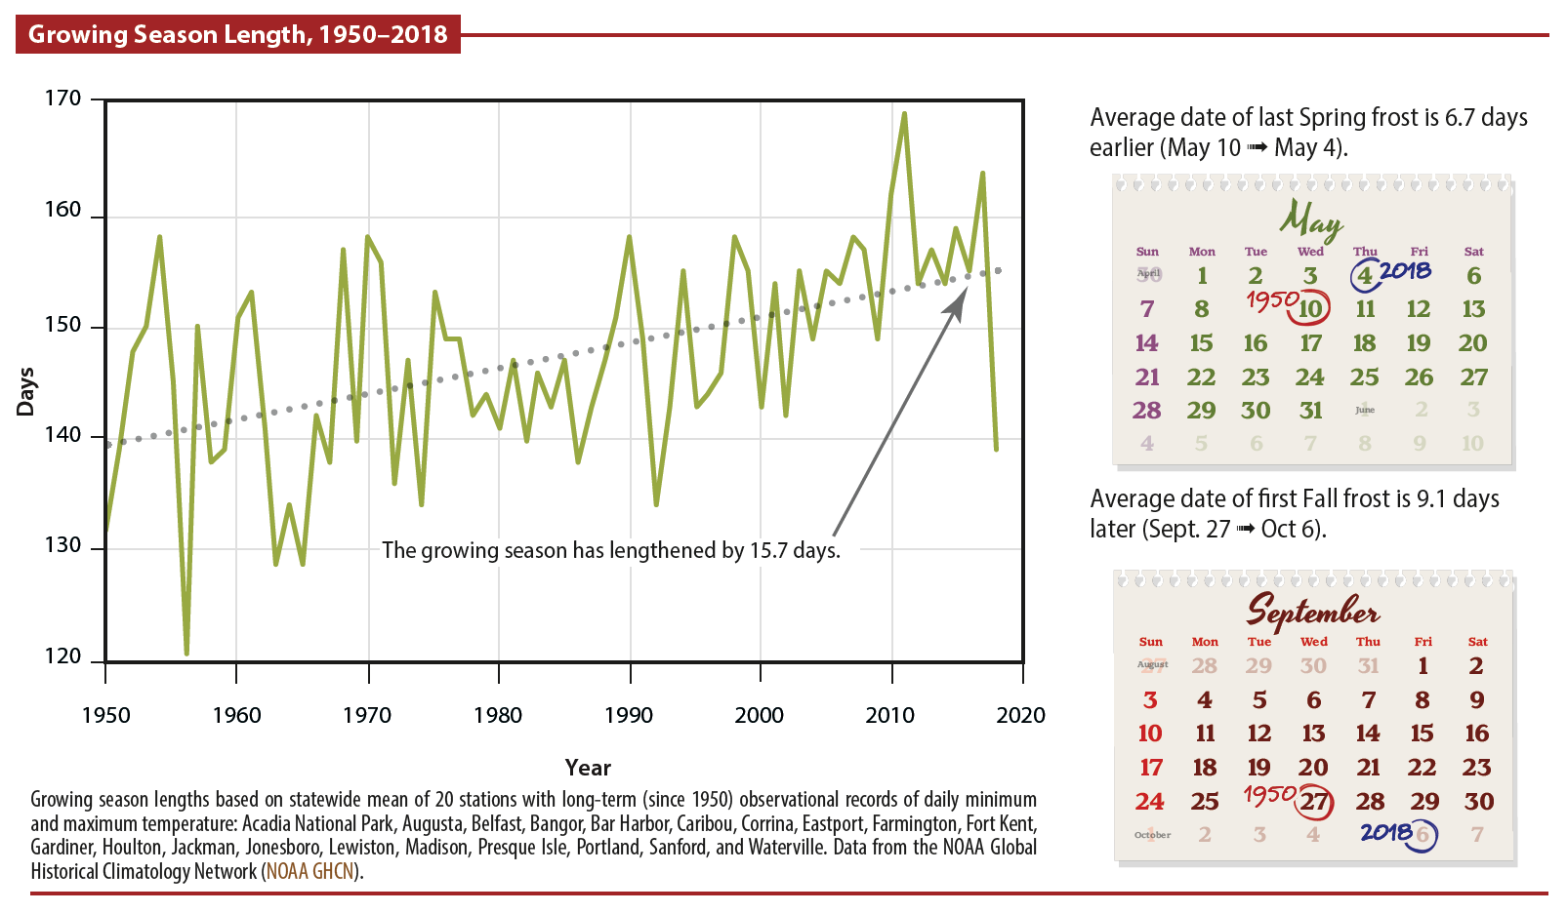
Season Lengths are Changing
Statewide Mean Annual Temperature (°F)
MCF 2015 Update
The warm season has increased and snow season has decreased by about 2 weeks over the past century.
Since 1950, the growing season has lengthened by ~16 days (Fernandez, 2020).
Summer weather and growing season extension mostly into fall.
Trends projected to continue, but some years will bring unexpected late spring or early fall frosts.
MCF 2020 Update

Slide 8
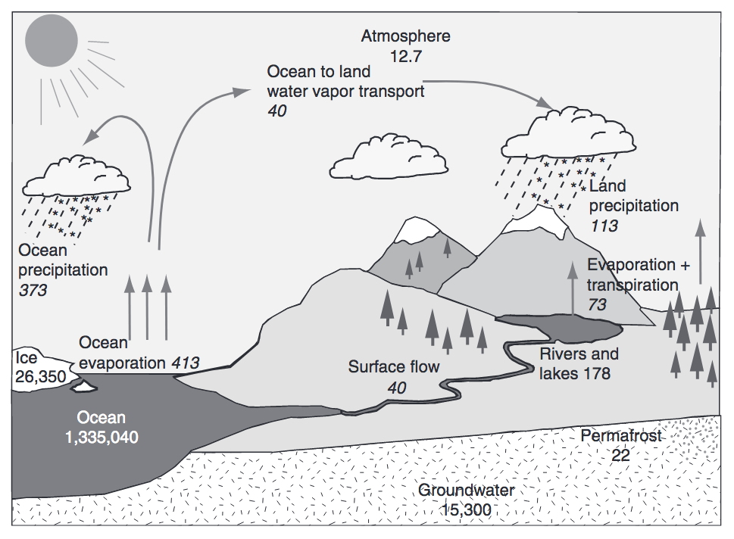
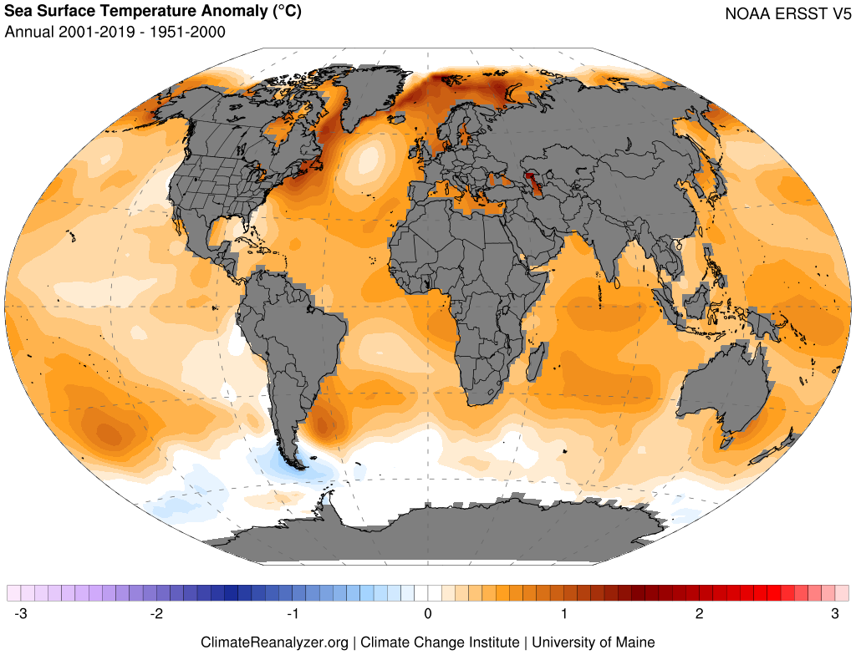
Warming Oceans and an Intensifying Hydrologic Cycle
Trenberth et al. (2007), Huntington (2010)
Warming drives increased evaporation, atmospheric water-vapor content, and changes in circulation that lead to greater potential for wet and dry extremes.

Slide 9
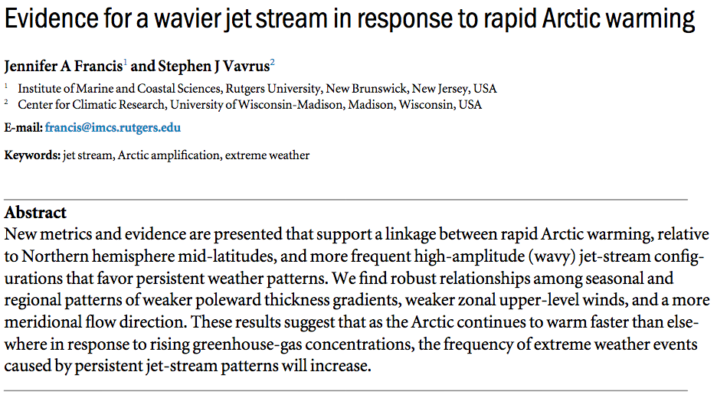
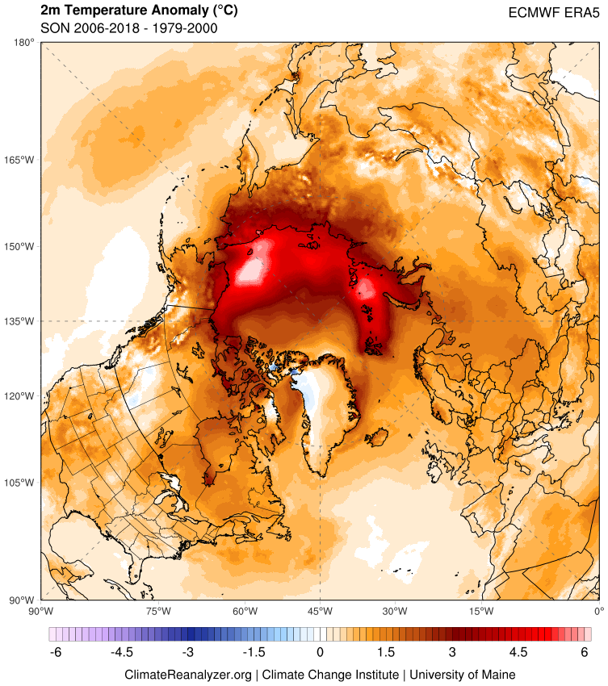
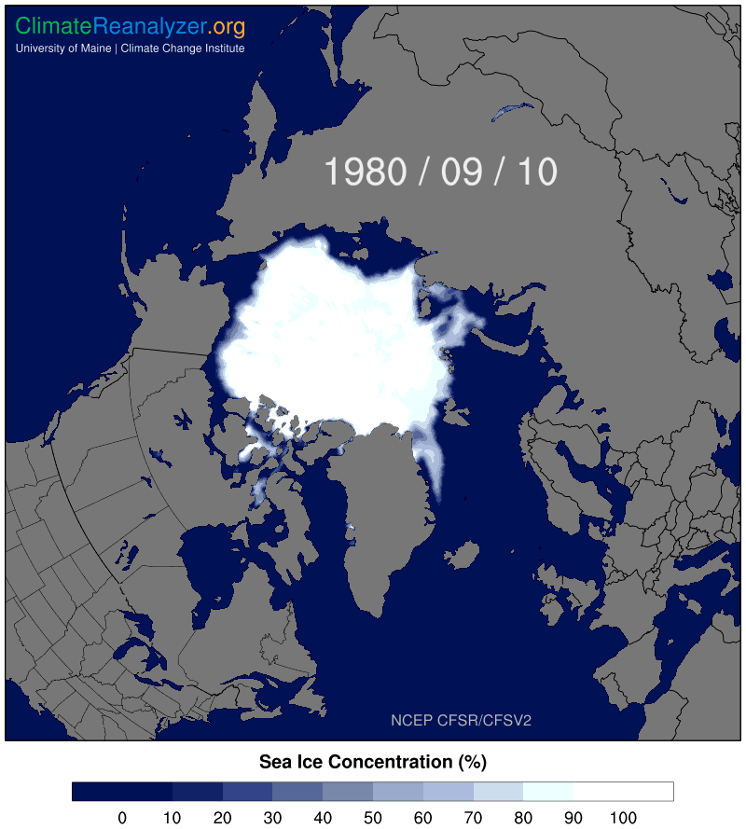
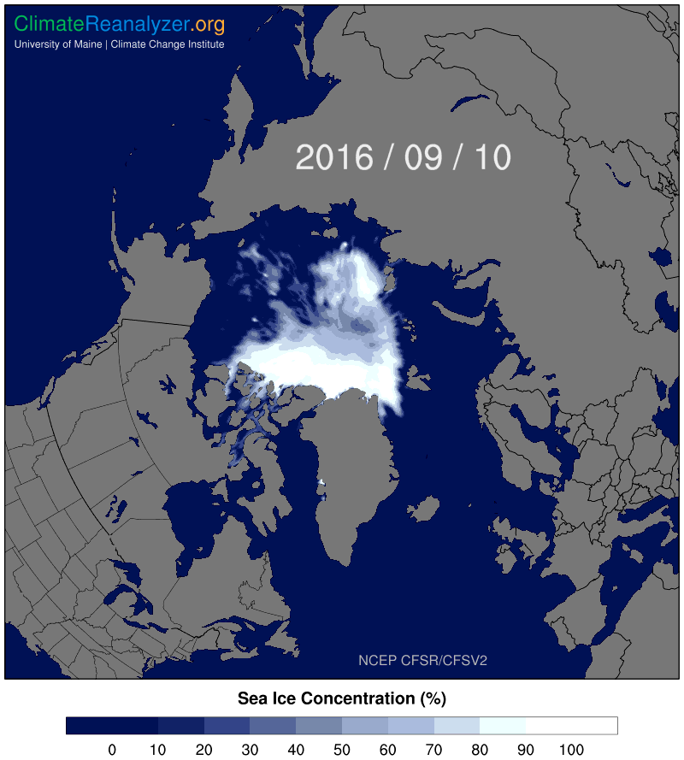
Arctic Amplification

Slide 10

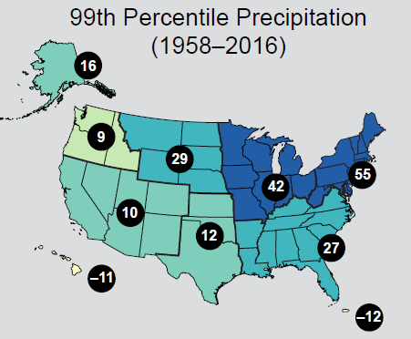
Extreme Weather
Extreme weather is becoming more common around the N. Hemisphere due to changes in atmospheric circulation.
Increased likelihood of heat/cold waves, intense storms.
Large increases (55%) in annual heavy daily precipitation across the USNE.
In Maine, the last 10-15 years have seen the highest occurrence of 2”, 3”, and 4” precipitation events.
Easterling et al., 2017

Slide 11
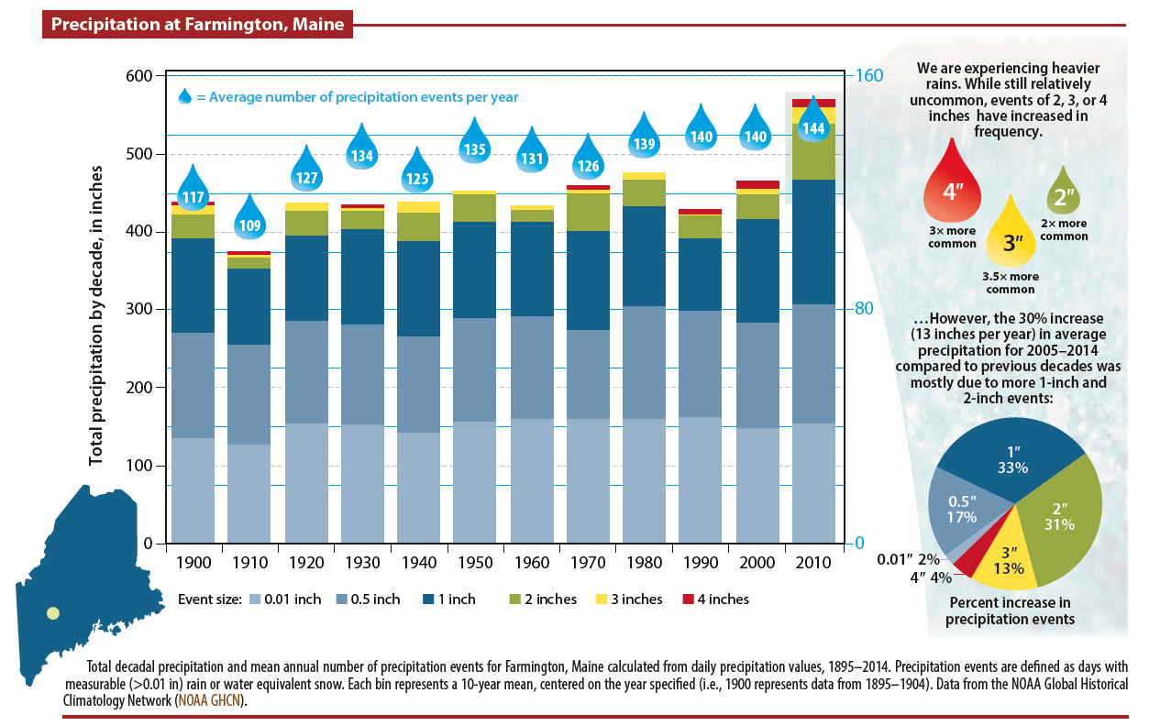
Maine’s Climate Future 2020 Update

Slide 12
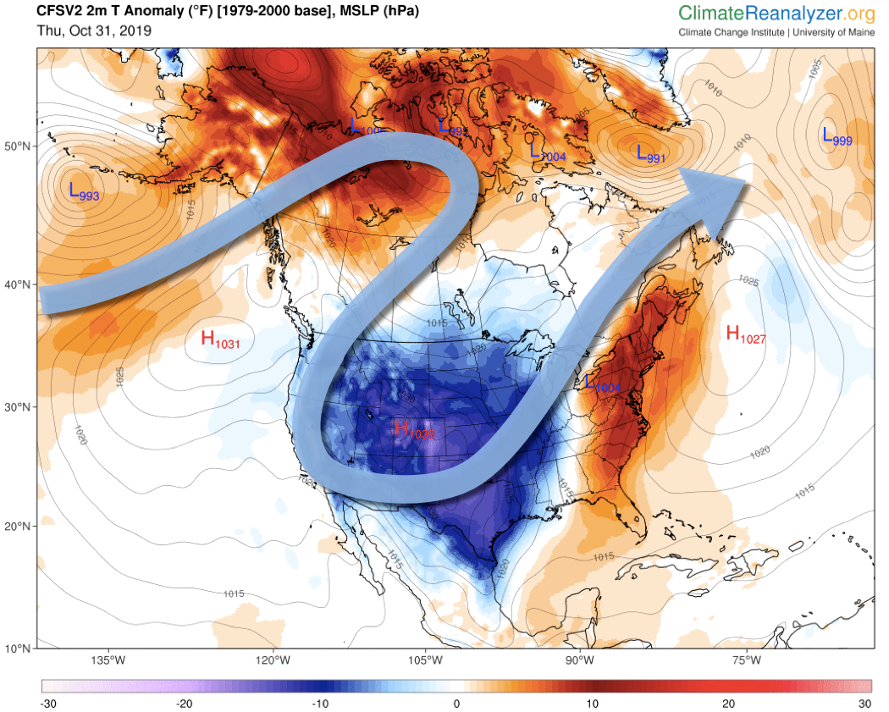
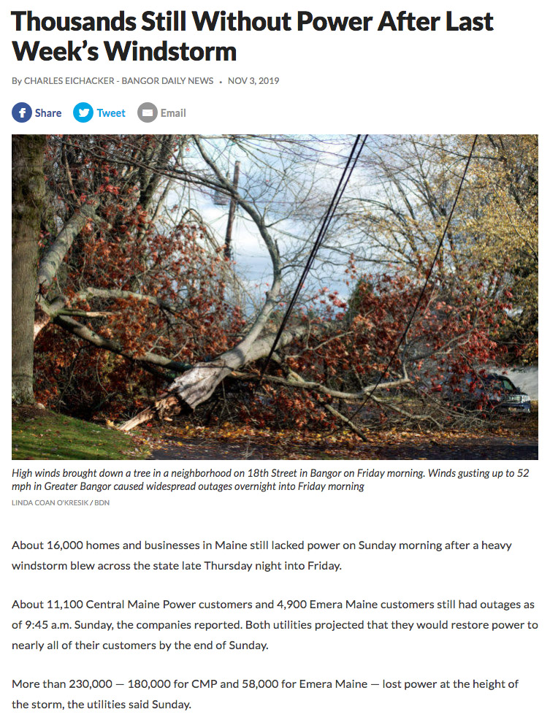
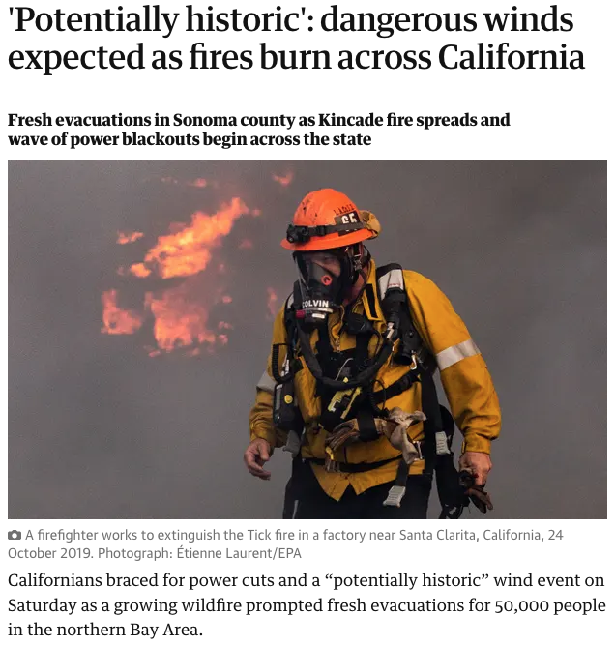
Connecting Extremes via the Jetstream
Late October /
Early November
2019
The Guardian 10/26/2019

Slide 13
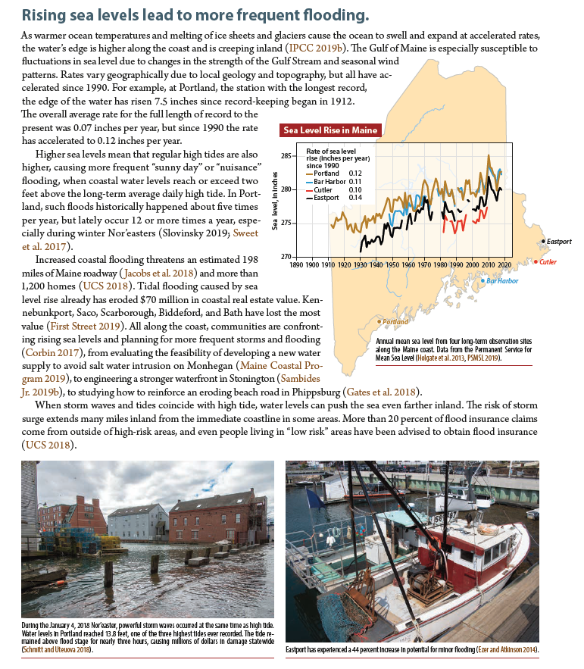
Sea Level Rise
Sea level has risen about 7.5 inches along the Maine coast over the past century.
High tide “nuisance” flooding becoming more common in some places.
Increased coastal erosion.
Changes to coastal habitats, namely salt marshes.
Concerns about salt-water intrusion in drinking water supplies.
Maine’s Climate Future 2020 Update Fernandez et al. (2020)

Slide 14
Year of Extremes, 2023

Slide 15
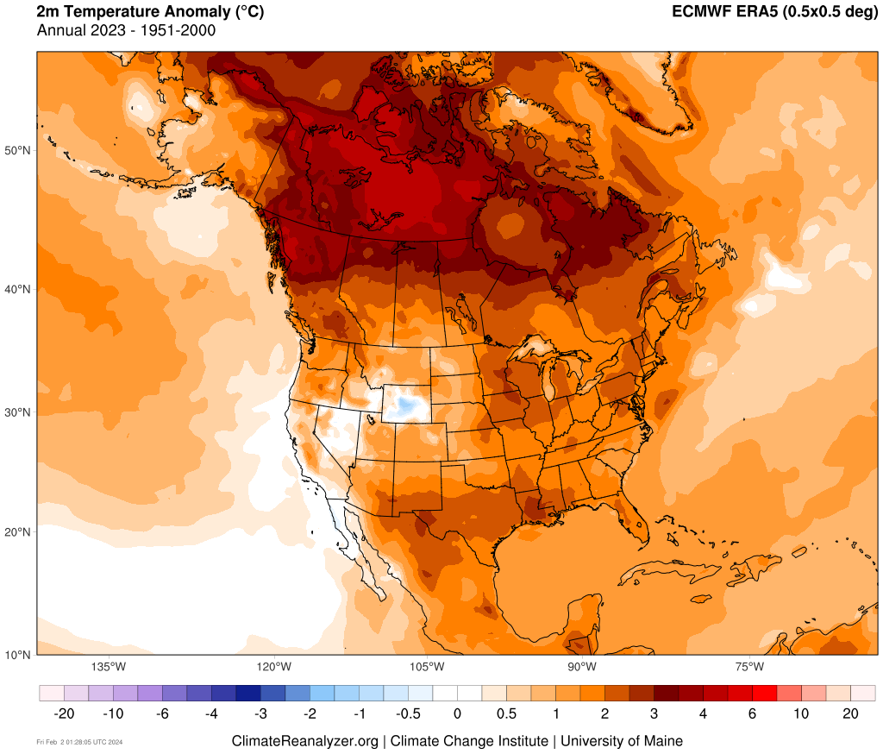
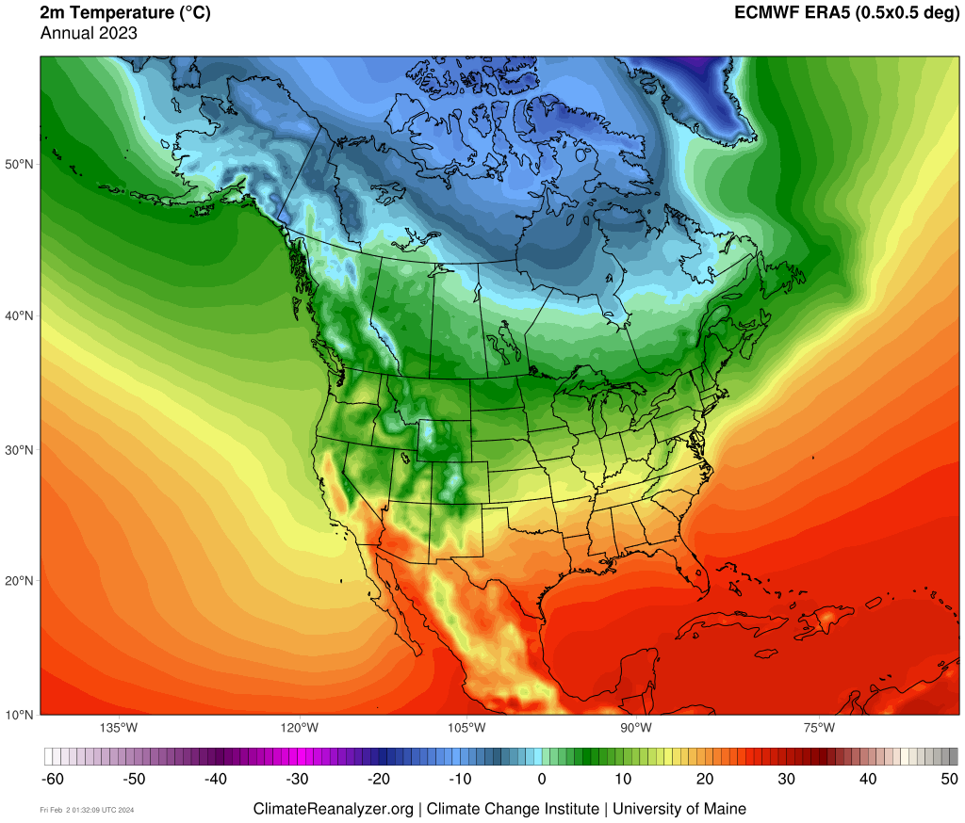
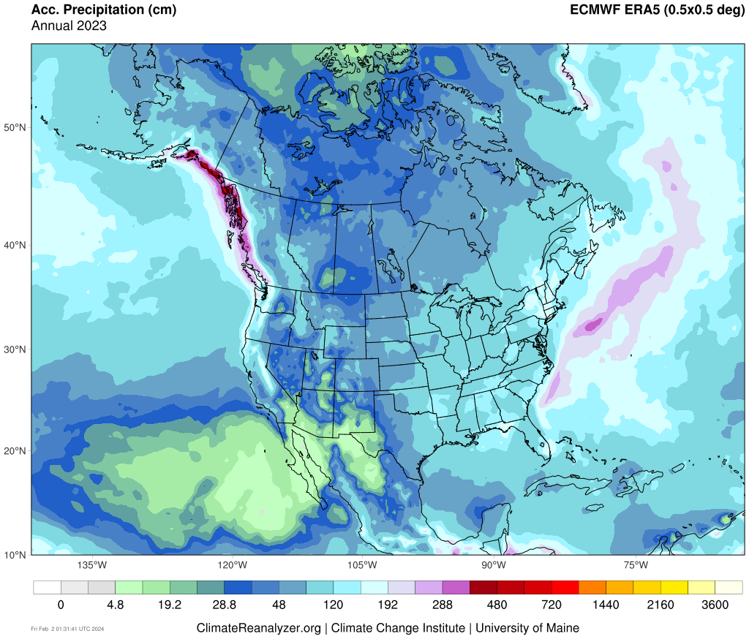
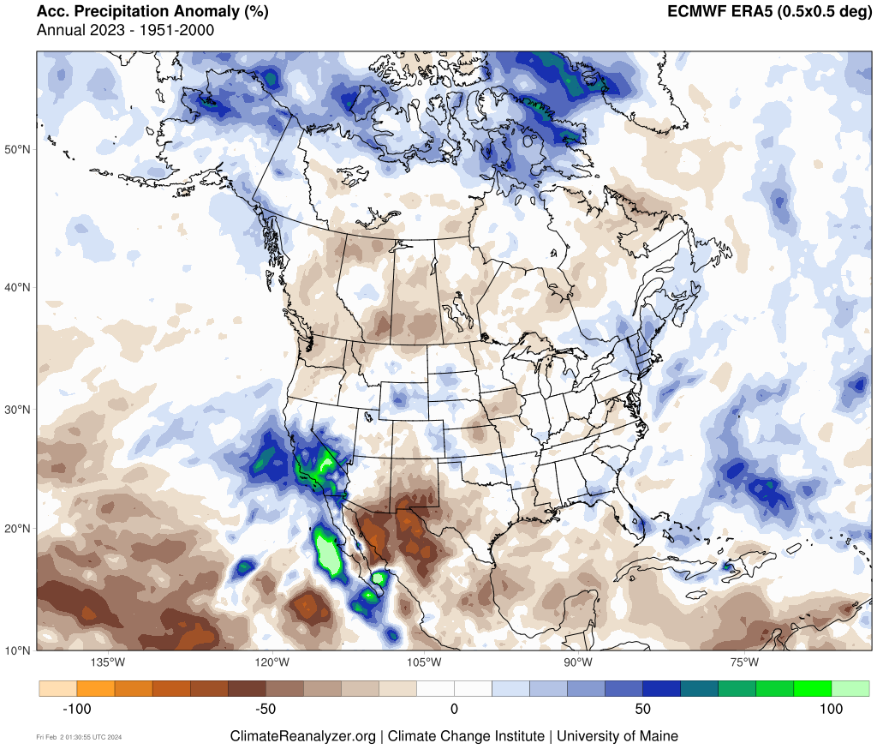
2023 Annual Temperature & Precipitation

Slide 16
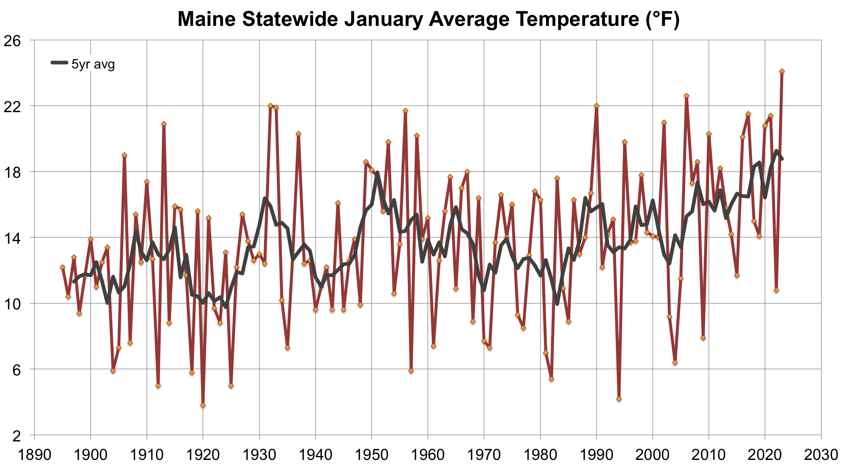
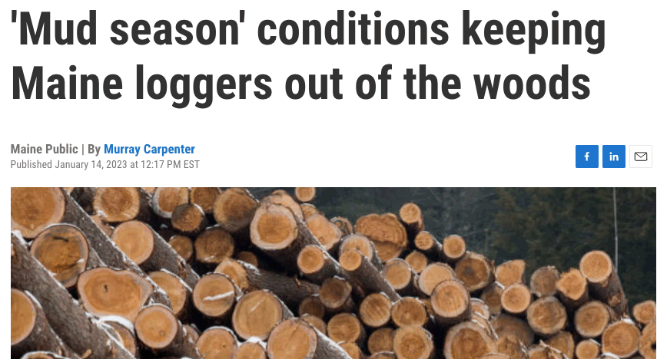
Notable Statistics
Maine Statewide 2023
2nd warmest, 5th wettest Jan–Dec
1st warmest January
3rd warmest DJF
1st warmest July (tied 1921, 1952)
1st warmest T_{min}
2nd wettest JJA (near tie 1917)
3rd warmest SON (tied 2021)
1st warmest T_{min}
2nd warmest, 4th wettest December
NOAA Climate Divisional Database

Slide 17
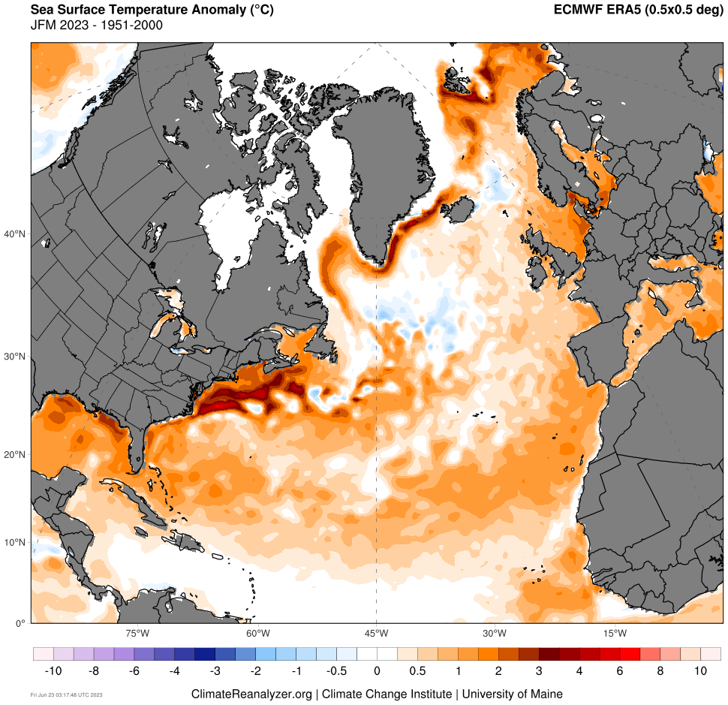
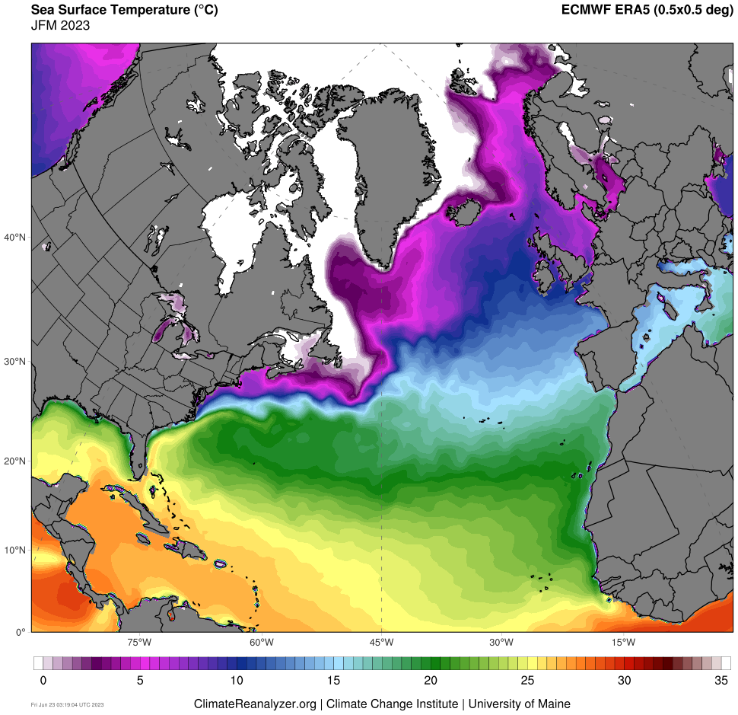
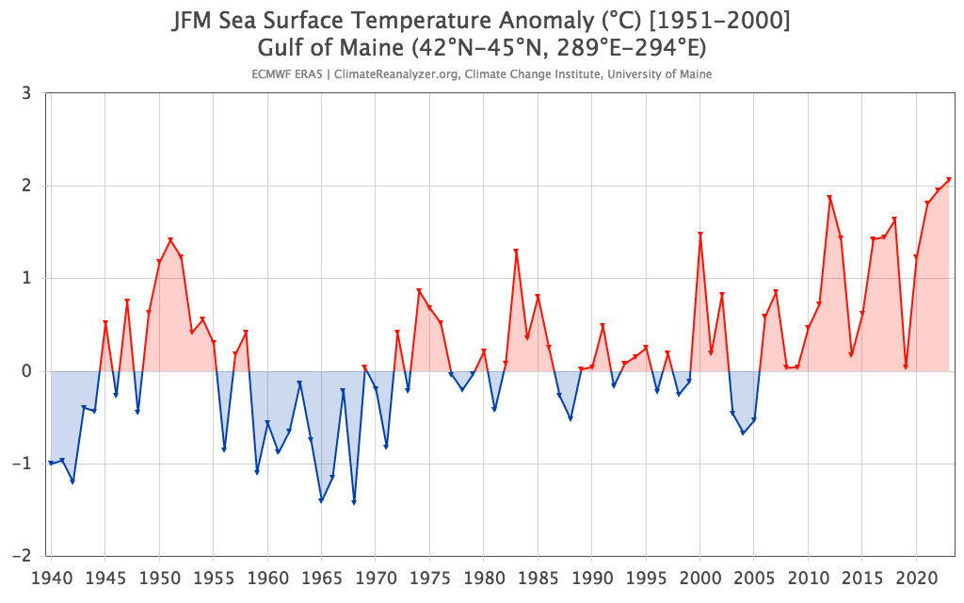
Notable Statistics
Maine Statewide 2023
2nd warmest, 5th wettest Jan–Dec
1st warmest January
3rd warmest DJF
1st warmest July (tied 1921, 1952)
1st warmest T_{min}
2nd wettest JJA (near tie 1917)
3rd warmest SON (tied 2021)
1st warmest T_{min}
2nd warmest, 4th wettest December
Gulf of Maine (SST) 2023
1st warmest February and JFM

Slide 18
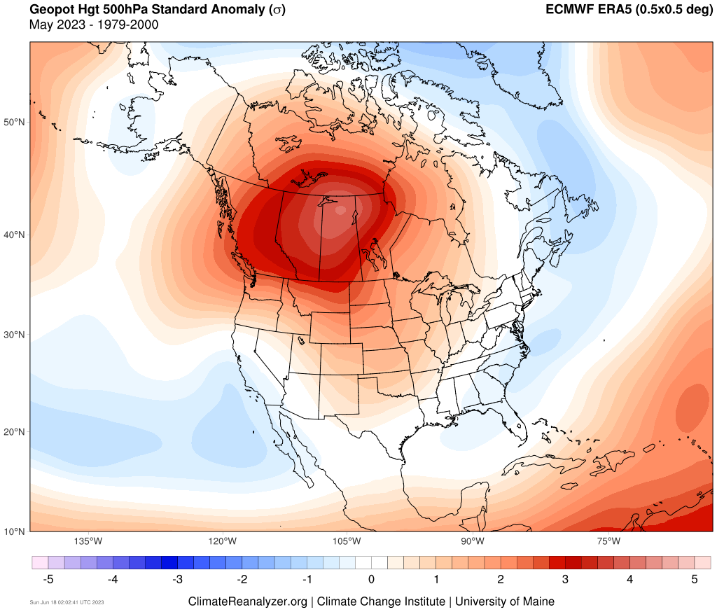
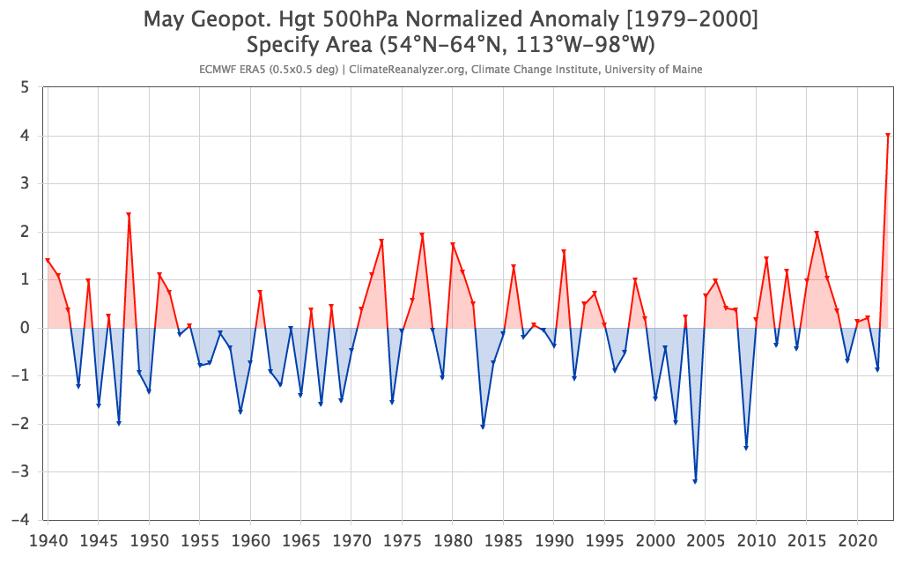
2023 Extremes

Slide 19
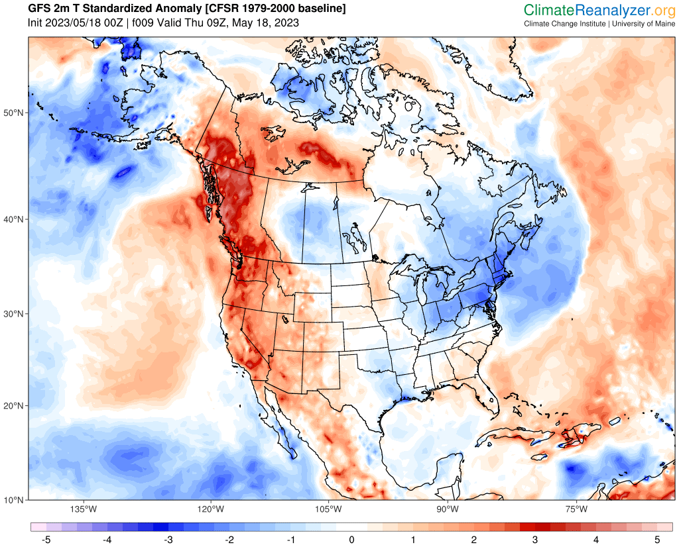
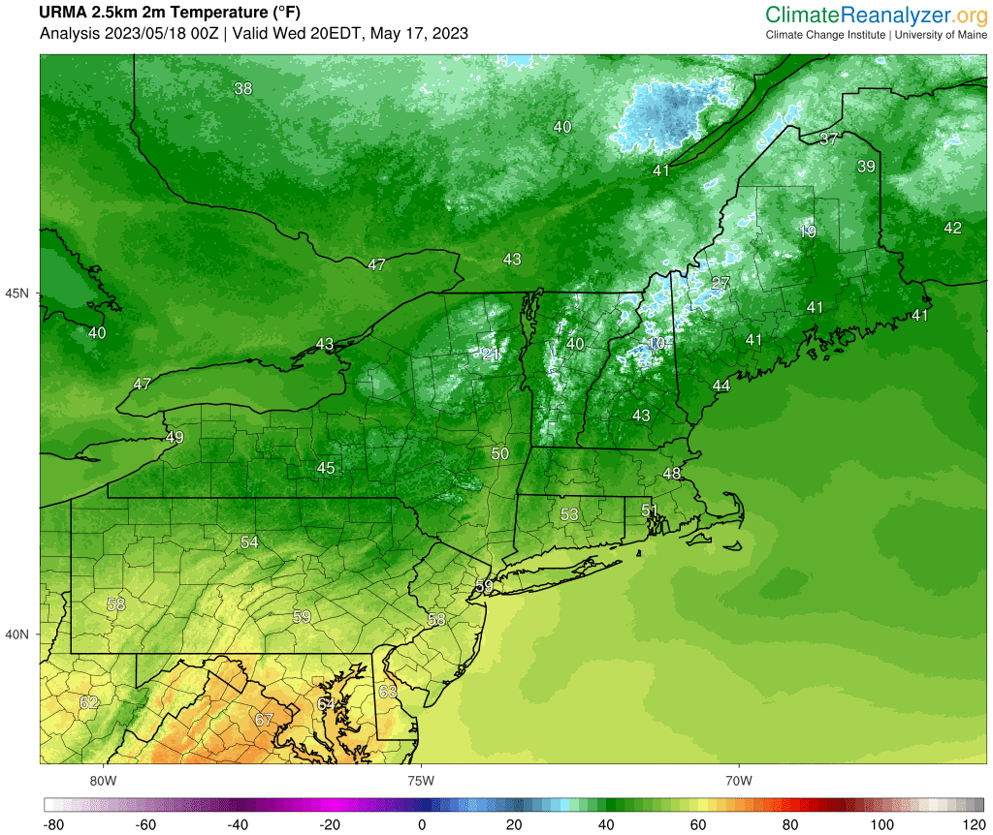
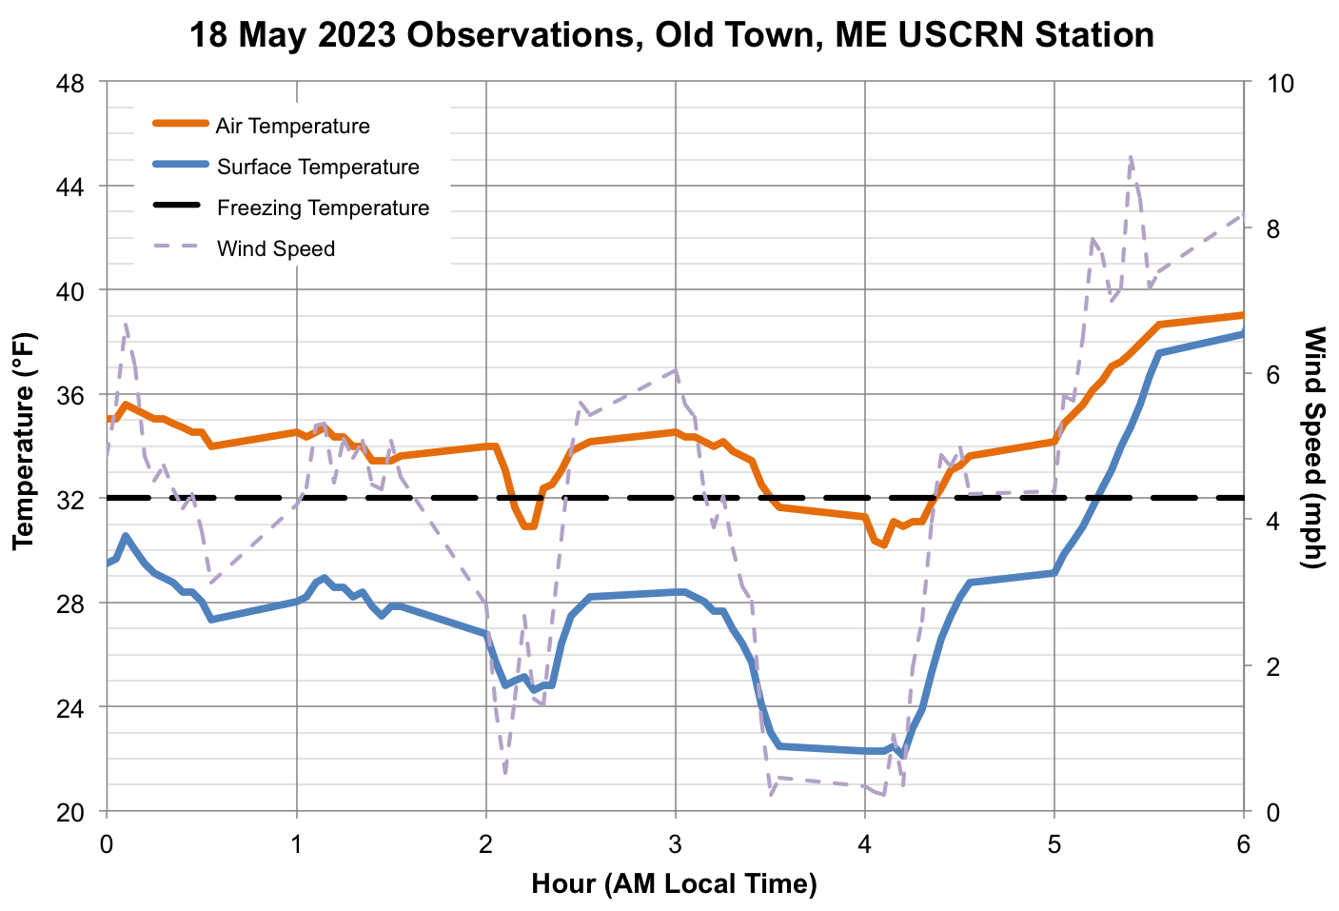
Late Season Freeze
May 18, 2023
2m T Standardized Anomaly
22°F

Slide 20
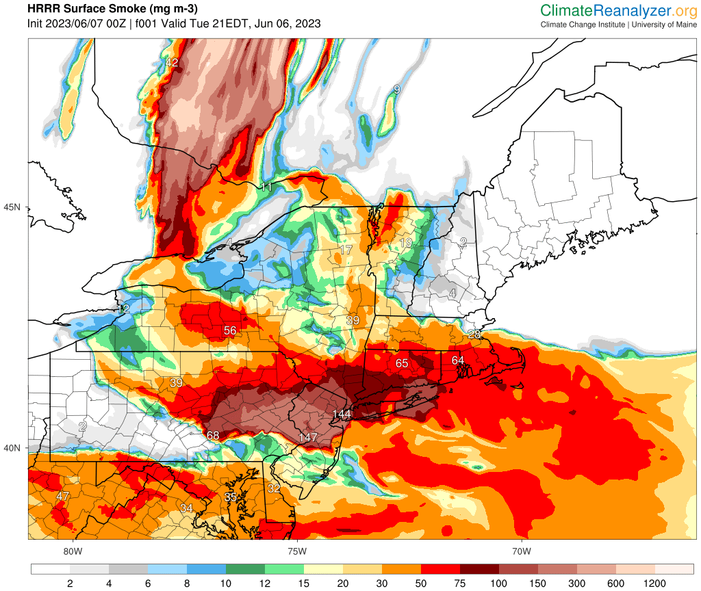
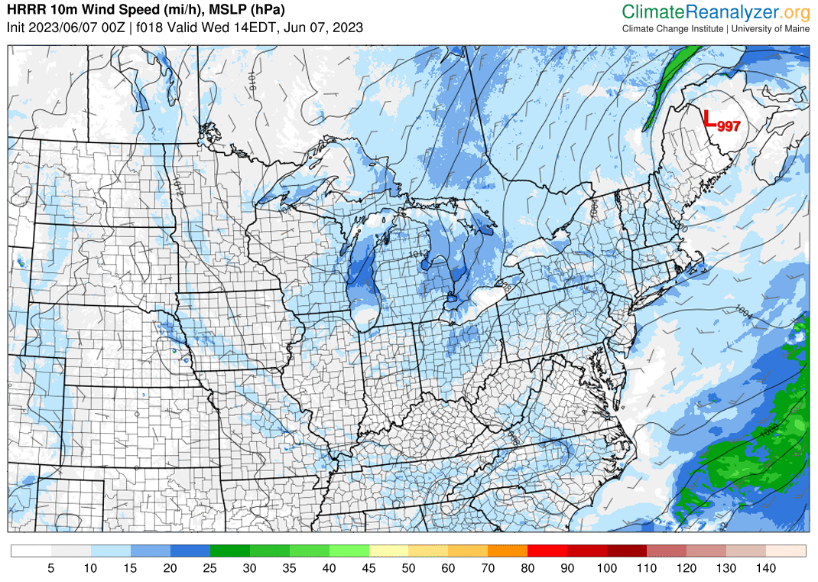
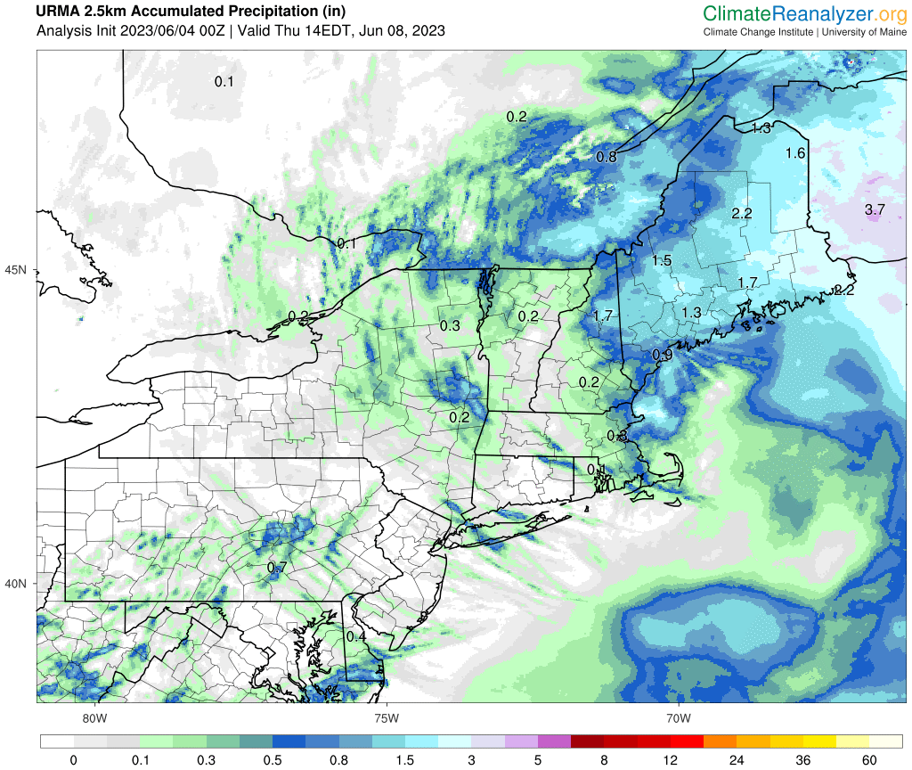
Stalled Low Pressure System
June 6–9, 2023
HRRR Smoke
URMA Precipitation

Slide 21
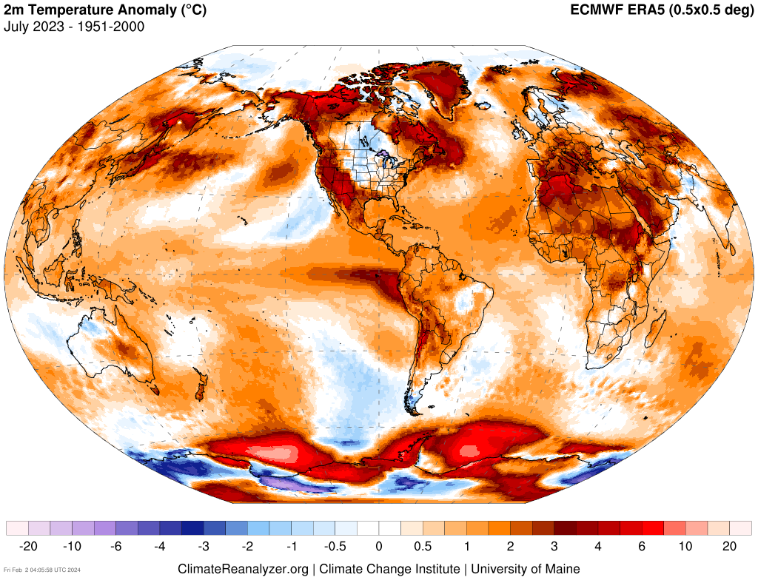
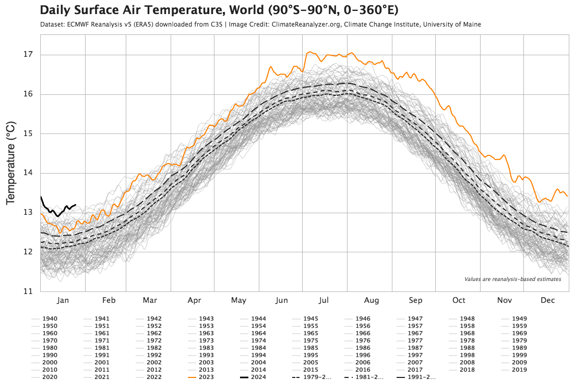
Record Global Mean Temperature
July, 2023
2023
2024

Slide 22
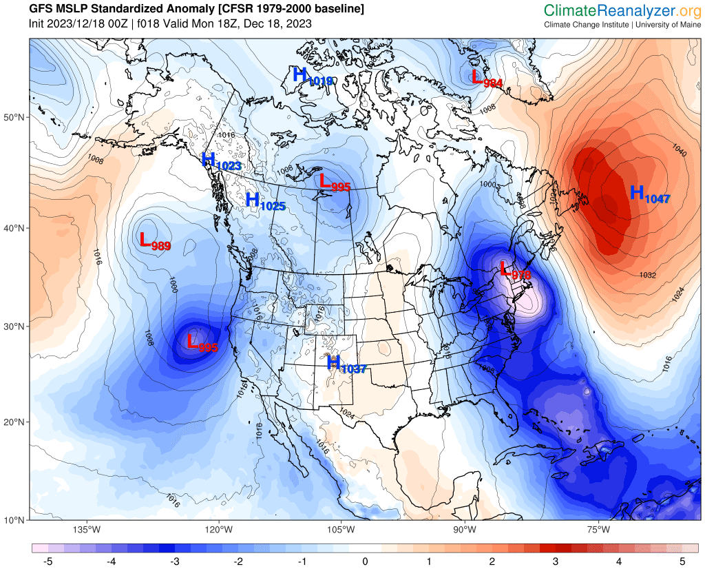
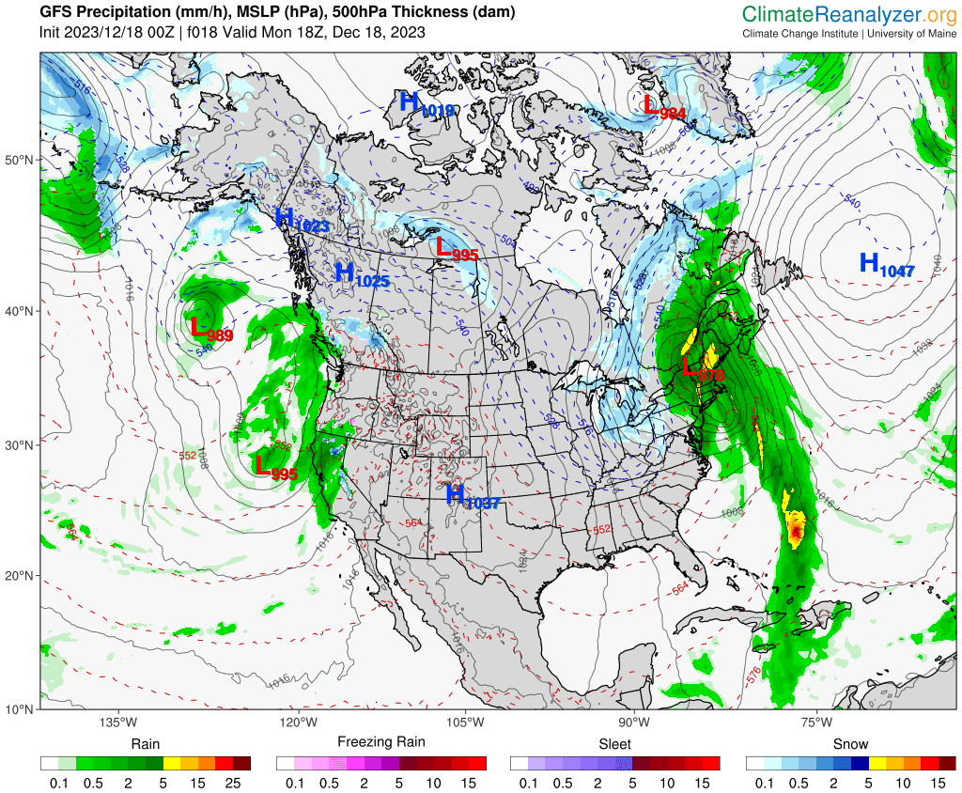
December 18th, 2023
Southeaster
A strong low pressure system developed (Dec. 15–16) over the Gulf of Mexico, traveled along eastern seaboard, then veered north, passing over eastern NY into Quebec.
The northward shift was facilitated by high pressure stalled off Newfoundland that prevented a more easterly track.
Storms tracking north across the eastern Great Lakes region is a classic setup producing strong SE winds over Maine (e.g., the October 30th, 2017 southeaster).
These SE storm systems can be associated with an inverted wave trough in the jet stream, where cold air is forced over warm air, creating instability.
The steep pressure gradient in this setup drives strong winds, and warm moisture-laden air into Maine and New England.
About 2/3 of Maine saw gust potential > 50mph for around 12 hours; some areas along the coast and inland experienced periods with gusts > 60 or 70mph.

Slide 23
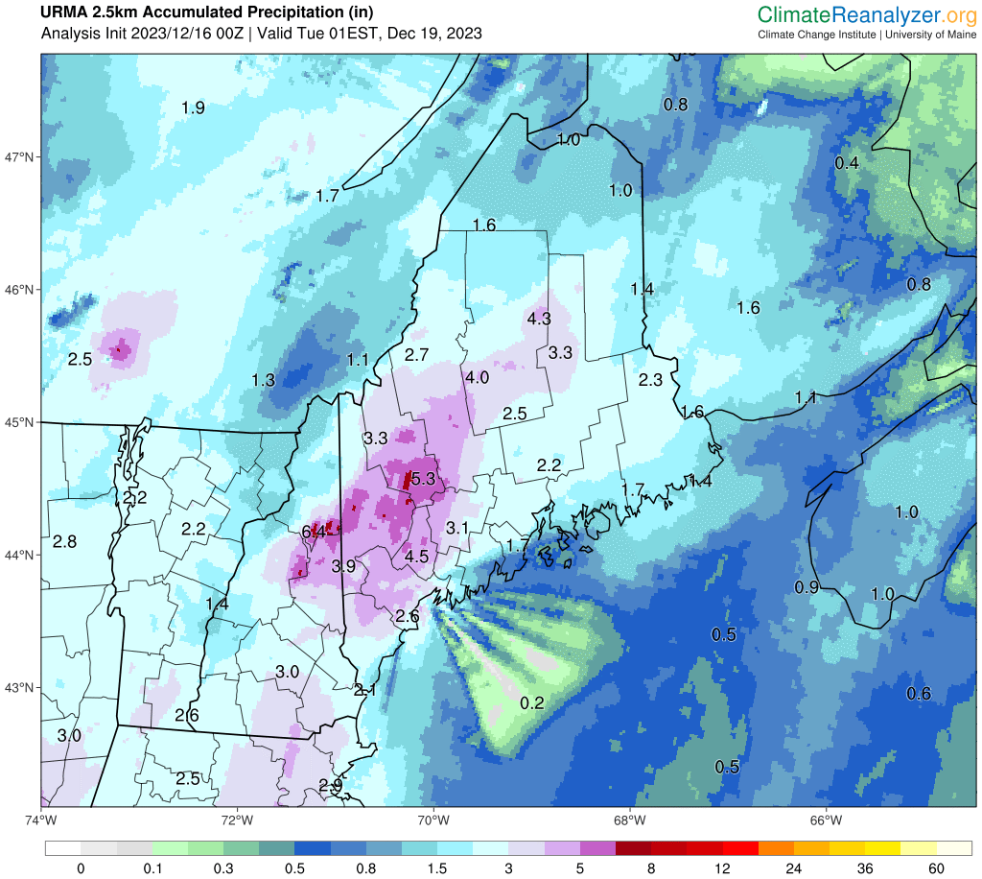
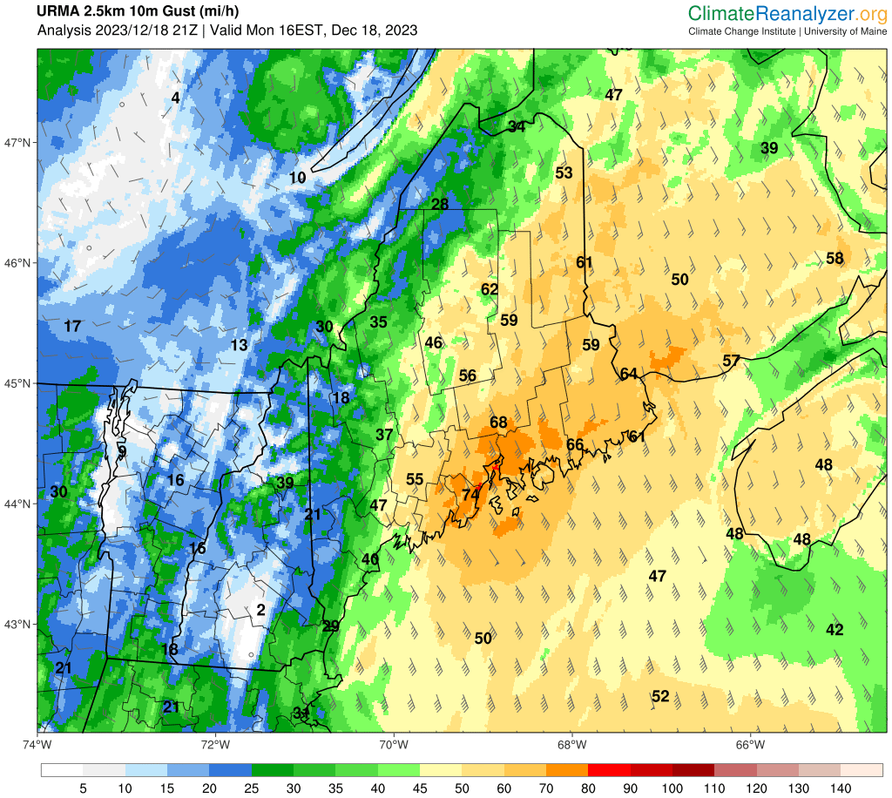
December 18th, 2023 Southeaster

Slide 24
Future Storm Trends?
Maine’s climate is getting wetter and heavy precipitation events are becoming more common in association with warming-driven intensification of the hydrologic cycle.
A study of mid-autumn (Oct–Nov) storms in New England found a significant trend toward more precipitation accompanying wind storms with gusts > 58mph, but did not find any significant trend in storm frequency or wind intensity for the period 1979–2019 (Simonson et al., 2020).
Colle et al. (2015) find that most climate models project an overall decrease in extratropical cyclones along the U.S. East Coast, but with an increase in intensity. Authors note large interdecadal and interannual variability.
This projected trend could be in relation to weaker atmospheric circulation and tendency toward more frequent blocked wave patterns in the jet stream under which temperature extremes develop and fuel intense storms.
More research is needed to understand both historical and projected storm trends in Maine.

Slide 25
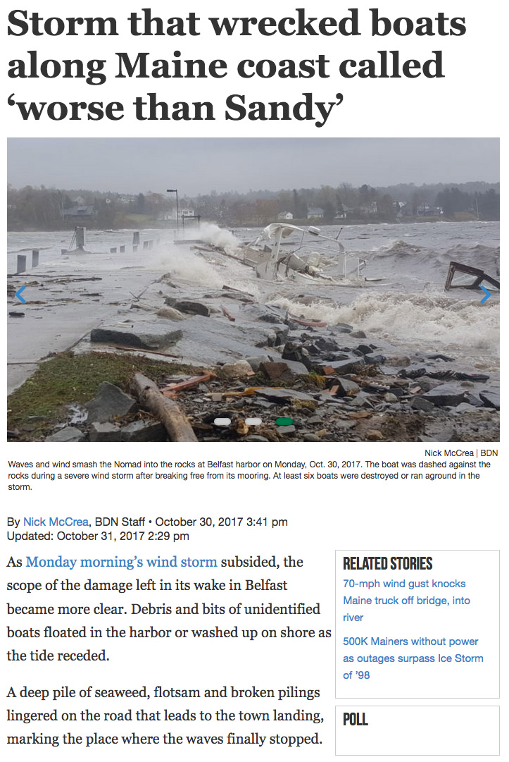
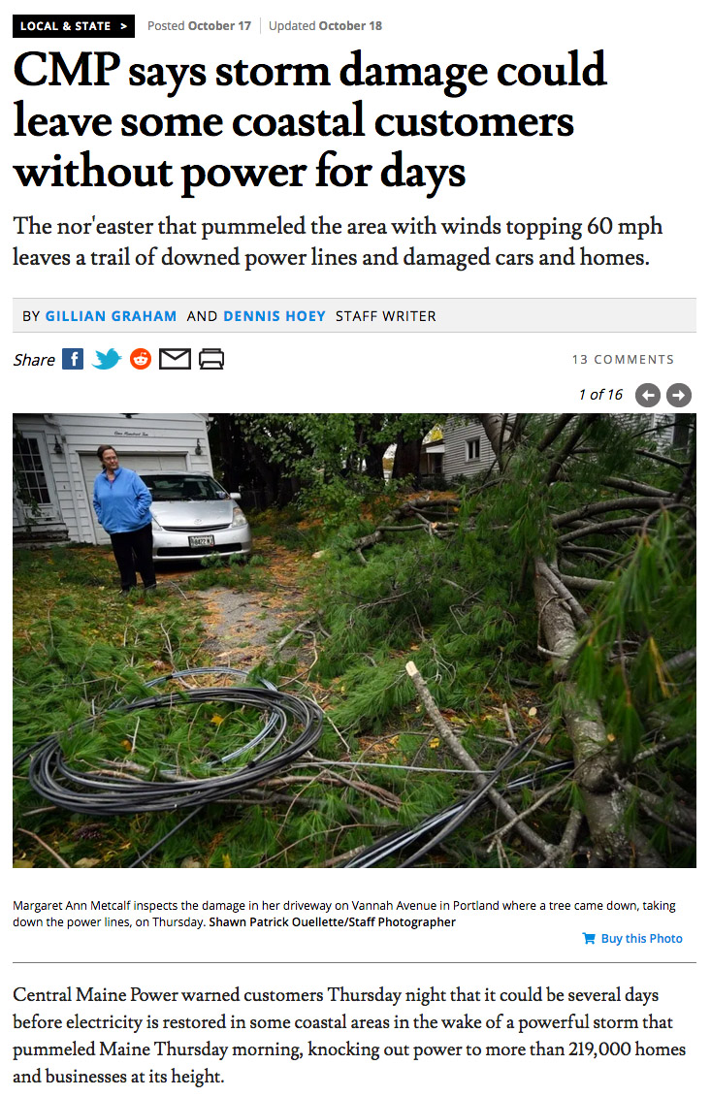
(Bomb Cyclone)
Oct. 17th, 2019
Gusts BGR 43, PWM 62 mph
219k power outages
Nov. 1st, 2019
Gusts 53 BGR, PWM 49 mph
230k power outages
(Bomb Cyclone)
Oct. 30th, 2017
Gusts BGR 66, PWM 69 mph
500k power outages

Slide 26
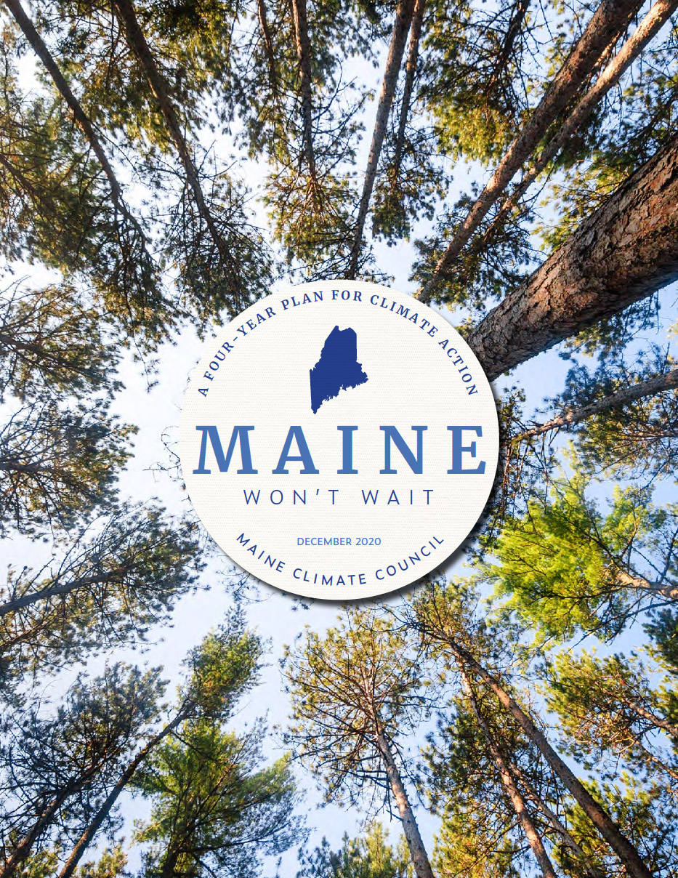
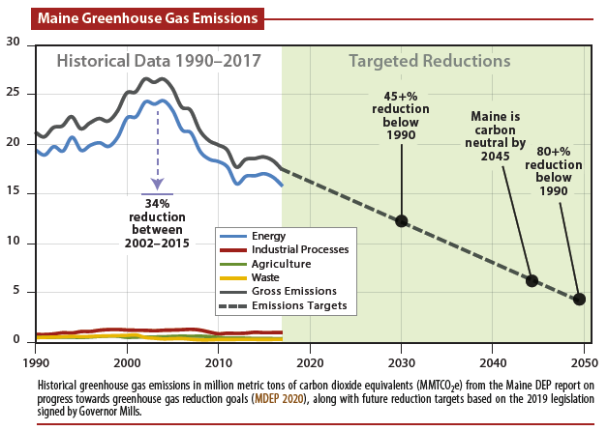
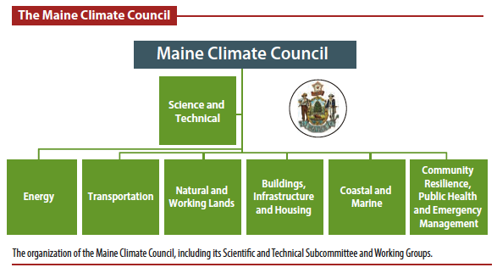
Maine Climate Action
Maine joined the 25-member U.S. Climate Alliance in 2019
Commitments to reduce GHG emissions to ~26% below 2005 levels by 2025
Bills signed into law to reduce GHG emissions by enhancing renewable energy, and to establish the Maine Climate Council
MCC developed the climate action plan Maine Won’t Wait
Critical goals for reducing annual emissions in Maine by 45% below 1990 levels by 2030, and 80% below 1990 levels by 2050
Fernandez et al. (2020)

Slide 27

Thank You
Sean Birkel
Assistant Professor
Maine State Climatologist
birkel@maine.edu

Slide 29

Oct 14–15
5”
95th percentile daily records
3.2”
1.8”

Slide 30



Notable Stats & Extremes 2022 – 2023
Portland Press Herald
Maine Statewide
2nd warmest June–May, 2022–2023
1st warmest January, 2023
3rd warmest DJF, 2023
Gulf of Maine (SST)
1st warmest November, 2022
1st warmest DJF and JFM, 2023
Extremes
Rainstorm October 14–15, 2022
Overnight warmth November 6–7, 2022
Late season freeze/frost May 18, 2023*
Stalled low pressure / Quebec wildfire smoke June 6–9, 2023*
* Associated with anomalous long-wave pattern over North America

Slide 31



Notable Stats & Extremes 2022 – 2023
Maine Statewide
2nd warmest June–May, 2022–2023
1st warmest January, 2023
3rd warmest DJF, 2023
Gulf of Maine (SST)
1st warmest November, 2022
1st warmest DJF and JFM, 2023
Daily max temp records set Nov 4–7
74°F max temp on Nov 6 is record for the month
Normal high is 51°F
Extremes
Rainstorm October 14–15, 2022
Record temps November 4–7, 2022
Late season freeze/frost May 18, 2023*
Stalled low pressure / Quebec wildfire smoke June 6–9, 2023*
* Associated with anomalous long-wave pattern over North America
2m T Std. Anomaly
ACIS2

Slide 32


January 2022 Hunga Tonga–Hunga Haʻapai eruption
Most explosive eruption & largest perturbation to the stratosphere since 1883 Krakatoa
Ejecta reached into the Mesosphere ~ 58km (36mi)
Estimated 10% excess water vapor in lower stratosphere

Slide 33


Slide 34

CMIP6 projections suggest annual precipitation could increases 2–7” (5–14%) over this century.
Future seasonal distribution of surpluses and deficits is uncertain.
+7”
+2”
CMIP6 = Coupled Model Intercomparison Project version 6
SSP = Shared Socio-econmic Pathways
CMIP6 SSP 245, 585 are similar to CMIP5 RCP 4.5, 8.5
Ensemble average of 13 models (one member each: AWI-CM-1-1-MR, BCC-CSM2-MR, CAMS-CSM1-0, CanESM5 p1, CanESM5 p2, CESM2, CESM2-WACCM, FGOALS-g3, MCM-UA-1-0 f2, MIROC6, MIROC-ES2L f2, MRI-ESM2-0, UKESM1-0-LL f2). Gridded data downloaded from KNMI Climate Explorer; processed via UMaine Climate Reanalyzer.

Slide 35

Drought Overview
U.S. Drought Index Descriptions
General Categories
Meteorological (precipitation)
Agricultural (soil moisture)
Hydrologic (runoff, streamflow, and groundwater)
Drought Indices
Palmer Drought Severity Index (PDSI)
Standardized Precipitation Index (SPI)
SPEI = SPI + evapotranspiration
Short-term or “flash” droughts (2-6 months), followed by quick return to normal or above normal precipitation, are common in the USNE.
National Weather Service & U.S. Drought Monitor
https://www.weather.gov/riw/drought_index
https://droughtmonitor.unl.edu/

Slide 36


U.S. Drought Monitor
https://droughtmonitor.unl.edu/
NOAA Climate Divisional Database

Slide 37



Lombard et al., 2020
2020/21 Drought
After a cool spring with late snowfall and good snowpack, dryness set in quickly middle of May. Drought conditions developed and persisted for several months with significant impact to water resources and agriculture.
September, ranked as the driest month on record, saw the most severe conditions and drought disaster declarations made by the U.S. Secretary of Agriculture.
During September the Piscataquis, Saint John, and Aroostook Rivers had record low flows and significant riverbed exposure.
Beneficial rains in October and November brought conditions to near-norm.
Drought signal carried into 2021 due to warm winter with below normal snowfall, and early spring snowmelt.
D0 (abnormal dryness)
D1 (moderate drought)
D2 (severe)
D3 (extreme)

Slide 38


2020 May–June Weather Patterns
H
L
L
L
H
H
L

Slide 39


Meteorological drought has not increased over the past century.
Uncertain whether drought will become more or less common in the future.
However, when droughts develop, warmer temperatures will likely exacerbate dryness through increased evaporative losses.
MCF 2020 Update, MCC STS 2020

Slide 40


Evidence for a Volcanic Underpinning of the Atlantic Multidecadal Oscillation
Sean D. Birkel, Paul A. Mayewski, Kirk A. Maasch, Andrei V. Kurbatov, Bradfield Lyon
NPJ Climate and Atmospheric Science (2018)

Slide 41




Natural forcings cannot account for the observed warming since at least 1960
Data from Hansen et al. 2011
Volcanic aerosols and solar variability constitute the most significant natural climate perturbations
Meehl et al, 2012
Mt. Pinatubo, 1991 USGS https://pubs.usgs.gov/fs/1997/fs113-97/

Slide 42




Summer in March, 2012
Temperatures into the 80s across southern half of Maine 22-23 March without historical equivalent.
Farmington 83°F March 23rd – a daily high temperature record set by 17°F!
18 March, 2012

Slide 43


However…
Despite the overall warming trend, variability can bring unexpected cold winters (e.g., 2013/14 and 2014/15), and occasional very good snow seasons.
This is especially true in the northern climate division owing to the steep S-N temperature gradient across the state.

Slide 44



The Greenhouse Effect
NOAA Global Monitoring Laboratory
https://gml.noaa.gov/ccgg/trends/mlo.html
500 ppm 2100
Ice Core Record Vostok Station, Antarctica
400 ppm 2015
290 ppm Natural
http://www.oxfordpresents.com/ms/krohne/global-warming-and-ecological-communities/
Warm
Cold

Slide 45


1981-2000
Northward Shift of Plant Hardiness Zones
Based on PRISM annual extreme minimum temperatures and USDA key
2001-2020

Slide 46




Longer summers and shorter winters drive black-legged tick habitat expansion
Elias et al. (2020)
Larval emergence and tick survival is associated with attainment of ~1240 degree days from a 6°C baseline

Slide 47

Warm season longer and snow season shorter by about 2 weeks since early 1900s. Could change another 2–4 weeks by 2100.
Extension of summer temperature skewed towards fall.
Trends projected to continue, but some years could bring unexpected late spring or early fall frosts.

